Slide 1
Systems analysis and design
Lecture 7.
UML II

Slide 2
Package Diagrams
To organize complex class diagrams, you can group classes into packages. A package is a collection of logically related UML elements
Notation
  Packages appear as rectangles with small tabs at the top.
  The package name is on the tab or inside the rectangle.
  The dotted arrows are dependencies. One package depends on another if changes in the other could possibly force changes in the first.
  Packages are the basic grouping construct with which you may organize UML models to increase their readability

Slide 3
Package Example
DispatcherInterface
Notification
IncidentManagement

Slide 4
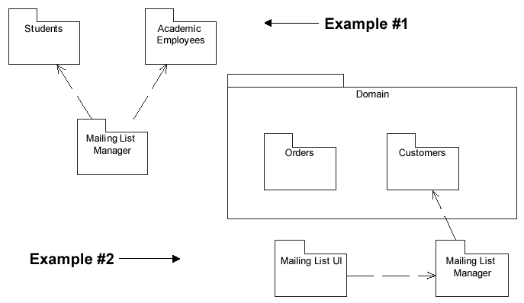
More Package Examples

Slide 5
Interaction Diagrams
Interaction diagrams are dynamic -- they describe how objects collaborate.
A Sequence Diagram:
  Indicates what messages are sent and when
  Time progresses from top to bottom
  Objects involved are listed left to right
  Messages are sent left to right between objects in sequence

Slide 6
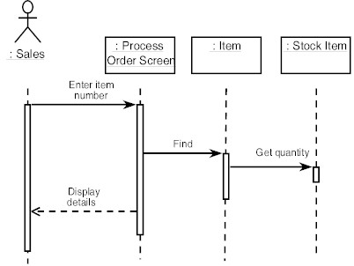
Sequence Diagram Format
Actor from
Use Case
Objects
1
Activation
2
3
4
Lifeline
Calls = Solid Lines
Returns = Dashed Lines

Slide 7
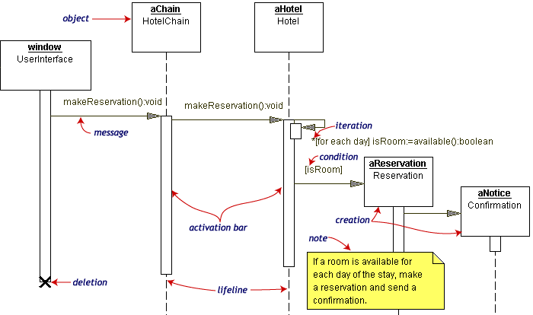
Sequence Diagram Example
Hotel Reservation

Slide 8
Collaboration Diagram
Collaboration Diagrams show similar information to sequence diagrams, except that the vertical sequence is missing. In its place are:
  Object Links - solid lines between the objects that interact
  On the links are Messages - arrows with one or more message name that show the direction and names of the messages sent between objects
Emphasis on static links as opposed to sequence in the sequence diagram

Slide 9
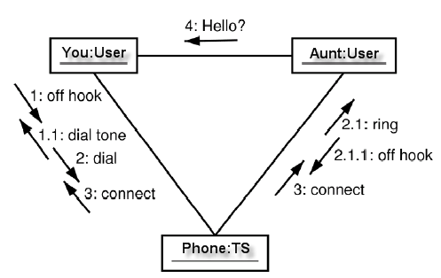
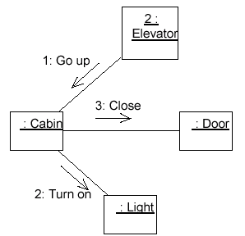
Collaboration Diagram

Slide 10
Activity Diagrams
Fancy flowchart
  Displays the flow of activities involved in a single process
  States
    Describe what is being processed
    Indicated by boxes with rounded corners
  Swim lanes
    Indicates which object is responsible for what activity
  Branch
    Transition that branch
    Indicated by a diamond
  Fork
    Transition forking into parallel activities
    Indicated by solid bars
  Start and End

Slide 11
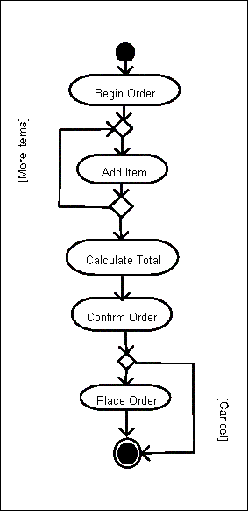
Sample Activity Diagram
Ordering System
May need multiple diagrams from other points of view

Slide 12
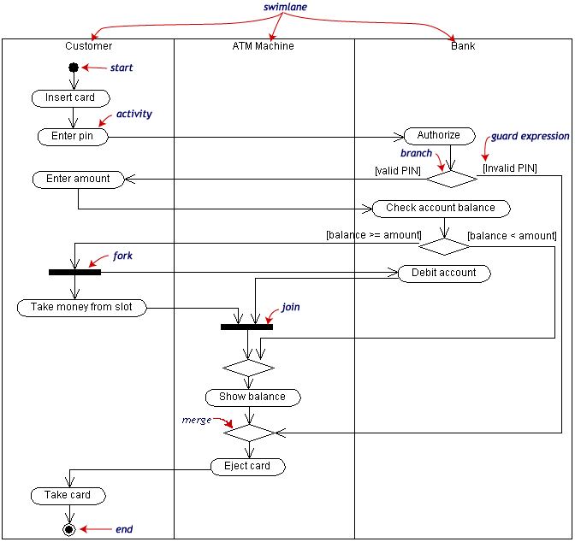
Activity Diagram Example

Slide 13
State Transition Diagrams
Shows the possible states of the object and the transitions that cause a change in state
  i.e. how incoming calls change the state
Notation
  States are rounded rectangles
  Transitions are arrows from one state to another. Events or conditions that trigger transitions are written beside the arrows.
  Initial and Final States indicated by circles as in the Activity Diagram
    Final state terminates the action; may have multiple final states

Slide 14
button1&2Pressed
button2Pressed
Blink
Increment
Hours
Hours
button1Pressed
button1&2Pressed
Blink
button2Pressed
Increment
Minutes
Minutes
button1Pressed
button2Pressed
Stop
Blink
Increment
Blinking
Seconds
Seconds
Figure 2-4. A UML statechart diagram for SetTime use case of the SimpleWatch.

Slide 15
State Representation
The set of properties and values describing the object in a well defined instant are characterized by
  Name
  Activities (executed inside the state)
    Do/ activity
  Actions (executed at state entry or exit)
    Entry/ action
    Exit/ action
  Actions executed due to an event
    Event [Condition] / Action ^Send Event

Slide 16
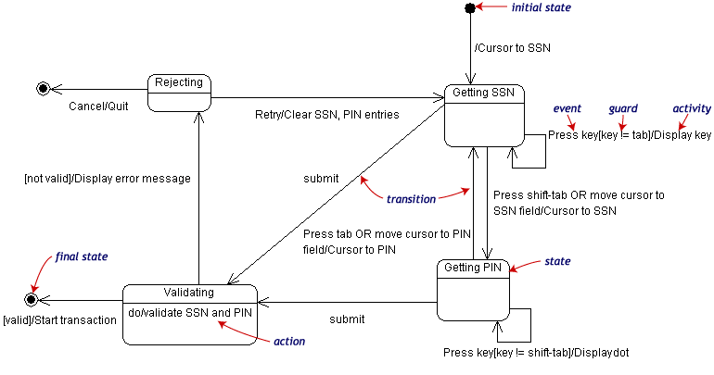
State Transition Example
Validating PIN/SSN

Slide 17
Component Diagrams
Shows various components in a system and their dependencies, interfaces
Explains the structure of a system
Usually a physical collection of classes
  Similar to a Package Diagram in that both are used to group elements into logical structures
  With Component Diagrams all of the model elements are private with a public interface whereas Package diagrams only display public items.

Slide 18


Component Diagram Notation
Components are shown as rectangles with two tabs at the upper left
Dashed arrows indicate dependencies
Circle and solid line indicates an interface to the component

Slide 19
Deployment Diagrams
Shows the physical architecture of the hardware and software of the deployed system
Nodes
  Typically contain components or packages
  Usually some kind of computational unit; e.g. machine or device (physical or logical)
Physical relationships among software and hardware in a delivered systems
  Explains how a system interacts with the external environment

Slide 20
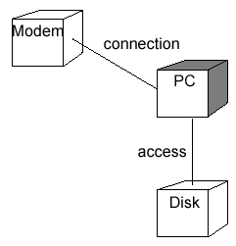
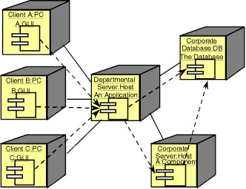
Some Deployment Examples

Slide 21
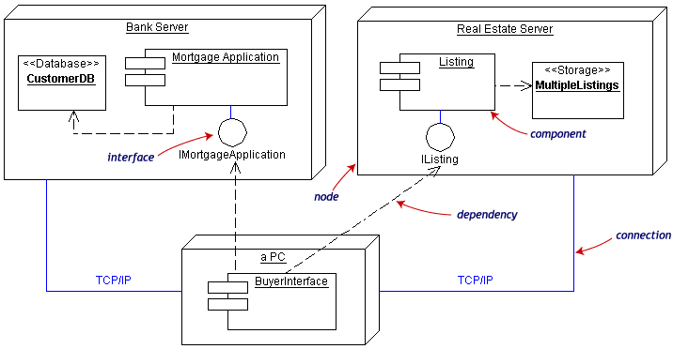
Deployment Example
Often the Component Diagram is combined with the Deployment

Slide 22
Summary and Tools
UML is a modeling language that can be used independent of development
Adopted by OMG and notation of choice for visual modeling
  http://www.omg.org/uml/
Creating and modifying UML diagrams can be labor and time intensive.
Lots of tools exist to help
  Tools help keep diagrams, code in sync
  Repository for a complete software development project
  Examples here created with TogetherSoft ControlCenter, Microsoft Visio, Tablet UML
  Other tools:
    Rational, Cetus, Embarcadero
    See http://plg.uwaterloo.ca/~migod/uml.html for a list of tools, some free

