Slide 1
SYSTEMS ANALYSIS AND DESIGN
Lecture 10. Scrum and Kanban Methodologies

Slide 2
Agenda
Scrum Methodology
Kanban
Recommended reading

Slide 3
Scrum: Iterative and incremental
There a many Software Development Models with their strengths and weaknesses. But, they can be categorized into 3 major categories:
  Waterfall – Structured, top/down approach.
  Examples: Waterfall, Structured System Analysis and Development Methodology (SSADM).
  Iterative & Incremental – Iteratively go through important software development “steps” (analysis, design, build, etc.) and incrementally build the system.
  Examples: Spiral, RAD, Agile, etc.
  Prototyping – Build prototypes, get feedback, refine. Once get the final version – build the software and deploy.
  Examples: RAD, Prototyping.

Slide 4
The Scrum Process
Video Link

Slide 5
Scrum background
In their book, “New Product Development Game”, Hirotaka Takeuchi and Ikujiro Nonaka explained the ideas of what we now call Scrum as:
  "a flexible, holistic product development strategy where a development team works as a unit to reach a common goal“.
In 1995 Jeff Sutherland and Ken Schwaber presented the main ideas at Object-Oriented Programming, Systems, Languages & Applications.

Slide 6
Scrum: roles
There are 3 roles in Scrum:
  Product owner
  Scrum master
  The team

Slide 7
Scrum: product owner role
The team member who knows the business and customer needs, as well as can make decisions on behalf of the client.
S/he is responsible for communication between the developer team and the business.
The main goal of Product Owner is successfully build the final product that meets business needs. The Product Owner must be “friends” with both: the business and the developer team.

Slide 8
Scrum: scrum master role
Scrum Master has experience in managing Scrum projects and is responsible to make sure the team follows Scrum principles, also (tries to) removes any obstacles so that the developer team delivers the shippable product on time.
S/he is responsible for organizing daily scrum meetings, teaching stakeholders about the Scrum processes.
Scrum Master is not a Project Manager. Scrum Master does not deal with HR, Finances, etc.

Slide 9
Scrum: developer team role
The developer team is a group of self-organized people that do the work. A team may consist of a programmer, designer, tester, etc.
Usually the team members have interchangeable roles.
In order for this setup to work, your team members must be responsible, professional and understand the main goal – to deliver quality product to the client.

Slide 10
Scrum: process
The project is split into smaller manageable parts called Sprints.
The Scrum has the following stages:
  Product backlog
  Sprint planning
  Sprint backlog
  Sprint (daily scrum meeting)
  Potentially shippable product
Sprint is timeboxed (from 1 week to 1 month) and aims to produce a potentially shippable product.

Slide 11
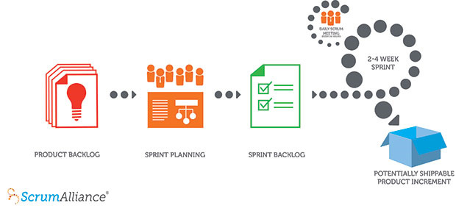
Scrum: process

Slide 12
Scrum: side effects
Video link

Slide 13
Kanban
Video Link

Slide 14
Kanban: advantages
Planning flexibility
Shortened time cycles
Fewer bottlenecks
Continuity of development

