Slide 1
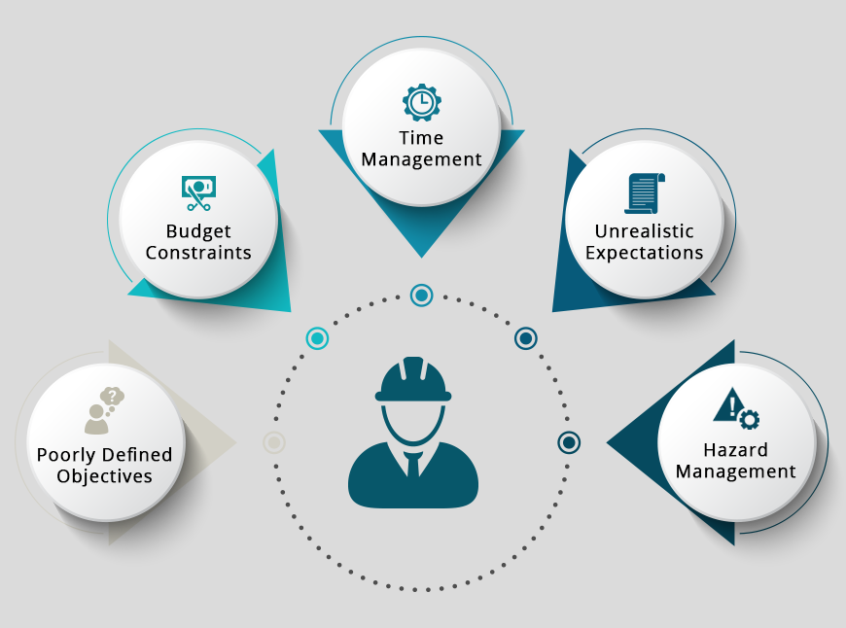
INTRODUCTION.
THE ROLE AND THE CHALLENGE.
Lesson 1
https://www.crmjetty.com/blog/construction-project-management/
Lecturer: M. Kurbonov

Slide 2
THE ROLE AND THE CHALLENGE
What is engineering project management? Why do we teach engineering project management? Do engineering projects matter to society? Do engineering projects matter to business? What is a “project?” What is an “engineering project?” What is a “project manager?” In this lesson, we discuss all of these questions, and also provide you basic information about the role of engineering project manager and the opportunity that this role represents for you.

Slide 3
INTRODUCTION
In this lesson, we study the subject of engineering project management. Let’s look carefully at the first two of those three words:
“Project.” By this word, we mean a deliberately undertaken endeavor to create some- thing that we believe will be of value. This desired result might be a tangible artifact (“product”), or it might be a service. We might plan to use it ourselves, or we might be planning to offer it for sale.
“Engineering project.” By adding the modifier “engineering,” we now indicate that the methods we will use to create this result involve “engineering.” By this we mean the methods that we will use depend significantly on the application of technology and technological concepts in order to achieve a practical effect. Other disciplines – such as finance, art, and so forth – may also be made use of in order to create our desired product or service, but by identifying this as an “engineering project,” we are indicating that we consider the role played by the application technology and technological concepts to be central to the success of the project.

Slide 4
INTRODUCTION
The judgment about whether the role of technology and technological concepts is central to a project is sometimes fairly obvious (e.g. designing a new computer processor microchip), but in other cases it may be more subtle. For example, painting in oils on canvas involves quite a lot of technology; someone has to know how to create the paints, someone has to figure out what methods of preparing the canvas are likely to create a surface to which the paint will adhere well, and so forth. These are highly technological subjects! But since those technologies have already been worked out, and can today be made available in a form that allows the paint and the canvas to be used in a manner that requires only minimal knowledge of the underlying technology, we prob- ably would no longer consider creating an oil painting an engineering project.

Slide 5
INTRODUCTION
This is because, while painters must learn the technique for preparing a canvas, and for applying the paint, they generally no longer have to learn how to do the underlying technological work, such as creating the paint, and no longer have to understand how certain materials in the paint result in certain properties for the paint. There was certainly a time (a few hundred years ago), before these technologies had been worked out, that one could properly have considered painting in oils on canvas an engineering project. But by now, these technologies have matured to a point where a non‐technologist can apply them by learning a technique; the artist need not know the underlying technologies. Given the maturity of these technologies, and their availability in a form that non‐ technologists can learn to use, we would probably consider that the creation of technology is no longer central to the success of our oil‐painting project, and therefore, today we would likely not consider painting in oils on canvas an engineering project.

Slide 6
INTRODUCTION
This is akin to the difference between operating a car or a computer and designing a car or a computer. Operating the car or the computer requires technique, but does not require detailed knowledge of the underlying technology.
Now, let’s add our third word:
“Engineering project management.” By adding this third word, we have moved from focusing on the desired end result (that is, the product or service that we intend to create) to focusing on the process and method by which we will create it. By management, herein we mean the notion of planning and organizing the activities that will create the desired end product or service – e.g. things that are done before we start the actual project. It has the additional connotation of providing leadership to that activity while the effort is underway – e.g. things that are done during the conduct of the actual project.

Slide 7
INTRODUCTION
Engineering project management is therefore a discipline that provides the method to get to our desired result: that product or service that we want to use or offer for sale, where the application of technology or technological concepts is central to the eventual success of the project.
Why Do We Care About Project Management in Engineering?
Let’s start this part of the story with two assertions:
Engineering projects are vital for society.
Engineering projects are “of the essence” to business – they are the only source of revenue for many companies – and the creator of new methods and new products for almost every organization (business, government, non‐profit, etc.).
Being the manager of an engineering project is a great job! Let’s discuss each of these three assertions.

Slide 8
INTRODUCTION
In your opinion, what is the most important human accomplishment of the last 2000 years? Think about it for a moment, and write down a phrase describing your answer.
Your Answer:

Slide 9
INTRODUCTION
When I ask this question on the first day of my engineering project management courses, I get lots of really good and interesting answers. Obviously, this is a matter of opinion, and we can all have an opinion. But here is my answer:
The most important human accomplishment of the last 2000 years is the doubling of the average length of human life.
What the archeologists and other scientists who study these matters tell us is that for hundreds of thousands of years, the human lifespan averaged around 35 years until around 125 years ago, when the average human lifespan started increasing. Recently, the average human lifespan has reached more than 70 years.

Slide 10
INTRODUCTION
Obviously, living to 70 rather than to 35 is viewed by most people as a very good thing indeed! But what caused this doubling of human life expectancy? This question has been studied by the US National Academies.¹ Apparently, engineering projects deserve most of the credit, due to the following types of large‐scale societal systems that have been created by such projects:
Water treatment and delivery
Sewage treatment and transport
Motor‐powered tractors
Motorized transport and delivery
Large‐scale electricity generation and delivery
Affordable, mass‐scale refrigeration
Canning and other mass‐scale food storage/preservation techniques
… and so forth.
__________
1 There are three US National Academies: Science, Engineering, and Medicine.

Slide 11
INTRODUCTION
To be a little more precise, the National Academies estimate that 80% of the increase in human life expectancy is due to such engineered systems; most of the rest is due to improved healthcare. And all of these important societal systems were created by engineering projects!
Ergo: If you want to change the world for the better, become an engineering project manager! (We get paid pretty well too.)
My second assertion was that engineering projects are “of the essence” to business – they are the only source of revenue for many companies – and the creator of new methods and new products for almost every organization (business, government, non‐ profit, etc.).
Consider an aerospace contractor. They obtain revenue by signing contracts with external customers (which might be their national government) who want to build something (e.g. a new military airplane, a government data processing system, an air traffic control radar, or whatever). The process of building this product is in fact an engineering project. It is the successful performance and completion of this engineering project that provides the company with its revenue.

Slide 12
INTRODUCTION
Now, consider a consumer‐oriented company like Apple or Microsoft. They don’t have customers who give them contracts to build something; instead, they make their own decisions about what they want to build, use their own funds to build it, and then offer it for sale as a product or service in the market. But they would have nothing to sell if they did not undertake (in this case, at their own expense) an engineering project to create that product or service. The result of this internally funded engineering project might be a new version of a software product, or it might be a device (e.g. a new type of mobile phone), or it might be a service (e.g. it might be software that allows them to do your accounting for you, using that new accounting software package). But whatever the result of this internally funded engineering project, it is the project that created the artifact that the company is able to offer for sale. Without the result of that engineering project, the company would have no revenue.
So, whether the “customer” who is paying for the conduct of the engineering project is external (as is usually the case for an aerospace contractor), or is internal (as is usually the case for companies that build products for the general public), their revenue results from being able to offer for sale the results created by engineering projects. In most companies, in fact, this accounts for nearly 100% of their revenue. Hence, my assertion that engineering projects are “of the essence” to business.

Slide 13
INTRODUCTION
Why is it a great job?
You have a lot of freedom
You have a lot of responsibilities
You have the ability to make a difference
You have the ability to try out your ideas
You have the ability to hone your people skills
… and you are in charge!
Make no mistake, being the manager of an engineering project is usually difficult, and at times can be downright stressful. But undertaking something that is hard, yet at the same time worth doing (engineering projects are important for society!), and doing your best, usually leads in the end to significant job satisfaction. I like to say that being the manager of an engineering project has two great attributes: It is both interesting and important.
Interesting, because every project is different and difficult, presenting new problems to be solved.
Important, because engineering projects, as described above, benefit both society and business.

Slide 14
THE OPPORTUNITY FOR YOU
Becoming the manager of an engineering project might sound like something to which only a few people can aspire. That is not the case; in fact, there is lots of opportunity.
Think about it – many companies have lots of engineering projects, and every one of those engineering projects needs a project manager. And if the project is of any size, each engineering project needs many subordinate managers (e.g. people who are in charge of segments of the project) too. As we will learn in a later lesson, projects are usually organized as a hierarchy: someone is in charge of the entire project, but reporting to that person are people who each run a segment of the project, and so forth. So, in fact, engineering projects usually need lots of managers.

Slide 15
THE OPPORTUNITY FOR YOU
Being the manager of a large engineering project may sound a little scary. At times, it is. But there are lots of ways to prepare yourself for the role of being an engineering project manager. You might start by working on a big project … then become the manager of a small piece of that same big project … and then run a small project … and then run a mid‐sized project … and thereby work your way up to running a big project. Each step along the way teaches you part of what you need to know, provides you with the necessary experiences, and allows you to improve your skills. By the time you are offered some sort of management role on an engineering project, you will likely be ready for that responsibility.

Slide 16
THE PROJECT
At the beginning of the lesson, we defined a project as a deliberately undertaken endeavor to create something that we believe will be of value. Let’s now go into this in a little more detail, so as to elicit a better understanding of the characteristics of projects, and why it is important to distinguish them from other activities (e.g. activities that are not projects).
By “temporary,” we mean that a project has a deliberate commencement and termination; the project must proceed forward toward some well‐defined conclusion, an ending. Here are some examples, to help you understand the concept that a project must have a planned ending:
Building an oil refinery is a project, but operating the refinery after it is complete is not a project.
Inventing and designing the next iPhone is a project, but building 100 000 000 of them and then selling/supporting them is not.
Building a new web page is a project, but using it for sales and advertising once it is complete is not.
Making a flower bouquet is a project, but tending your garden year after year is not.

Slide 17
THE PROJECT
Notice that the result of the project may be offered for sale, or may just be used internally by the creating organization. Both would qualify as projects; the result need not be intended for sale.
If the actions of operating the oil refinery, continuing to build and sell iPhones until people stop buying them, using the web page after it is complete, and tending your garden year after year are not projects, what are they? I term these continuous business operations, rather than projects. These types of activities are characterized by the fact that they proceed forward on an open‐ended basis, without a well‐defined conclusion or ending.

Slide 18
THE PROJECT
The table captures these differences in a comparative format.
Projects | Continuous business operations
Temporary | On-going
Unique | Repetitive
Specific time frame | Open-ended time frame
Situational | Standardized
Project-specific measures | Company-specific measures
Subtle performance indicators | Clear performance indicators
Focus is on creating something new | Focus is on reducing unjustified variation
Changes the status quo | Is the status quo
Table 1.1. Comparison of a project with a continuous business operation.

Slide 19
THE PROJECT
Why do we make this distinction? After all, the oil refinery will be shut down someday. There are two reasons:
The activities and challenges faced by a project and by a continuous business operation are quite different, and likely call for people with different experiences and expertise to act as their managers.
The mechanisms through which projects and continuous business operations create revenue and repay their investments are quite different. This creates a need to use different techniques to manage the two different types of endeavor.

Slide 20
WHERE DO PROJECTS COME FROM?
A project is created when an organization needs to create (or replace) a product or service. They therefore need a temporary activity to create that new (or revised) product or service. The project is complete when the new product or service has been created, and is ready to start being operated.
Someone pays for it. This person or organization is usually called the “customer” or the “client”. The actual customer may hire someone to oversee the project acquisition process for them; this person or organization is called the “buyer”.

Slide 21
ATTRIBUTES OF PROJECTS
Projects are important.
Therefore, we aim to be rigorous.
We achieve this rigor via appropriate levels of planning, via the use of credible analytical methods, and via formal procedures to verify the correctness of our project’s products and services
Projects are difficult.
Therefore, we aim to learn from past experiences, and from experts.
We accomplish this learning via engineering and management processes. A process is written guidance about how to accomplish a task. The process is written in a fashion to incorporate the lessons our organization has learned from performing on previous projects: both those projects that were successful, and those projects that were not. We use such processes to guide engineering activities, management activities, personnel activities (e.g. recruiting and hiring), and many other things that we must do in order to complete our project.
Projects involve more than one person.
Therefore, communication among the team members is “of the essence.”
We accomplish this via written artifacts, face‐to‐face meetings, and many other methods so as to ensure that “we are all on the same page.”

Slide 22
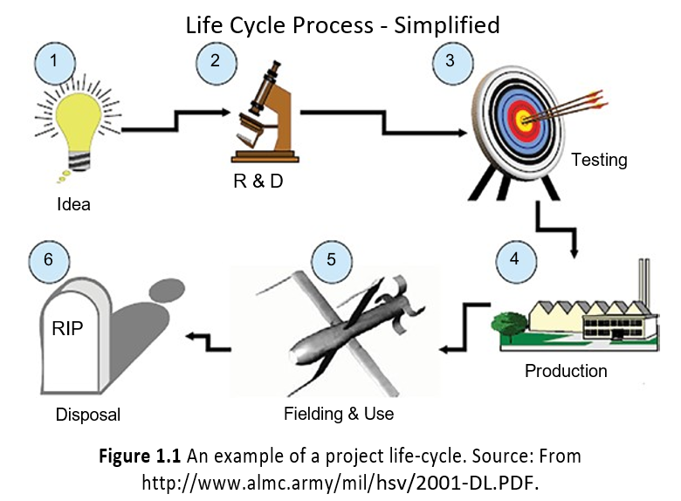
THE PROJECT LIFE‐CYCLE
It has been found useful to group the steps typically undertaken to start, perform, and complete a project into a standardized set of categories; these categories, taken together, form a conceptual life‐cycle for a project. Figure 1.1 shows one version of such a depiction of the project life‐cycle.

Slide 23
THE PROJECT LIFE‐CYCLE
Actually, “fielding and use” and “production” are likely to be “continuous business operations,” as I defined that term above, rather than a “project,” because they usually will not have a well‐defined completion date. But almost everyone includes them in such depictions of an engineering project life‐cycle; I will do that too.
You will see that as we discuss various steps and methods of engineering project management, they generally can be related to one or more of these six life‐cycle categories.

Slide 24
GOALS OF THE PROJECT/FACTORS IN TENSION WITH EACH OTHER
An engineering project will usually have more than one goal. For example:
We want to complete the project, having built a product or service that has all the required capabilities.
We want to complete the project on the end date that we promised.
We want to complete the project within the amount of money we promised.
The goals usually tend to compete with, or be in tension with, each other. For example, one could usually increase the probability of completing the project on time (and within the allocated budget) if one omits some of the capabilities.

Slide 25
THE PROJECT LIFE‐CYCLE
The essence of engineering project management, however, is achieving a balance between these competing goals. One may have to work very hard, for example, to create a design that provides the required capabilities while also staying within the constraints of time and money. It is often the case, in my experience, that it is relatively easy to find a design that seems to work, but much harder to find a design that works within the constraints of time and money. As the manager of your engineering project, you must find a design that accomplishes a large portion of all the goals. This is an example of resolving factors that are in tension (in this case, capability, schedule, cost) by achieving a balance. Maybe you decide that there are a few capabilities that are not actually needed, or not worth the cost of implementing them; you can go back and show your customer how much time and money you could save by omitting them, and obtain their written concurrence to do so. This is a very typical action for the manager of an engineering project.
You may also have to reject a design that would in fact work, but one that you deter- mine would take too much time and cost too much; you must create a different design that will achieve a better balance. This, too, is a very typical action for the manager of an engineering project.

Slide 26
THE PROJECT LIFE‐CYCLE
But you must do all of this without taking inordinate risks. For example, someone on your team may promise you that they can develop a revolutionary new algorithm that will perform the necessary computations 10 times faster than current algorithms, and such an improvement is needed to meet all of your requirements. But this revolutionary new algorithm is still just a promise, and many things can go wrong between the promise and completion of a useable algorithm.
Therefore, I (along with some others) place a fourth item on the list of key goals for your engineering project:
Managing the risks that will be encountered by the project, so as to avoid catastrophic failure.

Slide 27
THE PROJECT LIFE‐CYCLE
In addition to the risk that the project will not work, there is another category of risk: that in the conduct of the project, we might inadvertently harm people or the environment.
Risk is one key area where engineering projects are different from other sorts of projects; since we are often inventing new things via our engineering projects, we often face far more risks – and more profound risks – than do other types of projects. Engineering project managers must always think about risks.
Because of the centrality of risk to engineering projects, I always like to focus on these four constraints as the key factors in tension that I must manage over the course of my engineering project. I call this the quadruple constraint. Not surprisingly, those who only use the first three items on the list call their version of this list the “triple constraint.” That shorter list may be fine for other types of projects, but for engineering projects we will usually need my version, the quadruple constraint.

Slide 28
THE PROJECT LIFE‐CYCLE
We must complete the project having built a product or service that has all of the required capabilities We must complete the project on the end date that we promised We must complete the project within the amount of money that we promised We must manage the risks that will be encountered by the project, so as to avoid catastrophic failure
Table 1.2. The quadruple constraint.

Slide 29
THE PROJECT LIFE‐CYCLE
If your project is for an external customer, the elements of the quadruple constraint are usually expressed in a legally binding document called a contract. One portion of this contract (called specifications) will define the capabilities (“what” your project’s product or service is supposed to do) and quantifiable measures (“how fast, how far, how long, how reliable”). The contract will also specify a date by which the product or service must be delivered, and the agreed‐upon price that you will be paid when the work is complete to the satisfaction of the contractual terms.
Often, there are financial incentives and penalties; perhaps you don’t get paid until you prove that the project satisfies all of these requirements; or there are penalties for being late; or there are bonuses for completing the product on time; or some combination of all these.

Slide 30
THE PROJECT LIFE‐CYCLE
On complex projects, it is common for the contract also to mandate certain standards for how the work is accomplished, in addition to the specifications for the end product. For example, the contract may require certain engineering and/or business methods to be employed; these are one of the ways in which the customers show that they expect you to manage the risks that will be encountered by the project.
If your project is for an internal customer, the written documents that embody the quadruple constraint will still exist; they may be less formal, and probably are not legally binding. But your management still expects you to adhere to them! Your promotions, and perhaps even your job, will be on the line.

Slide 31
THE PROJECT LIFE‐CYCLE
So, what constitutes success for an engineering project?
Meet the quadruple constraint:
  Within allocated time
  Within budgeted cost
  At proper capability and performance level
  And with risks kept under control.
But also:
  Accepted and liked by the buying customer
  Accepted and liked by the users
  Without disturbing the main workflow of your company
  Without exhausting, hurting, or demoralizing your people
  And accomplish all of the above while complying with all applicable laws, regulations, and company policies.

Slide 32
THE PROJECT LIFE‐CYCLE
The quadruple constraint defines a major portion of all engineering projects, whether external or internal. The specifics of your engineering project determine the relative importance of each dimension of the quadruple constraint. Sometimes, capability is the most important. Often, meeting the promised delivery time is the most important. Every customer care about cost and risk too.
How do you know the right balance of emphasis for your project? Through frequent and forthright discussions with your customers (remember, however, there are usually multiple customers for your project, and they likely will not agree with each other on all matters), your technical personnel, your corporate management, and other stakeholders and experts. You must do this not just at the beginning of the project, but on a continuous basis.

Slide 33
THE PROJECT MANAGER
Whether the customer is internal or external, the project is performed by some set of people; this set of people are called the “project team” or the “development team.” That project development team is led by someone; that person is the project manager.
Being a project manager is about “doing,” not “consulting.” You are responsible for achieving a good outcome, creating the capability of the delivered product or service, completing the project on time, completing the project for the amount of money agreed to, and many other things. You are provided with the authority necessary to accomplish those ends.
You lead a large number of activities: planning the activities; recruiting, motivating, and aligning the people involved; managing, monitoring, and controlling the project’s activities; ensuring that the work is actually accomplished according to the plan and according to the requirements in your contract (more about that later); verification of completeness and quality; and many other things too.

Slide 34
THE PROJECT MANAGER
Projects are almost always accomplished by teams, not by single individuals. The image in the movies of one person sitting at home and building something over the weekend that changes the world seldom happens. It almost always takes teams – in fact, often large teams – to accomplish something important.
As the project manager, therefore, you will break the project into small pieces, and then assign responsibility for each piece to a named person.
Since the work is being performed by a team, you must ensure that all of the people on that team have:
A shared vision of the desired outcome of the project
A shared understanding of the means and methods that will be employed to create the desired outcomes
A shared knowledge of the constraints (including schedule and cost).

Slide 35
THE PROJECT MANAGER
Furthermore, each member of the team must learn to derive his or her satisfaction from the accomplishments of the team, rather than solely from their own accomplishments.
You must create the conditions whereby this can take place. Note that this is quite different from what we are taught to do in school; in school, although we may occasionally participate in a team project, the general emphasis is that we do our own work, and derive our satisfaction and sense of accomplishment almost exclusively from our own work. This is not at all how real engineering projects work; what matters on an engineering project is the accomplishment of the team.
A good team can do so much more than any single person! Fashioning the team in such a manner that it can actually realize this potential is part of your responsibility as project manager.

Slide 36
THE PROJECT MANAGER
As the manager of an engineering project, you have both authority and responsibility.
Authority means that you have been designated by your company or organization as being the person allowed to make certain types of decisions regarding the project. The types of decisions that you are authorized to make are usually spelled out in writing, and likely include decisions about selecting personnel for your project (usually you also get a role in determining their compensation), technical decisions about the design, what companies and vendors to use to provide parts and services, and so forth.
Responsibility means that you have accepted that you have the obligation to accomplish all the goals of the project within the constraints and limits that have been specified to you. These constraints and limits are also spelled out in writing, and likely include items such as how much time it will take to complete the project, how much money the project will cost, what you will deliver, that you will not do anything illegal or against your organization’s rules and policies (or knowingly allow someone else on the project to do anything illegal or against your organization’s rules and policies), and so forth.

Slide 37
THE PROJECT MANAGER
Since the project you will be leading is an engineering project, and we are engineers, it is natural to think that most of our time, and most of our decisions, are about engineering. This is not correct; as the manager of an engineering project, we have many responsibilities other than engineering. In fact, we lead every aspect of the project, which includes social factors and matters of business, contracts, and finance (just to name a few), in addition to technical and engineering matters. Being the manager of an engineering project is a very multi‐faceted role. We need to learn a little bit about a lot of subjects. We do not need to be an expert in all of them, but we need to know enough to be able to talk effectively to the experts in each discipline.
My own opinion, however, is that it is vitally important that the manager of a complex engineering project be an engineer. You will not be the lead designer; you will have someone working for you who fills that role. But in many of your interactions, you must judge the credibility of the people to whom you are talking, and on an engineering project the majority of those people are fellow engineers. And engineering considerations are central, as we said at the beginning of the lesson, to the success of the project (else we would not consider it an engineering project).

Slide 38
THE PROJECT MANAGER
You also lead the interaction with all of the people involved in the project. This includes your team, the people who will actually do the work of the project. But you will interact with many more people than just your team; we use the term stakeholders to indicate all of the various people who have some sort of vital interest in the outcome and conduct of your project. Examples of such stakeholders include:
Your management
Corporate specialist staff functions (e.g. human resources, finance, law, contracts, quality, etc.)
The people and organization who are paying for your project
The people and organization who are buying your project (these are usually hired by the organization that is paying for the project)
Your users – the people who will be using the product or service, once you complete it
Other interested and affected parties, sometimes including the general public.

Slide 39
THE PROJECT MANAGER
As the manager of your engineering project, you have to take in account all sides. You synchronize and align all of them. You work with them so that they understand and agree with your goals and limitations. You help them understand your approach to the project (e.g. in what order and sequence we will do the various steps, and so forth), and to some extent you must even help them understand your design. You must keep them working in alignment, keep them motivated, and keep them believing in the value of your project. You must collaborate with them to keep the project sold; we will learn that most engineering projects that are started are not completed successfully; most encounter problems, and many are stopped before completion. It is part of your job to deal with the problems as they arise (and ideally, to anticipate them in advance!), and do so in a fashion that allows all of the stakeholders to agree that the project should be allowed to continue until it is complete.

Slide 40
THE PROJECT MANAGER
You need to align our team. What do I mean by that expression? Here’s an example. I like cats, but when we had four cats all at once it was often chaos at home; they each had their own ideas about priorities, objectives, methods, and who ought to be in charge! In that case, it was cute and often a little silly. But you cannot be an effective manager of an engineering project without herding those cats! When we start, everyone will have a different opinion, on each of hundreds of matters. That is, we need to reach a state where we have a shared set of goals; a shared plan for methods, tools, and techniques; an agreed‐upon sequence of steps; shared priorities; agreed‐upon concepts for the design; and so forth. We do not reach this state all at once; indeed, even if you have a great plan with which to start, every single day you will discover new areas and additional details requiring new discussions, new realignment, and additional decisions. That is part of what makes the job so interesting!

Slide 41
YOU AS THE MANAGER OF AN ENGINEERING PROJECT
According to the dictionary,² “management” is (i) [verb] the judicious use of means to accomplish an end (ii) [noun] the group of those who manage or direct an enterprise. So, by “management” we can mean either the process and activity of overseeing an activity to accomplish an end goal, or the person or people that perform such an activity. In this lesson, we will talk about both the process of management and the person who is the manager.
Our project is an engineering project, and we said that we call it that because engineering and technological considerations are central to the success of the project. But only a portion of the people working on your project are engineers performing engineering tasks; there are many other people with other skills as well. You manage all of them, not just the engineers. Let’s look at your responsibilities.
___________
2 Merriam-Webster, © 2000 Zane Publishing, Inc.

Slide 42
YOU AS THE MANAGER OF AN ENGINEERING PROJECT
You work with your customer(s) to establish the goals of the project (e.g. what we are trying to build) and the constraints within which you and the team must accomplish them (time, money, laws, company rules, and so forth).
You lead the planning of the project, by which we mean determining in advance what you will do, in what sequence, who will do each portion, how many people with what skills will be required, how we will obtain access to those people, where the work will be performed, what methods and tools will be employed, what records will be kept, and many other matters. These must mostly be determined in advance of the commencement of the project, and must be committed to writing.
You lead the effort to agree upon methods for measuring progress of the project, in every applicable dimension: technical, schedule, staffing, cost, risk, and many others.

Slide 43
YOU AS THE MANAGER OF AN ENGINEERING PROJECT
You select the key people for the project, and agree with each of them regarding their role (responsibility and authority), committing these agreements to writing.
You motivate those people to work effectively, to work well as a team, to believe in the importance of the project and its objectives. As we will discuss later on, it turns out that motivated people are far more productive than unmotivated people, which is important in achieving success in your project.
You monitor the progress of your project as it proceeds, by which we mean you peri- odically compare results to date against your plans, and if there are material differences between those results to date and the plans, you take actions to resolve those differences.
When the project reaches its conclusion, you take actions to close‐out the project, which includes finding new work assignments for all of your personnel, returning facilities to the control of the company for other uses, archiving documented materials, properly dispositioning materials, closing the accounting books, and so forth.

Slide 44
THE PROJECT MANAGER
In summary, you as the manager of an engineering project will direct the application of knowledge, skills, tools, and techniques to a set of activities that are designed to meet the needs and goals of your project. To achieve success (and to do so safely, legally, and ethically) is your responsibility. In order to execute those responsibilities, your company or organization will grant you certain authorities, that is, you can make certain types of decisions, commit certain types of resources, and so forth. But you do not have to invent all of this by yourself, or from scratch either.

Slide 45
ENGINEERING PROCESSES CAN HELP YOU
Other people have been managers of engineering projects before you, so you can learn from their experiences (both the positive and negative parts of those experiences!). Most organizations that undertake to perform engineering projects have captured the lessons learned from previous projects, in the form of written guidance about how to do each of the different types of activities involved in an engineering project, ranging from planning to execution, monitoring, dealing with personnel, and close‐out.
We call this type of written guidance about how to conduct the steps of an engineering project engineering processes. They might take the form, for example, of written step‐by‐step instructions, or the form of checklists, or be in other formats. But they are always in writing and are always intended to tell you and your team how your organization expects your project to perform each type of project activity, to show you what artifacts that activity needs to produce, and what is expected on the content and format of those artifacts.

Slide 46
ENGINEERING PROCESSES CAN HELP YOU
So, there is a rich body of guidance available to you. Furthermore, there are actual examples of previous artifacts; most large companies build libraries of these too, for the use of new projects. In such a library, you can see an actual project plan, an actual risk register, an actual software test plan, and so forth. You can even use these as a model for your own project, adapting these existing artifacts to the specifics of your project.
Good companies also require that their engineering projects, after they are completed (whether successfully or not), contribute data to the library of past project artifacts and data and also a written “lessons‐learned” report; these reports should also be made available to new projects. This is a chance for your peers to learn about what worked and did not work on your project.
As we noted above, although engineering is central to the success of your project, many of the people who do make important contributions to your project’s success are not engineers. I have depicted a representative sampling of the range of people and skills with whom you will have to work in Figure 1.2.

Slide 47
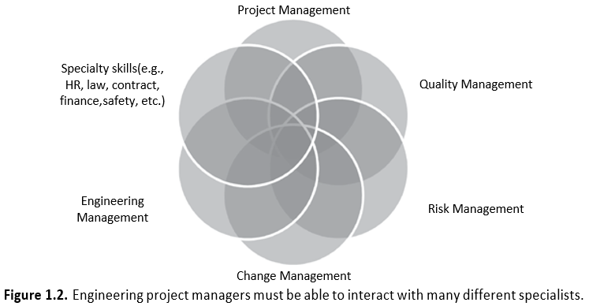
ENGINEERING PROCESSES CAN HELP YOU
As the project manager, you must manage and work with all of these people. Because of this, you have to learn a bit about each of those specialty skills – contracts, law, human relations, configuration control, quality management, and many others – so that you can interact with those people, reviews their plans and progress, and provide guidance to them, just like you do for the engineering staff. The way I like to think about it is that you need to know how to talk to each of these experts, but need not be an expert yourself.

Slide 48
THE ENGINEERING PROJECT MANAGER MIND‐SET
I have found that a certain mental orientation helps make for a better engineering project manager. You must:
Be willing to spend time and effort to create realistic planning documents, in each of a number of domains.
Be committed to the success of the project, and be able to motivate your employees to share that commitment.
Be able to persuade people with the requisite skills to come and work on your project.
Be willing to spend time learning about your customer, what they value, and what they consider success.
Be willing to spend time to build relationships of trust with many different people – your customers, your management, your other stakeholders, your employees, and your suppliers.

Slide 49
THE ENGINEERING PROJECT MANAGER MIND‐SET
Collaborate with your team to create a clear statement of scope and objectives for your project, and be willing to spend the time and effort necessary to obtain alignment of your team and stakeholders so that they agree with those descriptions.
Motivate your team so that they believe in the importance of the project, and in the feasibility of the plan for implementing it.
Be willing to accept that things will go wrong; spend time to create effective risk management and quality systems so that you can spot them and correct them.
Be willing to solicit and act on advice; you cannot do this complex and demanding job without help.
Be willing to insist on (and invest in) appropriate tools, technologies, methodologies, and techniques.
Always be thinking ahead, looking for what might go wrong, and looking for opportunities.

Slide 50
THE ENGINEERING PROJECT MANAGER MIND‐SET
An engineering project, however, is not a science project; it is important to understand the difference between science and engineering. Look at Table 1.3. Science seeks to study and understand the world; it asks questions about the underlying mechanisms and principles. Engineering does something different: it is concerned with using that knowledge (and other skills) in order to create a practical application, or a practical effect. Engineering is not knowledge for knowledge’s sake; such knowledge is important, but it is a job for scientists, not for engineers and engineering projects. We, in order to be effective engineering project managers, must keep our focus on achieving those practical results. But our projects must be feasible too; therefore, we may well have to consult with scientists in order to make sure that we are not promising more than we can feasibly deliver.
A presentation by an Englishman named Chris Wise (who, at the time, was a professor at University College, London) that I attended in 2013 got me thinking about what one might call “the tao of engineering project management”; tao is a Chinese word meaning approximately “way” or “path.” I believe that the path to successful engineering project management encompasses much more than engineering. I have adapted what Professor Wise said to arrive at Figure 1.3.

Slide 51
THE ENGINEERING PROJECT MANAGER MIND‐SET
As engineers we must base our work on facts, measurement, and rigor; it must actually achieve a practical result in the real world. But that is not enough; we must exercise judgment about what our product should be, create a compelling vision of what it could be, and use craftsmanship and artisanship to build it well.
Science “Study the world” | Engineering “Change the world”
First principles | Practical applications, which at times might be based on those scientific principles
Engineers and projects create practical devices, systems, and processes We use science when we can, but engineering has often actually preceded science: through tinkering and experimentation, someone builds something that works, and that motivates others to try to figure out the underlying scientific principles.
Table 1.3. Science and engineering have different objectives.

Slide 52
THE ENGINEERING PROJECT MANAGER MIND‐SET
Lastly, we must meet the ever‐rising expectations of our users and the general public. If you are a baseball player, you have the luxury of being considered a great success if you get a hit 30% of the time; that means you are allowed to “fail” 70% of the time! Not so in the world of engineered products; those are expected to work essentially 100% of the time. That may not seem fair, but it is a fact. We must also achieve the desired benefits of our product, but minimize the unintended adverse consequences. Actually, our track record as engineers is pretty good, but expectations are very high, and continuously getting higher. What was good enough yesterday will not be good enough tomorrow.
Vision / Art
What could be
Figure 1.3. “The tao of engineering project management.”
Artisanship
How to do it?
People
Who will do it with you?
Philosophy & Judgment
What it should be
Math & Science
Measurement & rigor

Slide 53
References:
1. Engineering Project Management, Neil G. Siegel, Wiley, 2019
2. English for Careers: business, professional and Technical, Leila R. Smith, Roberta Moore, Pearson Education Inc, 2020
3. Technical Communication. Process and Product, Sharon J. Gerson, Steven M. Gerson, Pearson Education Inc, 2020

Slide 54
THANK YOU FOR YOUR ATTENTION!

