Slide 1

HOW DO ENGINEERING PROJECTS
GET CREATED?
Lesson 4
https://www.synrgise.com/implementation-process/
Lecturer: M. Kurbonov

Slide 2
How Do Engineering Projects Get Created?
L4
When we get our first job, we are likely to be assigned to work on an existing engineering project; we are not troubled by the question of how this engineering project came into existence. Who created it? Why? How is it being paid for? How did it come to pass that it is our company that is doing the work? But as we progress in our careers, we come to realize that these aspects matter a lot. In fact, understanding them, so that you can help your company win new projects, is an important path for you to achieve attractive assignments and career success.

Slide 3
Engineering Projects are Created in Response to a Need, or a Vision
L4
Somewhere out there in the world is a group of users who need something; let us imagine a scenario wherein they decide that they can best obtain it by buying it from some- one outside of their own organization, rather than making it themselves. Let’s say that what they need is a loaf of bread.
First of all, they need to talk among themselves, and reach agreement on exactly what is it that they want to buy. White or whole wheat? Non‐GMO flour? Gluten free? Sliced? What kind of packaging? As you can see, even to buy a simple loaf of bread, there are a set of decisions to be made.
If we write down simple things like the above (or a grocery shopping list), you can be sure that when someone plans to pay money for a complex engineered system, they will also try to write down something about what they want to buy. They will write down not only the characteristics of the item they wish to buy, but perhaps other things too: what is the date by which they need it, what kind of payment terms are they offering (e.g. payment upon placing an order versus payment upon delivery, or some other arrangement), and so forth. We call such a document a request for proposal.

Slide 4
Engineering Projects are Created in Response to a Need, or a Vision
L4
Buyers of engineered systems shop around too. The way they do this is to send their written request for proposal to a set of companies that they believe might be able to build what they want (or these days, post their request for proposal onto an on‐line forum where vendors know to look), and ask them to make an offer – in writing – about what they could provide, when they could provide it, how much it would cost, what kind of warranty they would offer, and many other relevant factors. We call such a written offer a proposal.
Companies can then look at the request for proposal, decide if they wish to respond (or not – it costs money to write a proposal; we call this decision a bid/no-bid decision), and if they decide to respond, they create a written proposal that they send back to the buyer. The buyer has likely specified a date by which such proposals are due.
The buyer will then read all of the proposals (and might invite some or all of the proposers to make an in‐person presentation), and eventually will select the provider that appeals to them, based on whatever selection factors the buyer deems important: price, schedule, capability, reputation, warranty, other factors, or some combination of all of these. The buyer then negotiates additional details with the selected vendor, which allows the two parties to agree on some type of formal purchase agreement; this might be a purchase order, a contract, or some other form of written agreement.
For the typical complex engineered system, this formal purchase agreement will take the form of a legally binding contract.

Slide 5
Engineering Projects are Created in Response to a Need, or a Vision
L4
And then the selected vendor is ready to start the engineering project, to build the item that the buyer wanted, in accordance with the terms of their proposal and that formal purchase agreement.
The vendor in general will not (and ought not) to start working on the project until the formal purchase agreement (of whatever type) is executed by both parties. Otherwise, they may get stuck with unreimbursed costs if the buyer ends up selecting some other vendor, changes their mind and decides not to buy anything at all at this time, changes their mind about what they want to buy or when they want to receive it, or any other material factor that would be defined in rigorous terms in the executed purchase agreement.
Let’s define the term proposal in a little more detail. A proposal is a written formal offer to perform a specified piece of work, under specified conditions, to create a specified set of deliverables (products, services, and data), on a specified schedule, for a specified price, under a specified set of payment terms and timing, and under a specified set of contract terms (e.g., how to resolve disputes, etc.).
Since the proposal, as an offer to the buying organization, usually legally commits the offering organization to the terms specified in the proposal, the proposal must be signed by someone who is authorized to commit the offering organization (e.g., an officer of the corporation).

Slide 6
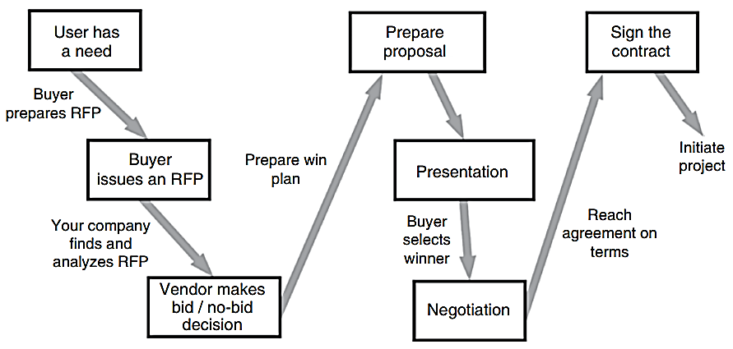
Engineering Projects are Created in Response to a Need, or a Vision
L4
Figure 1. The steps leading to the commencement of an engineering project.

Slide 7
Engineering Projects are Created in Response to a Need, or a Vision
L4
Once the buying organization has read your company’s proposal, they may choose to accept your proposal, that is, tell you in writing that they wish to engage your company to do the work described in their request for proposal and your proposal. Alternatively, they may choose to reject your proposal, which is their way of saying “we have decided not to engage your firm for this piece of work.”
Receiving written notice from the buying organization that they have chosen to accept your proposal is good news, but you still ought not to start work until the purchase order or contract is actually negotiated and signed by both parties.
Proposals are often prepared in the context of a competition, that is, someone who wants to buy a product or service will ask more than one company to prepare a written proposal, stating in advance that they will only be signing a contract with one of the bidders (the winner).
The buying organization then selects the winner and notifies the other bidders that they were not the winner.

Slide 8
Engineering Projects are Created in Response to a Need, or a Vision
L4
On occasion, the buying organization might already know that they want your company to do the work, and therefore they do not plan to have a competition. Perhaps you built a related product for that buying organization already, and they were happy with your work. Running a competition takes time and money, and the buying organization may decide that running one for this particular product is not to their advantage, since they have confidence that your organization is the supplier they want.
We use the term sole source for such a situation, that is, the buying organization will solicit a proposal only from a sole organization. Notice that they will still ask for a proposal; in this case, not as a basis for a competitive selection process, but instead to make sure that there is agreement between them and you about what is to be done, how it will be done, when it will be done, how much it will cost, and so forth. Even for sole‐source contracting, it is still necessary and appropriate to get all of the terms and conditions agreed to in writing before work starts … and the proposal is a big part of that task.
Why do we care about proposals? Remember, in in the previous lessons, we discussed the fact that virtually 100% of company revenue comes from projects. And nearly every one of those projects (whether internally funded or externally funded) comes from a proposal. Proposals are what bring revenue – in the form of projects – to companies. Writing winning proposals is the only way to generate revenue, pay the bills, pay employees, and keep the company in business.

Slide 9
Engineering Projects are Created in Response to a Need, or a Vision
L4
And if you are the buyer, proposals are what allow you to select the right team and organization to build your product or service. Whether you are buying or selling, proposals are essential.
Let’s describe the process for externally funded and internally funded projects in more detail.
In many businesses (e.g. aerospace, construction and building contracting, public works, architecture, and many others), virtually 100% of company revenue comes from competitive contract awards (or, on occasion, sole‐source contracts that follow success- fully completed competitive contracts). Every single one of those awards is the result of a proposal in response to an externally sponsored competition.
In other types of businesses (e.g. those that build for the marketplace – like car companies and computer companies), there is an internal competition to decide what products or services to build and offer. Those too are usually resolved via proposals, albeit sometimes less formal than externally sponsored proposals.

Slide 10
Engineering Projects are Created in Response to a Need, or a Vision
L4
Here is an example of how it works in such internal competitions. Let’s say that you are the chairman of Apple. Your executive team probably has dozens of ideas (proposals, in various degrees of formality and completeness) about what the company should invest in and bring to market next. You, as chairman, will in essence run an internal competition (the degree of formality will vary) to decide which are the products and services in which you will invest as the “next thing.”
As you can see, whether your company lives off external competitions or internal competitions, proposals are the mechanism that creates engineering projects.
There are additional (and more personal) reasons why you should care about proposals:
I can assure you that becoming recognized as a good proposal manager is a sure path to enhanced career opportunities!
Furthermore, one proven method to get the chance to be a project manager is to be the person who wins the project, by having led the proposal.
And finally: working on proposals can be a very interesting work assignment. It is hard work with long hours, and sometimes a little stressful, but it is also intensely creative, interesting, and makes a difference to the company and to the customer.

Slide 11
How to Win
L4
We talked about internal competitions and external competitions. Here’s a twist: there is always an internal competition, even when the explicit competition is external.
What do I mean by that? Let’s consider a scenario:
An organization wants to buy an engineered system, and has issued a request for proposal (actually, as we will discuss a bit later, you must start long before the customer issues the request for proposal, but for this little scenario, we will ignore that detail).
Your company knows this buying organization, finds them reputable and reasonable, and furthermore, you think that your company has the skills and people appropriate to build the engineered system that they seem to want to buy.

Slide 12
How to Win
L4
You spend some time and money gathering all of this information. You also have to estimate business‐related items, such as:
How much revenue and profit could this project provide to your company?
How much will it cost to win? This includes preparing the proposal, conducting negotiations, related marketing costs, and so forth.
What are your chances of winning? Which other companies are likely to bid, and what are their skills, what is their reputation with this buying customer, and so forth?
What people will you need to make this bid? What facilities will you need to make this bid?
Since it will require money to make the bid (we call this an opportunity cost), you need to ask the appropriate person in your company to authorize that expenditure. They will certainly ask for information like that indicated in the previous bullets. You there- fore gather all of your information, and create some sort of written artifact, and prob- ably also get to make an in‐person presentation to the person within your company who has the authority to approve such an expenditure.

Slide 13
How to Win
L4
Now, put yourself in the shoes of the person who gets to make the decision: will your company bid or not bid on this job? In actual fact, this person not only has to consider the merits of the bid that you want the company to make, but this person also has to consider the merits of every other course of action open to the company at this time. For example, there are likely to be many other such bid opportunities available to the company; the company probably does not have enough money or people with the appropriate skills to bid on all of them; therefore, someone has to choose from among the options. Every possible course of action (e.g. bid this opportunity, bid this second opportunity, but do not bid this third opportunity) has its costs and potential benefits. The person with the decision authority considers all of these options – not just the merits of your potential bid – when making the decision. That is, you are in a competition against all of the other potential courses of action (and all of the other teams that have their own favorite bid opportunities) inside your company!
This is even more complicated than I just described, because not all of the opportunities competing for attention, funding, and people need to be bids; for example, someone in the company might want to spend money enlarging a factory instead of making your bid. The landscape of potential opportunities against which you have to compete in this internal competition can be very complicated.
Therefore, you must first win the internal competition for attention and funds, just so that you can gain permission to prepare a bid to the external customer.

Slide 14
How to Win
L4
In the little scenario above, I hinted at some of the information that you must develop in order to win this internal competition. The following is a more complete version of that list:
Understand the problem. Who is buying it? Who will use it? By when will they need it? How many will they buy? What is it supposed to do? How is that different or better than the way they do it now?
How to solve the problem. What will our solution look like? What will we invent or make, and what will we buy from other companies? What exists already, and what, therefore, must yet be invented in order to create this solution? How long will it take to do this research and invention process? How much money will it cost?
How to measure the goodness of your solution. This, of course, starts with the technical performance measures and operational performance measures. But it goes on to include something that we have not yet discussed: what will be our areas of positive differentiation (e.g. where will we try to be better than the other bidders, and where will we be content to only be as good as the other competitors)?
How to prove that you can solve the problem and achieve differentiation. What will we prove by building prototypes? What will we prove by benchmark measurements in our laboratories? What will we prove via computer‐based models?
How to show that it can be a viable business proposition. What is the business model, pricing/costing/margin, teaming, intellectual property rights and licensing, sales projections, cash‐flow projections, etc.?

Slide 15
How to Win
L4
If you are working at Apple, and want to build a new gizmo, something like the above may be enough to get you funding and authorization to build your team, and to start designing your gizmo. Probably, however, you will not be given enough funding actually to finish it; instead, you will be asked to come in every few months and show your progress, and to update your market assessment. If your progress is satisfactory, and the market assessment still seems credible and favorable, you have a chance to get a next increment of funding in order to do a few more months of work toward finishing your new gizmo.
If, however, you are working at Lockheed Martin, and your goal is to get funding and permission to bid on a new fighter jet contract, you are just getting started. The good news is that the company has authorized you to start getting ready to make the bid, and authorized some funding for you to get to work on the proposal. However, that is just Step 1. You still have three more steps to get through:
Step 2. Do what is needed so that you are allowed to submit the actual bid to the buying customer.
Step 3. Win the external competition.
Step 4. Close the deal.

Slide 16
How to Win
L4
A proposal is a formal, legally binding commitment. If you submit a proposal to a buying customer, and they accept it and then you both sign a contract, your company is legally committed to providing the products and services specified in the contract (and in the proposal, if the contract incorporates that proposal, as is sometimes done), and to do so on schedule, for the price, and in accordance with the other terms defined in those documents.
Because of this, companies go through an analysis and decision process before you are allowed to submit a proposal, in order to determine if – in light of what we continue to learn – they actually want to submit this bid. Step 1 (above) got you authorized to start preparing the proposal, but the company will still want to review all of the terms and conditions that will be embodied in a potential contract before letting you submit the proposal; that review is Step 2. The following list describes the typical items that you company will want to review before they authorize you actually to submit the proposal to the buying customer:

Slide 17
How to Win
L4
Price to win. Of course, this is a competition, and we do not get to see the other bidders’ proposals, so we do not know the actual price that they will bid. But we may have some public information about what our competitors bid on similar jobs in the past, and we may also have legal access to some information about how much the buying customer wishes to spend. Your company will want you to use that information to estimate what price the company is likely to have to bid in order to win the competition. This amount can then be compared to your estimate for how much it will actually cost for the company to build the item, and therefore the company can estimate whether it will make or lose money on the project. This will be one of the factors used by the company to decide whether or not you are allowed to submit a bid; most companies will not bid if they believe that the price needed to win is so low that they cannot make a fair and reasonable profit margin on the project.
Time phasing of costs versus time phasing of revenues. On most projects, the company must expend money before receiving revenue. Therefore, the company will want to understand the cash flow involved: can they provide the cash to pay salaries, suppliers, and other bills while waiting for payment from the customer? There are also a number of financial measures that the company will calculate to quantify the quality of the financial deal: for example, something called the return on assets employed, and other similar financial measures.

Slide 18
How to Win
L4
Opportunity costs. To perform on your project will entail a commitment by the company of money, facilities, equipment, and talented people. The company always has the option to use those assets for other activities; to assign them to your project is to forego the opportunity to use them on something else. We call this an opportunity cost. Your company will do an assessment of what else they could do in this same time period with those funds, facilities, and people. Would those other opportunities be better for the company, and/or better for those employees?
Risks to the company. Obviously, any project could lose money, but many other things could go wrong too: accidents that damage facilities or injure people; legal liabilities if the company is late, or unable to perform on some portion of the contract; damage to the reputation of the company; damage to the environment through an accident or a poorly designed work process; or other things that could go wrong. The company will want to assess all of these, as part of making a determination of whether they want to make this bid or not. Do we appear to understand all of the risks, and have appropriate strategies for mitigating those risks in place? Examples of such risks that must be identified, assessed, and plans for their mitigation created include:

Slide 19
How to Win
L4
Capability. Does the company believe that we can deliver all of the promised capabilities?
Schedule. Does the company believe that we can deliver all of the promised items by the promised dates?
Price. Does the company believe that we can complete all of the tasks required by the contract for an amount that will allow the company to make a reasonable profit on our efforts?
Contractual. Are there contractual terms in the request for proposal, or in our proposal, that the company cannot tolerate?
Probability of winning. Writing a fully-fledged proposal, and supporting the presentations and negotiations, can cost a lot of money; literally, at times, millions of dollars. So, if this is an externally-sponsored competition, the company will want to estimate their chances of winning the competition. If this is an internally-sponsored competition, the company will want to estimate the probability of achieving the projected levels of sales and profits.

Slide 20
How to Win
L4
If you get through all of this successfully, you have passed Step 2 and are allowed to submit your proposal to the buying customer. Now, you want to win! How do we maximize our chances of actually winning? This is Step 3 from the above list. I will summarize the answer briefly now, then discuss Step 4, and finally return to a more detailed discussion of Step 3: how to win.
You will mostly likely win or lose based on what is written in your proposal. There may be some opportunities to make face‐to‐face presentations to the customer as well, but what is written is usually the main determinant of proposal success.
So, as we plan and prepare our proposal, we consider factors such as:
Our value proposition, as expressed in the customer’s coordinate system of value.
The differentiators that we offer.

Slide 21
How to Win
L4
Trust – have we earned this customer’s trust?
Contractual terms – have we offered attractive terms and conditions for the contract in our proposal?
Schedule – are we proposing to deliver the product by the date that the customer desires? Are our claims about delivery date credible to the customer?
Price – how much do we propose to charge? Does the customer have to pay us more than that amount if the job runs into complications, or is our company committing to absorb any such additional costs?
Compliance – are we proposing to meet every single requirement in the request for proposal?
Want factors – are there aspects of our offer that are attractive enough to the customer, so that they will prefer to select us over the other bidders?

Slide 22
How to Win
L4
Getting good answers to these items into your proposal comprises Step 3.
We will return to this aspect in a moment, but first we will talk briefly about Step 4: closing the deal.
Let’s say that you win: you are formally notified by the customer that you have been selected as the company that they want to hire. You must still sign a contract. Creating a contract that both parties are willing to sign involves a lot of face‐to‐face discussion, which is termed contract negotiations. Sometimes, a customer will conduct such negotiations with all of the bidders, prior to announcing the winner; this allows them to negotiate with the contractor before they are selected, and customers think that this provides them leverage in the negotiations. It also, of course, allows the customer to be sure that the company they select is willing to sign up for contractual terms that the customer can tolerate, because they do not finalize the selection of a winner until after all of the bidders (including the eventual winner) have agreed to contract terms. Some customers, however, find negotiating with all of the bidders too expensive and too time‐consuming, and defer some or all of the contract negotiations until after they have selected a winner.

Slide 23
How to Win
L4
Contracts are both very detailed and legally binding, so negotiating a contract is a complicated process. You will be directly involved, together with your contract specialists and your company’s attorneys.
Congratulations! You finished all four steps, won the external competition, and were able to negotiate an acceptable contract. Now you can start work.
An important insight: to do all of the above really well takes a lot of time. For a big engineered system, your company probably needs to start two or three years before the request for proposal is expected to be issued. Your company will need to pay for the team working to get ready to write this proposal for a long time.
Here is another, equally important insight: starting early is really important. The data that I have seen indicates that the probability of winning is much higher for those teams that start early, as compared to those teams that wait to start until shortly before the request for proposal is issued. Companies that enter a competition late seldom win.

Slide 24
How to Win
L4
And still another important insight: there will be delays along the way.
The customer may issue the request for proposal on a later date than that indicated in their original plan.
The source‐selection process (e.g., the process conducted by the customer to select a winner) may take longer than originally expected.
If this is a government procurement, one or more of the losing contractors may file a protest, which holds up the awarding of the contract to the winner until an independent government agency assesses and adjudicates the merit of the claims by the losers.
What all of the potential sources of delay mean is that it will take a lot longer (and cost a lot more) than you might think to write a proposal and win a competition for an engineering project. You, your key personnel, and your company need to be prepared for the reality of how hard, how long, and how expensive this process really is. You and your company must be committed to this proposal! If not, it is better to decide early on that you are not going to make this bid, and find another, more suitable business opportunity. We now return to Step 3: how to win. You can pick and choose between them, based on what seems best for you, your company, and your particular bid opportunity.

Slide 25
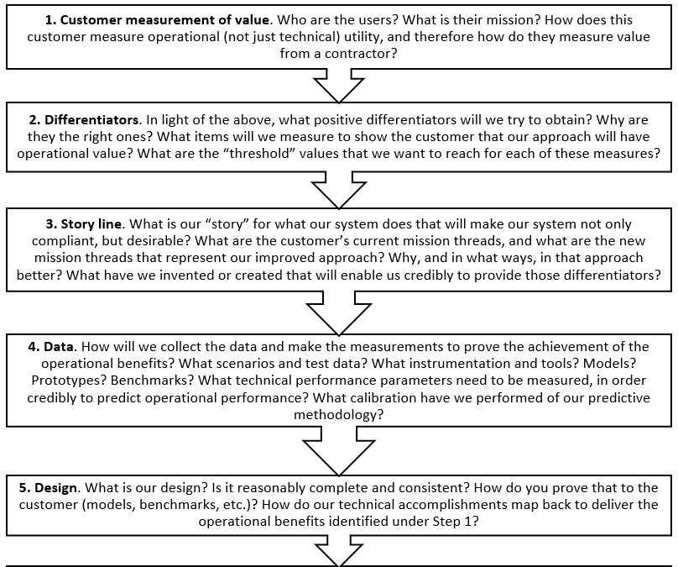
Achieve Positive Competitive Differentiation
L4

Slide 26
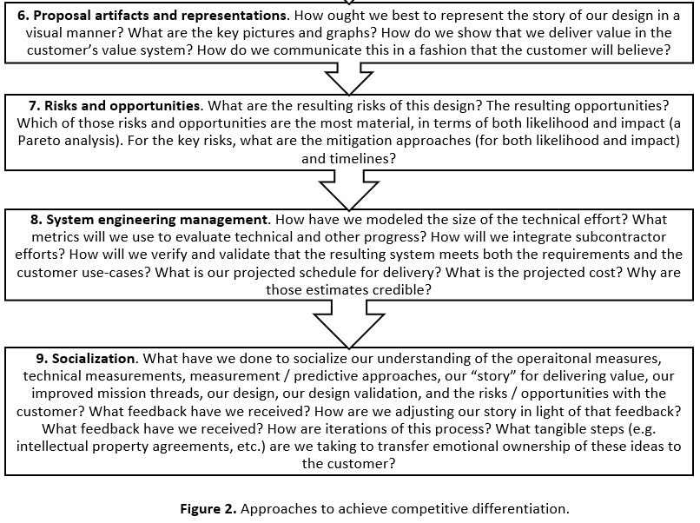
Achieve Positive Competitive Differentiation
L4

Slide 27
Achieve Positive Competitive Differentiation
L4
The idea of obtaining positive competitive differentiation from your competitors may sound obvious, but most proposal teams simply do not make such a list. It is not surprising, therefore, that the proposals that result do not convey strong positive differentiation. I believe that it is essential – absolutely the core of a winning proposal – to do this step explicitly, and to create a written list of candidate differentia- tors that are then explicitly discussed among the team, with your management, and (once you think that you have a pretty good list) with every element of the customer: the buying customer, the paying customer, the users, the other stakeholders. This is not, in my experience, common practice. But having such a list provides guidance to every person participating in the proposal, and provides your potential customers with a clear view of what you are offering. In my view, every proposal ought to do this.
Good proposals have more than text; they have a small number of key depictions (figures, tables, and graphs) that concisely convey our key points. We next create these depictions. We also write theme sentences (or short paragraphs) to go with each depiction. Together, the depictions and the theme sentences are the artifacts that will tell our story, both in the proposal and in our face‐to‐face interactions that lead up to the formal submission of the proposal, and the eventual selection of a winning contractor.

Slide 28
Achieve Positive Competitive Differentiation
L4
The last step is not enough for us to create great differentiators; we must get the customer actually to believe them. In my experience, explaining these great differentiators to your customer for the first time in the proposal is not sufficient in order to get customers to believe in your differentiators. In order to get them to believe in those differentiators, we must socialize those differentiators (and our other key ideas too) via face‐to‐face meetings with the customer before we submit our proposal. We do this for two reasons:
First, we are likely to learn something from such interactions with the customers that allows us to refine and improve our differentiators, and our other ideas.
Second, people are always reluctant truly to believe other people’s ideas; they are far more likely to believe an idea if they feel that they have had a hand in creating it. You therefore need to allow your customer to have intellectual skin in the game of creating your differentiators. I like to say that we must transfer some emotional ownership of our ideas to our customers; if we can make them feel that these ideas are in part theirs, they are much more likely to believe in those ideas, to accept the arguments that led to them, and to accept the inferences that derive from them. That is what we want!

Slide 29
Achieve Positive Competitive Differentiation
L4
The value of your differentiators must be measured in the customer’s coordinate system of value, not just in the engineer’s coordinate system of value. We have talked about this before: customers are seldom engineers or scientists, and therefore have a different “coordinate system of value” than we do. Therefore, if we want them to like our ideas and select our proposal (especially if we want them to like us so much that they will pay a price premium to get us – always a great aspiration), then we must convey our value proposition in their coordinate system of value.
Here’s a little complication: almost always, there is more than one “customer.” There will be multiple influential people within the buying organization, multiple influential people within the user’s organization, and multiple influential people in other places. We must therefore determine the “coordinate system of value” for each of these people and/or groups. Usually, the needs and desires of these various groups will be in conflict in some ways. We must resolve that, through balance; we must convince them that our proposed balance is the best possible outcome.
That seems like a lot of trouble. Can’t we just ask the customer what would constitute a set of differentiators?

Slide 30
Achieve Positive Competitive Differentiation
L4
The conventional wisdom, of course, it that “the customer is always right.” My view is different: my experience suggests that many customers are so busy operating their mission that their view of the future is “three minutes from now.” They know well what they do now (and you should learn from that), but you usually cannot depend on them to create an effective vision for revolutionary future improvements.
In any case, if they did it for you, they would have to share that information with all of your potential competitors (in a competition, the customer will try to be sure that they are providing all of the bidders the same information, so that the competition is fair). And, since all of the potential bidders could avail themselves of that knowledge, this would deprive you of any potential differentiation from your competitors!
But if you create a vision for the future for the customers – and then convince them that it is valid, valuable, and feasible – they need not share that information with the other bidders, and therefore the differentiators that we create can provide you with competitive differentiation.

Slide 31
Achieve Positive Competitive Differentiation
L4
Since the customer has criteria for how they are going to select the winner, you must be able to credibly show that your proposal is superior in a set of factors (some of which are quantifiable; price is certainly quantifiable) that relate to those criteria. And remember the want factor too. You therefore need differentiators for each of the following:
The explicit source‐selection criteria
The unstated source‐selection criteria
The “want factor.”

Slide 32
Achieve Positive Competitive Differentiation
L4
The general process for selecting differentiators that I use is as follows:
Understand the customer’s point of view:
What they do now, and why they do it that way
What they have tried and rejected in the past
Their “unwritten rules.”
Use this to derive a statement of what they value.
Use that to create actual quantifiable metrics (the operational performance metrics) that can express the goodness of a candidate solution in their coordinate system of value.
Now that you have metrics that reflect the customer’s coordinate system of value, you next (and this is the critical step) create ideas for what the system ought to do to score well against those metrics; these are the core of your potential differentiators.
Socialize the above with the customer, continuously.

Slide 33
Achieve Positive Competitive Differentiation
L4
Remember, if the customer has identified something as an explicit need (usually, by writing a mandatory requirement), every bidder will claim that they are doing that. Therefore, the mere fact that you are meeting a requirement cannot be a differentiator. It may be, however, that there is something superior about how you are implementing that requirement (e.g. something about your design that lowers risk, provides more design margin, or some other characteristic that is of benefit to the customer). That how may be an opportunity for differentiation. This is a frequent mistake that I see teams preparing competitive proposals make over and over again: they believe that the mere fact that they are meeting a mandatory requirement can constitute a differentiator. That is never true.
One way to test the effectiveness of your candidate list of differentiators is to write the briefing slide that you imagine the customer would use to brief their boss about why they chose you over the other competitors.
Having differentiators is necessary, but not sufficient. The step of socialization with customers is also vital. As I have said previously, most of us can be counted on liking our own ideas, but are far less open to the ideas of others. Therefore, in order to get the customer to like your idea, you need to allow it (at least, in part) to become “their idea.”

Slide 34
Achieve Positive Competitive Differentiation
L4
There are many ways to accomplish the transfer of emotional ownership:
Joint brainstorming
Collaborative research, under some sort of formal agreement
Grant generous intellectual property rights
… and many, many others.
Here some key suggested steps to winning:
Start early
Qualified, committed capture and proposal team
Work hard on building a strong relationship with all elements of the customer community Within legal limits, influence what they intend to buy
Marshal strong and credible examples of good past performance, and create viable arguments for why they are relevant to this procurement
Understand the competition
Conduct an unbiased price-to-win analysis
Create a complete offering package and win strategy (including desired differentiators) Select teaming partners to fill in your weaknesses, and to strengthen your desired differentiators
Have the design and the business strategy complete and approved before the request for proposal comes out
Follow an orderly and systematic process to prepare the actual proposal

Slide 35
Achieve Positive Competitive Differentiation
L4
And typical mistakes made during competitions:
Failure to identify the customer’s principal issues or problems in advance
The customer contact plan is inadequate to uncover the customer’s needs, desires, and predispositions. We should determine who the customer views as the other strong bidders, and why, and find out what the customer wants and expects to happen.
You fail to pre-sell your solution to the customer. We should take every opportunity to conduct one-on-one discussions with customers in advance of the request for proposal
Failing to use the available and appropriate (e.g. ethical and legal) methods to achieve influence on the customer’s acquisition strategy. We should: validate our understanding of the procurement approach through frequent interaction with the customer;
issues and solicit customer opinion and comment; help the customer clearly communicate their needs toward developing an RFP package that will reflect an understanding of available technologies and solutions

Slide 36
Achieve Positive Competitive Differentiation
L4
Failing to identify key personnel (especially the program manager) early enough to become known by the customer as someone they firmly believe can get the job done
Failure to carry through frequent customer-meeting plans. We should meet frequently with the customer(s), and have a systematic process for bringing feedback from the customer contacts back into the capture activities
There is not a complete and reviewed win strategy completed long before the RFP is issued
Teaming is conducted on an ad-hoc or sentimental basis, rather than in accordance with the win strategies and competitive pricing strategy
Fail to set and validate the target price to win. We should use both a top-down estimating model and generate a bottom-up price estimate; do the same for each competitor, so as to estimate their likely bid price
Allowing the costs to “roll-up” as they will, rather than driving every portion of the bid to a price-to-win target
There is not a regular tempo of management reviews and management involvement

Slide 37
Your Role in All of This
L4
Failing to identify key personnel (especially the program manager) early enough to become known by the customer as someone they firmly believe can get the job done
Failure to carry through frequent customer-meeting plans. We should meet frequently with the customer(s), and have a systematic process for bringing feedback from the customer contacts back into the capture activities
There is not a complete and reviewed win strategy completed long before the RFP is issued
Teaming is conducted on an ad-hoc or sentimental basis, rather than in accordance with the win strategies and competitive pricing strategy
Fail to set and validate the target price to win. We should use both a top-down estimating model and generate a bottom-up price estimate; do the same for each competitor, so as to estimate their likely bid price
Allowing the costs to “roll-up” as they will, rather than driving every portion of the bid to a price-to-win target
There is not a regular tempo of management reviews and management involvement

Slide 38
Your Role in All of This
L4
Among all of the people involved in winning proposals for engineering projects, there are three key roles:
The capture manager. This person is the strategist, the person who leads the effort from the earliest days of identifying or creating the opportunity, through the internal efforts that assess the opportunity, the shaping of the opportunity through continuous interactions with the various portions of the customer, the definition and validation of the desired differentiators, the qualification of the opportunity, the selection of the designated project manager and their socialization with the customer, the selection of the proposal manager, and so forth.
The proposal manager. This person is the one who actually leads the efforts to pre- pare the written documents that respond to the request for proposal.
The designated project manager. This person is the one who will become the manager of our engineering project after we win.
On a proposal effort for a large project, these are likely to be three separate people. As is usual in systems engineering, there is tension between these people. For example, the capture manager wants to win, and will therefore be looking for ways to decrease the price that the company will eventually bid, in order to increase their chance of winning. But the designated project manager knows that he or she has actually to execute the eventual contract, and will press to ensure that the price bid is high enough to provide adequate resources to do the work. This tension (and there are many other examples of such tensions between these three people) is healthy!

Slide 39
Your Role in All of This
L4
For projects of more moderate size, the designated project manager may also assume one of the other roles. But in this case, someone else must be appointed to focus on achieving a balance among the factors in tension; for example, if the designated project manager is also the capture manager (I have performed this double role at times), someone must be designated to be the person with the authority to ensure that the price bid is high enough to provide adequate resources to do the work.
As the capture manager, proposal manager, and/or designated project manager, you of course organize all of the tasks described in this lesson, select the people who will lead each task, and ensure that they then follow through on the execution of those tasks. You must also personally be involved in the creation and validation of the desired differentiators. Since many of those differentiators describe desired characteristics of the design for your system or product, the creation of differentiators involves the use of engineering techniques and skills; this task cannot be performed by sales &/or marketing personnel.

Slide 40
References:
Engineering Project Management, Neil G. Siegel, Wiley, 2019
English for Careers: business, professional and Technical, Leila R. Smith, Roberta Moore, Pearson Education Inc, 2020
Technical Communication. Process and Product, Sharon J. Gerson, Steven M. Gerson, Pearson Education Inc, 2020

Slide 41
THANK YOU FOR YOUR ATTENTION!

