Slide 1
Computer Science Fundamentals
Lecture 1: Computer generations
Lecturer: Olga Yugay

Slide 2
Agenda
Module overview
  Learning outcomes
  Layers of the computing systems
History of the computers
Brief history of computing software

Slide 3
1. Module overview

Slide 4
1.1 Learning outcomes
Identify and interpret the numerical processes running within computer system.
Describe the tasks and features of each of the main components of a computer system and how these components work together.
Show understanding of the von Neumann architecture and stored program paradigm.
Explore and experiment with algorithms and other relevant computer science topics.
Explore current trends in technology and learn to use relevant resources and tools
Demonstrate a thorough knowledge of basic command line commands and git

Slide 5


Slide 6

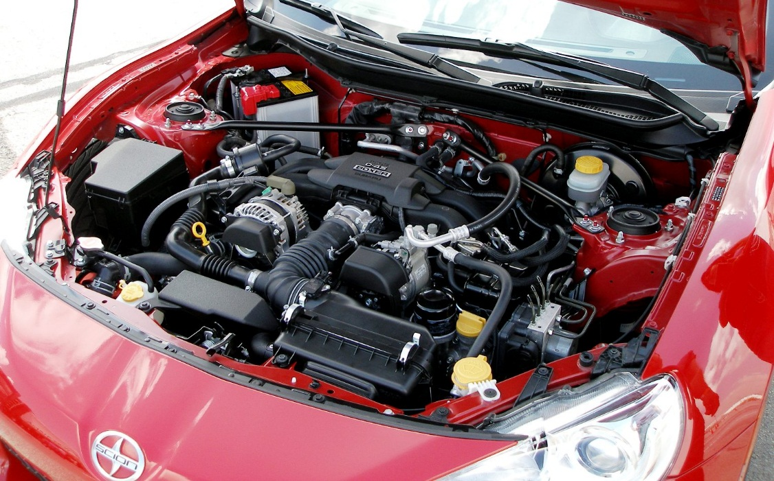
Abstraction is
…way to think about the something which removes or hides complex details ¹
…a technique for managing complexity of computer systems
Abstraction
Reality
¹ Dale, N., & Lewis, J. (2020). Computer Science Illuminated (7th ed.). Jones & Bartlett Learning, Ch1

Slide 7
Abstraction...
Software, in the form of a program stored in the computer's memory, is, itself, a kind of abstraction. It is what makes a computer usable for more than one purpose
Underlying computer technology (transistors) becomes smaller, cheaper and fast enough to support the program abstraction=>computers became usable by general public²
FYI: Smallest transistor is 50,000 times thinner than human hair
² Dale, N., & Lewis, J. (2020). Computer Science Illuminated (7th ed.). Jones & Bartlett Learning, Ch 1

Slide 8
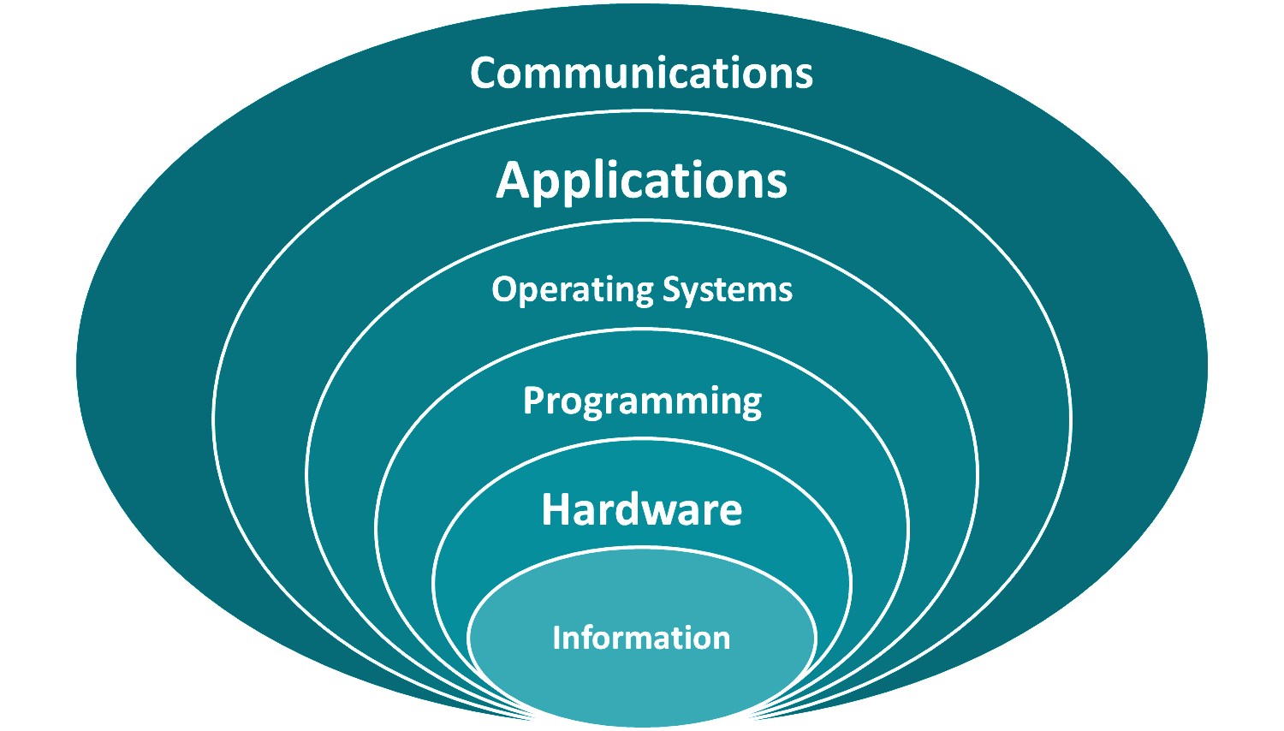
1.2 Layers of computing systems

Slide 9
1.2 Layers of the computing systems
audio
numbers
text
video
Images
Information
01001010101010

Slide 10
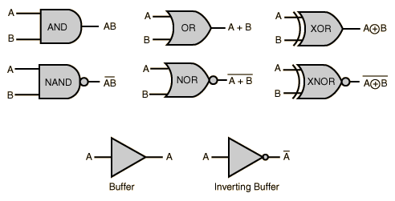
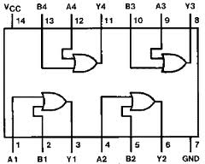
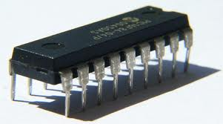
1.2 Layers of the computing systems
gates
circuits
Hardware
Information

Slide 11
1.2 Layers of the computing systems
Programming
Algorithms
Assembly Languages
Data types
OOD and High level languages
Hardware
Information

Slide 12
1.2 Layers of the computing systems
Operating Systems
Memory Management
Process Management
CPU Scheduling
Programming
File Systems and
Directories
Hardware
Information

Slide 13
1.2 Layers of the computing systems
Applications
Operating Systems
Programming
Hardware
Information

Slide 14
2. History of computers

Slide 15
WHY COMPUTER HISTORY?
“History places us in time. The computer has altered the human experience, and changed the way we work, what we do… and even how we think.” ³
³ Shustek, L. J. (2011, January 11). Why a computer history museum? Computer History Museum. Retrieved March 12, 2022, from https://computerhistory.org/blog/why-a-computer-history-museum/

Slide 16
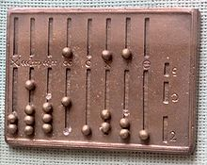
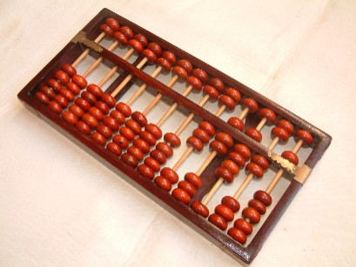
Early history of computing
Abacus
- An early device to record numeric values ⁴
⁴ Dale, N., & Lewis, J. (2020). Computer Science Illuminated (7th ed.). Jones & Bartlett Learning.

Slide 17
Early history of computing
Blaise Pascal(In the middle of 17th century)
Mechanical device to add, subtract, divide & multiply
Joseph Jacquard(late 18th century)
Jacquard’s Loom, the punched card
Charles Babbage(19th century)
Analytical Engine ⁵
⁵ Dale, N., & Lewis, J. (2020). Computer Science Illuminated (7th ed.). Jones & Bartlett Learning, Ch1

Slide 18
20 century development
Dr. Herman Hollerith
first electro-mechanical tabulator, US census
Alan M. Turing
abstract mathematical model called a Turing machine, major area of computing theory.
Thomas Flowers (1943)
Colossus - first all-programmable electronic digital computer
John von Neumann (1950)
EDVAC ⁶
⁶ Dale, N., & Lewis, J. (2020). Computer Science Illuminated (7th ed.). Jones & Bartlett Learning, Ch1

Slide 19
More recent history: generations of computers
First generation computers (1951 – 1959)
Second generation computers (1959-1965)
Third Generation computers(1965-1971)
Fourth Generation computers(1965-1971)
Fifth Generation: Artificial Intelligence (Present and Beyond)⁶
⁶ Dale, N., & Lewis, J. (2020). Computer Science Illuminated (7th ed.). Jones & Bartlett Learning, Ch1

Slide 20
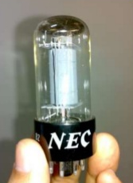
First generation computers (1951 – 1959)
Vacuum tubes stored information
Generated a lot of heat
Primary memory device – magnetic drum that rotated under read/write head
Slow Input/Output
  Input device – card reader that read the holes punched in an IBM card
  Output – punched card or a line printer
Use: UNIVAC was the first commercial computer delivered to a business client, the U.S. Census Bureau in 1951.⁷
⁷ Dale, N., & Lewis, J. (2020). Computer Science Illuminated (7th ed.). Jones & Bartlett Learning, Ch1

Slide 21
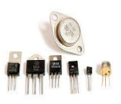
Second generation computers (1959-1965)
Transistor replaced vacuum tubes
Smaller, more reliable
Memory made from magnetic cores, tiny dougnut-shaped devices, each capable of storing one bit of information -> Immediate access memory
Transistors and other components - were assembled by hand on printed circuit board
Use: atomic energy industry ⁸
⁸ Dale, N., & Lewis, J. (2020). Computer Science Illuminated (7th ed.). Jones & Bartlett Learning, Ch1

Slide 22
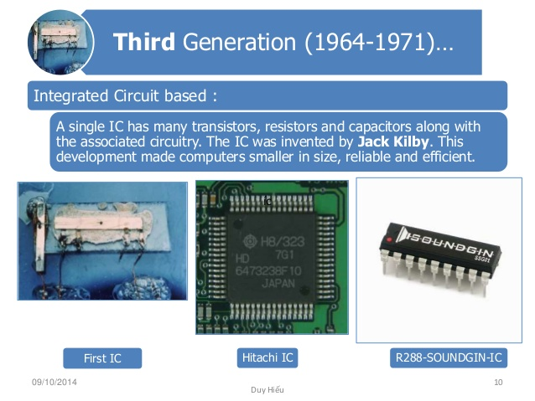
Third Generation computers(1965-1971)
Integrated Circuits (IC) - solid pieces of silicon with transistors, other components, and their connections.
Smaller, cheaper, faster, and more reliable
1970s – several thousand transistors on a silicon chip
Memory – use of transistor, each transistor one bit of information, volatile memory – the information went away when the power was turned off
Input, output device – the terminal with keyboard and screen first appeared
Use: Computers for the first time became accessible to a mass audience because they were smaller and cheaper than their predecessors ⁹
⁹ Dale, N., & Lewis, J. (2020). Computer Science Illuminated (7th ed.). Jones & Bartlett Learning, Ch1

Slide 23
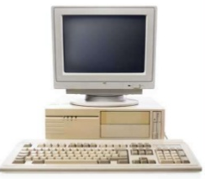
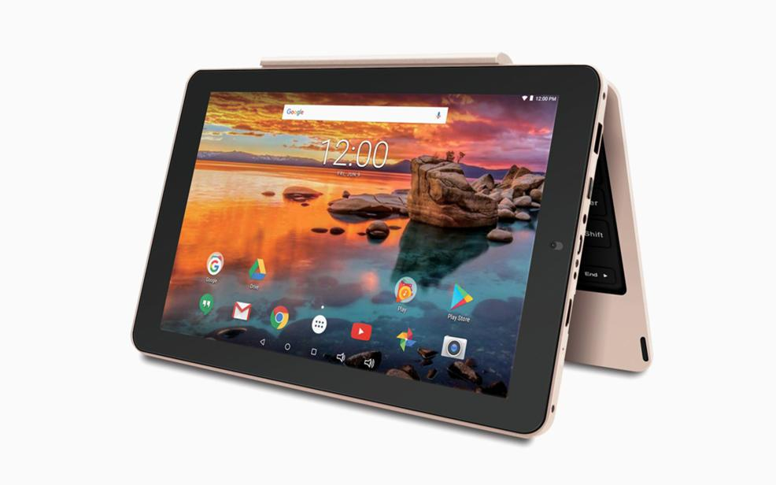
Fourth Generation computers(1965-1971..present?)
Large scale integration
Micro-computer on a chip
Development of GUIs, the mouse and handheld devices.
The workstations were networked
PC (Personal Computer) entered the vocabulary
  Apple
  Tandy/Radio Shack
  Atari
  Commodore
  Sun
  IBM
  Hewlett-Packard and many others
Use: desktop computers in many areas of life as more and more everyday products began to use microprocessors ¹⁰
¹⁰ Dale, N., & Lewis, J. (2020). Computer Science Illuminated (7th ed.). Jones & Bartlett Learning, Ch1

Slide 24
Fifth Generation: Artificial Intelligence (Present and Beyond)
Fifth generation computing devices, based on artificial intelligence, are still in development, though there are some applications, such as voice recognition, that are being used today.
The use of parallel processing and superconductors is helping to make artificial intelligence a reality.
Quantum computation and molecular and nanotechnology will radically change the face of computers in years to come.
Use: The goal of fifth-generation computing is to develop devices that respond to natural language input and are capable of learning and self-organization. ¹¹
¹¹ Dale, N., & Lewis, J. (2020). Computer Science Illuminated (7th ed.). Jones & Bartlett Learning, Ch1

Slide 25
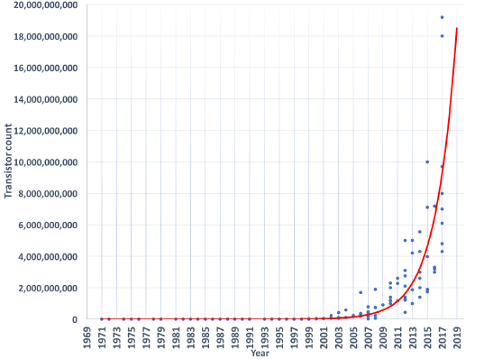
Moore's Law
In 1965, Gordon Moore, one of the pioneers of integrated circuits, predicted that the number of transistors that could be fit on one chip would double every year.
In 1975, he revised his estimate to doubling every two years. This prediction is known as Moore's Law.
Limitations: denser chips and faster signal processing both generate increased heat => multicore chips ¹²
¹² Encyclopædia Britannica, inc. (n.d.). Moore's law. Encyclopædia Britannica. Retrieved March 11, 2022, from https://www.britannica.com/technology/Moores-law

Slide 26
3. Brief history of computing software

Slide 27
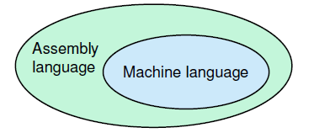
First generation software
First programs were written on machine language
Instructions were built into the electrical circuitry of a particular computer
E.g.: small task of adding two numbers together used three instructions written in binary (1s and 0s), and the programmer had to remember which combination of binary digits means what
Programming in machine language is both time-consuming and prone to errors -> first artificial programming languages were developed - assembly languages, used mnemonic codes to represent each machine-language instruction.¹³
¹³ Dale, N., & Lewis, J. (2020). Computer Science Illuminated (7th ed.). Jones & Bartlett Learning, Ch1

Slide 28
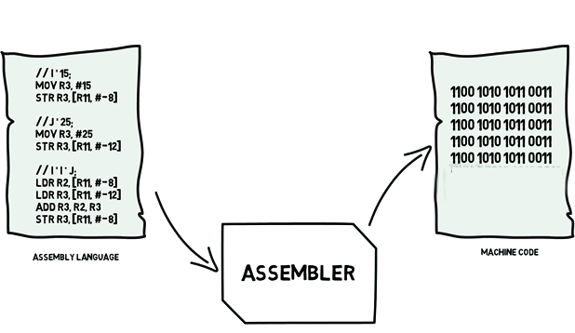
First generation software
¹⁴ Dale, N., & Lewis, J. (2020). Computer Science Illuminated (7th ed.). Jones & Bartlett Learning, Ch1

Slide 29
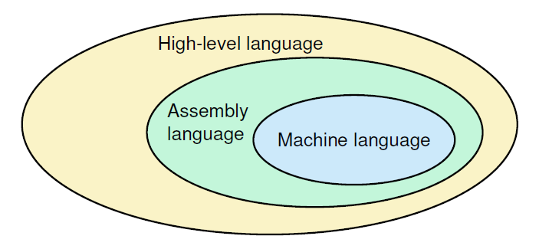
Second generation software
More powerful hardware → more powerful tools to use it effectively
Assembly language limitation (thinking in terms of machine instructions) → more powerful languages (high level) developed
  Fortran, Cobol, Lisp
Same program could now run on more than 1 computer
  Compiler – translating program ¹⁵
¹⁵ Dale, N., & Lewis, J. (2020). Computer Science Illuminated (7th ed.). Jones & Bartlett Learning, Ch1

Slide 30
Second generation software
Systems programmers wrote tools like assemblers and compilers
Application programmers used these tools to write programs
The application programmer was becoming even more insulated from the computer hardware¹⁶
¹⁶ Dale, N., & Lewis, J. (2020). Computer Science Illuminated (7th ed.). Jones & Bartlett Learning, Ch1

Slide 31
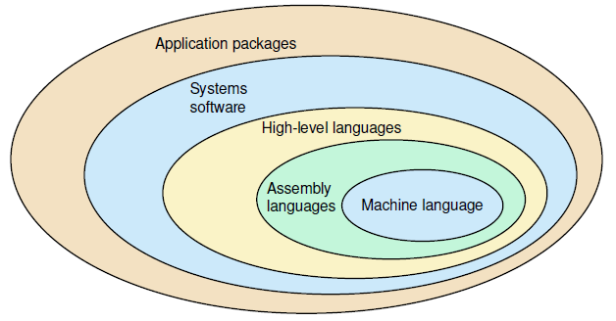
Third generation software (1965 - 1971)
With 3rd generation of computers, it became clear that the human was slowing down the computing process.
Computers were sitting idle while waiting for the computer operator to prepare the next job.
Solution: put the computer resources under the control of the computer => to write a program that would determine which programs were run when => an operating system ¹⁷
¹⁷ Dale, N., & Lewis, J. (2020). Computer Science Illuminated (7th ed.). Jones & Bartlett Learning, Ch1

Slide 32
Fourth generation software (1971 - 1989)
Structured programming, a logical, disciplined approach to programming
  Pascal
  Modula-2
  BASIC
  C
  C++
More powerful operating systems
  UNIX under AT&T
  PC-DOS for IBM PC
  MS-DOS
  OS for Macintosh with mouse and point-and-click graphical interface
Application software packages appeared
  Spreadsheets
  Word processors
  Database management systems¹⁸
¹⁸ Dale, N., & Lewis, J. (2020). Computer Science Illuminated (7th ed.). Jones & Bartlett Learning, Ch1

Slide 33
Fifth generation (1990 - present)
Microsoft
Apple
Open source software (Linux and alike)
Object-oriented design and programming
World Wide Web
Embedded systems¹⁹
¹⁹ Dale, N., & Lewis, J. (2020). Computer Science Illuminated (7th ed.). Jones & Bartlett Learning, Ch1

Slide 34
The Big Ideas of Computing
Creativity
Abstraction
Data and information
Algorithms
Programming
The Internet
Global impact ²⁰
²⁰ Dale, N., & Lewis, J. (2020). Computer Science Illuminated (7th ed.). Jones & Bartlett Learning, Ch1

Slide 35
Recommended reading and videos
Dale, N., & Lewis, J. (2020). Computer Science Illuminated (7th ed.). Jones & Bartlett Learning, Chapter 1
Downey, A. (2015). Think python. O'Reilly.
Downey, A. B., Elkner, J., & Meyers, C. (2015). Learning with python: How to think like a computer scientist. Green Tea Press.
Videos
First Programming languages
Early Computing: Crash Course Computer Science #1
Electronic Computing: Crash Course Computer Science #2

Slide 36
Demo

Slide 37
A bit of history...1980s
Before Windows OS, the most common operating system that ran on IBM PC compatibles was DOS (Disk Operating System)
not graphical, purely textual
command line interface
to run programs or manipulate the operating system you had to type in commands
When Windows was first created it was actually a graphical user interface that was created in order to make using the DOS operating system easier for a novice user

Slide 38
Command prompt a.k.a. a shell, console window, a cmd prompt
Though the newer operating systems do not run on DOS, they do have the command prompt (cmd.exe), which has a similar appearance to DOS.
Other OS families like Macintosh, Unix, Linux have slightly different analogue to Windows command prompt under different name terminal.
So why bother with cmd if we have graphical interface?
To become expert computer user
  It enables you to work faster
  Basic commands are needed while using Git

Slide 39
Command prompt or terminal
WIndows:
Click on the Start Menu
Search for cmd.exe
OR
Ubuntu:
Press Ctrl+Alt+T or
Click on Show applications icon and search for Terminal
The command prompt is simply a window that by default displays the current directory, or in windows term a folder, that you are in and has a blinking cursor ready for you to type your commands.
To use the command prompt you would type in the commands and instructions you want and then press enter.
Notes:
I will add Ubuntu related commands later

Slide 40
Help command
This command lists all the commands built into the command prompt. If you would like further information about a particular command you can type help command name. For example help cd will give you more detailed information on a command dir.
In command prompt:
Type help
Select any command from the list and type help [command]
E.g. help cd

Slide 41
MKDIR command or MD
Creates directory
Syntax
mkdir [Drive:]Path (for Ubuntu)
md [Drive:]Path
Parameters
Drive: Specifies the drive on which you want to create the new directory.
Path: Required. Specifies the name and location of the new directory. The maximum length of any single path is determined by the file system.
/? : Displays help on the command
Try yourself type in command prompt
md /?
md 2022-2023\csf
Notes:
mkdir ~/myfolder/myfolder

Slide 42
Dir command
Lists the files and directories contained in your current directory, if used without an argument, or the directory you specify as an argument.
Type dir and press enter and you will see
a listing of the current files in the directory you are in
information about their file sizes
date and time they were last written to
how much space the files in the directory are using and the total amount of free disk space available on the current hard drive.
Notes:
For Ubuntu: du -h /home/U
~/ is shorthand for the current user's home folder.
what are user home directories for?
These directories are a kind of personal place(Working space) for all the users other than root. There will be a separate folder for each user in /home directory. For example if you have a user called â€˜Tomâ€™, then his default home directory is /home/tom. We can change this default folder when creating user in Linux. Our Tom user can do what ever he wants in /home/tom folder where he have full rights on the files he created and owned in that folder.

Slide 43
Dir command continued
Note two directories named . and .., which have special meaning in operating systems.
. stands for the current directory and
.. stands for the previous directory in the path.
Also note for many commands you can use the * symbol which stands for wildcard.
E.g. typing dir *.txt will only list those files that end with .txt.

Slide 44
Cd command or CHDIR
Displays name of or allows you to change your current directory to the one specified
Syntax
chdir [Drive:] [Path]
cd [Drive:] [Path] for Ubuntu
cd [/d] [Drive:] [Path] - changes the drive
Parameters
Drive: Specifies the drive
Path: Required. Specifies the name and location of the new directory. The maximum length of any single path is determined by the file system.
/? : Displays help on the command
Try yourself type in command prompt
cd /?
cd 2022-2023\csf
cd..
cd /d e:\users
cls
Notes:
For Ubuntu
cd ~/Documents

Slide 45
Thank you!

