Slide 1
Computer Science Fundamentals
Seminar 2
Lecturer: Olga Yugay

Slide 2
Seminar objectives
Part A
Positional notation, conversion between number systems
Binary addition
Part B
Practise python and conversion, variables, data types, boolean expressions
Python conditionals and recursion
Practise basic cmd commands
Practise basic git commands

Slide 3
Part A: Lecture review

Slide 4
Positional notation
Positional notation is a system of expressing numbers in which ¹
the digits are arranged in succession (0, 1, 2, 3…)
the position of each digit has a place value
the number is equal to the sum of the products of each digit by its place value.
9 | 4 | 3
9*10² | 4*10¹ | 3*10 ⁰
900 | 40 | 3
900+40+3=943
Place value
¹ Dale, N., & Lewis, J. (2020).
Computer Science Illuminated
(7th ed.). Jones & Bartlett Learning,

Slide 5
Positional notation
The rightmost digit represents its value multiplied by the base to the zeroth power, the digit to the left represents its value multiplied by the base to the first power
Number 943 demystified: 9*x²+4*x¹+3*x⁰
Base
9 | 4 | 3
9*10² | 4*10¹ | 3*10 ⁰
900 | 40 | 3
900+40+3=943

Slide 6
Convert from decimal to other number systems
The algorithm:
While the quotient is not zero
Divide the decimal number by the new base
Make the remainder the next digit to the left in the answer
Replace the decimal number with the quotient ²
² Dale, N., & Lewis, J. (2020). Computer Science Illuminated (7th ed.). Jones & Bartlett Learning, Chapter 3.

Slide 7
Example:
Let’s try to convert 1632 in decimal to its hex equivalent
 | Remainder | Hex
1632/16=102

Slide 8
Example:
Let’s try to convert 1632 in decimal to its hex equivalent
Hex: 660
 | Remainder | Hex
1632/16=102 | 0 | 0
102/16=6 | 6 | 6
6/16=0 | 6 | 6

Slide 9
Arithmetic in binary

Slide 10
Recall arithmetic in decimal
Basic addition in decimal (base 10)
0+1=1
1+1=2
2+1=3
…
9+1=10
Because there is no symbol for 10, we reuse same digits.
The rightmost digit reverts to 0 and there is a carry into next position to the left ⁴
⁴ Dale, N., & Lewis, J. (2020). Computer Science Illuminated (7th ed.). Jones & Bartlett Learning, Chapter 3.

Slide 11
Recall arithmetic in decimal
Basic addition in decimal (base 10)
0+1=01
1+1=02
2+1=03
…
9+1=10
Because there is no symbol for 10, we reuse same digits.
The rightmost digit reverts to 0 and there is a carry into next position to the left ⁵
carry
⁵ Dale, N., & Lewis, J. (2020). Computer Science Illuminated (7th ed.). Jones & Bartlett Learning, Chapter 3.

Slide 12
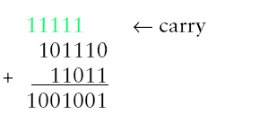
Arithmetic in binary
The rules of binary arithmetic same as decimal
But run out of digits much sooner ⁶
Example 1:
  0+1=1
  1+1=10
  Example 2:
⁶ Dale, N., & Lewis, J. (2020). Computer Science Illuminated (7th ed.). Jones & Bartlett Learning, Chapter 3.

Slide 13
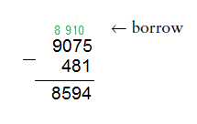
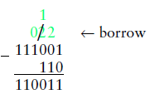
Subtraction in binary
Decimal subtraction
The subtraction rules in binary are simple, same as with decimal system:
1-0=1
1-1=0
Note, when you try to subtract a larger digit from a smaller one, such as 0-1, you have to borrow one from the next left digit of the number from which you are subtracting.
More precisely, you borrow one power of the base. So in base 10, when you borrow, you borrow 10. The same logic applies to binary subtraction.
Every time you borrow in a binary subtraction, you borrow 2, which is the power of the base 2 (binary numbers). ⁷
Binary subtraction
⁷ Dale, N., & Lewis, J. (2020). Computer Science Illuminated (7th ed.). Jones & Bartlett Learning, Chapter 3.

Slide 14
Tasks 1-4 Binary, octal, hex
Enter the first link Google Spreadsheet (Tasks 1-4)
Create Google Sheet and copy tasks there
Complete the tasks listed (Review conversion, addition and subtraction on slides 4, 5 and 6)
Compare answers with Google Spreadsheet (Answers)
Notes:
Refer to relevant lecture slides

Slide 15
Part B

Slide 16
Python ⁸
The int() function can be used to convert numbers into a base 10 integer from any base between 2 and 36 by changing the second parameter. e.g. int(number, 8)
Number system | Function | Prefix | Example
Binary | bin() | ‘0b’ | 0b100
Octal | oct() | ‘0o’ | 0o17
Hex | hex() | ‘0x’ | 0x1C
⁸ Downey, A. B., Elkner, J., & Meyers, C. (2015). Learning with python: How to think like a computer scientist. Green Tea Press., Chapter 1
Notes:
octal_number = oct(decimal_number).replace("0o", "")
print("The octal value for {} is {}".format(decimal_number,octal_number ))

Slide 17
int()
int(value, base)
value A number or a string that can be converted into an integer number
base A number representing the number format. Default value: 10
Examples:
x = int("12")
y = int(“0b01010”, 2)
¹⁰ Downey, A. B., Elkner, J., & Meyers, C. (2015). Learning with python: How to think like a computer scientist. Green Tea Press., Chapter 1

Slide 18
Hexadecimal
What does it this code do?
hex_num1 = "0x10"
hex_num2 = "0x10"
my_sum = int(hex_num1, 16) + int(hex_num2, 16)
print(my_sum)
print(hex(my_sum))

Slide 19
Important terms
Variables are simply places to store information and to give that information a name. As the term indicates the information stored is "variable", meaning that it can change
Example: hex_num1 = "0x10"
Expressions are combinations of values, variables, and operators that the Python interpreter evaluates to compute a resulting value.
Statements are units of code that have an effect, like creating a variable or displaying a value. The Python interpreter executes statements to produce the effect. (When executing a statement, the interpreter evaluates any expressions included in the statement.)
Functions are named sequences of statements that perform computations. After you define a function, you can call it any number of times to have the Python interpreter execute the statements in the function. ¹¹
¹¹ Downey, A. B., Elkner, J., & Meyers, C. (2015). Learning with python: How to think like a computer scientist. Green Tea Press., Chapter 1-2
Notes:
A critical advantage of variables, expressions, statements, and functions is that they allow you to take small building blocks of functionality and compose them into larger features.
WHY CARE about variables! - because if you hard code the values , you may later need to update it

Slide 20
Expression vs statement
Here are some examples of expressions: ¹²
2 + 2
3 * 7
1 + 2 + 3 * (8 ** 9) - sqrt(4.0)
min(2, 22)
max(3, 94)
round(81.5)
"foo"
"bar"
"foo" + "bar"
None
True
False
2
3
4.0
All of the above can be printed or assigned to a variable.
Here are some examples of statements:
if CONDITION:
elif CONDITION:
else:
for VARIABLE in SEQUENCE:
while CONDITION:
try:
except EXCEPTION as e:
class MYCLASS:
def MYFUNCTION():
return SOMETHING
raise SOMETHING
with SOMETHING:
None of the above constructs can be assigned to a variable. They are syntactic elements that serve a purpose, but do not themselves have any intrinsic “value”. In other words, these constructs don’t “evaluate” to anything.
¹² Downey, A. B., Elkner, J., & Meyers, C. (2015). Learning with python: How to think like a computer scientist. Green Tea Press., Chapter 1
Notes:
The statements will be covered in greater detail in upcoming seminars

Slide 21
Boolean expression
A boolean expression is an expression that is either true or false. The following examples use the operator == , which compares two operands and produces True if they are equal and False otherwise: ¹³
>>> 5 == 5
True
>>> 5 == 6
False
True and False are special values that belong to the type bool ; they are not strings:
¹³ Downey, A. B., Elkner, J., & Meyers, C. (2015). Learning with python: How to think like a computer scientist. Green Tea Press., Chapter 1-2
Notes:
True and False are special values that belong to the type bool ; they are not strings:
>>> type(True)
<class 'bool'>
>>> type(False)
<class 'bool'>

Slide 22
Relational operators¹⁴
Symbol | Name | Example | Value
== | Equal to | 2==2 | True
!= | Not Equal to | 3!=2 | True
> | Greater Than | 3>2 | True
< | Less Than | 3<2 | False
>= | Greater Than or Equal to | 3>=2 | True
<= | Less Than or Equal to | 2<=2 | True
¹⁴ Downey, A. B., Elkner, J., & Meyers, C. (2015). Learning with python: How to think like a computer scientist. Green Tea Press., Chapter 1-2

Slide 23
Logical operators ¹⁵
Python is not very strict. Any nonzero number is treated as True
Symbol | Name | Example (x = 5) | Value
and | Returns True if both statements are true | x <= 5 and x < 10 | True
or | Returns True if one of the statements is true | x <= 5 or x >4 | True
not | Reverse the result, returns False if the result is true | not(x <= 5 and x < 10) | False
¹⁵ Downey, A. B., Elkner, J., & Meyers, C. (2015). Learning with python: How to think like a computer scientist. Green Tea Press., Chapter 1-2

Slide 24
Arithmetic operators ¹⁶
Symbol | Name | Example | Value
+ | Addition | 8+3 | 11
- | Subtraction | 8-3 | 5
* | Multiplication | 8*3 | 24
/ | Division | 8/2 | 4
// | Floor Division | 9//2 | 4
** | Power | 8**3 | 512
% | Modulus | 8%3 | 2
More on operators https://www.w3schools.com/python/python_operators.asp
¹⁶Downey, A. B., Elkner, J., & Meyers, C. (2015). Learning with python: How to think like a computer scientist. Green Tea Press., Chapter 1-2

Slide 25
Floor division ¹⁷
Floor division // divides two numbers and rounds down to an integer
Example: Run time of a movie is 105 minutes. You want to know the runtime in hours.
>>> minutes = 105
>>> minutes / 60
1.75
But hours are usually not recorded with decimal points. ⇒ Try floor division
Floor division returns the integer number of hours, rounding down:
>>> minutes = 105
>>> hours = minutes // 60
>>> hours
1
To get the remainder, you could subtract off one hour in minutes:
>>> remainder = minutes - hours * 60
>>> remainder
45
¹⁷ Downey, A. B., Elkner, J., & Meyers, C. (2015). Learning with python: How to think like a computer scientist. Green Tea Press., Chapter 1-2

Slide 26
Modulus ¹⁸
Modulus operator % divides two numbers and returns the remainder.
>>> remainder = minutes % 60
>>> remainder
45
Using % you can check whether one number is divisible by another, if x % y is zero, then x is divisible by y
¹⁸ Downey, A. B., Elkner, J., & Meyers, C. (2015). Learning with python: How to think like a computer scientist. Green Tea Press., Chapter 1-2.
Notes:
Guess what % can be used for

Slide 27
f-string
F-strings provide a concise and convenient way to embed python expressions inside string literals for formatting. ¹⁹
Example:
name = “Olga”
module = “CFS”
print(f"Hello, My name is {name} and I'm teaching {module}")
¹⁹ Downey, A. B., Elkner, J., & Meyers, C. (2015). Learning with python: How to think like a computer scientist. Green Tea Press., Chapter 1-2

Slide 28
Getting input
input() - is built-in function to get user input. The result of it has to be assigned to the variable
int() - built-in function converts the specified value into an integer number ²⁰
year = input("What year were you born?")
year_now = 2021
print("You are", year_now-int(year), "years old")
²⁰ Downey, A. B., Elkner, J., & Meyers, C. (2015). Learning with python: How to think like a computer scientist. Green Tea Press., Chapter 1-2

Slide 29
Task 5: Python
Write a small Python program to convert decimal into other number systems. Take input from the user. Experiment with int(), bin(), oct(), hex().
Create a PyCharm project e.g. CSF/seminar2/
Make a comment #task5 inside main.py
Notes:
https://www.programiz.com/python-programming/examples/conversion-binary-octal-hexadecimal
Note: A number with the prefix 0b is considered binary, 0o is considered octal and 0x as hexadecimal.
# Python program to convert decimal into other number systems
dec = 344
print("The decimal value of", dec, "is:")
print(bin(dec), "in binary.")
print(oct(dec), "in octal.")
print(hex(dec), "in hexadecimal.")

Slide 30
Task 6
Write a Python program to find whether a given number (accept from the user) is even or odd, print out an corresponding message to the user. Make a comment #task6 inside main.py inside CSF/seminar2/ project
Hint:
if condition :
print(“This is odd number”)
else:
print(“This is even number”)

Slide 31
Function
In Python a function is defined using the def keyword: ²¹
def my_function():
print("Hello!")
The function can be called multiple times by using function name followed by parenthesis
my_function()
²¹ Downey, A. B., Elkner, J., & Meyers, C. (2015). Learning with python: How to think like a computer scientist. Green Tea Press., Chapter 1-2

Slide 32
Function
Function is a named sequence of statements that performs a computation. When you define a function, you specify the name and the sequence of statements. Later, you can “call” the function by name. ²²
def calculateMark(weight, mark):
result = weight*mark
return result
calculateMark(0.4, 65)
calculateMark(0.6, 55)
Function definition
Function is called
²² Downey, A. B., Elkner, J., & Meyers, C. (2015). Learning with python: How to think like a computer scientist. Green Tea Press., Chapter 1-2

Slide 33
Function
Name of a function is type
>>>type(42)
<class ‘int’>
It is common to say that a function “takes” an argument and “returns” a result. The result is also called the return value.
Argument of a function

Slide 34
Function: interface
interface of a function is a summary of how it is used:
What are the parameters?
What does the function do?
What is the return value?
def calculateMark(weight, mark):
return weight*mark
Function parameters

Slide 35
Function: example
def calculateMark(weight, mark):
return weight*mark
cwWeight = 0.4
cwMark =65
calculateMark(cwWeight, cwMark)
calculateMark(0.6, 55)
Parameter. A name used inside a function to refer to the value passed as an argument.
Argument. A value provided to a function when the function is called. This value is assigned to the corresponding parameter in the function.

Slide 36
void function vs value returning function ²³
Void function
Function that performs an action but does not return any value. *In fact None a special value is returned by void functions.
id = 000123
def printID():
print(id)
Value returning function
Function that performs an action and returns a value
def calculateMark(weight, mark):
return weight*mark
²³ Downey, A. B., Elkner, J., & Meyers, C. (2015). Learning with python: How to think like a computer scientist. Green Tea Press., Chapter 1-2

Slide 37
Task 7
Comment the previous tasks using Ctrl+/
Modify previous tasks 5 and 6 into functions, e.g. conversion and even_odd functions. Call the functions.

Slide 38
Global variables
Unlike local variables, which disappear when their function ends, global variables persist from one function call to the next. ²⁴
globalVariable = 10
def functionToCallGlobalVariable:
print(globalVariable)
def someFunction():
localVariable = 2
²⁴ Downey, A. B., Elkner, J., & Meyers, C. (2015). Learning with python: How to think like a computer scientist. Green Tea Press., Chapter 1-2

Slide 39
Global variables
Global variables are usually used for flags => boolean variables that indicate (“flag”) whether a condition is true. ²⁵
For example, some programs use a flag named verbose to control the level of detail in the output:
verbose = True
def example1():
if verbose:
print('Running example1')
²⁵ Downey, A. B., Elkner, J., & Meyers, C. (2015). Learning with python: How to think like a computer scientist. Green Tea Press., Chapter 1-2

Slide 40
Global variables
To reassign a global variable inside a function you have to declare the global variable before you use it: ²⁶
been_called = False
def example2():
global been_called
been_called = True
The global statement tells the interpreter something like, “In this function, when I say been_called, I mean the global variable; don’t create a local one.”
²⁶ Downey, A. B., Elkner, J., & Meyers, C. (2015). Learning with python: How to think like a computer scientist. Green Tea Press., Chapter 1-2

Slide 41
Global variables
Here’s an example that tries to update a global variable: ²⁷
count = 0
def example3():
count = count + 1 # WRONG
UnboundLocalError: local variable 'count' referenced before assignment
How to fix it??
when you make an assignment to a variable in a scope, that variable becomes local to that scope and shadows any similarly named variable in the outer scope
=> count became local
²⁷ Downey, A. B., Elkner, J., & Meyers, C. (2015). Learning with python: How to think like a computer scientist. Green Tea Press., Chapter 1-2

Slide 42
Solution to previous problem
def example3():
global count
count += 1

Slide 43
Be careful
Global variables can be useful, but if you have a lot of them, and you modify them frequently, they can make programs hard to debug.

Slide 44
Task 8
Write additional comments for the functions that you have written.
Define which function takes an argument. Specify where the function call takes place. Identify what code is the argument and what code is the parameter.

Slide 45
git

Slide 46
Configure git
Open git-cmd.exe
Type the following commands
git config --global user.name "Your name"
git config --global user.email "youremail@gmail.com"
You first type "git", followed by a command – "config" and pass an option, which is "--global" in the code above.
The option "--global" means that you set your username and email for Git globally on your computer. No matter how many projects with separate local repositories you create, Git will use the same username and email to mark your commits.

Slide 47
Let’s try it
Go to directory
cd PycharmProjects\CSF\
Type git init - to initialize, this command creates new git repository
Type git status - to check the status of the files
git add --all
git commit -m “first commit, seminar 2” - add meaningful message

Slide 48
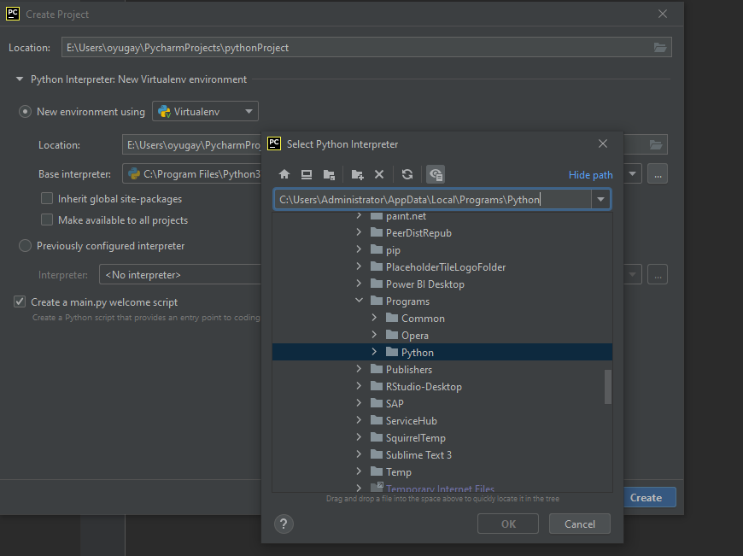
If there are problems running Pycharm
C:\Users\Administrator\AppData\Local\Programs\Python

Slide 49
Homework 0:
Register on Github with your google account (containing ID, not your name)
Push all you previous Tasks 5-8 tasks to your Github. Remember to register using your google profile

Slide 50
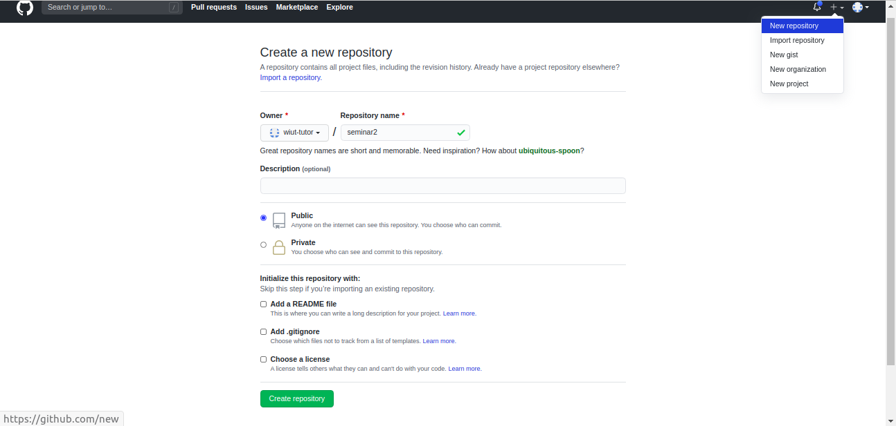
Github instructions 1
Click on + and select New Repository
Specify repository name
Keep the repository public
Skip the checkboxes as you will be pushing
existing repository

Slide 51
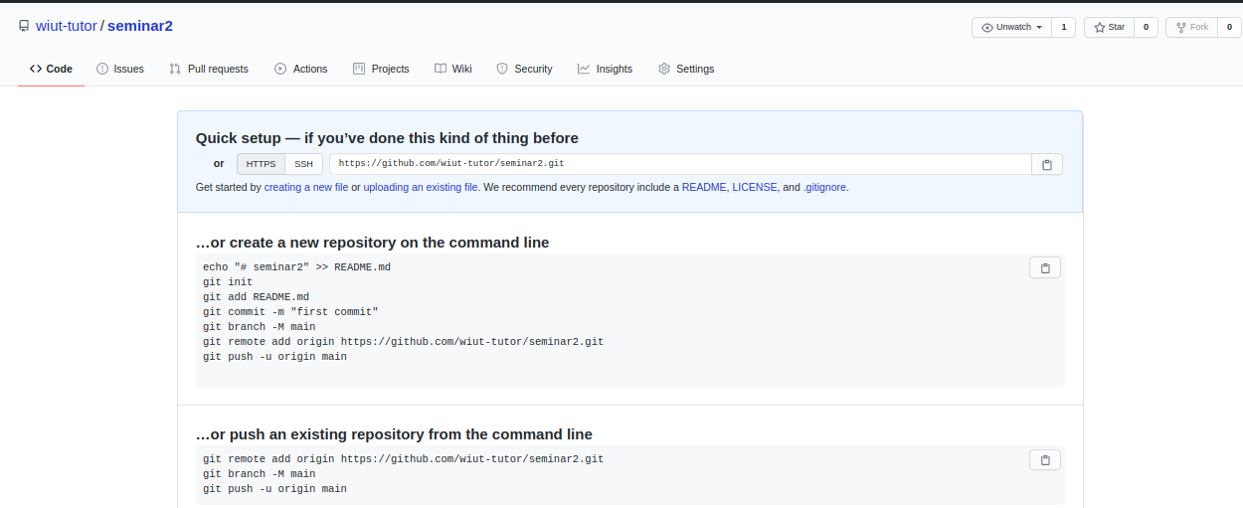
Github instructions 2
Follow instructions on the next page

Slide 52
Homework task 1
Call your function from Task 5 and 6 three times with different kinds of arguments: a value, a variable, and an expression. Identify which kind of argument is which in comments.
Commit changes and push to GitHub repository

Slide 53
Homework 2
Use f-string, input(), int() functions to calculate mark for the CSF module.
40% CW, 60% exam.
Push to GitHub repository

Slide 54
Homework 3
Complete the following task
https://docs.google.com/document/d/15TOOtQxjrDtLoHHB3H0OTDyQFcIfZ1Yjc_3s_W8P5Mo/edit?usp=sharing
Push task to GitHub repository

Slide 55
Recommended actions
Downey, A. (2015). Think Python: How to think like a computer scientist. Green Tea Press. Ch1, 2, 3, available on intranet
Read and practice Git
  http://rogerdudler.github.io/git-guide/
  https://git-scm.com/about
  https://rubygarage.org/blog/most-basic-git-commands-with-examples
  https://ru.atlassian.com/git/tutorials

Slide 56
Resources
https://realpython.com/python-data-types/
https://realpython.com/python-variables/
https://www.youtube.com/watch?v=_uQrJ0TkZlc&t=301s

Slide 57
References
Dale, N., & Lewis, J. (2020). Computer Science Illuminated (7th ed.). Jones & Bartlett Learning, Chapter 2.
Downey, A. B., Elkner, J., & Meyers, C. (2015). Learning with python: How to think like a computer scientist. Green Tea Press., Chapter 1
Atlassian. 2022. Git Tutorials and Training | Atlassian Git Tutorial. [online] Available at: <https://atlassian.com/git/tutorials> [Accessed 19 April 2022].
Git-scm.com. 2022. About - Git. [online] Available at: <https://git-scm.com/about> [Accessed 19 April 2022].
Rogerdudler.github.io. 2022. git - the simple guide - no deep shit!. [online] Available at: <http://rogerdudler.github.io/git-guide/> [Accessed 19 April 2022].
Rubygarage.org. 2022. Most Basic Git Commands with Examples. [online] Available at: <https://rubygarage.org/blog/most-basic-git-commands-with-examples> [Accessed 19 April 2022].
Youtube.com. 2022. Python Tutorial - Python Full Course for Beginners. [online] Available at: <https://www.youtube.com/watch?v=_uQrJ0TkZlc&t=301s> [Accessed 19 April 2022].
Python, R., 2022. Variables in Python – Real Python. [online] Realpython.com. Available at: <https://realpython.com/python-variables/> [Accessed 19 April 2022].

