Slide 1
Computer Science Fundamentals
Lecture 4 Data representation

Slide 2
Part A

Slide 3
Today’s focus
Applications
Operating Systems
Programming
Hardware
Information

Slide 4
Today’s focus
Understand how to represent and store the various kinds of information a
computer manages.
text
numbers
video
audio
Information
Images
01001010101010

Slide 5
Agenda
Analog vs Digital information
Representation of different data types on a computer
  Numbers
  Text
  Audio
  Images and graphics
  Video
Data compression

Slide 6
Some background: analog vs digital

Slide 7
Background
In the not-so-distant past, computers dealt almost exclusively with numeric and textual data
But now computers are truly multimedia devices. They can store, present, and help us modify many different types of data:
  Numbers
  Text
  Audio
  Images and graphics
  Video
All of this data is stored as binary digits, i.e. strings of 0s and 1s.
10010101010100100101010101001001010101010 ¹
¹ Dale, N., & Lewis, J. (2020). Computer Science Illuminated (7th ed.). Jones & Bartlett Learning, Ch3

Slide 8
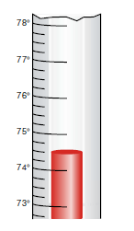

Analog and Digital Information
Information can be represented in one of two ways:
Analog data is a continuous representation, analogous to the actual information it represents. ²
Digital data is a discrete representation, breaking the information up into separate elements. ²
² Dale, N., & Lewis, J. (2020). Computer Science Illuminated (7th ed.). Jones & Bartlett Learning, Ch3
Notes:
The natural world, for the most part, is continuous and infinite. A number line is continuous, with values growing infinitely large and small.
Computers, on the other hand, are finite. Computer memory and other hardware devices have only so much room to store and manipulate a certain amount of data.

Slide 9
Analog and Digital Information
Computers cannot work well with analog information. So instead, we digitize information by breaking it into pieces and representing those pieces separately.
Electronic signals are far easier to maintain if they transfer only binary data.
  An analog signal continually fluctuates in voltage up and down.
  Digital signal has only a high or low state, corresponding to the two binary digits. ³
³ Dale, N., & Lewis, J. (2020). Computer Science Illuminated (7th ed.). Jones & Bartlett Learning, Ch3

Slide 10
Binary representations

Slide 11
Intro
Khan Academy and Code.org | Binary & Data ⁴
⁴ Khan Academy and Code.org | Binary & Data. 2022. [online] Available at: <https://www.youtube.com/watch?v=ewokFOSxabs> [Accessed 19 April 2022].
Notes:
up until certain minute

Slide 12
Binary representations
One bit can be either 0 or 1. There are no other possibilities. Therefore, one bit can represent only two things.
  For example, if we wanted to classify a food as being either sweet or sour, we would need only 1 bit
What if we need to represent gear of a car (park, drive, reverse, or neutral)?
  2 bits for four different states
    00 - park
    01 - drive
    10 - reverse
    11 - neutral ⁵
⁵ Dale, N., & Lewis, J. (2020). Computer Science Illuminated (7th ed.). Jones & Bartlett Learning, Ch3

Slide 13
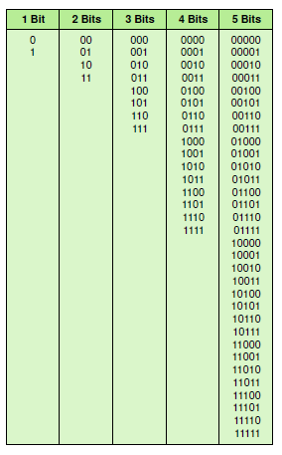
Bit combinations
1 bit = 2¹ = 2 combinations
2 bit = 2² = 4 combinations
3 bit = 2³ = 8 combinations
4 bit = 2⁴ = 16 combinations
And etc.
==>
n bits can represent 2^{n} things because 2^{n} combinations of 0 and 1 can be made from n bits ⁶
⁶ Dale, N., & Lewis, J. (2020). Computer Science Illuminated (7th ed.). Jones & Bartlett Learning, Ch3

Slide 14
Bit combinations
How many bits are needed to represent 25 unique states?
How many bits are needed to represent “regions” of Uzbekistan, a.k.a. “tumans” or “viloyats”?

Slide 15
Bit combinations
Keep in mind that even though we may technically need only a certain minimum number of bits to represent a set of items, we may allocate more than that for the storage of data.
There is a minimum number of bits that a computer architecture can address and move around at one time, and it is usually a power of 2, such as 8, 16, or 32 bits.
==> the minimum amount of storage given to any type of data is allocated in multiples of that value.

Slide 16
Representing text

Slide 17
Representing text
Did you ever get an email with the subject line “???? ?????? ??? ????”?
=> caused by incorrect encoding settings

Slide 18
Character encoding
..is a mechanism which tells the computer how to interpret raw zeroes and ones into real characters.
How the computer does it?
By pairing numbers with characters

Slide 19
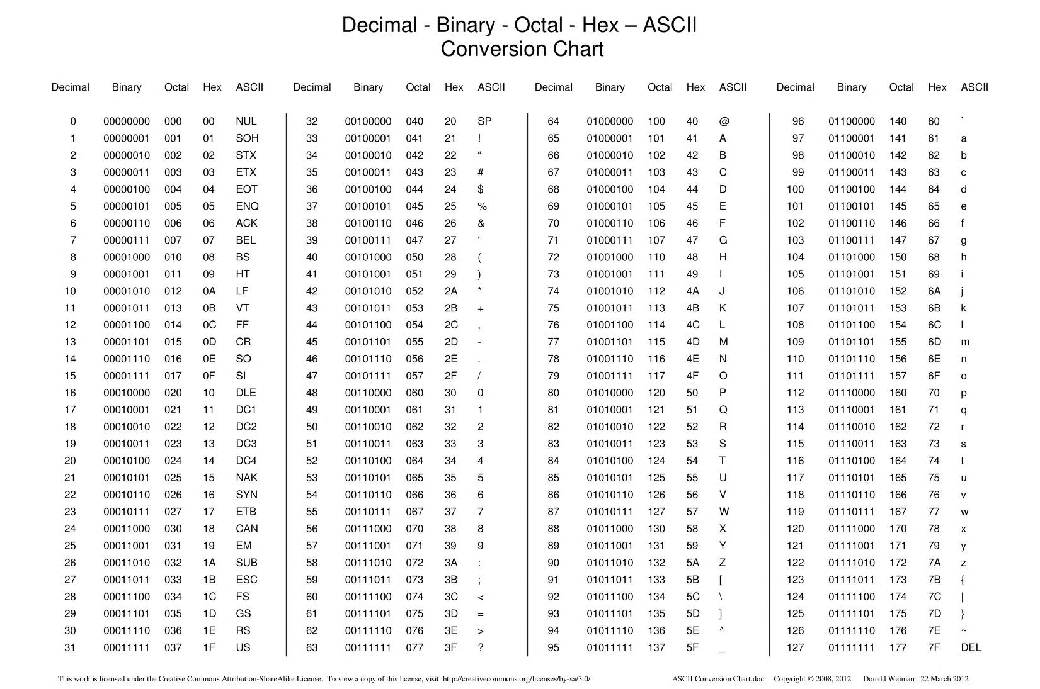
⁷ Internet Archive. 2022. ASCII Conversion Chart : Decimal - Binary - Octal - Hex – ASCII Conversion Chart : Free Download, Borrow, and Streaming : Internet Archive. [online] Available at: <https://archive.org/details/ASCIIConversionChart/mode/1up> [Accessed 19 April 2022].

Slide 20
Character set
Character set – a list of characters and the codes to represent each one
ASCII – American Standard Code for Information Interchange
  8 bit per character
  Limited to 128 unique characters ( 8 bits >> 2⁷)
Unicode Standard
  Superset of ASCII (256 characters in unicode correspond to ASCII character set)
  Represent every character in every language used in the entire world and special scientific symbols
  UTF-8 - one of most popular encodings defined by the Unicode Standard ⁸
⁸ Dale, N., & Lewis, J. (2020). Computer Science Illuminated (7th ed.). Jones & Bartlett Learning, Ch3

Slide 21
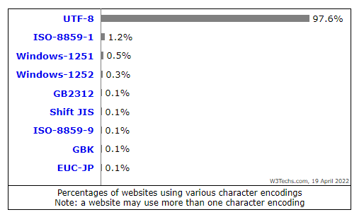
Usage Statistics and Market Share of Character Encodings for Websites
UTF-8 is used by 97.6% of all the websites whose character encoding we know. ⁹
⁹ W3techs.com. 2022. Usage Statistics and Market Share of Character Encodings for Websites, April 2022. [online] Available at: <https://w3techs.com/technologies/overview/character_encoding> [Accessed 19 April 2022].

Slide 22
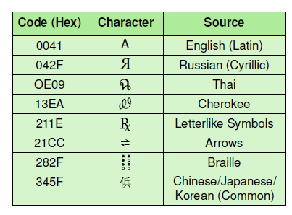
Unicode character set
UTF-8 – character encoding defined by Unicode
Goal: represent every character in every language used in entire world and scientific symbols
Unicode is a superset of ASCII
  256 characters in the Unicode character set correspond exactly to the extended ASCII character set ¹⁰
¹⁰ Dale, N., & Lewis, J. (2020). Computer Science Illuminated (7th ed.). Jones & Bartlett Learning, Ch3

Slide 23
Representing audio data

Slide 24
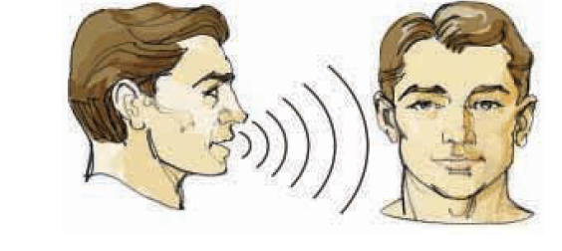
Representing audio data
A series of air compressions vibrate a membrane in our ear, which sends signals to our brain. Thus a sound is defined in nature by the wave of air that interacts with our eardrum. ¹¹
¹⁰ Dale, N., & Lewis, J. (2020). Computer Science Illuminated (7th ed.). Jones & Bartlett Learning, Ch3

Slide 25
Representing audio data
To represent audio information on a computer, we must digitize the sound wave, somehow breaking it into discrete, manageable pieces.
To digitize the signal we periodically measure the voltage of the signal and record the appropriate numeric value - sampling.
sampling rate of around 40,000 times per second is enough to create a reasonable sound reproduction. ¹¹
¹¹ Dale, N., & Lewis, J. (2020). Computer Science Illuminated (7th ed.). Jones & Bartlett Learning, Ch3

Slide 26
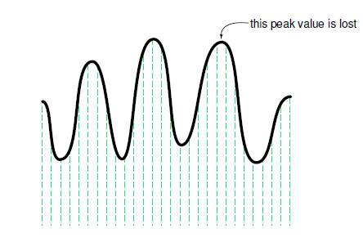
Representing audio data
Sampling an audio signal ¹²
¹² Dale, N., & Lewis, J. (2020). Computer Science Illuminated (7th ed.). Jones & Bartlett Learning, Ch3

Slide 27
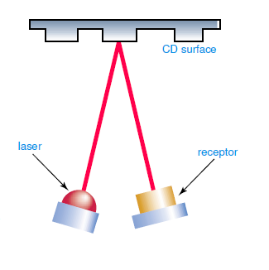
Representing audio data
CD surface contains microscopic pits that represent binary digits.
A low intensity laser is pointed at the disk.
  If surface smooth = laser reflects strongly
  If surface pitted = laser reflects poorly
A receptor analyzes the reflection and produces appropriate string of binary data
The signal is reproduced and sent to the speaker ¹³
¹³ Dale, N., & Lewis, J. (2020). Computer Science Illuminated (7th ed.). Jones & Bartlett Learning, Ch3

Slide 28
Representing images and graphics

Slide 29
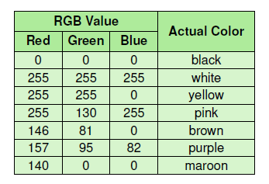
Representing images and graphics
Our retinas have three types of color photoreceptor cone cells that respond to different sets of frequencies (red, green, and blue)
On computer colour represented as an RGB
  Three numbers that indicate the relative contribution of each of these three primary colours
  0 no contribution
  255 full contribution ¹⁴
¹⁴ Dale, N., & Lewis, J. (2020). Computer Science Illuminated (7th ed.). Jones & Bartlett Learning, Ch3

Slide 30
Digitized images and graphics
Pixels - Individual dot used to represent a picture; stands for picture elements
  Each pixel composed of a single colour
Resolution - The number of pixels used to represent a picture ¹⁵
¹⁵Dale, N., & Lewis, J. (2020). Computer Science Illuminated (7th ed.). Jones & Bartlett Learning, Ch3

Slide 31
Graphics formats
Raster-graphics format
  Storing image information pixel by pixel
  E.g. BMP, GIF, JPEG
  Photoshop – famous raster graphics editor
Vector graphics format
  Representation of an image in terms of lines and shapes
  Use formula to calculate the shape and represent image
  E.g. PDF, SVG
  Corel draw – famous vector graphics editor

Slide 32

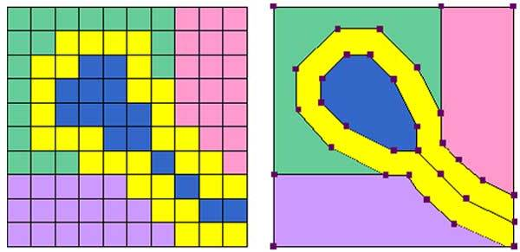
Raster vs Vector
¹⁶ Vector-conversions.com. 2022. Raster (Bitmap) vs Vector. [online] Available at: <https://vector-conversions.com/vectorizing/raster_vs_vector.html> [Accessed 19 April 2022].

Slide 33
SVG file
An SVG file is a graphics file that uses a two-dimensional vector graphic format created by the World Wide Web Consortium (W3C).
images are described using a text format that is based on XML ¹⁶
¹⁶Dale, N., & Lewis, J. (2020). Computer Science Illuminated (7th ed.). Jones & Bartlett Learning, Ch3

Slide 34
Representing video

Slide 35
Representing video
Video information is one of the most complex types of information to capture and compress to get a result that makes sense to the human eye.
Video clips contain the equivalent of many still images, each of which must be compressed. ¹⁷
¹⁷Dale, N., & Lewis, J. (2020). Computer Science Illuminated (7th ed.). Jones & Bartlett Learning, Ch3

Slide 36
Representing video
Video codec refers to the methods used to shrink the size of a movie to allow it to be played on a computer or over a network.
Almost all video codecs use lossy compression to minimize the huge amounts of data associated with video.
The goal therefore is not to lose information that affects the viewer’s senses. ¹⁸
¹⁸Dale, N., & Lewis, J. (2020). Computer Science Illuminated (7th ed.). Jones & Bartlett Learning, Ch3

Slide 37
Video summary
Read Ch 3, and watch the following video to understand more about representing numbers
Representing Numbers and Letters with Binary: Crash Course Computer Science #4

Slide 38
Data compression

Slide 39
Data compression
Data compression - reducing the amount of space needed to store a piece of data.
Compression ratio - The size of the compressed data divided by the size of the uncompressed data. The ratio should result in a number between 0 and 1. The closer the ratio is to zero, the tighter the compression.
Lossy compression - A technique in which there is loss of information
Lossless compression - A technique in which there is no loss of information
Bandwidth restrictions - the maximum number of bits or bytes that can be transmitted from one place to another in a fixed amount of time ¹⁹
¹⁹Dale, N., & Lewis, J. (2020). Computer Science Illuminated (7th ed.). Jones & Bartlett Learning, Ch3
Notes:
In the past, we needed to keep data small because of storage limitations. Today, computer storage is relatively cheap—but now we have an even more pressing reason to shrink our data: the need to share it with others. The Web and its underlying networks have inherent bandwidth restrictions that define the maximum number of bits or bytes that can be transmitted from one place to another in a fixed amount of time. In particular, today’s emphasis on streaming video (video played as it is downloaded from the Web) motivates the need for efficient representation of data

Slide 40
Text compression
Keyword encoding
  Replacing a frequently used word (or part of the word) with a single character
Run-length encoding
  Replacing a long series of a repeated character with a count of the repetition
Huffman encoding
  Using a variable-length binary string to represent a character so that frequently used characters have short codes ²⁰
²⁰Dale, N., & Lewis, J. (2020). Computer Science Illuminated (7th ed.). Jones & Bartlett Learning, Ch3

Slide 41
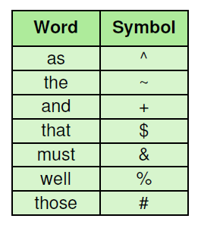
Keyword encoding
“The human body is composed of many independent systems, such as the circulatory system, the respiratory system, and the reproductive system. Not only must all systems work independently, they must interact and cooperate as well. Overall health is a function of the well-being of separate systems, as well as how these separate systems work in concert.”
TOTAL: 352 characters
Encoded version
“The human body is composed of many independent systems, such ^ ~ circulatory system, ~ respiratory system, + ~ reproductive system. Not only & each system work independently, they & interact + cooperate ^ %. Overall health is a function of ~ %-being of separate systems, ^ % ^ how # separate systems work in concert.” ²¹
TOTAL: 317 characters
Compression rate: 317/352=0.9
²¹Dale, N., & Lewis, J. (2020). Computer Science Illuminated (7th ed.). Jones & Bartlett Learning, Ch3

Slide 42
Run-length encoding
A.k.a. recurrence coding
Sequence of repeated characters is replaced by flag character, followed by the repeated character, followed by a single digit that indicates how many times the character is repeated ²²
E.g. * is a flag
  AAAAAAA -> *A7
²²Dale, N., & Lewis, J. (2020). Computer Science Illuminated (7th ed.). Jones & Bartlett Learning, Ch3

Slide 43
Run-length encoding
  *n5*x9ccc*h6 some other text *k8eee
TOTAL: 35 characters
Decoded as:
  nnnnnxxxxxxxxxccchhhhhh some other text kkkkkkkkeee
TOTAL: 51 characters
compression ratio 35/51 = 0.68.

Slide 44

Run-length encoding for bitmap ²³
In raw format the first three rows would be
0 0 0 0 0 0 0 0 0 0 0 0 0 0 0 0
0 0 0 0 0 0 0 0 0 0 0 0 0 0 0 0
0 0 1 1 1 1 1 1 1 1 1 1 1 1 0 0
Using run length encoding the first three rows would be
16 0 16 0 2 0 12 1 2 0
²³Dale, N., & Lewis, J. (2020). Computer Science Illuminated (7th ed.). Jones & Bartlett Learning, Ch3

Slide 45
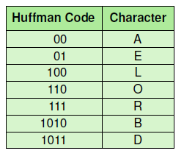
Huffman encoding
Use variable-length bit strings to represent each character
Use only few bits to represent frequently used characters
Use longer bit strings for rarely used characters ²⁴
E.g.
DOORBELL -> 1011110110111101001100100
²⁴Dale, N., & Lewis, J. (2020). Computer Science Illuminated (7th ed.). Jones & Bartlett Learning, Ch3

Slide 46
Decoding Huffman code
Since the variable length encoding is used, won’t we get confused when trying to decode a string?
  we do not know how many bits we should include for each character!!
  Read the book and get the answer ready for the tutorial! ☺

Slide 47
Part B:

Slide 48
A development plan (one of several approaches)
A development plan is a process for writing programs.
1. Start by writing a small program with no function definitions.
2. Once you get the program working, identify a coherent piece of it, encapsulate the piece in a function and give it a name.
3. Generalize the function by adding appropriate parameters.
4. Repeat steps 1–3 until you have a set of working functions. Copy and paste working code to avoid retyping (and re-debugging).
5. Look for opportunities to improve the program by refactoring. For example, if you have similar code in several places, consider factoring it into an appropriately general function.

Slide 49
docstring
A docstring is a string at the beginning of a function that explains the interface (“doc” is short for “documentation”). Here is an example:
def square(n):
'''Takes in a number n, returns the square of n'''
return n**2
print(square.__doc__)
By convention, all docstrings are triple-quoted strings, also known as multiline strings because the triple quotes allow the string to span more than one line.
It explains what effect each parameter has on the behavior of the function and what type each parameter should be

Slide 50
Homework
Dale, Computer Science Illuminated, Ch3
  End of the chapter questions and exercises
Representing Numbers and Letters with Binary: Crash Course Computer Science #4
Character Encoding in Depth
Downey, A. (2015). Think Python, How to think like a computer scientist. Chapter 3, 4

Slide 51
References
Dale, N., & Lewis, J. (2020). Computer Science Illuminated (7th ed.). Jones & Bartlett Learning, Chapter 2
Downey, A. B., Elkner, J., & Meyers, C. (2015). Learning with python: How to think like a computer scientist. Green Tea Press., Chapter 1
Khan Academy and Code.org | Binary & Data. 2022. [online] Available at: <https://www.youtube.com/watch?v=ewokFOSxabs> [Accessed 19 April 2022].
Internet Archive. 2022. ASCII Conversion Chart : Decimal - Binary - Octal - Hex – ASCII Conversion Chart : Free Download, Borrow, and Streaming : Internet Archive. [online] Available at: <https://archive.org/details/ASCIIConversionChart/mode/1up> [Accessed 19 April 2022].

Slide 52
References
Vector-conversions.com. 2022. Raster (Bitmap) vs Vector. [online] Available at: <https://vector-conversions.com/vectorizing/raster_vs_vector.html> [Accessed 19 April 2022].
W3techs.com. 2022. Usage Statistics and Market Share of Character Encodings for Websites, April 2022. [online] Available at: <https://w3techs.com/technologies/overview/character_encoding> [Accessed 19 April 2022].
Youtube.com. 2022. Representing Numbers and Letters with Binary: Crash Course Computer Science. [online] Available at: <https://www.youtube.com/watch?v=1GSjbWt0c9M> [Accessed 19 April 2022].
Medium. 2022. Character Encoding in Depth. [online] Available at: <https://medium.com/tech-tajawal/https-medium-com-tech-tajawal-character-encoding-in-depth-6f1df87888d8> [Accessed 19 April 2022].

