Slide 1

INTRODUCTION TO INFORMATION TECHNOLOGY II
Concept of Innovative and Creative uses of IT
Riovan Styx Roring, S.T., M.Kom

Slide 2
IT Utilization Nowadays
Information Technology is used in almost every field of the society ranging from personal to business type of interest.
Email, social media, various chat tools have become the principal of communication for almost all aspect of the society.
Digital media such as text, picture, audio, as well as videos have become the primary media for various level of education.
IT has become the main source of entertainment for the people.

Slide 3


Creative Practices Using IT
Why creativity in IT?
* Creativity is a crucial role in various culture of society that give personal, social, educational, and inventions.
“BETTER RECIPES, NOT JUST MORE COOKING”
Image Source: pngtree.com

Slide 4
Creative Practices Using IT (Cont.)
Information Technology and Creative Practice (ITCP) successfully produce great results in numerous fields such as:
Optical: Eyeglasses are thinner.
Chemical: Less side effects and eco-friendly.
Photography: Better picture quality.
Culture: Work From Home (WFH) and remote job.
Notes:
ITCP has already yielded results of astonishing variety and significant cultural and economic value. These results have taken such forms as innovative architectural and product designs, computer animated films, computer music, computer games, Web-based texts, and interactive art installations, to name just a few. They have developed from individual, group, and institutional activities; the processes by which they have been produced have spanned both the commercial and not-for-profit worlds and the formal and informal economic sectors. The products of ITCP have begun to appear in many different countries, in ways that reflect cultural, economic, and political differences. IT has now reached a stage of maturity, cost-effectiveness, and diffusion that enables its effective engagement with many areas of the arts and design—not just to enhance productivity or to allow more efficient distribution, but to open up new creative possibilities.

Slide 5
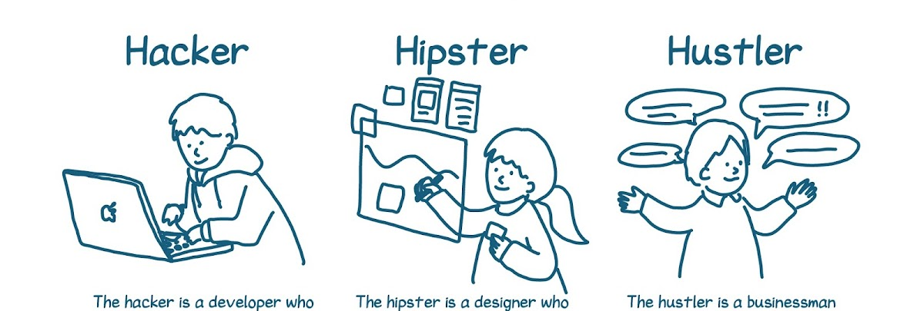
Strategies in ITCP
ITCP can be started with a lot of approach, individually or team with the knowledge of IT media, structure, management, and more importantly a cross-discipline field of expertise.
Image Source: 1000 Startup Digital 1000startupdigital.id
Notes:
ITCP can be engaged at multiple levels—by individual artists and designers who deal with IT tools, media, and themes; in the structuring and management of cross-disciplinary research and production groups working in the ITCP domain; in directing educational and cultural institutions with interests in ITCP; at the level of regional development strategy aimed at fostering ITCP clusters; as an aspect of national economic and cultural policy; and in multinational collaborative efforts. All of these levels are important, and there are crossconnections among them. There is, therefore, considerable advantage in coordinated, multilevel strategies for encouraging, supporting, and benefiting from ITCP.

Slide 6



Preparing Tools and Media
ITCP experimentation could be done by exploring possibilities in computer graphic, audio, text and software. Artist and Designer can perform computer tasks such as Create, Read, Update, Delete (CRUD), multimedia distribution, and creator-based activity using standardized tools or purpose-built tools.
Notes:
Individual artists and designers have experimented with IT since its earliest incarnations. Artistic exploration of the possibilities of computer graphics, for example, now extends back more than 30 years, and 40 years for computer music. As IT has matured and been assimilated into the mass market, the IT tools and media available to artists and designers have become both more diversified and more affordable. There are popular, standardized tools for performing such tasks as creating, editing, and distributing images, audio, and text; there are variants on standard tools customized to the needs of particular artists or designers; and there are highly specialized, purpose-built tools used by nobody but their creators. To a software developer or an information services manager, it might seem that the keys to ITCP are simply equipment and software—developing and providing access to standard, commercial IT tools for artists and designers. This perspective is useful as far as it goes, and it can provide a good way to get started with ITCP, but in the long run it is an insufficiently rich or flexible one. We make our tools; then our tools make us.1 Furthermore, software tools encode numerous assumptions about the making of art and design—precisely the sorts of presuppositions that truly creative practitioners will want to challenge. And the more software tools emphasize ease of use or familiar metaphors, the more they must depend on restrictive assumptions in order to do so. Such tools not only must be available, but they also must be objects of critical reflection; they must be open to adjustment and tweaking, they must support unintended and subversive uses—not just anticipated ones—and they must not be too resistant to being torn apart and reconceived. If creative practice can develop the powerful spaces and tools that it needs, like the electronic easel or electronic studio, these spaces and tools could help transform or enlarge the metaphors, spaces, and tools (office, desktop, files) that the rest of us have to work with.

Slide 7
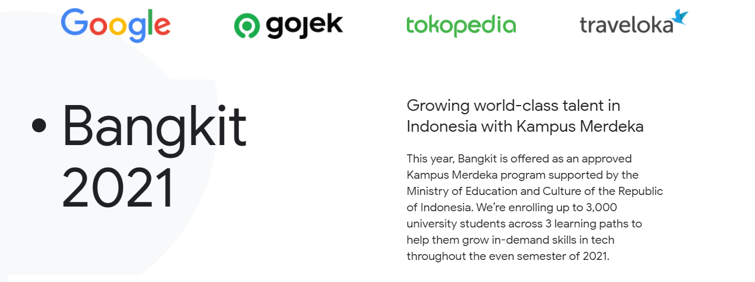
Finding Opportunities to Develop ITCP Skills
Generally, people can try to develop ITCP skills by learning across multiple field of studies. There has been a lot of artists and designers with programming and hardware specialist capability.
Source: Bangkit 2021 https://grow.google/intl/id_id/bangkit/

Slide 8

Environments That Support ITCP
ITCP venues may occupy physical or virtual spaces, be large or small, range from loosely organized collectives to formal programs, and be either free-standing or connected to established institutions. Specialized exhibitions, performance festivals, presentation and lecture series, conferences, Internet forums, and display and performance sites have all played important roles in the growth of ITCP communities.
Image Source: kedaireka.id

Slide 9
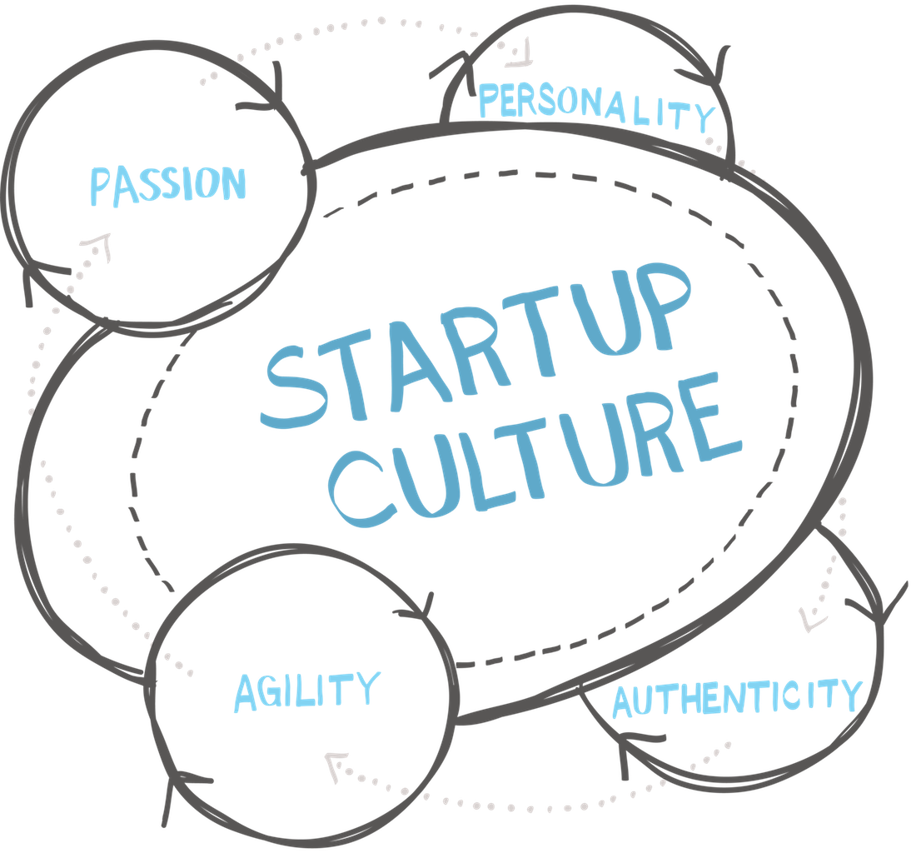
Fostering the Culture of ICTP
It is also essential to foster the culture of ITCP—the flow and exchange of ideas among those engaged, the development of a sense of intellectual community, the representation of ideals and values, and the recognition and validation of outstanding work.
Image Source: myturnstone.com

Slide 10
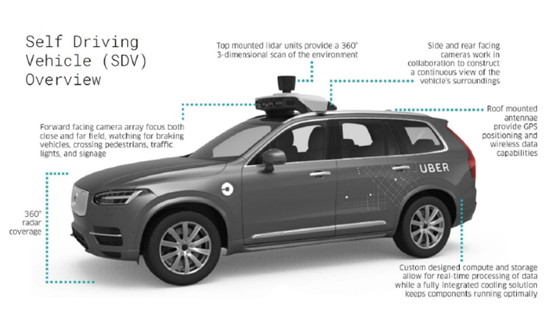
A New Form of Research in ITCP
ITCP has huge potential for providing new concept and innovation in IT. In the implementation, it pushes on the boundaries of both IT and all other field of studies.
Computer science has always been stimulated by exposure to new points of view and new problems.
Image Source: https://spectrum.ieee.org/ntsb-investigation-into-deadly-uber-selfdriving-car-crash-reveals-lax-attitude-toward-safety

Slide 11
ITCP Implementation
ITCP covers huge scope of fields in the implementation that needs funding capability for direct and in-direct business activity. Essential support for uncertain activity is particularly needed, for example when doing experimentation activity in the society where it is still unsure whether the activity is producing profit to the business or not.
The hybrid nature of ITCP tends to confound its funding.
Source: Mitchell, William J., Alan S. Inouye, and Marjory S. Blumenthal. Beyond productivity: Information technology, innovation, and creativity. Washington, DC: National Academies Press, 2003.

Slide 12

Inventional Mind in ITCP
Creativity is difficult to be defined and understand, but easy to see when it is implemented. Complexity and the unknown territory of creativity should never become a hindrance.
Output of creativity into intellectual product can be divided into:
  Routine skilled activity such as academic or research writing.
  Applying methods for problems and giving solutions.

Slide 13

Advantage of Creativity
Creativity has no sector for a monopoly.
Outcome in form of new knowledge.
Inventions result in the improvements to the quality of life.
Unique products and services.
New kind of cultural creativity.

Slide 14
Creative Industry
The creative industry has become a huge business that influence the society today. It affects the Gross Domestic Product (GDP),as an official communication media for the government, causes new job position including “unemployed with income”.

Slide 15
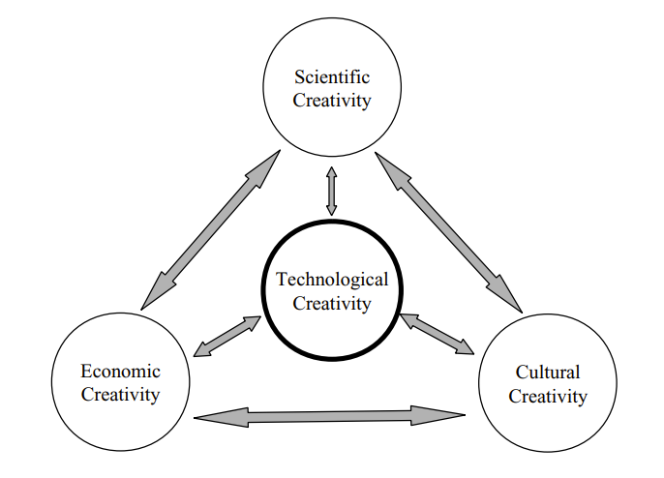
Domain of Creative Activity
Image Source: Mitchell, William J., Alan S. Inouye, and Marjory S. Blumenthal. Beyond productivity: Information technology, innovation, and creativity. Washington, DC: National Academies Press, 2003.

Slide 16

Creativity Activity Correlation Among Each Other
Different, but support and parallelly depends on each other.
Usually, a two-way interaction.
The interaction creates opportunity.
Case Study: Smart Online Transportation
Image Source: gojek.com

Slide 17
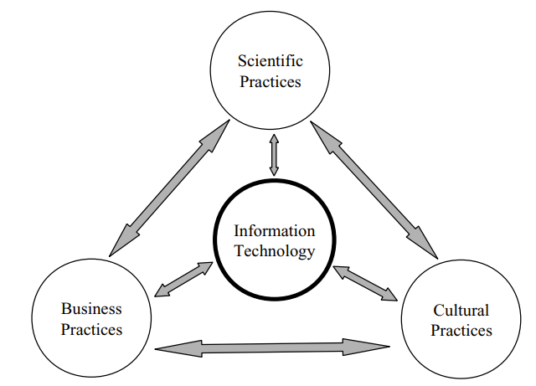
IT Roles in Creativity
IT acts as a glue to hold science, culture, and business creativity practice. It also enhance capacity, and concept application across field of studies.
Image Source: Mitchell, William J., Alan S. Inouye, and Marjory S. Blumenthal. Beyond productivity: Information technology, innovation, and creativity. Washington, DC: National Academies Press, 2003.

Slide 18

Creativity in Networked World
Collaborations of experts such as: artists, designers, information technologist need to be established. This type of practices should not be restricted by institutional constraints, incentives, intellectual property arrangements, funding policies, etc.
Notes:
Not only WWW, but Business Networking, Circles (Followers, Friends, Family, etc).

Slide 19
Creative Personality
What makes one action ordinary and another creative? Part of the answer is personality, although there has been surprisingly little study of creativity by psychologists. Research points to a tendency for creative people “to be independent, nonconformist, unconventional, and to have wide interests, greater openness to new experiences, a more conspicuous behavioral and cognitive flexibility, and more risk-taking boldness.
A survey of psychological research on creativity, intended to motivate more attention, can be found in Dean Keith Simonton, 2000, “Creativity: Cognitive, Personal, Developmental, and Social Aspects,” American Psychologist 55(1): 151-158.

Slide 20
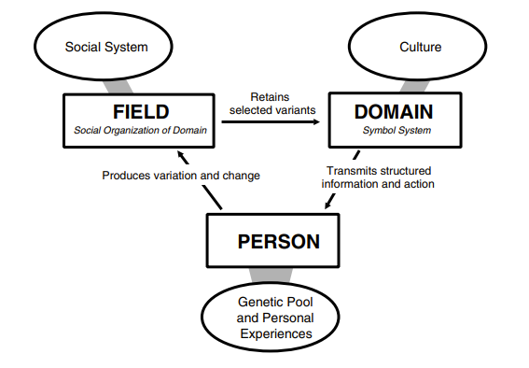
Systematical View of Creativity
Image Source: Mitchell, William J., Alan S. Inouye, and Marjory S. Blumenthal. Beyond productivity: Information technology, innovation, and creativity. Washington, DC: National Academies Press, 2003.

Slide 21
CREATIVE PEOPLE AT WORK
A person can obtain creative skills through the broadening of individual skill sets and through collaborations. Some individuals involved in the arts and design are indeed expanding their knowledge and skills related to IT, and, perhaps less obviously, some computer scientists and engineers are acquiring knowledge and skills in the arts and design (there are distinctive bases in such subdisciplines as graphics and computer music).

Slide 22
Diverse Expertise and Skills
There are some unusually talented people who can do it all or do enough to create work that straddles more than one discipline and creates new skill sets.
Model of multiskilled sets for individuals.
“Move fast and travel light”

Slide 23
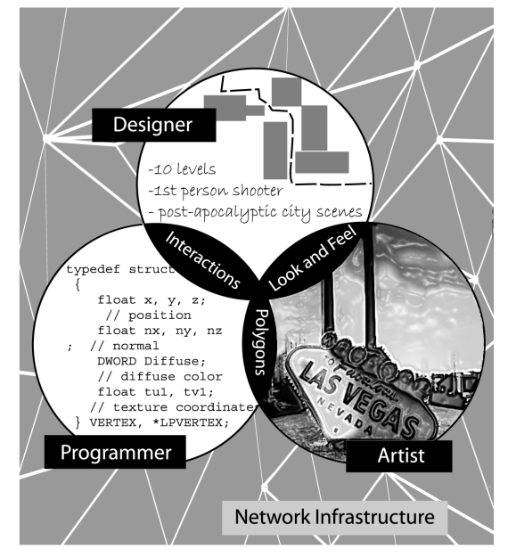
Case Study: Indie Game Development
Stardew Valley
Image Source: Mitchell, William J., Alan S. Inouye, and Marjory S. Blumenthal. Beyond productivity: Information technology, innovation, and creativity. Washington, DC: National Academies Press, 2003.

Slide 24
Cross-Disciplinary Cultural Challenges
Communication and Team-play Management.
Accessing funding resources.
Absence of frameworks.
Long time project periods.

Slide 25
Main Resources for Creative Practices
Skills Training to acquire new capabilities.
Physical and/or Digital Workspaces.
Various Social Platform

Slide 26

Hardware and Software to Support Creative Work
List of gross needed hardware and support:
Automation Software for multimedia tasks, ex. Adobe Animate.
Integrated system to handle and showing information.
Information and Communication Technology (ICT) infrastructures, ex. Hosting Rakyat.
Image Source: Microsoft PowerPoint Template

Slide 27
ITCP Technologies
Networked and free-standing interactive computer games
Avatar creation and utilization
Massive multiplayer online games
Digital entertainment
Specialty venues such as theme parks
Motion-based rides
Console and PC interactive game design
Creation of unique input devices
Virtual reality utilizing head-mounted displays
Other forms of virtual reality technology
Wearable computing for entertainment purposes
Massive immersive display environments
Interactive robot animatronics
Synthetic interview technology
Speech recognition
Augmented reality
Telepresence for entertainment and education purposes
Digital production and postproduction
Sound synthesis, surround sound, three-dimensional sound, and streaming audio, ex. Adobe Audition.
Development of haptic devices (e.g., force feedback)
Entertainment robotics.

Slide 28
Economic Realities
The main point that changes the outcome of ITCP is the economics of the software for ITCP. Premium (Pay-to-Use) is not always better than Open-Source software, but still a good choice for safety measurement.
In-direct payment alternative such as: Collaborational software uses, Educational Licenses, Profit-sharing contract, etc.

Slide 29
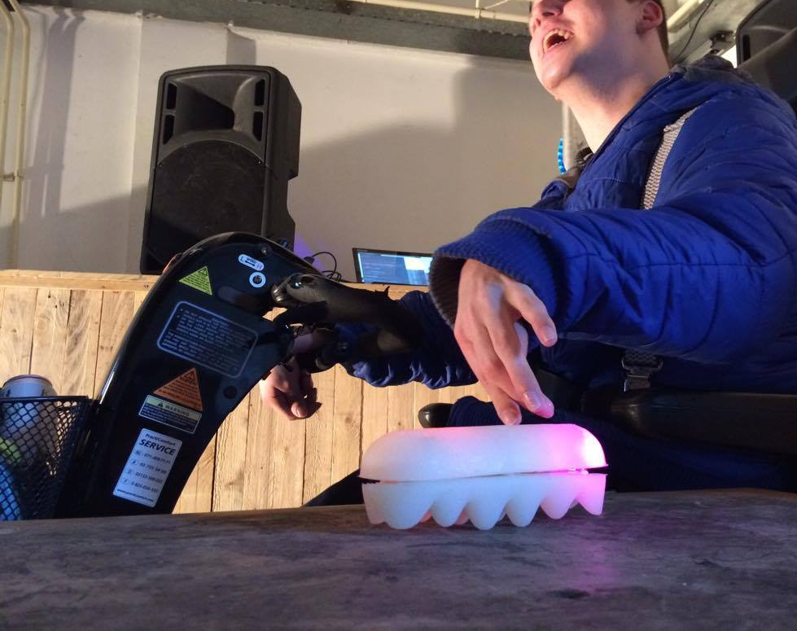
Case Study: Studio for Electro-Instrument Music (STEIM) Subsidies
A technology organization in Amsterdam that helps many musicians to create new instruments using sensors. They subsidize the cost of engineering sensor system to enable the development of artist instrument design especially in electronics.
Image Source: STEIM Facebook Page

Slide 30
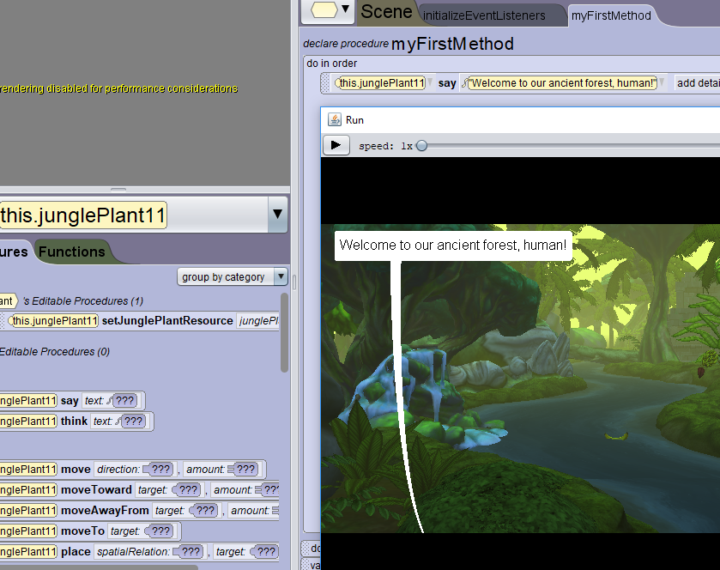
Case Study: Python, An Open-Source Programming Language
Python is a programming language created in the early 1990s by Guido van Rossum, who is still its principal author. Python has gathered a large following, finding important applications in graphics including Alice a 3D interactive graphics programming environment, gaming, Web services, teaching, collaboration support, and research.
Image Source: Association for the Advancement of Computing in Education https://www.aace.org/

Slide 31

Discussion
Implementing your ideas individually or team project. Where to start?
Image Source: Microsoft PowerPoint Template

Slide 32
References
Mitchell, William J., Alan S. Inouye, and Marjory S. Blumenthal. Beyond productivity: Information technology, innovation, and creativity. Washington, DC: National Academies Press, 2003.
Rijal, M. "Integrated Curriculum Practice: An Inclusive and Creative Practice." Academia Letters (2021): 2.
Lee, Lo. "Designing for Creative Making in the Everyday Environment." Companion Publication of the 2021 Conference on Computer Supported Cooperative Work and Social Computing. 2021.

