Slide 1

INTRODUCTION TO INFORMATION TECHNOLOGY II
Week 2
Fundamentals of Cloud Application and Content Management System (CMS)
Riovan Styx Roring, S.T., M.Kom

Slide 2
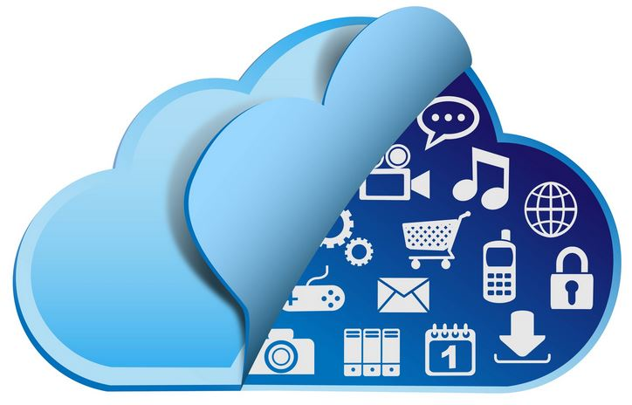

Introduction to the cloud
The cloud was originally thought of as a bunch of combined services, technologies, and activities, with the things that happened inside was not known to the users of the services, which is where the cloud got its name.
As time goes on many users show interest as what goes on inside them.
Image Source: https://www.networkcomputing.com

Slide 3

Introduction to the cloud (Cont)
As with all services, the cloud and the services it offers have change over time, especially technology-related services. With all these improvement the definition of cloud itself keeps changing.
Even with the changes, the definition that National Institute of Standard and Technology remain the standard most people refer to when talking about cloud.
The NIST definition has three main components that comprise of:
Five key cloud characteristics
Four cloud deployment models
Three cloud services models
Image Source: https://nist.edu

Slide 4
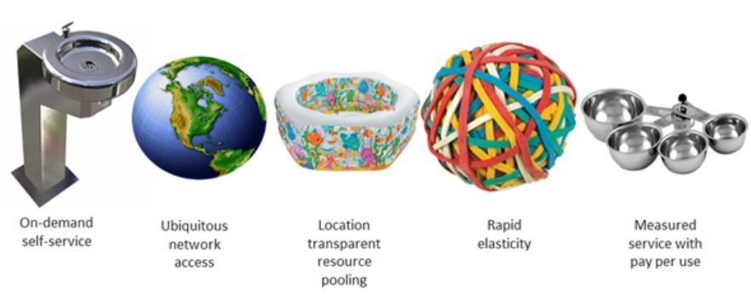
2. 1. Five Key Cloud Characteristics
Image Source: http://aka.ms/532

Slide 5

a. On-Demand Self-Service
On-demand self-service means that consumer can request and receive access to service offering, without an administrator or some sort of support staff.
By implementing user self-service allows customers to quickly procure and access the services they want. It also reduces the administrative burden on the provider.
User self-service is generally implemented via a user portal. On the front end, users will be presented with a template interface to input information, and on the back end the portal will interface with management application programming interfaces (APIs)

Slide 6
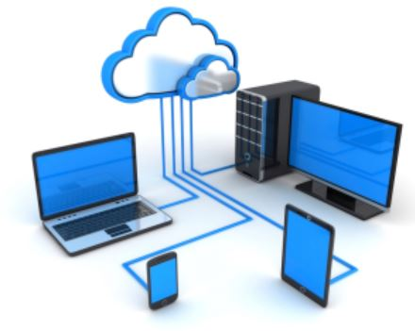

b. Ubiquitous/Broad Network Access
Cloud services should be easily accessed, with a basic network connection to connect to services or application, which means this services should be able to be accessed by a wide variety of devices, such as desktop, laptops and smartphones

Slide 7
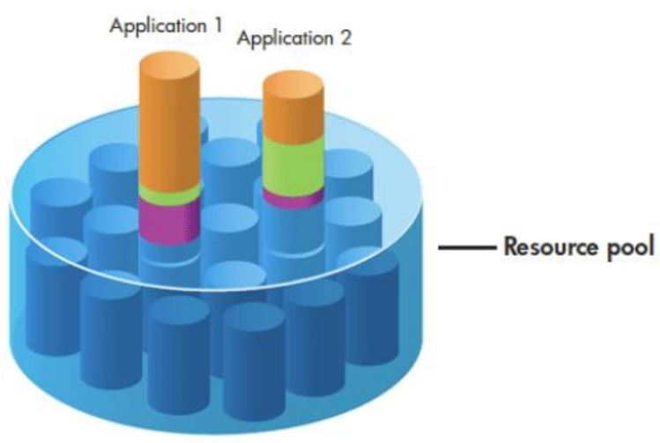
c. Location Transparent Resources Pooling
Resource pooling is based on the fact that clients will not have a constant need for all the resources available to them, so when these resources are not being used by one customer, instead of sitting idle those resources can be used by another customer.

Slide 8
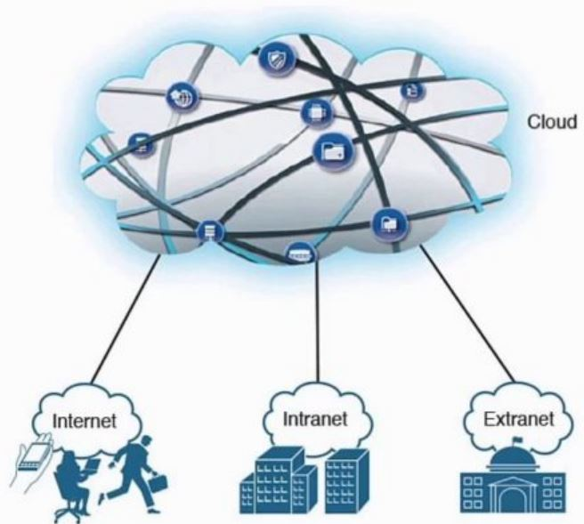
d. Rapid Elasticity
Rapid elasticity describes the ability of a cloud environment to easily grow to satisfy user demand. Cloud deployments should already have the needed infrastructure in place to expand the services capacity.
This is accomplished through the use of automation and orchestration. Which in turn enables them to be able to handle the “burst” capacity needed by many of their users.
Image Sources : https://www.hitechmv.com

Slide 9

e. Measured Service with Pay per Use
Cloud services must have the ability to measure usage, this can be quantified using various metrics, such as time used, bandwidth used, and data used.
As user, they need to make sure that they understand exactly which services are being measured and charged for.

Slide 10
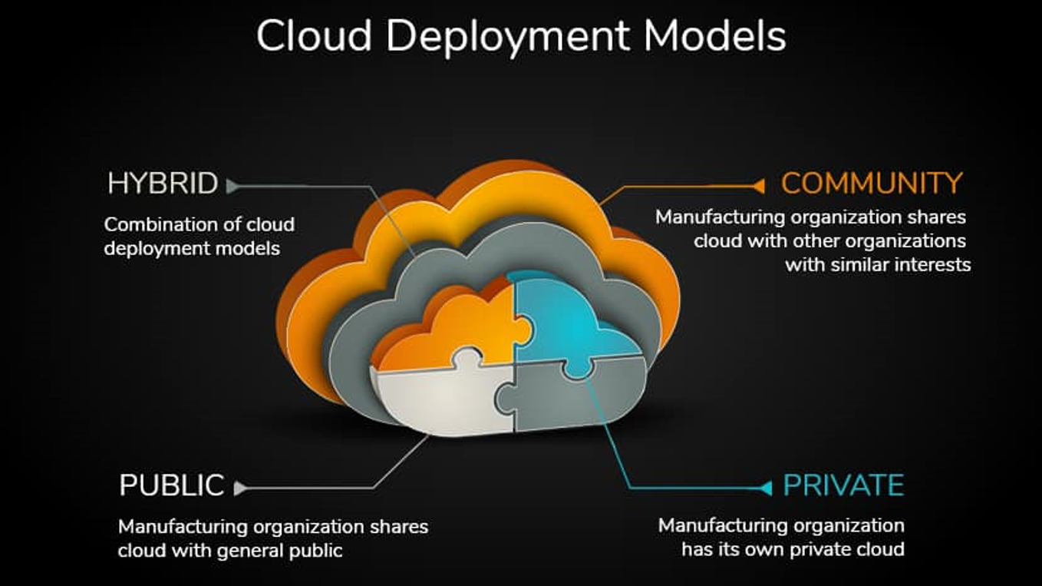

Slide 11
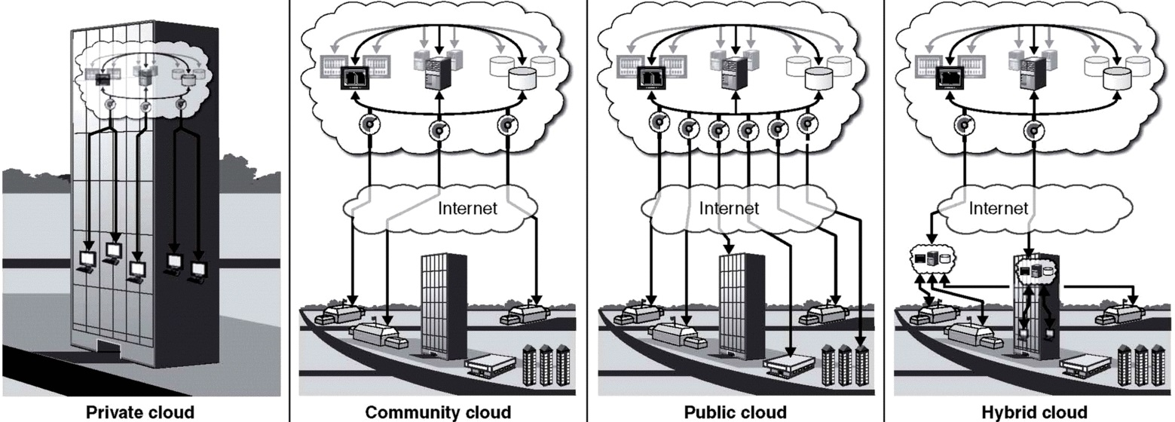
2. 2. Cloud Deployment Models
The way the cloud is used varies from organization to organization, where each has its own requirements as to what services it wants to access from cloud and how much control it wants to have over the environment.
The NIST definition of cloud computing outlines four different cloud deployment models; public, private, community and hybrid.
Image Sources :http://electricala2z.com

Slide 12
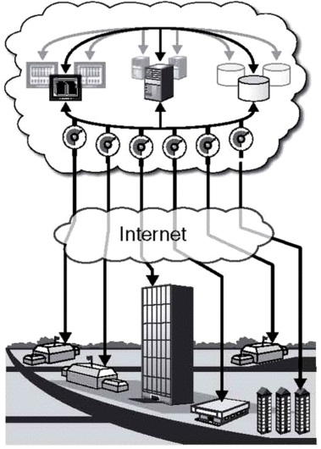
a. Public Cloud
Public Cloud are what most people think of cloud computing, where all the systems and resources that provide the service are housed at an external service provider.
That service provider is responsible for the management and administration of the systems that are used to provide the service.
Image Sources :http://electricala2z.com

Slide 13
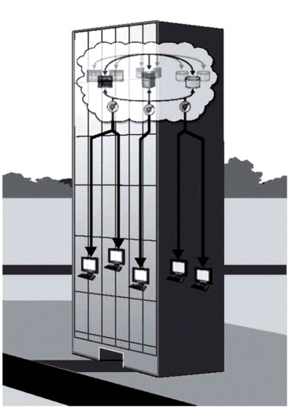
b. Private Cloud
In private cloud, the systems and resources that provide the service are located internal to the company or organization that uses them, where they are responsible for the management and administration of the systems that used to provide the service
Image Sources :http://electricala2z.com

Slide 14
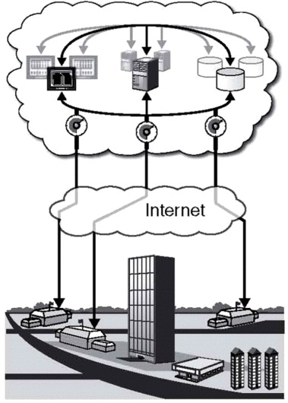
c. Community Cloud
Community cloud are semi-public clouds that are shared between members of a select group of organizations, which they will generally have a common purpose or mission, so they can have shared responsibilities with the others.
Image Sources :http://electricala2z.com

Slide 15
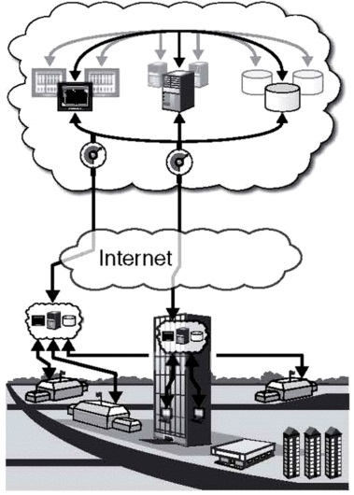
d. Hybrid Cloud
Hybrid cloud model is a combination of two or more other cloud models. The cloud themselves are not mixed together so they can have more complexity to their environment.
Image Sources :http://electricala2z.com

Slide 16
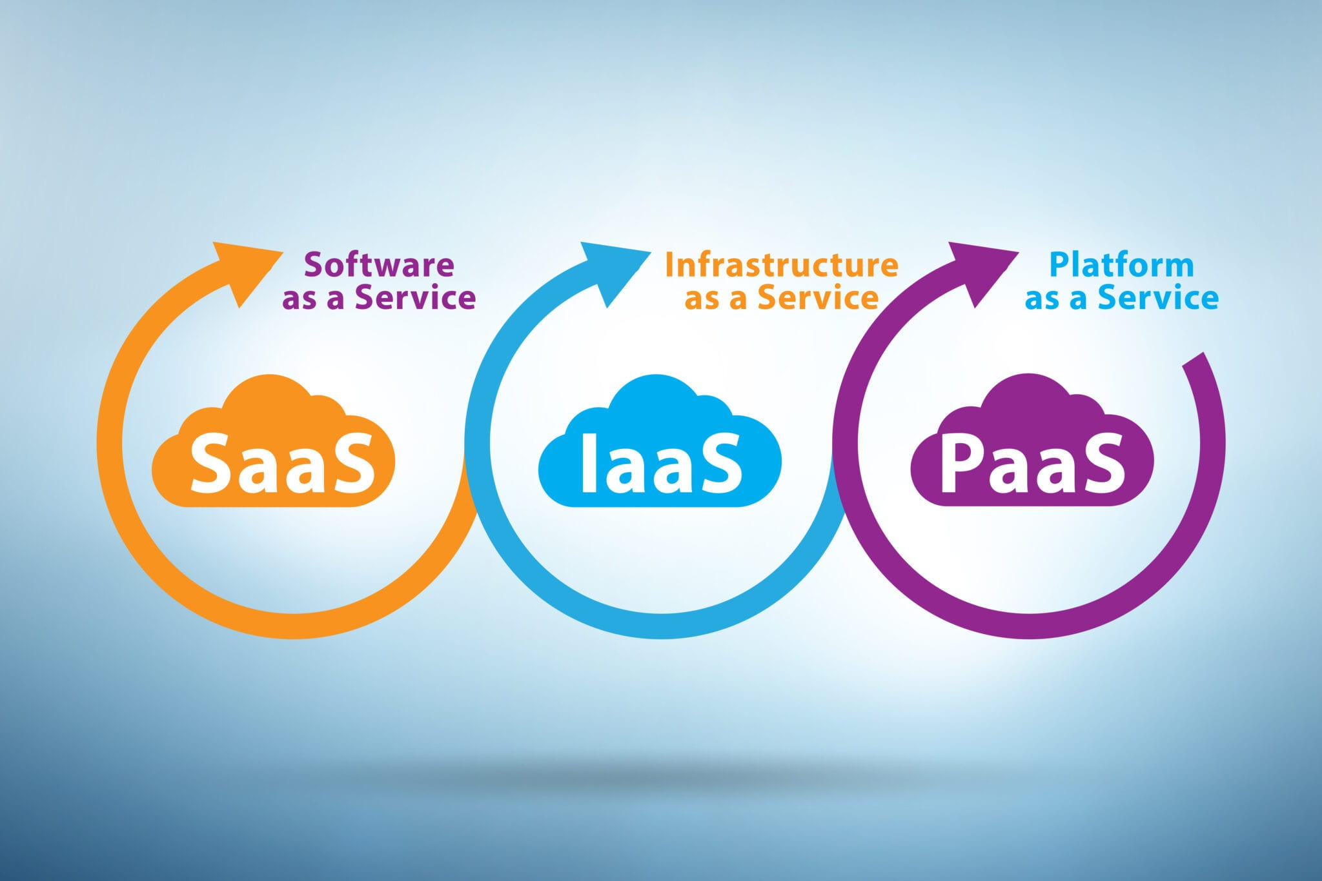
Cloud Service Models
Image Sources :https://susannetedrick.com

Slide 17
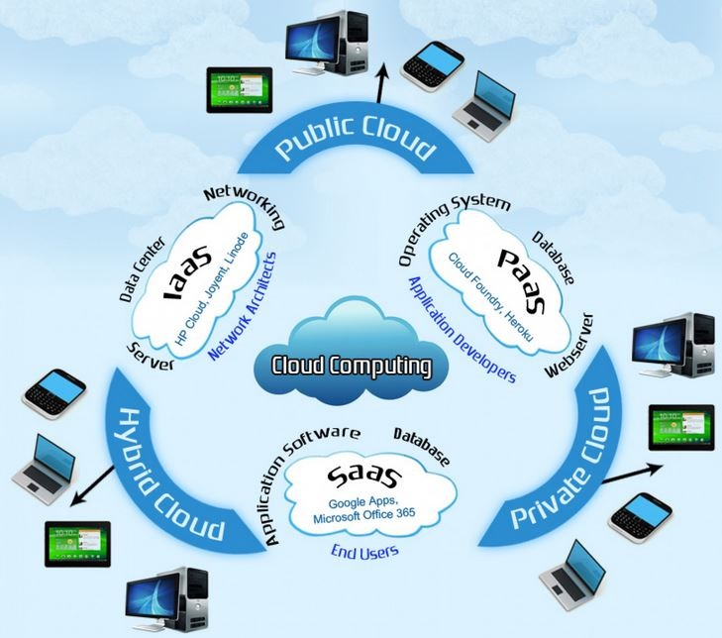
2. 3. Cloud Service Models
There are a lot of service that can be provided by a cloud implementation.
In the NIST definition of cloud computing, outline there basis service models; Infrastructure as a Service (IaaS), Platform as a Service (PaaS), and Software as a Service (SaaS)
Image Source: http://thumbnails-visually.netdna-ssl.com

Slide 18
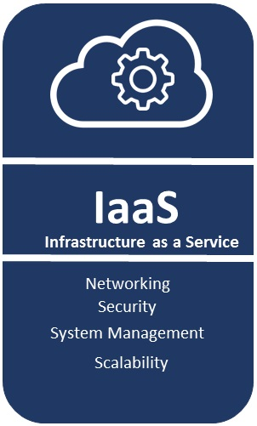
a. Infrastructure as a Service (IaaS)
Infrastructure as a Service, or IaaS, provides basic infrastructure to customers. These services may include physical machines, virtual machines, networking, storage or some combination of these.
IaaS implementation are used to replace internally managed datacenters, which allow organization more flexibility but at a reduced cost
Image Sources :http://electricala2z.com

Slide 19
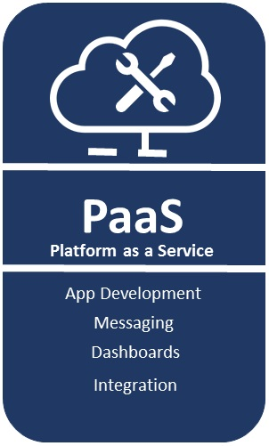
b. Platform as a Service (PaaS)
Platform as a Service, or PaaS, provides an operating system, development platform, and/or a database platform. PaaS implementation allow organization to develop applications without having to worry about building the infrastructure needed to support the development environment.
Image Sources :http://electricala2z.com

Slide 20
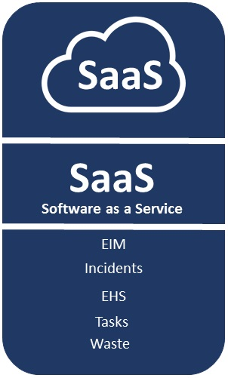
c. Software as a Service (SaaS)
Software as a Service or SaaS, provides application and data services, all of those necessary platforms and infrastructure are provided by the service provider.
SaaS is the original cloud service model, where it remains the most popular, offering by far the largest number of provider options.
Image Sources :http://electricala2z.com

Slide 21
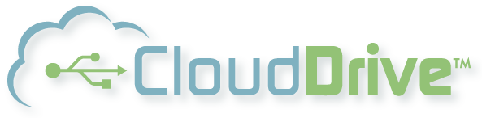
2. 4. Cloud Drive
The cloud present people with many new opportunities, where it ushers a new age of consumerism, or user-centric IT. End users don’t have to be stuck using application that they don’t like or don’t fit their needs.
Nowadays, some of the most widely used SaaS application are customer relationship management (CRM) and enterprise resource planning (ERP) application.
Image Source: https://www.usflash.net

Slide 22
2. 5. System Drivers
There are many system drivers that are steering organization to the cloud, these organization might not have the expertise or funding to achieve certain environment characteristics internally, that is why they look to a cloud provider to provide them. These characteristics are as stated as:
Agility
Reliability
Scalability & Elasticity
Performance
Security and Compliance
Ease of Maintenance

Slide 23

Agility
Agility is something that is offered in cloud environment, where user can reappropriate resources easily any given time, that is why when needed, user can take or add resources into the system, and like resources when user need systems they simply need to add them to expand the capacity.
With better internal infrastructure resources user can get a healthy internal cloud environment.
Image Sources :https://vectorified.com

Slide 24

Reliability
It cost quite a lot to be able to build reliability into cloud environment, because it usually need a handsome amount datacenter locations with multiple systems, in which they need to be disaster proof in case something unimaginable happen, and even when that happen the systems need to recover data with ease.
Most of cloud provider already have this in mind with them having multiple location set up as their contingency in case disaster happen.
Image Sources :https://vectorified.com

Slide 25
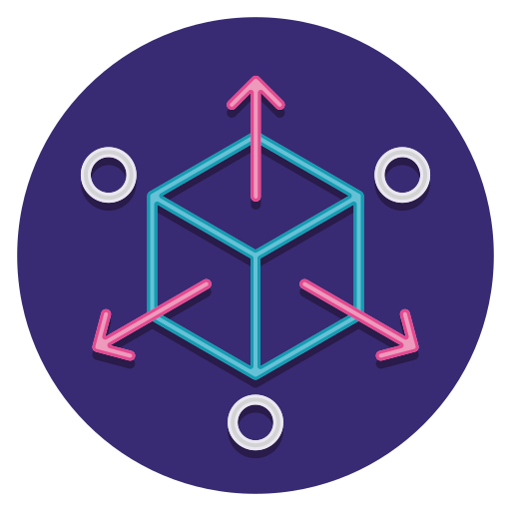
Scalability & Elasticity
To meet customer demand, cloud environment needs to adapt automatically, so in the scenario when the increased usage is needed, the system will add new resources dynamically. This means users need will always be satisfied what ever their demand.
It also save on the power and space consumption because, it only needs to meet what ever the user demand without having anything stay idle for quite a lot of time
Image Sources :https://vectorified.com

Slide 26

Performance
In cloud system the thing that is constantly being monitored and measured is performance, which is why when the performance did not meet expectation the system can adjust automatically to give more capacity, it also help with having service-level agreement (SLA).
With SLA, the system has a guarantee of a certain level of performance.
Image Sources :https://vectorified.com

Slide 27

Ease of Maintenance
One of the appealing things which can benefit user of cloud computing is ease of maintenance, it help when the people giving the service is the one that manage the infrastructure, it means they are generally responsible for maintenance.
In the case of cloud environment, user only need to have an agreement with the service provider, and let them deal with the infrastructure management and many more.
Image Sources :https://vectorified.com

Slide 28

Security and Compliance
In the field of cloud computing security is consider by many experts to be more robust than in any other fields.
It help because the focus is only on securing one type of environment or one type of data.
Companies are usually looking to the cloud to mitigate their compliance burden, where they more often than not have a big strain on their IT environment.
Image Sources :https://vectorified.com

Slide 29
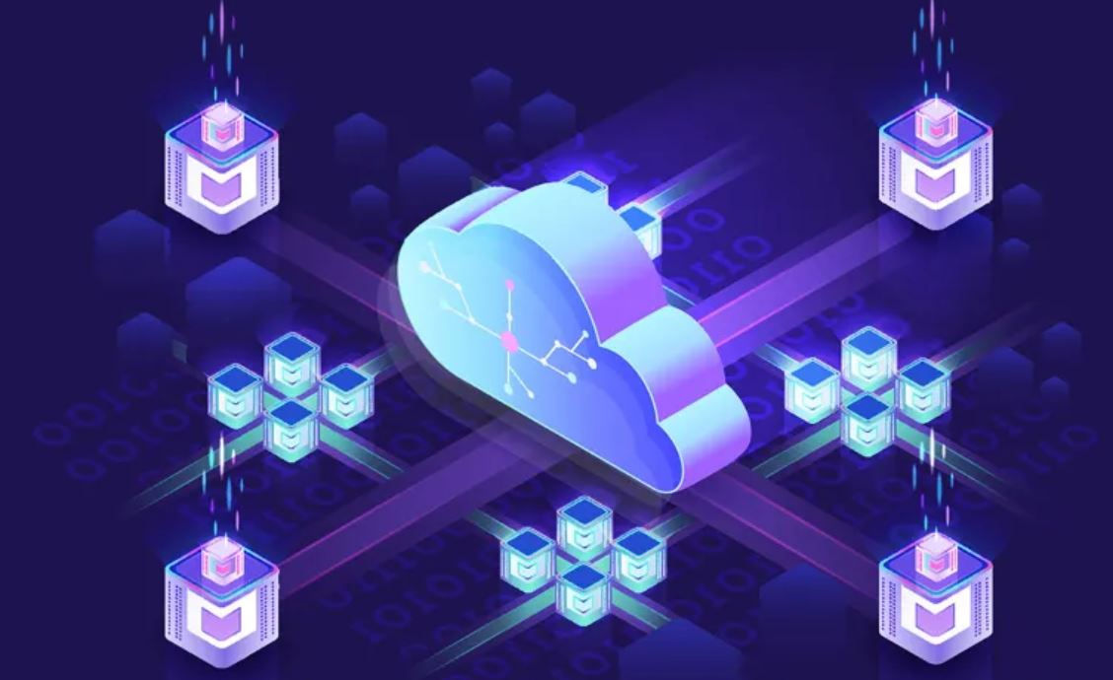
Content Management
System (CMS)
Image Sources :https://www.dotcms.com

Slide 30
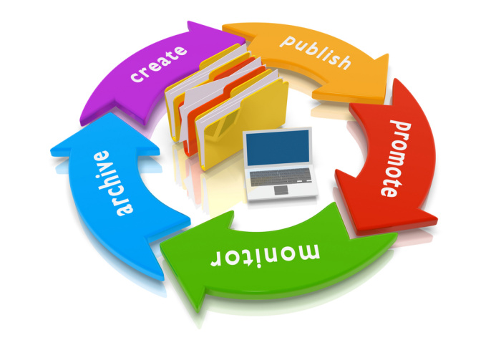
2. 6. Content Management System
Content Management System is software that helps users create, manage, and modify content on a website without the need for specialized technical knowledge, or you could say that CMS is a tool that user utilize to make website without having to write any code at all.
In this case, user only need to think of how the website is going to look while the images storing and any basic infrastructure is going to be handled by CMS
Image Source: http://worldzoo.com

Slide 31
References
Rountree D., Castrillo I. The Basic of Cloud Computing: Understanding the Fundamental of Cloud Computing in Theory and Practice. Waltham, MA: Elsevier Inc, 2014.

