Slide 1

INTRODUCTION TO INFORMATION TECHNOLOGY II
Week 3
Cloud Application for Work Collaboration
Riovan Styx Roring, S.T., M.Kom

Slide 2

Workplace Environment
The workplace environment consist of physical location and also the surroundings of that workplace. Workplace environment can also be defined as a forms of employees’ involvement with their job as well, such as the connection between co-workers and their boss, etc.
Image Source: Microsoft PowerPoint Template

Slide 3
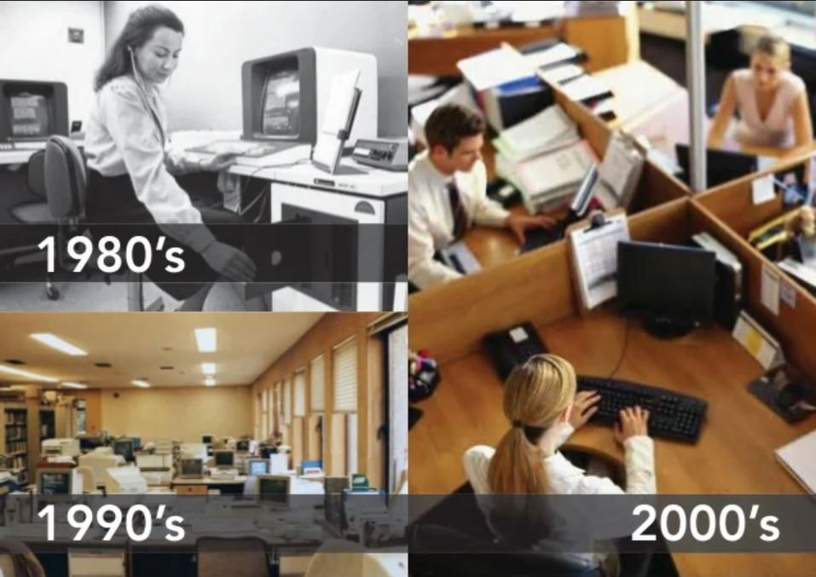
The evolution of workplace
Though out times, the workplace environment have change, from the introduction of new technology and tools, to the size of the working environment themselves. All of those changes happen to cater for the employees’ needs and their working habits.
Image Source: http://slideshare.net

Slide 4
Workplace in the 70s-90s
Offices used to be made up of cubicles. Employees usually work on their own and they need to focus all the times, a stark contrast to the modern workplace environment where collaboration is paramount and also required.
Workplaces those days were a lot less tech orientated, with the most modern thing that they have is fax and printing machine with most business communication happen over landlines and in person and documents were all hard copies.

Slide 5

Workplace in the 2000s
There is more focus on feeling comfortable in the workplace, with things like comfy seating and this is the era where the tech trends are rising, from the web 2.0 to video conference meeting where employees can collaborate on their work.
Image Source: http://condecosoftware.com

Slide 6

Workplace in the 2010s
The 2010s saw a huge shift in how the design of the office did not only change how people worked but their relationship with the workplace environment. The workplace become highly designed with bright and vibrant offices, a place that employees want to spend time and make a deeper bond with their co-worker.
Image Source: http://openpng.net

Slide 7
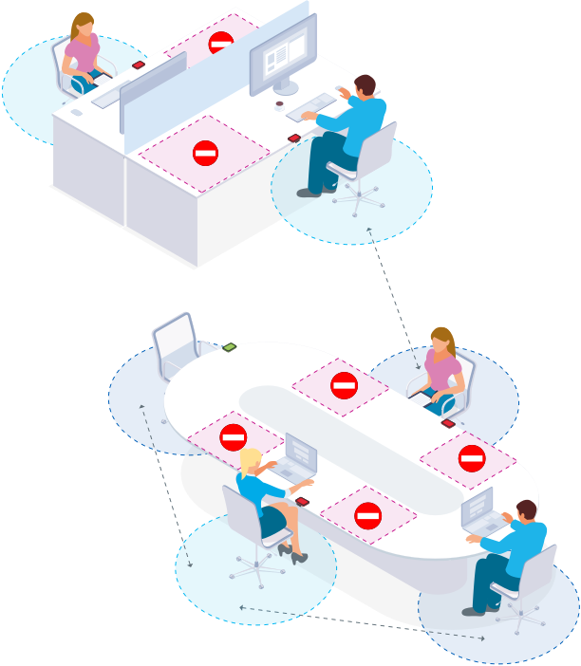
Workplace in the 2020s
The COVID-19 pandemic has changed the way we will work forever. With offices closed, employees working remotely from home, and meetings taking place over video calls employees have had to adjust to a ‘new normal’.
Image Source: http://workit.net

Slide 8
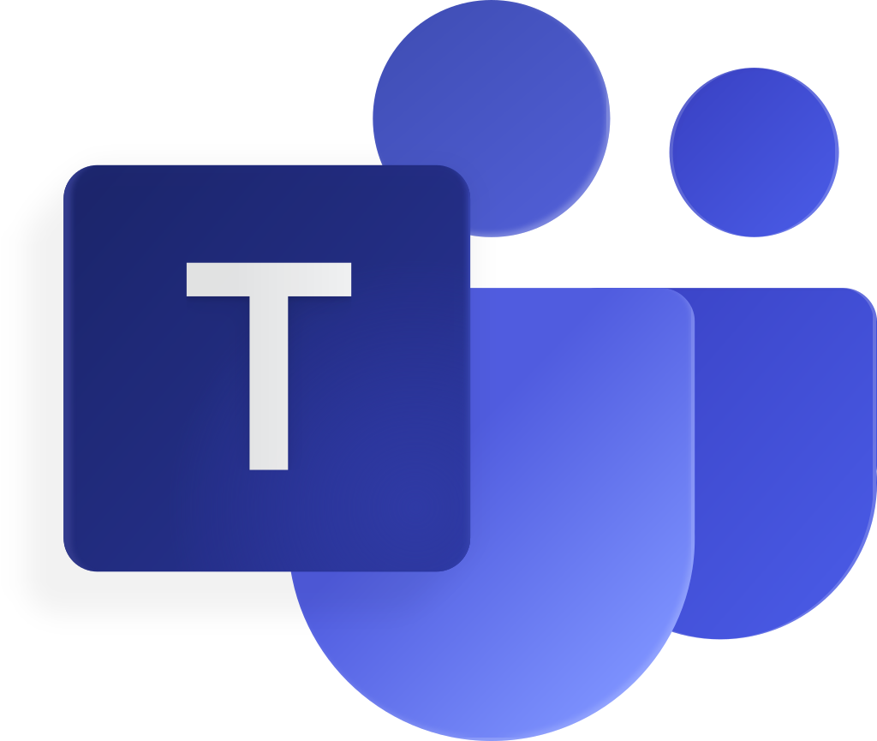

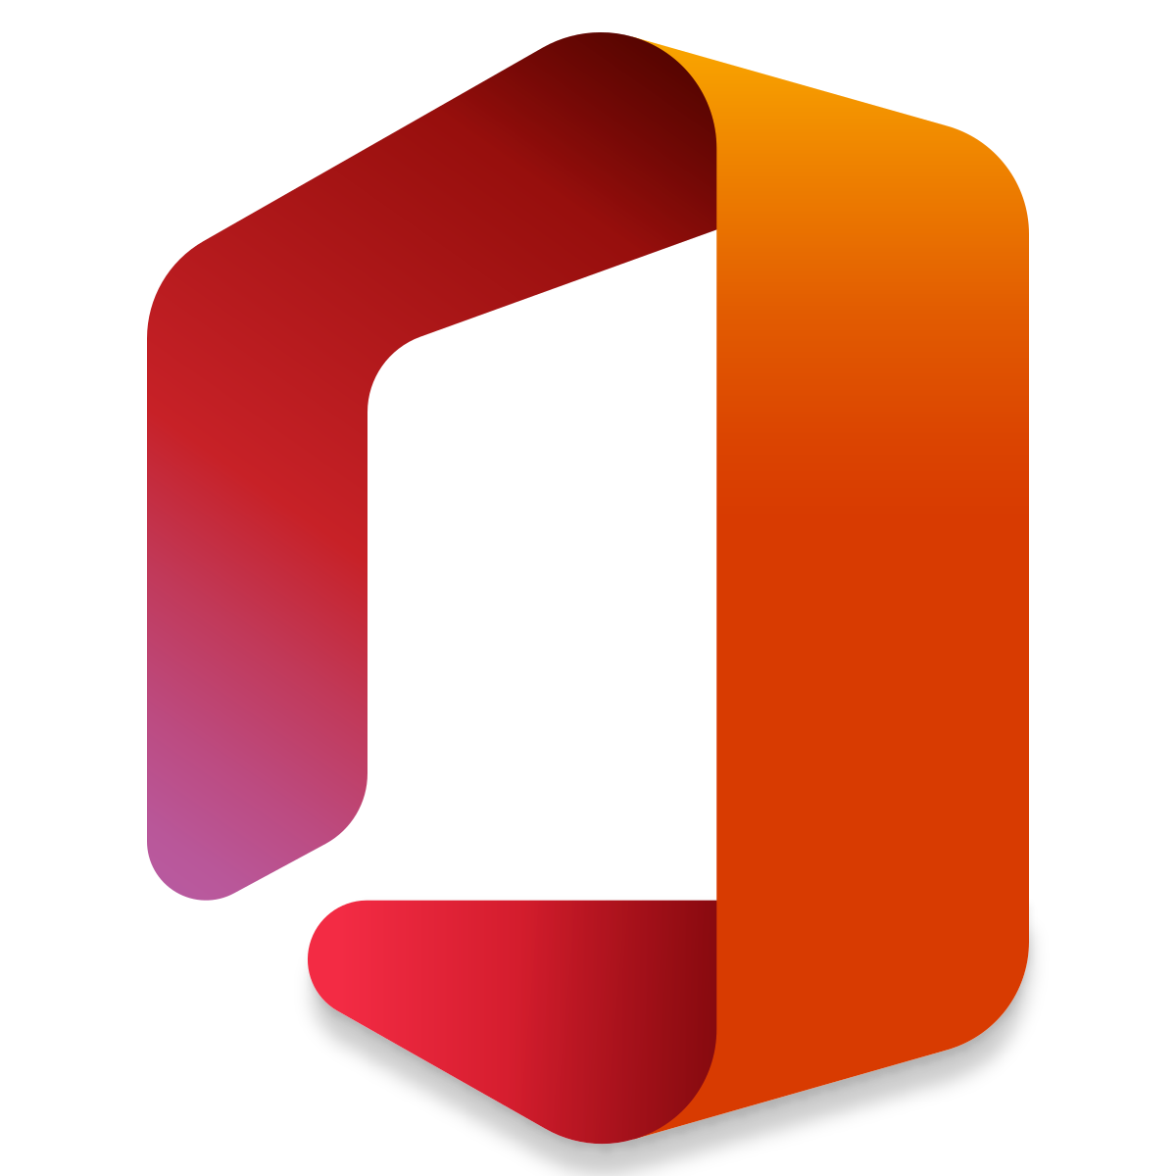

Cloud Application for work collaboration
Collaboration is crucial for every part of a small business, without communication between teams and departments, it’s impossible to get anywhere.
With teams more spaced out than ever, collaborating even with a small team can be difficult without the right tools.
This is where a cloud collaboration tool comes into play.
Image Source: http://pngicon.com

Slide 9

How Cloud collaboration tool can improve works
With most cloud collaboration tools, one of the biggest advantages is the transparency amongst the tasks and how projects will be done on time.
These apps function in a workplace that’s been healthy from the start, only amplifying the things that have worked for the team. That said, some teams may have problems that should be addressed, and introducing a software solution may or may not solve these issues.
Image Source: http://pngicon.com

Slide 10

Cloud-based collaboration method
The purpose of cloud collaboration is not just to be able to communicate with each other, it is also a mean to help teams work together, sharing files and making changes to their tasks in real time, no matter where they are and at any given time.
It is achieved by using multiple platforms, and a plethora of apps and software.
Image Source: http://elematic.com

Slide 11

Video Conferencing
This is one of the most used form of work collaboration between employees in teams, it all comes from the idea that meeting face to face is not really that necessary in work flow, but since communicating with just audio can sometimes be not enough, this can be the middle ground.
With the pandemic in this last few years make the work culture in general change drastically. More and more company have their employees work from home, and this make the proliferation of video conferencing more apparent.
Image Source: http:/completebusinessgroup.com

Slide 12
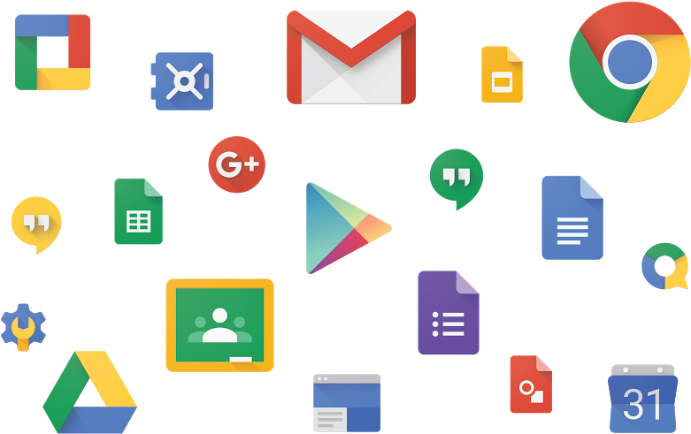
Team messaging
Having a space where employees can have a conversation where they can exchange ideas is a must these days, not only that but also having the ideas bounce in real time.
For example a scenario where a group of employees can edit a spreadsheet, and those changes can be seen by the others, and the other employees can give their input in real time.
Image Source: http://pimgbin.com

Slide 13

File sharing and editing
When team members are all working from the same digital file, cloud-based storage and editing tools make sure everyone is looking at the most up-to-date version
Image Source: http://pngicon.com

Slide 14

Screen sharing
Sharing what happen or what their doing on the screen let some people to show or even educate people more easily.
This also means that people in the group would have things on the same page.
Although some users need to be aware of what might be showing on their screen so a more careful approach of sharing is very much advised.
Image Source: http://pngicon.com

Slide 15
Good Cloud collaboration characteristic
Ease of use
Multifunctionality
Scalability
Integration
Image Source: http://pngicon.com

Slide 16

Ease of use
When the scale of a team of employees is small, everyone needs to be as productive as much as possible. They can not afford to spend days or even hours training and educating themselves about new tools.
That’s why ease of use is one of the most important things to consider when choosing a cloud collaboration solution for a business and when deciding on a tool, look for something that is intuitive and designed with the end user in mind.
Image Source: http://pngicon.com

Slide 17
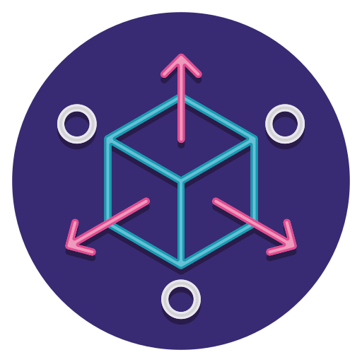
Scalability
As employees grow and along with their team, they want a collaboration tool that can grow along with them. While it might make sense to choose something basic and cost-effective early on, if it won’t work for a larger or more complex team, you’ll just end up needing to invest in something new.
Although it might not happen in the foreseeable future, but being prepared means less hassle and more time and resource could be used for something better.
Image Source: http://pngicon.com

Slide 18

Multifunctionality
A cloud collaboration solution is more than just a way to communicate with people within the team, because the features offered by each tool will vary, to find the right one for one’s business, they need to know what additional functions are most important for their team.
The biggest benefit of using a multi-functional tool that puts everything in one place is that it minimizes human error. Files are stored right where your team communicates, and tasks can be assigned within your messaging thread. Team members only need to stay up to date on one app, saving them time and ultimately making them more productive.
Image Source: http://pngicon.com

Slide 19

Integration
While a cloud collaboration tool, especially one with a lot of features can do a lot, it can not do everything on its own. This is where integrations will become important. Users want their collaboration tool to connect with other apps so that the task that they do can be open by other tool as well.
Users are required to choose the tools that they might want to use in the future, to prevent the case of having to overhaul the entire system just because their collaboration tool can not connect to the apps that the team usually use.
Image Source: http://pngicon.com

Slide 20

Challenges in implementing
Cloud Collaboration Tools
Image Source: http://nsimplecore.com

Slide 21
Too many application
Companies on average use at least 16 SaaS apps to manage all their internal operations. With the majority of the workforce going remote in 2020 because of the ongoing pandemic, this number has only increased. Introducing another app for cloud collaboration will not only overwhelm employees but also create issues within teams.
They will have to clearly decide the purpose of the tool, especially if they are already using other applications with overlapping functionalities. Integrating it with the existing system and ensuring the data doesn’t get siloed will be another challenge.

Slide 22
Absence of an organization-wide collaboration strategy
No matter how great of a cloud collaboration tool people use within their company, it won’t do any good if collaboration is not a part of their core company values. Organizations should develop a collaboration strategy that encourages employees to collaborate and communicate with each other. It should also include the right practices to ask colleges for inputs, offer constructive feedback, and reach a common consensus.

Slide 23

Cloud
Collaboration Tools
Image Source: http://nojitter.com

Slide 24


Microsoft Teams isn’t actually one cloud collaboration tool but rather a collection of apps and tools that can make working with teams easy and productive. With 365, you can use the Office products you love, use OneDrive to edit, share, and collaborate on documents, and stay in contact with employees and team members.
Although Microsoft’s suite of tools is designed to work together, the collection of apps means your team needs to be well versed in a variety of apps. They also work best when using the full range of Microsoft tools, so integrating with other apps can be a no-go.
Image Source: http://teams.microsoft.com

Slide 25
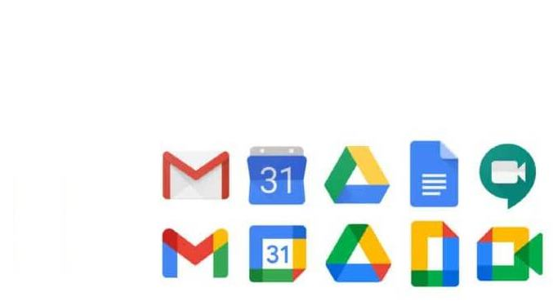

Google Workspace is Google’s new productivity toolkit. It brings all users favorite G Suite tools -- Calendar, Gmail, Drive, Docs, Slides, Meet, Keep, Forms, Sites, Currents and Sheets, even closer together under a neat, tidy, and colorful umbrella.
Google has taken a look at their existing tool to see how they can create some kind of digital office for its users. Google Workspace has been developed to encourage effective collaboration, bringing teams closer together when they’re not together.
Image Source: http://workspace.com

Slide 26


The RingCentral app is a phone, team messaging, video, and task management tool that allows teams to share files, create and manage tasks, and work together on the go. Although it looks like a chat-based tool, user can easily make a phone call, switch to video calls, drop links to files and documents, and integrate it with popular apps like Google Drive, and Microsoft Teams.
RingCentral’s messaging feature is free, and lets users add unlimited team members. It also has built-in to-dos and tasks so they can coordinate with thier team and get things done without a second project management system
Image Source: http://ringcentral.com

Slide 27
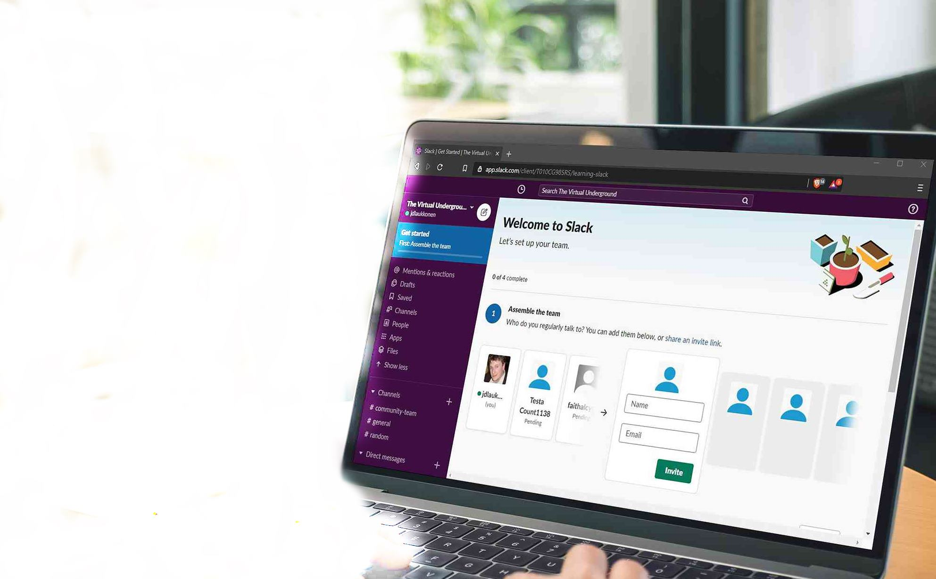

Slack is another popular cloud collaboration tool that looks and functions similar to the RingCentral app. Like the RingCentral app, Slack’s primary communication method is team messaging, with video calling and file sharing tacked on. Slack also has a long list of apps it integrates with.
Slack does have a free offering, but it doesn’t come without some limitations. The number of available messages is limited to just 10,000 (meaning you can’t scroll back to look at past chats), and you’re limited on the number of integrations you can have with the free plan.
Image Source: http://slack.com

Slide 28
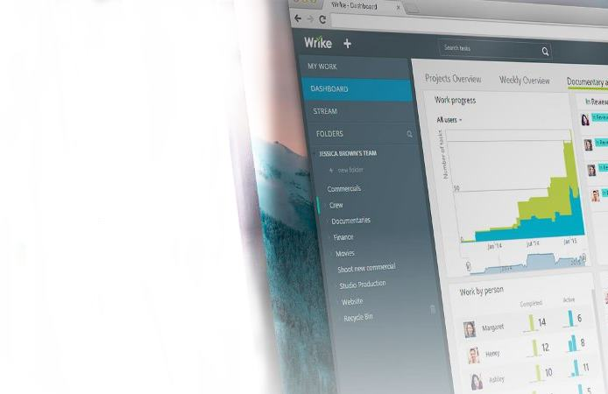

Wrike is first and foremost a project management tool. While team communication is important, Wrike prioritizes organization and information management to make collaboration easy.
Wrike shares project data in real time, which is great for small businesses with a lot of different moving pieces. While it does integrate with communications platforms, the only in-app communication is text-based, which might not be enough for some teams.
Image Source: http://nojitter.com

Slide 29

Which Cloud collaboration tools should you choose?
If you’re looking for a cloud collaboration solution for your small business team, take some free trials for a test drive! Get a feel for what works for you (and what doesn’t) and make a decision that feels comfortable to your team.
Image Source: http://qualityze.com

Slide 30

Cloud collaboration tools are future-proof
The way the digital world is evolving, there’s no other way but forward. Cloud collaboration tools, being fully digital and online, are sure to move along with this progress.
These tools have been proven to be relevant especially after the pandemic hit in 2020. Whether your teams are in-house or remote, digital collaboration tools are a necessity to maintain communication, collaboration, and productivity.
Image Source: http://qualityze.com

Slide 31
References
Miller M., Cloud Computing: Web-Based Applications That Change the Way You Work and Collaborate Online, Que Publishing 2009

