Slide 1

INTRODUCTION TO INFORMATION TECHNOLOGY II
Week 4
Content Management Systems (CMS) for Creative Industry Technopreneur
Riovan Styx Roring, S.T., M.Kom

Slide 2

Creative Industry Technopreneur
High-tech and entrepreneurial skills are driving our economy back to prosperity. Technopreneur-ship merging technology prowess and entrepreneurial skills- is the real source of power in today’s knowledge-based economy. A technopreneur distinguishes logic from tradition, tradition from prejudice, prejudice from common sense and common sense from nonsense while integrating a variety of ideas from diverse groups and disciplines.
Technopreneur-ship is not a product but a process of synthesis in engineering the future of a person, an organization, a nation and the world. Strategic directions or decision-making processes are becoming more demanding and complex. This requires universities, and in site professional development programs and training to produce strategic thinkers who will have skills to succeed in a rapidly changing global environment.
Image Source: http://cloudcms.com

Slide 3
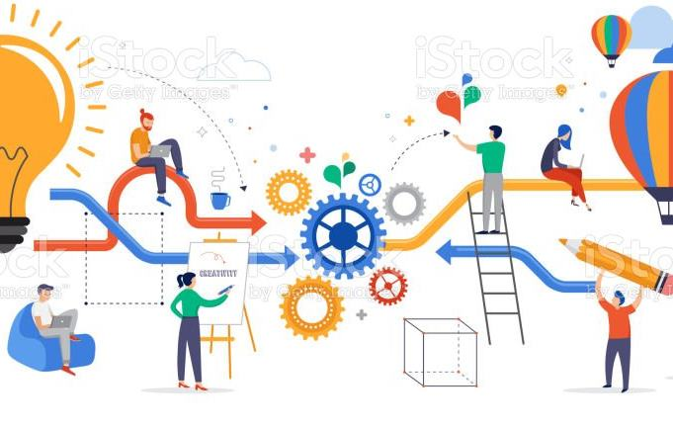
Creative Industries in Indonesia
Creative industry in some countries becomes the new economic locomotive. In Indonesia, creative industry is still being developed, and various problems still occur. The era of 4.0 industries is dominated by the utilization of digital technology that makes life easier like today.
creative industry is born as a new stream of economy in some counties including Indonesia. The phenomena of creative industries in America, South Korea, and India are the proof that creative industries give significant contribution to the economic development of those countries.
Image Source: http://gettyimage.com

Slide 4

The Problems of Creative Industries in Indonesia
Even though Indonesia is already beginning its journey into becoming a technopreneur country, there are still problems that need an immediate solution, before that can happen, some of those problems are as follow:
the uneven distribution of resources among the sixteen sub sectors of creative industry.
resources for creative industry have not yet been evenly distributed throughout Indonesia. Industries in Java island still dominates the export activities in this industry.
workers in the creative industry still need supports and contribution from highly-educated workers.
While those are a pretty major problem, there is quite an easy solution for that, which is
Image Source: http://easishare.com

Slide 5
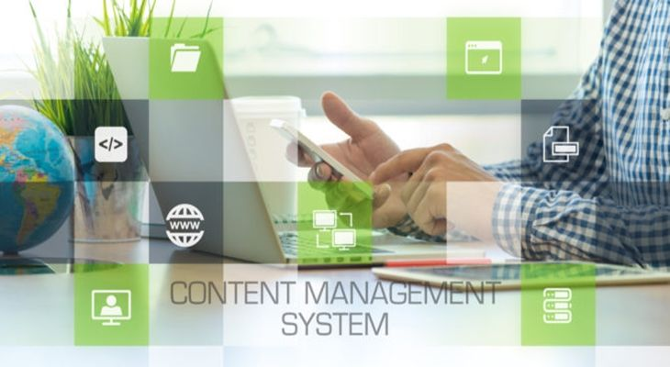
Image Source: http://roweb.ro

Slide 6
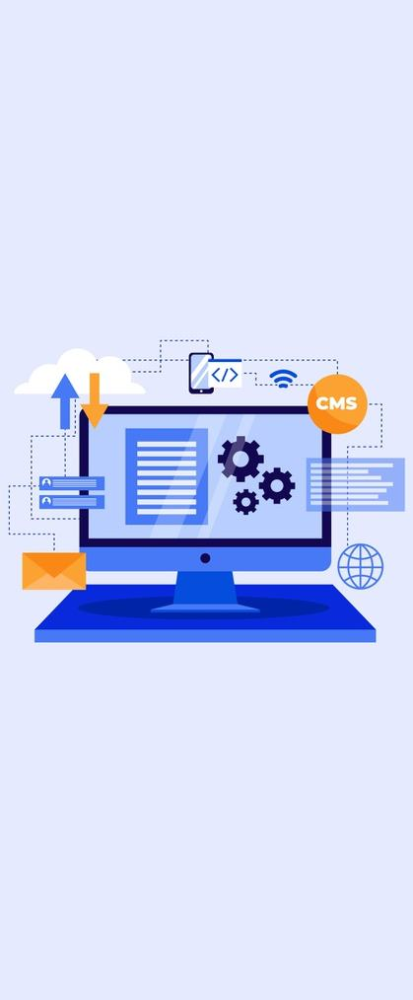
Advanced Content Management Systems (CMS) technologies
HTML and CSS are OK for creating simple, readable documents, but they are limited when building websites that offer extensive capabilities and functionality—the kind of modern website most companies need to be successful.
For example, to add interactive features and more nuanced functionality to users website, they need to use JavaScript. HTML and CSS are relatively straightforward codebases used to create simple documents. JavaScript is a dedicated programming language not dissimilar from the languages used to develop smartphone or desktop applications.
Image Source: http://cloudcms.com

Slide 7
Advanced Content Management Systems (CMS) technologies [cont..]
Suppose they plan to migrate their blog site into a media website that serves thousands of visitors per month and posts several pieces of content per day. In that case, they need to start incorporating database technologies to house and access all their content. They need a database with its own programming language as well as another programming language to pass information between the database and the part of the website that users access and navigate. Just like that, things got complicated rather quickly, which is where CMS comes in.
Image Source: http://cloudcms.com

Slide 8
What is Content Management Systems (CMS)
“Content Management Systems
have become one the internet’s most powerful web developer tools.
“
A Content Management System (CMS) is a Web application that uses a database (usually MySQL) or other methods to create, edit, and store HTML content in a manageable way.
Content is created and edited on the web in an administration portion of the web application (referred to as the Backend). The resulting content is then displayed to the viewers on the regular site (referred to as the Frontend).
A CMS thus makes website content authoring, editing and publishing easy. It enables users to quickly build and efficiently maintain content-rich websites by streamlining the web publishing process. One does not have to be an HTML or CSS expert to use the Content Management System.

Slide 9
Using Content Management Systems (CMS) for Creative Industry
Provides an easy and accessible way to update content
Enable users to maintain content consistency
Support inner and cross-team collaboration
Increases content visibility
Scales as users need grow
Improves productivity
Reduces cost
A content management system helps users create, manage, and publish content on the web. It also helps them keep content organized and accessible so it can be used and repurposed effectively. There are various kinds of content management systems available from cloud-based to a headless CMS, to meet every audience need.
Not only does it give users a way to store and manage all their information in a single, easily accessible database, but it also does the following:

Slide 10
Types of Content Management Systems (CMS)
a. Coupled CMS
b. SaaS CMS
c,. Decoupled CMS
d. Headless CMS
Nearly every CMS is comprised of two parts, the front end and the back end. The front end is the part the user interacts with. It’s how websites are visibly structured and styled. The front end brings HTML, CSS, and JavaScript together to deliver rich, interactive content that’s styled to match users company’s branding.
The back end of a CMS is the application that is used to post new content to a website. The process begins by accessing a web interface to easily add, create, and publish content to their CMS’s front end. Rather than knowing HTML, CSS, and JavaScript, users can create content in an interface similar to Microsoft Word. The back end then stores this content in the database and publishes it to the front end of the website.

Slide 11
a. Coupled CMS
A coupled CMS is often referred to as a traditional CMS. It offers a fully accessible back end that connects to and modifies a website’s database and publishes content to a styled front end.
While a coupled CMS is an all-in-one solution, the main distinction between it and a software-as-a-service (SaaS) CMS is that a coupled CMS requires dedicated web hosting to run. Although web hosting is relatively inexpensive, it's important to remember that a CMS requires installing and maintaining specific technologies to make the software functional.

Slide 12
b. SaaS CMS
A SaaS CMS is also a complete, end-to-end solution, but unlike coupled CMS, SaaS CMS is hosted in the cloud. Which means that it requires no actual setup, installation, or preconfigured web hosting.
A SaaS-based CMS is an excellent solution for companies who need a straightforward web presence, as it offers all the capabilities without any of the server or web-hosting overhead. It enables all kinds of users to quickly create websites, manage the content, and distribute it through digital channels.

Slide 13
c. Decoupled CMS
In a decoupled CMS, the presentation part of the website is “decoupled” from the back end. The delivery system sits between the presentation of the website and accesses the back end through an application programming interface (API).
A decoupled CMS is an advanced solution that offers greater flexibility to interact with the content created in the back end, decoupled CMS is an appealing solution because it supports multiple, adaptable applications on the front end while keeping your content and information consistent in the back end.

Slide 14
d. Headless CMS
A headless CMS has only a back-end system that accesses a database and stores content with a custom-built, front-end web application. It offers greater flexibility than a decoupled CMS, but it also requires considerably more work than any other option. A headless CMS also usually requires a developer to design, create, and connect a front-end application.
A headless CMS is a good solution for organizations that need complete control and flexibility over how their content is accessed. It provides content storage and organizational capabilities while allowing for a custom application on the front end—whether a website, a mobile app, or some other front end.

Slide 15
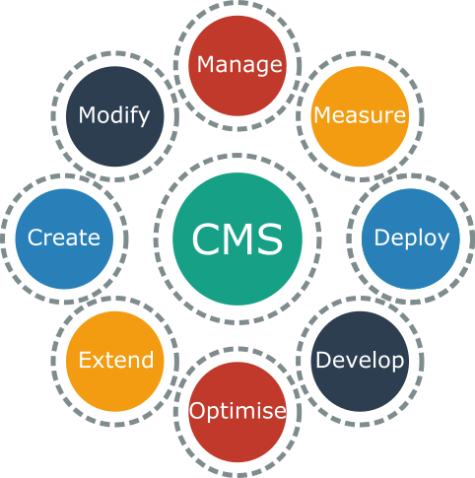
How does Content Management Systems (CMS) help to build websites?
Basically, a CMS platform takes care of all the technical details around building and managing a website. For example, to post content on the web, such as a blog post, users need to start with an HTML file. HTML allows them to structure their written content so that a web browser can read it. It also allows them to embed images and videos into their content and link to other HTML documents.
Image Source: http://pincms.net

Slide 16
How does Content Management Systems (CMS) help to build websites? [cont..]
Once the content is created and structured, you can change the look and feel of it by using cascading style sheets (CSS). With CSS, you can change the font, color, and size of every element on your page to achieve the desired styling. Once completed, you upload the HTML and CSS files—along with any image and video files—to a web server where your new website is accessible to anyone.
While this process may not seem terribly difficult, it’s not a very efficient way to create documents and share them online. And most organizations don’t have the IT resources to devote to this task.
Image Source: http://pincms.net

Slide 17
Benefit of Content Management Systems (CMS)
Strong Bond
User Friendly
Strong Optimization
More Time
The demand for digital marketing experiences is growing, and shows no signs of letting up. Today’s modern consumers are demanding omnichannel solutions and frictionless experiences. Digital technology provides endless ways for companies to engage with their customers and stay connected. So it’s no wonder that CMS market is expected to grow from $36 billion in 2018 to $123.5 billion by 2026.
Companies recognize how a content management system can help them leverage the full value of their content by streamlining the content creation and distribution process. Marketing and sales teams who invest in a CMS can expect to gain four key benefits as they work to get their message into the market and improve customer experiences.
Image Source: http://pngicon.com

Slide 18

a. Stronger collaboration and organization
With a CMS, multiple content marketing team members can contribute and help publish content. With its workflow management, content storage, and scheduling capabilities, the system helps them keep everything organized. Browser-based CMSs can be accessed from anywhere, and teammates in different locations can collaborate on content projects in the same system and on the most current version. Team members can all access the same content since it’s stored in the same place. There’s no need to send multiple files to multiple people—and no headaches from trying to control multiple versions.
Image Source: http://pngicon.com

Slide 19

b. User friendly
With a CMS, users don’t have to learn HTML or CSS. No matter their skill level, users across the organization can create and publish content. A content management system makes it easy to upload content onto web pages and update it through a content editor.
Image Source: http://pngicon.com

Slide 20

c. SEO and content optimization tools and plug-ins
One of the way users can to improve their search engine optimization (SEO) and drive traffic to their site is by using a CMS, where they can add plug-ins and tools to increase their search ranking. These tools can include options within the front-end interface to add web page titles, meta descriptions, and alt tags.
Image Source: http://pngicon.com

Slide 21

d. More time to spend on content
With a straightforward CMS system, better organization, and tools and plug-ins to help SEO, Content creators can concentrate on producing quality content. Marketing teams don't have to work with multiple files or code. They can share their work with colleagues easily, even if those colleagues are miles away. They have time to refine copy, tweak imagery, produce more video content, or conduct A/B testing on different subject lines, offers, CTAs, and formats.
Image Source: http://pngicon.com

Slide 22
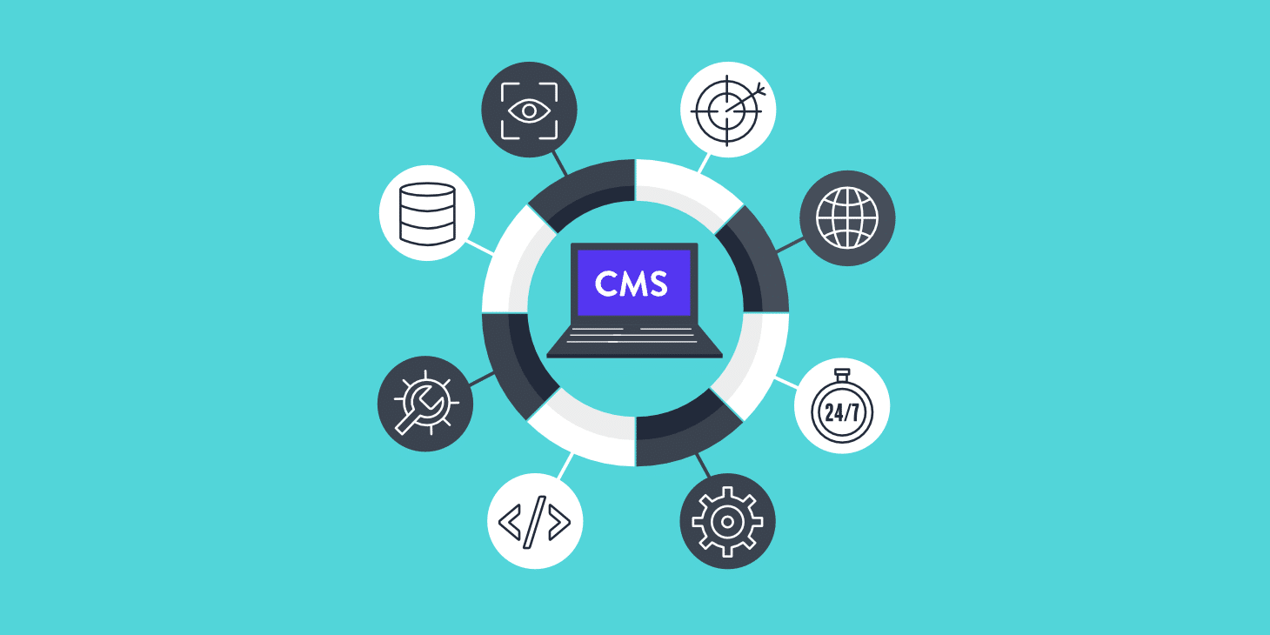
Core features to a Content Management Systems (CMS)
Finding out what features of a CMS are critical to user’s business might start with what features are core to a content management system. Leveraging side-by-side comparisons of content management solutions and products can be helpful to people that undergo decision-making process.
Image Source: http://easishare.com

Slide 23

a. User roles and role-based content management
There are different types of roles within any Content Management System. Understanding how they work together is essential to giving customer access to perform their duties and access appropriate digital content. These range from typical organization roles to application management roles, task and feature comparison by application roles, to the resource (permissions) type roles, deciding what users can see and do with the content, including documents, sites, or templates.
Image Source: http://easishare.com

Slide 24
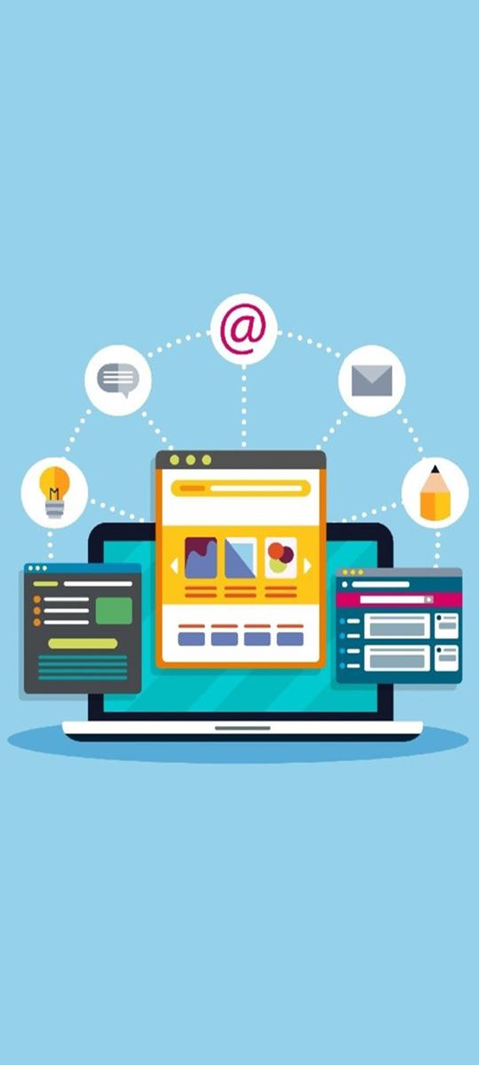
b. Digital asset management
Content Management systems offer powerful capabilities to manage all users digital assets for use in different marketing channels, including websites, marketing materials, email campaigns, online stores, paid search, and blogs. It provides a centralized content hub for all their assets, where they can organize them into repositories and collections and create rules and workflow to define how the content can be used and where.
Creating asset types to define what information they need to collect when users create assets is critical to any CMS. Digital asset types will define the custom attributes required for their digital assets (files, images, and videos).
Image Source: http://weshareitpng.com

Slide 25
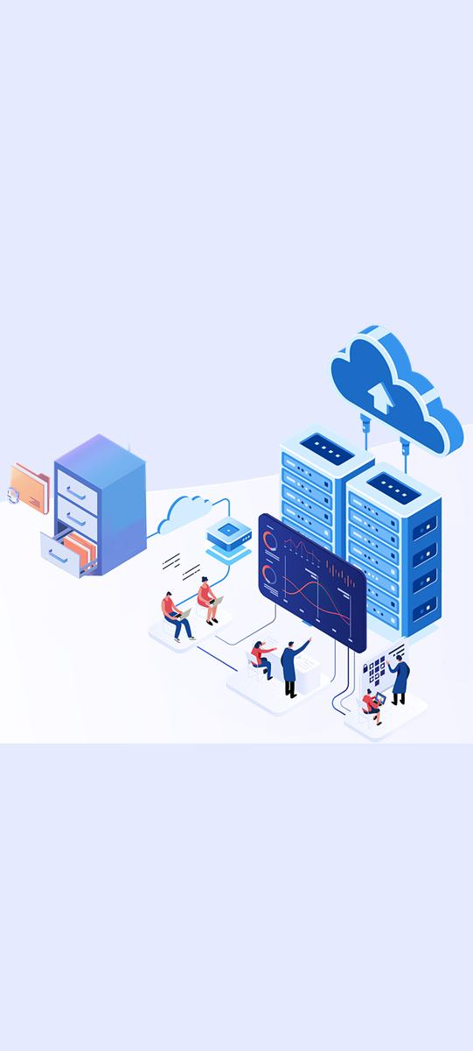
c. Manage content in the cloud
it is critical to move users content management to the cloud, centralizing their content all in one place and making it accessible anywhere.
Users can group their files in folders to perform everyday file management operations, including copy, move, delete, in much the same way as on your local system and architecture. Since all the content files reside in the cloud, users will access them wherever they go, including mobile devices.
Image Source: http://easishare.com

Slide 26

d. Content collaboration
With all users organizations’ content in the cloud, it will be easy to share assets or folders to collaborate with others both inside and outside of their organization. The people that they share their content with will have access to the latest information—wherever they are, whenever they need it. Sharing and recording content coloration will enable the user to monitor how and when each shared item was accessed.
Image Source: http://hellinimg.com

Slide 27
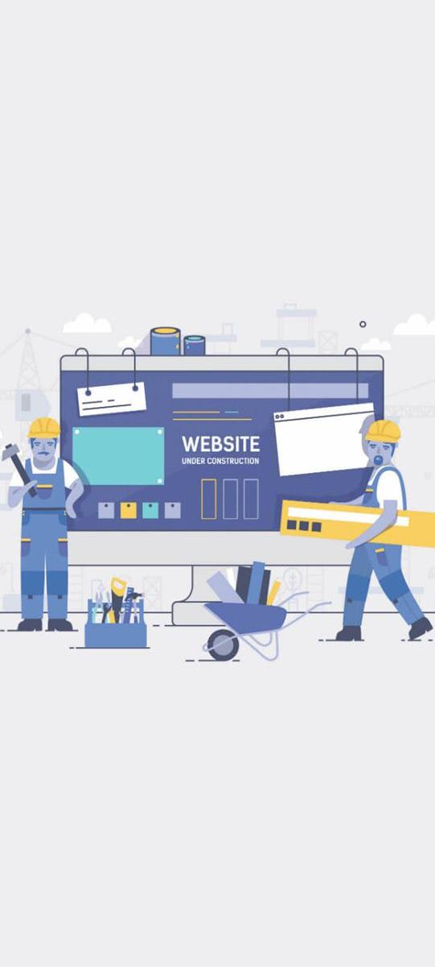
e. Build websites
With content management solutions, users can rapidly build and publish marketing, help, and community websites, from concept to launch, with engaging online experiences. The website building process is completely integrated across content, collaboration, and design are via a single authoring and publishing environment.
Cloud-based solutions make it easy to get started quickly by using out-of-the-box templates, drag-and-drop components (WYSIWYG), sample page layouts, and site themes to assemble a website from predefined building blocks, or their developers can create custom designs, including templates, themes, or components to create unique online experiences.
Image Source: http://toonicon.com

Slide 28
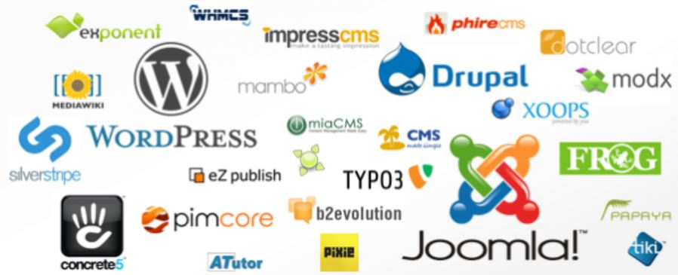
Top 3 Content Management Systems (CMS)
Image Source: http://easishare.com

Slide 29
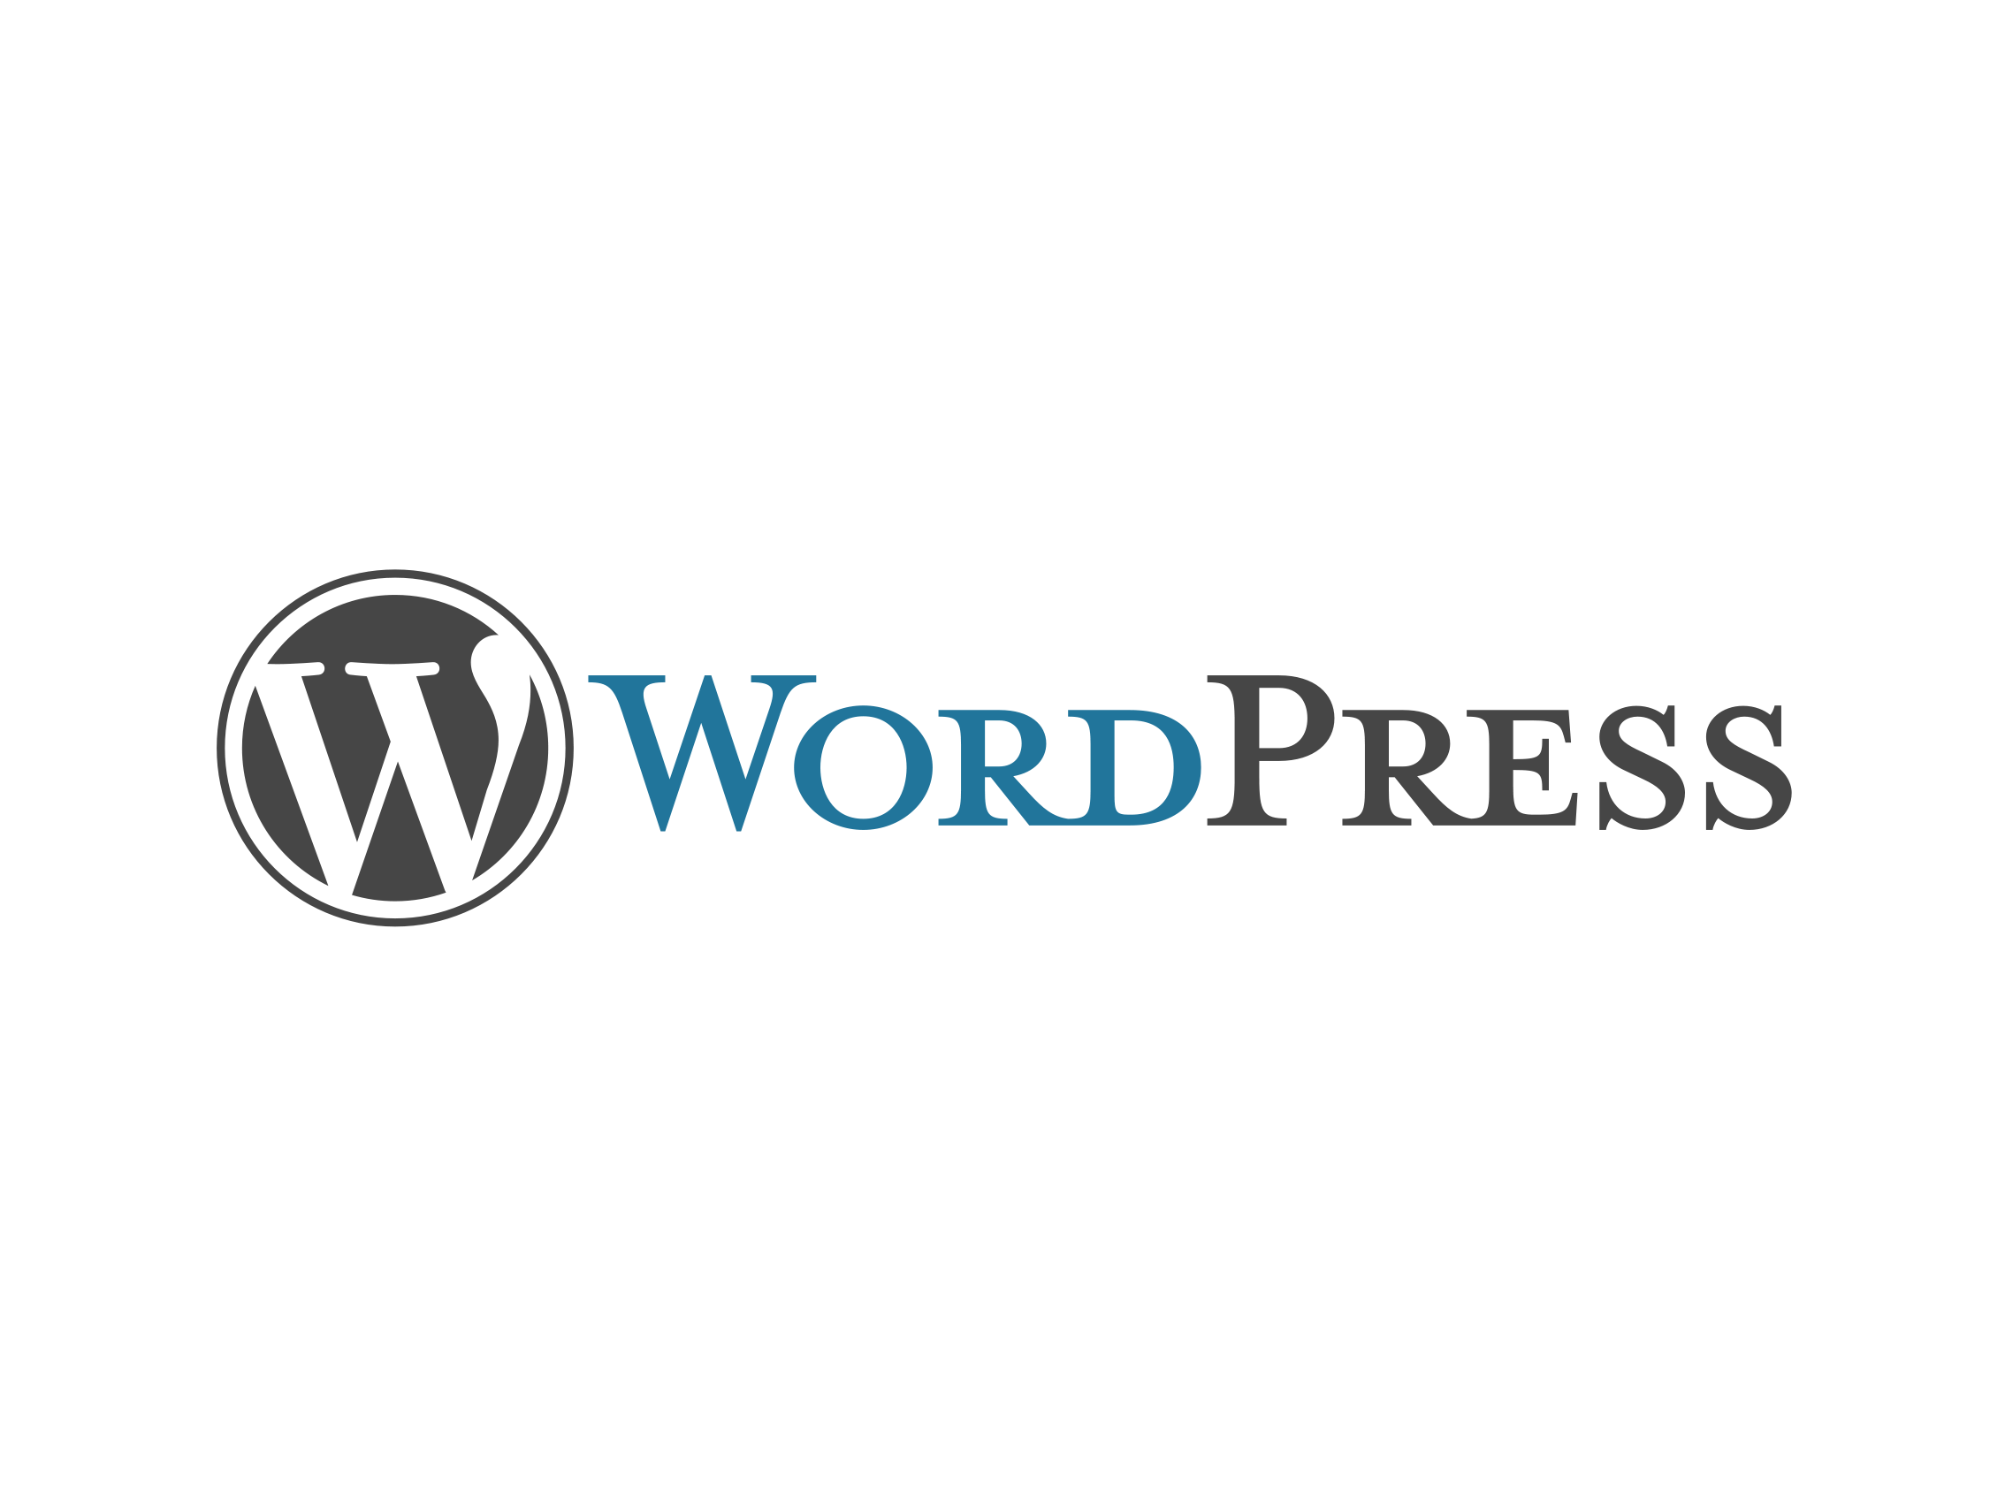
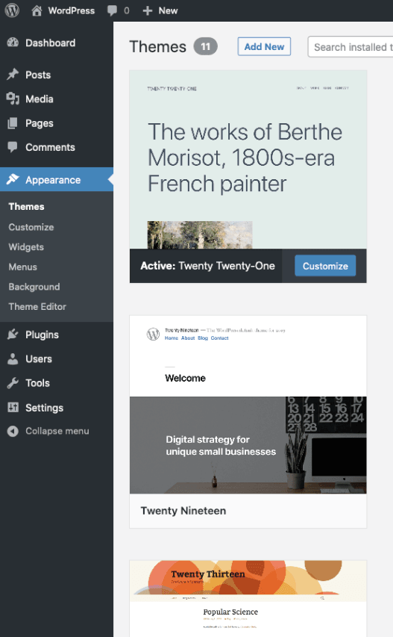
More than one-third of the entire Internet is powered by WordPress. This platform is the most popular content management system in the world. It’s trusted by 60+ million people across the globe.
For beginners and experienced users alike, WordPress has all of the tools users need to create, edit, manage, and publish content on the web.
As a free and open-source CMS, WordPress can be customized to meet the needs of any type of website. Just browse from 55,000+ plugins to add functionality to their site.
Image Source: http://worpress.com

Slide 30
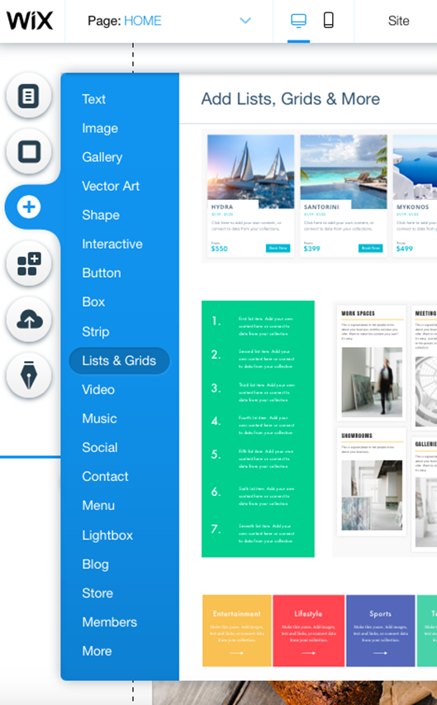
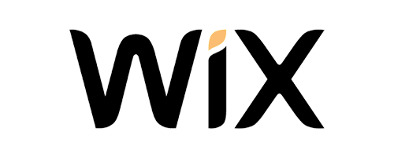
Wix is branded as a website builder. It’s not quite the same as a traditional CMS system, but it does have components and applications that function for content management.
For beginners that want an all-in-one solution for creating a website from scratch, Wix will be a top choice to consider. With Wix, you can create a website, edit your content, and publish everything on the web without writing a single line of code.
Even if user don’t have any design or development skills, they can build a Wix website in minutes.
Image Source: http://wix.com

Slide 31
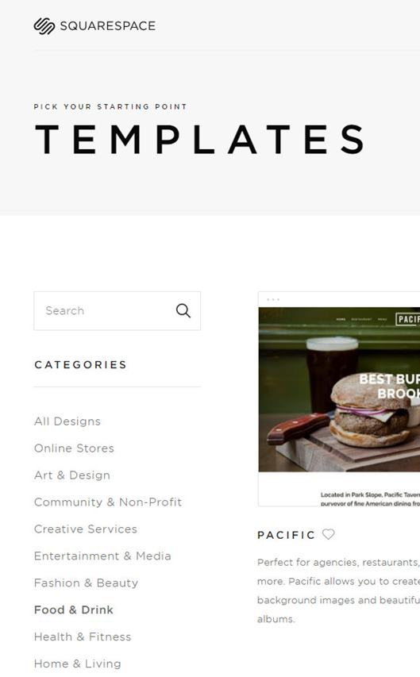
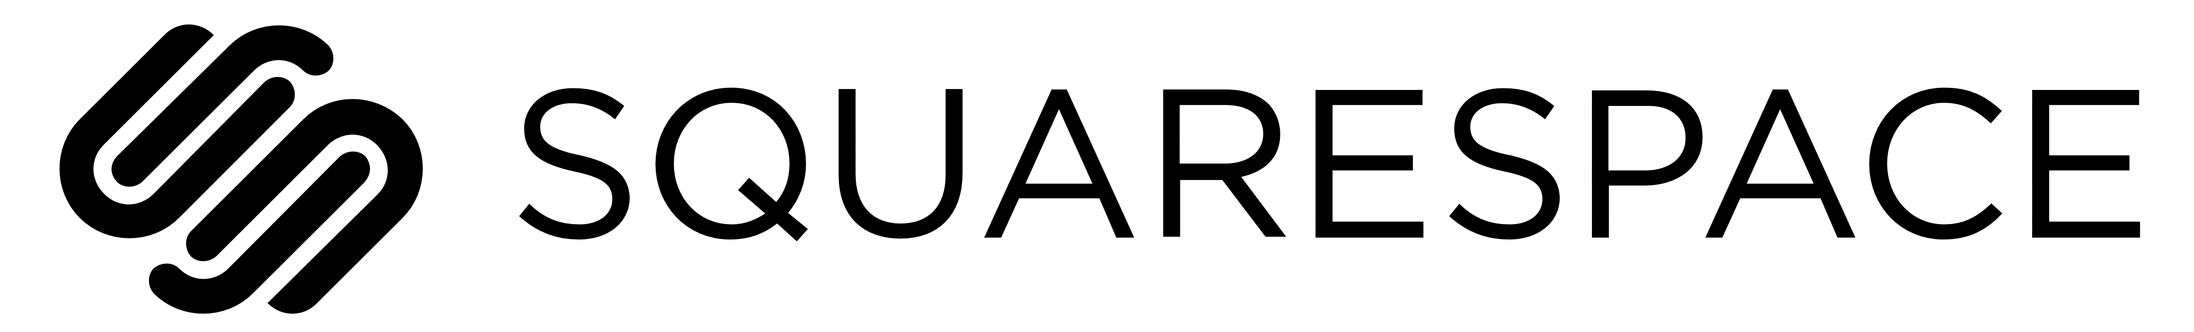
Squarespace is another website builder that’s perfect for beginners or anyone who doesn’t want to code from scratch. The platform is known for its beautiful designs, making it a top choice for people creative professionals.
Photographers, musicians, designers, artists, and anyone with a creative portfolio are all viable candidates for this CMS platform.
In addition, Squarespace has the flexibility to meet the needs of other sites too, including restaurants, online stores, professional services, and more.
Image Source: http://squarespace.com

Slide 32
References
Maulina E., PROBLEMS AND SOLUTIONS OF CREATIVE INDUSTRY IN INDONESIA: A CRITICAL AND REFLECTIVE REVIEW, Business Administration Studies, Faculty of Social and Political Sciences, University of Padjadjaran, Indonesia 2018

