Slide 1

INTRODUCTION TO INFORMATION TECHNOLOGY II
Week 5
Mobile Application for innovative and creative uses
Riovan Styx Roring, S.T., M.Kom

Slide 2
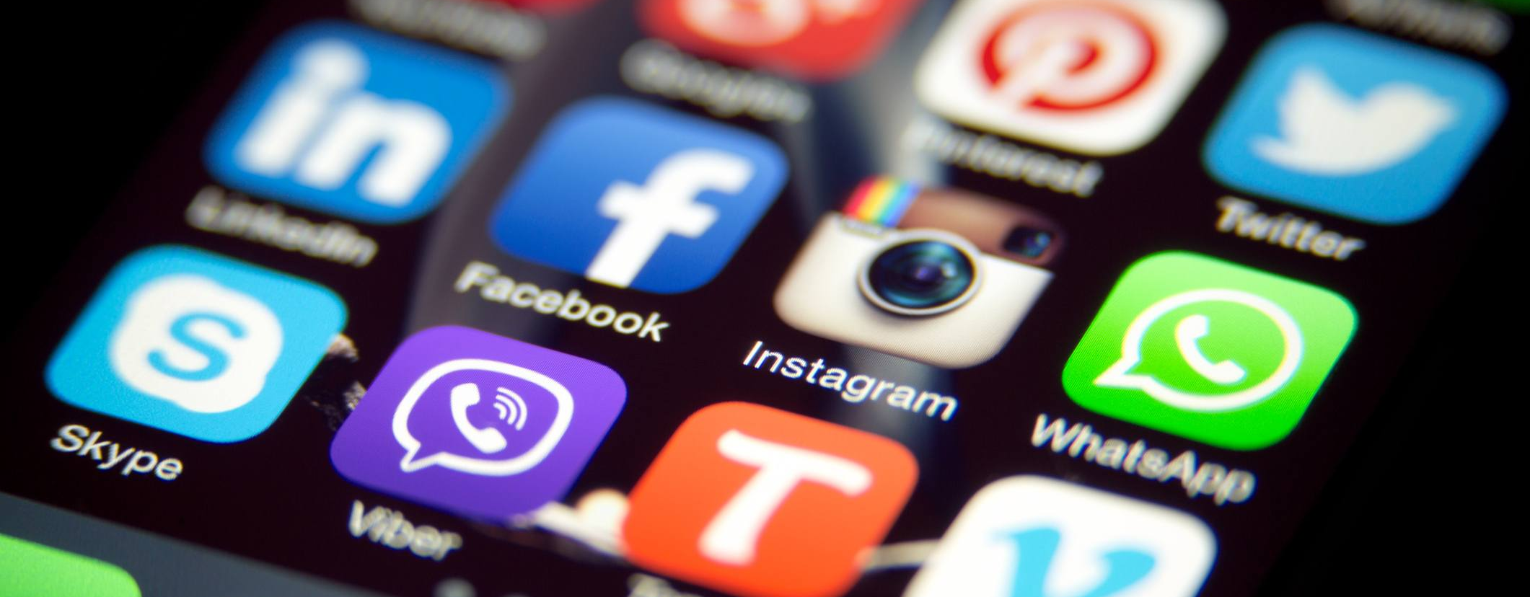
Mobile Application
The rise of technology is one of the reason why people can receive and exchange information faster
Image Source: http://appuneed.com

Slide 3
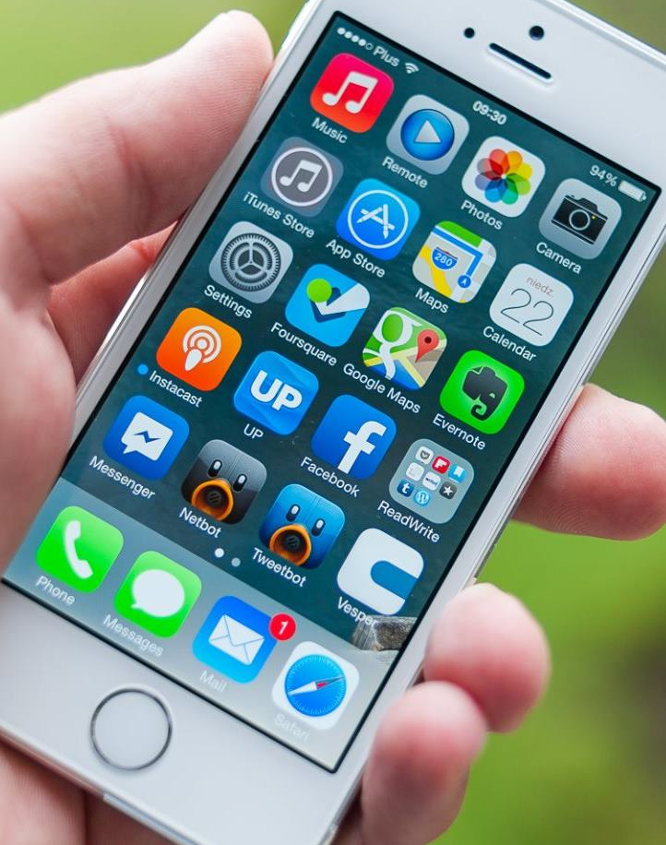
Mobile Application
A mobile application is a type of application designed to run on a mobile device, which can be a smartphone or tablet computer. Even if apps are usually small software units with limited function, they still manage to provide users with quality services and experiences.
Because of the limited hardware resources of the early mobile devices, mobile apps avoided multi-functionality. However, even if the devices used today are far more sophisticated, mobile apps remain narrowly functional. This is how mobile app owners allow consumers to handpick exactly the functions their devices should have.
Image Source: http://stockimage.com

Slide 4

History of mobile app
1948
Tom Kilburn create first electronically computer program
1978
Dan Bricklen created VisiCalc for Aplle II using an assembler language
1994
The first ever smartphone was launched by IBM called Simon
2007
More recognizable mobile apps launched together with the first iPhone
Image Source: http://wikipedia.com

Slide 5

1948 - Small-Scale Experimental Machine
Small-Scale Experimental Machine (SSEM), was the first electronic stored-program computer. It was built at the University of Manchester by Frederic C. Williams, Tom Kilburn, and Geoff Tootill, and ran its first program on 21 June 1948.
The Baby was not intended to be a practical computing engine, but was instead designed as a testbed for the Williams tube, the first truly random-access memory, as soon as the Baby had demonstrated the feasibility of its design, a project was initiated at the university to develop it into a full scale operational machine, the Manchester Mark 1. The Mark 1 in turn quickly became the prototype for the Ferranti Mark 1, the world's first commercially available general-purpose computer.
Image Source: http://wikipedia.com

Slide 6
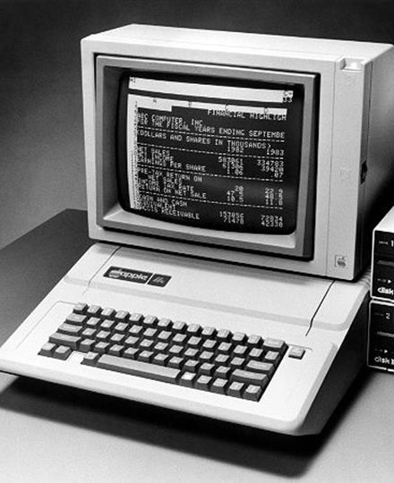
1978 – Visible Calculator (VisiCalc)
Visible calculator (VisiCalc) is the first spreadsheet computer program for personal computers, originally released for Apple II by VisiCorp in 1979. Initially developed for the Apple II computer using a 6502 assembler running on the Multics time sharing system, VisiCalc was ported to numerous platforms, both 8-bit and some of the early 16-bit systems. In order to do this, the company developed porting platforms that produced bug compatible versions. The company took the same approach when the IBM PC was launched, producing a product that was essentially identical to the original 8-bit Apple II version. Sales were initially brisk, with about 300,000 copies sold.
Image Source: http://wikipedia.com

Slide 7
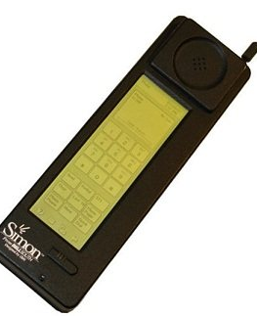
1994 – IBM Simon
The IBM Simon Personal Communicator (simply known as IBM Simon) is a handheld, touchscreen PDA designed by International Business Machines (IBM), and manufactured by Mitsubishi Electric. Although the term "smartphone" was not coined until 1995, because of Simon's features and capabilities, it has been retrospectively referred to as the first true smartphone.
BellSouth Cellular Corp. distributed the IBM Simon in the United States between August 1994 and February 1995, selling 50,000 units. The Simon Personal Communicator was the first personal digital assistant or PDA to include telephony features (make phone calls). The battery lasted only an hour, and flip phones became increasingly slim which led to its demise.
Image Source: http://wikipedia.com

Slide 8
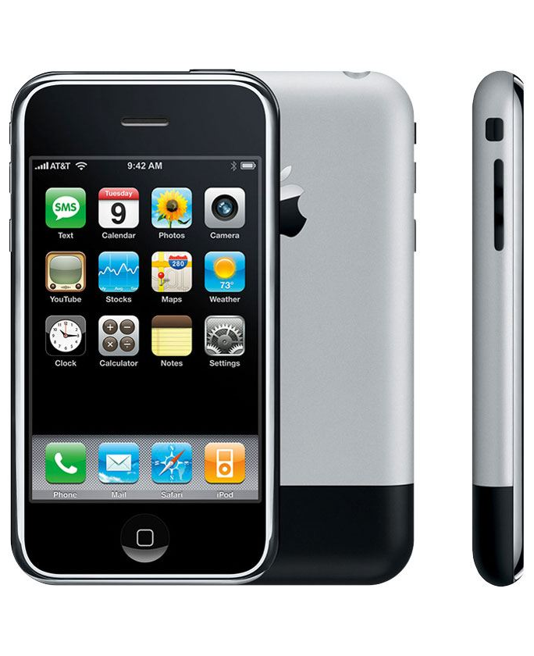
2007 – iPhone 1
The iPhone is the first smartphone designed and marketed by Apple Inc. it was officially announced on January 9, 2007, and was released in the United States on June 29, 2007.
Development of the iPhone as a product began in 2005 and continued in complete secrecy until its public unveiling. The iPhone quickly became Apple's most successful product.
The introduction of the App Store allowed established companies and startup developers to build careers and earn billions of dollars via the platform, while providing consumers with new ways to access information and connect with other people.
Image Source: http://wikipedia.com

Slide 9

Key mobile app development technologies
Native App
Advanced UI interaction
Fastest Performance
Web App
Instant Update
Unrestricted Distribution
Hybrid App
Access To Native Platform
App store distribution
App Store Distribution
Image Source: http://stockpng.com

Slide 10



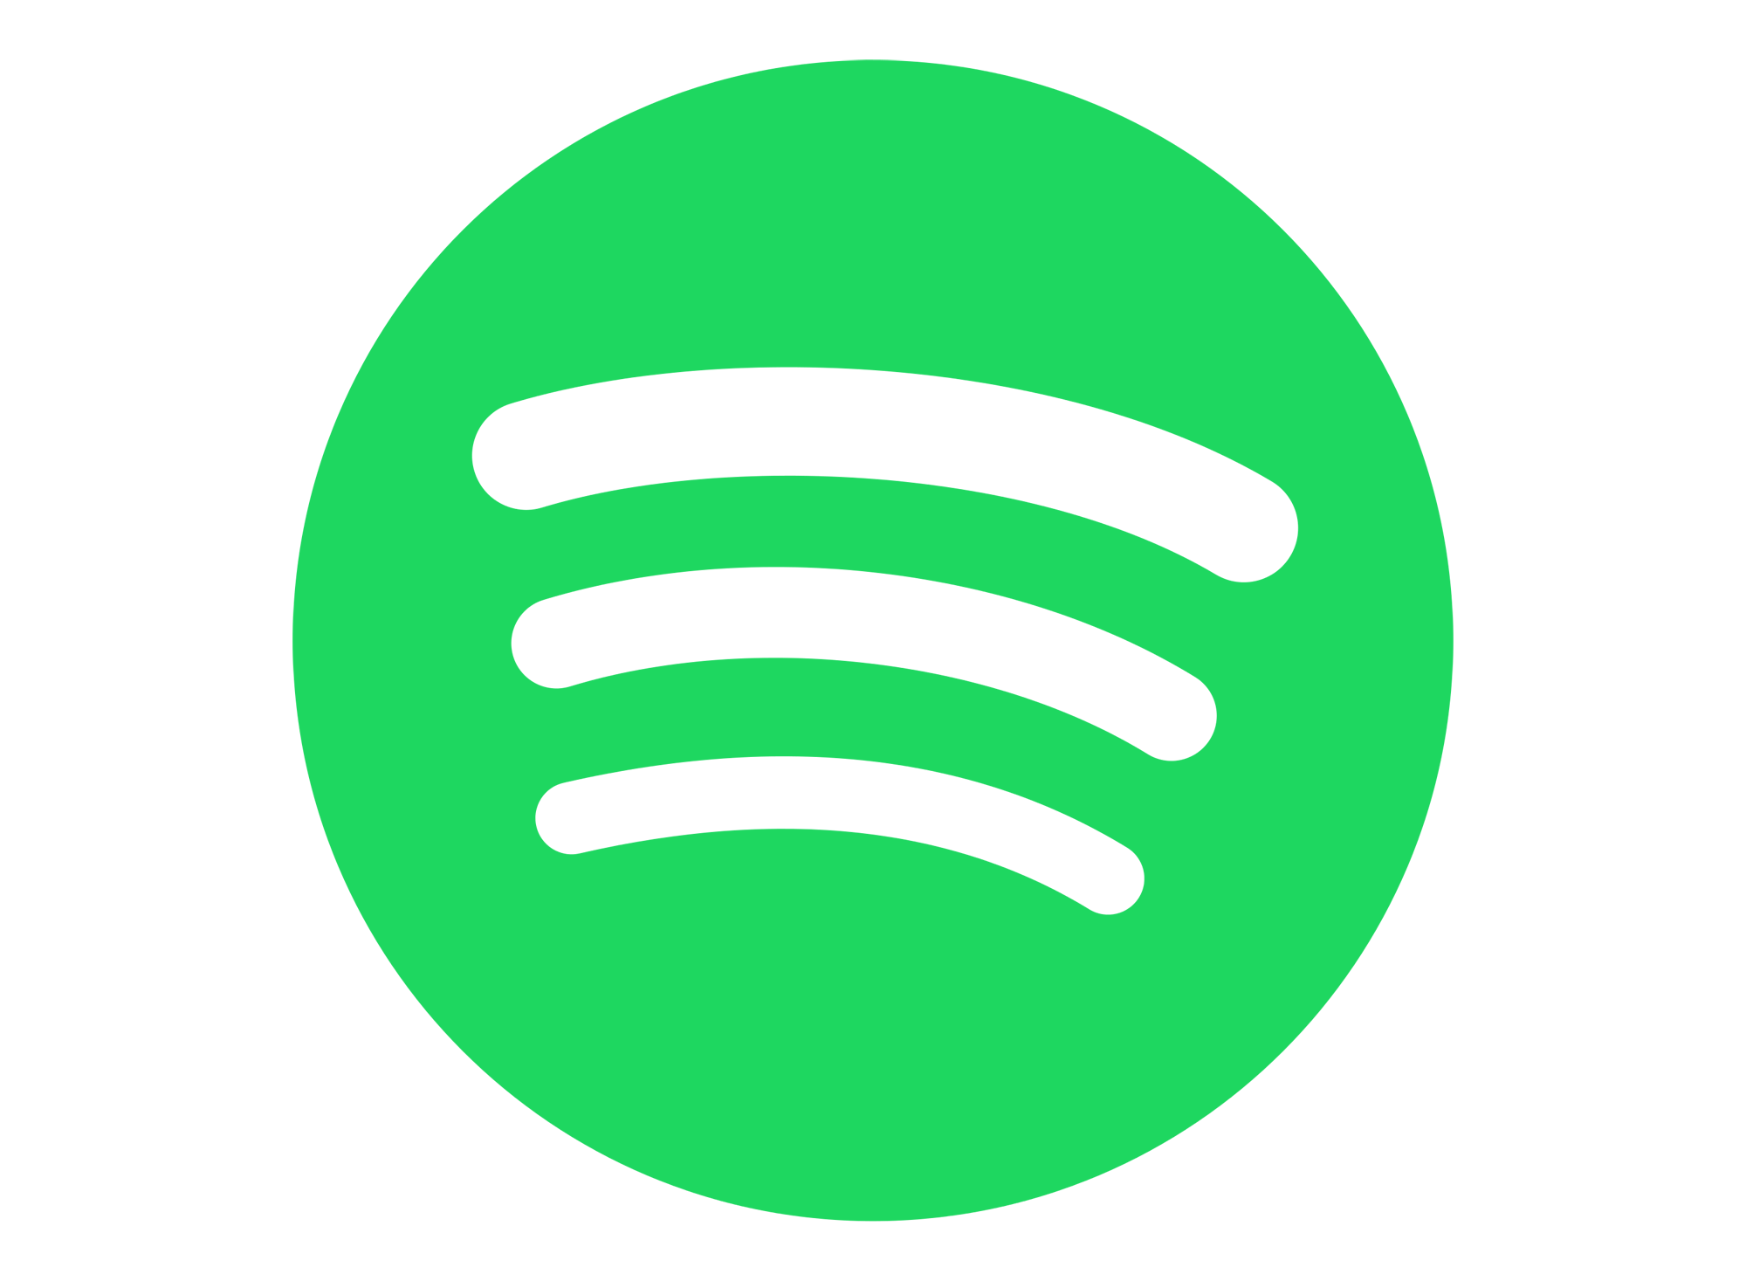

Native Application
Native apps are build for a single mobile operating system. That’s why they’re called native – they’re native to a particular platform or device. The majority of mobile apps today are built for systems like Android or iOS. To put it simply, you can’t install and use an Android app on iPhone, and vice versa.
The main benefit of native apps is their high performance and excellent user experience. After all, developers who build them use native device UI. Access to a broad range of APIs also helps to accelerate the development work and extend the boundaries of app usage. Native applications can only be downloaded from app stores and installed directly into devices.
Example
WhatsApp
Spotify
Waze
Image Source: http://pngicon.com

Slide 11
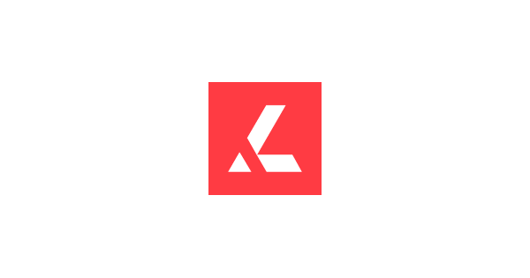

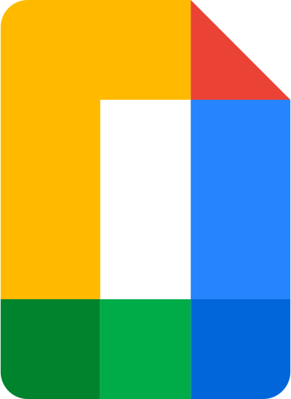
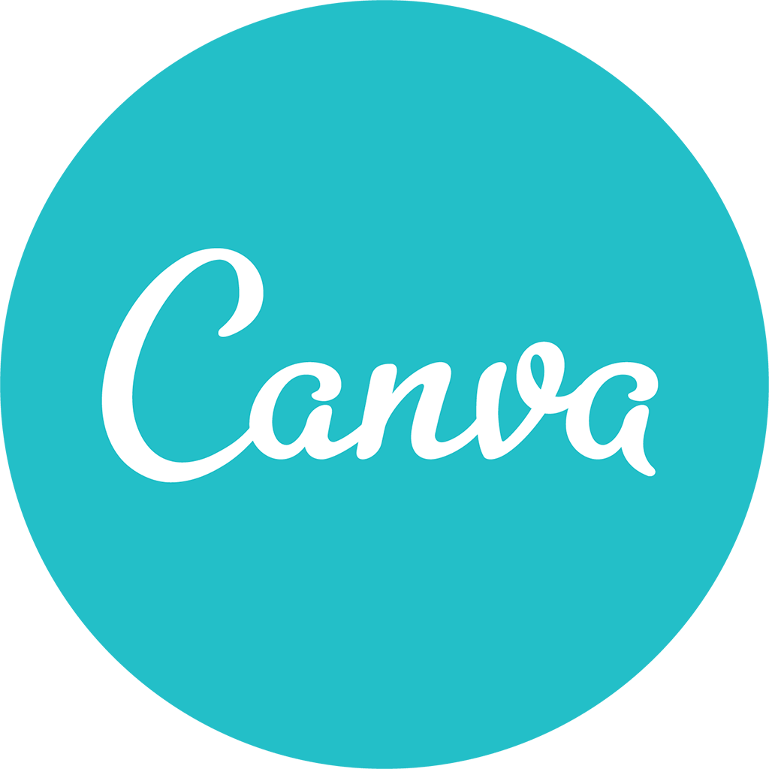
Web Application
Web apps are software applications that behave similarly to native mobile apps and work on mobile devices. However, there are significant differences between native apps and web apps. For starters, web apps use browsers to run, and they’re usually written in CSS, HTML5, or JavaScript. Such apps redirect the user to the URL and then offer them the option to install the app. They simply create a bookmark on their page. That’s why they require minimum device memory.
Since all of the personal databases will be saved on the server, users can only use the application if they have an internet connection. This is the main drawback of web apps – they always require a good internet connection. Otherwise, you risk delivering a subpar user experience.
Example
Google Doc Editor
Canva
Lumin PDF
Image Source: http://pngicon.com

Slide 12




Hybrid Application
Hybrid apps are built using web technologies such as JavaScript, CSS, and HTML 5. Hybrid apps basically work like web apps disguised in a native wrapper.
Hybrid apps are easy and fast to develop, which is a clear benefit. Users also get a single codebase for all the platforms. This lowers the cost of maintenance and streamlines the updating process. Developers can also take advantage of many APIs for features such as gyroscope or geolocation.
On the other hand, hybrid applications may lack speed and performance. Also, you might experience some design issues as the app might not look the same on two or more platforms.
Example
Instagram
Twitter
Uber
Image Source: http://pngicon.com

Slide 13

Most common Programming Language for mobile app development
JavaScript
Kotlin
Python
C++
C#
The demand for mobile applications has been on a steady rise ever since the smartphone was invented. Now developer need to focus on choosing the right technology, the right programming language, and the right UX design tools to create a robust, innovative and user-friendly app for their business needs.
With several mobile programming languages to choose from, they have to consider multiple factors, pros, and cons, as well as the popularity of the language, before making thier decision to build the most popular mobile app. Here are the most common programming language for mobile app develompmnet
Image Source: http://pngicon.com

Slide 14
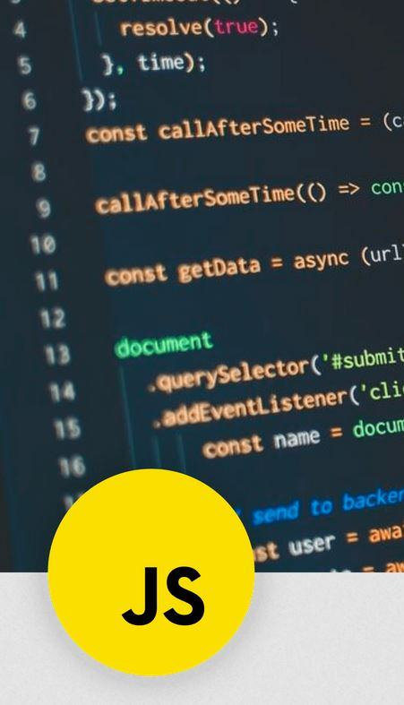
JavaScript
JavaScript is best for cross-platform app development, mobile apps used for various platforms, and web browsing. It smoothly runs in other environments, outside of browsers, and can be compiled from a wide array of programming languages.
JavaScript Pros
Clean, concise, and perceptive syntax increases team efficiency.
Interoperable and versatile and can easily overrule the shortcomings of JAVA.
JavaScript Cons
vulnerable and can be exploited for malicious purpose in some cases .
encounter some browser support issues.
Server-side scripts always provide the same output
Image Source: http://jscript.com

Slide 15
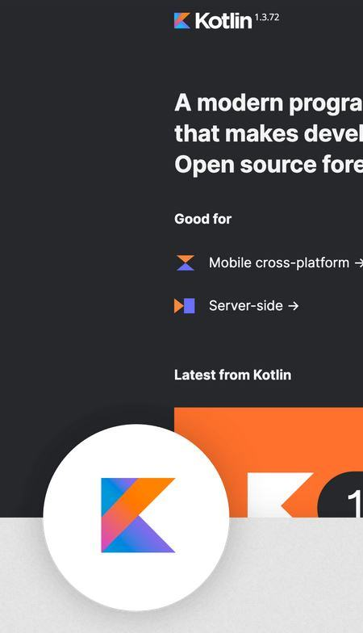

Kotlin
Kotlin is a statistically typed programming language used for developing modern Android applications. Kotlin is a really best language for apps. Kotlin has the potential to influence other programming languages such as JAVA to make high-performing and robust apps. Some popular apps built-in Kotlin are Trello, Evernote, Coursera, and many more.
Kotlin Pros
Faster on the client-side browsing and don’t need to be compiled.
Straightforward to work with and easy to control.
No set standard and plenty of room for variation.
Kotlin Cons
Still a new language in the market so hard to learn, so, think before you choose it .
Sometimes gets slower.
There are limited resources for learning.
Image Source: http://kotlin.com

Slide 16
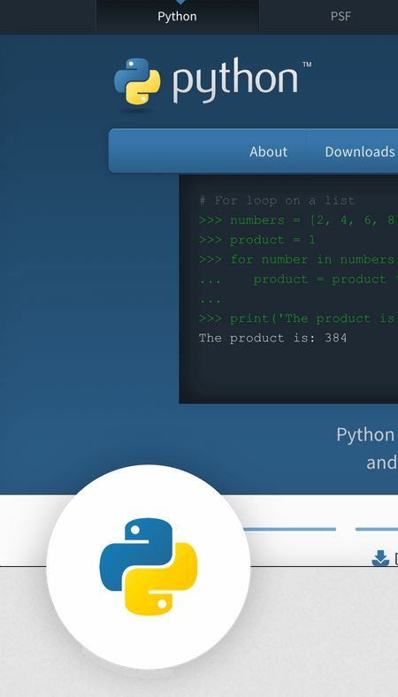

Python
Python is used for developing web applications, desktop apps, media tools, machine learning, network server, and more. Examples of Python are YouTube, Instagram, and Pinterest. The language provides excellent library support, robust integration, and enhanced control capabilities.
Python Pros
Fast, easy-to-use, quick to deploy, easy to learn, and excellent at readability.
Supports multiple systems and platforms.
Has huge-set of frameworks which programming flexible.
Python Cons
vulnerable and can be exploited for malicious purpose in some cases .
encounter some browser support issues.
Server-side scripts always provide the same output
Image Source: http://python.com

Slide 17
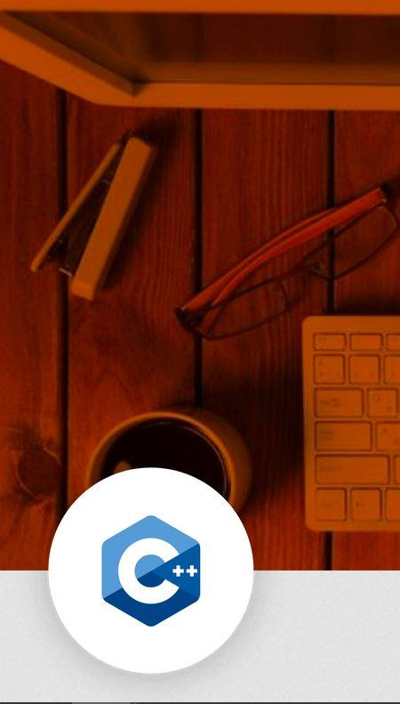
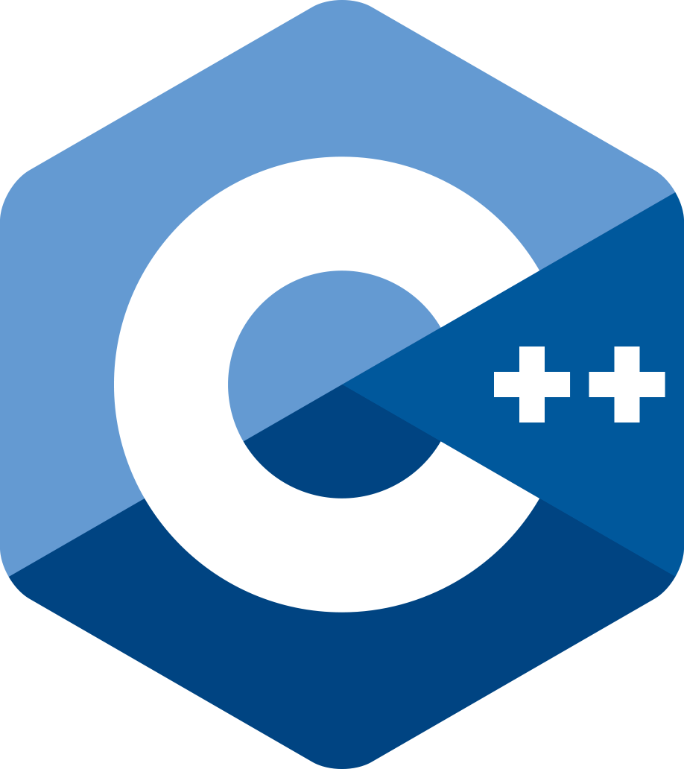
C++
C++ is considered to be an upstanding choice for mobile app development. It is a general-purpose, object-oriented language with generic and low-level memory manipulation features. Used for Android App and Native app development, C++ is used for developing games, GUI-based applications, real-time mathematical simulations, banking apps, etc. C++ is popular with Cloud computing apps as it can quickly adapt to changing hardware or ecosystems.
C++ Pros
Fast and stable and has in-built libraries and compilers.
Users can quickly learn JAVA C#.
No garbage collector is running in the background.
C++ Cons
Complex syntax, small standard library.
Most complicated programming language to master.
Cannot support garbage collection or dynamic memory allocation.
Image Source: http://imagestock.com

Slide 18
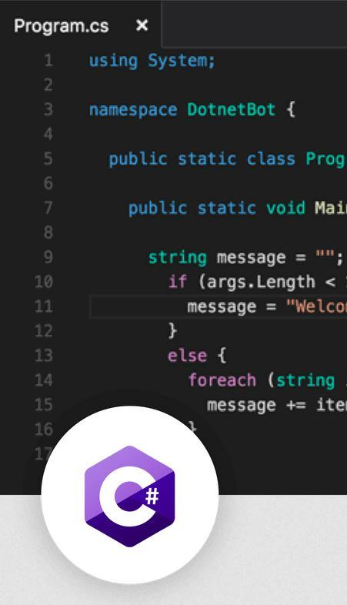
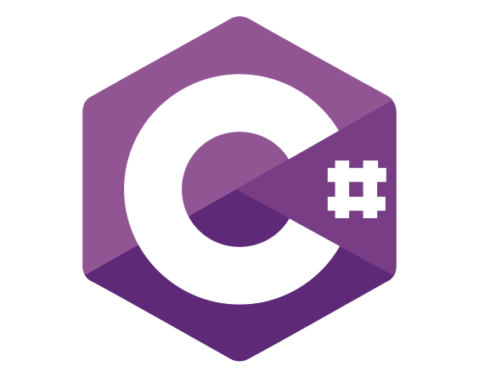
C#
Pronounced as ‘C-sharp’ – this is another object-oriented, general-purpose programming language extensively used for mobile development, majorly for cross-platform and windows app development. C# has everything users want to achieve using other programming languages such as Swift, Objective-C, and JAVA programming languages.
C# Pros
Fast, easy-to-use, and quick to deploy
Simple, modern, and general-purpose language
Most preferred programming language
C# Cons
Intricate and complex language for fresh learners
Case-sensitive language and creates confusion even if there is a slight miss-match between even alphabets
Image Source: http://imagestock.com

Slide 19
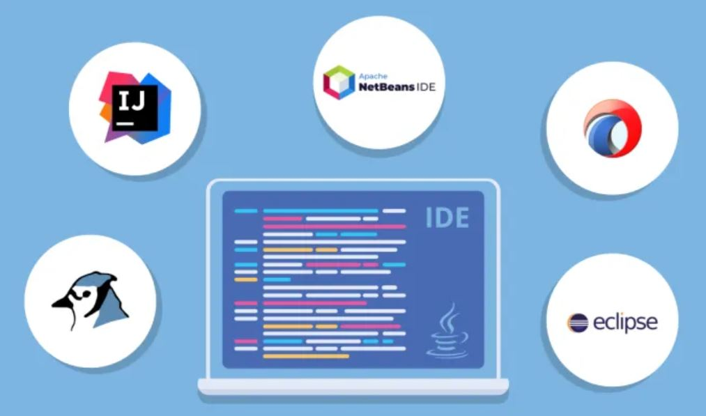
Integrated Development Environment (IDE)
Image Source: http://slidestock.com

Slide 20
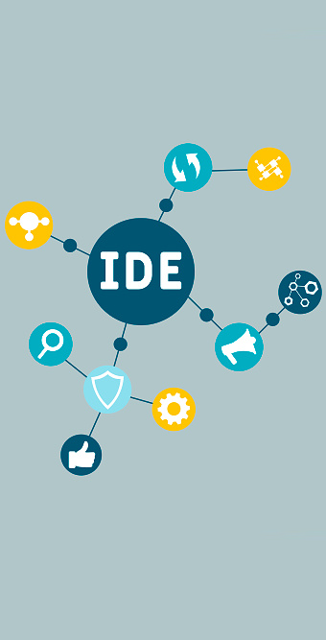
Integrated Development Environment (IDE)
An Integrated Development Environment (IDE), is software designed to streamline the development of other programs. It primarily provides developers with all of their programming needs together with a central interface in one platform.
Tools such as code editors, compilers, debuggers, and build automation apps are included in IDEs. Additionally, some of the more comprehensive IDE options today can also have class browsers, object browsers, and class hierarchy diagrams.
Many years ago, developers had to write their programs using text editors, which can be troublesome and time-consuming to do. Today, Integrated Development Environment facilitates the process of creating programs and makes it easier for programmers to create software.
Image Source: http://imagestock.com

Slide 21
Integrated Development Environment (IDE) [cont..]
Increased setup speeds and accessibility
Improved programming productivity
Software developers need time to set up the various development tools individually if they aren’t using an IDE. With an IDE interface, these programmers don’t have to configure each of their tools and can access them from one place.
Since all development needs are found in a single location, development tasks can be accomplished at a tighter pace resulting in increased productivity. For instance, it’s possible for programmers to write code while checking their syntax to check for errors immediately.
Main Benefits of Integrated Development Environments (IDE)
Standardized procedures
Continuous learning
One major advantage that Integrated Development Environments bring to the table is that they help standardize the overall development process for programmers. This means that they can work seamlessly with other team members through its collaborative features.
Programmers have the benefit of continuously teaching themselves the latest trends in programming by leveraging the help topics provided by many IDEs. Being able to stay updated on the best practices allows them to continue to add value to their team.

Slide 22
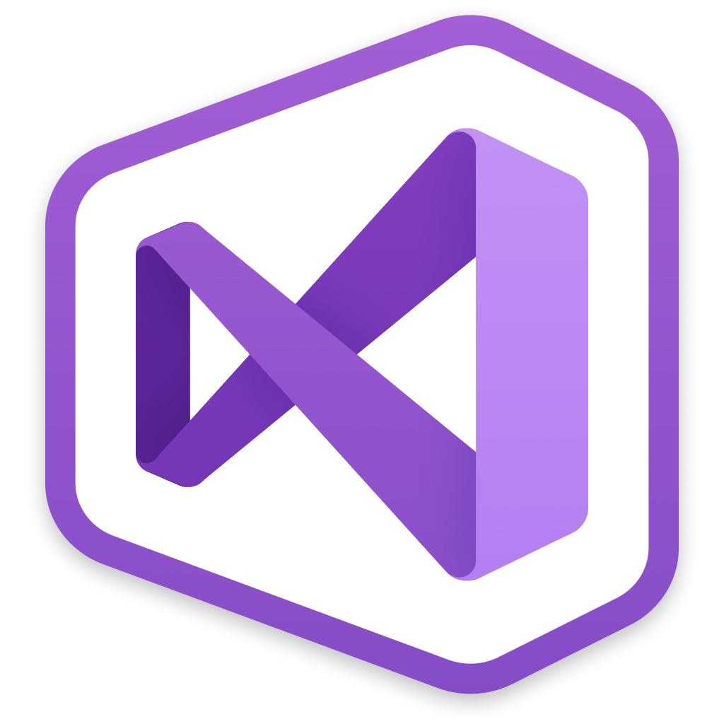


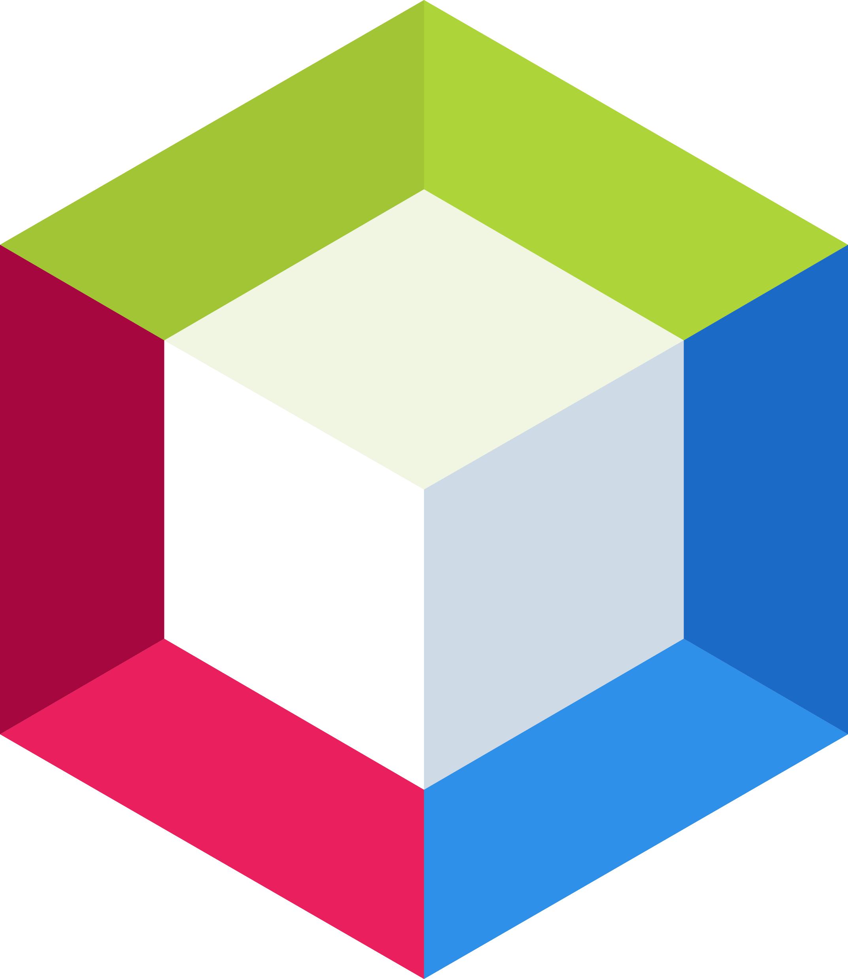
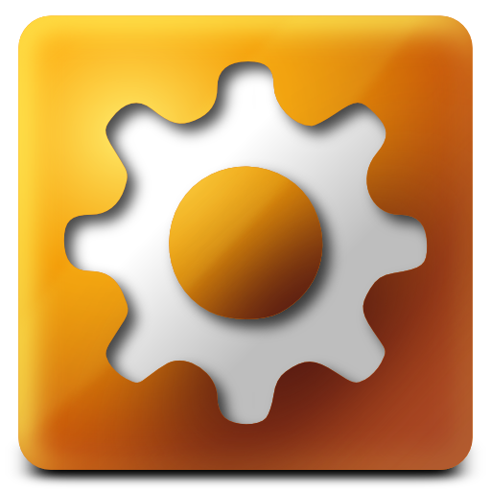
Best IDE for Web Development
Visual Studio IDE
Python
Node.js
C++
Unity
Android Studio
Kotlin
Java
C#
Python
IntelliJ IDEA
SQL
JavaScript
Groovy
Scala
NetBeans
PHP
HTML 5
CSS
Java
Aptana Studio 3
HTML
CSS
JavaScript
Image Source: http://pngicon.com

Slide 23
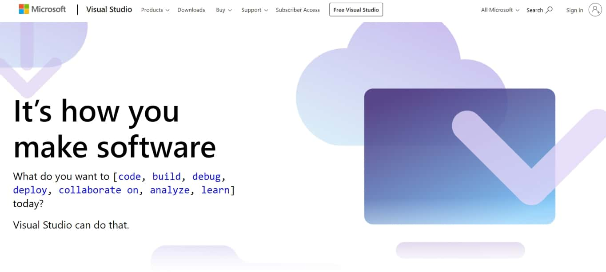

Visual Studio IDE is one of the most popular and best IDE web development options available. It uses AI to learn from users edits as they code so it can finish their sentences – er, lines of code.
On top of that, users can collaborate with their team, live, when you’re editing and debugging. You can also share servers, terminals, and comments.
Visual Studio supports web, mobile, app, and game development, ASP.NET, Python, Node.js, C++, Unity as well as support for Azure.
Image Source: http://pngicon.com

Slide 24
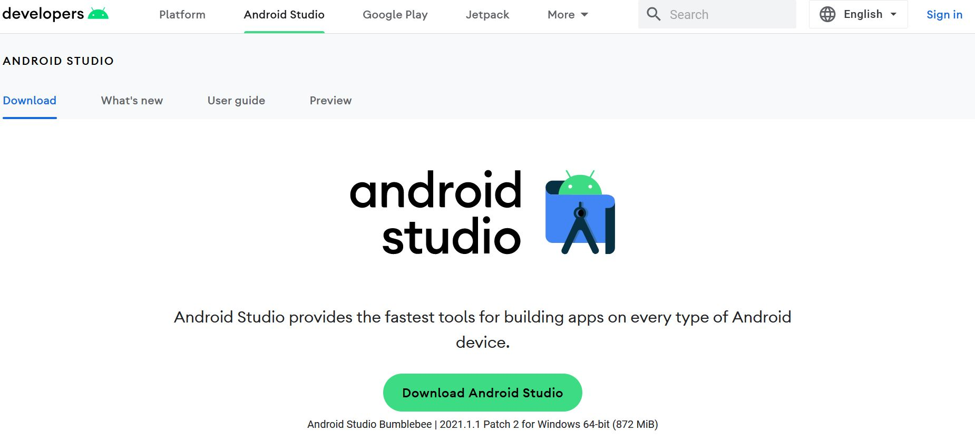
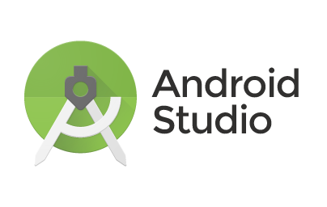
Android Studio is the official Integrated Development Environment (IDE) for android application development. Android Studio provides more features that enhance users productivity while building Android apps.
Android Studio was announced on 16th May 2013 at the Google I/O conference as an official IDE for Android app development. It started its early access preview from version 0.1 in May 2013. The first stable built version was released in December 2014, starts from version 1.0.
Since 7th May 2019, Kotlin is Google's preferred language for Android application development. Besides this, other programming languages are supported by Android Studio.
Image Source: http://pngicon.com

Slide 25
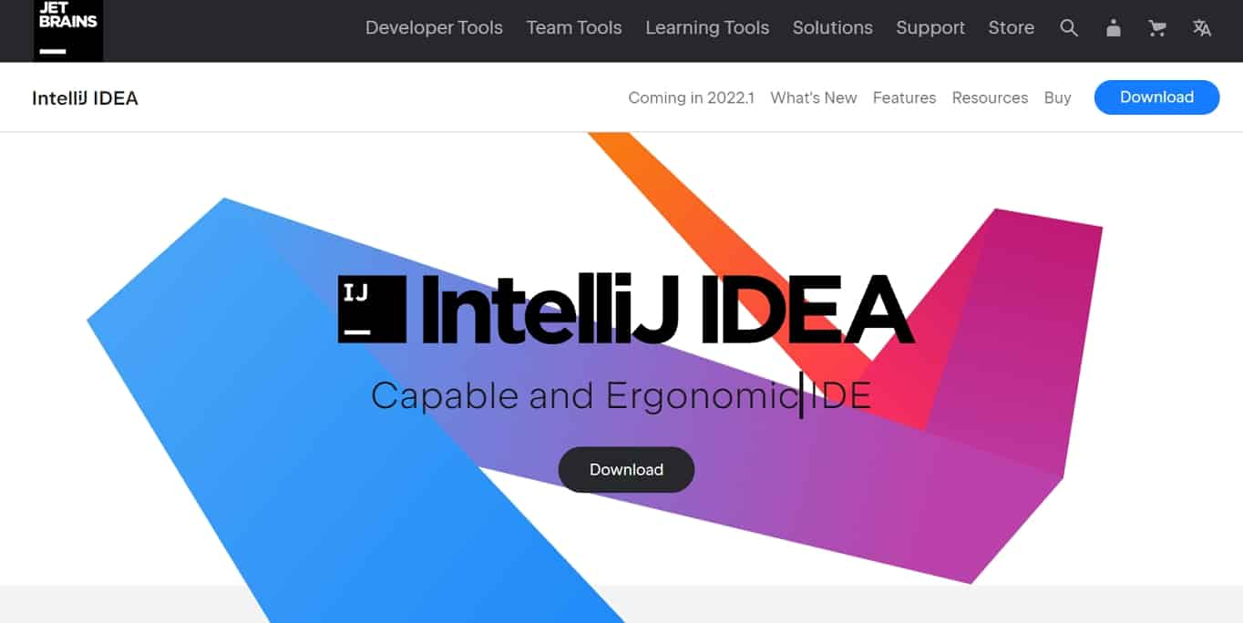

IntelliJ IDEA is an Integrated Development Environment (IDE) for JVM languages designed to maximize developer productivity. It does the routine and repetitive tasks for users by providing clever code completion, static code analysis, and refactorings, and lets them focus on the bright side of software development, making it not only productive but also an enjoyable experience.
Image Source: http://pngicon.com

Slide 26
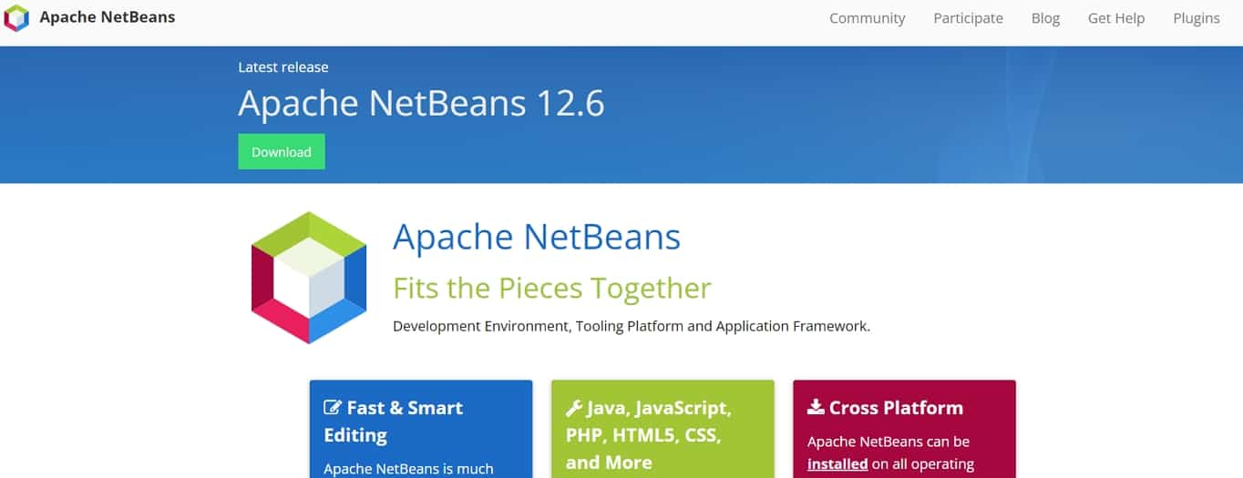
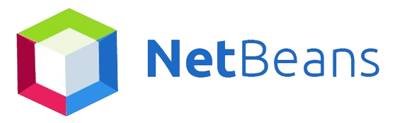
An Integrated Development Environment (IDE) for any programming language which allows applications to be developed and modified is called NetBeans. Modules are a set of software modular components. Windows, MacOS, Linux and Solaris allows NetBeans to be run in their system. It is written in Java and developed by Apache Software Foundation and Oracle Corporation. This is open source and allows Java desktop applications to be written in the IDE. Any development of web, enterprise, desktop and mobile applications can be developed in NetBeans IDE. Other than Java, it supports C, C++, XML, HTML, PHP, Groovy and scripting languages.
Image Source: http://pngicon.com

Slide 27
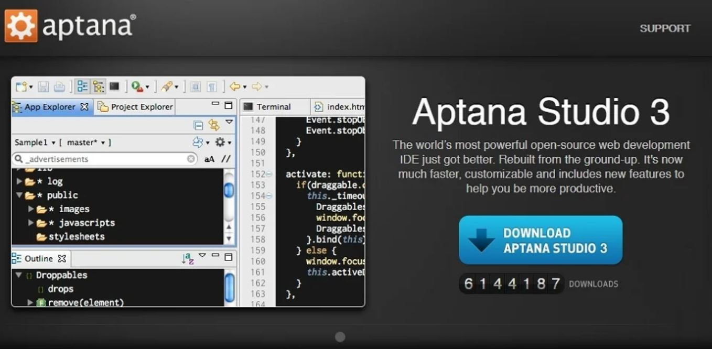
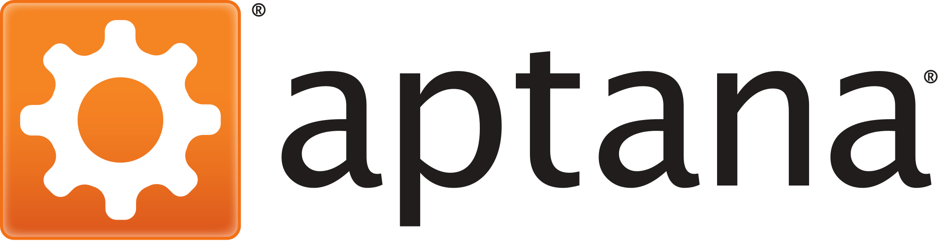
Aptana Studio 3 is one of the best IDE web development options available and it’s also open source.
Users can customize the GUI, it has a built-in terminal, Git integration, a debugger as well as a deployment wizard. Autocomplete is also available for HTML, CSS, and JavaScript.
Image Source: http://pngicon.com

Slide 28
Types of mobile applications
EDUCATIONAL APP
mobile apps that help users gain new skills and knowledge. Educational game apps are an excellent tool for kids.
LIFESTYLES APP
BUSINESS APP
this broad category of apps spans shopping, fashion, virtual fitting rooms, workout, dating, and diet apps. These apps basically focus on various aspects of personal lifestyle.
M-Commerce app
hold a large chunk of the market today because people are increasingly prone to using their smartphones to perform complex tasks on the go.
Mobile commerce applications provide customers with convenient access to products and seamless payment methods for an optimal shopping experience.
Entertainment app
GAMING APP
these apps allow users to stream video content, search for events, chat, or watch content online. Social media apps like Facebook or Instagram are great examples.
the most popular category of mobile apps. The most successful mobile games like Candy Crush Saga or Angry Birds become known all over the world.
03
04
02
UTILITY app
05
utility apps usually have the shortest user session times – people use them to get things done and then move on.
01
06
07

Slide 29

Conclusion
Creativity is quickly becoming one of the most highly valued traits of the 21st century. Given its increasing importance, some might be wondering whether there is anything they can do to foster their creativity. One tool we all have at our disposal but perhaps don’t always use as effectively as we could is technology.
Although technology is sometimes viewed as an unwelcome distraction in educational settings and the workplace, it also has huge potential to help people think in new ways and stumble on original ideas.
Image Source: http://showeet.com
Notes:
© Copyright Showeet.com – Creative & Free PowerPoint Templates

Slide 30
Conclusion [cont..]
Mobile phone with its vast array of downloadable apps can give people the means to improve their creativity but only if they use them wisely, what have been laid out so far describe the complexity of how mobile application are made and also how far they have become.
It is up to each and every individuals to download what they need and use them to better themselves
Image Source: http://showeet.com
Notes:
© Copyright Showeet.com – Creative & Free PowerPoint Templates

Slide 31
References
Mesquita A., Technology for Creativity and Innovation: Tools, Techniques and Applications, ISCAP/IPP and Algoritmi Centre, University of Minho, Portugal 2011

