Slide 1

INTRODUCTION TO INFORMATION TECHNOLOGY II
Week 6
Advanced Web-based Information Technology
Riovan Styx Roring, S.T., M.Kom

Slide 2

Information Technology
Image Source: http://slideshare.com
Notes:
© Copyright Showeet.com – Creative & Free PowerPoint and Google Slides Templates

Slide 3

What is Information Technology (IT)
Information technology (IT) refers to everything that businesses use computers for. Information technology is building communications networks for a company, safeguarding data and information, creating and administering databases, helping employees troubleshoot problems with their computers or mobile devices, or doing a range of other work to ensure the efficiency and security of business information systems. Demand for professionals in this field is high and growing, and people entering the field have a range of career paths to choose from.
Image Source: http://slideshare.com

Slide 4

Advanced Technology
A technology that is still immature but promises to deliver significant value, or that has some technical maturity but still has relatively few users. Among current examples: artificial intelligence, agents, speech and handwriting recognition, virtual reality and 3D visualization, smart cards, real-time collaboration, enhanced user authentication, data mining, and knowledge management.
Image Source: http://slideshare.com
Notes:
© Copyright Showeet.com – Creative & Free PowerPoint and Google Slides Templates

Slide 5

Advanced Web-based Information
The World Wide Web and its underlying technologies are increasingly gaining importance for the development of interactive Web applications. In order to be proficient at web-based technology development one must possess the following knowledge and skills:
An understanding of development concepts and technology
The ability to express business logic in terms of data
The skill to build a dynamic user interface and content using data driven objects
The skill to extract, modify and insert data through a web interface
An understanding of the architecture of a distributed web application.
Image Source: http://slideshare.com

Slide 6
Advanced Web-based Information [cont..]
The user types in a website address to initiate the interaction. The server detects the request and sends a web page to the client. The web page sent by the server is written in programming code. The main language used is HTML. The HTML file is executed by the client and the corresponding web page becomes visible to the user.
The web page stored on the server can be a mixture of HTML and code from another language. This language could be one with reduced functionality, called a scripting language. An example is JavaScript. HTML and JavaScript are processed by the client. That is, they are used for simple web pages that are stored on the server and simply downloaded when the client requests it.
Image Source: http://slideshare.com

Slide 7

Active Server Pages on Microsoft's .NET Framework (ASP.NET)
Sometimes when people type a website address, the browser converts the address to something else. Sometimes the address changes to one ending with .aspx. When this happens users usually know that the website is an ASP one.
ASP.NET is a web development technology. It is server-side software produced by Microsoft. It can be used with VisualStudio, an integrated development environment.
Image Source: http://slideshare.com

Slide 8

Developing a web-based application
To develop a web application it is not necessary to have a client computer and a server computer connected over the internet. Instead the web server can be installed on the same PC as the web browser. The complete development of the web application can then take place and, when finished, the files can be uploaded to an external web host.
When writing programming code for a web application, one needs to conform to best practice. This includes making use of object oriented programming (OOP). The problem needs to be expressed in terms of objects. Each object is a member of a predefined class that has methods associated with it.

Slide 9
Developing a web-based application [cont..]
It is possible for several users to be interacting with the same web page at the same time. The programming code has to be able to cope. The variables used in the code that are not dependent on individual use are isolated from the variables that are specific to individual use. We refer to the specific use as a session.
The values of the session variables for a user are lost when the user ceases using the website. To overcome this, the values can be stored on the user's PC. This is referred to as a cookie. When the user revisits the website, the browser searches for the cookie and sets the variables to the values contained therein.
Image Source: http://slideshare.com

Slide 10

Security in Web-based Application
Security of any database connected to a website needs to be borne in mind. In order to restrict access to a website, a login control is provided. It requests the user to enter a username and password before allowing the user to proceed. Other steps must be taken too.
The software engineer needs to have an awareness of the activities that hackers can get up to. For example, when completing the entry on a form, a hacker could enter some text and some programming code into a field. If the web application simply concatenates strings, and makes no allowance for this malicious type of input, then the hacker can change the logic used in the web application.
Image Source: http://secu-rl.com

Slide 11
The benefits of web-based technology
More manageable
Web application development systems need only be installed on the server placing minimal requirements on the end user workstation. Maintaining and updating the system is much simpler, ny client updates can be deployed via the web server with ease.
Highly deployable
Cross platform compatibility
Due to the manageability and cross platform support deploying web applications for any platform in any type of work environment is easier. It is ideal where bandwidth is limited and the system and data is remote to the user. At their most deployable you simply need to send the user a website address to log in to and provide them with internet access.
Most web based technology are far more compatible across platforms than traditional installed software. Typically the minimum requirement would be a web browser of which there are many. (Internet Explorer, Firefox, Chrome, Safari to name but a few).
Secure live data
Larger and complex systems carry more data and have separate systems and data sources. In web based systems these systems and processes can often be consolidated by reducing the need to have separate systems.
02
03
Reduced costs
One can dramatically lower costs with the help of Web based applications due to reduced support and maintenance, lower requirements on the end user system and simplified architecture.
04
01
05

Slide 12
Problems related to web-based technology
a. DNS issues and network connectivity
b. Slow servers and loading time
c. Poorly written code
d. Lack of balancing
e. Traffic spikes
f. Specific HTML title tag
g. Failing to optimize bandwidth usage
One of the cornerstones of a successful business in today’s digital environment is ensuring that web application performance is user-friendly and runs smoothly. A well-oiled website and its applications represent the face of a company, and in an ideal scenario, they serve as a mark of reliability, innovation, and progress.
there are a number of roadblocks that companies face when developing their web applications, changing the interface of their design, or increasing the scale of their operations. Some of the most common issues include the presence of slow servers, poorly written code, and duplicate title tags.
Here are seven of the most common web application performance roadblocks

Slide 13
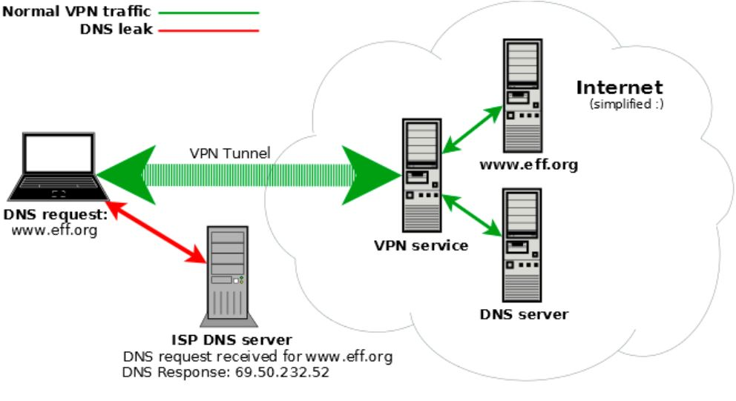
a
DNS issues and network connectivity
Solution
The best way to tackle these issues is by implementing DNS monitoring safeguards to identify what’s causing them.
An essential element of successful web traffic management is DNS queries, which is why an issue with these systems can result in a plethora of issues. Without the proper protection, faulty DNS queries can prevent visitors from reaching their website, while also causing errors, 404s, and incorrect pathways. In a similar vein, network connectivity and an efficient firewall are key parts of their site’s access and productivity.
Image Source: http://dnsleaktest.com
Notes:
© Copyright Showeet.com – Creative & Free PowerPoint and Google Slides Templates

Slide 14
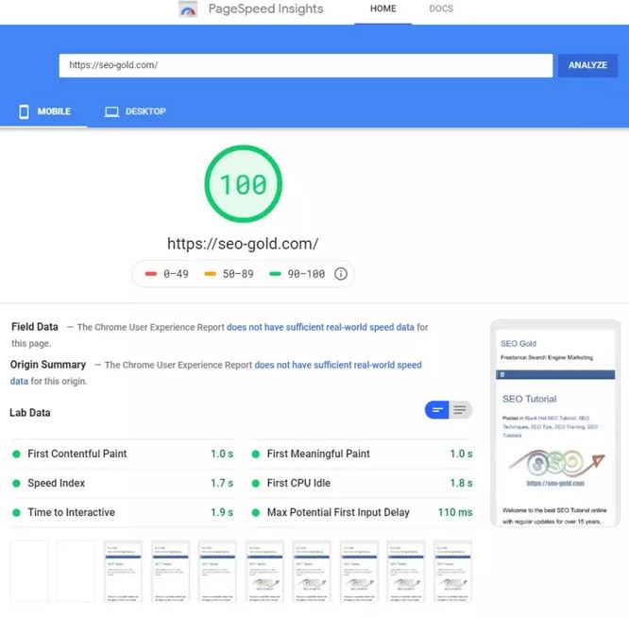
b
Slow servers and loading time
If people’s servers are particularly slow, they could be hosted using a shared account, which means that their site is sharing the server with hundreds, possibly thousands of other websites. They can address this common roadblock by checking with their hosting company to determine whether or not the site is hosted on a dedicated server. If it isn’t, they can request this service, but it may come at an additional price.
Solution
If users hoping to see just how slow their site is, go to Google and use its PageSpeed Insights tool. All they have to do is enter their domain name and click Analyze.
Image Source: http://pagespeed.com
Notes:
© Copyright Showeet.com – Creative & Free PowerPoint and Google Slides Templates

Slide 15
c
Poorly written code
Another web application performance problem that many face is with poorly written code, which could refer to inefficient code, memory leaks, or synchronization issues. Their application could also deadlock due to ineffectual algorithms, as well as the performance degradation of a web application. Old versions of software or integrated legacy systems can also take a toll on your website’s performance.
Solution
Users can tackle this issue by ensuring that their developers are using the optimal coding practices, as well as some automated tools such as profilers and code reviews.
Notes:
© Copyright Showeet.com – Creative & Free PowerPoint and Google Slides Templates

Slide 16
d
Lack of balancing
Slow response times can also be caused by poor load distribution. When new site visitors are assigned incorrectly, it can drown out users servers even if the system is under capacity. Such an issue can cause a slow response time, especially if their site is receiving too many requests.
Solution
Tools such as NeoLoad and AppPerfect help users find infrastructural weaknesses that they may be experiencing, while also testing problem areas. They should also work on a cluster of servers instead of simply having a single server that takes all the load. Service-oriented architecture (SOA) can help with scalability issues when more servers are added. This design tool causes application components to provide services to the site’s other components through the communication protocol.
Notes:
© Copyright Showeet.com – Creative & Free PowerPoint and Google Slides Templates

Slide 17
e
Traffic spikes
Spikes happen, especially during a marketing promotion with videos, and a company may not be prepared for the extra traffic. This issue can also cause users’ servers to slow down, hindering the performance of their site and harming their brand.
Solution
One solution is by setting up an early warning system using simulated user monitoring systems such as NeoSense. Doing so will help developer see when traffic is impacting transactions before users are affected negatively by the experience.
Notes:
© Copyright Showeet.com – Creative & Free PowerPoint and Google Slides Templates

Slide 18
f
Specific HTML title tag
Even the name of customer website can affect its performance as HTML title tags are essential to its success. These tags sum up the entire content of their website or web page to major search engines such as Google. However, a lack of specificity in their domain name can lower its visibility. This is due to the fact that sometimes site owners use the same title throughout their website, which causes search engines to look for duplicate title tags and pares them, causing sites to lose traffic.
Solution
Site owner can tackle this issue by doing a name search as “site:yourdomain.com.” Go to Google Search Console (which used to be known as Google Webmaster Tools) to analyze your website. The tool will offer you information on HTML errors such as missing title tags, duplicate meta descriptions, missing descriptions and more.
Notes:
© Copyright Showeet.com – Creative & Free PowerPoint and Google Slides Templates

Slide 19
g
Failing to optimize bandwidth usage
When developing and testing a site, businesses often rely on a local network environment. This may not seem like an issue at first because adding visual, audio, video or other high-volume data may not affect users’ local network. However, consumers accessing the website at home through their smartphones may face a series of issues they weren’t anticipating.
Solution:
Make sure users optimize their bandwidth usage for a performance boost. Some of the elements they can include are the minification of JavaScript, the minification of all CSS, server side HTTP compression and optimization of image size and resolution.
Notes:
© Copyright Showeet.com – Creative & Free PowerPoint and Google Slides Templates

Slide 20
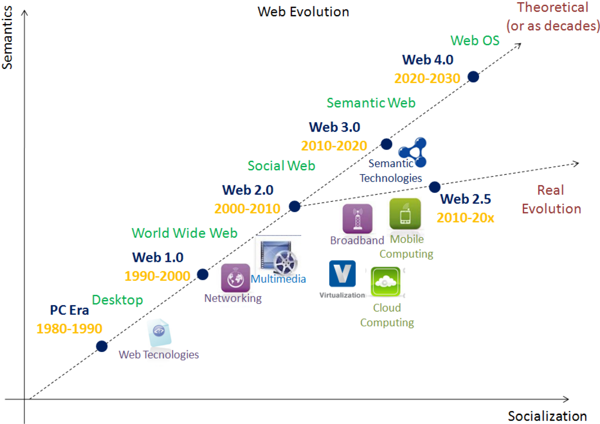
Evolution of Web
Image Source: http://trendtech.com

Slide 21
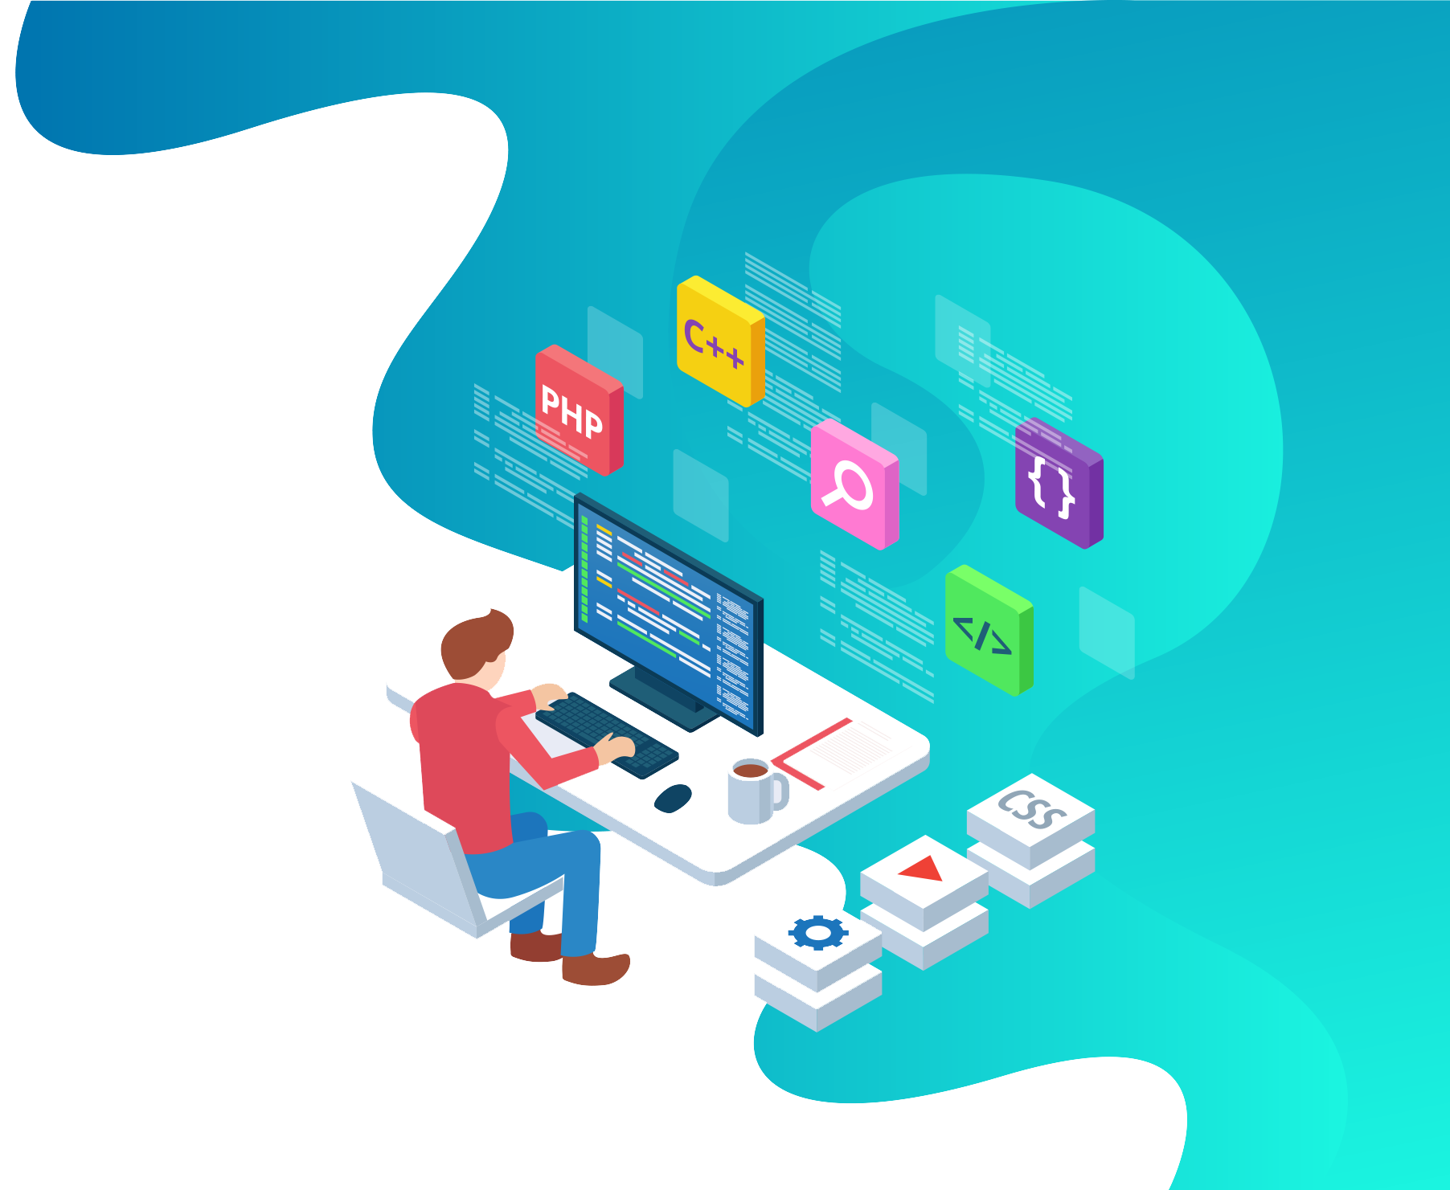
Evolution of Web
World Wide Web is the primary tool used by billions of people to share, read, and write information to interact with other people via internet. World Wide Web made much progress since its advent.

Slide 22

Web 1.0
The term Web 1.0 didn’t appear until the term Web 2.0 was coined in 1999 by Darci DiNucci. During that time, the web was undergoing a major transformation. Most websites in the 1990s had originally been built with static HTML pages, and a few simple styles embedded in the HTML markup. In the late 1990s and early 2000s, interactive website features redefined what could be accomplished in a web browser and marked a major point of evolution in the world of web development.
The first version of web Web 1.0 also referred as Syntactic web or read only web is the era(1990–2000) where the role of a user is limited to reading information provided by the content producers. There is no option given for user or consumer to communicate back the information to the content producers. Example of Web 1.0 are static web sites and personal sites.
Image Source: http://pngicon.com
Notes:
© Copyright Showeet.com – Creative & Free PowerPoint and Google Slides Templates

Slide 23
Web 1.0 Characteristics
Static Page
Website content stored in files
Combination of content and layout
Proprietary HTML tags
Guestbooks
E-mailing of forms
A
B
C
A
Pages didn’t offer interactive features that changed based on website visitor behavior. At that point websites were largely informational.
Virtually every modern website makes use of a database to store the majority of website content. During Web 1.0 this was not the case and most website content was stored directly in the website files, not in a separate database.
Good web design practice today dictates the separation of webpage markup and styling. Virtually every modern website makes use of external style sheets to determine the look and layout of webpages.
B
C
D
E
F
D
Website visitor comments were usually added to a Guestbook page rather than attached directly to content pages.
Web hosting servers during the Web 1.0 phase rarely offered support for server-side scripting, which is required to use the web server to submit a form.
During Web 1.0 browsers attempted to stand out by offering support for proprietary tags, creating significant incompatibility problems between websites that used these tags and site visitors using unsuported browsers.
E
F

Slide 24
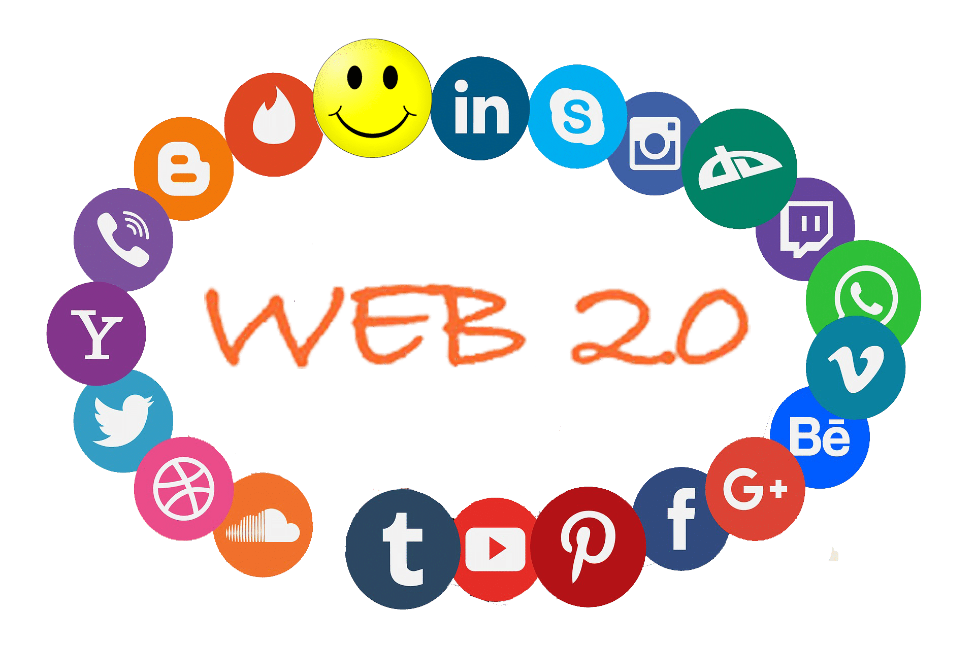
Web 2.0
The Web 2.0 also referred as Social Web or read-write web is the era(2000–2010 and continues even now) which facilitates interaction between web users and sites which intern allows users to communicate with other users. In this era every user can be a content producers and content is distributed and shared between sites. Some of the famous Web 2.0 applications are Facebook, Youtube, Flickr, Twitter etc., The web technologies like HTML5, CSS3 and Javascript frameworks like ReactJs, AngularJs, VueJs etc., enables startups to innovate new ideas which enables users to contribute more in this Social Web. Web 2.0 is build around the users, producer just need build a way to enable and engage them.
Notes:
© Copyright Showeet.com – Creative & Free PowerPoint and Google Slides Templates

Slide 25

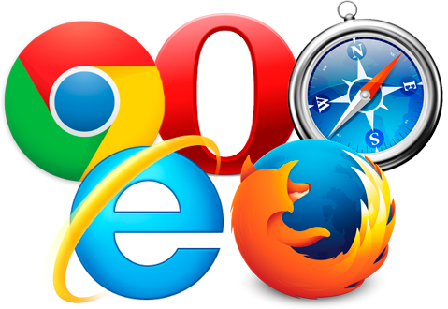

Web 2.0 Characteristics
User-generated content
An emphasis on user experience
Improved interoperability
Whether in the form of blog comments, social media posts, product reviews, or wiki article submissions and editorial input, Web 2.0 sites enable website visitors to contribute to the content of the website.
Features that are responsive to user input, such as a map web application that you can use to create personalized directions for a road trip, are a key component of Web 2.0.
Web 2.0 websites began to incorporate application programming interfaces (API) to enable the use of website content in an external application or website, such as placing a social media feed in a website sidebar.
Image Source: http://pngicon.com
Notes:
© Copyright Showeet.com – Creative & Free PowerPoint and Google Slides Templates

Slide 26
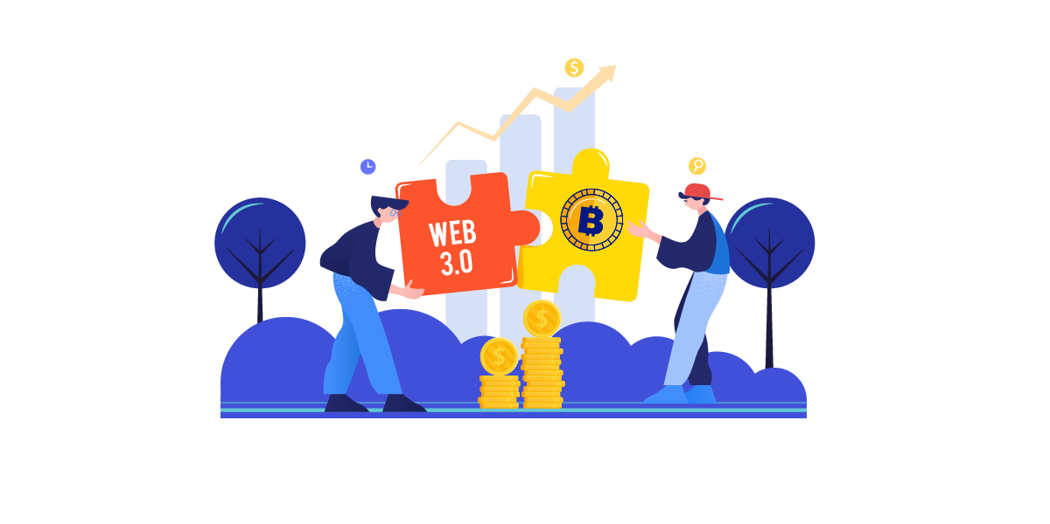
Web 3.0
The Web 3.0 also referred as Semantic Web or read-write-execute is the era(2010 and above) which refers to the future of web. In this era computers can interpret information like humans via Artificial Intelligence and Machine Learning. Which help to intelligently generate and distribute useful content tailored to a particular need of a user.
What if computers can understand meaning behind information
What if they can learn “what we are interested in”
Then they can help us find what we want
It can recognize People, Place, Events, Companies, Product, Movies etc.,
It can understand the relationship between things
Image Source: http://web4all.com
Notes:
© Copyright Showeet.com – Creative & Free PowerPoint and Google Slides Templates

Slide 27




Potential of web 3.0 in Blockchain Technology
Web 3.0, has many improvements over the older version of Web 2.0, and it has the potential to transform our experiences into the new world.
The major drawback of older versions like web 1.0 and web 2.0 was in its client-server architecture, and there was a treat to privacy.
Blockchain adds incredible value to the features of web 3.0 by eliminating and fixing the undermining issues of older versions. Here is a list of features that illustrates how this new version of the internet (Brave, an example) is exceptionally the best.
Image Source: http://pngicon.com
Notes:
© Copyright Showeet.com – Creative & Free PowerPoint and Google Slides Templates

Slide 28





Features of Web 3.0
Security
Web 3.0 possesses a decentralized exchange for providing seamless user trade experience without thinking of issues related to hacks or lack of transparency. By this, users will have full control over their funds, and there will be lesser chances of data tampering.
Privacy
Web 3.0 focusses on maintaining privacy and confidentiality with the safe transmission of data. As everything is decentralized, it eliminates the need for the middle-man, hence no anti-monopoly.
Interoperability
Web 3.0 will allow users to access data across various applications without the need for any specific platform, which means you will not have to worry about a single device being accessible to Web 3.0 while not others.
Permissionless
It offers a peer-to-peer network that will make it possible for digital assets to be transferred to cross-border. There will be no restrictions and discrimination, hence allowing everyone to connect with the network.
Semantic Web
web 3.0 tries to understand web content like human behavior; this is what semantic web is all about. Semantic web, with the integration of artificial intelligence and machine learning techniques, teaches the computer to understand data and how it behaves.
Image Source: http://pngicon.com

Slide 29


How will artificial intelligence be used in Web 3.0
AI on the web will be used to make judgement calls about the web. For example, some organizations have already created an intelligent application that can make predictions about hit songs based on data mined from college music websites. The potential applications of AI are hard to wrap one’s mind around, but will likely be seen in areas such as search engine results ranking, personalized content filtering services, and similar applications that produce data-driven content recommendations.
Image Source: http://shareme.com
Notes:
© Copyright Showeet.com – Creative & Free PowerPoint and Google Slides Templates

Slide 30
Conclusion
Web based applications can offer competitive advantages to traditional software based Systems allowing businesses to streamline information and processes with reduced costs. Developing a website with higher than expected traffic may lead to issues that require increased scalability. Many of these problems boil down to the coding of these sites, while others could be related to server issues, faulty HTML code, and DNS roadblocks.
Image Source: http://myslide.com
Notes:
© Copyright Showeet.com – Creative & Free PowerPoint Templates

Slide 31
References
Kohli S., Web technologies: Web Programming and Internet Technologies, Manish Jain, BPB Publication, India 2015

