Slide 1

AGRICULTURE BUSINESS PLANNING
Chapter 1:
Problem Identification at Agriculture Field
By: Liska Simamora, S.P., M.Sc

Slide 2
THE OUTLINE
Discover the problem
Analysing the problem

Slide 3
Discover the problem
Oxford Languages Dictionary defines Problem as a matter or situation regarded as unwelcome or harmful and needing to be dealt with and overcome

Slide 4
HOW TO DISCOVER THE PROBLEM?
Observation
Literature
Discussion

Slide 5
OBSERVATION
explore the situation in a particular object or area.
touching the object or visiting the area that you want to explore.
determined what things show irregularities
Finally problems generated

Slide 6
literature
scientific literature.
leads the entrepreneurs to get the novel things
keep adjusting the products and model business to fulfil the societies needs.

Slide 7
discussion
Planned discussion with a certain topic.
Discussion group must have people who understand the discussed issue
Bears a findings
Has a conclusion
Confirming the findings
The importance of time limitation

Slide 8
discussion
The rule of discussion group
Listen respectfully, without interrupting.
Listen actively and with an ear to understanding others' views. (Don’t just think about what you are going to say while someone else is talking.)
Criticize ideas, not individuals.
Commit to learning, not debating. Comment in order to share information, not to persuade.
Avoid blame, speculation, and inflammatory language.
Allow everyone the chance to speak.
Avoid assumptions about any member of the class or generalizations about social groups. Do not ask individuals to speak for their (perceived) social group.

Slide 9
Analysing the problem
There are so many approaches to analyse the problem such as problem tree, fishbone analysis, force field, and SWOT (Strengths-Weakness-Opportunity-Threat) analysis).

Slide 10
Analysing the problem
What is the problem tree?
It is a tool for community groups identify problems and determine what the most effective interventions are.
This method is used by groups to determine the extent to which an organization’s program activities address the root causes of the problems it seeks to alleviate and to verify that these programs can achieve the desired impact (Feed the Future, 2017).

Slide 11
Analysing the problem
2. Advantages of the problem trees
Ingenio Empresa (2022) states 4 the advantages of the problem trees
It allows us to break down the problem, the causes and its effects, improving its analysis.
There is a better understanding of the problem by disaggregating it into causes and consequences.
It is linked to other research and analysis tools such as the Vester matrix or solution tree.
Facilitates the realization of other important components of a research or project in its planning stage, e.g. stakeholder analysis, risk analysis and objectives.

Slide 12
Analysing the problem
3. The problem tree in project planning
The importance of using the problem tree in conjunction with other tools, where what we seek is to:
Obtain significant data to describe the problem
Determine the causes and effects
Elaborate project objectives¹

Slide 13
Step by step to make the problem tree
Step 1.
Analyse the situation by asking these question
What is happening,
why is it happening
what is triggering it.
Further, Collect data that will allow you to understand the problem situation. This in itself will give you a lot of input for the next step.

Slide 14
Step by step to make the problem tree
Step 2.
Identify the main problems of the situation.

Slide 15
Step by step to make the problem tree
Step 3. Determine the effects and causes of the main problem:
Your work has to be displayed with these:
You already have the trunk of the tree, now identify the causes (roots) and the effects or consequences (leaves or branches). Again, it is better if this is done as a team, seeking to reach a consensus.

Slide 16
Step by step to make the problem tree
Step 4. Draw the tree: Simple.

Slide 17
Step by step to make the problem tree
Step 5. Go deeper into causes and effects:
Draw a line and go as deep as possible.

Slide 18
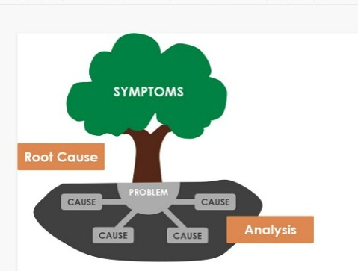
The illustration
https://images.app.goo.gl/pgNywioXMzJHrXDH9

Slide 19
Discuss an example
Analysing Problem at Agriculture Field Applying Problem Tree Approach

Slide 20
Discuss an example
Step 1 : White jasmine flower (Jasminum sambac) is a well known flower in Indonesia. It has various purposes and special meaning to celebrate many events for many tribes and religions. Central Java Province is the production centre of this crops, particularly in Depok Village, Kandeman City, Regency of Batang. Since the flower has many purposes, the demand of it is so high. The data shows that the Indonesian white jasmine flower only fulfil 20% of domestic demands

Slide 21
Discuss an example
Step 2: According to the farmers in the region, the production decreasing is occurred by the reducing of white jasmine plantation. It is driven by the price fluctuation, the salt content in the soil is increasing, and the interest of the younger generation for jasmine cultivation has decreased dramatically

Slide 22
Discuss an example
Step 3 : Occurred by the problem revealed in step 2 drives the farmers to transform their daily job from farmers to fishermans; some of them sell their land; another ones converting the white jasmine plantation with other Crops such as mango and another kinds of fruits.

Slide 23
Discuss an example
Step 4 : draw the problem tree

Slide 24
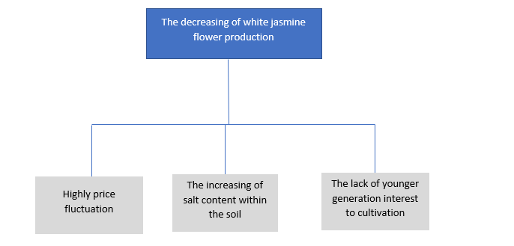
Discuss an example
Step 4 : draw the problem tree

Slide 25
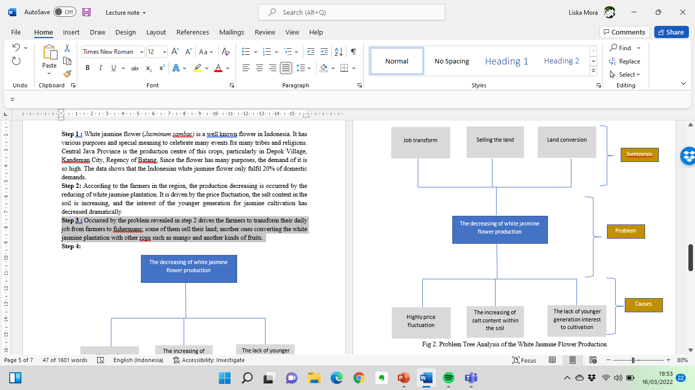
Discuss an example
Step 4 : draw the problem tree

Slide 26
REFERENCES
Feed the Future. The U.S. Government’s Global Hunger & Food Security Initiative. 2007. Participatory Methods and Tools for Extension. Problem Tree Analysis. https://meas.illinois.edu/wp-content/uploads/2017/02/MEAS-Participatory-Methods-Tip-Sheet-Problem-Tree-Analysis.pdf
Ingenio Empresa. 2022. How to Make a Problem Tree: A Practical Example. https://www.ingenioempresa.com/en/problem-tree/#What_is_the_problem_tree
How to use 5 Whys Tree Diagram for Root Cause Analysis?. Visual paradigm online. https://images.app.goo.gl/pgNywioXMzJHrXDH9
Oxford language dictionary

Slide 27
Guideline to exercise
Exercise 1 :
Go to the lecture note and fill the column.
Requirements

Slide 28
Guideline to exercise
Exercise 2 : (individual task)
Requirements need to explain

Slide 29
Guideline to exercise
Exercise 3a and 3b : (group task)
Make the report
Write down the discussion topic
Write down the findings
Write down the conclusion
Attach the discussion photos within the report
requirements

Slide 30
Guideline to exercise
Exercise 4:
Draw it with various app you are interested ini
Do it in group according to group at exercise 3
Elaborate the problem tree within minimum 500 words.

Slide 31
Grouping the students
Lecturer will do it randomly
A group consisted of 5 students
This group is made to accomplish exercise 3-4

Slide 32
Thank you for your attention
See you next week

