Slide 1

AGRICULTURE BUSINESS PLANNING
Chapter 4: market analysis, product design
By: liska simamora, s.p., m. sc

Slide 2
outline
Introduction
Product Design
References
Market Analysis

Slide 3
Introduction
Based on the formulated solutions, the students will design particular products as the answer to the problems identified.

Slide 4
Market definition
Businesses sell goods, services.
Goods and service exchange for money
Market is formed because there are needs to be fulfilled
The lack of goods and services create problems.

Slide 5
Market analysis
There are so many problems that occur in the agricultural sector in Indonesia that have a direct impact on the socio-economic and environmental aspects.
All these problems must be solved by not only eliminating problems but also generating profits that will improve the farmers welfare.
Problems
Solutions
Products
Business Model
Problem solved
Profit

Slide 6
Market analysis
Market analysis on this topic focuses on 2 specific topics:
market size and
market trends

Slide 7
1. Market size
Market volume
Market potential

Slide 8
Market size
Market volume
Totality of all realized sales volume of a special market.
The quantity of consumers and their ordinary
The demand of consumers.
The market volume is either measured in quantities or qualities

Slide 9
Market size
Market Potential
Upper limit of the total demand and takes potential clients into consideration
It offers good values of orientation
The relation of market volume to market potential provides information about the chances of market growth

Slide 10
2. Market trends
Market trends are the upward or downward movement of a market, during a period of time

Slide 11
Market survey
Survey Result Report
The information of market sizes and market trends gathered by doing survey following the flows.
Survey Design
Data Collection
Data Analysis
Decision Making

Slide 12
Market survey
Survey Design
An important part of doing business and market research
Understand the market
Understand the customer
Helps to make a good decision

Slide 13
Market survey
Problem Surveyed
Survey Objectives
Survey Method
Survey Location
Data Sources
Survey Instruments
Survey Cost
Exercise 1 : Apply the survey flow to collect the information about the market size and market trends of agriculture product.

Slide 14
Market survey
Data Collection
Documentation all the data explored through interview or questionnaires
Starting to organize the data obtained in a proper form

Slide 15
Market survey
Data Analysis
Recognize the data type (NOIR)
Turning data into valuable informations
Using tools

Slide 16
Market survey
Survey Result Report
Display the data turned into information
Displayed in many forms such as graph, chart, table, or presentation

Slide 17
Product design
Product design flow
Market Needs
Consumer Segmentation
Marketing Mix
Product Determination
Competitor Analysis

Slide 18
Product design
Market Needs
- This step is completed when the solution has been formulated

Slide 19
Product design
Consumer Segmentation
How old are they?
What is their gender?
Where are they live?
What are their needs?
What are their monthly income & expenses?
What is their level of education?
What is their lifestyle like?

Slide 20
Product design
Marketing Mix
4P
Product
Price
Place
Promotion

Slide 21
Marketing MIX
Product
The goods and services offered by the organisation
The bundle of benefits which a marketeer offers to the consumer for a price
Product can also take the form of a service like an air travel, telecommunication, etc. Thus, the term product refers to goods and services offered by the organisation for sale

Slide 22
Marketing MIX
Price
The amount charged for a product or service
Pricing is a very crucial decision area as it has its effect on demand for the product and also on the profitability of the firm

Slide 23
Marketing MIX
Place
Where the customers can conveniently make purchase
Called a channel of distribution

Slide 24
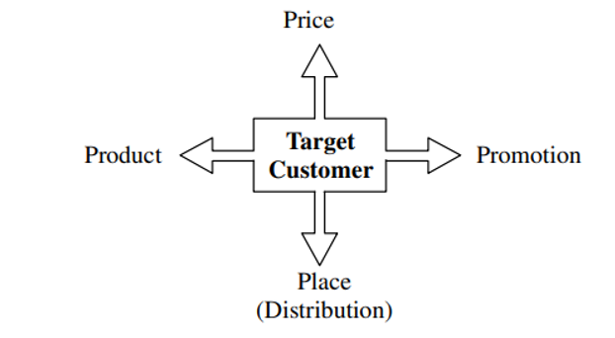
Marketing MIX
Promotion
A process of informing, persuading and influencing a consumer to make choice of the product
Promotion is done through means of personal selling, advertising, publicity and sales promotion
It is done mainly with a view to provide information to prospective consumers about the availability, characteristics and uses of a product.

Slide 25
Competitor analysis
Associated with the task of defining markets
Supports the analysis of:
pricing policies
product design
development and positioning
communications strategy
channels of distribution

Slide 26
Competitor analysis
Associated with the task of defining markets
In Marketing Supports the analysis of:
Pricing policies
Product design
Development and positioning
Communications strategy
Channels of distribution

Slide 27
Competitor analysis
In strategic management:
Provides a foundation for competitor analysis
The analysis of industry structure
Analysis of conditions of rivalry
Analysis competitive advantage

Slide 28
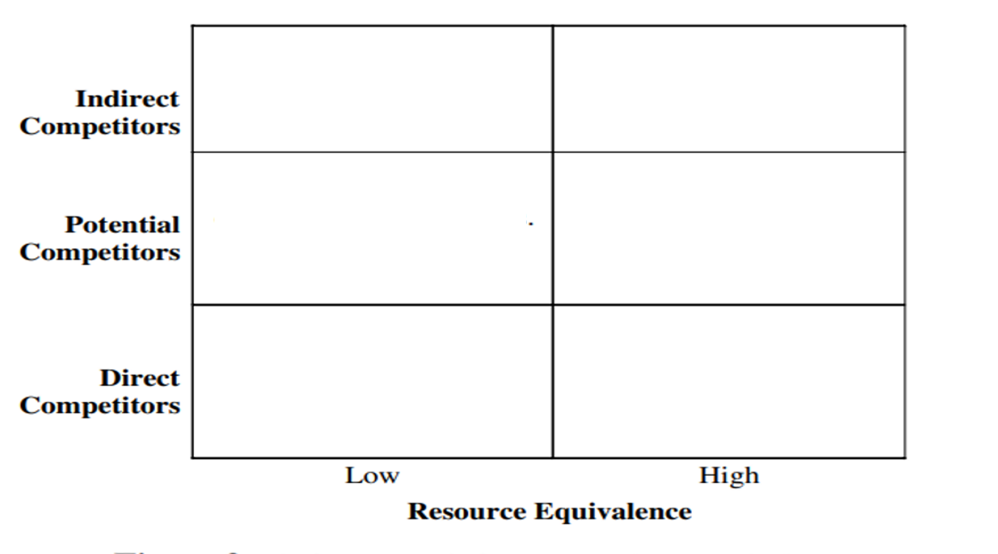
Competitor analysis
Framework for Competitor Analysis:

Slide 29
Competitor analysis
Framework for Competitor Analysis:
The horizontal axis: the firms according to whether they have high-or low-resource equivalence relative to the focal firm

Slide 30
Competitor analysis
Framework for Competitor Analysis:
The vertical axis: The firms according to the three basic competitive categories identified
direct competitors
potential competitors
indirect competitors.

Slide 31
references
¹Wikipedia. Market Analysis. https://en.wikipedia.org/wiki/Market_analysis#Dimensions_of_market_analysis
² Kadence International. How to Design a Survey. https://kadence.com/what-is-survey-design/
³Hubspot. How to Analyse Survey Results Like a Data Pro. https://blog.hubspot.com/service/survey-results
⁴ James, H. (2012). Concept and Components of Marketing Mix. Journal of Marketing, 5(2), 101–122. http://www.uop.edu.pk/ocontents/marketing mix.pdf
⁵ Bergen, M., & Peteraf, M. A. (2002). Competitor Identification and Competitor Analysis: A Broad-Based Managerial Approach. Managerial and Decision Economics, 23, 157–169. https://assets.csom.umn.edu/assets/71542.pdf

Slide 32
Exercise
Do a mini research to identify the market analysis of Indonesian white jasmine flower by following the step of market analysis and market trends
Use Microsoft words
5-10 pages
TNR, 12
1,5 line space
4,3,3,3

