Slide 1

AGRICULTURE BUSINESS PLANNING
CHAPTER 5: MARKET TEST AND SELLING
BY: LISKA SIMAMORA, S.P., M. SC

Slide 2

Outline
Introduction
Individual Product Decision
Product Line Decision
Product Mix Decision
References

Slide 3

Introduction
Market test will help the students to generate information and strategies to stand firmly in the market
Thus, the product decisions have to be mapping

Slide 4
Introduction
The Product Decision at Three Levels
Individual product decisions
Product line decisions
Product mix decisions

Slide 5
Individual product decisions
product attributes
branding
packaging
labelling
product-support services.

Slide 6
Individual product decisions
Product Attributes
Developing a product involves defining the benefits that the product will offer.
Tangible: quality, features, style, design.
they greatly affect consumer reactions to a product.

Slide 7
Individual product decisions
Branding
Name,
Term,
Sign,
Symbol,
Design or a combination of these,
Identifies the maker or seller of the product or service.
Consumers view a brand as an important part of a product, and branding can add value to a product.

Slide 8
Individual product decisions
Packaging
Involves designing and producing the container or wrapper for a product.
Labelling, printed information appearing on or with the package, is also part of packaging.

Slide 9
Individual product decisions
Labelling
Range from simple tags attached to products to complex graphics
They perform several functions.
At the very least, the label identifies the product or brand
The label might also grade the product, or
Describe several things about the product
The label might promote the product through attractive graphics

Slide 10
Individual product decisions
Product-Support Service
Product-support services – services that augment actual products.
More and more companies are using product-support services as a major tool in gaining competitive advantage.

Slide 11
2. Product Line Decision
A group of products that are closely related
They function in a similar manner
Sold to the same customer groups
Marketed through the same types of outlet
Fall within given price ranges

Slide 12
2. Product Line Decision
Product line-length decisions
The number of items in the product line.
The line is too short if the manager can increase profits by adding items;
the line is too long if the manager can increase profits by dropping items.
Product line length is influenced by company objectives and resources.
Companies that want to be positioned as full-line companies, or that are seeking high market share and market growth, usually carry longer lines.
Companies that are keen on high short-term profitability generally carry shorter lines consisting of selected items. Another objective may be to allow upselling.

Slide 13
2. Product Line Decision
Product line-length decisions
Product line managers tend to add new products
Lead to the rise of several costs

Slide 14
2. Product Line Decision
Product line-length decisions
The company can systematically increase the length of its product line in two ways
stretching the line
filling the line

Slide 15
2. Product Line Decision
Product line-length decisions
stretching the line
A company lengthens its product line beyond its current range
Three ways to product-line stretching decision
Downward stretch
Upward stretch
Two-way stretch

Slide 16
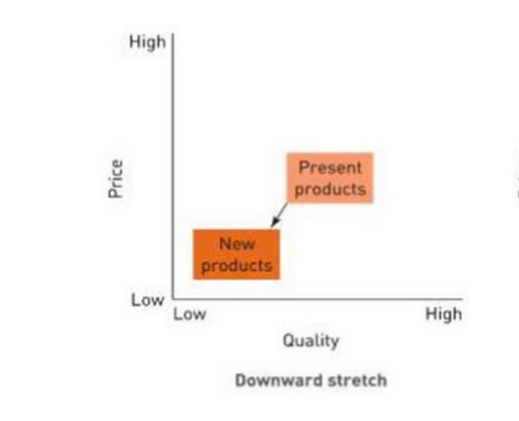
2. Product Line Decision
Product line-length decisions
stretching the line
Downward stretch

Slide 17
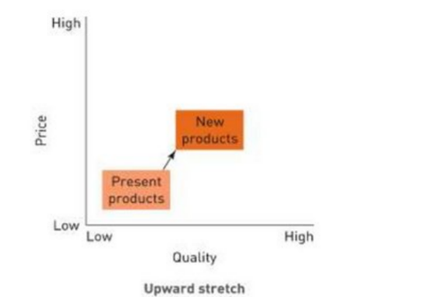
2. Product Line Decision
Product line-length decisions
stretching the line
Upward stretch

Slide 18
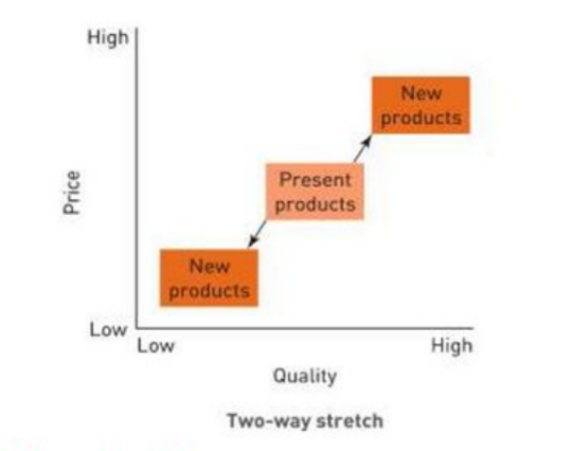
2. Product Line Decision
Product line-length decisions
stretching the line
Two-way stretch

Slide 19
3. Product Mix Decision
Some companies may offer several lines of products
Those form a product mix or product assortment-
Product assortment : the set of all product lines and items that a particular seller offers for sale to buyers.
A company’s product mix has four important dimensions: width, length, depth and consistency.

Slide 20
3. Product Mix Decision
A company’s product mix has four important dimensions:
width
length
depth
consistency.

Slide 21
3. Product Mix Decision
width :
It can add new product lines, thus widening its product mix.
In this way, its new lines build on the company’s reputation in its other lines.

Slide 22
3. Product Mix Decision
Length:
The company can lengthen its existing product lines to become a more full-line company.

Slide 23
3. Product Mix Decision
Depth:
It can add more product versions of each product and thus deepen its product mix.

Slide 24
3. Product Mix Decision
Consistency:
The company can pursue more product line consistency, or less, depending on whether it wants to have a strong reputation in a single field or in several fields.

Slide 25
3. Product Mix Decision
Example:
 | Width
Length | Vegetable | Flower | Medicinal Plant | Fruit
 | -Cabbage -Lettuce -Spinach -Chili | -Rose -Jasmine -Orchid | -Turmeric -Curcuma -Chamomile | -Guava -Papaya -Banana -Pineapple

Slide 26
3. Product Mix Decision
Example:
 | Flower
Depth | Rose | Jasmine | Orchid
 | -Fresh -Dried -Sprinkle -Essence | -Fresh -Dried -Bud -Sprinkle -Essence | -Fresh -Dried
Quiz: Make the Depth Dimension for vegetable, medicinal plant and fruit.

Slide 27
Reference
Smith, J. G., & Clark, F. E. (1928). Principles of Marketing. In The Economic Journal (Vol. 38, Issue 151). https://doi.org/10.2307/2224326

Slide 28
Exercise
Before launching your products, make the list for:
Individual product decisions
Product line decision
Product mix decisions

Slide 29
Guidance
Use the template on lecture note page 6
This part will be done when there are some amount of products sold. According to your selling experience, consider the product-line stretching decision you are going to make
Display the product from exercise number one in to product mix decision

Slide 30
Requirements
Work in team
Use Ms. Word
Exercise no 1-3 elaborate within minimum 300 words.
Submit to F-learn

Slide 31
Thank You For Your Attention

