Slide 1
Mathematics for Science
Lecture 1
Arithmetic of Complex Numbers
Kahenya, N.P

Slide 2
Course Descriptive
Mathematics for science lays a foundation for mathematical concepts for science and engineering courses.
It is designed to equip science, engineering, and mathematics students with pre-calculus knowledge and skills necessary for pursuing other mathematical courses such as calculus, discrete mathematics, linear algebra, among others.

Slide 3
Course Intended learning outcomes
Apply the mathematical concepts learnt in problem-solving and logical skills.
Become familiar with basic knowledge in key concepts discussed in mathematics for science.
Use the knowledge and skills in solving applied real-life problems.

Slide 4
Course Content/Lectures Content
Arithmetic of Complex Numbers
Polar Equations and Graphs
Conic Sections and their application: Circles, Parabolas, Ellipses, and Hyperbolas
Polynomials: Remainder and Factor theorem; Decomposing Rational Functions (CASES I, II, III, and IV).
Trigonometrical equations, solving triangles, identities, and formula
Introduction to Permutations and Combinations
Permutation functions
Introduction to Mathematical Induction

Slide 5
Introduction to lecture 1
This lecture will introduce the set and arithmetic of complex numbers.
Intended learning outcomes
At the end of this lecture, you will be able to;
Define a complex number.
Operate the arithmetic of complex numbers.

Slide 6
References
These lecture notes should be complemented with relevant topics:
Kahenya, N.P. (2017) Foundation Mathematics. LAP publishers
Stewart, J.(2012) Calculus 7th ed. Brooks/Cole Cengage Learning

Slide 7
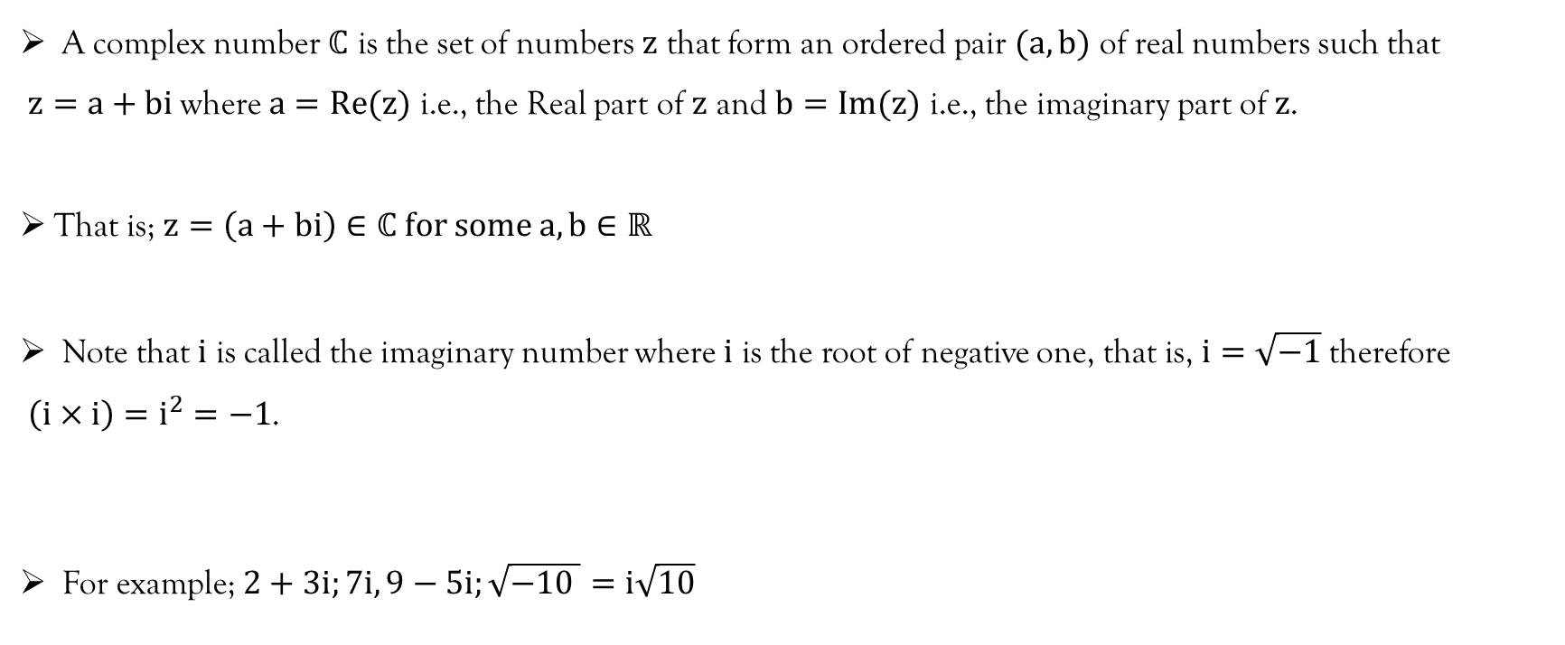
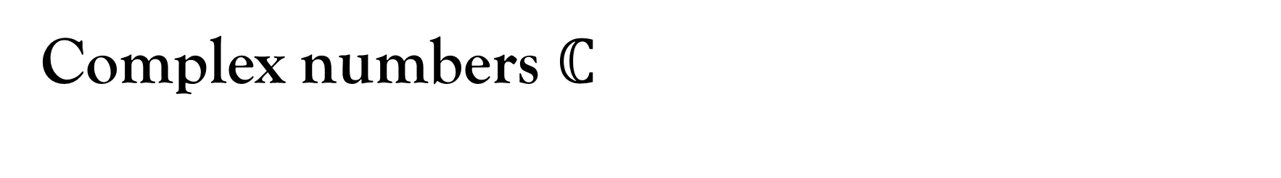
Complex numbers $ℂ$
A complex number $ℂ$ is the set of numbers $z$ that form an ordered pair $(a,b)$ of real numbers such that $z=a+bi$ where $a=Re(z)$ i.e., the Real part of $z$ and $b=Im(z)$ i.e., the imaginary part of $z$.
That is; $z=\left(a+bi\right)∈ℂ for some a,b∈ℝ$
Note that $i$ is called the imaginary number where $i$ is the root of negative one, that is, $i=\sqrt{−1}$therefore $\left(i×i\right)=i^{2}=−1$.
For example; $2+3i;7i, 9−5i;\sqrt{−10 }=i\sqrt{10}$

Slide 8
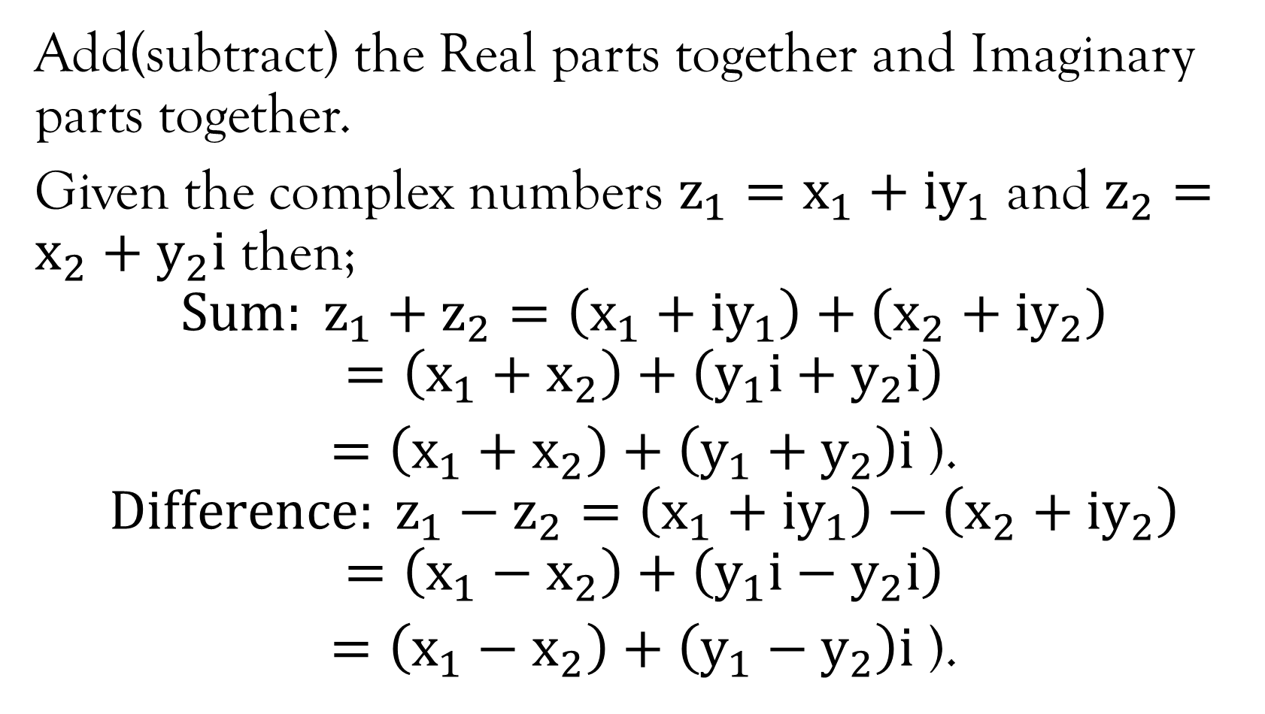
Sum and difference of complex numbers
Add(subtract) the Real parts together and Imaginary parts together.
Given the complex numbers $z_{1}=x_{1}+iy_{1}$ and $z_{2}=x_{2}+y_{2}i$ then;
$$Sum: z_{1}+z_{2}=\left(x_{1}+iy_{1}\right)+\left(x_{2}+{iy}_{2}\right)$$
$$=\left(x_{1}+x_{2}\right)+\left(y_{1}i+y_{2}i\right)$$
$=\left(x_{1}+x_{2}\right)+\left(y_{1}+y_{2}\right)i$ ).
$$Difference: z_{1}−z_{2}=\left(x_{1}+iy_{1}\right)−\left(x_{2}+{iy}_{2}\right)$$
$$=\left(x_{1}−x_{2}\right)+\left(y_{1}i−y_{2}i\right)$$
$=\left(x_{1}−x_{2}\right)+\left(y_{1}−y_{2}\right)i$ ).

Slide 9
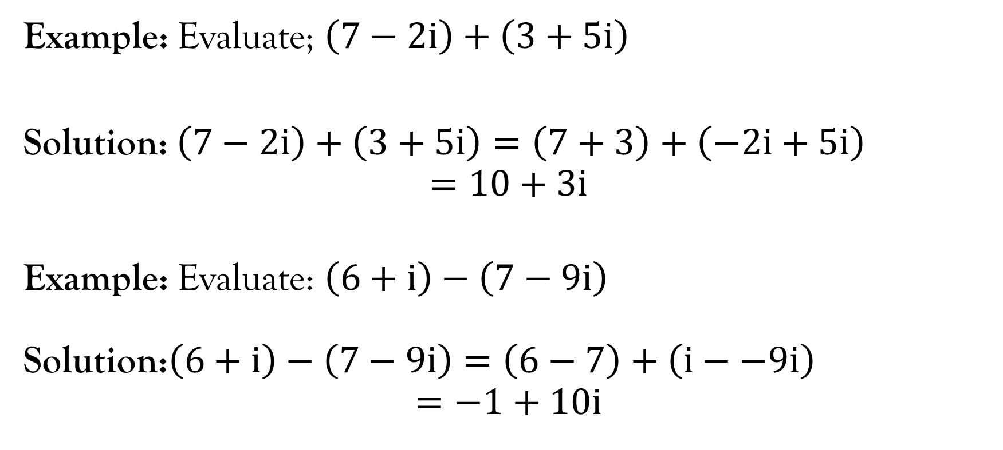
Sum and difference of complex numbers
Example: Evaluate; $\left(7−2i\right)+\left(3+5i\right)$
Solution: $\left(7−2i\right)+\left(3+5i\right)=\left(7+3\right)+\left(−2i+5i\right)$
$$=10+3i$$
Example: Evaluate: $\left(6+i\right)−\left(7−9i\right)$
Solution:$\left(6+i\right)−\left(7−9i\right)=\left(6−7\right)+\left(i−−9i\right)$
$$=−1+10i$$

Slide 10
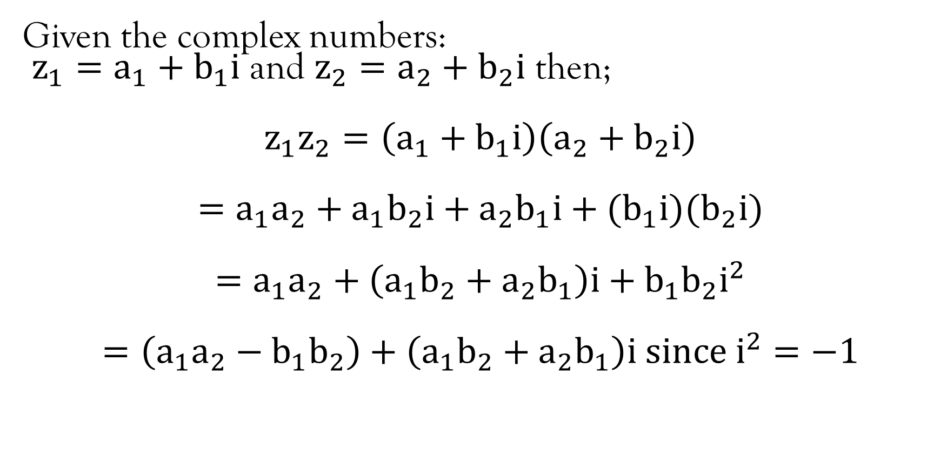
Product of Complex numbers
Given the complex numbers:
$z_{1}=a_{1}+b_{1}i$ and $z_{2}=a_{2}+b_{2}i$ then;
$$z_{1}z_{2}=\left(a_{1}+b_{1}i\right)\left(a_{2}+b_{2}i\right)$$
$$=a_{1}a_{2}+a_{1}b_{2}i+{a_{2}b}_{1}i+(b_{1}i)(b_{2}i)$$
$$=a_{1}a_{2}+\left(a_{1}b_{2}+a_{2}b_{1}\right)i+b_{1}b_{2}i^{2}$$
$$=\left(a_{1}a_{2}−b_{1}b_{2}\right)+\left(a_{1}b_{2}+a_{2}b_{1}\right)i since i^{2}=−1$$

Slide 11
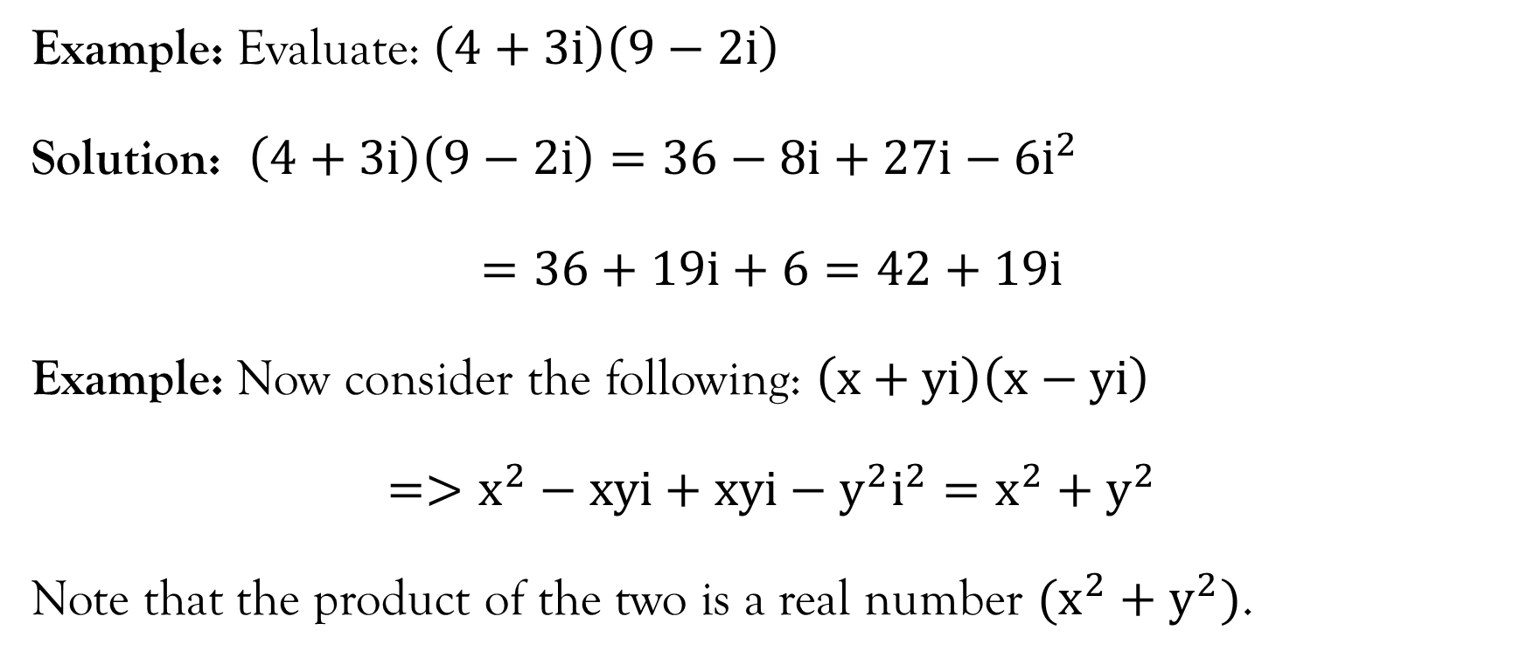
Product of complex numbers…contd.
Example: Evaluate: $\left(4+3i\right)\left(9−2i\right)$
Solution: $\left(4+3i\right)\left(9−2i\right)=36−8i+27i−6i^{2}$
$$=36+19i+6=42+19i$$
Example: Now consider the following: $\left(x+yi\right)\left(x−yi\right)$
$$=>x^{2}−xyi+xyi−y^{2}i^{2}=x^{2}+y^{2}$$
Note that the product of the two is a real number $(x^{2}+y^{2})$.

Slide 12
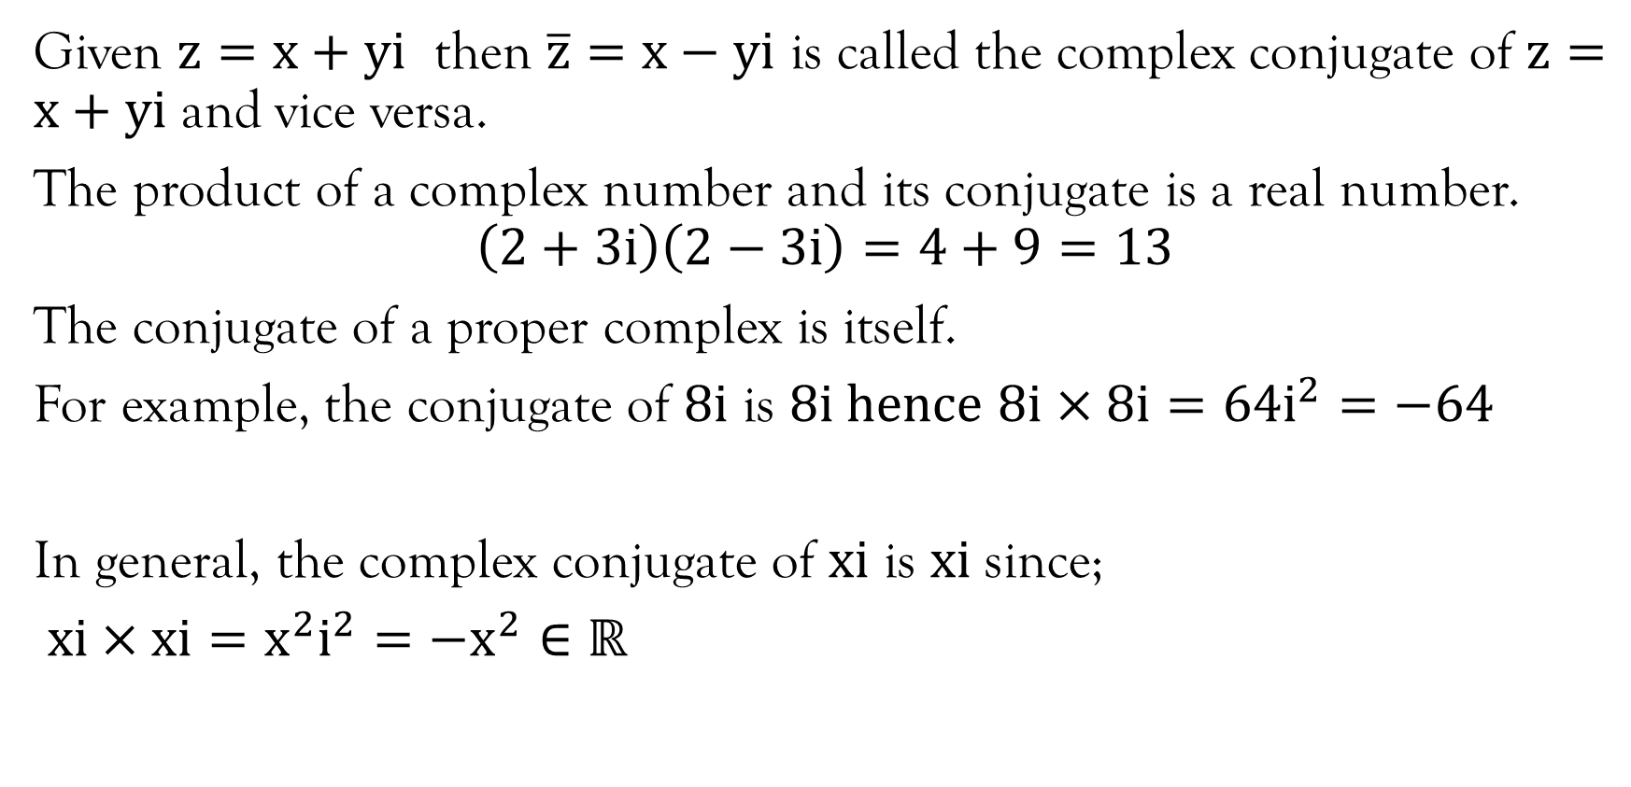
Conjugate of complex number
Given $z=x+yi$ then $\overline{z}=x−yi$ is called the complex conjugate of $z=x+yi$ and vice versa.
The product of a complex number and its conjugate is a real number.
$$\left(2+3i\right)\left(2−3i\right)=4+9=13$$
The conjugate of a proper complex is itself.
For example, the conjugate of $8i$ is $8i hence$ $8i×8i=64i^{2}=−64$
In general, the complex conjugate of $xi$ is $xi$ since;
$xi×xi=x^{2}i^{2}=−x^{2}∈ℝ$

Slide 13
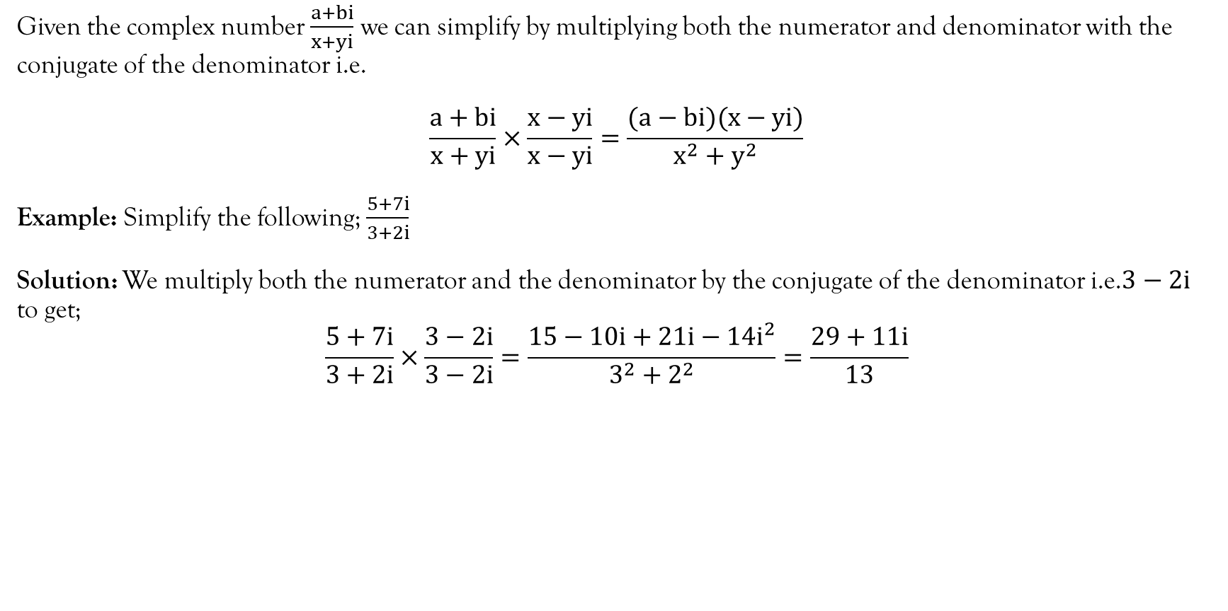
Division of complex numbers
Given the complex number $\frac{a+bi}{x+yi}$ we can simplify by multiplying both the numerator and denominator with the conjugate of the denominator i.e.
$$\frac{a+bi}{x+yi}×\frac{x−yi}{x−yi}=\frac{(a−bi)(x−yi)}{x^{2}+y^{2}}$$
Example: Simplify the following; $\frac{5+7i}{3+2i}$
Solution: We multiply both the numerator and the denominator by the conjugate of the denominator i.e.$3−2i$ to get;
$$\frac{5+7i}{3+2i}×\frac{3−2i}{3−2i}=\frac{15−10i+21i−14i^{2}}{3^{2}+2^{2}}=\frac{29+11i}{13}$$

Slide 14
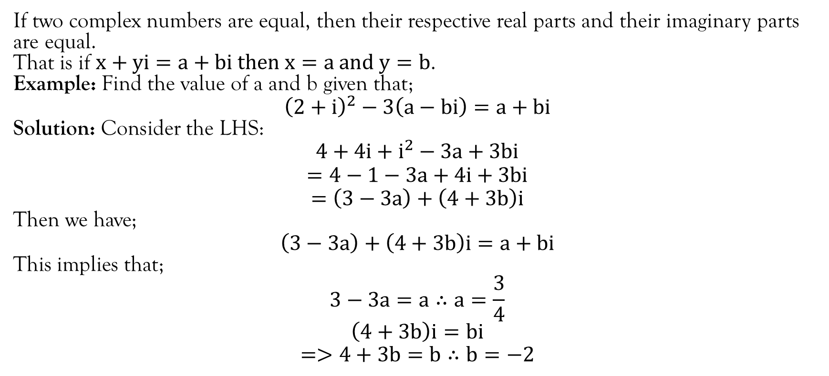
Equal complex numbers
If two complex numbers are equal, then their respective real parts and their imaginary parts are equal.
That is if $x+yi=a+bi then x=a and y=b$.
Example: Find the value of a and b given that;
$${\left(2+i\right)}^{2}−3\left(a−bi\right)=a+bi$$
Solution: Consider the LHS:
$$4+4i+i^{2}−3a+3bi$$
$$=4−1−3a+4i+3bi$$
$$=\left(3−3a\right)+\left(4+3b\right)i$$
Then we have;
$$\left(3−3a\right)+\left(4+3b\right)i=a+bi$$
This implies that;
$$3−3a=a∴a=\frac{3}{4}$$
$$\left(4+3b\right)i=bi$$
$$=>4+3b=b∴b=−2$$

Slide 15
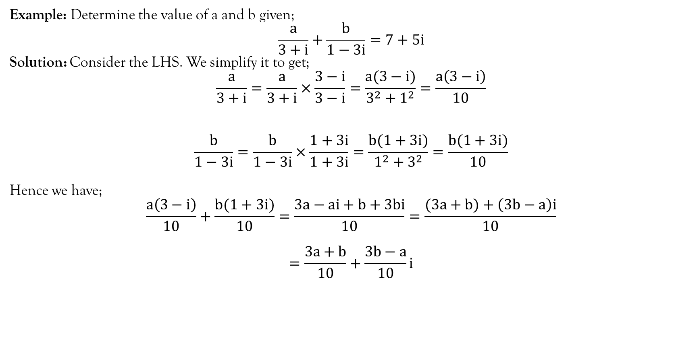
Example
Example: Determine the value of a and b given;
$$\frac{a}{3+i}+\frac{b}{1−3i}=7+5i$$
Solution: Consider the LHS. We simplify it to get;
$$\frac{a}{3+i}=\frac{a}{3+i}×\frac{3−i}{3−i}=\frac{a(3−i)}{3^{2}+1^{2}}=\frac{a\left(3−i\right)}{10}$$
$$\frac{b}{1−3i}=\frac{b}{1−3i}×\frac{1+3i}{1+3i}=\frac{b(1+3i)}{1^{2}+3^{2}}=\frac{b(1+3i)}{10}$$
Hence we have;
$$\frac{a\left(3−i\right)}{10}+\frac{b(1+3i)}{10}=\frac{3a−ai+b+3bi}{10}=\frac{(3a+b)+\left(3b−a\right)i}{10}$$
$$=\frac{3a+b}{10}+\frac{3b−a}{10}i$$

Slide 16
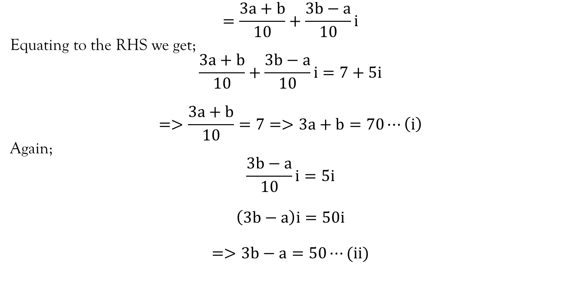
Example…contd.
$$=\frac{3a+b}{10}+\frac{3b−a}{10}i$$
Equating to the RHS we get;
$$\frac{3a+b}{10}+\frac{3b−a}{10}i=7+5i$$
$$=>\frac{3a+b}{10}=7=>3a+b=70⋯\left(i\right)$$
Again;
$$\frac{3b−a}{10}i=5i$$
$$\left(3b−a\right)i=50i$$
$$=>3b−a=50⋯(ii)$$

Slide 17
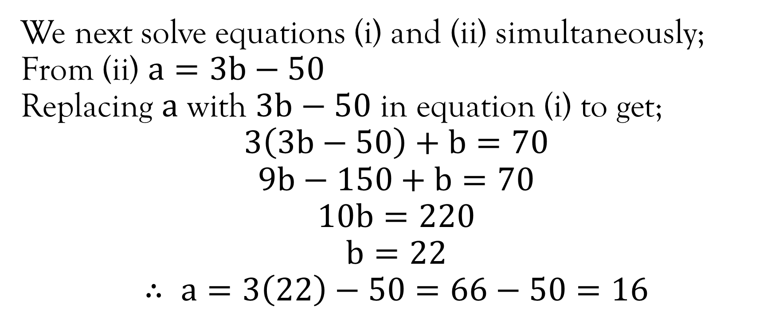
Example…contd.
We next solve equations (i) and (ii) simultaneously;
From (ii) $a=3b−50$
Replacing $a$ with $3b−50$ in equation (i) to get;
$$3\left(3b−50\right)+b=70$$
$$9b−150+b=70$$
$$10b=220$$
$$b=22$$
$$∴ a=3\left(22\right)−50=66−50=16$$

Slide 18
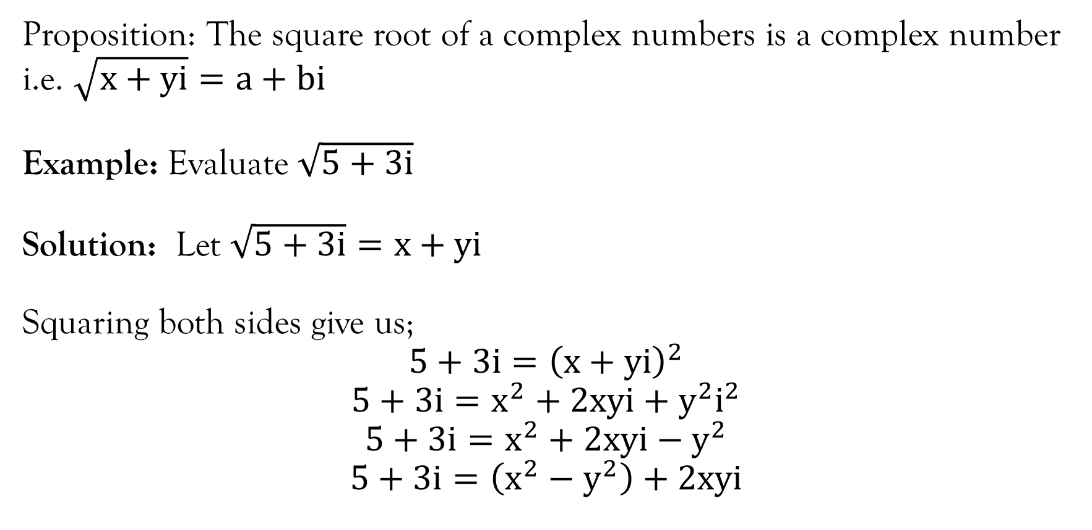
Square root of complex numbers
Proposition: The square root of a complex numbers is a complex number i.e. $\sqrt{x+yi}=a+bi$
Example: Evaluate $\sqrt{5+3i}$
Solution: Let $\sqrt{5+3i}=x+yi$
Squaring both sides give us;
$$5+3i={\left(x+yi\right)}^{2}$$
$$5+3i=x^{2}+2xyi+y^{2}i^{2}$$
$$5+3i=x^{2}+2xyi−y^{2}$$
$$5+3i=\left(x^{2}−y^{2}\right)+2xyi$$

Slide 19
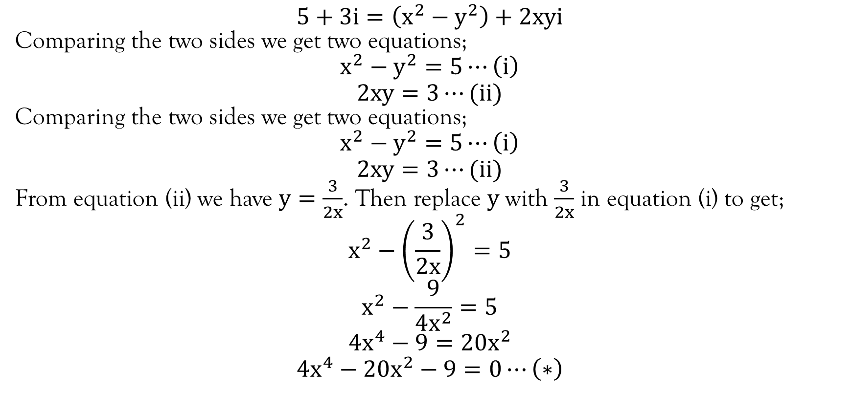
Example…contd.
$$5+3i=\left(x^{2}−y^{2}\right)+2xyi$$
Comparing the two sides we get two equations;
$$x^{2}−y^{2}=5⋯\left(i\right)$$
$$2xy=3⋯(ii)$$
Comparing the two sides we get two equations;
$$x^{2}−y^{2}=5⋯\left(i\right)$$
$$2xy=3⋯(ii)$$
From equation (ii) we have $y=\frac{3}{2x}$. Then replace $y$ with $\frac{3}{2x}$ in equation (i) to get;
$$x^{2}−{\left(\frac{3}{2x}\right)}^{2}=5$$
$$x^{2}−\frac{9}{4x^{2}}=5$$
$$4x^{4}−9=20x^{2}$$
$$4x^{4}−20x^{2}−9=0⋯\left(∗\right)$$

Slide 20
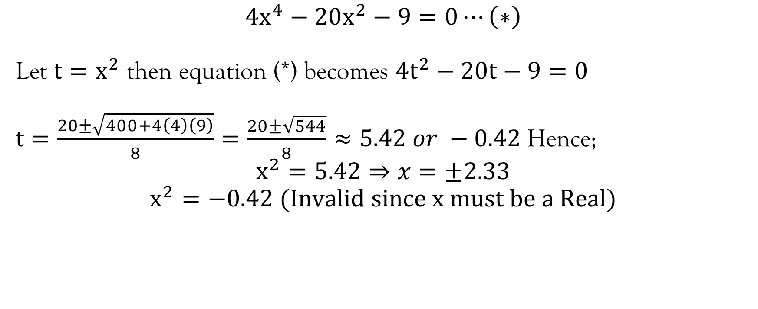
Example…contd.
$$4x^{4}−20x^{2}−9=0⋯\left(∗\right)$$
Let $t=x^{2}$ then equation (*) becomes $4t^{2}−20t−9=0$
$t=\frac{20±\sqrt{400+4\left(4\right)\left(9\right)}}{8}=\frac{20±\sqrt{544}}{8}≈5.42 or −0.42$Hence;
$$x^{2}=5.42⇒x=±2.33$$
$$x^{2}=−0.42 (Invalid since x must be a Real)$$

Slide 21
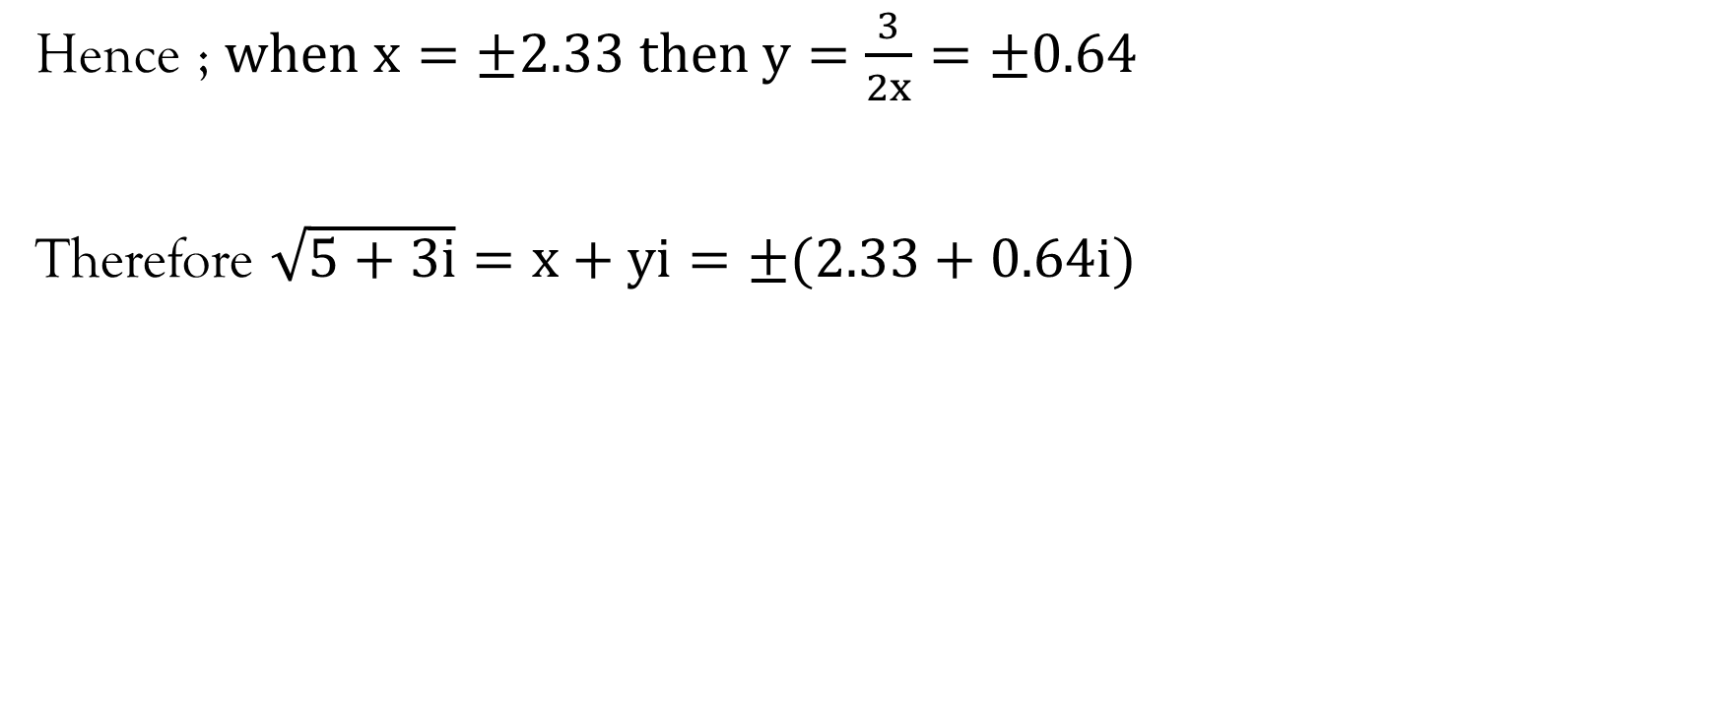
Example…contd.
Hence ; $when x=±2.33 then y=\frac{3}{2x}=±0.64$
Therefore $\sqrt{5+3i}=x+yi=±(2.33+0.64i)$

Slide 22
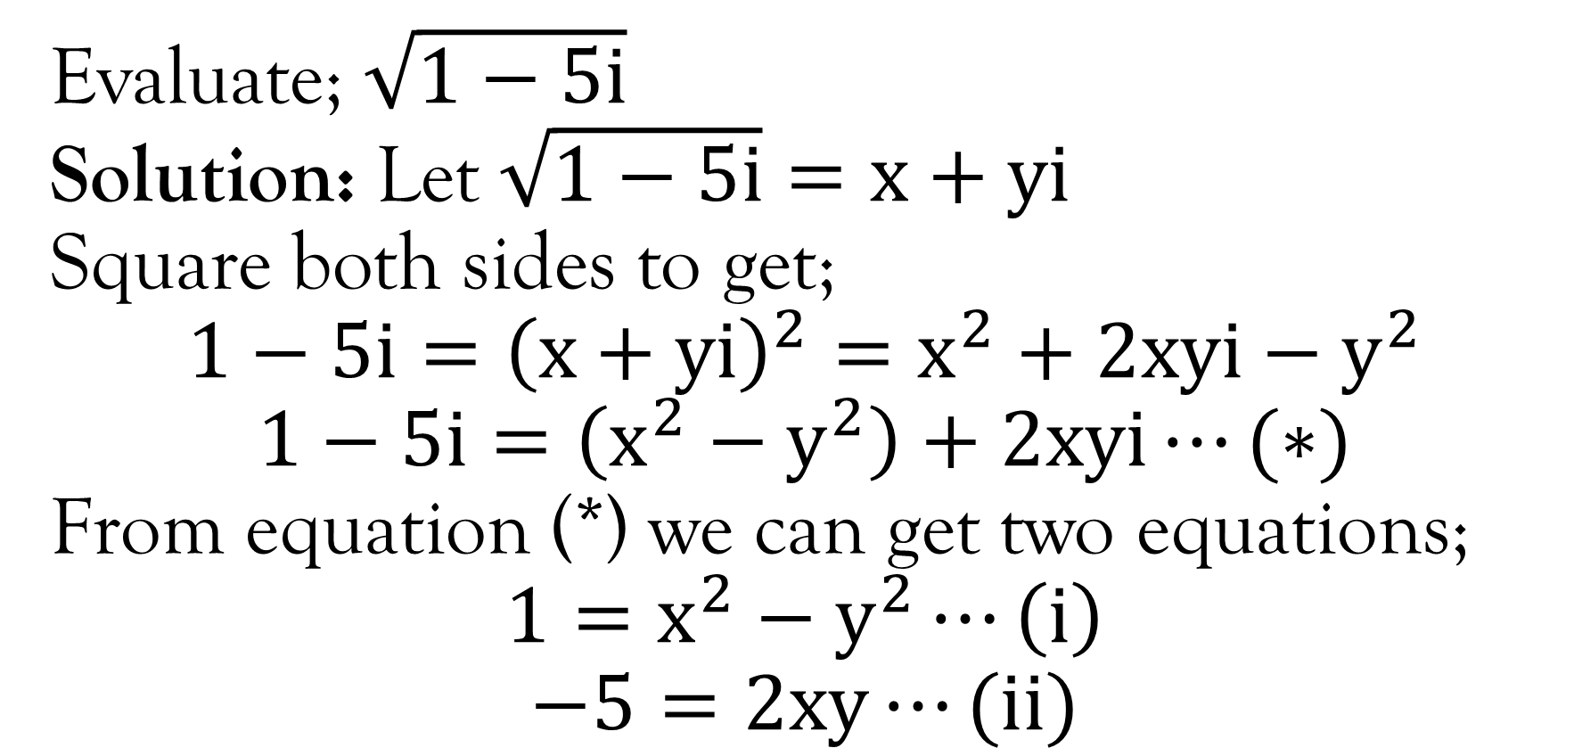
Example…
Evaluate; $\sqrt{1−5i}$
Solution: Let $\sqrt{1−5i}=x+yi$
Square both sides to get;
$$1−5i={\left(x+yi\right)}^{2}=x^{2}+2xyi−y^{2}$$
$$1−5i=\left(x^{2}−y^{2}\right)+2xyi⋯(∗)$$
From equation (*) we can get two equations;
$$1=x^{2}−y^{2}⋯\left(i\right)$$
$$−5=2xy⋯(ii)$$

Slide 23
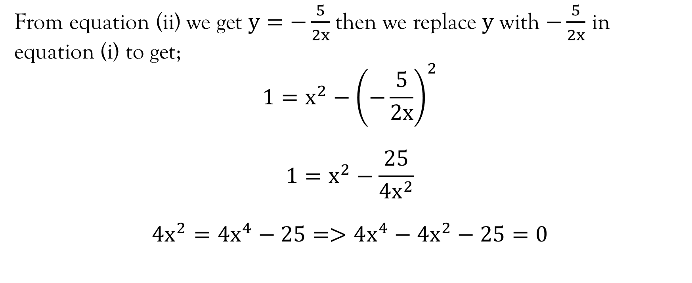
Example…contd.
From equation (ii) we get $y=−\frac{5}{2x}$then we replace $y$ with $−\frac{5}{2x}$ in equation (i) to get;
$$1=x^{2}−{\left(−\frac{5}{2x}\right)}^{2}$$
$$1=x^{2}−\frac{25}{4x^{2}}$$
$$4x^{2}=4x^{4}−25=>4x^{4}−4x^{2}−25=0$$

Slide 24
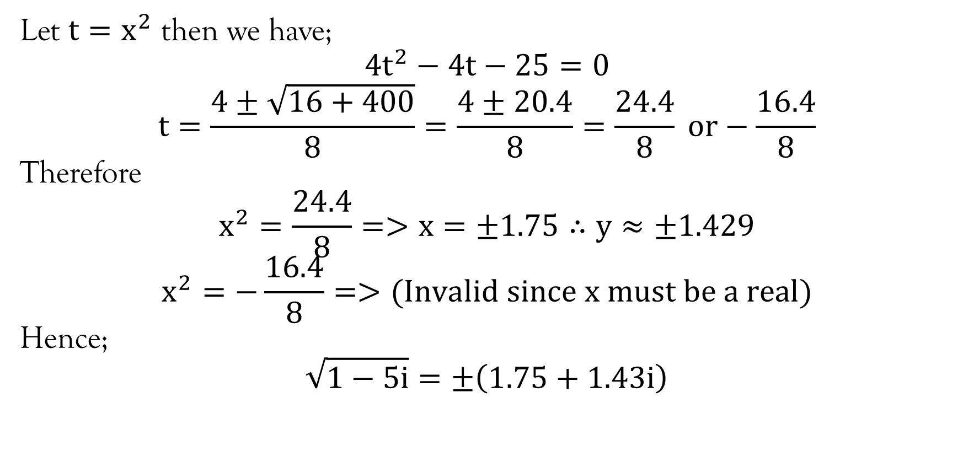
Example…contd.
Let $t=x^{2}$ then we have;
$$4t^{2}−4t−25=0$$
$$t=\frac{4±\sqrt{16+400}}{8}=\frac{4±20.4}{8}=\frac{24.4}{8} or−\frac{16.4}{8}$$
Therefore
$$x^{2}=\frac{24.4}{8}=>x=±1.75∴y≈±1.429$$
$$x^{2}=−\frac{16.4}{8}=>(Invalid since x must be a real)$$
Hence;
$$\sqrt{1−5i}=±\left(1.75+1.43i\right)$$

Slide 25
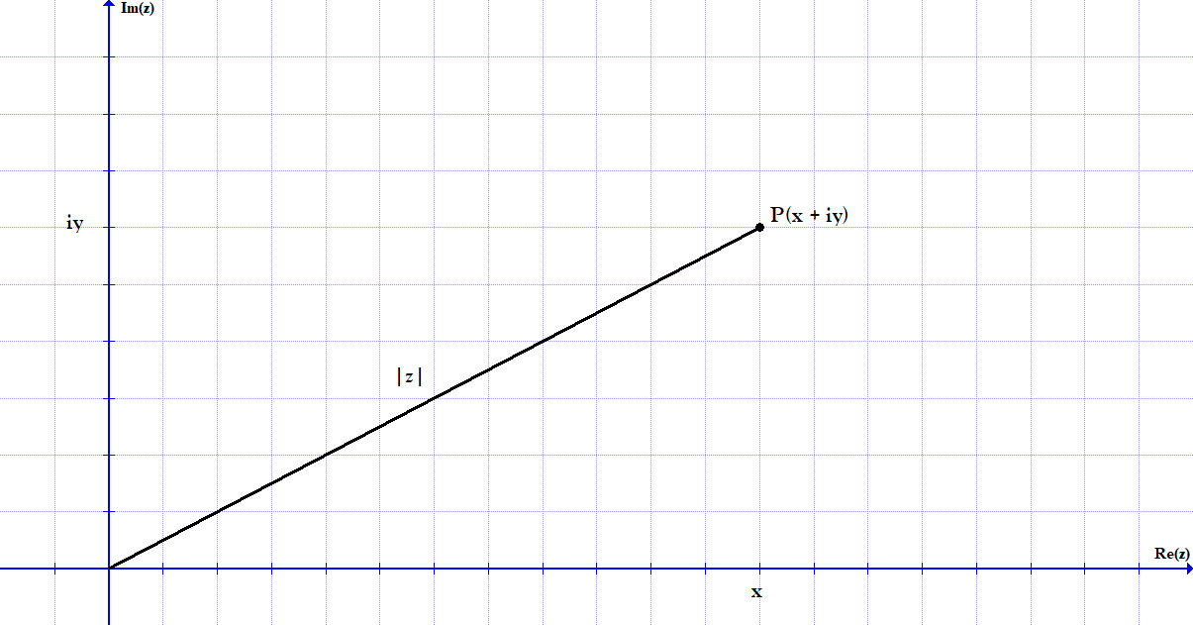
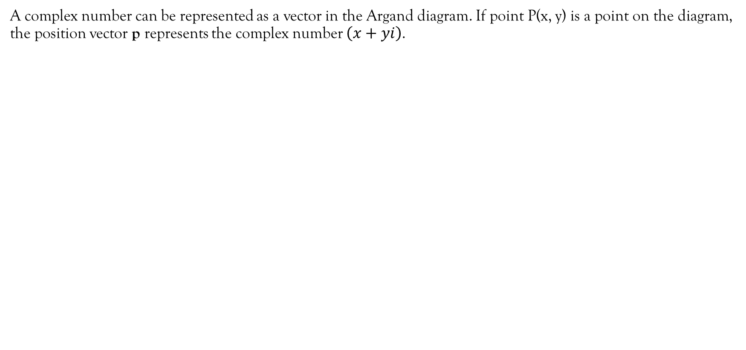
Argand diagram
A complex number can be represented as a vector in the Argand diagram. If point P(x, y) is a point on the diagram, the position vector p represents the complex number $\left(x+yi\right)$.

Slide 26
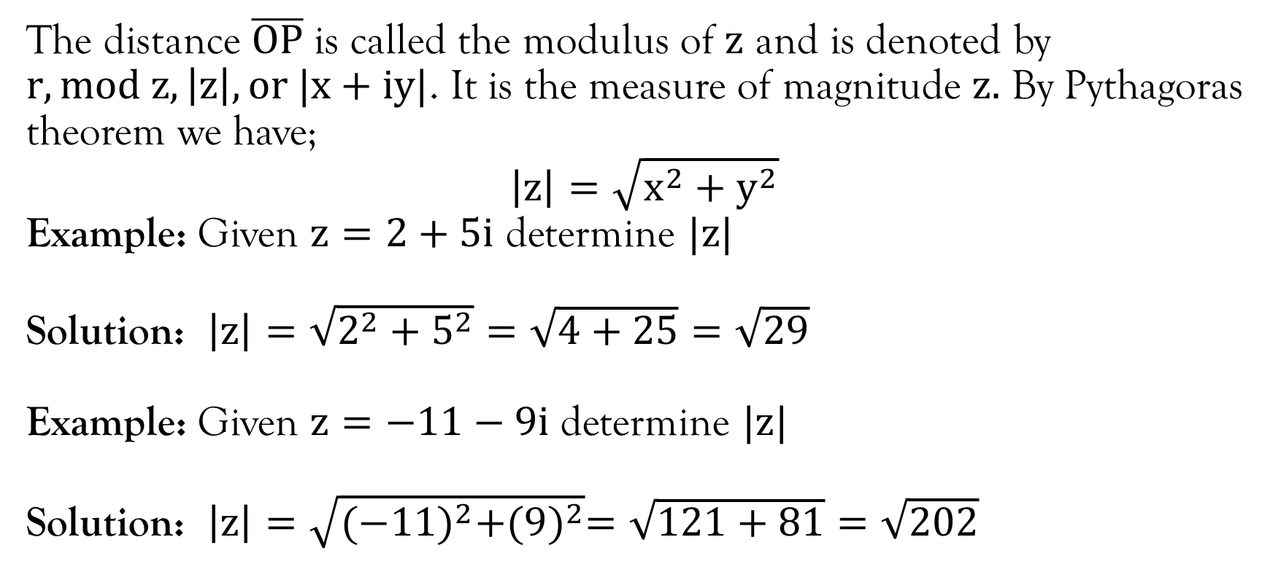
Modulus of a complex number
The distance $\overline{OP}$ is called the modulus of $z$ and is denoted by $r, mod z, \left|z\right|, or |x+iy|$. It is the measure of magnitude $z.$ By Pythagoras theorem we have;
$$\left|z\right|=\sqrt{x^{2}+y^{2}}$$
Example: Given $z=2+5i$ determine $|z|$
Solution: $\left|z\right|=\sqrt{2^{2}+5^{2}}=\sqrt{4+25}=\sqrt{29}$
Example: Given $z=−11−9i$ determine $|z|$
Solution: $\left|z\right|=\sqrt{{(−11)}^{2}+{(9)}^{2}}=\sqrt{121+81}=\sqrt{202}$

Slide 27
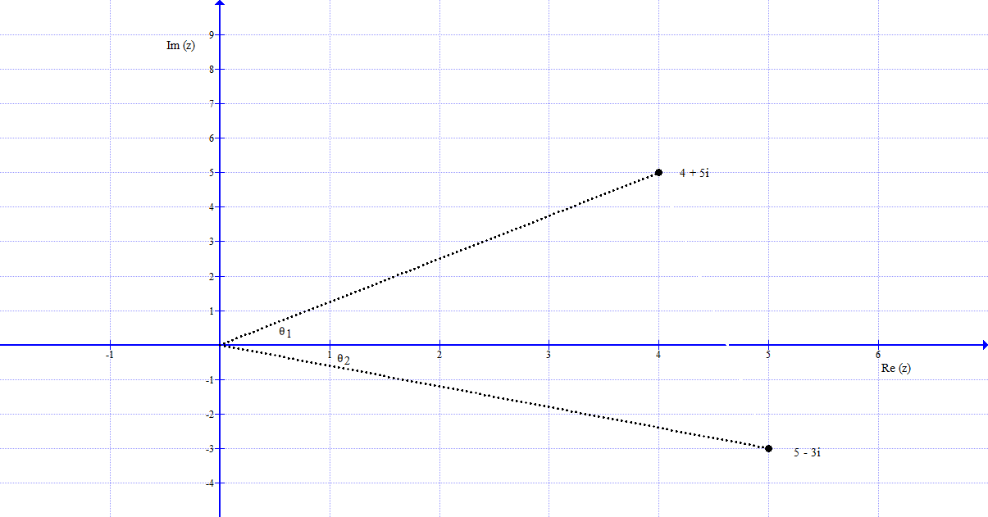
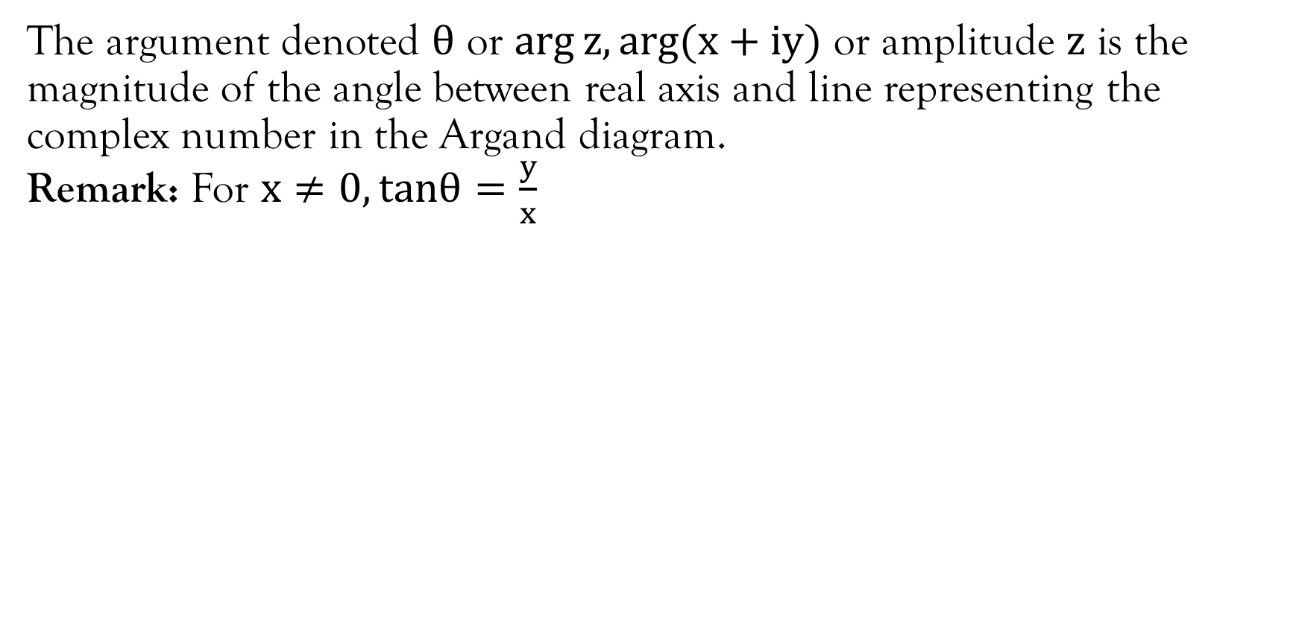
Argument
The argument denoted $θ$ or $\arg{z, arg⁡(x+iy)}$ or amplitude $z$ is the magnitude of the angle between real axis and line representing the complex number in the Argand diagram.
Remark: For $x≠0, tanθ=\frac{y}{x}$

Slide 28
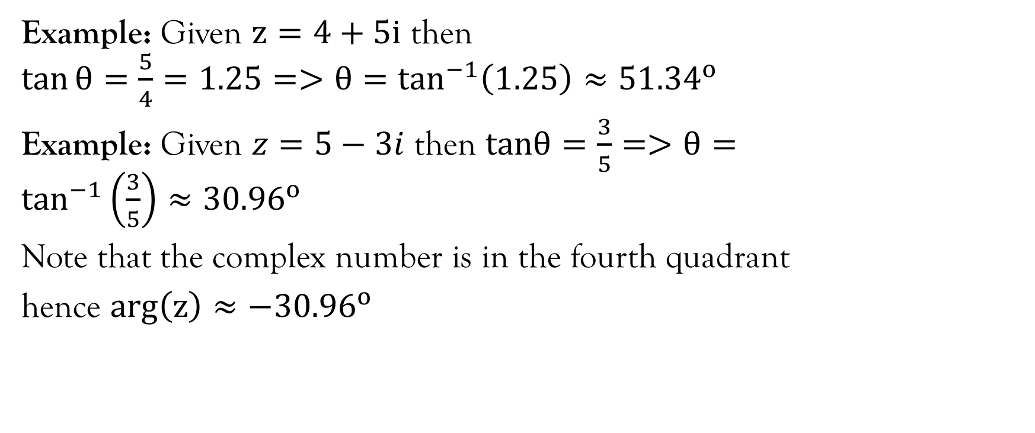
Example
Example: Given $z=4+5i$ then $\tan{θ=\frac{5}{4}=1.25=>θ=\tan^{−1}\left(1.25\right)≈{51.34}^{o}}$
Example: Given $z=5−3i$ then $tanθ=\frac{3}{5}=>θ=\tan^{−1}\left(\frac{3}{5}\right)≈{30.96}^{o}$
Note that the complex number is in the fourth quadrant
hence $\arg\left(z\right)≈−{30.96}^{o}$

Slide 29
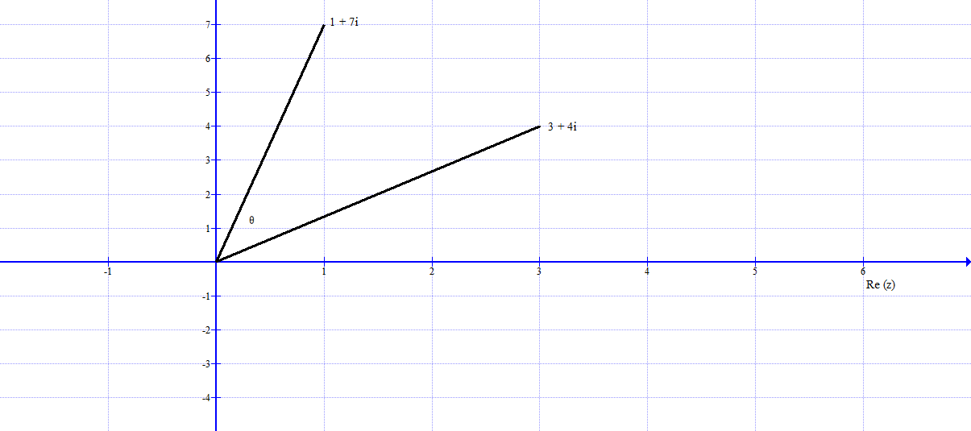
Example

Slide 30
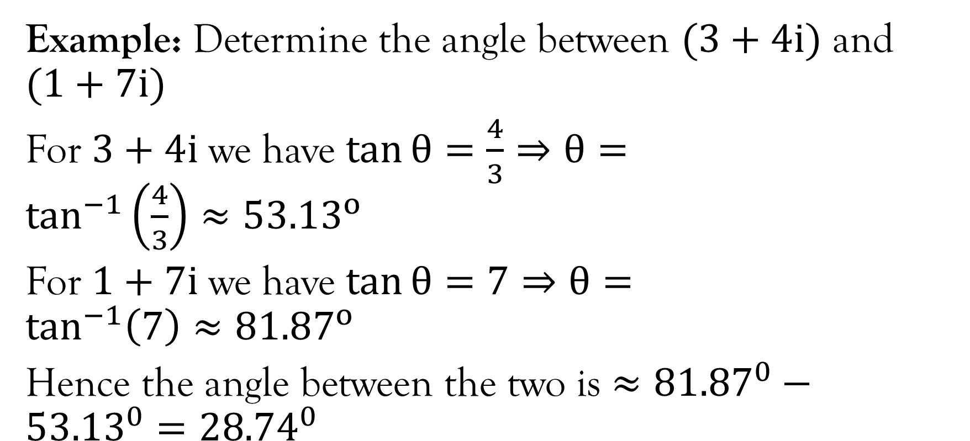
Example…contd.
Example: Determine the angle between $(3+4i)$ and $(1+7i)$
For $3+4i$ we have $\tan{θ}=\frac{4}{3}⇒θ=\tan^{−1}\left(\frac{4}{3}\right)≈{53.13}^{o}$
For $1+7i$ we have $\tan{θ}=7⇒θ=\tan^{−1}\left(7\right)≈{81.87}^{o}$
Hence the angle between the two is $≈{81.87}^{0}−{53.13}^{0}={28.74}^{0}$

Slide 31
Mod-arg form of complex numbers
Also referred to as polar coordinate form of complex numbers
This will be covered in the lecture 2 on polar coordinates.

Slide 32
References
Kahenya, P. (2017). Foundation Maths. LAP Lambert Academic Publishers.
Stewart, J. (2012). Calculus (7th ed.). BROOKS/COLE Cengage Learning.

Slide 33
End of Lecture 1
Thank you

