Slide 1
Mathematics for Science
Lecture 2
Polar Equations and Graphs
Kahenya, N.P

Slide 2
Introduction to Lecture 2
This lecture will introduce the rectangular and polar coordinates systems.
Intended learning outcomes
At the end of this lecture, you will be able to;
  Define rectangular and polar coordinates .
  Convert from one system to another.
  Plot graphs of polar equations.

Slide 3
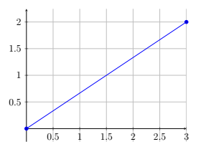
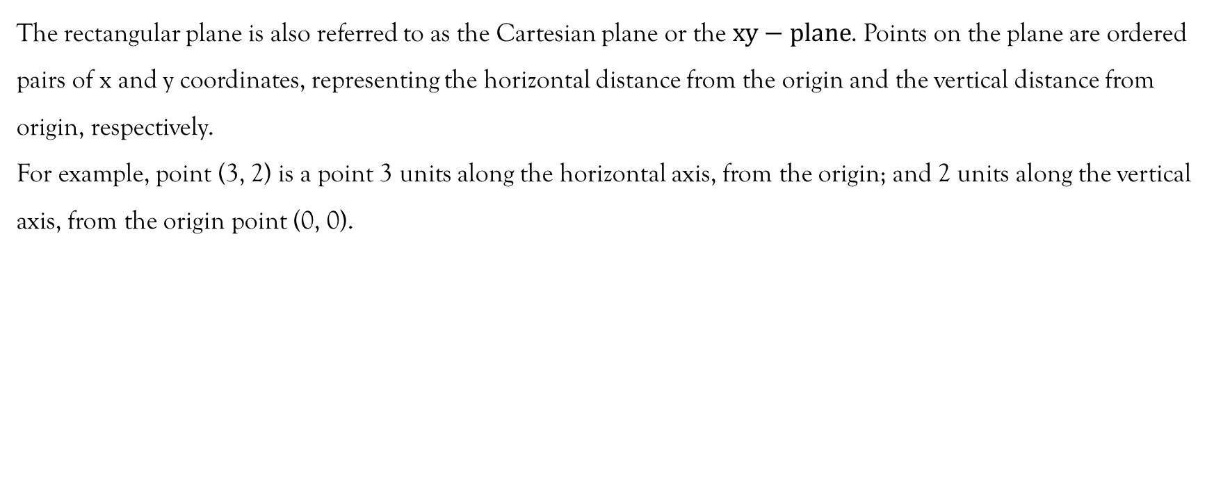
Rectangular coordinates
The rectangular plane is also referred to as the Cartesian plane or the $xy−plane$. Points on the plane are ordered pairs of x and y coordinates, representing the horizontal distance from the origin and the vertical distance from origin, respectively.
For example, point (3, 2) is a point 3 units along the horizontal axis, from the origin; and 2 units along the vertical axis, from the origin point (0, 0).

Slide 4
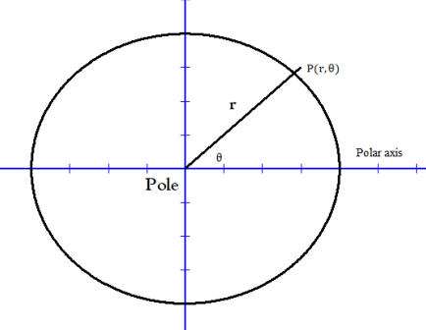
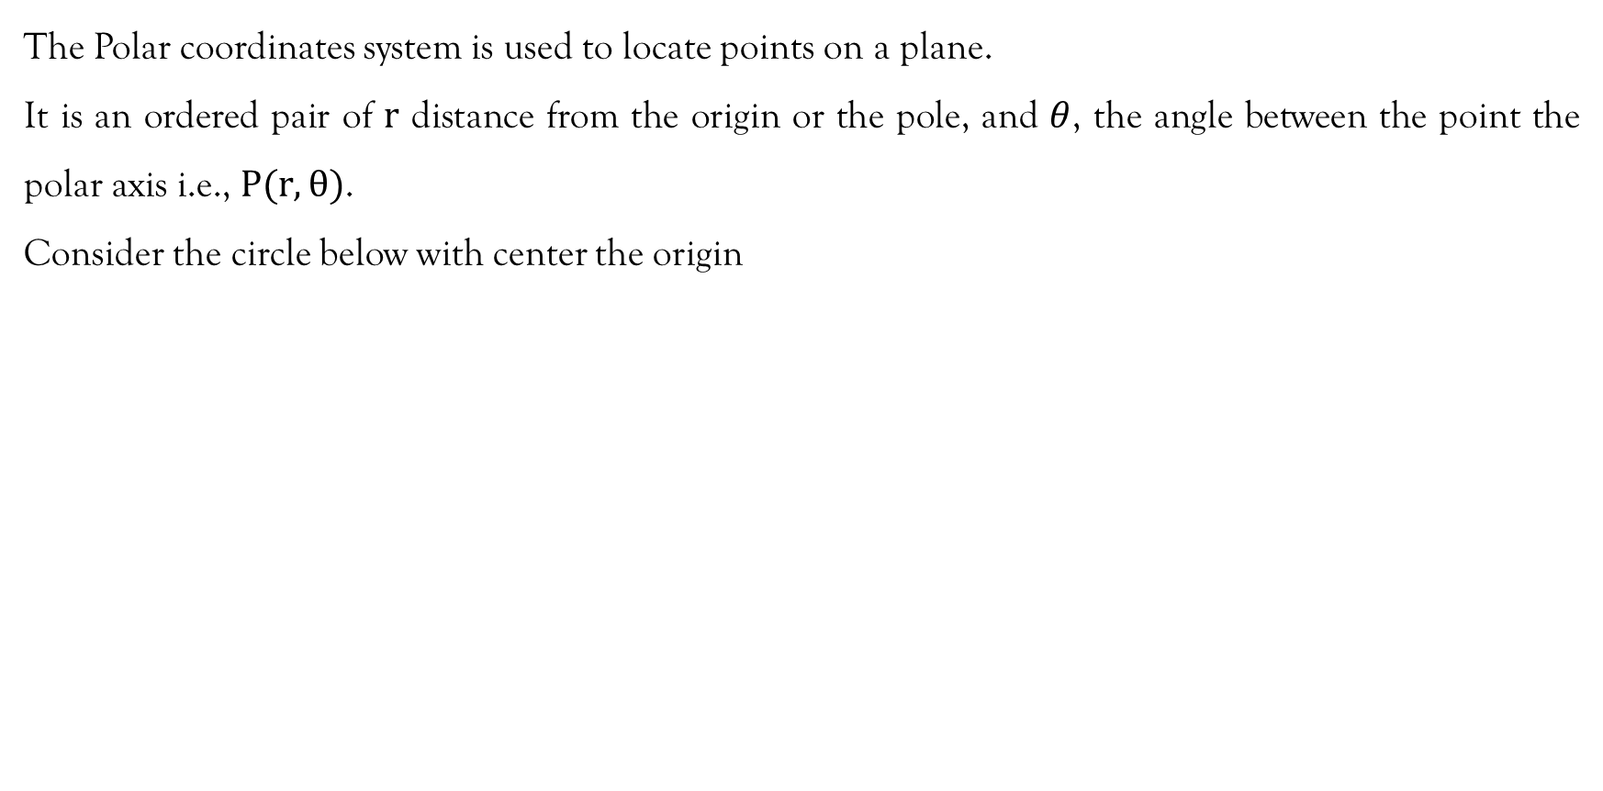
Polar coordinates
The Polar coordinates system is used to locate points on a plane.
It is an ordered pair of $r$ distance from the origin or the pole, and $θ$, the angle between the point the polar axis i.e., $P(r, θ)$.
Consider the circle below with center the origin

Slide 5
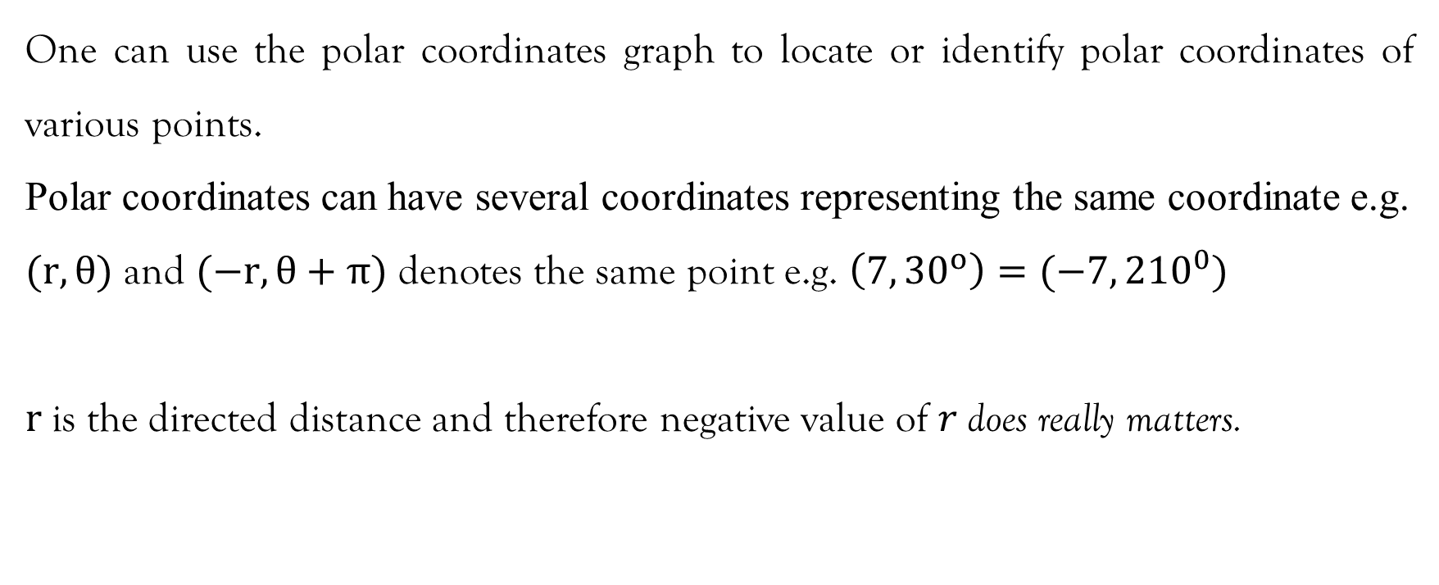
Remark
One can use the polar coordinates graph to locate or identify polar coordinates of various points.
Polar coordinates can have several coordinates representing the same coordinate e.g.
$(r,θ)$ and $(−r,θ+π)$ denotes the same point e.g. $\left(7, {30}^{o}\right)=(−7, {210}^{0})$
$r$is the directed distance and therefore negative value of $r$does really matters.

Slide 6
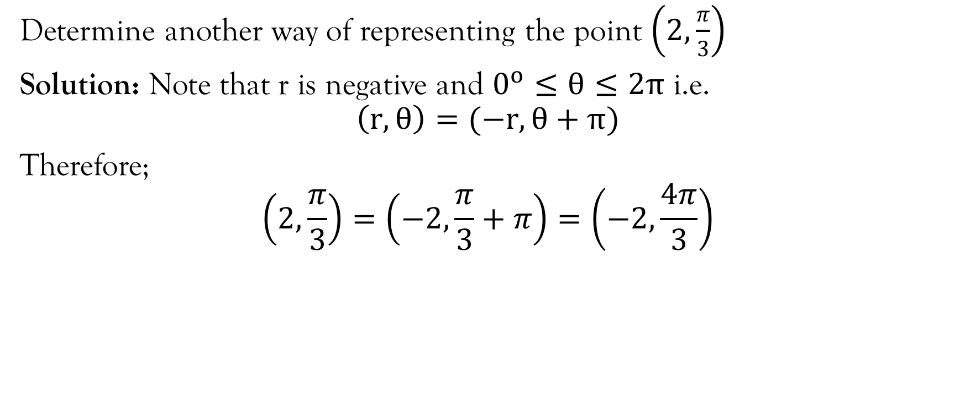
Example
Determine another way of representing the point $\left(2,\frac{π}{3}\right)$
Solution: Note that r is negative and $0^{o}≤θ≤2π$ i.e.
$$\left(r,θ\right)=(−r,θ+π)$$
Therefore;
$$\left(2,\frac{π}{3}\right)=\left(−2,\frac{π}{3}+π\right)=\left(−2,\frac{4π}{3}\right)$$

Slide 7
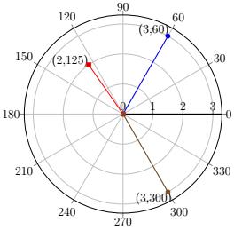
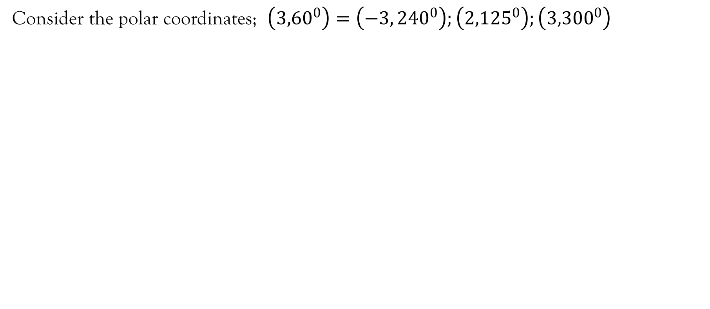
Examples
Consider the polar coordinates; $\left({3,60}^{0}\right)=\left(−3, {240}^{0}\right);\left({2,125}^{0}\right);\left({3,300}^{0}\right)$

Slide 8
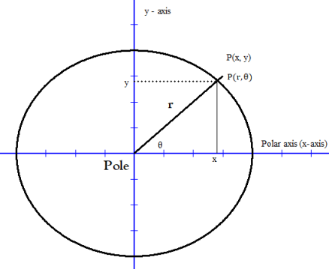
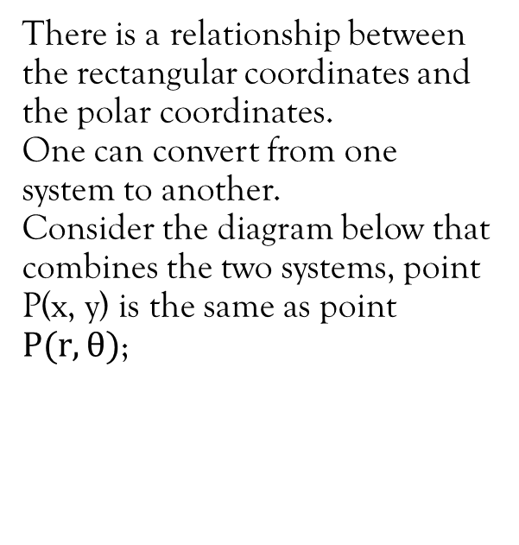
Polar and rectangular coordinates
There is a relationship between the rectangular coordinates and the polar coordinates.
One can convert from one system to another.
Consider the diagram below that combines the two systems, point P(x, y) is the same as point $P(r,θ)$;

Slide 9
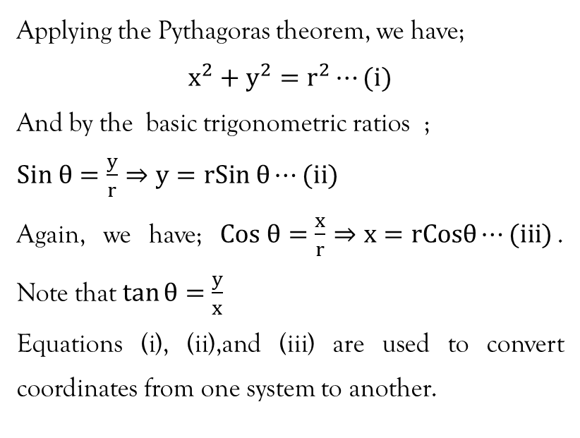
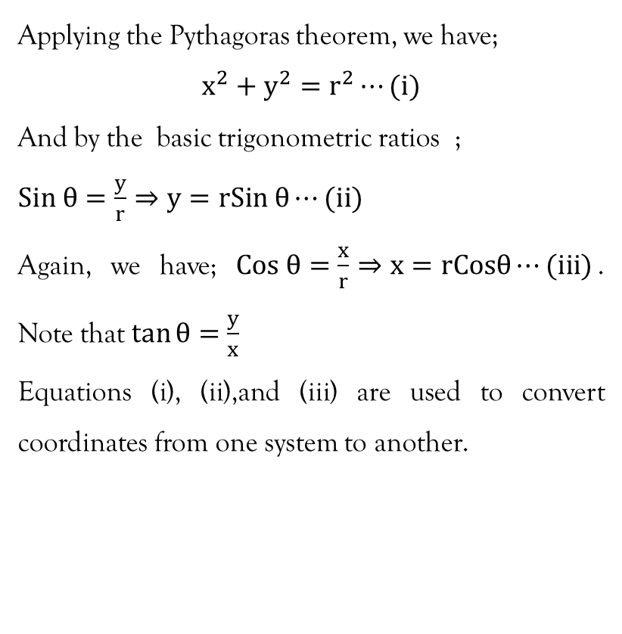
Contd…
Applying the Pythagoras theorem, we have;
$$x^{2}+y^{2}=r^{2}⋯(i)$$
And by the basic trigonometric ratios ;
$Sin θ=\frac{y}{r}⇒y=rSin θ⋯(ii)$
Again, we have; $Cos θ=\frac{x}{r}⇒x=rCosθ⋯(iii)$. Note that $\tan{θ=\frac{y}{x}}$
Equations (i), (ii),and (iii) are used to convert coordinates from one system to another.

Slide 10
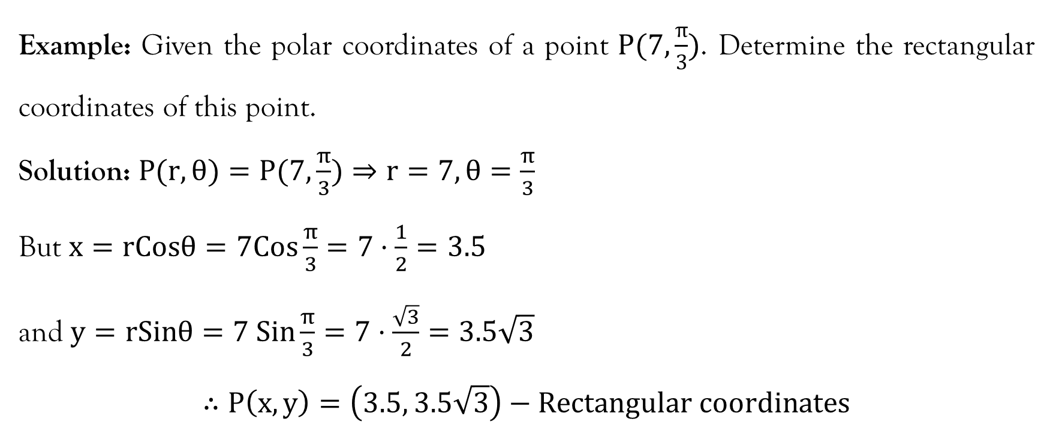
Example (Coordinates)
Example: Given the polar coordinates of a point $P(7,\frac{π}{3})$. Determine the rectangular coordinates of this point.
Solution: $P(r,θ)=P(7,\frac{π}{3})⇒r=7,θ=\frac{π}{3}$
But $x=rCosθ=7Cos\frac{π}{3}=7⋅\frac{1}{2}=3.5$
and $y=rSinθ=7 Sin\frac{π}{3}=7⋅\frac{\sqrt{3}}{2}=3.5\sqrt{3}$
$$∴P\left(x,y\right)=\left(3.5, 3.5\sqrt{3}\right)−Rectangular coordinates$$

Slide 11
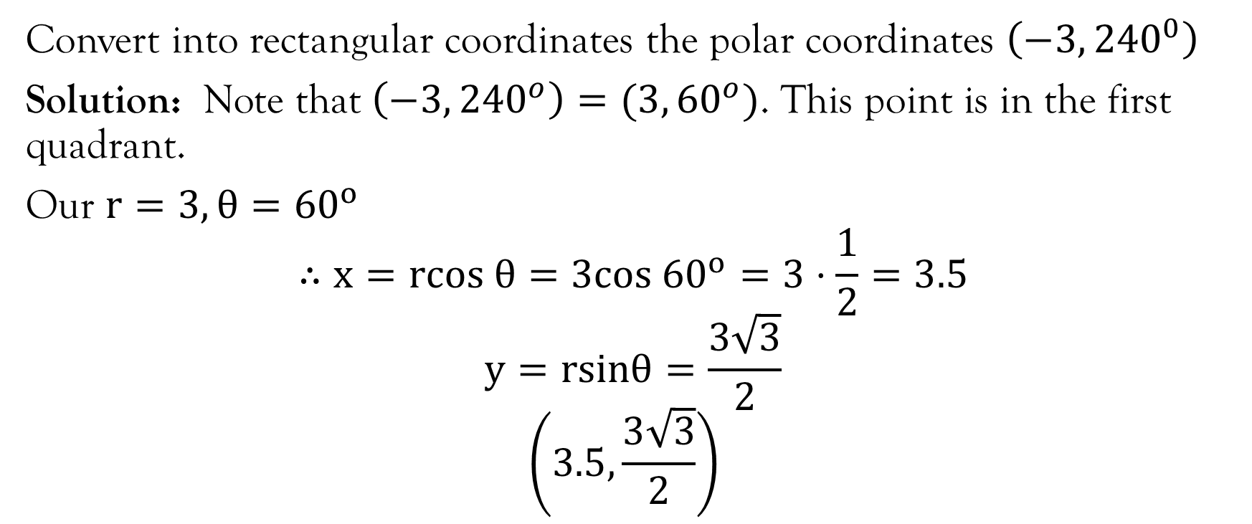
Example (Coordinates)
Convert into rectangular coordinates the polar coordinates $\left(−3, {240}^{0}\right)$
Solution: Note that $\left(−3, {240}^{o}\right)=(3, {60}^{o})$. This point is in the first quadrant.
Our $r=3, θ={60}^{o}$
$$∴x=rcos θ=3cos {60}^{o}=3⋅\frac{1}{2}=3.5$$
$$y=rsinθ=\frac{3\sqrt{3}}{2}$$
$$\left(3.5,\frac{3\sqrt{3}}{2}\right)$$

Slide 12
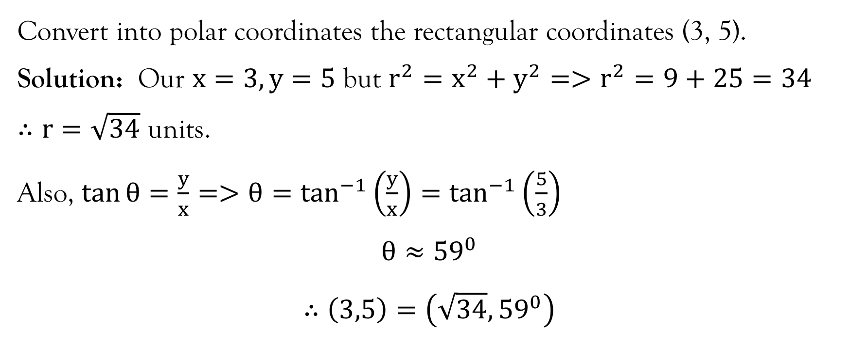
Example (Coordinates)
Convert into polar coordinates the rectangular coordinates (3, 5).
Solution: Our $x=3, y=5$ but $r^{2}=x^{2}+y^{2}=>r^{2}=9+25=34$
$∴r=\sqrt{34}$ units.
Also, $\tan{θ=\frac{y}{x}=>θ=\tan^{−1}\left(\frac{y}{x}\right)=\tan^{−1}\left(\frac{5}{3}\right)}$
$$θ≈{59}^{0}$$
$$∴\left(3,5\right)=\left(\sqrt{34}, {59}^{0}\right)$$

Slide 13
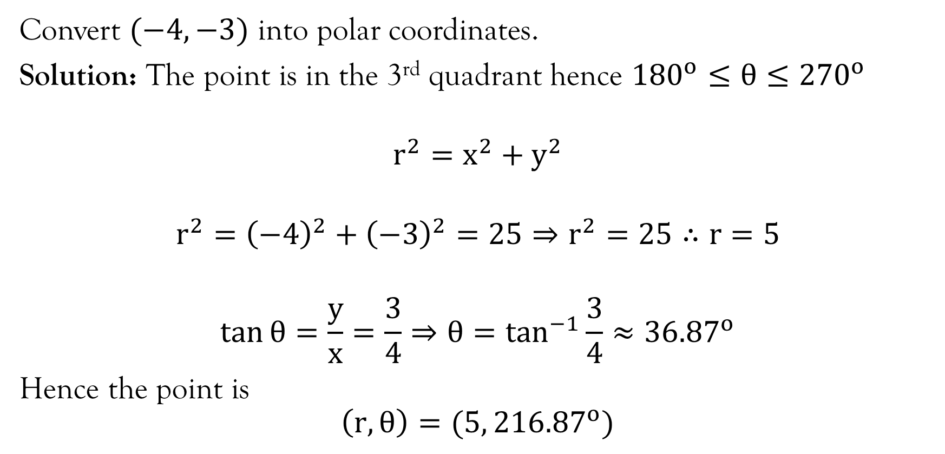
Example (Coordinates)
Convert $(−4, −3)$ into polar coordinates.
Solution: The point is in the 3rd quadrant hence ${180}^{o}≤θ≤{270}^{o}$
$$r^{2}=x^{2}+y^{2}$$
$$r^{2}={\left(−4\right)}^{2}+{\left(−3\right)}^{2}=25⇒r^{2}=25∴r=5$$
$$\tan{θ=\frac{y}{x}=\frac{3}{4}⇒θ=\tan^{−1}{\frac{3}{4}≈{36.87}^{o}}}$$
Hence the point is
$$\left(r, θ\right)=(5, {216.87}^{o})$$

Slide 14
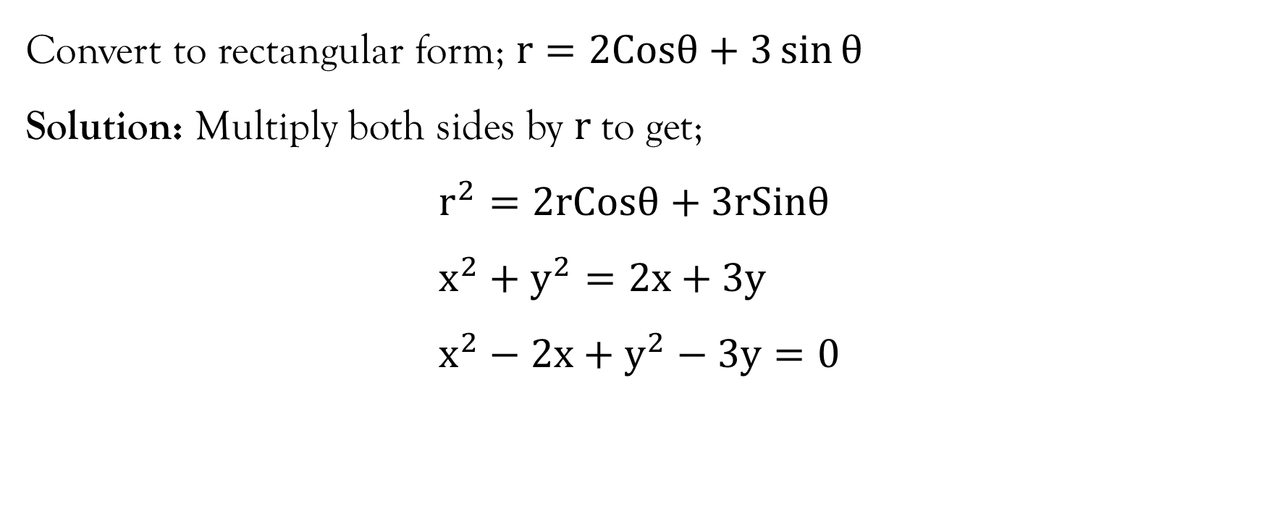
Example (Equations)
Convert to rectangular form; $r=2Cosθ+3\sin{θ}$
Solution: Multiply both sides by $r$to get;
$$r^{2}=2rCosθ+3rSinθ \\ x^{2}+y^{2}=2x+3y \\ x^{2}−2x+y^{2}−3y=0$$

Slide 15
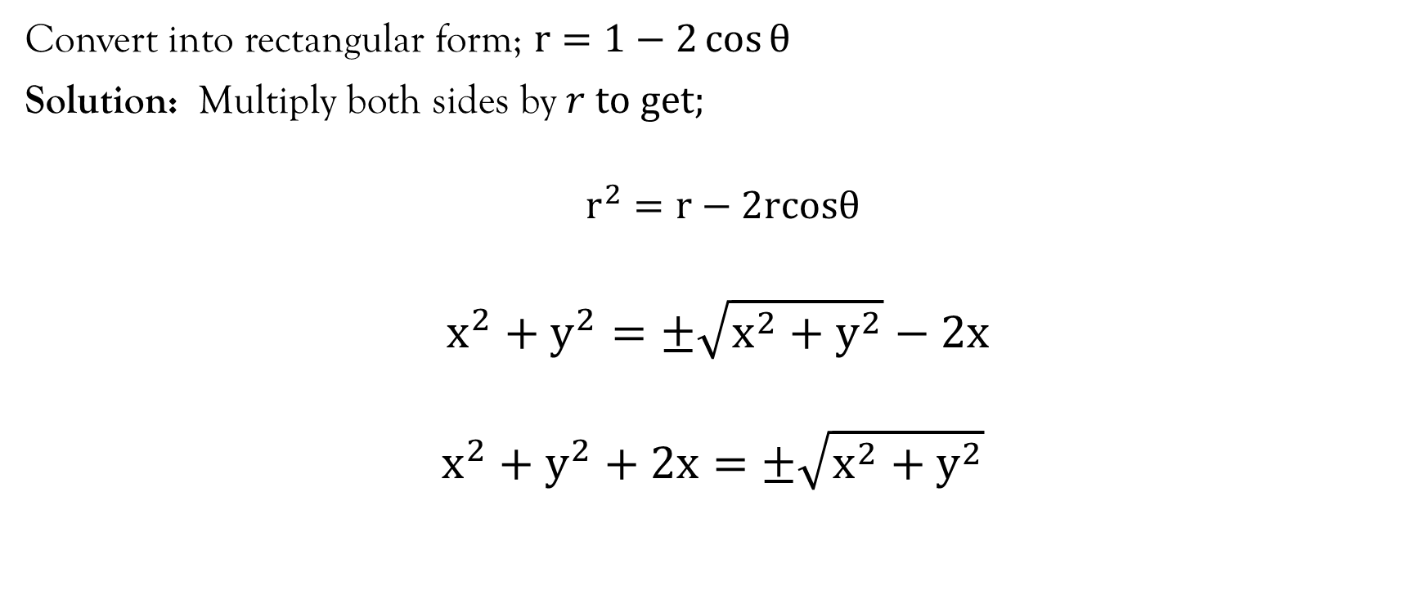
Example (Equations)
Convert into rectangular form; $r=1−2\cos{θ}$
Solution: Multiply both sides by $r to get;$
$$r^{2}=r−2rcosθ$$
$$x^{2}+y^{2}=±\sqrt{x^{2}+y^{2}}−2x$$
$$x^{2}+y^{2}+2x=±\sqrt{x^{2}+y^{2}}$$

Slide 16
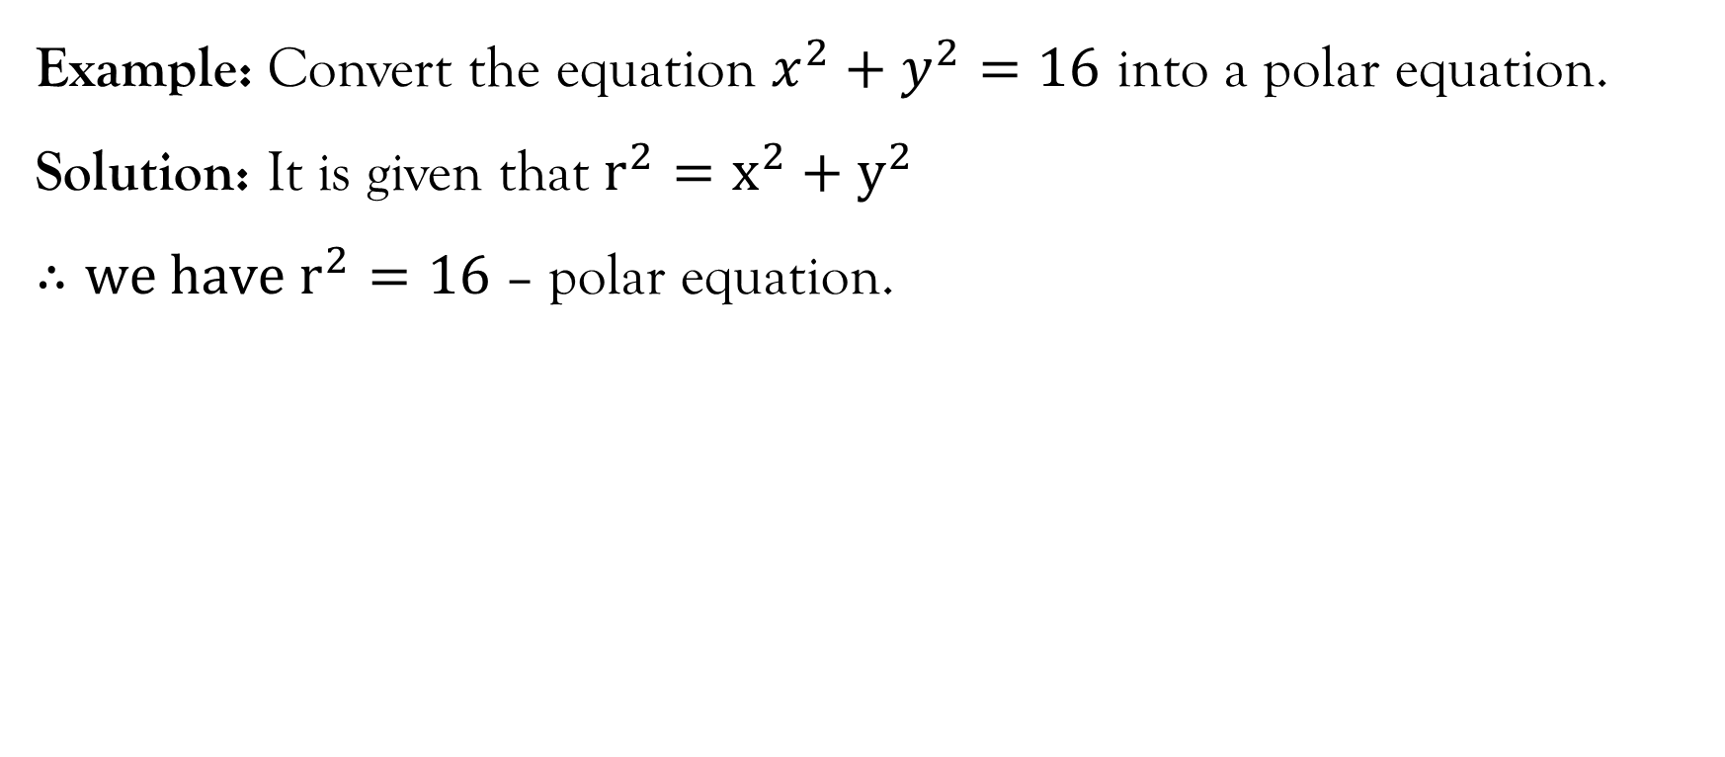
Example (Equations)
Example: Convert the equation $x^{2}+y^{2}=16$ into a polar equation.
Solution: It is given that $r^{2}=x^{2}+y^{2}$
$∴we have r^{2}=16$ – polar equation.

Slide 17
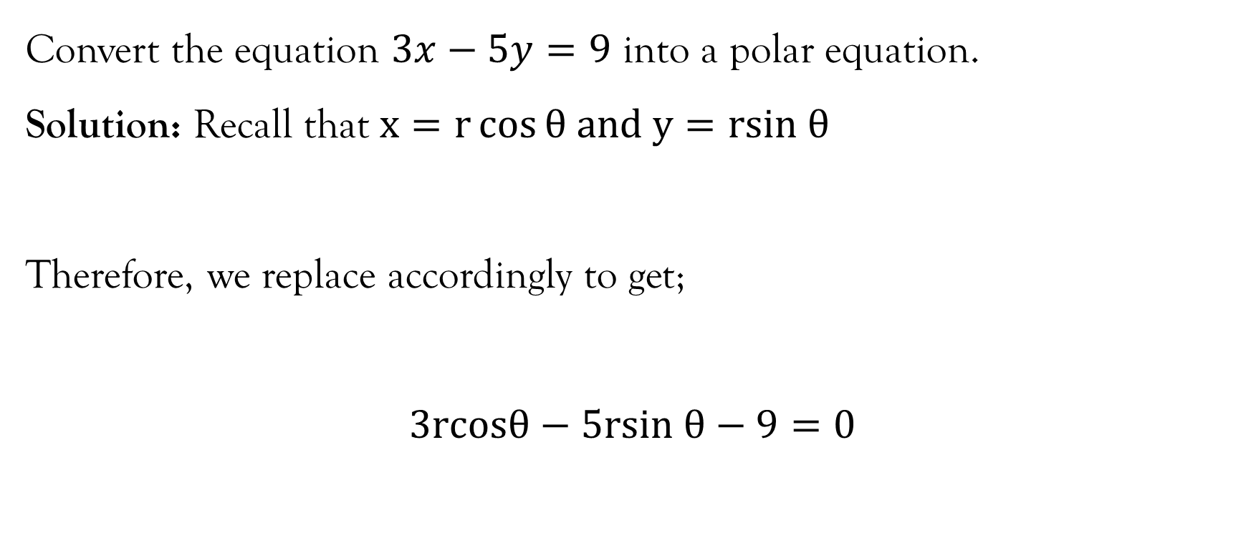
Example (Equations)
Convert the equation $3x−5y=9$ into a polar equation.
Solution: Recall that $x=r\cos{θ and y=rsin θ}$
Therefore, we replace accordingly to get;
$$3rcosθ−5rsin θ−9=0$$

Slide 18
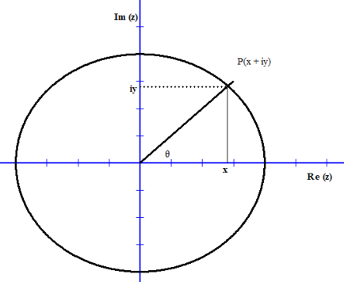
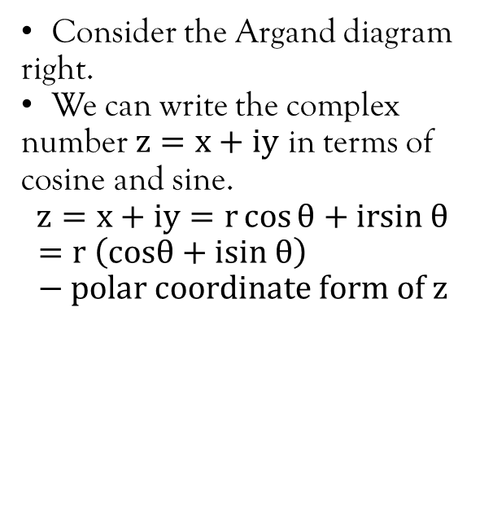
Mod-arg form/polar coordinates of Complex numbers
Consider the Argand diagram right.
We can write the complex number $z=x+iy$ in terms of cosine and sine.
$$z=x+iy=r\cos{θ+irsin θ}$$
$$=r \left(cosθ+isin θ\right)−polar coordinate form of z$$

Slide 19
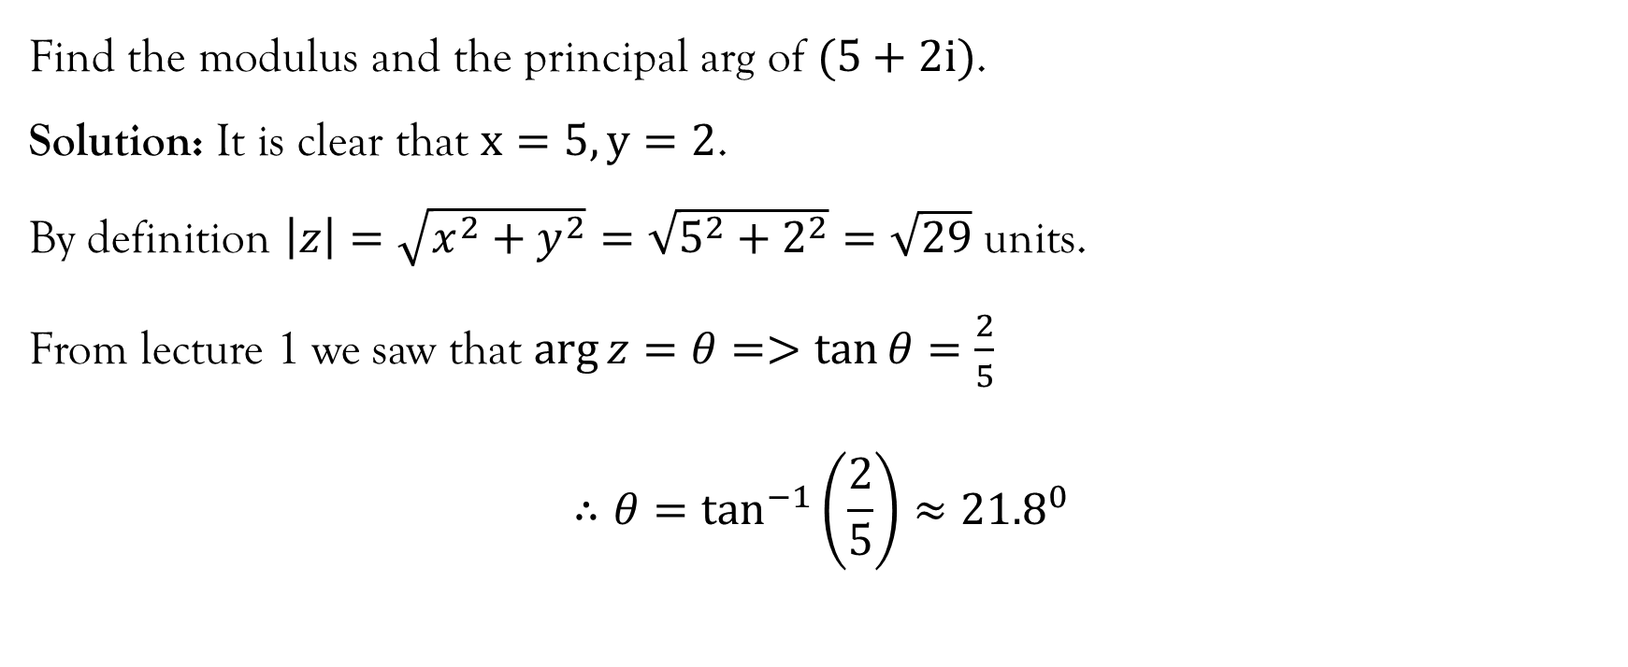
Example
Find the modulus and the principal arg of $(5+2i)$.
Solution: It is clear that $x=5, y=2$.
By definition $\left|z\right|=\sqrt{x^{2}+y^{2}}=\sqrt{5^{2}+2^{2}}=\sqrt{29}$ units.
From lecture 1 we saw that $\arg{z=θ=>\tan{θ=\frac{2}{5}}}$
$$∴θ=\tan^{−1}\left(\frac{2}{5}\right)≈{21.8}^{0}$$

Slide 20
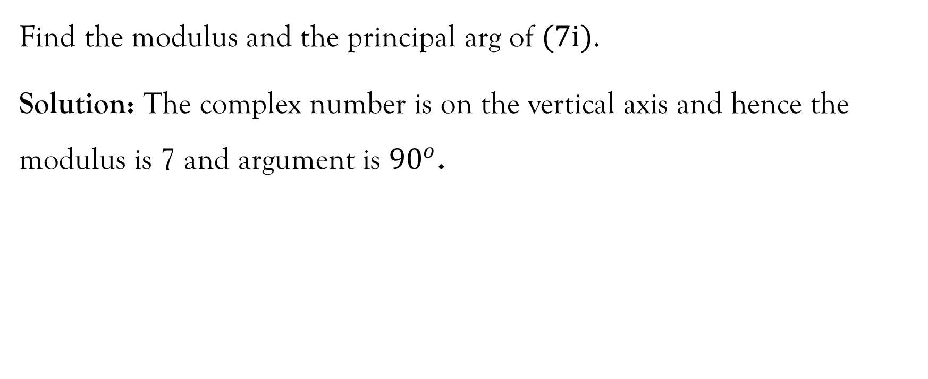
Example
Find the modulus and the principal arg of $(7i)$.
Solution: The complex number is on the vertical axis and hence the modulus is 7 and argument is ${90}^{o}$.

Slide 21
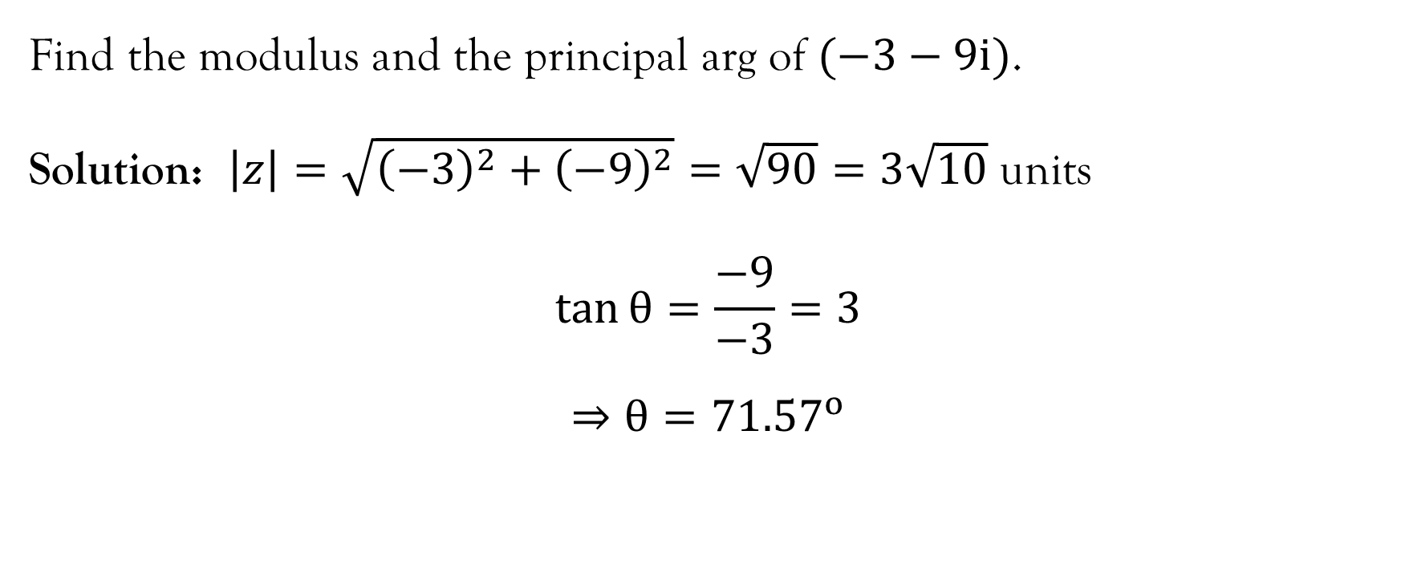
Example
Find the modulus and the principal arg of $(−3−9i)$.
Solution: $\left|z\right|=\sqrt{{\left(−3\right)}^{2}+{\left(−9\right)}^{2}}=\sqrt{90}=3\sqrt{10}$ units
$$\tan{θ=\frac{−9}{−3}=3}$$
$$⇒θ={71.57}^{o}$$

Slide 22
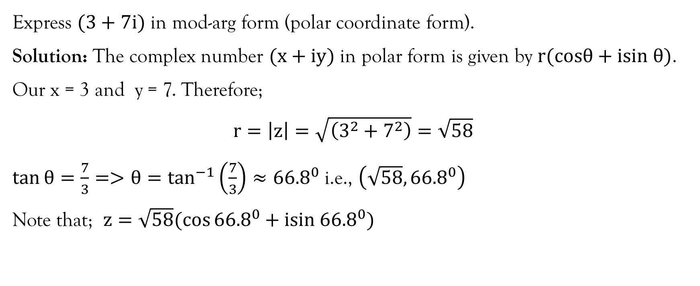
Example:
Express $(3+7i)$ in mod-arg form (polar coordinate form).
Solution: The complex number $(x+iy)$ in polar form is given by $r(cosθ+isin θ)$.
Our x = 3 and y = 7. Therefore;
$$r=\left|z\right|=\sqrt{\left(3^{2}+7^{2}\right)}=\sqrt{58}$$
$\tan{θ=\frac{7}{3}=>θ=\tan^{−1}\left(\frac{7}{3}\right)≈{66.8}^{0}}$ i.e., $\left(\sqrt{58},{66.8}^{0}\right)$
Note that; $z=\sqrt{58}(\cos{{66.8}^{0}+isin {66.8}^{0})}$

Slide 23
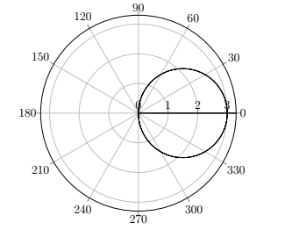
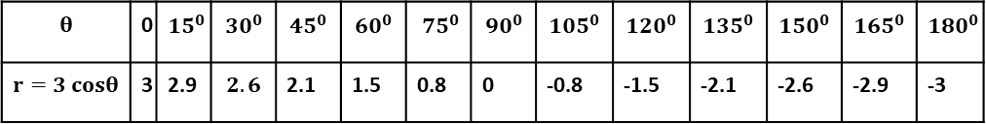
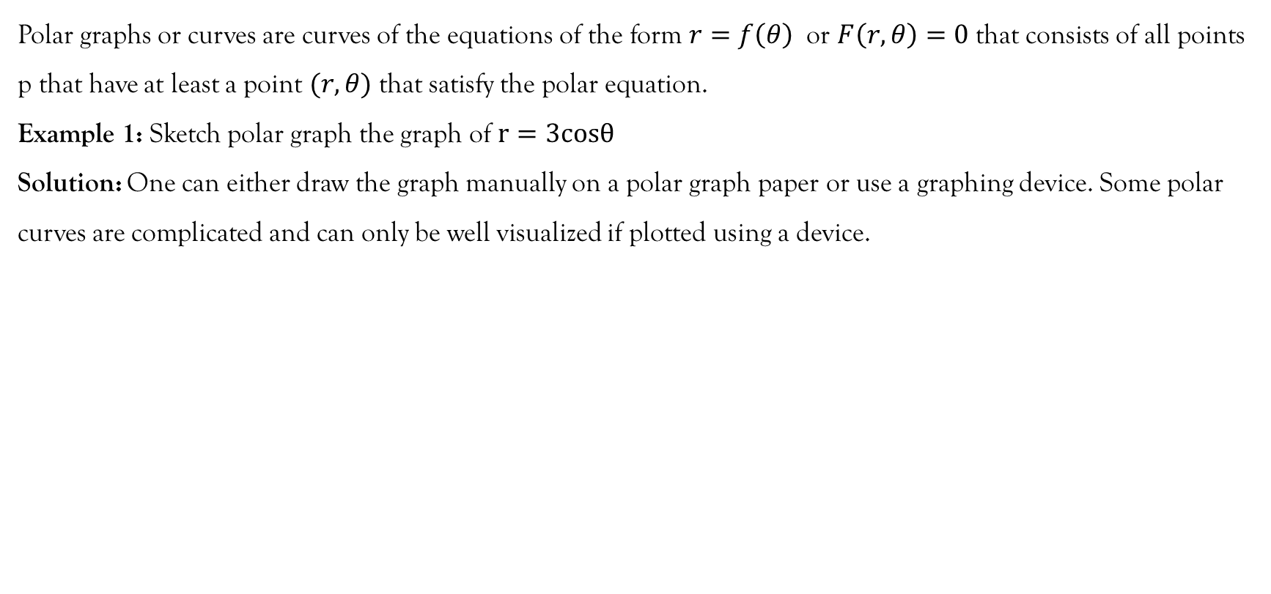
Polar graphs
Polar graphs or curves are curves of the equations of the form $r=f\left(θ\right)$ or $F\left(r, θ\right)=0$ that consists of all points p that have at least a point $(r,θ)$ that satisfy the polar equation.
Example 1: Sketch polar graph the graph of $r=3cosθ$
Solution: One can either draw the graph manually on a polar graph paper or use a graphing device. Some polar curves are complicated and can only be well visualized if plotted using a device.
$$θ$$ | 0 | $${15}^{0}$$ | $$30^{0}$$ | $$45^{0}$$ | $$60^{0}$$ | $75^{0}$ | $$90^{0}$$ | $$105^{0}$$ | $$120^{0}$$ | $$135^{0}$$ | $$150^{0}$$ | $$165^{0}$$ | $$180^{0}$$
$$r=3 cosθ$$ | 3 | 2.9 | $$2.6$$ | 2.1 | 1.5 | 0.8 | 0 | -0.8 | -1.5 | -2.1 | -2.6 | -2.9 | -3

Slide 24
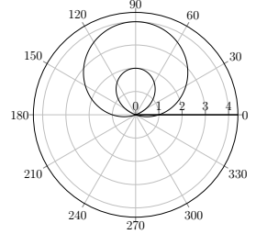
Polar graphs in TexStudio
\usepackage{tikz,pgfplots}
\usepackage{pgfplots}
\usepgfplotslibrary{polar}
\usepackage{pgfplots, pgfplotstable}
\begin{document}
\begin{tikzpicture}
\begin{polaraxis}
\addplot[domain=0:360, samples=2000]{1+3*sin(x)};
\end{polaraxis}
\end{tikzpicture}
\end{document}

Slide 25
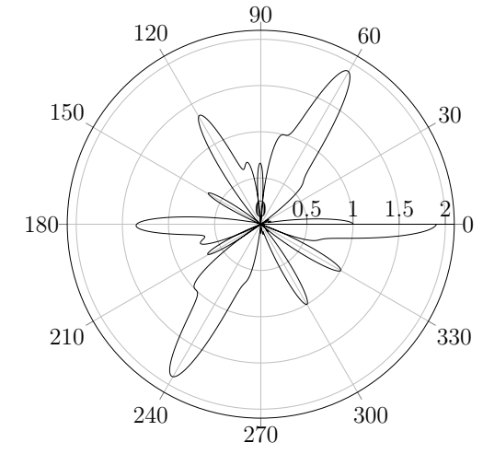

Polar graph; $r=\sin^{2}\left(1.2θ\right)+\cos^{3}{(6θ)}$
\begin{tikzpicture}
\begin{polaraxis}
\addplot[domain=0:360, samples=2000]{sin((1.2*x))^2+cos((6*x))^3};
\end{polaraxis}
\end{tikzpicture}

Slide 26
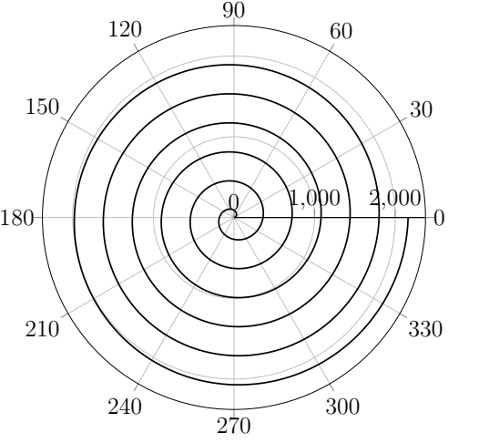

Archimedean spiral
$r=θ$
Application in spiral antennae, scroll compressors used in gas compression, arcs in buildings etc.

Slide 27
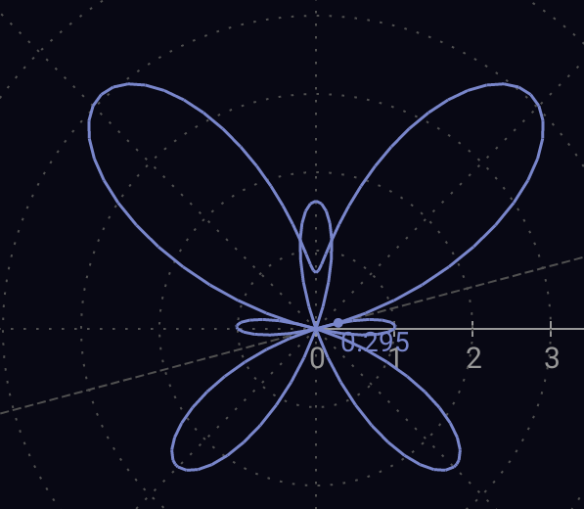

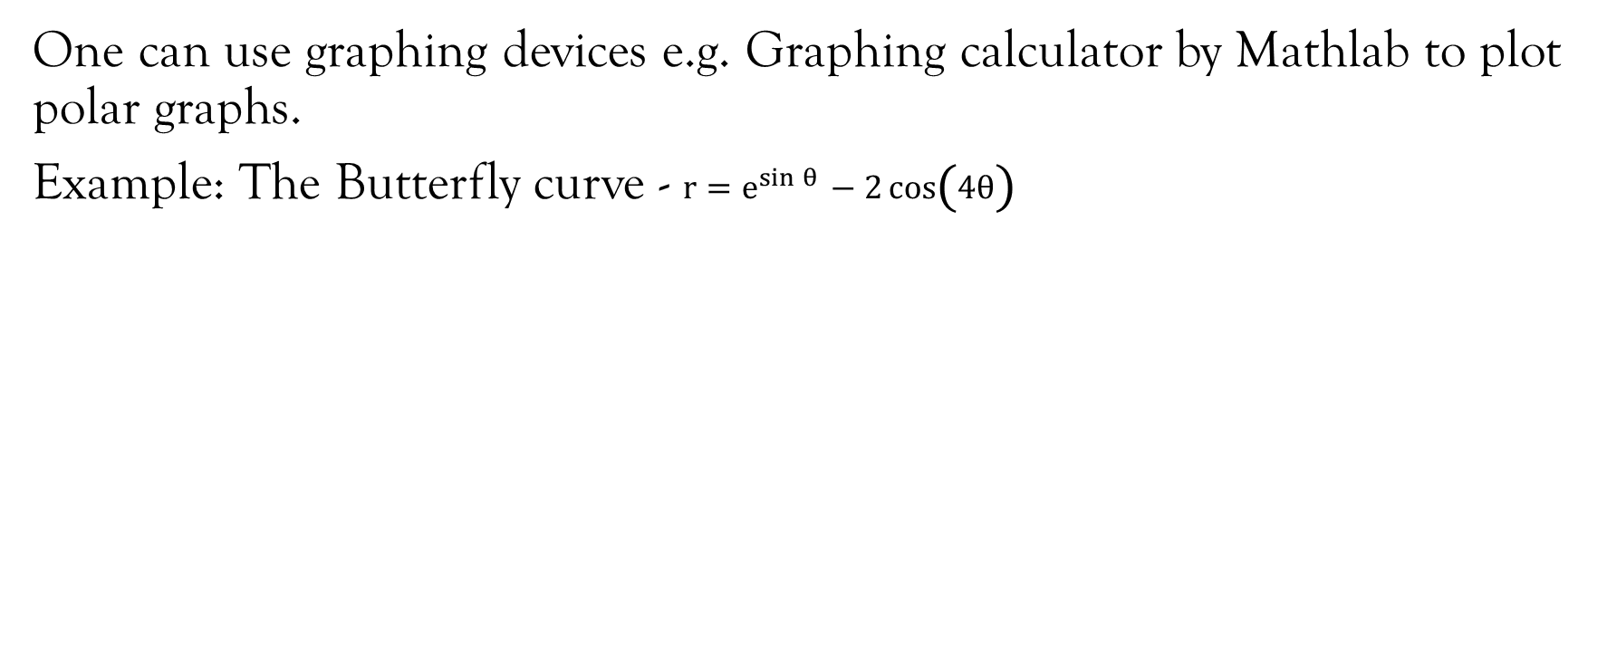
Polar graphs
One can use graphing devices e.g. Graphing calculator by Mathlab to plot polar graphs.
Example: The Butterfly curve - $r=e^{\sin{θ}}−2\cos\left(4θ\right)$

Slide 28
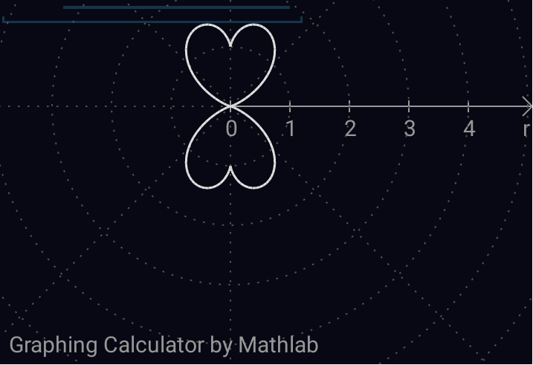
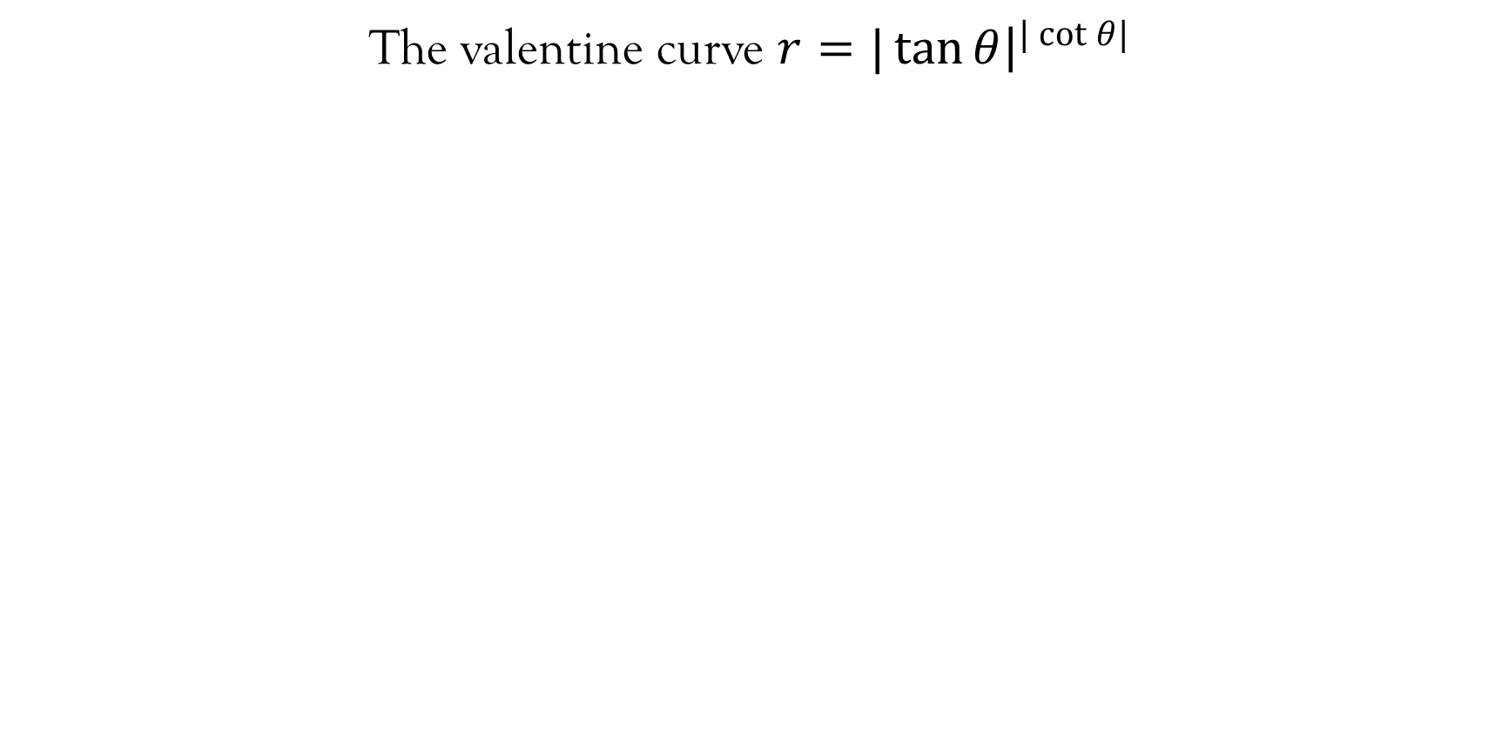
Polar curve – The Valentine Curve
The valentine curve $r=|\tan{θ{\left.​\right|}^{|\cot{θ|}}}$

Slide 29
References
These lecture notes have been adopted from, and should be complemented with relevant topics in;
Kahenya, P. (2017). Foundation Maths. LAP Lambert Academic Publishers.
Stewart, J. (2012). Calculus (7th ed.). BROOKS/COLE Cengage Learning.
Swokowski, E., & Cole, J. A. (2009). Algebra and Trigonometry with Analytical Geometry. BROOKS/COLE Cengage Learning.
https://mathcurve.com/courbes2d.gb/archimede/archimede.shtml
Texstudio can be download at https://www.texstudio.org/

Slide 30

End Lecture 2
Thank you

