Slide 1
Mathematics for Science
Lecture 5
Polynomials: Remainder and Factor Theorem
Lecturer: Kahenya, N.P

Slide 2
Introduction to lecture 5
This lecture will introduce polynomial expressions and equations, Remainder and Factor theorems and their applications.
Polynomial functions are important in calculus and other branches of mathematics e.g., abstract algebra that deal with polynomial codes among others

Slide 3
Intended learning outcomes
At the end of this lecture, you will be able to;
Define a polynomial expression and/or equation.
State and prove the remainder and factor theorems.
Apply remainder and factor theorems.

Slide 4
References
These lecture notes should be complemented with relevant topics in (Kahenya, 2017; Murray & Robert, 2009; Stewart, 2012).
Murray and Robert (2009) has more details in solving polynomial functions while Stewart (2012) calculus deals with polynomial functions in great details.

Slide 5
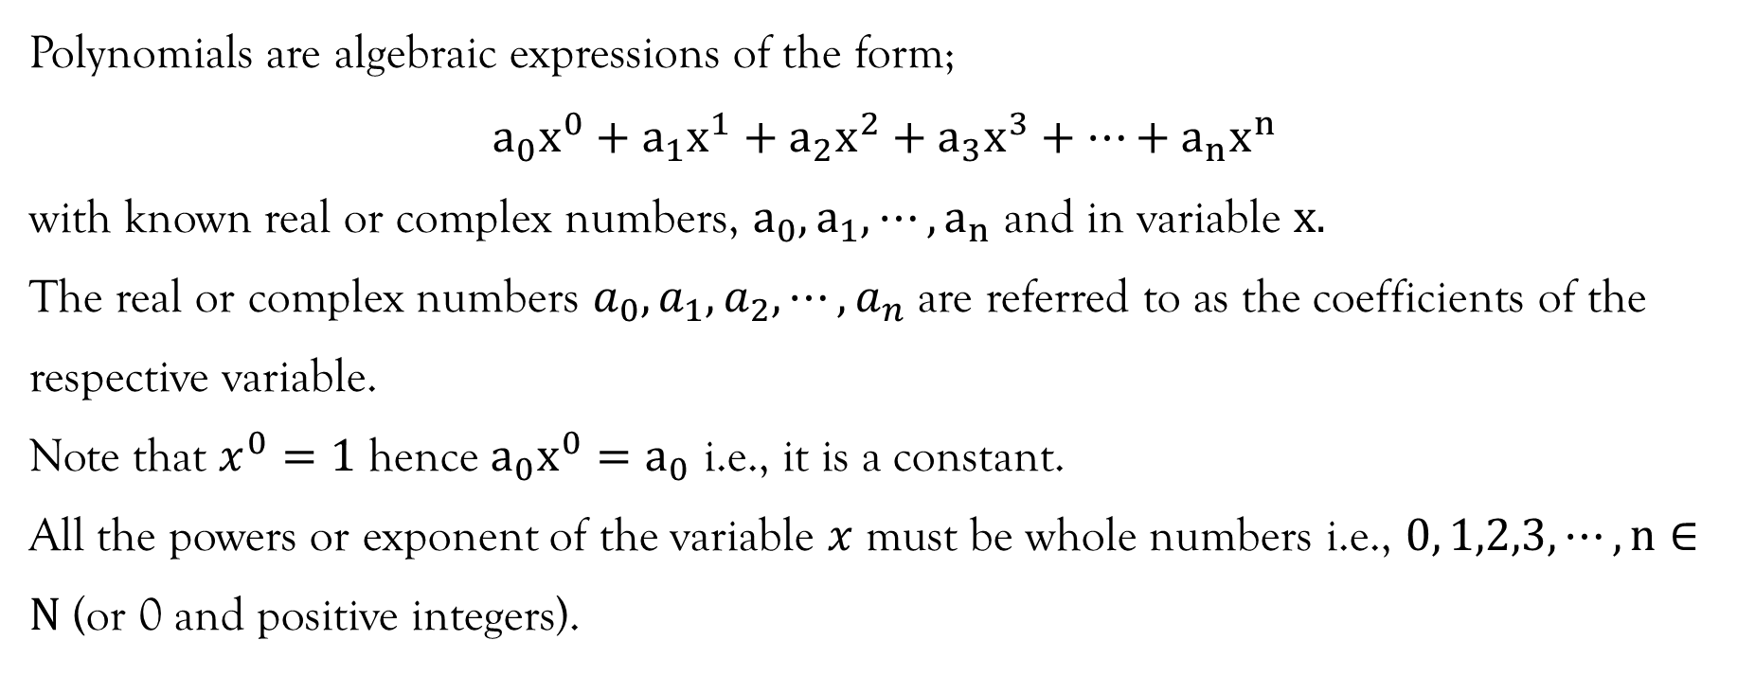
Definition (Polynomial)
Polynomials are algebraic expressions of the form;
$$a_{0}x^{0}+a_{1}x^{1}+a_{2}x^{2}+a_{3}x^{3}+⋯+a_{n}x^{n}$$
with known real or complex numbers, $a_{0}, a_{1},⋯,a_{n}$ and in variable $x.$
The real or complex numbers $a_{0},a_{1},a_{2},⋯, a_{n}$ are referred to as the coefficients of the respective variable.
Note that $x^{0}=1$ hence $a_{0}x^{0}=a_{0}$ i.e., it is a constant.
All the powers or exponent of the variable $x$ must be whole numbers i.e., $0, 1,2,3,⋯,n∈N$ (or 0 and positive integers).

Slide 6
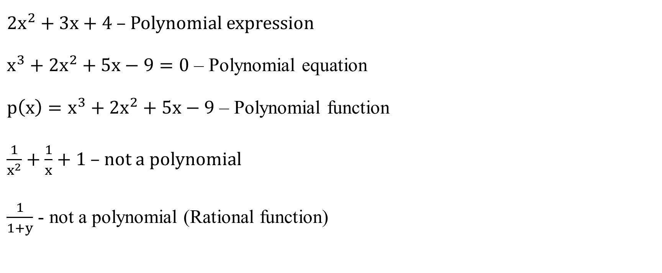
Examples
$2x^{2}+3x+4$ – Polynomial expression
$x^{3}+2x^{2}+5x−9=0$ – Polynomial equation
$p\left(x\right)=x^{3}+2x^{2}+5x−9$ – Polynomial function
$\frac{1}{x^{2}}+\frac{1}{x}+1$ – not a polynomial
$\frac{1}{1+y}$ - not a polynomial (Rational function)

Slide 7
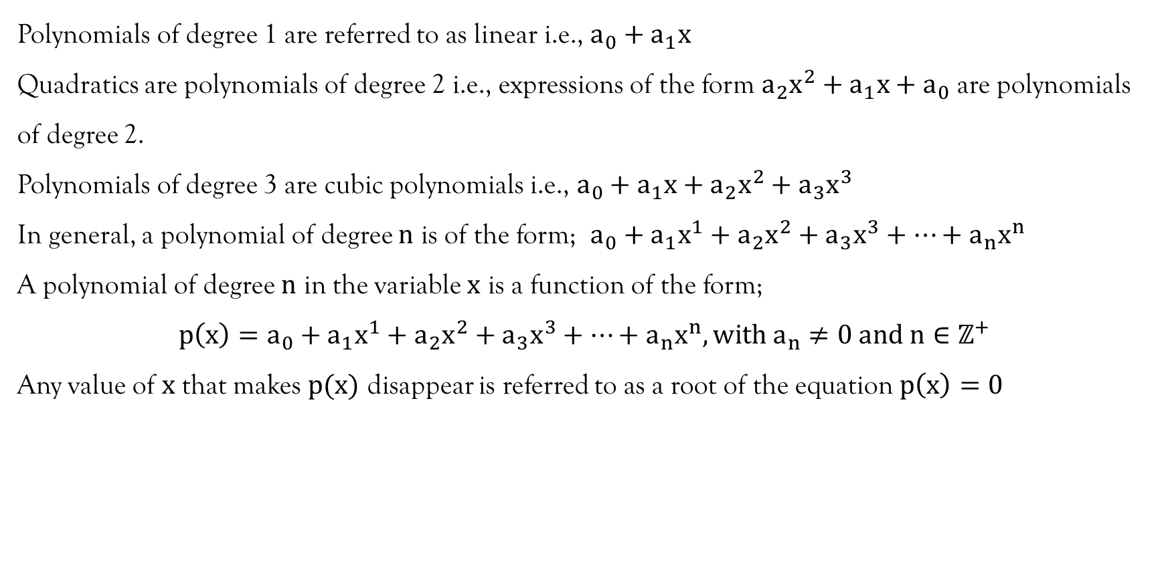
Type of polynomials
Polynomials of degree 1 are referred to as linear i.e., $a_{0}+a_{1}x$
Quadratics are polynomials of degree 2 i.e., expressions of the form $a_{2}x^{2}+a_{1}x+a_{0}$ are polynomials of degree 2.
Polynomials of degree 3 are cubic polynomials i.e., $a_{0}+a_{1}x+a_{2}x^{2}+a_{3}x^{3}$
In general, a polynomial of degree $n$ is of the form; $a_{0}+a_{1}x^{1}+a_{2}x^{2}+a_{3}x^{3}+⋯+a_{n}x^{n}$
A polynomial of degree $n$ in the variable $x$ is a function of the form;
$$p\left(x\right)=a_{0}+a_{1}x^{1}+a_{2}x^{2}+a_{3}x^{3}+⋯+a_{n}x^{n}, with a_{n}≠0 and n∈ℤ^{+}$$
Any value of $x$ that makes $p(x)$ disappear is referred to as a root of the equation $p\left(x\right)=0$

Slide 8
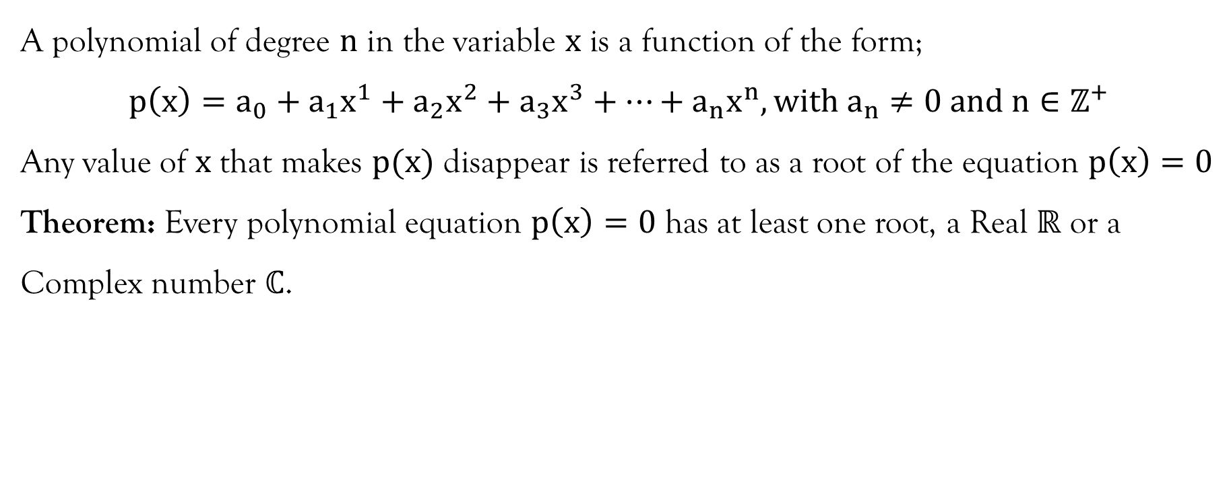
Theorem 1: Fundamental theorem of algebra
A polynomial of degree $n$ in the variable $x$ is a function of the form;
$$p\left(x\right)=a_{0}+a_{1}x^{1}+a_{2}x^{2}+a_{3}x^{3}+⋯+a_{n}x^{n}, with a_{n}≠0 and n∈ℤ^{+}$$
Any value of $x$ that makes $p(x)$ disappear is referred to as a root of the equation $p\left(x\right)=0$
Theorem: Every polynomial equation $p\left(x\right)=0$ has at least one root, a Real $ℝ$ or a Complex number $ℂ$.

Slide 9
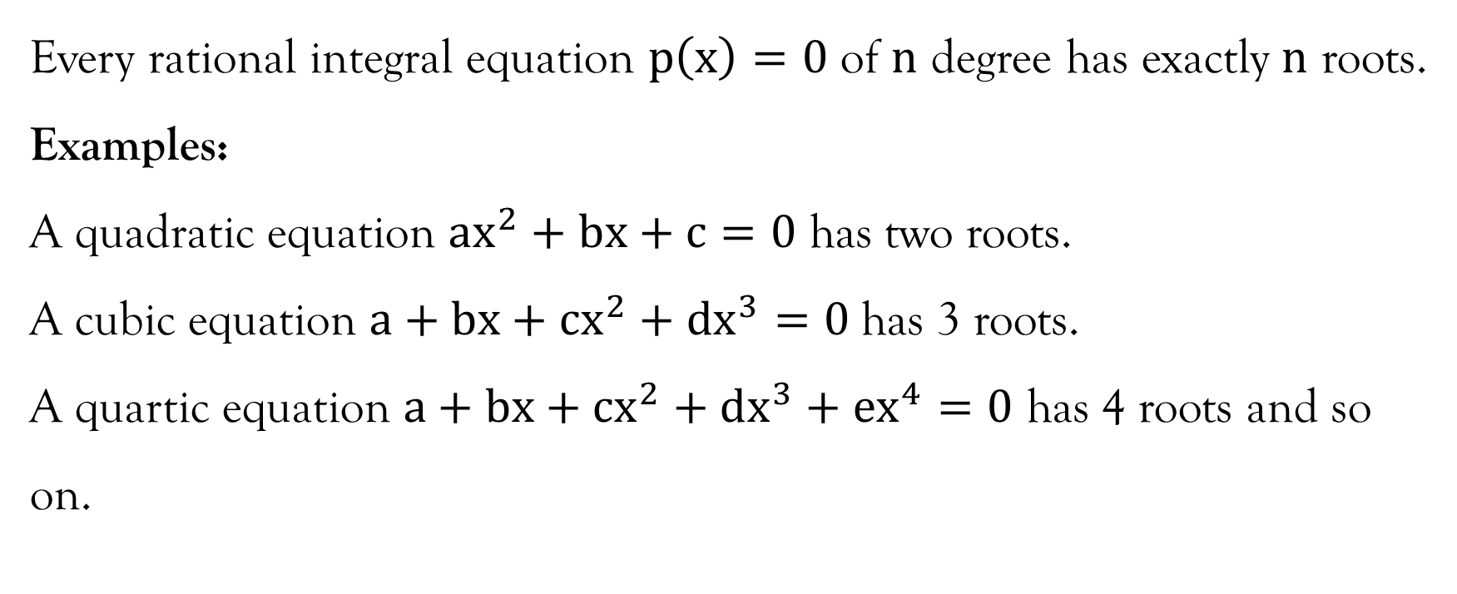
Proposition
Every rational integral equation $p\left(x\right)=0$ of $n$ degree has exactly $n$ roots.
Examples:
A quadratic equation $ax^{2}+bx+c=0$ has two roots.
A cubic equation $a+bx+cx^{2}+dx^{3}=0$has 3 roots.
A quartic equation $a+bx+cx^{2}+dx^{3}+ex^{4}=0$ has 4 roots and so on.

Slide 10
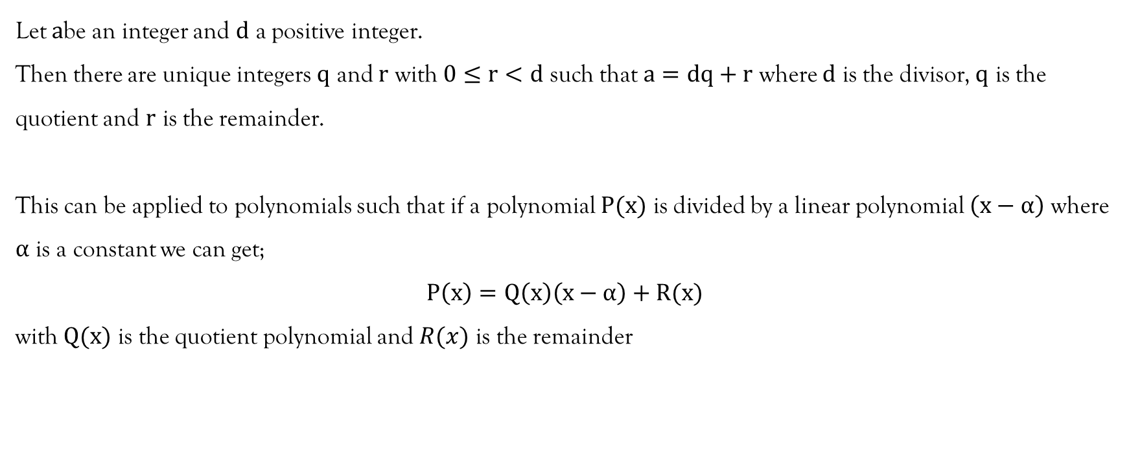
The Division Algorithm
Let $a$be an integer and $d$ a positive integer.
Then there are unique integers $q$ and $r$ with $0≤r<d$ such that $a=dq+r$ where $d$ is the divisor, $q$ is the quotient and $r$ is the remainder.
This can be applied to polynomials such that if a polynomial $P(x)$ is divided by a linear polynomial $\left(x−α\right)$ where $α$ is a constant we can get;
$$P\left(x\right)=Q\left(x\right)\left(x−α\right)+R(x)$$
with $Q(x)$ is the quotient polynomial and $R(x)$ is the remainder

Slide 11
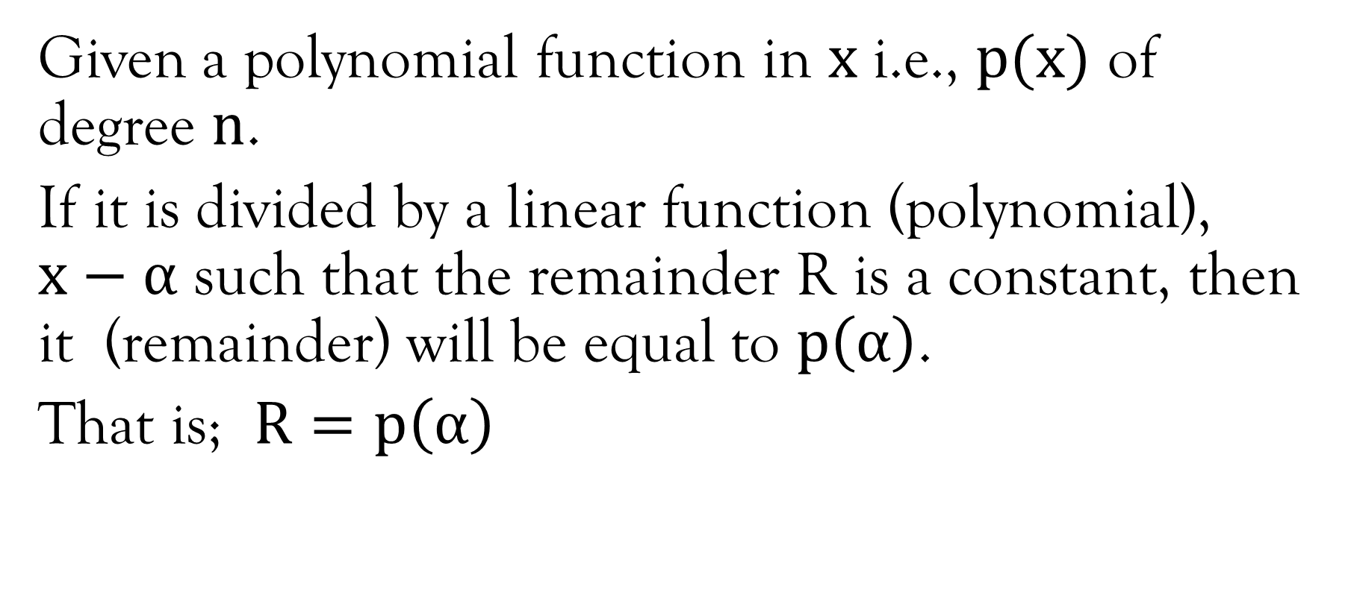
Remainder theorem
Given a polynomial function in $x$i.e., $p(x)$ of degree $n$.
If it is divided by a linear function (polynomial), $x−α$ such that the remainder R is a constant, then it (remainder) will be equal to $p\left(α\right)$.
That is; $R=p\left(α\right)$

Slide 12
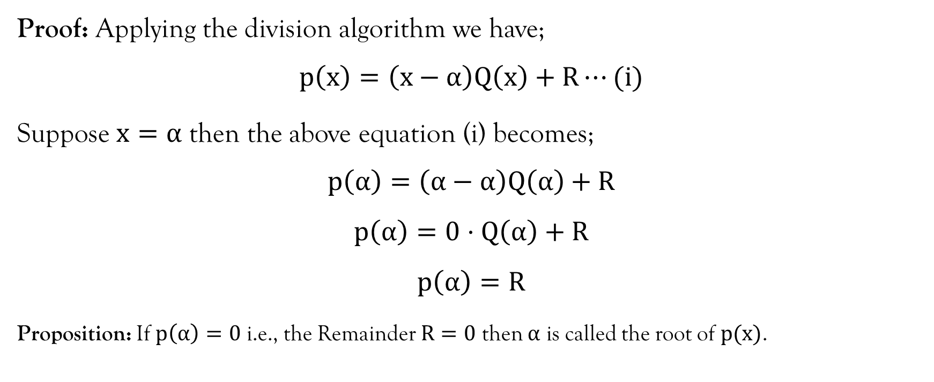
Remainder theorem
Proof: Applying the division algorithm we have;
$$p\left(x\right)=\left(x−α\right)Q\left(x\right)+R⋯(i)$$
Suppose $x=α$ then the above equation (i) becomes;
$$p\left(α\right)=\left(α−α\right)Q\left(α\right)+R$$
$$p\left(α\right)=0⋅Q\left(α\right)+R$$
$$p\left(α\right)=R$$
Proposition: If $p\left(α\right)=0$ i.e., the Remainder $R=0$ then $α$ is called the root of $p(x)$.

Slide 13
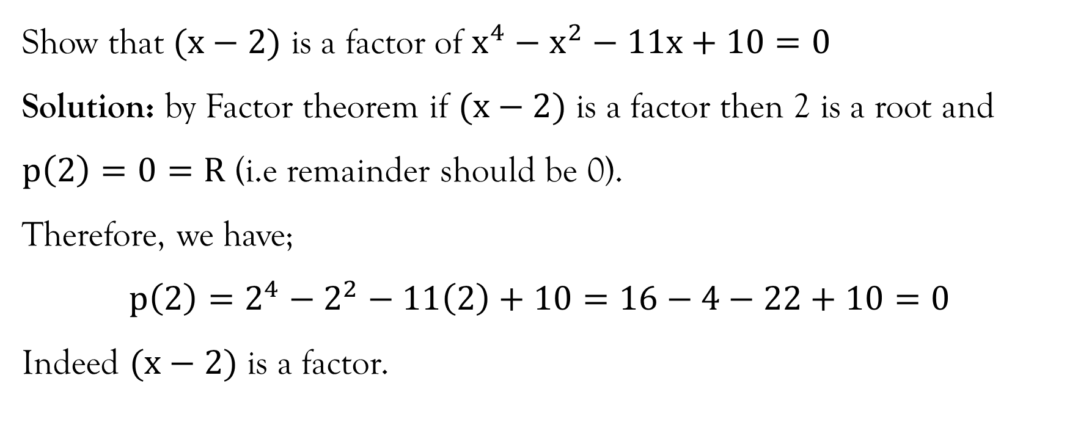
Example
Show that $(x−2)$ is a factor of $x^{4}−x^{2}−11x+10=0$
Solution: by Factor theorem if $(x−2)$ is a factor then 2 is a root and $p\left(2\right)=0=R$ (i.e remainder should be 0).
Therefore, we have;
$$p\left(2\right)=2^{4}−2^{2}−11\left(2\right)+10=16−4−22+10=0$$
Indeed $(x−2)$ is a factor.

Slide 14
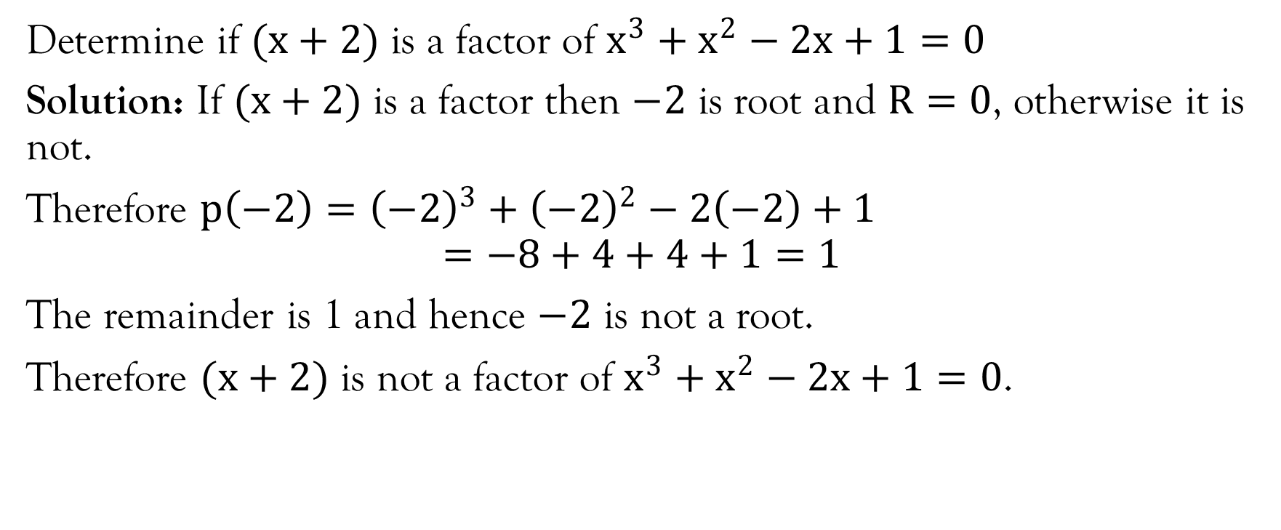
Example
Determine if $(x+2)$ is a factor of $x^{3}+x^{2}−2x+1=0$
Solution: If $(x+2)$ is a factor then $−2$ is root and $R=0$, otherwise it is not.
Therefore $p\left(−2\right)={\left(−2\right)}^{3}+{\left(−2\right)}^{2}−2\left(−2\right)+1$
$$=−8+4+4+1=1$$
The remainder is 1 and hence $−2$ is not a root.
Therefore $(x+2)$ is not a factor of $x^{3}+x^{2}−2x+1=0$.

Slide 15
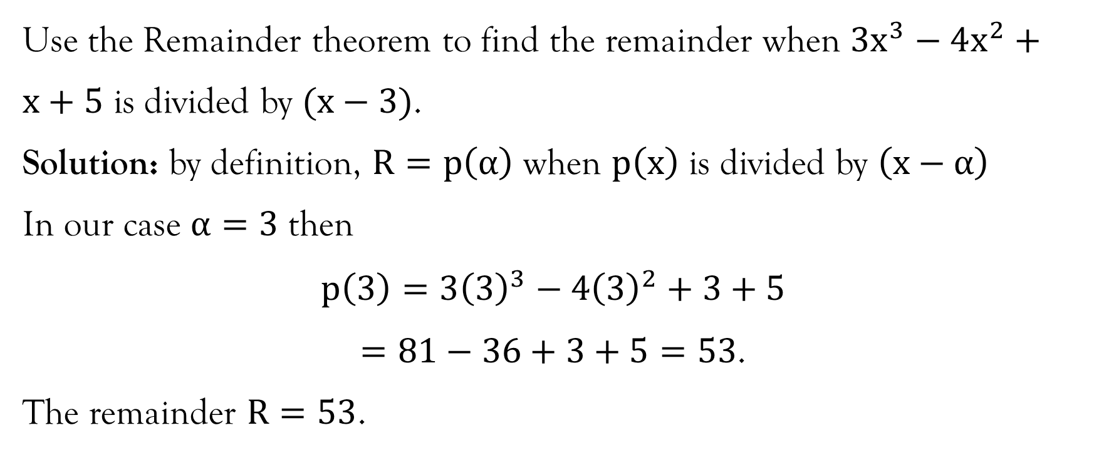
Example
Use the Remainder theorem to find the remainder when $3x^{3}−4x^{2}+x+5$ is divided by $(x−3)$.
Solution: by definition, $R=p\left(α\right)$ when $p\left(x\right)$ is divided by $\left(x−α\right)$
In our case $α=3$ then
$$p\left(3\right)=3{\left(3\right)}^{3}−4{\left(3\right)}^{2}+3+5$$
$=81−36+3+5=53$.
The remainder $R=53$.

Slide 16
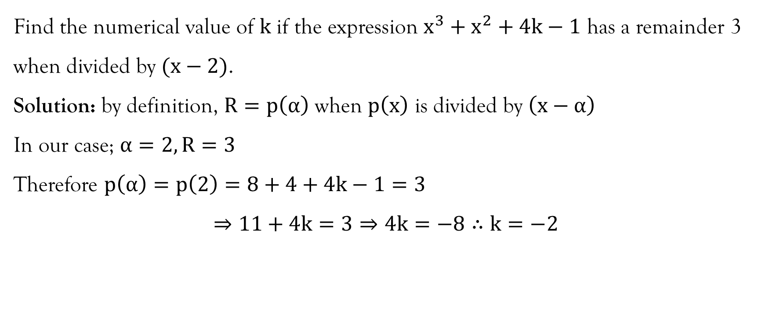
Example
Find the numerical value of $k$ if the expression $x^{3}+x^{2}+4k−1$ has a remainder 3 when divided by $(x−2)$.
Solution: by definition, $R=p\left(α\right)$ when $p\left(x\right)$ is divided by $\left(x−α\right)$
In our case; $α=2, R=3$
Therefore $p\left(α\right)=p\left(2\right)=8+4+4k−1=3$
$$⇒11+4k=3⇒4k=−8∴k=−2$$

Slide 17
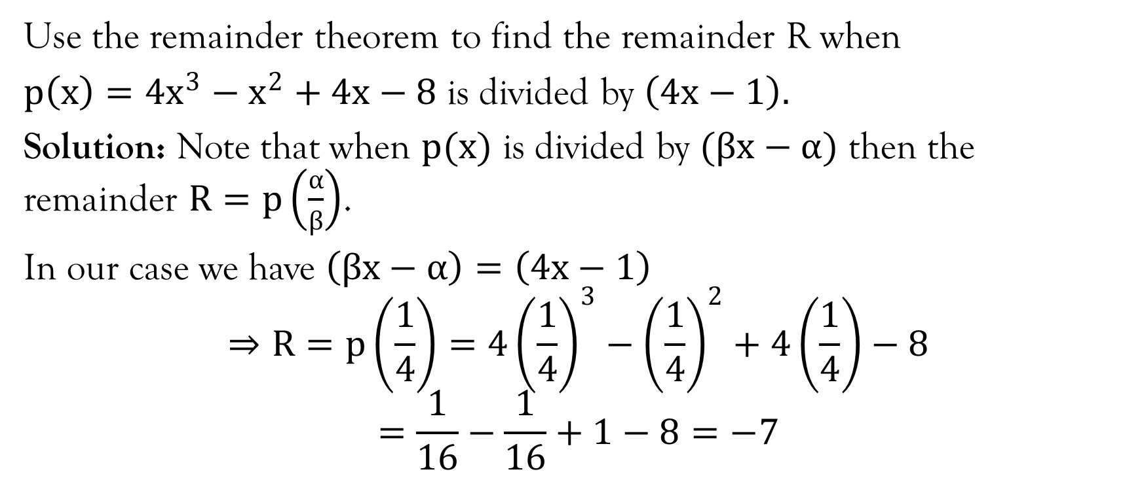
Example
Use the remainder theorem to find the remainder R when
$p\left(x\right)=4x^{3}−x^{2}+4x−8$ is divided by $\left(4x−1\right).$
Solution: Note that when $p(x)$ is divided by $(βx−α)$ then the remainder $R=p\left(\frac{α}{β}\right)$.
In our case we have $\left(βx−α\right)=\left(4x−1\right)$
$$⇒R=p\left(\frac{1}{4}\right)=4{\left(\frac{1}{4}\right)}^{3}−{\left(\frac{1}{4}\right)}^{2}+4\left(\frac{1}{4}\right)−8$$
$$=\frac{1}{16}−\frac{1}{16}+1−8=−7$$

Slide 18
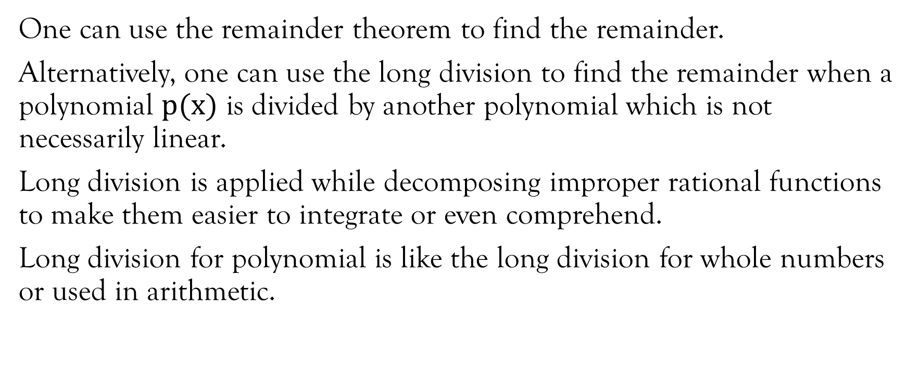
Long division
One can use the remainder theorem to find the remainder.
Alternatively, one can use the long division to find the remainder when a polynomial $p(x)$ is divided by another polynomial which is not necessarily linear.
Long division is applied while decomposing improper rational functions to make them easier to integrate or even comprehend.
Long division for polynomial is like the long division for whole numbers or used in arithmetic.

Slide 19
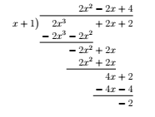
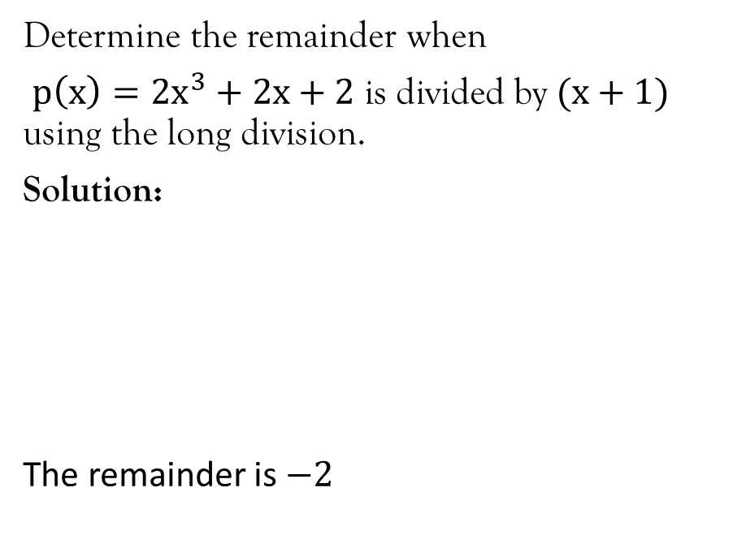
Example
Determine the remainder when
$p\left(x\right)=2x^{3}+2x+2$ is divided by $(x+1)$ using the long division.
Solution:
The remainder is $−2$

Slide 20
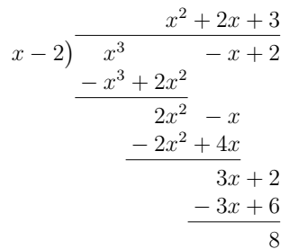
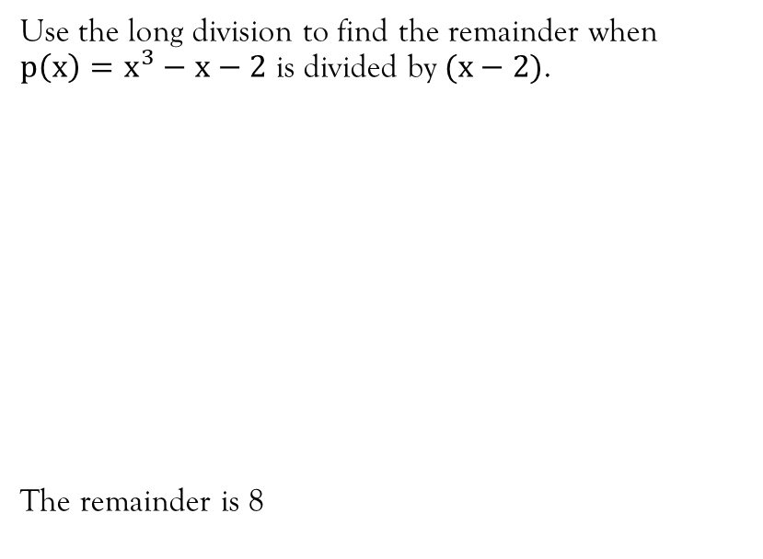
Example 7
Use the long division to find the remainder when $p\left(x\right)=x^{3}−x−2$ is divided by $(x−2)$.
The remainder is 8

Slide 21
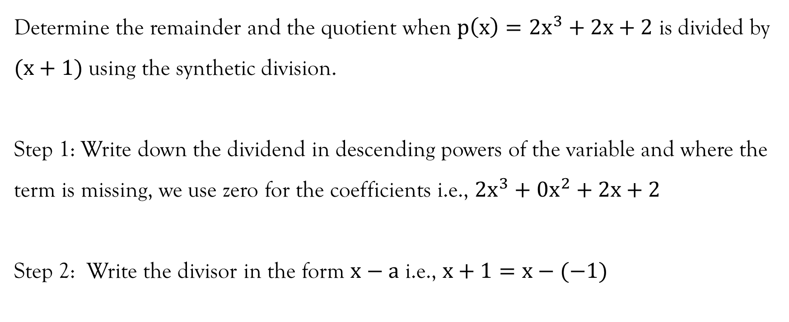
Synthetic Division
Determine the remainder and the quotient when $p\left(x\right)=2x^{3}+2x+2$ is divided by $(x+1)$ using the synthetic division.
Step 1: Write down the dividend in descending powers of the variable and where the term is missing, we use zero for the coefficients i.e., $2x^{3}+0x^{2}+2x+2$
Step 2: Write the divisor in the form $x−a$ i.e., $x+1=x−(−1)$

Slide 22
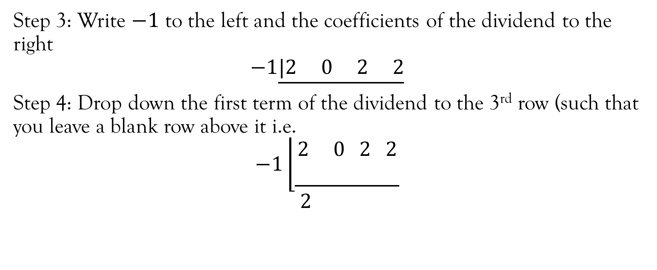
Synthetic division…contd…
Step 3: Write $−1$ to the left and the coefficients of the dividend to the right
$$−1\underline{|2 0 2 2}$$
Step 4: Drop down the first term of the dividend to the 3rd row (such that you leave a blank row above it i.e.
$$−1\left\lfloor \begin{aligned}2 0 2 2 \\ \underline{ }\end{aligned}\right.$$
$$2$$

Slide 23

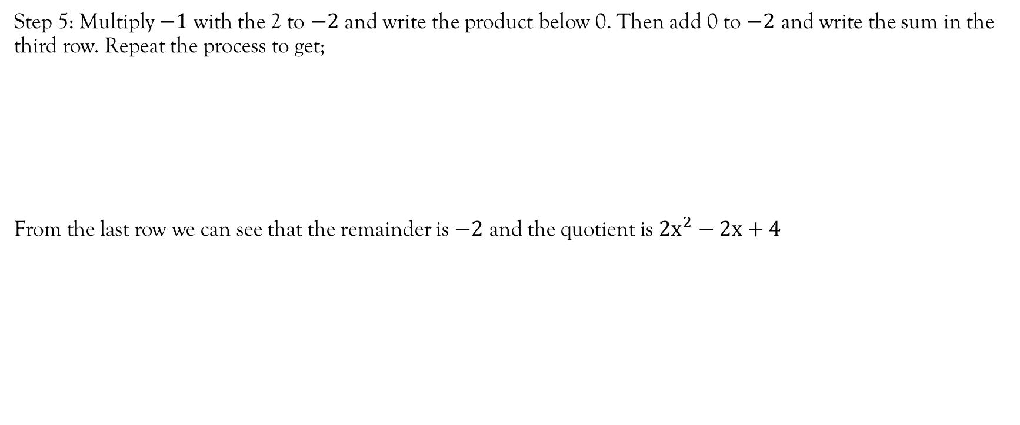
Synthetic division …Contd…
Step 5: Multiply $−1$ with the 2 to $−2$ and write the product below 0. Then add 0 to $−2$ and write the sum in the third row. Repeat the process to get;
From the last row we can see that the remainder is $−2$ and the quotient is $2x^{2}−2x+4$

Slide 24

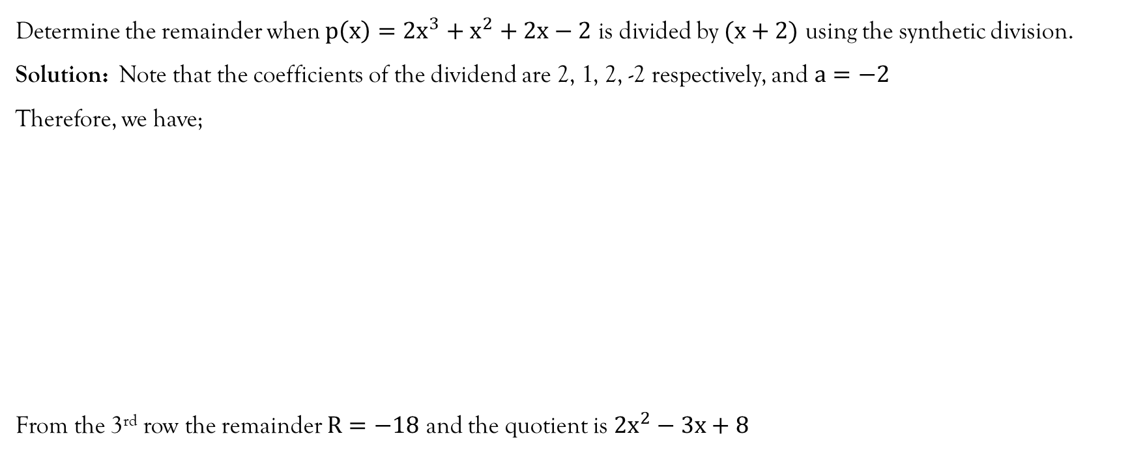
Example
Determine the remainder when $p\left(x\right)=2x^{3}+x^{2}+2x−2$ is divided by $(x+2)$ using the synthetic division.
Solution: Note that the coefficients of the dividend are 2, 1, 2, -2 respectively, and $a=−2$
Therefore, we have;
From the 3rd row the remainder $R=−18$ and the quotient is $2x^{2}−3x+8$

Slide 25
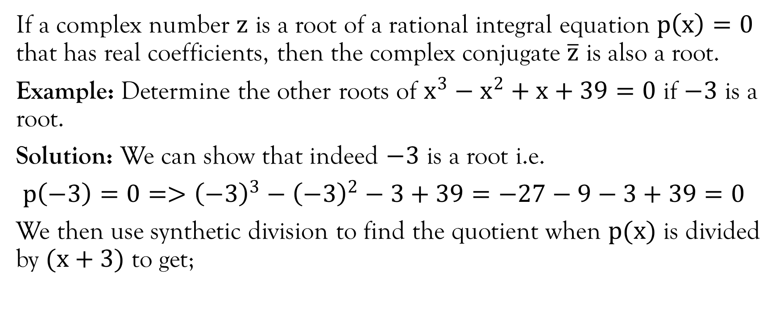
Proposition
If a complex number $z$ is a root of a rational integral equation $p\left(x\right)=0$ that has real coefficients, then the complex conjugate $\overline{z}$ is also a root.
Example: Determine the other roots of $x^{3}−x^{2}+x+39=0$ if $−3$ is a root.
Solution: We can show that indeed $−3$ is a root i.e.
$p\left(−3\right)=0=>{\left(−3\right)}^{3}−{\left(−3\right)}^{2}−3+39=−27−9−3+39=0$
We then use synthetic division to find the quotient when $p(x)$ is divided by $(x+3)$ to get;

Slide 26

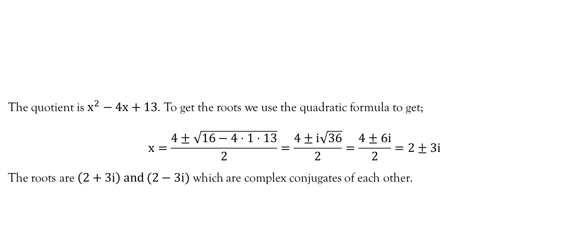
Example…contd…
The quotient is $x^{2}−4x+13$. To get the roots we use the quadratic formula to get;
$$x=\frac{4±\sqrt{16−4⋅1⋅13}}{2}=\frac{4±i\sqrt{36}}{2}=\frac{4±6i}{2}=2±3i$$
The roots are $\left(2+3i\right) and (2−3i)$ which are complex conjugates of each other.

Slide 27
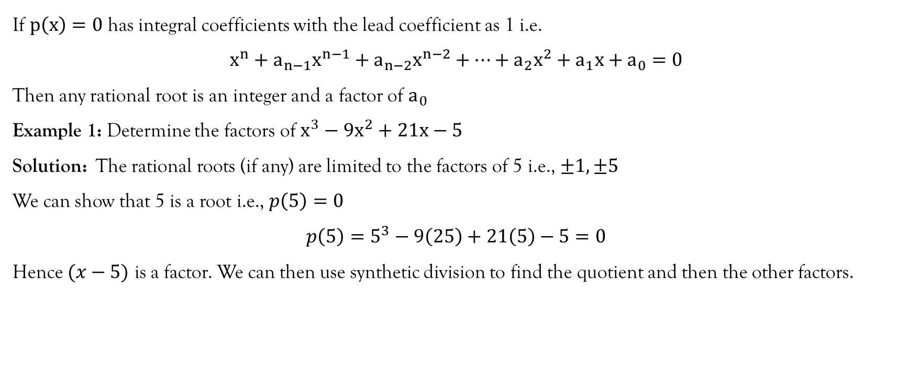
Integral root theorem
If $p\left(x\right)=0$ has integral coefficients with the lead coefficient as 1 i.e.
$$x^{n}+a_{n−1}x^{n−1}+a_{n−2}x^{n−2}+⋯+a_{2}x^{2}+a_{1}x+a_{0}=0$$
Then any rational root is an integer and a factor of $a_{0}$
Example 1: Determine the factors of $x^{3}−9x^{2}+21x−5$
Solution: The rational roots (if any) are limited to the factors of 5 i.e., $±1,±5$
We can show that 5 is a root i.e., $p\left(5\right)=0$
$$p\left(5\right)=5^{3}−9\left(25\right)+21\left(5\right)−5=0$$
Hence $(x−5)$ is a factor. We can then use synthetic division to find the quotient and then the other factors.

Slide 28

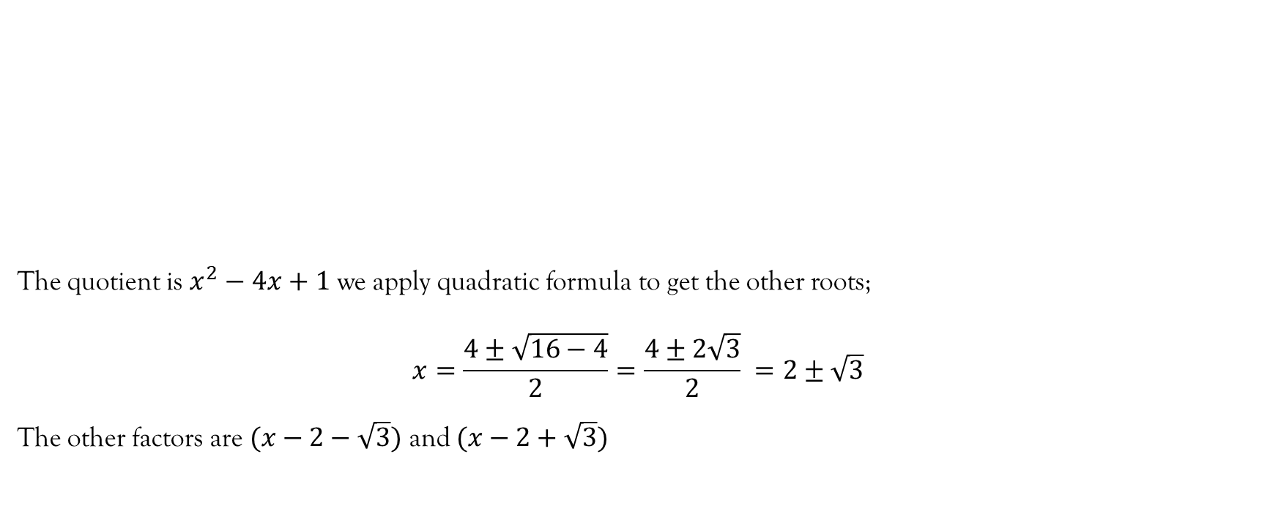
Integral root theorem…contd…
The quotient is $x^{2}−4x+1$ we apply quadratic formula to get the other roots;
$$x=\frac{4±\sqrt{16−4}}{2}=\frac{4±2\sqrt{3}}{2} =2±\sqrt{3}$$
The other factors are $(x−2−\sqrt{3})$ and $(x−2+\sqrt{3})$

Slide 29
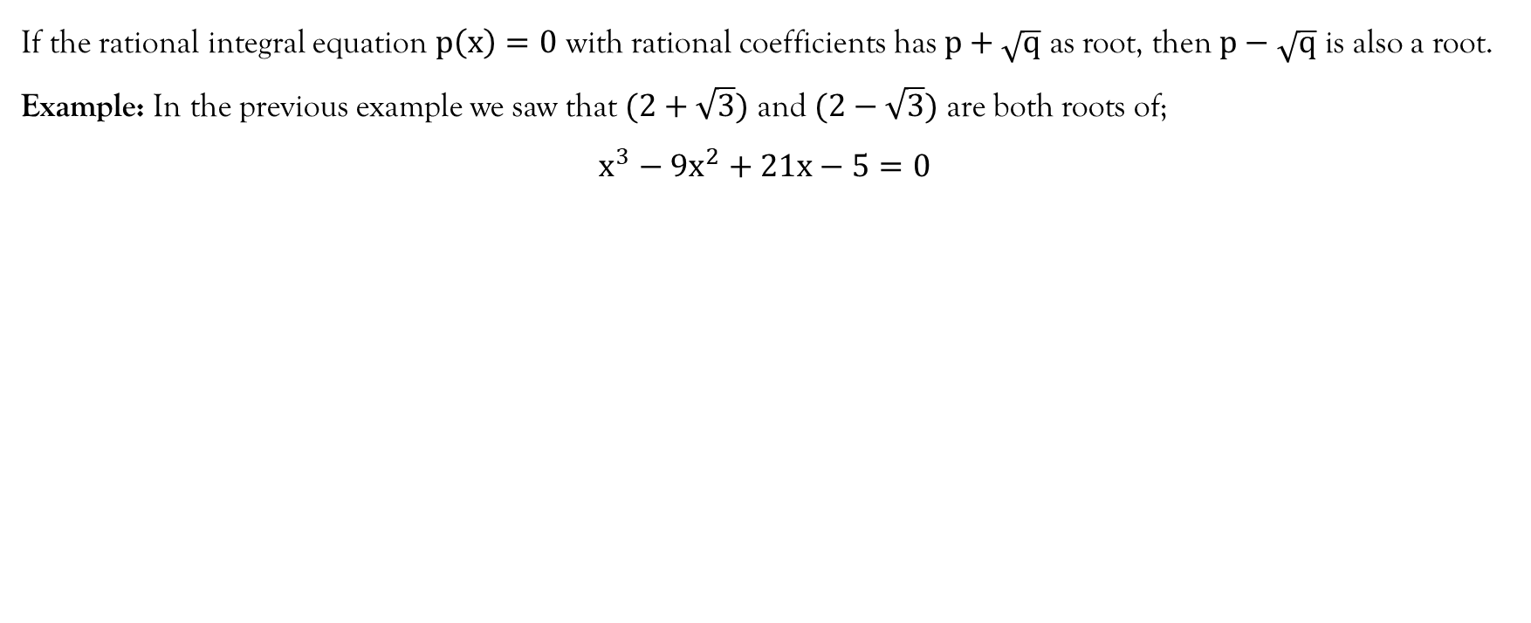
Proposition
If the rational integral equation $p\left(x\right)=0$ with rational coefficients has $p+\sqrt{q}$ as root, then $p−\sqrt{q}$ is also a root.
Example: In the previous example we saw that $(2+\sqrt{3})$ and $(2−\sqrt{3})$ are both roots of;
$x^{3}−9x^{2}+21x−5=0$

Slide 30
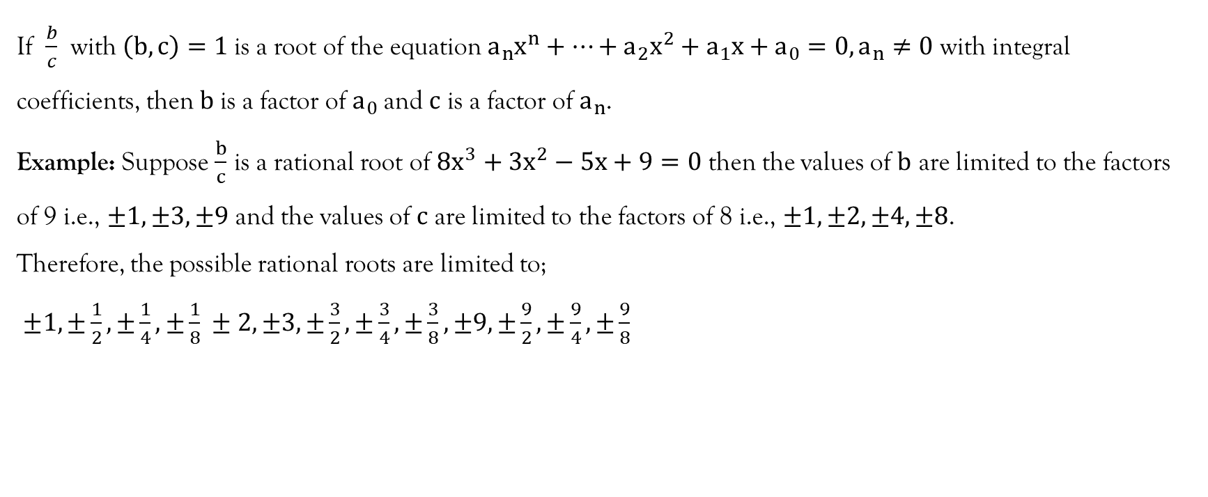
Rational root theorem
If $\frac{b}{c}$ with $\left(b,c\right)=1$is a root of the equation $a_{n}x^{n}+⋯+a_{2}x^{2}+a_{1}x+a_{0}=0, a_{n}≠0$ with integral coefficients, then $b$is a factor of $a_{0}$and $c$ is a factor of $a_{n}$.
Example: Suppose $\frac{b}{c}$ is a rational root of $8x^{3}+3x^{2}−5x+9=0$ then the values of $b$ are limited to the factors of 9 i.e., $±1, ±3,±9$ and the values of $c$ are limited to the factors of 8 i.e., $±1, ±2, ±4, ±8$.
Therefore, the possible rational roots are limited to;
$±1, ±\frac{1}{2}, ±\frac{1}{4},±\frac{1}{8} ±2,±3, ±\frac{3}{2}, ±\frac{3}{4}, ±\frac{3}{8}, ±9, ±\frac{9}{2}, ±\frac{9}{4},±\frac{9}{8}$

Slide 31
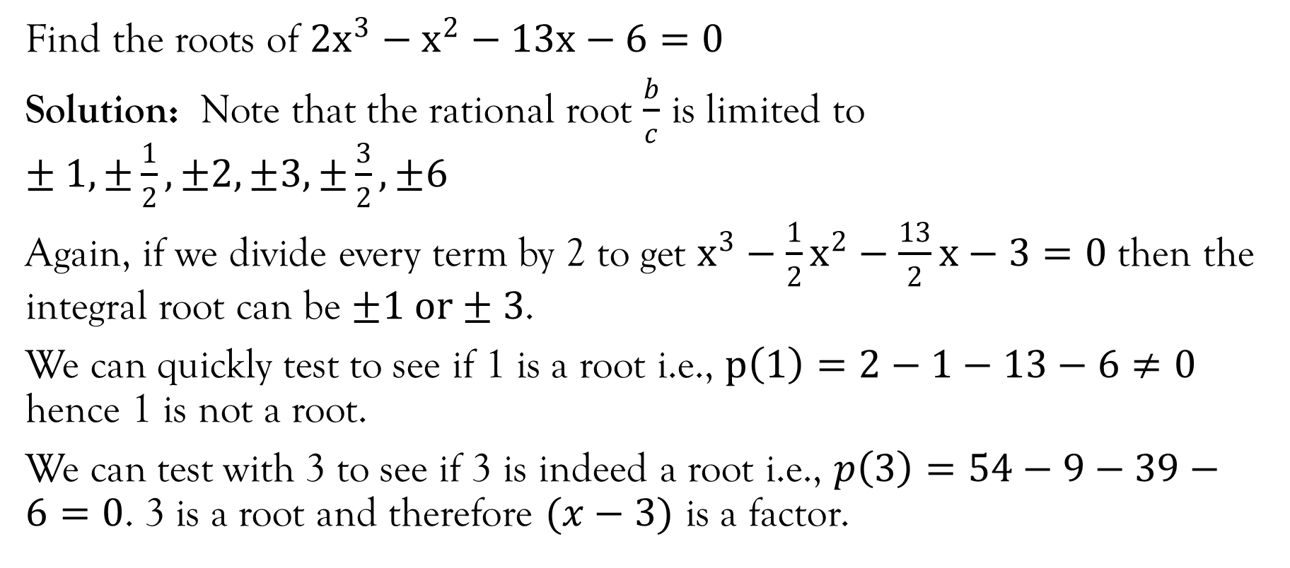
Example
Find the roots of $2x^{3}−x^{2}−13x−6=0$
Solution: Note that the rational root $\frac{b}{c}$ is limited to $±1, ±\frac{1}{2}, ±2, ±3, ±\frac{3}{2},±6$
Again, if we divide every term by 2 to get $x^{3}−\frac{1}{2}x^{2}−\frac{13}{2}x−3=0$ then the integral root can be $±1 or±3$.
We can quickly test to see if 1 is a root i.e., $p\left(1\right)=2−1−13−6≠0$ hence 1 is not a root.
We can test with 3 to see if 3 is indeed a root i.e., $p\left(3\right)=54−9−39−6=0$. 3 is a root and therefore $(x−3)$ is a factor.

Slide 32

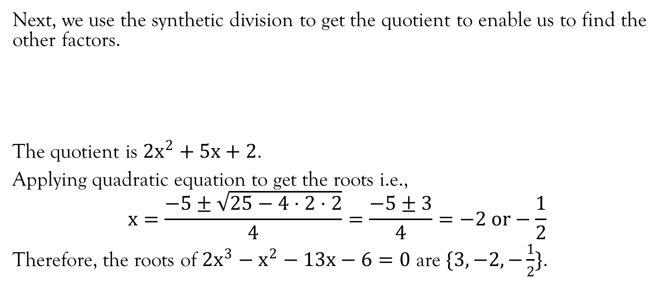
Example…contd…
Next, we use the synthetic division to get the quotient to enable us to find the other factors.
The quotient is $2x^{2}+5x+2$.
Applying quadratic equation to get the roots i.e.,
$$x=\frac{−5±\sqrt{25−4⋅2⋅2}}{4}=\frac{−5±3}{4}=−2 or−\frac{1}{2}$$
Therefore, the roots of $2x^{3}−x^{2}−13x−6=0$ are $\{3, −2, −\frac{1}{2}\}$.

Slide 33
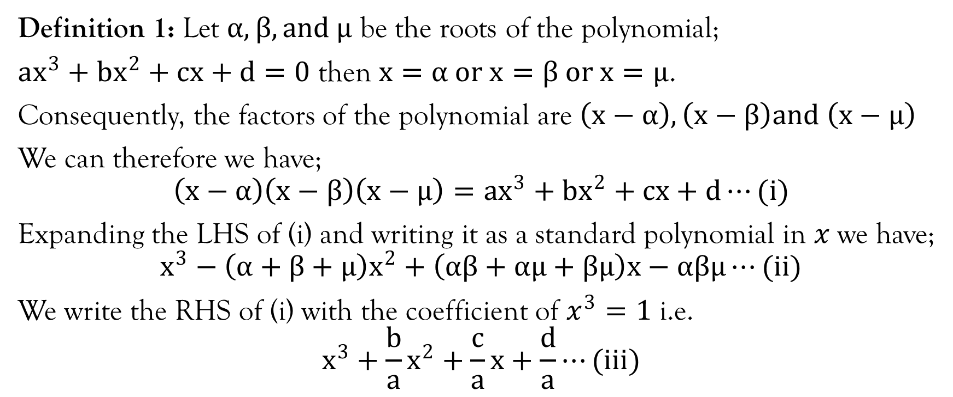
Determining a polynomial given its roots (Degree 3)
Definition 1: Let $α,β, and μ$ be the roots of the polynomial;
$ax^{3}+bx^{2}+cx+d=0$ then $x=α or x=β or x=μ$.
Consequently, the factors of the polynomial are $\left(x−α\right), \left(x−β\right)and \left(x−μ\right)$
We can therefore we have;
$$\left(x−α\right)\left(x−β\right)\left(x−μ\right)=ax^{3}+bx^{2}+cx+d⋯(i)$$
Expanding the LHS of (i) and writing it as a standard polynomial in $x$we have;
$$x^{3}−\left(α+β+μ\right)x^{2}+\left(αβ+αμ+βμ\right)x−αβμ⋯(ii)$$
We write the RHS of (i) with the coefficient of $x^{3}=1$ i.e.
$$x^{3}+\frac{b}{a}x^{2}+\frac{c}{a}x+\frac{d}{a}⋯(iii)$$

Slide 34
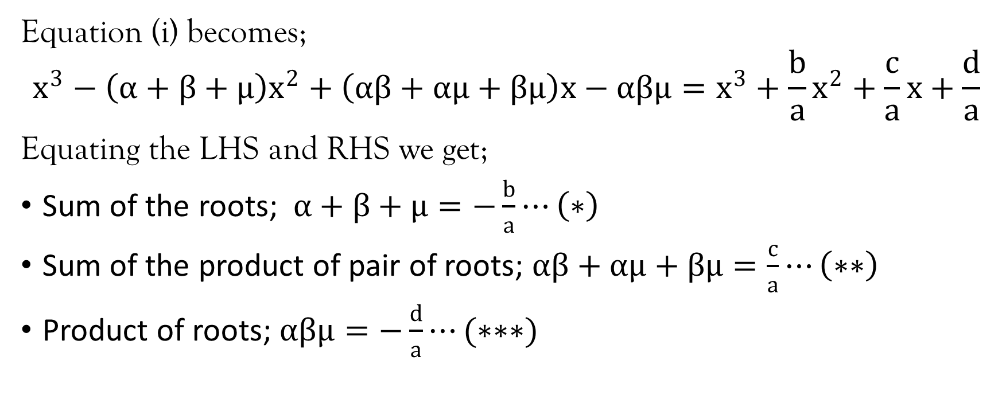
Example…contd…
Equation (i) becomes;
$$x^{3}−\left(α+β+μ\right)x^{2}+\left(αβ+αμ+βμ\right)x−αβμ=x^{3}+\frac{b}{a}x^{2}+\frac{c}{a}x+\frac{d}{a}$$
Equating the LHS and RHS we get;
Sum of the roots; $α+β+μ=−\frac{b}{a}⋯\left(∗\right)$
Sum of the product of pair of roots; $αβ+αμ+βμ=\frac{c}{a}⋯\left(∗∗\right)$
Product of roots; $αβμ=−\frac{d}{a}⋯(∗∗∗)$

Slide 35
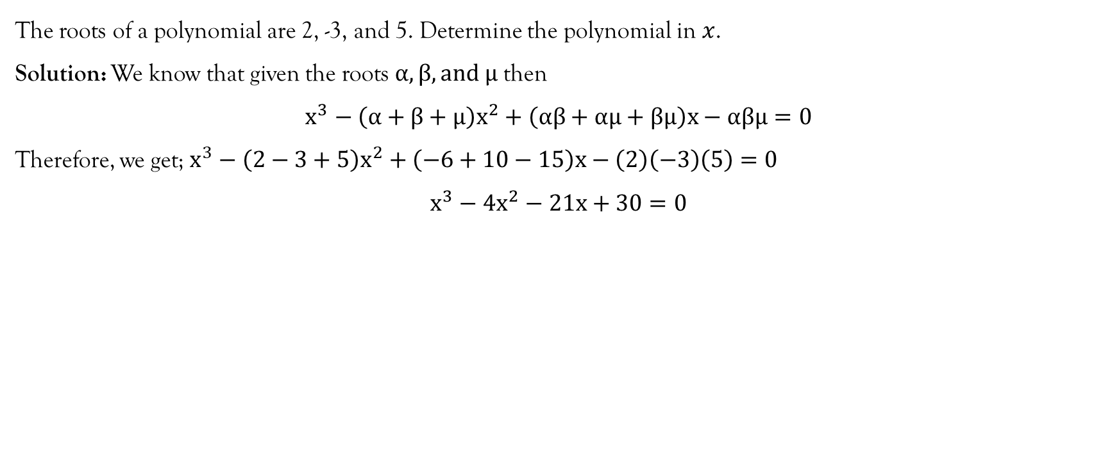
Example
The roots of a polynomial are 2, -3, and 5. Determine the polynomial in $x$.
Solution: We know that given the roots $α, β, and μ$ then
$$x^{3}−\left(α+β+μ\right)x^{2}+\left(αβ+αμ+βμ\right)x−αβμ=0$$
Therefore, we get; $x^{3}−\left(2−3+5\right)x^{2}+\left(−6+10−15\right)x−\left(2\right)\left(−3\right)\left(5\right)=0$
$$x^{3}−4x^{2}−21x+30=0$$

Slide 36
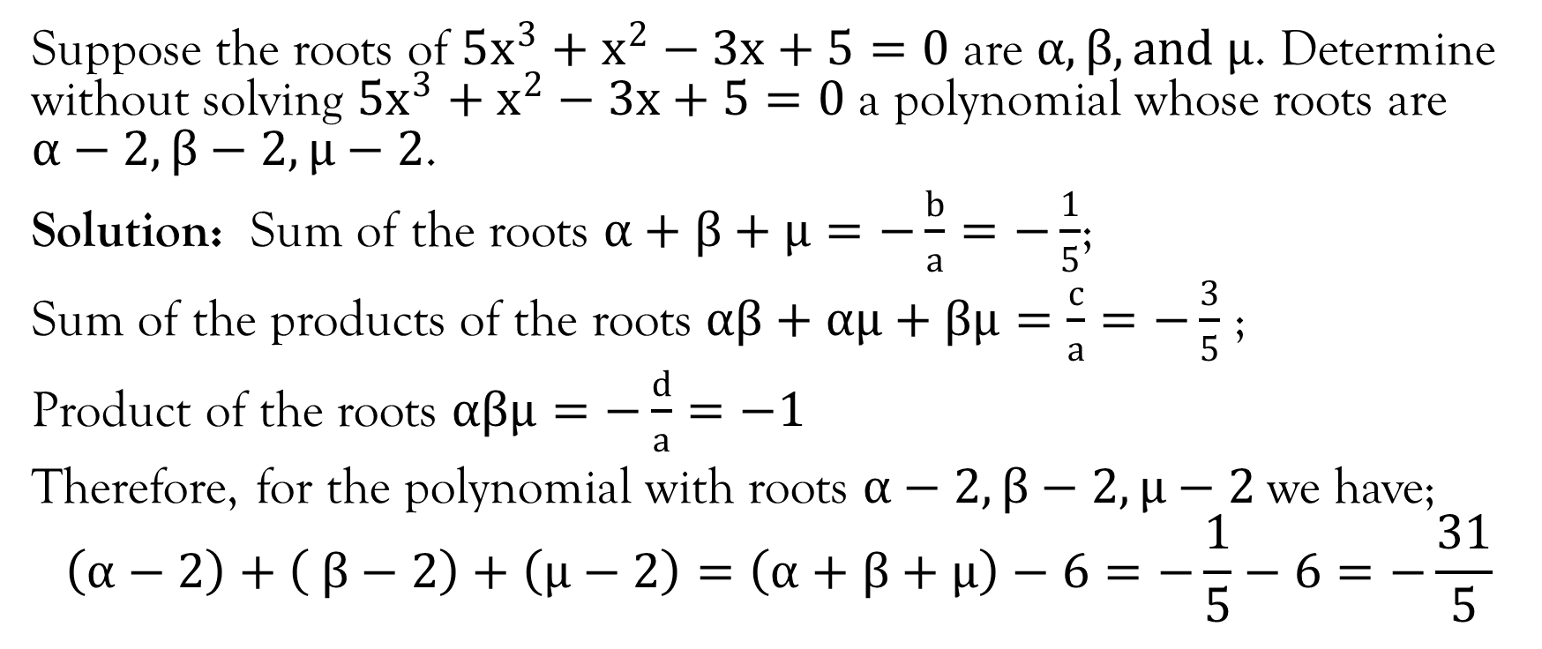
Example
Suppose the roots of $5x^{3}+x^{2}−3x+5=0$ are $α, β, and μ$. Determine without solving $5x^{3}+x^{2}−3x+5=0$ a polynomial whose roots are $α−2, β−2, μ−2$.
Solution: Sum of the roots $α+β+μ=−\frac{b}{a}=−\frac{1}{5}$;
Sum of the products of the roots $αβ+αμ+βμ=\frac{c}{a}=−\frac{3}{5}$ ;
Product of the roots $αβμ=−\frac{d}{a}=−1$
Therefore, for the polynomial with roots $α−2, β−2, μ−2$we have;
$$\left(α−2\right)+\left( β−2\right)+\left(μ−2\right)=\left(α+β+μ\right)−6=−\frac{1}{5}−6=−\frac{31}{5}$$

Slide 37
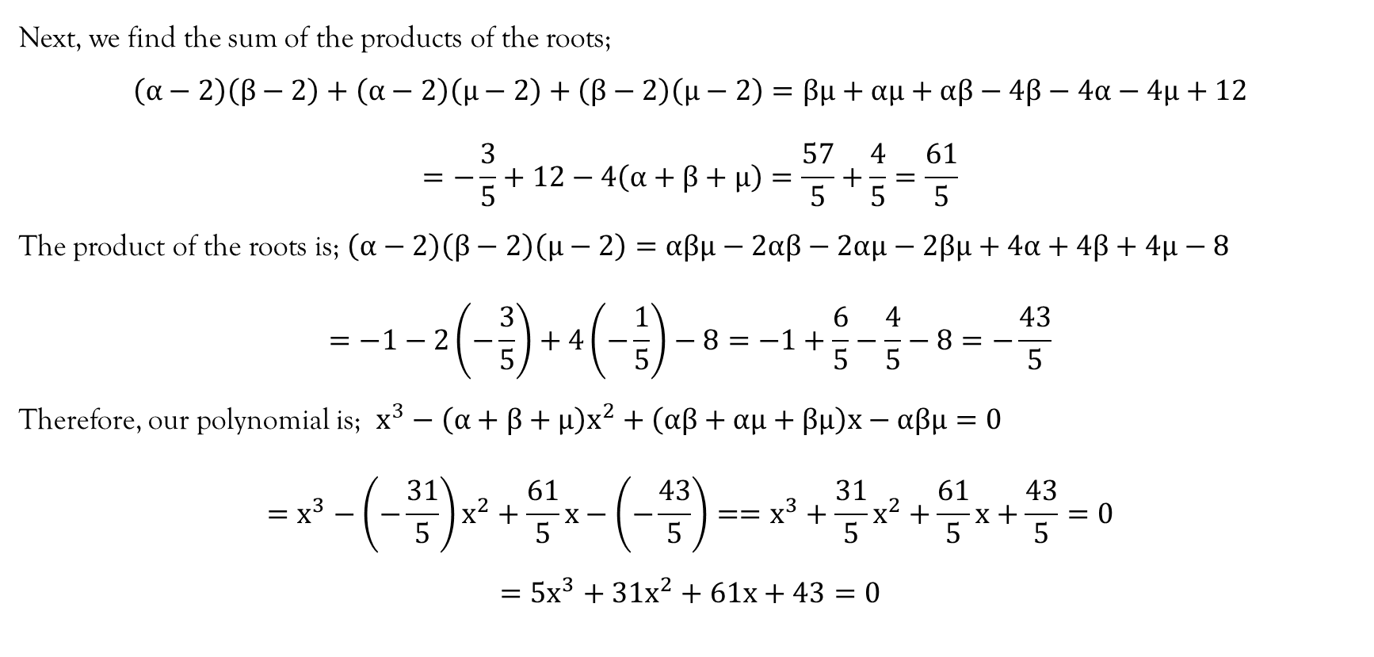
Example
Next, we find the sum of the products of the roots;
$$\left(α−2\right)\left(β−2\right)+\left(α−2\right)\left(μ−2\right)+\left(β−2\right)\left(μ−2\right)=βμ+αμ+αβ−4β−4α−4μ+12$$
$$=−\frac{3}{5}+12−4\left(α+β+μ\right)=\frac{57}{5}+\frac{4}{5}=\frac{61}{5}$$
The product of the roots is; $\left(α−2\right)\left(β−2\right)\left(μ−2\right)=αβμ−2αβ−2αμ−2βμ+4α+4β+4μ−8$
$$=−1−2\left(−\frac{3}{5}\right)+4\left(−\frac{1}{5}\right)−8=−1+\frac{6}{5}−\frac{4}{5}−8=−\frac{43}{5}$$
Therefore, our polynomial is; $x^{3}−\left(α+β+μ\right)x^{2}+\left(αβ+αμ+βμ\right)x−αβμ=0$
$$=x^{3}−\left(−\frac{31}{5}\right)x^{2}+\frac{61}{5}x−\left(−\frac{43}{5}\right)==x^{3}+\frac{31}{5}x^{2}+\frac{61}{5}x+\frac{43}{5}=0$$
$$=5x^{3}+31x^{2}+61x+43=0$$

Slide 38
References
Kahenya, P. (2017). Foundation Maths. LAP Lambert Academic Publishers.
Murray, S., & Robert, M. (2009). College Algebra. McGraw-Hill.
Stewart, J. (2012). Calculus (7th ed.). BROOKS/COLE Cengage Learning.

Slide 39
End of Lecture 5
Thank You

