Slide 1
Mathematics for Science
Lecture 6
Decomposing Rational Functions: CASE I and II
Lecturer: Kahenya, N.P

Slide 2
Introduction to lecture 6
This lecture will introduce Rational functions and their decomposition.
In Lecture 5 we discussed polynomials and the application of the remainder and factor theorems.
Decomposing rational fractions is applicable when integrating rational functions in calculus.

Slide 3
Intended learning outcomes
At the end of this lecture, you will be able to;
Define a rational function.
b) Decompose rational functions cases I and II.

Slide 4
Further reading
These lecture notes should be complemented with relevant topics in (Kahenya, 2017; Murray & Robert, 2009; Stewart, 2012).
Murray & Robert (2009) have more additional details on rational functions especially on the asymptotes and graphing of rational functions while Stewart (2012) has application of decomposition of rational functions in integration.

Slide 5
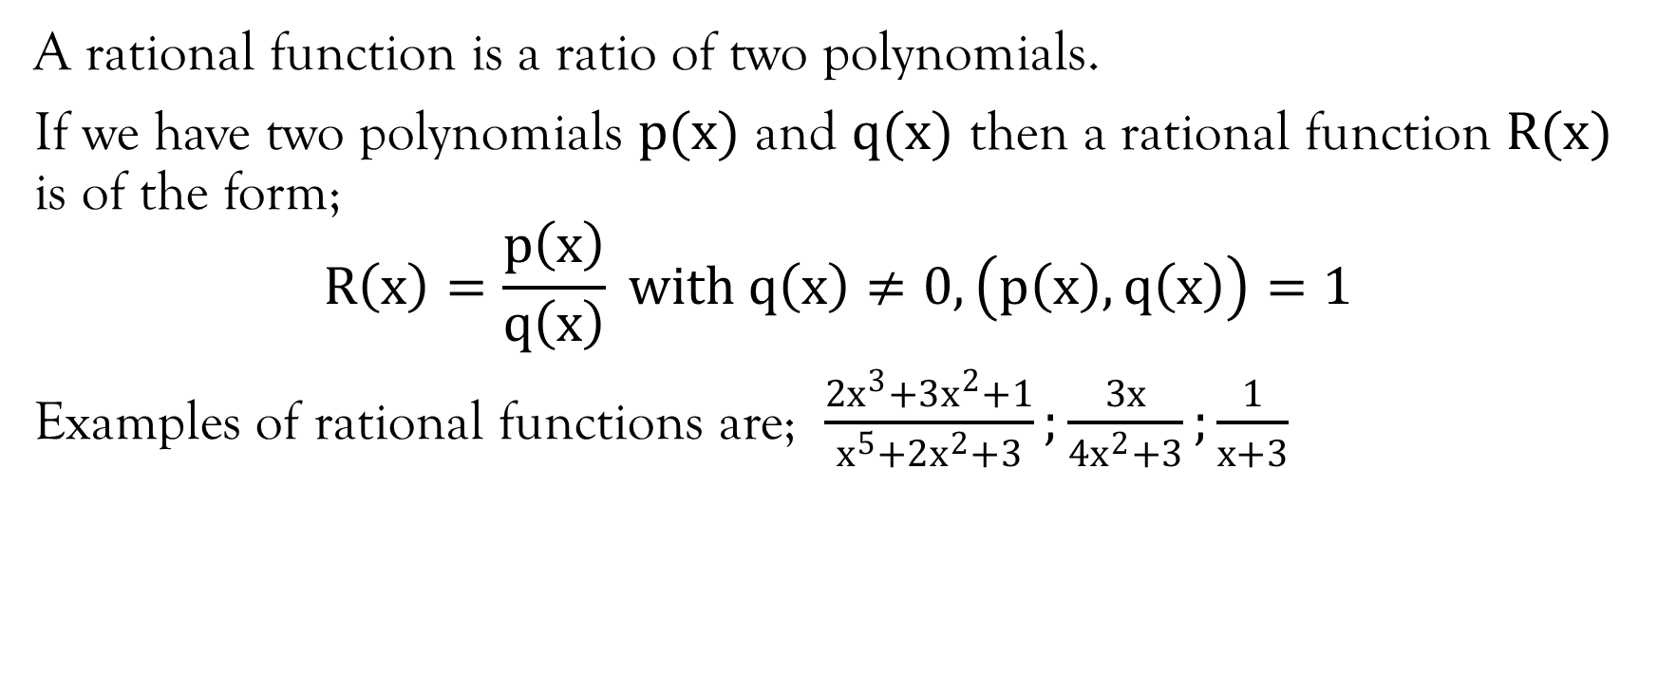
Rational functions
A rational function is a ratio of two polynomials.
If we have two polynomials $p(x)$ and $q(x)$ then a rational function $R(x)$ is of the form;
$$R\left(x\right)=\frac{p\left(x\right)}{q\left(x\right)} with q\left(x\right)≠0, \left(p\left(x\right), q\left(x\right)\right)=1$$
Examples of rational functions are; $\frac{2x^{3}+3x^{2}+1}{x^{5}+2x^{2}+3};\frac{3x}{4x^{2}+3};\frac{1}{x+3}$

Slide 6
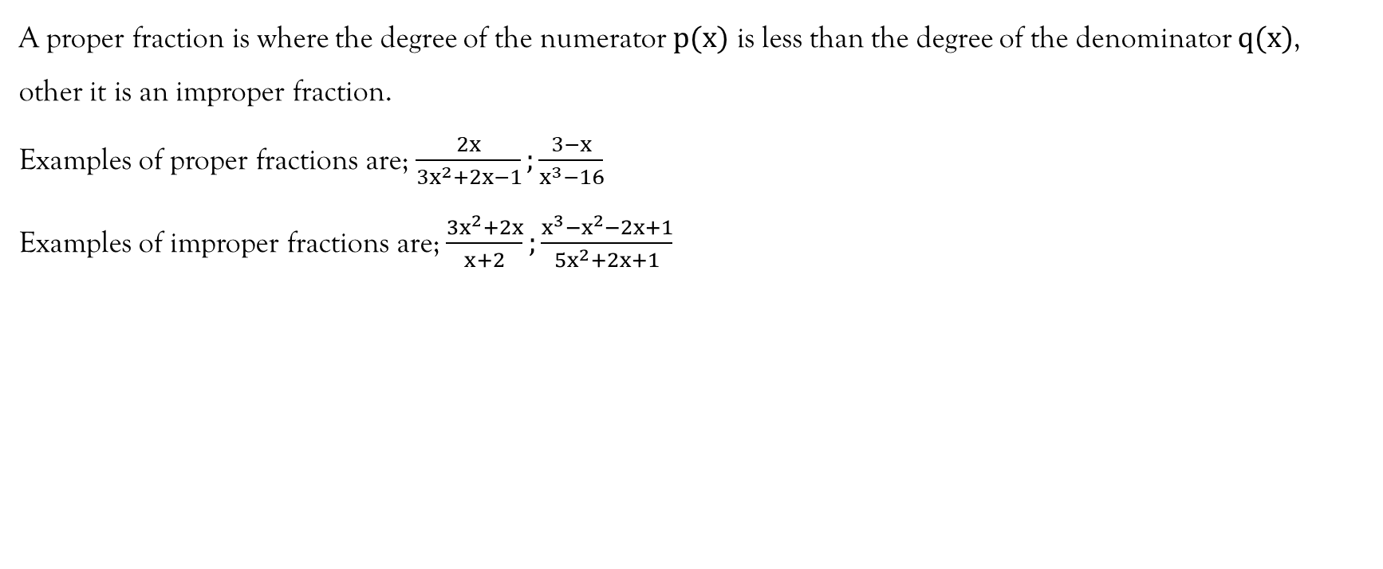
Proper and improper fractions
A proper fraction is where the degree of the numerator $p(x)$ is less than the degree of the denominator $q(x)$, other it is an improper fraction.
Examples of proper fractions are; $\frac{2x}{3x^{2}+2x−1};\frac{3−x}{x^{3}−16}$
Examples of improper fractions are; $\frac{3x^{2}+2x}{x+2};\frac{x^{3}−x^{2}−2x+1}{5x^{2}+2x+1}$

Slide 7
Partial fractions
A proper fraction may be written as a sum of other proper fractions called partial fractions, whose denominators are of lower degree than the denominator of the given proper fraction.
An improper fraction may be written as a sum of a polynomial (a whole) and a proper fraction.
Rules of decomposing a proper fraction
The factors of the denominator determine the decomposition of proper fractions.
Rule 1: If the denominator can be factorized into linear factors that occurs once, then we have CASE I.
Rule 2: If the denominator can factorize into linear factors with some being repeated then we call this CASE II
Rule 3: If the denominator can be factorized into quadratic factors that occurs once, then we have CASE III.
Rule 4: If the denominator can factorize into quadratic factors with some being repeated then we get CASE IV.

Slide 8
Factors of the Denominator
Linear factors
Non-repeated
Repeated
Quadratic factors
Non-repeated
Repeated
CASE I
CASE II
CASE III
CASE IV

Slide 9
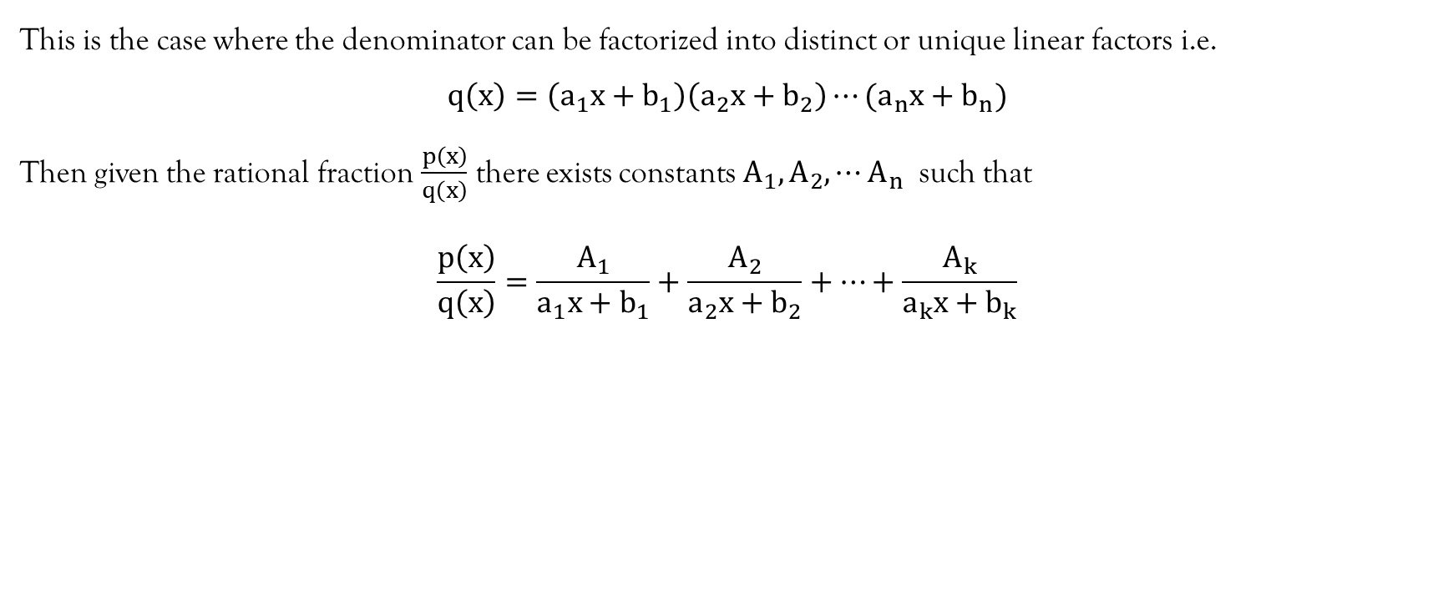
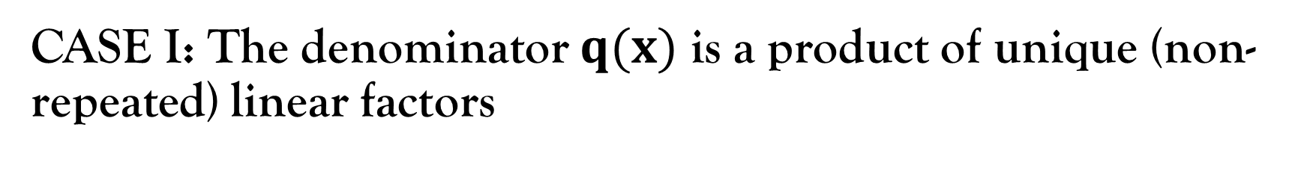
CASE I: The denominator $q(x)$ is a product of unique (non-repeated) linear factors
This is the case where the denominator can be factorized into distinct or unique linear factors i.e.
$$q\left(x\right)=\left(a_{1}x+b_{1}\right)\left(a_{2}x+b_{2}\right)⋯(a_{n}x+b_{n})$$
Then given the rational fraction $\frac{p\left(x\right)}{q\left(x\right)}$ there exists constants $A_{1}, A_{2},⋯A_{n}$ such that
$$\frac{p\left(x\right)}{q\left(x\right)}=\frac{A_{1}}{a_{1}x+b_{1}}+\frac{A_{2}}{a_{2}x+b_{2}}+⋯+\frac{A_{k}}{a_{k}x+b_{k}}$$

Slide 10
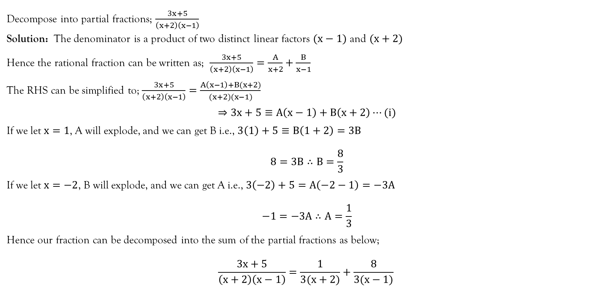
Example
Decompose into partial fractions; $\frac{3x+5}{\left(x+2\right)\left(x−1\right)}$
Solution: The denominator is a product of two distinct linear factors $(x−1)$ and $(x+2)$
Hence the rational fraction can be written as; $\frac{3x+5}{\left(x+2\right)\left(x−1\right)}=\frac{A}{x+2}+\frac{B}{x−1}$
The RHS can be simplified to; $\frac{3x+5}{\left(x+2\right)\left(x−1\right)}=\frac{A\left(x−1\right)+B(x+2)}{(x+2)(x−1)}$
$$⇒3x+5≡A\left(x−1\right)+B\left(x+2\right)⋯(i)$$
If we let $x=1$, A will explode, and we can get B i.e., $3\left(1\right)+5≡B\left(1+2\right)=3B$
$$8=3B∴B=\frac{8}{3}$$
If we let $x=−2$, B will explode, and we can get A i.e., $3\left(−2\right)+5=A\left(−2−1\right)=−3A$
$$−1=−3A∴A=\frac{1}{3}$$
Hence our fraction can be decomposed into the sum of the partial fractions as below;
$$\frac{3x+5}{\left(x+2\right)\left(x−1\right)}=\frac{1}{3(x+2)}+\frac{8}{3(x−1)}$$

Slide 11
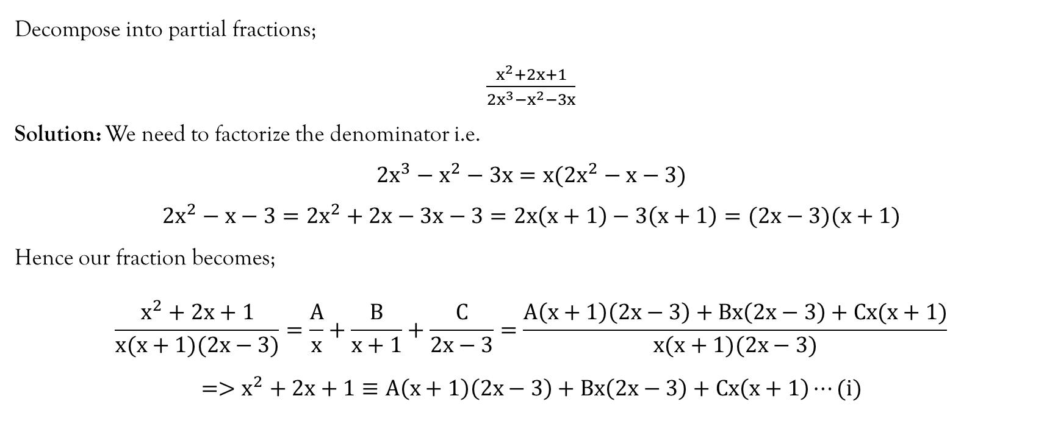
Example
Decompose into partial fractions;
$\frac{x^{2}+2x+1}{2x^{3}−x^{2}−3x}$
Solution: We need to factorize the denominator i.e.
$$2x^{3}−x^{2}−3x=x(2x^{2}−x−3)$$
$$2x^{2}−x−3=2x^{2}+2x−3x−3=2x\left(x+1\right)−3\left(x+1\right)=(2x−3)(x+1)$$
Hence our fraction becomes;
$$\frac{x^{2}+2x+1}{x(x+1)(2x−3)}=\frac{A}{x}+\frac{B}{x+1}+\frac{C}{2x−3}=\frac{A\left(x+1\right)\left(2x−3\right)+Bx\left(2x−3\right)+Cx(x+1)}{x(x+1)(2x−3)}$$
$$=>x^{2}+2x+1≡A\left(x+1\right)\left(2x−3\right)+Bx\left(2x−3\right)+Cx\left(x+1\right)⋯(i)$$

Slide 12
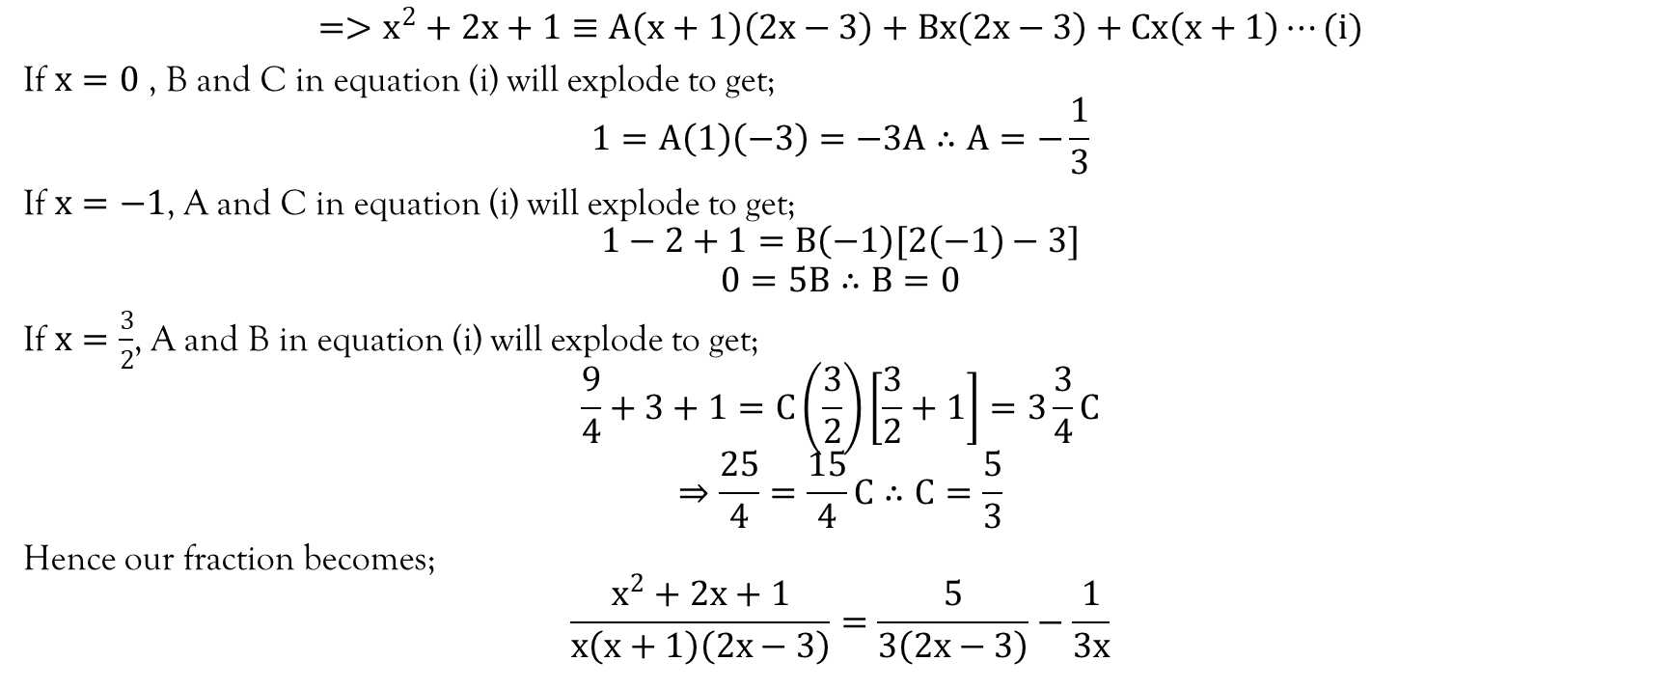
Example…contd…
$$=>x^{2}+2x+1≡A\left(x+1\right)\left(2x−3\right)+Bx\left(2x−3\right)+Cx\left(x+1\right)⋯(i)$$
If $x=0$ , B and C in equation (i) will explode to get;
$$1=A\left(1\right)\left(−3\right)=−3A∴A=−\frac{1}{3}$$
If $x=−1$, A and C in equation (i) will explode to get;
$$1−2+1=B\left(−1\right)[2\left(−1\right)−3]$$
$$0=5B∴B=0$$
If $x=\frac{3}{2}$, A and B in equation (i) will explode to get;
$$\frac{9}{4}+3+1=C\left(\frac{3}{2}\right)\left[\frac{3}{2}+1\right]=3\frac{3}{4}C$$
$$⇒\frac{25}{4}=\frac{15}{4}C∴C=\frac{5}{3}$$
Hence our fraction becomes;
$$\frac{x^{2}+2x+1}{x\left(x+1\right)\left(2x−3\right)}=\frac{5}{3\left(2x−3\right)}−\frac{1}{3x}$$

Slide 13
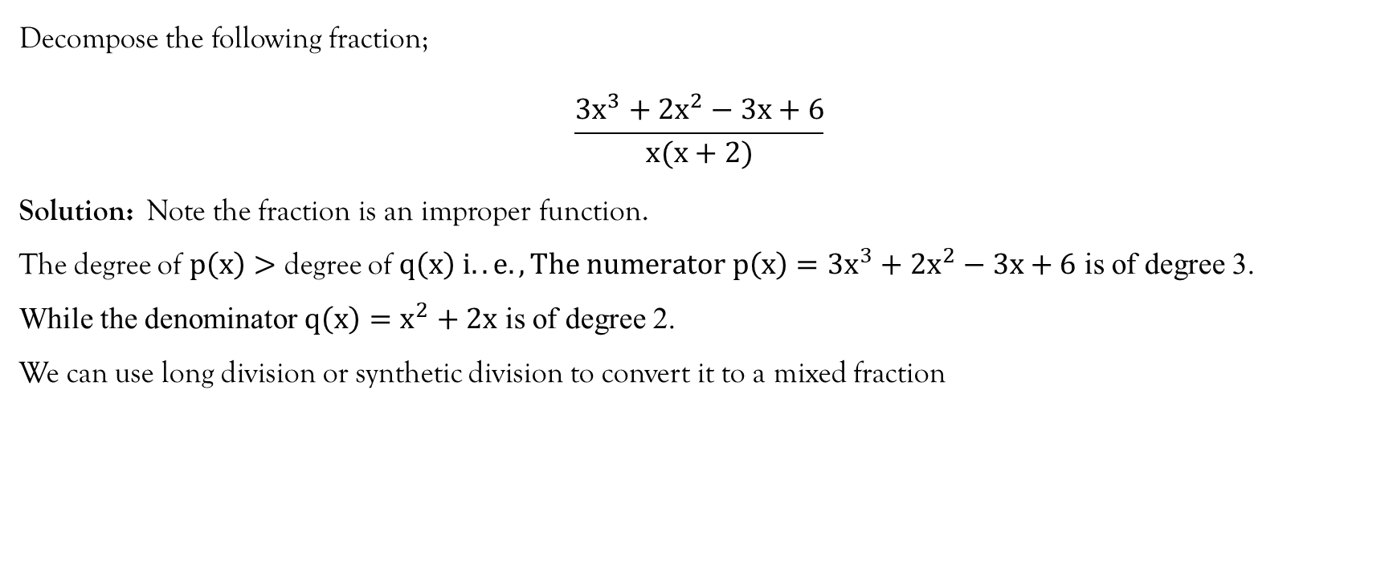
Example
Decompose the following fraction;
$$\frac{3x^{3}+2x^{2}−3x+6}{x(x+2)}$$
Solution: Note the fraction is an improper function.
The degree of $p\left(x\right)>$ degree of $q\left(x\right) i..e., The numerator p\left(x\right)=3x^{3}+2x^{2}−3x+6$ is of degree 3.
While the denominator $q\left(x\right)=x^{2}+2x$ is of degree 2.
We can use long division or synthetic division to convert it to a mixed fraction

Slide 14
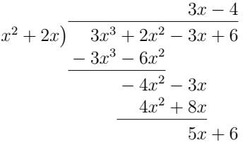
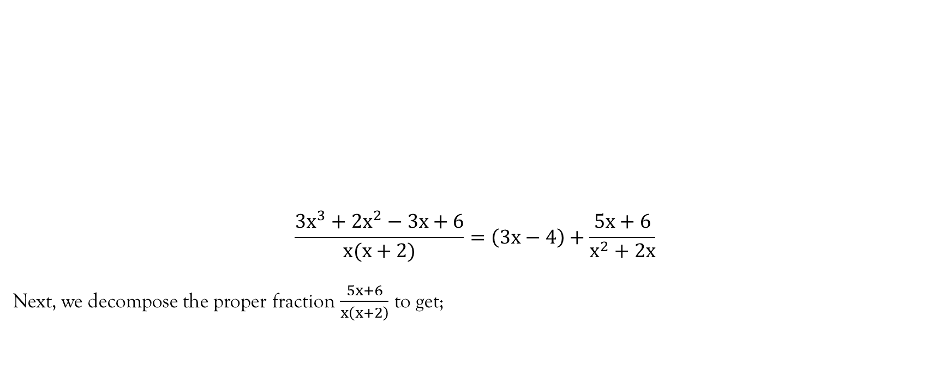
Example…contd…
$$\frac{3x^{3}+2x^{2}−3x+6}{x(x+2)}=\left(3x−4\right)+\frac{5x+6}{x^{2}+2x}$$
Next, we decompose the proper fraction $\frac{5x+6}{x\left(x+2\right)}$ to get;

Slide 15
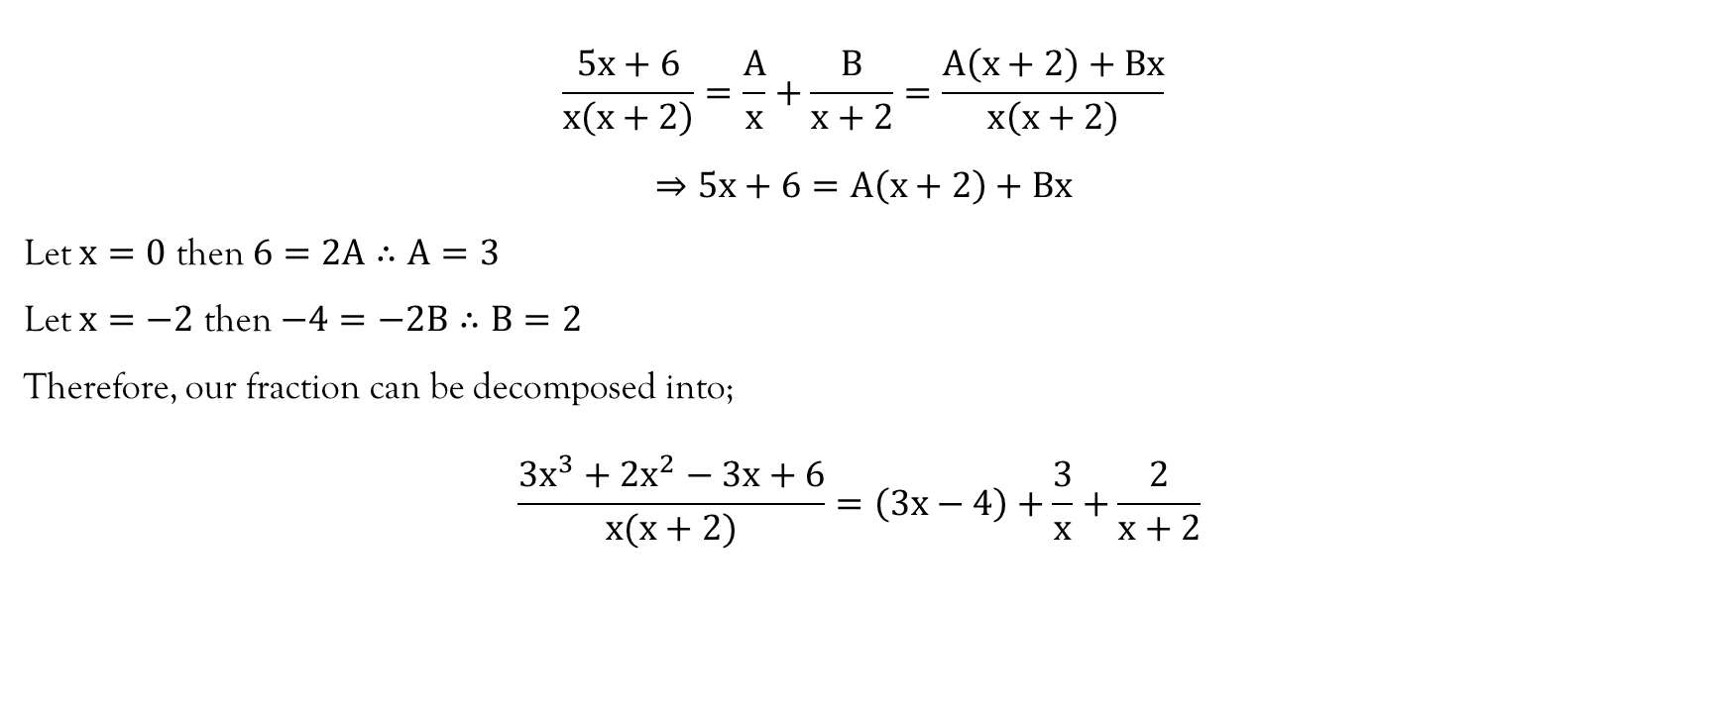
Example…contd…
$$\frac{5x+6}{x\left(x+2\right)}=\frac{A}{x}+\frac{B}{x+2}=\frac{A\left(x+2\right)+Bx}{x\left(x+2\right)}$$
$$⇒5x+6=A\left(x+2\right)+Bx$$
Let $x=0$ then $6=2A∴A=3$
Let $x=−2$ then $−4=−2B∴B=2$
Therefore, our fraction can be decomposed into;
$$\frac{3x^{3}+2x^{2}−3x+6}{x(x+2)}=\left(3x−4\right)+\frac{3}{x}+\frac{2}{x+2}$$

Slide 16
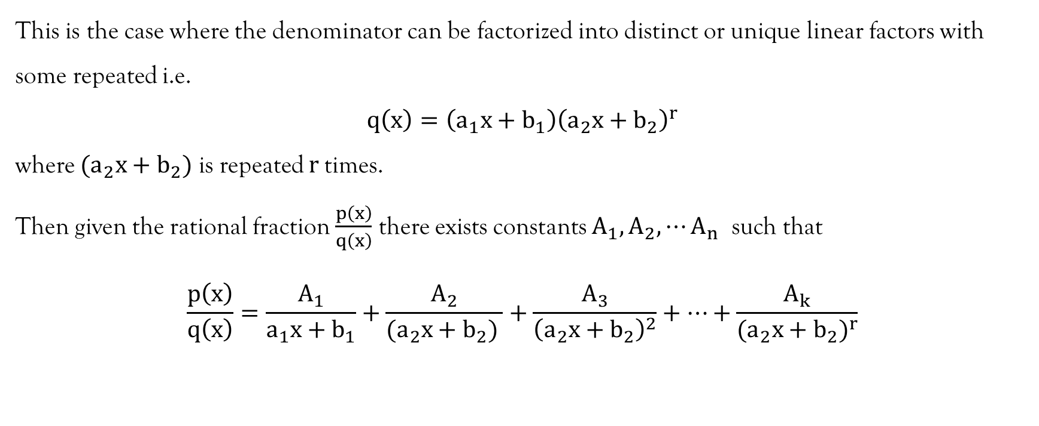

CASE II: The denominator $q(x)$ is a product of linear factors, with some being repeated
This is the case where the denominator can be factorized into distinct or unique linear factors with some repeated i.e.
$$q\left(x\right)=\left(a_{1}x+b_{1}\right){\left(a_{2}x+b_{2}\right)}^{r}$$
where $(a_{2}x+b_{2})$ is repeated $r$times.
Then given the rational fraction $\frac{p\left(x\right)}{q\left(x\right)}$ there exists constants $A_{1}, A_{2},⋯A_{n}$ such that
$$\frac{p\left(x\right)}{q\left(x\right)}=\frac{A_{1}}{a_{1}x+b_{1}}+\frac{A_{2}}{{(a}_{2}x+b_{2}) }+\frac{A_{3}}{{\left(a_{2}x+b_{2}\right)}^{2}}+⋯+\frac{A_{k}}{{{(a}_{2}x+b_{2})}^{r}}$$

Slide 17
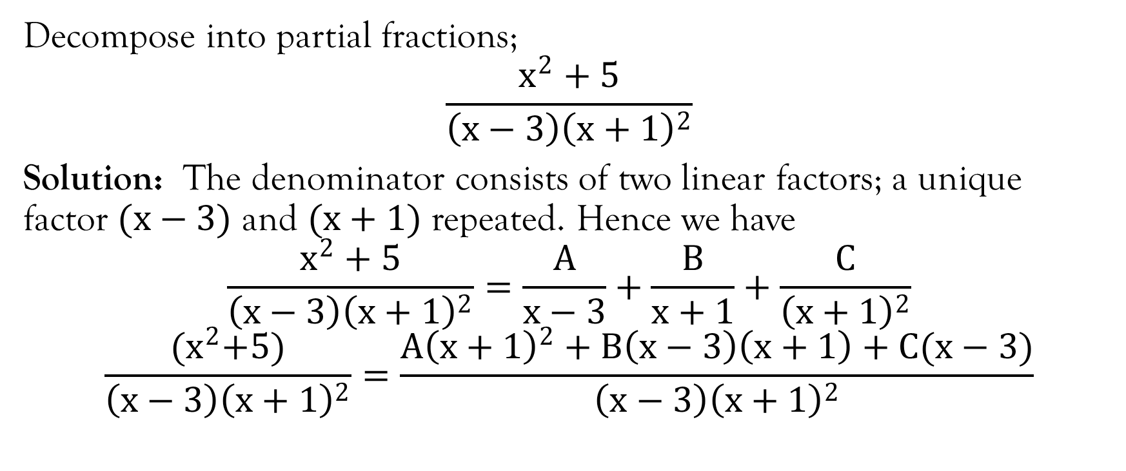
Example
Decompose into partial fractions;
$$\frac{x^{2}+5}{\left(x−3\right){\left(x+1\right)}^{2}}$$
Solution: The denominator consists of two linear factors; a unique factor $(x−3)$ and $(x+1)$ repeated. Hence we have
$$\frac{x^{2}+5}{\left(x−3\right){\left(x+1\right)}^{2}}=\frac{A}{x−3}+\frac{B}{x+1}+\frac{C}{{\left(x+1\right)}^{2}}$$
$$\frac{{(x}^{2}+5)}{\left(x−3\right){\left(x+1\right)}^{2}}=\frac{A{\left(x+1\right)}^{2}+B\left(x−3\right)\left(x+1\right)+C(x−3)}{\left(x−3\right){\left(x+1\right)}^{2}}$$

Slide 18
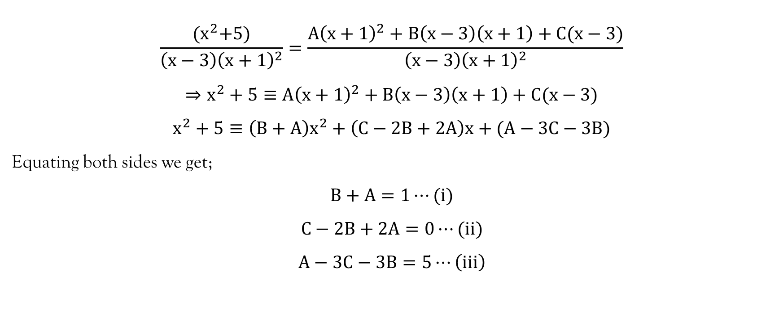
Example…contd…
$$\frac{{(x}^{2}+5)}{\left(x−3\right){\left(x+1\right)}^{2}}=\frac{A{\left(x+1\right)}^{2}+B\left(x−3\right)\left(x+1\right)+C(x−3)}{\left(x−3\right){\left(x+1\right)}^{2}}$$
$$⇒x^{2}+5≡A{\left(x+1\right)}^{2}+B\left(x−3\right)\left(x+1\right)+C(x−3)$$
$$x^{2}+5≡\left(B+A\right)x^{2}+\left(C−2B+2A\right)x+(A−3C−3B)$$
Equating both sides we get;
$$B+A=1⋯(i)$$
$$C−2B+2A=0⋯(ii)$$
$$A−3C−3B=5⋯\left(iii\right)$$

Slide 19
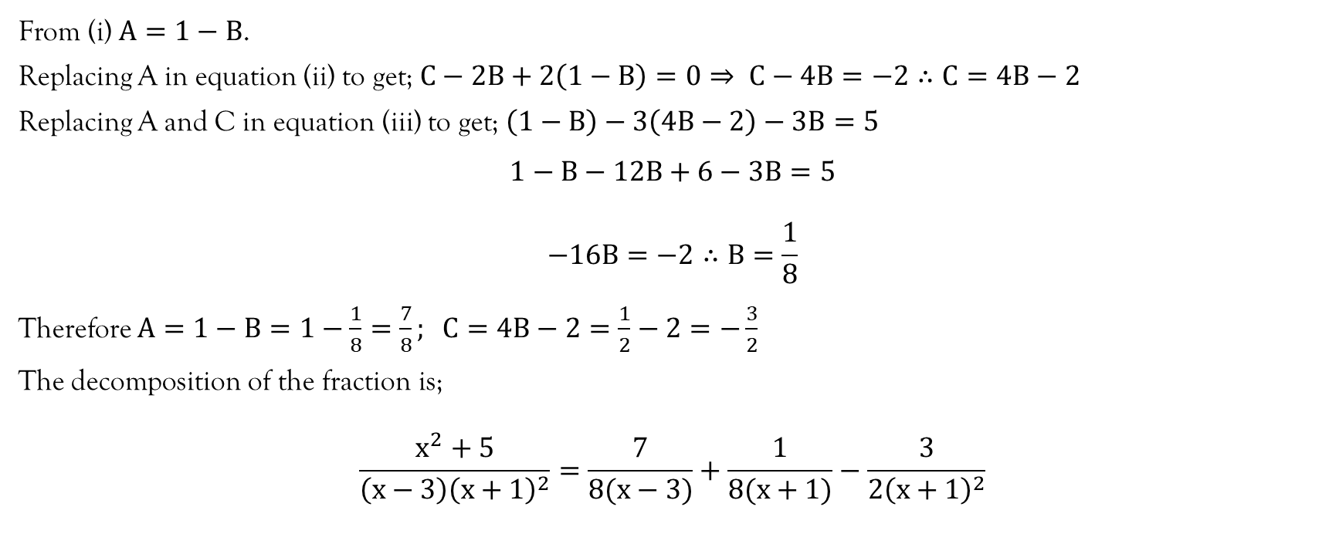
Example…contd…
From (i) $A=1−B$.
Replacing A in equation (ii) to get; $C−2B+2\left(1−B\right)=0⇒ C−4B=−2∴C=4B−2$
Replacing A and C in equation (iii) to get; $\left(1−B\right)−3\left(4B−2\right)−3B=5$
$$1−B−12B+6−3B=5$$
$$−16B=−2∴B=\frac{1}{8}$$
Therefore $A=1−B=1−\frac{1}{8}=\frac{7}{8}; C=4B−2=\frac{1}{2}−2=−\frac{3}{2}$
The decomposition of the fraction is;
$$\frac{x^{2}+5}{\left(x−3\right){\left(x+1\right)}^{2}}=\frac{7}{8(x−3)}+\frac{1}{8(x+1)}−\frac{3}{{2\left(x+1\right)}^{2}}$$

Slide 20
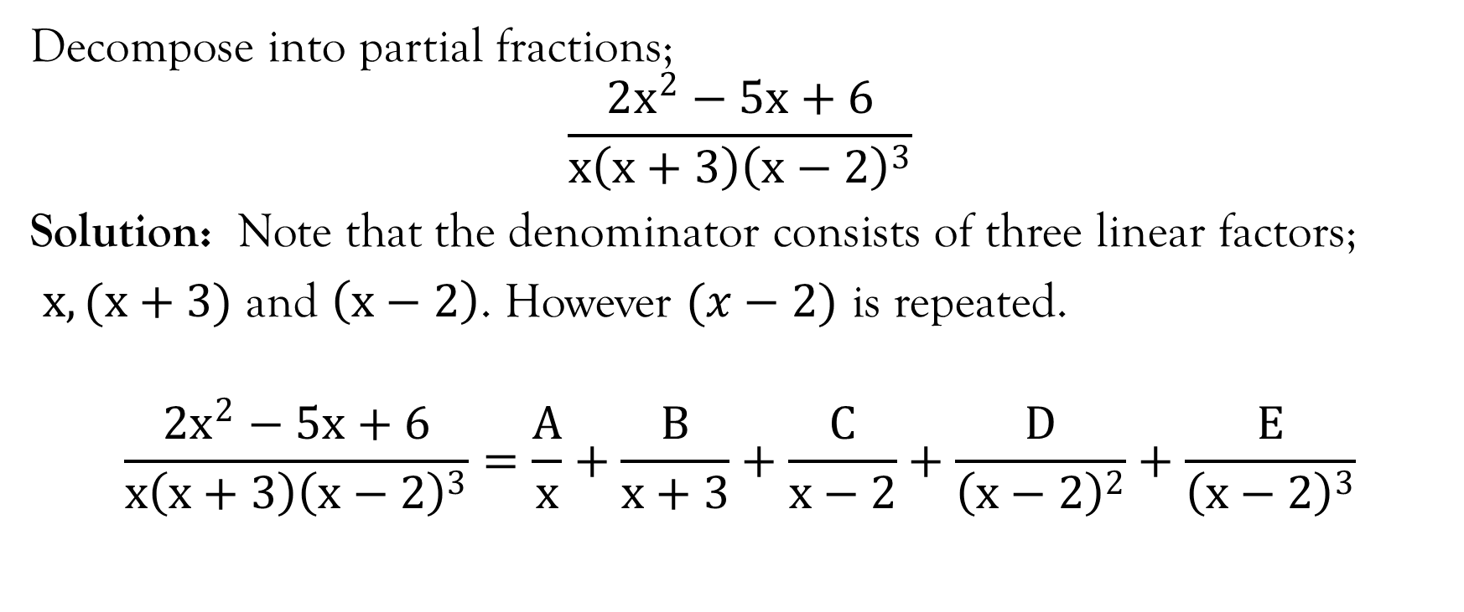
Example
Decompose into partial fractions;
$$\frac{2x^{2}−5x+6}{x\left(x+3\right){\left(x−2\right)}^{3}}$$
Solution: Note that the denominator consists of three linear factors;
$x, (x+3)$ and $\left(x−2\right)$. However $(x−2)$ is repeated.
$$\frac{2x^{2}−5x+6}{x\left(x+3\right){\left(x−2\right)}^{3}}=\frac{A}{x}+\frac{B}{x+3}+\frac{C}{x−2}+\frac{D}{{\left(x−2\right)}^{2}}+\frac{E}{{\left(x−2\right)}^{3}}$$

Slide 21
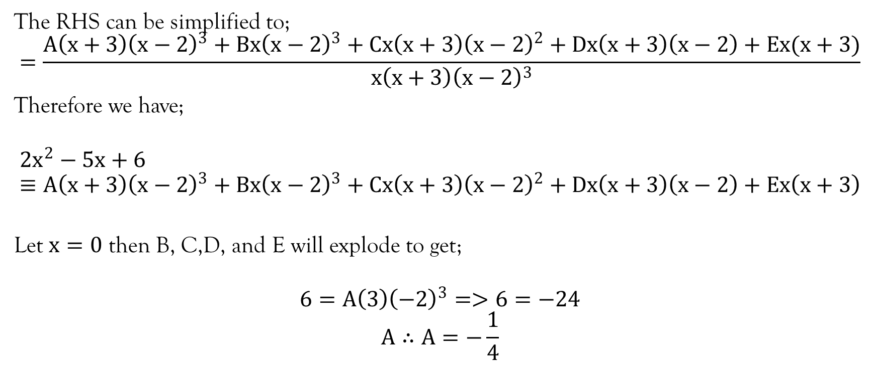
Example…contd…
The RHS can be simplified to;
$$=\frac{A\left(x+3\right){\left(x−2\right)}^{3}+Bx{\left(x−2\right)}^{3}+Cx\left(x+3\right){\left(x−2\right)}^{2}+Dx\left(x+3\right)\left(x−2\right)+Ex(x+3)}{x\left(x+3\right){\left(x−2\right)}^{3}}$$
Therefore we have;
$$2x^{2}−5x+6≡A\left(x+3\right){\left(x−2\right)}^{3}+Bx{\left(x−2\right)}^{3}+Cx\left(x+3\right){\left(x−2\right)}^{2}+Dx\left(x+3\right)\left(x−2\right)+Ex\left(x+3\right)$$
Let $x=0$ then B, C,D, and E will explode to get;
$$6=A\left(3\right){\left(−2\right)}^{3}=>6=−24$$
$$A∴A=−\frac{1}{4}$$

Slide 22
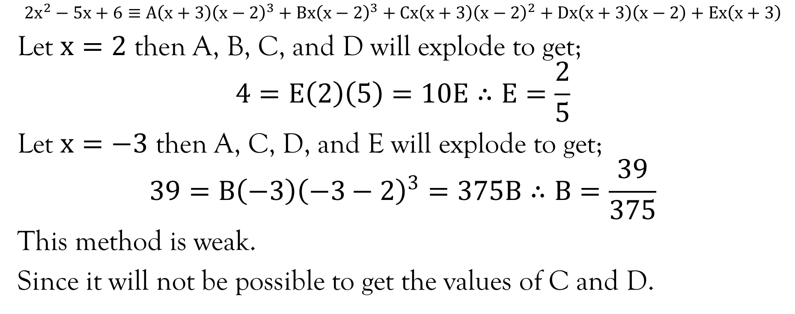
Example…contd…
$$2x^{2}−5x+6≡A\left(x+3\right){\left(x−2\right)}^{3}+Bx{\left(x−2\right)}^{3}+Cx\left(x+3\right){\left(x−2\right)}^{2}+Dx\left(x+3\right)\left(x−2\right)+Ex\left(x+3\right)$$
Let $x=2$ then A, B, C, and D will explode to get;
$$4=E\left(2\right)\left(5\right)=10E∴E=\frac{2}{5}$$
Let $x=−3$ then A, C, D, and E will explode to get;
$$39=B\left(−3\right){\left(−3−2\right)}^{3}=375B∴B=\frac{39}{375}$$
This method is weak.
Since it will not be possible to get the values of C and D.

Slide 23
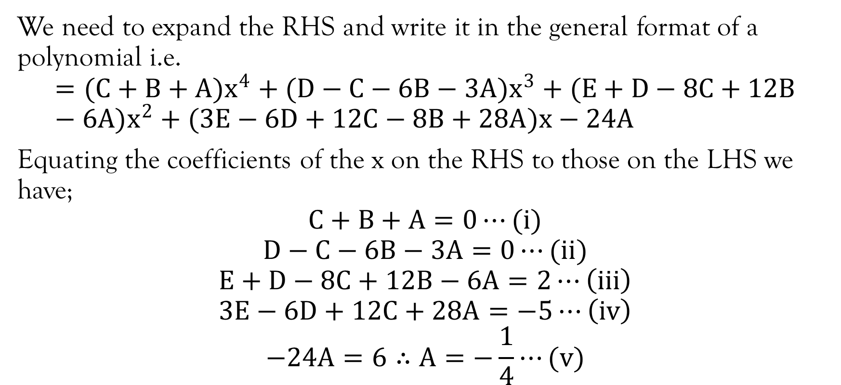
Example…Contd…
We need to expand the RHS and write it in the general format of a polynomial i.e.
$$=(C+B+A)x^{4}+(D−C−6B−3A)x^{3}+(E+D−8C+12B−6A)x^{2}+(3E−6D+12C−8B+28A)x−24A$$
Equating the coefficients of the x on the RHS to those on the LHS we have;
$$C+B+A=0⋯(i)$$
$$D−C−6B−3A=0⋯(ii)$$
$$E+D−8C+12B−6A=2⋯\left(iii\right)$$
$$3E−6D+12C+28A=−5⋯\left(iv\right)$$
$$−24A=6∴A=−\frac{1}{4}⋯(v)$$

Slide 24
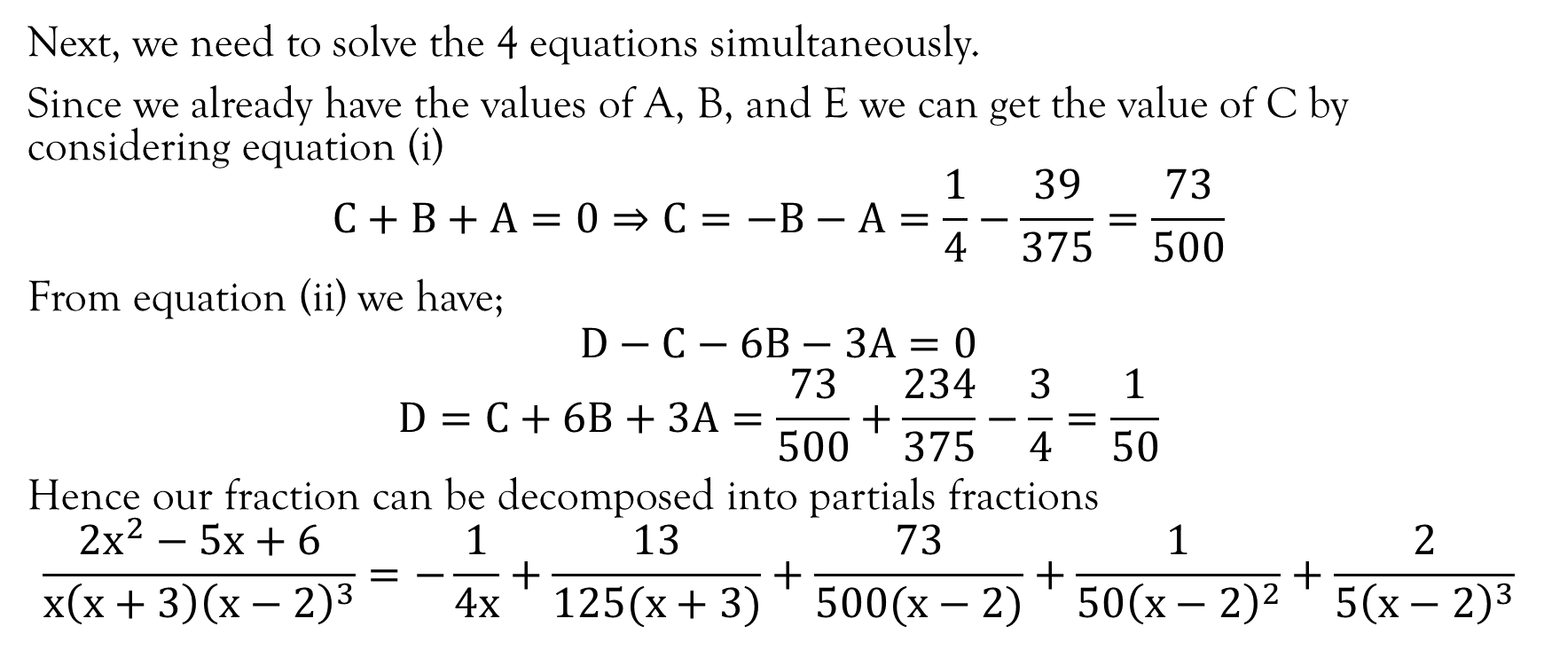
Example…contd…
Next, we need to solve the 4 equations simultaneously.
Since we already have the values of A, B, and E we can get the value of C by considering equation (i)
$$C+B+A=0⇒C=−B−A=\frac{1}{4}−\frac{39}{375}=\frac{73}{500}$$
From equation (ii) we have;
$$D−C−6B−3A=0$$
$$D=C+6B+3A=\frac{73}{500}+\frac{234}{375}−\frac{3}{4}=\frac{1}{50}$$
Hence our fraction can be decomposed into partials fractions
$$\frac{2x^{2}−5x+6}{x\left(x+3\right){\left(x−2\right)}^{3}}=−\frac{1}{4x}+\frac{13}{125(x+3)}+\frac{73}{500(x−2)}+\frac{1}{{50\left(x−2\right)}^{2}}+\frac{2}{{5\left(x−2\right)}^{3}}$$

Slide 25
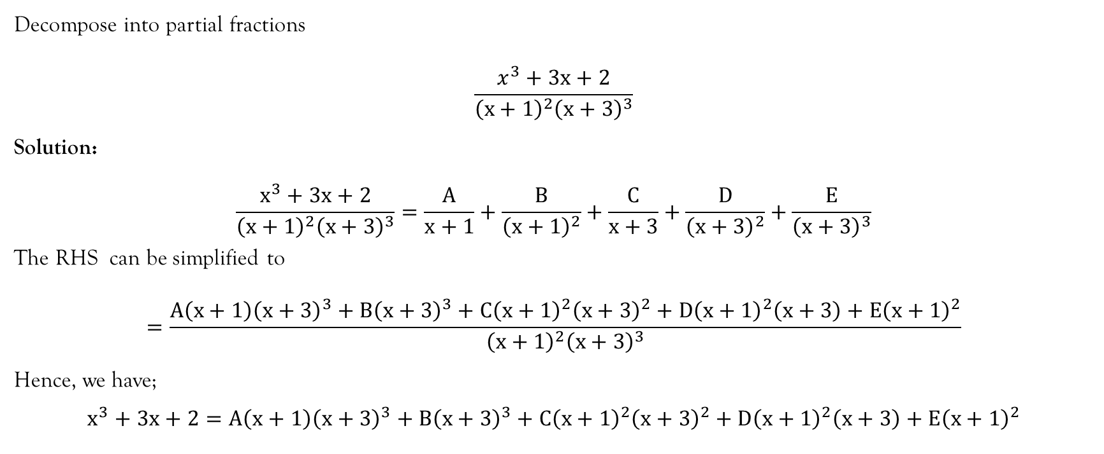
Example
Decompose into partial fractions
$$\frac{x^{3}+3x+2}{{\left(x+1\right)}^{2}{\left(x+3\right)}^{3}}$$
Solution:
$$\frac{x^{3}+3x+2}{{\left(x+1\right)}^{2}{\left(x+3\right)}^{3}}=\frac{A}{x+1}+\frac{B}{{\left(x+1\right)}^{2}}+\frac{C}{x+3}+\frac{D}{{\left(x+3\right)}^{2}}+\frac{E}{{\left(x+3\right)}^{3}}$$
The RHS can be simplified to
$$=\frac{A\left(x+1\right){\left(x+3\right)}^{3}+B{\left(x+3\right)}^{3}+C{\left(x+1\right)}^{2}{\left(x+3\right)}^{2}+D{\left(x+1\right)}^{2}\left(x+3\right)+E{\left(x+1\right)}^{2}}{{\left(x+1\right)}^{2}{\left(x+3\right)}^{3}}$$
Hence, we have;
$$x^{3}+3x+2=A\left(x+1\right){\left(x+3\right)}^{3}+B{\left(x+3\right)}^{3}+C{\left(x+1\right)}^{2}{\left(x+3\right)}^{2}+D{\left(x+1\right)}^{2}\left(x+3\right)+E{\left(x+1\right)}^{2}$$

Slide 26
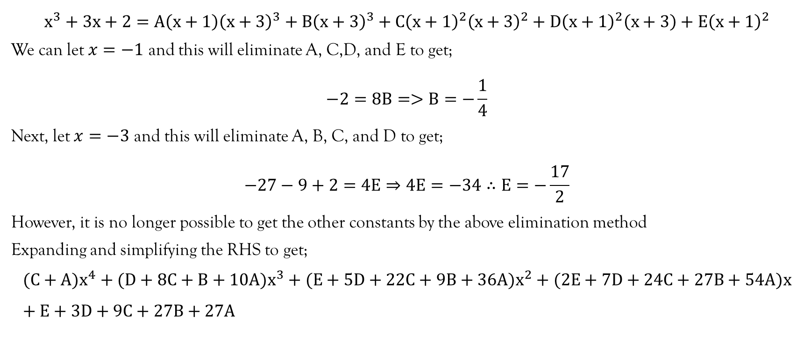
Example…contd…
$$x^{3}+3x+2=A\left(x+1\right){\left(x+3\right)}^{3}+B{\left(x+3\right)}^{3}+C{\left(x+1\right)}^{2}{\left(x+3\right)}^{2}+D{\left(x+1\right)}^{2}\left(x+3\right)+E{\left(x+1\right)}^{2}$$
We can let $x=−1$ and this will eliminate A, C,D, and E to get;
$$−2=8B=>B=−\frac{1}{4}$$
Next, let $x=−3$ and this will eliminate A, B, C, and D to get;
$$−27−9+2=4E⇒4E=−34∴E=−\frac{17}{2}$$
However, it is no longer possible to get the other constants by the above elimination method
Expanding and simplifying the RHS to get;
$$(C+A)x^{4}+(D+8C+B+10A)x^{3}+(E+5D+22C+9B+36A)x^{2}+(2E+7D+24C+27B+54A)x+E+3D+9C+27B+27A$$

Slide 27
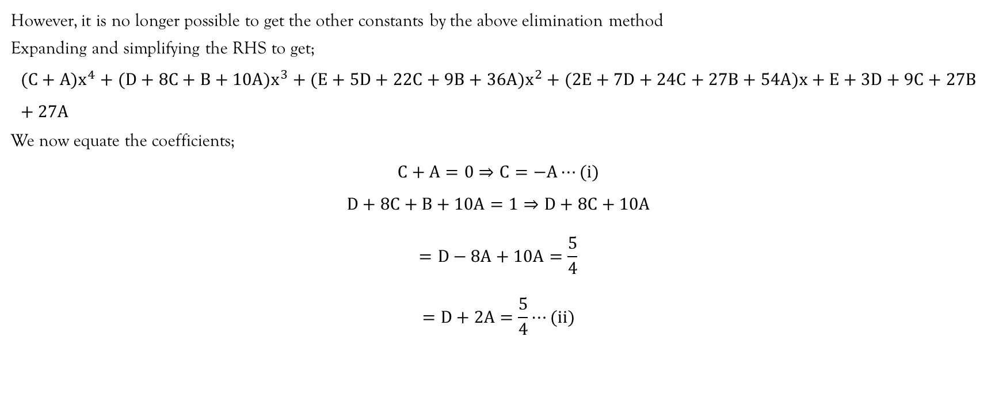
Example…contd…
However, it is no longer possible to get the other constants by the above elimination method
Expanding and simplifying the RHS to get;
$$(C+A)x^{4}+(D+8C+B+10A)x^{3}+(E+5D+22C+9B+36A)x^{2}+(2E+7D+24C+27B+54A)x+E+3D+9C+27B+27A$$
We now equate the coefficients;
$$C+A=0⇒C=−A⋯(i)$$
$$D+8C+B+10A=1⇒D+8C+10A$$
$$=D−8A+10A=\frac{5}{4}$$
$$=D+2A=\frac{5}{4}⋯(ii)$$

Slide 28
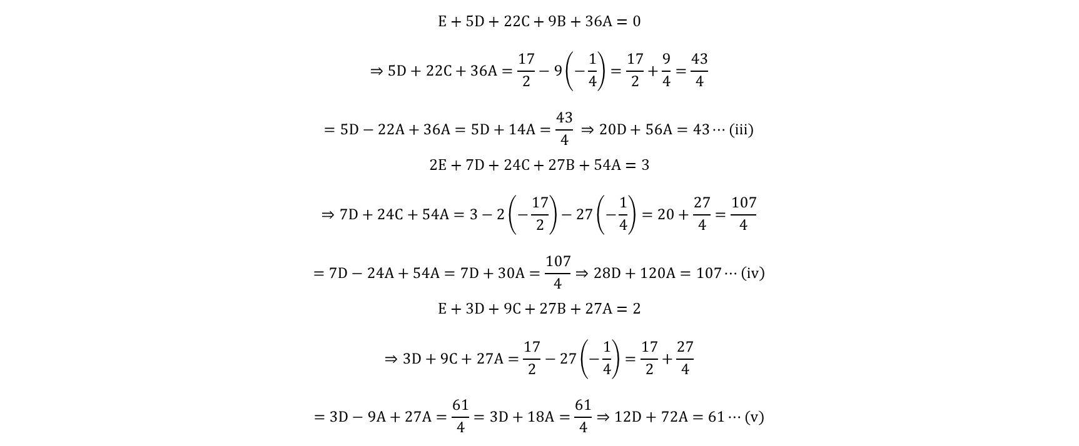
Example…contd…
$$E+5D+22C+9B+36A=0$$
$$⇒5D+22C+36A=\frac{17}{2}−9\left(−\frac{1}{4}\right)=\frac{17}{2}+\frac{9}{4}=\frac{43}{4}$$
$$=5D−22A+36A=5D+14A=\frac{43}{4} ⇒20D+56A=43⋯(iii)$$
$$2E+7D+24C+27B+54A=3$$
$$⇒7D+24C+54A=3−2\left(−\frac{17}{2}\right)−27\left(−\frac{1}{4}\right)=20+\frac{27}{4}=\frac{107}{4}$$
$$=7D−24A+54A=7D+30A=\frac{107}{4}⇒28D+120A=107⋯\left(iv\right)$$
$$E+3D+9C+27B+27A=2$$
$$⇒3D+9C+27A=\frac{17}{2}−27\left(−\frac{1}{4}\right)=\frac{17}{2}+\frac{27}{4}$$
$$=3D−9A+27A=\frac{61}{4}=3D+18A=\frac{61}{4}⇒12D+72A=61⋯(v)$$

Slide 29
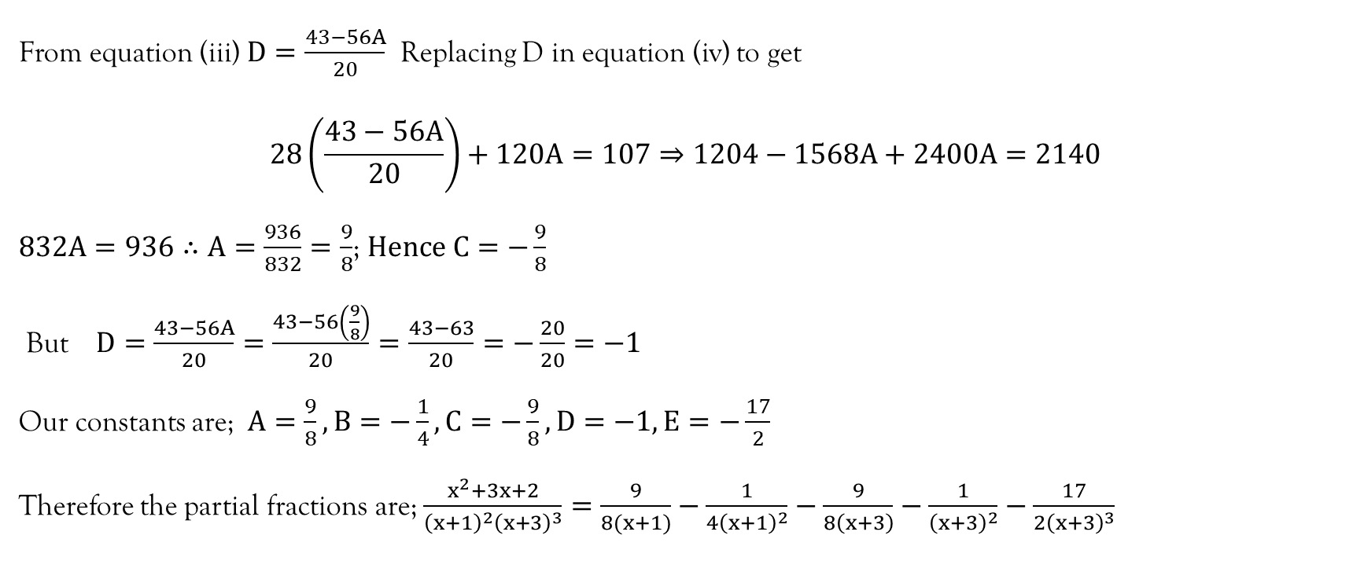
Example…contd…
From equation (iii) $D=\frac{43−56A}{20}$ Replacing D in equation (iv) to get
$$28\left(\frac{43−56A}{20}\right)+120A=107⇒1204−1568A+2400A=2140$$
$832A=936∴A=\frac{936}{832}=\frac{9}{8}$; $Hence C=−\frac{9}{8}$
But $D=\frac{43−56A}{20}=\frac{43−56\left(\frac{9}{8}\right)}{20}=\frac{43−63}{20}=−\frac{20}{20}=−1$
Our constants are; $A=\frac{9}{8},B=−\frac{1}{4},C=−\frac{9}{8},D=−1,E=−\frac{17}{2}$
Therefore the partial fractions are; $\frac{x^{2}+3x+2}{{\left(x+1\right)}^{2}{\left(x+3\right)}^{3}}=\frac{9}{8(x+1)}−\frac{1}{{4\left(x+1\right)}^{2}}−\frac{9}{8\left(x+3\right)}−\frac{1}{{\left(x+3\right)}^{2}}−\frac{17}{{2\left(x+3\right)}^{3}}$

Slide 30
References
Kahenya, P. (2017). Foundation Maths. LAP Lambert Academic Publishers.
Murray, S., & Robert, M. (2009). College Algebra. McGraw-Hill.
Stewart, J. (2012). Calculus (7th ed.). BROOKS/COLE Cengage Learning.

Slide 31
End of Lecture 6
Thank You

