Slide 1
MARKETING OF FINANCIAL SERVICES
LECTURE 3: Financial Services Consumer Behavior
DR. John Kamau

Slide 2
Welcome !
This is the third lecture in marketing of financial services series
It is my joy to take you through this and hope you will understand your personal consumption pattern
The lecture is expected to add to your building blocks in knowledge as you pursue your college education
.

Slide 3
Introduction
Last week we examined the environment in which marketers offer their services and its implication to marketing decisions and strategies.
We examined both internal, external and task environment
We also examined environmental scanning model and how to apply that knowledge
This week we shift our focus to behavior displayed by consumers in the process of purchasing a financial service or product.
.

Slide 4
Intended Learning outcomes
At the end of this lecture, you will be able to
Define consumer behavior in service context
Determine factors influencing consumer behavior
Evaluate service consumption process
Establish significance of consumer behavior knowledge
.

Slide 5
Definition of Financial Service Consumer Behavior
The behavior that consumers’ display in searching for, purchasing, using, evaluating and disposing of products and services that they expect will satisfy their needs ((Schiffman and Kanuk, 2004)..
The field of consumer behavior is the study of individual groups or organization and the processes they use to select, secure, use and dispose of products services, experiences, or ideas to satisfy needs and the impact that these have on the consumer and society (Hawkins, Best, and Coney, 2001)).
.

Slide 6
Definition cont.
The sum of how individual and groups recognize and determine their needs and how they purchase and experience goods and services to meet those needs (Solomon, Bamossy, Askegaard and Hog, 2006).
It includes what, when, where why and how of the purchase and experience process.
.

Slide 7
Definition cont.
From the various definitions we extract the following about consumer behavior
Consumer behavior is a process not a single activity
The goal of this process is to satisfy a need
It may involve groups or individuals
.

Slide 8
Definition cont.
The process involves need recognition
The process further involves means of satisfying the need
Consumer will evaluate the extent to which their expectations have been met
Impact of behavior to society
.

Slide 9
Definition cont.
Consumer behavior of a financial services is the process which consumers go through in looking for, purchasing, consuming, and evaluating the quality of a financial product.
This definition implies that the consumer will have to recognize his need, looking for a service that can satisfy a need and finally evaluate whether that service has met his expectation or not.
.

Slide 10
Significance of consumer behavior knowledge
Consumers are the reason for business existence
Consumers demand satisfaction hence value, quality and service.
It helps reduce the risks in buying to the consumer
Helps build long-term customer relationship necessary for customer retention.
It helps in management of marketing activities.
.

Slide 11
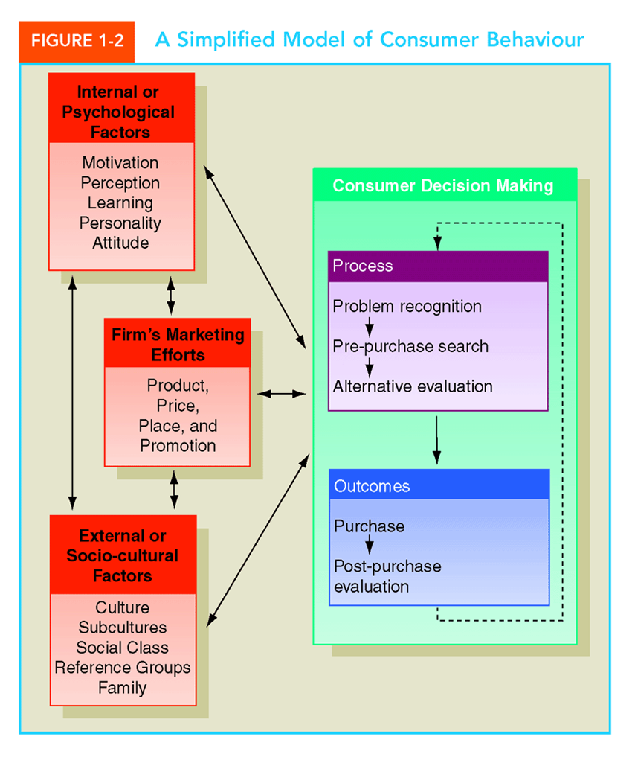
Factors influencing consumption of Financial Products
.

Slide 12
Intrinsic factors
Personality is the total pattern of characteristic ways of thinking, feeling and behaving constituting an individual’s distinctive relationship with the environment
An attitude is a predisposition toward an object, event that determines response
.

Slide 13
Intrinsic factors cont.
Perception is the meaning an individual assigns to an object or stimulus.
Motivation is a goal-oriented behavior.
Learning is the process of acquiring knowledge through experience leading to behaviors change.
.

Slide 14
Extrinsic factors
Culture is away of life handled down through generations-learned and acquired. It consists of society norms, beliefs, customs etc.
Subculture identifies a distinct group within a cultural community
Social class is an indicator of lifestyle exerting a strong influence on individual consumers and behavior
.

Slide 15
Extrinsic factors cont.
A reference group is a group of people whose standards of behavior influence a person’s attitudes, opinion and values.
This can be primary or secondary.
In each group there are opinion leaders and group norms.
The family is the most intimate group and is dependent on the family lifecycle
.

Slide 16
Stages in Purchase of a Financial Products
Consumption of a service is affected by service characteristics and offerings.
A) Search qualities refer to attributes such as color, price, feel, smell all of which a consumer can determine before buying a product.
Financial Services are poor in these characteristics making it difficult for a marketer to evaluate before making a purchase decision.
.

Slide 17
Purchase stages cont.
B) Experience qualities are noted during and after consumption.
They constitute what the customer is going through and the results of the process.
In purchase of a financial service, the consumer can assess the friendliness courtesy and appearance.
.

Slide 18
Purchase stages cont.
c) Credence qualities implies the characteristics that the consumer may find impossible to evaluate even after purchase and consumption.
The financial services are also poor in this since limited evaluation can be done to some extent after purchase.
Understanding of these qualities helps us in appreciating how consumers make purchase decisions.
.

Slide 19
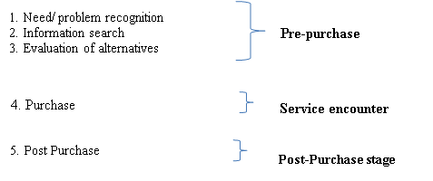
Financial product Purchase stages
.

Slide 20
Purchase stages cont.
a) Pre-purchase stage
This stage constitutes problem recognition, information search and evaluation of alternatives stage.
1. Need/problem recognition
Triggered by internal stimuli or external
Awaken latent needs thro marketing activities
Demonstrate urgency and consequences of not fulfilling it.
Needs could range from physiological needs to safety, social esteem, and self-actualization.
Each of these could be fulfilled through certain financial products.
.

Slide 21
Purchase stages cont.
2. Information search
Internal search within his subconscious mind.
External search: close friends and relatives, marketing promotion activities
Digital search at website
The marketer must ensure that there is enough information on their online platforms for them to be considered by the potential customer.
.

Slide 22
Purchase stages cont.
Consumers seek information due to perceived risks Lovelock (2011)
Financial risk (loss of money),
Time risk (waste of time),
Performance risk (services may not meet expectation),
Social risk (what friends will say about the service bought
Psychological risk (whether the service will injure self-esteem of the service receiver).
.

Slide 23
Purchase stages cont.
Perceived risk can be reduced thro:
Offering guarantees
Making the service more tangible
Offering a free or reduced-cost trial period for a service,
Employee training
Employee compensation
.

Slide 24
Purchase stages cont.
Seeking information from respected personal sources (family, friends, peers)
Relying on a firm that has a good reputation
Visiting service facilities of trying aspects of the service before purchasing
Using the web to compare service offerings
.

Slide 25
Purchase stages cont.
Evaluation of alternatives
Based on some criteria Schiffman (2006)
Objective criteria considered the tangible aspect of a service
Subjective criterion considers the symbolic meaning of a service
The compensatory criteria combine several features of a product,
The non-compensatory criteria look at an outstanding negative feature to reject the product
.

Slide 26
Purchase stages cont.
b) Service Encounter Stage
This is the stage in which the consumer makes actual purchase of the service.
Interacts in service facility or remotely through online, use of machines such as atm.
Determining service quality service.
Lovelock (2011) “service encounters as “moments of truth”
.

Slide 27
Purchase stages cont.
“(we) could say that the perceived quality is realized at the moment of truth when the service provider and the service customer confront one another in the same arena.
At that moment they are very much on their own…it is the skill, the motivation, and the tools employed by the firm’s representative and the expectations and behavior of the client which together will create the service delivery process.”
.

Slide 28
Purchase stages cont.
Lovelock (2011) further notes that the compatibility of various customers taking the service will affect service delivery.
Emotions and moods also affect service delivery. Positive mood may make customers more obliged and willing to participate in behavior that helps service encounter succeed.
Moods may also bias the way customers judge service encounters
This understanding is significant for a financial services provider in ensuring that this stage of service delivery is successful.
.

Slide 29
Purchase stages cont.
c) Post-Purchase Stage
This is the final stage in financial service purchase process.
It is the stage in which customer evaluates his service received.
Kotler (2006) notes that after consumption of the service a customer will either be satisfied, or disappointed
.

Slide 30
Purchase stages cont.
Zeithaml, Bitner and Gremler (2006) notes that the experience will have great impact on
Word-of-mouth communication
Attribution of dissatisfaction
Positive or negative biases
Brand loyalty.
.

Slide 31
Purchase stages cont.
Evaluation of services will be based on customer expectation.
Lovelock (2011) notes that customer expectation could be classified as
Desired service. The level of service the customer hopes to receive,
.

Slide 32
Purchase stages cont.
Adequate service which is the ‘minimum tolerable expectations.
The extent to which customers recognize and are willing to accept variation in service provision constitutes zone of tolerance
Predicted service is the level of service that customers anticipate receiving.
.

Slide 33
Purchase stages cont.
The level of service expected is affected by factors such as
Personal needs
Other people’s expectations
The skills of company’s managers / employees-
Location of business
Personal service philosophies and
Urgency of the situation in which a customer is in
.

Slide 34
References
Hawkins, Rodger., Best, Kenneth., & Coney, (2001). Consumer Behaviour. New York: McGraw-Hill.
Lovelock C. Wirtz J. (2011) Services Marketing People, Technology, Strategy. Pearson Education, Inc., publishing as Prentice Hall, One Lake Street, Upper Saddle River, New Jersey
Schiffman, L G. and Kanuk (2004) Consumer Behavior, Leslie Lazar Pearson Education Pvt Ltd., New York.
Solomon M, Bamossy G, Askegaard S. & Hogg M.K (2006). Consumer Behavior, A European Perspective. Pearson Education Limited
Zeithaml V.A., Bitner M.J., and Gremler D.D., (2006), Services Marketing, Integrating Customer Focus Across the Firm, McGraw-Hill, 4th Edition.
.

Slide 35
End
End
Thank you
.

