Slide 1
MARKETING OF FINANCIAL SERVICES
Developing and Managing Financial Service Products
Lecture Five
Dr John N Kamau

Slide 2
Welcome!
Welcome to week 5 lecture in marketing of financial services
It is my joy to have you in this class
Having covered the topic on segmentation targeting and positioning , it is my hope that we are ready to progress
This week we focus on developing and managing financial products
.

Slide 3
Intended learning outcomes
Define a financial service product
Describe factors affecting product strategy
Examine the process of new product development
Analyze factors affecting the adoption of new financial services
Describe ways of eliminating a financial product from the market.
.

Slide 4
Definition of a financial product/service
The terms service and product used interchangeably in marketing of a service.
A product is anything that can be offered to a market for attention acquisition, use or consumption that might satisfy a need (Kotler 1997).
Dibb et al (1997) define a product as everything both favorable and unfavorable that one receives in an exchange.
It is a complexity of intangible attributes, including functional, social, and psychological utilities or benefits.
.

Slide 5
Definition cont.
From this definition we can define a financial product as a bundle of benefits that a financial institution offers to its customers to satisfy their financial needs.
This could be a credit facility, a savings account, a current account, credit, or debit card ad many more,
.

Slide 6

Levels of a product
Augmented product
Expected product
Tangible product
Core Product
Potential product
.

Slide 7
Levels of product cont.
Level 1 Core product : the main benefit the customer is looking for.
Level 2 : actual product /the basic product which is the tangible product or the product features
Level 3: the expected product which in our context the minimum level of service that a customer expects to receive from a financial service
.

Slide 8
Product level cont.
Level 4: the augmented product that constitutes the extra benefit that a product/service provides
Level 5: potential product which is what customers expect to be there in the market but is currently not available.
The financial service provider must be aware of these levels of a product for them to offer an acceptable product to the market.
.

Slide 9
Factors Influencing Development of Financial Products
Financial service providers must keep on developing new products for their survival in the market.
The process of developing new product is generally affected by customers, competitors, technology, government legislation, shifting industry boundaries among others (Tina, 2000).
We examine these briefly
.

Slide 10
Factors cont.
Customers
The strongest influence on new product decisions.
They could be personal, corporate, or even intermediaries.
Have changing tastes and preferences
They make demands for the new product
.

Slide 11
Factors cont.
Competition
Raises standards for financial firms.
Seek to outdo competition.
Competition comes at augmented level of product
In Kenya most financial institutions have been forced to offer insurance service to remain competitive
.

Slide 12
Factors cont.
Changing technology :according to Schiffman:
Greater customization of products and services and targeted promotional messages.
Customers have more power than ever before
They have access to more information than ever before
.

Slide 13
Factors cont.
Marketers can offer more services and products than ever before.
The exchange between marketers and customers is increasingly interactive and instantaneous.
Marketers can gather more information about their customers (and prospects) more quickly and easily and track their behavior.
.

Slide 14
Factors cont.
Government legislation
keep on changing demanding that financial institutions to comply with.
Laws on interest rates charged
Laws on statutory contributions
Laws on foreign exchange
The financial institutions must develop product to tap into these markets and ensure they comply with these regulations.
.

Slide 15
Factors cont.
Industry blurring
There is a thin boundary between what some service industries are offering.
telecommunication offering money transfer services, loans, savings plans among
The savings and credit cooperatives offering insurance services.
The financial services marketer must consider the above factors in developing new product strategy.
.

Slide 16
Types of new financial products
New to the world products e.g. Mpesa products and M-shwari
New product lines (new to institution)
Addition to existing product lines e.g. Junior savings accounts
Improvements to and revision of existing products
Repositioning’s e.g. cheque books in savings account
Cost reduction products
.

Slide 17
New Financial products Development process
New products are the lifeblood of a business (kotler, 1997) .
Keep track of changing trends, preferences and tastes of consumers.
New government regulations
Competitors actions
Suggestions from middlemen
Research and development
.

Slide 18
Stages in new product development
1) New product idea generation:
Generated from within and without a firm.
Consider core product facilitating and supplementary services (lovelock 2011).
Facilitating services: information, order-taking, billing, and payment while
Supplementary services: consultation, hospitality, safekeeping, and exceptions.
Management encourage new ideas and reward creativity
.

Slide 19
Stages in new product development cont.
2) Idea screening:
Process of sifting ideas to identify the most viable.
Examine the proposed new product in terms of resources required and its effect on available products.
Avoid go error (adopting a bad idea) or drop error (dropping otherwise good ideas).
.

Slide 20
Stages in new product development cont.
3) Business analysis:
Determine feasibility and viability
Uses cost-benefit analysis.
Cost-effective
Potential of attracting a larger market share in future.
.

Slide 21
Stages in new product development cont.
4) Product development:
Idea is turned into a concrete service
Assess technical and commercial requirement.
Some products might require new software’s and personnel to implement it.
Determine some of the risks involved and how to manage them.
.

Slide 22
Stages in new product development cont.
5) Test marketing:
Pilot testing stage is critical for product success in the market.
Acceptability of the product by customers.
Introduced on selected markets.
Market reactions to the product.
Suggestions from test market incorporated in the final product
From tests marketing strategy is developed.
.

Slide 23
Stages in new product development cont.
6) Commercialization:
The final stage when the product is commercialized
Launched nationally.
Creates awareness of the new product through promotions.
Tracking the new product demands and make necessary adjustments.
Respond to customers demands
.

Slide 24
NB
New product development is an expensive process and therefore keenness is required for success of new product
Some products are developed very quickly while others may take along time
Research is extremely important in new product development
Careful monitoring of customers reaction will strengthen the new product features
.

Slide 25
New Financial Product National Launch.
Done to create awareness and win customers.
Promotion needs to be cost-effective well planned.
Internal marketing required in the firm.
Prepare its branch network
Some financial products marketed through intermediaries.
No cannibalization of the old product by the new
.

Slide 26
Financial Products Lifecycle
Product life cycle theory explain the stages through which products go through in their lifetime.
Products are like living organisms born, grow, mature and eventually die
The theory was developed by George R Vernon in (1966) and proposes that a product goes through four stages in its lifetime.
These include introduction, growth maturity and decline.
.

Slide 27
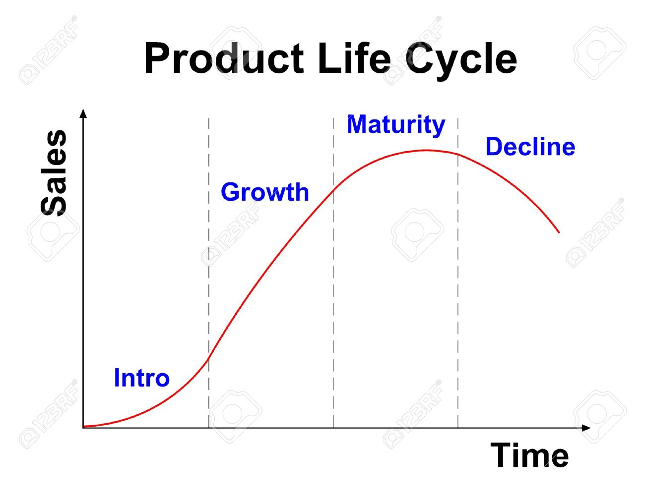
Product life cycle image
.

Slide 28
Product life cycle stages
a) Introductory stage
The new financial services is introduced
Introduction through promotion tools such as advertising, personal selling and even sales promotion.
Direct marketing and even websites are used.
Availability in branch networks and among intermediaries if any.
Creating awareness is the main marketing activity
.

Slide 29
Product life cycle stages cont.
b) Growth stage
The uptake of the new product is high demand
Commit more staff to attend to increasing number of clients
The marketer must continue to promote the new service to heighten the demand.
.

Slide 30
Product life cycle stages cont.
Maturity stage
The new product has hit a peak in demand and stabilized.
Faces stiff competition from competing products.
Yields high returns to the owner
The marketer must keep on promoting the product to keep it at the front of the mind of customers.
.

Slide 31
Product life cycle stages cont.
d) Decline stage.
The demand for the services goes down
Caused by stiff competition changing tastes and preference or new technologies.
Arrested through rebranding, adding new features or target a different segment
The marketer may also decide to eliminate the product in favor of others.
.

Slide 32
Product Elimination Strategies
Occur due to product becoming unprofitable
Make the product a closed
Withdraw some of the features
Change the nature and function of the product.
Merge several services or
Allow customers to eliminate the product
.

Slide 33
References
Dibb, S., Simkin, L., Pride, W. and Ferrell, O.C. (1997), Marketing: Concepts and Strategies, Houghton Mifflin, Boston, MA.
Kotler, P. (1997). Marketing Management Analysis, Planning, Implementation, and Control, 9th ed.,: Prentice-Hall International, Englewood Cliffs, NJ.
Lovelock C. Wirtz J. (2011) Services Marketing People, Technology, Strategy. Pearson Education, Inc., publishing as Prentice Hall, One Lake Street, Upper Saddle River, New Jersey
Tina, H (2000), Financial Services Marketing. Essex. Pearson Education Limited. Vernon, R. (1966) ‘International investment and international trade in the product cycle’, Quarterly Journal of Economics, Vol. 80, No. 2, pp.190–207
.

Slide 34
.
End
Thank you
.

