Slide 1
FUNDAMENTAL OF THERMODYNAMICS AND HEAT TRANSFER
Chapter - 1
Introduction
Lecture - 1
Basic Concepts of Thermodynamics
KEC, NEPAL
Dr. Lila Raj Koirala

Slide 2
Learning Objective of Lecture:
To impart a great deal of knowledge to undergraduate students on the following topics:
Definition and scope of engineering thermodynamics
Macroscopic and Microscopic approach
Value of energy to the society
Thermodynamic system, boundary and surroundings
Thermodynamic properties: Intensive properties, extensive properties, specific properties
Thermodynamic equilibrium: Thermal equilibrium, mechanical equilibrium, chemical equilibrium

Slide 3
Definition of Engineering Thermodynamics:
The name thermodynamics originates from the Greek words:
therme ⇒ heat and
dynamis ⇒ power
which is most descriptive of the early efforts to convert heat into power .
Branch of applied science which deals with the study of energy, its forms and transformations and its interactions with matters. Particularly work and heat.

Slide 4
Definition of Engineering Thermodynamics:
It is concerned with the study of feasibility of a process with respect to entropy and the concept of equilibrium processes.
Science of three “E”s namely Energy, Entropy and Equilibrium [1].
Entails four laws namely Zeroth, First, Second and Third law of thermodynamics which govern the energy conversion processes.

Slide 5
Scope of Engineering Thermodynamics:
It has wide range of applications in diverse areas of different engineering disciplines. It is used by
Mechanical engineers in the design of energy converting and transferring devices etc.
Civil engineers while choosing the layout of a building on a provided land space such that energy requirement for heating and lighting is minimum.
Electrical, electronics and computer engineers may have its application while selecting the proper cooling system for the different electrical and electronic appliances [2].

Slide 6
Value of Energy to the Society:
It is the basic necessity of the human life.
Its uses simplify our life style and make the human life comfortable.
The rate of energy consumption of a country reflects the life style of the people of that country, i.e. living standard of people.
As no activity can take place without the conversion of one energy form to another, it plays an unique and crucial role in the human society [3].

Slide 7
Microscopic VS Macroscopic Approach:
Thermodynamic studies or analysis of a system are undertaken by
Microscopic approach (Micro ⇒ small)
Macroscopic approach (Macro ⇒ big)
Microscopic Approach
Macroscopic Approach
System is analyzed with reference to its molecular behaviors.
System is analyzed with reference to certain measurable or observable bulk properties.
It needs large numbers of properties to describe a system.
It needs few numbers of properties to describe a system.

Slide 8
Microscopic VS Macroscopic Approach:
Properties that describe the behavior of the molecules can neither be felt by our senses nor easily measured by instruments.
Properties needed to describe a system can be felt by our senses and easily measured by instruments.
It requires advanced statistical mathematics for analysis of the system and calculation is time consuming and tedious.
It requires simple mathematics for analysis of the system and calculation is relatively faster and simpler.

Slide 9
Microscopic VS Macroscopic Approach:
It is usually used in the study of statistical thermodynamics and preferred by pure scientists.
It is used in the study of classical thermo-dynamics and preferred by engineers.
For example: Volume of air inside a room = number of air molecules inside room x volume of single air molecule.
For example: Volume of air inside a room = Volume of room = length x width x height.

Slide 10
Thermodynamic System and Surroundings:
A quantity of matter or a region in space under consideration which is selected for the analysis of a thermodynamic problem or for the study of the changes in its properties due to exchange of energy (heat and work) and mass is called a system.
Since an universe is composed of a system and its surroundings together, a system is the part of the universe which is to be studied or analyzed.
All the medium outside to the system is called surroundings.

Slide 11
Thermodynamic System:
Objective of the thermodynamic analysis is to study the interaction between the system and the surroundings and effects of this interaction on the system or on the surroundings.

Slide 12
Boundary and its Types:
The medium or surface which separates system from its surroundings is called boundary. As per its nature it has different types:
Fixed or movable Boundary
For example: Walls of a piston - cylinder device are fixed boundary. Piston side surface is movable boundary.

Slide 13
Types of Boundary:
Real or imaginary Boundary
For example: Walls of a room are real boundary.
Opened doors and windows are imaginary
boundary.
Deformable (Flexible) or Rigid Boundary
For example: While blowing a balloon is a deformable boundary. Walls of pressure cooker are rigid boundary.
Adiabatic or Diathermic Boundary
For example: Walls of a thermo flask are adiabatic boundary. Walls of a cooking pot are diathermic Boundary.

Slide 14
Types of Thermodynamic System:
System and surroundings can interact with each other either by mass transfer or energy transfer.
According to mode of interaction between the system and the surroundings, systems are classified into three types: closed system, open system and isolated system.
System | Mass | Energy
Closed | No | Yes
Open | yes | Yes
Isolated | No | No

Slide 15
Examples of Closed System:
Schematic diagram of a closed system
Piston-cylinder arrangement

Slide 16
Examples of Open System:
Schematic diagram of an open system
Piston Cylinder of Heat Engine

Slide 17
Examples of Isolated System:
Schematic diagram of an isolated system
Closed rigid insulated box

Slide 18
Control Mass:
  Total mass of a closed system always remains constant and therefore any closed system can be completely described by properties of particular amount of mass of the system.
  So, a closed system is also called a control mass (CM).
However, its volume can change against a flexible boundary. Furthermore, the physical nature and chemical composition of the mass may change, i.e., a liquid may evaporate, a gas may condense, even a chemical reaction may take place within the system.

Slide 19
Control Volume (CV):
In an open system, properties of particular mass cannot describe the properties of the system for any instant.
For the study of an open system, we select some specified region and analyze this region with reference to thermodynamic properties.
Hence, an open system is also called control volume (CV).

Slide 20
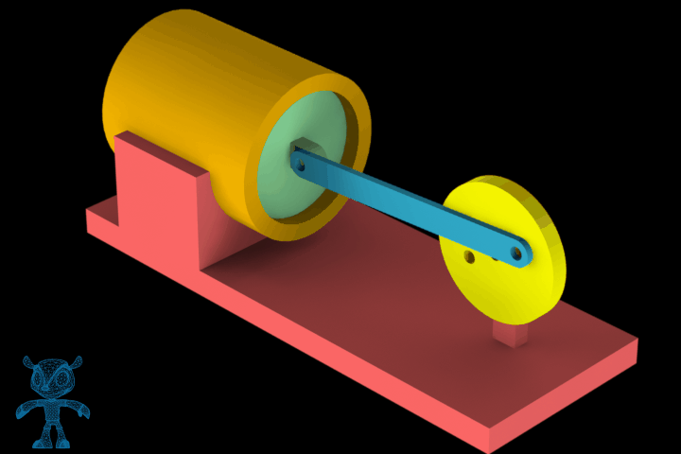
Control Mass (Piston Cylinder Assembly):
Source: [4]

Slide 21
Control Volume (Air Compressor):

Slide 22
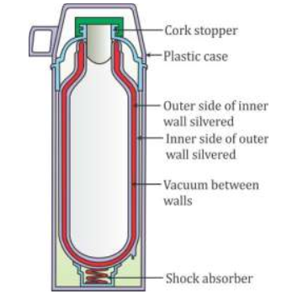
Isolated System (Thermos Flask):
Source: [5]

Slide 23
Thermodynamic Property:
Any parameter or variable used to describe a thermodynamic system is called a thermodynamic property.
Since a thermodynamic property is a function of the state of a system, it is also called a point function or a state function.
Most common thermodynamic properties are pressure (P), temperature (T) and volume (V).
Other properties which will be dealt frequently in the thermodynamics are internal energy (U), total energy (E), enthalpy (H) and entropy (S).

Slide 24
Types of Thermodynamic Properties:
According to their nature, they are generally classified into two groups: intensive property and extensive property.
Intensive Property: Thermodynamic property which is independent of mass or part of the system considered.
For examples, Pressure and temperature.
Extensive Property: Thermodynamic property which is proportional to mass or part of the system considered.
For examples, Volume, internal energy, total energy, enthalpy, entropy.

Slide 25

Specific Property:
Since extensive properties are proportional to mass they can be converted into intensive form by dividing its value by mass.
The ratio of an extensive property to the mass is called the specific property.
In general, capital letters will denote extensive properties and small letters will be used to represent the specific properties.

Slide 26
Extensive VS Intensive Properties:
Extensive property
Intensive property
It depends on mass or extent of the system.
It does not depend on mass or extent of the system.
Its value depends on how large a portion of the system is being considered.
Its value remains the same whether one considers the whole system or only a part of it.

Slide 27
Extensive VS Intensive Properties:
They are additive when a system is divided into a number of parts, i.e,
P =
They are not additive, i.e.,
P =
Here, P means any property.
For examples: Mass, volume, energy, enthalpy, entropy etc.
For examples: pressure, temperature, density etc.

Slide 28
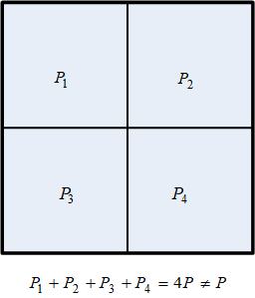
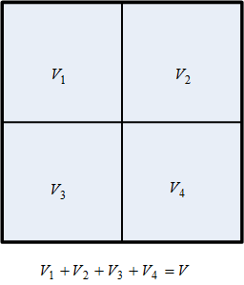
Illustration of Intensive and Extensive Properties:
Intensive Property
Extensive Property

Slide 29
Thermodynamic Equilibrium:
A system is said to be in a thermodynamic equilibrium if
there is no change in any properties of the system when it is isolated from its surroundings.
all intensive properties have same value throughout the system.
To be in a thermodynamic equilibrium a system should satisfy the following equilibrium conditions: thermal equilibrium, mechanical equilibrium and chemical equilibrium.

Slide 30
Thermal Equilibrium:
For a system to be in a thermal equilibrium, there should not be any temperature difference within the system.
For example, when a system having low temperature and surroundings having high temperature are at physical contact to each other, then heat will flow towards system from the surroundings. After some time both will attain the same temperature.
This condition of a system is also called equality of temperature.

Slide 31
Mechanical Equilibrium:
For a system to be in a mechanical equilibrium, there should not be any pressure difference within the system.
This condition exists in the system only when there is no unbalanced force within the system or at its boundaries.
For example, if the weight on the piston from the piston - cylinder arrangement is removed, the system boundary will expand until the mechanical equilibrium is attained.
This condition of a system is also known as the equality of pressure.

Slide 32
Chemical Equilibrium:
For a system to be in a chemical equilibrium, there should not be any chemical reaction and mass diffusion.
There are two types of Chemical Reactions:
Exothermic: ⇒ Heat generation
Endothermic: ⇒ Heat consumption
For example, in a petrol engine there will be spontaneous change in the properties of a system composed of a mixture of oxygen and petrol once it is ignited (exothermic reaction).
This condition of a system is also called the equality of chemical potential.

Slide 33
References:
[1] Thermal Science and Engineering: Kumar D.S., S. K. Kataria & Sons, India, 2009.
[2] Fundamentals of Thermodynamics & Heat Transfer: Luintel M.C., Heritage Publishers & Distributors Pvt. Ltd., Kathmandu, Nepal, 2016.
[3] Fundamentals of Thermodynamics and Heat Transfer: Lecture Manual published by Department of Mechanical Engineering, Institute of Engineering, Pulchowk Campus, Nepal, 2016.

Slide 34
References:
[4] Piston Cylinder Assembly, Kumar S., July 1st, 2015, https://grabcad.com/library/piston-cylinder-assembly-3, Viewed [March, 2022].
[5] Diagram of a Thermos Flask, Sawant S., October 26th, 2021, https://www.topperlearning.com/answer/diagram-of-a-theemos-flask%20/2p7bj988, Viewed [March, 2022].

Slide 35
Thank You

