Slide 1
FUNDAMENTAL OF THERMODYNAMICS AND HEAT TRANSFER
Chapter - 1
Introduction
Lecture - 2
Basic Concepts of Thermodynamics
Kathmandu Engineering College
Dr. Lila Raj Koirala

Slide 2
Learning Objective of Lecture:
To impart a great deal of knowledge to undergraduate students on the following topics:
Thermodynamic State , Path, Process and Cycle
State or Point Function and Path Function
Thermodynamic Processes: Quasi – Equilibrium Process, Reversible and Irreversible Process
Some Common Properties: Volume, Pressure, Temperature
Equality of Temperature
Zeroth Law of Thermodynamics

Slide 3
Thermodynamic State:
Each unique condition at which a thermodynamic system can exist is called a thermodynamic state.
Thermodynamic state is specified with the values of thermodynamic properties.
Properties of a Thermodynamic Property:
A variable is a property, if and only if,
it has a single value at each equilibrium state.
a change in its value between any two prescribed states is independent of path.

Slide 4
Independency of Path for a Change of Property Value :
(P₂ − P₁)_{A} = (P₂ − P₁)_{B} = (P₂ − P₁)_{C}
(V₂ − V₁)_{A} = (V₂ − V₁)_{B} = (V₂ − V₁)_{C}

Slide 5
State/ Point Function VS Path Function:
State/point function
Path function
Variable which only depends on the end states is called state or point function.
Variable which depends not only on the end states but also on the path is called path function.
It is a thermodynamic property.
It is not a thermodynamic property.
It has an exact differential.
It has an inexact differential.

Slide 6
Exact Differential:
Differential which can be integrated. For example, state functions like volume and pressure:
Inexact Differential:
Differential which can be integrated only when the relationship of two variables is known. For examples, path functions work and heat:
If P = C/V is given, then

Slide 7
State/ Point Function VS Path Function:
Its cyclic integral is zero.
Its cyclic integral is non-zero.
For examples: all thermo-dynamic properties such as pressure, temperature, volume etc.
For example: heat and work.

Slide 8
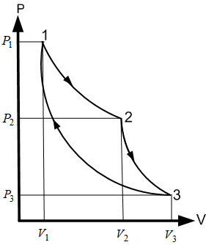
Cyclic integral of State or Point Functions:

Slide 9
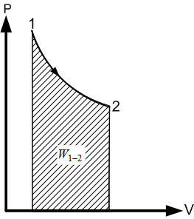
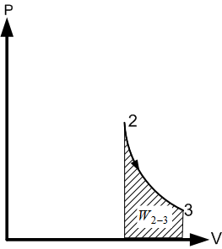
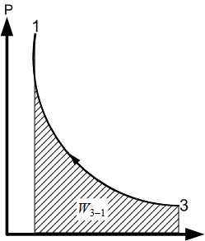
Cyclic integral of Path Functions:
on P – V diagram
on T – S diagram

Slide 10
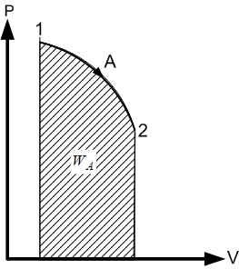
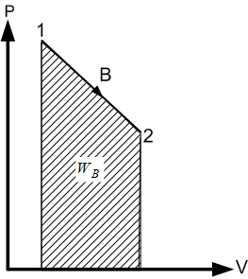
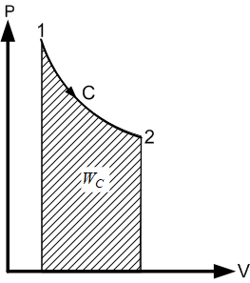
Why are Work and Heat Path Functions?
on P – V diagram
Similarly,
on T – S diagram

Slide 11
Path and Thermodynamic Process:
Path is a locus of states through which system passes when it undergoes from one equilibrium state to another.
Process is a path followed by a system when it undergoes from one equilibrium state to another.

Slide 12
Thermodynamic Process:
Process is simply a change in the state due to change of properties of a state of the system and is described with the help of property diagrams (P – V, P – T, T – V etc.)
There are many ways for a system to change from one state to another state and they are identified by special names as given below:
Isochoric process ⇒ Constant volume process
Isobaric process ⇒ Constant pressure process
Isothermal process ⇒ Constant temperature process
Isenthalpic process ⇒ Constant enthalpy process
Isentropic process ⇒ Constant entropy process

Slide 13
Property Diagrams of Thermodynamic Processes:

Slide 14
Quasi - Static or Quasi – Equilibrium Process:
When the process runs very slowly, the unbalance force is infinitely small and the system would be at almost close to state of equilibrium [1].
Quasi means almost, so every state passed by the system will be in an almost equilibrium state.

Slide 15
Quasi - Static or Quasi – Equilibrium Process:
Hence, quasi- equilibrium process is a locus of a series of such equilibrium intermediate states and infinite slowness is its characteristic feature.
A reversible process is a quasi-static process, but a quasi-static process need not be a complete reversible process [1].

Slide 16
Example of Quasi – Equilibrium Process:
A non- thermodynamic example of quasi – static process would be: going to top floor of a house from ground floor by using stairs.

Slide 17
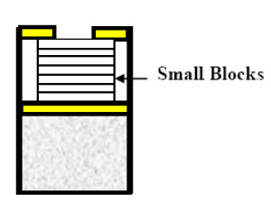
Reversible Process:
Any process which passes through a series of equilibrium states such that each intermediate states can be located on a property diagram.
It is infinitely slow process.
Initial state can be restored using same path.
It is represented by a continuous line on the property diagram.

Slide 18
Irreversible process:
Any process which passes through a series of intermediate states which cannot be defined or cannot be located on a property diagram.
It is very fast process.
Initial state can not be restored.
It is represented by a broken line on the property diagram.

Slide 19
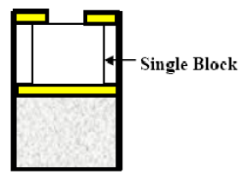
Example of Irreversible process:
Non-thermodynamic example of irreversible process would be: jumping from top floor of a house to ground floor without using stairs.

Slide 20
Cyclic Process (Cycle):
When the system is undergoes through the series of different thermodynamic processes in series such that the initial state can be restored.
Initial and final states are identical. E.g. Diesel engine.

Slide 21
Some Common Properties:
Specific Volume (v):
Volume per unit mass of the substance is called specific volume: v = V/m.
It is reciprocal of density (v = V/m = 1/ρ ).
Pressure (P):
Force per unit area is called pressure (P = F/A).
Expressed in Pascal (Pa = N/m2) and sometimes in bar (1 bar = 100 kPa) or in atmosphere (1 atm = 101.325 kPa).
Mainly 3 types of pressure are dealt: Atmospheric Pressure, Gauge Pressure and Absolute Pressure.

Slide 22
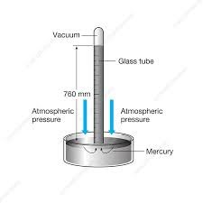
Atmospheric Pressure:
Pressure exerted by ambient (atmospheric) air on any surface.
It is measured by the instrument called barometer.
Source: [2]
Atmospheric pressure measured by barometer with height of mercury Zbaro is evaluated as Patm = ρgZbaro.

Slide 23
Gauge Pressure:
It is the pressure of a system measured with reference to atmospheric or surroundings pressure by using a pressure gauge (direct reading) or a manometer (indirect reading).
.
.
When pressure of a system is less than atmospheric pressure, gauge pressure becomes negative and this negative gauge pressure is also called vacuum gauge or vacuum pressure.
Gauge pressure measured by manometer with a height of manometric fluid is determined as

Slide 24
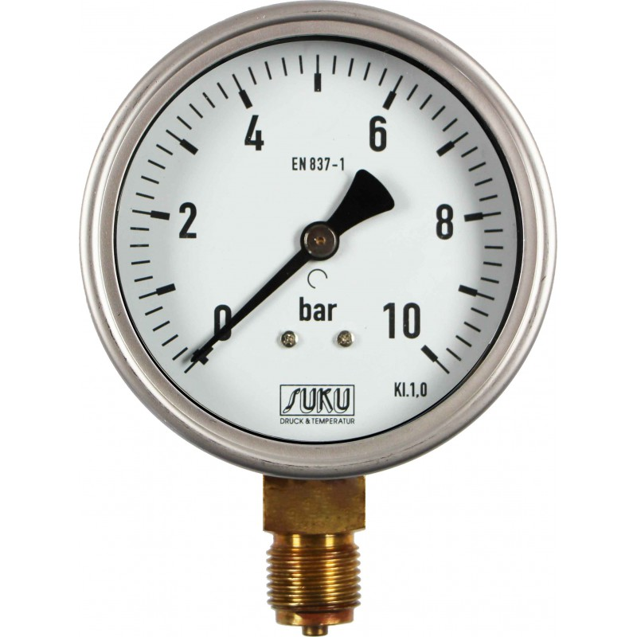
Measurement of Gauge Pressure Using Pressure Gauge and U-tube Manometer:
Pressure Gauge
Source:[3]
U-tube Manometer

Slide 25
Absolute Pressure (Actual Pressure):
Pressure of a system relative to perfect vacuum is known as absolute pressure.
A state of absolute zero pressure or perfect vacuum will occur only when molecular momentum is zero.
It is calculated as

Slide 26
Relationship between absolute, gauge, atmospheric and negative or vacuum gauge pressures represented on a pressure scale:

Slide 27
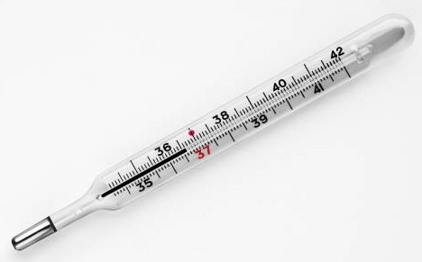
Temperature:
The degree of hotness or coldness of a system.
A property of a system which defines the direction and magnitude of heat transfer.
Measured by an instrument called thermometer.
Source: [4]

Slide 28
Temperature:
Measured in different temperature scales:
Degree Celsius,
Degree Fahrenheit and
Kelvin (absolute temperature)
They have relation as:
where N is any new scale, FP is freezing point of ice and BP is boiling point of water.

Slide 29
Temperature:
The values of Freezing and Boiling point on different temperature scales are given in a table below [5]:
Scale | Freezing Point (FP) | Boiling Point (BP)
Celsius (°C) | 0 | 100
Fahrenheit (°F) | 32 | 212
Kelvin (K) | 273 | 373

Slide 30
Equality of Temperature:
Two systems are said to have equal temperatures, if there is no change in any properties of both systems when they are brought in contact with each other.
Source: [5]

Slide 31
Zeroth Law of Thermodynamics:
When two systems are separately in thermal equilibrium with a third system, then these two systems should also be in thermal equilibrium.
If T_{X} = T_{Z} and T_{Y} = T_{Z} then
T_{X} = T_{Y}
Used in all temperature measurement processes and in comparison of the temperatures of the multiple objects.

Slide 32
References:
[1] Thermal Science and Engineering: Kumar D.S., S. K. Kataria & Sons, India, 2009.
[2] Science Photo Library: International Press Tele-communication Council (IPTC), https://www.sciencephoto.com/media/967157/view/ mercury-barometer-illustration, Viewed [March, 2022].
[3] Pressure Gauge with Bourdon Tubes: Suku Druck & Temperatur, https://suku.de/en/product/153-type-5331-bourdon-tube-pressure-gauge-ns100-connection-bottom.html, Viewed [March, 2022].

Slide 33
References:
[4] Sciencing: Different Parts of a Mercury Thermometer, Markings S., June 27th, 2018, https://sciencing.com/different-parts-of-a-mercury-thermometer-12073649.html Viewed [March, 2022].
[5] Fundamentals of Thermodynamics & Heat Transfer: Luintel M.C., Heritage Publishers & Distributors Pvt. Ltd., Kathmandu, Nepal, 2016.

Slide 34
Thank You

