Slide 1
FUNDAMENTAL OF THERMODYNAMICS AND HEAT TRANSFER
Chapter - 2
Energy and Energy Transfer
Lecture - 1
Energy and Its Types
Kathmandu Engineering College
Dr. Lila Raj Koirala

Slide 2
Learning Objective of Lecture:
To impart a great deal of knowledge to undergraduate students on the following topics:
Energy and its Types
Stored Energy: Internal Energy (Molecular Kinetic Energy and Molecular Potential Energy), Kinetic Energy and Potential Energy, Total Energy
Transient Energy: Work Energy, Heat Energy
Energy Transfer: Heat Transfer, Work Transfer

Slide 3
Energy and its Types:
In mechanics
Capacity for doing work
Capacity to exert a force through a distance.
In thermodynamics
A system quantity that describes a thermodynamic state of the system and its value is changed by transfer to and from the system.

Slide 4
Types of Energy:

Slide 5
Stored Energy and Transient Energy:
Energy is classified into two general types in thermodynamics: .
1. Stored energy within the system and
2. Transient energy in transition from one system to another system or surroundings.

Slide 6
Stored Energy VS Transient Energy:
Stored Energy
Transient Energy
Energy that remains within the system boundary as an inherent property of the system.
Energy that can cross the boundary of the system during a thermodynamic process.
It can be defined for a state.
It can be defined only for a process.
It is called a point or state function.
It is called a path function.
Its cyclic integral is zero.
Its cyclic integral is non-zero.

Slide 7
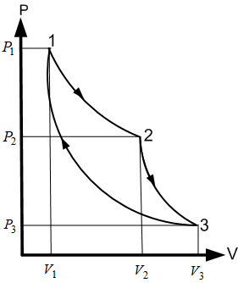
Cyclic integral of Stored Energy:
Cyclic integral of Volume:
Similarly, Cyclic integral of stored energy like internal energy:

Slide 8
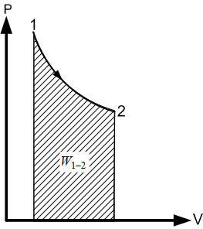
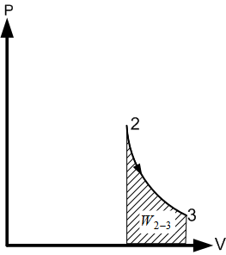
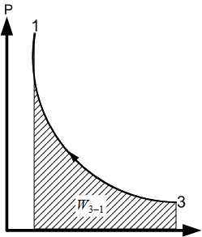
Cyclic integral of Transient Energy (Work):
v

Slide 9
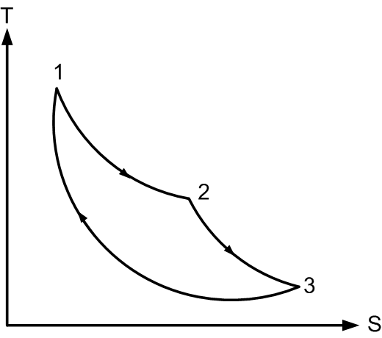
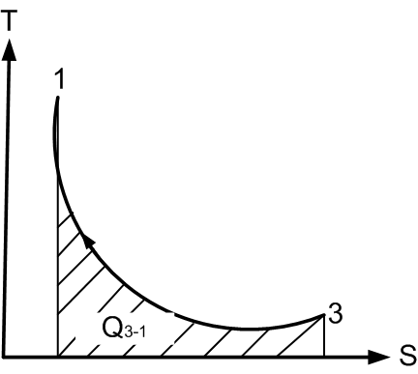
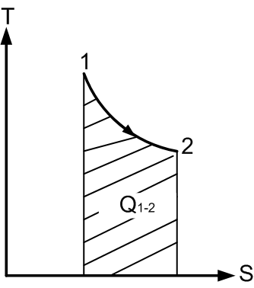
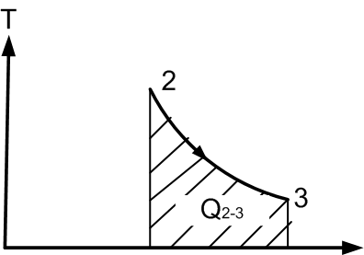
Cyclic integral of Transient Energy (Heat):

Slide 10
Stored Energy VS Transient Energy:
Stored Energy
Transient Energy
It is not a boundary- phenomenon.
It is a boundary phenomenon.
It is not a thermodynamic property.
It is a thermodynamic property.
It has single value for each equilibrium state.
It does not have single value for each equilibrium state.
For example: internal energy, kinetic energy and potential energy.
For example: work energy, heat energy and electrical energy.

Slide 11
Internal energy:
Like a system has external mechanical energy due to its velocity and position, it has internal energy resulting from the motion and arrangement of the molecules of the system.
The microscopic form of energy.
The energy of a system due to its molecular activities (inherent property).
The summation of molecular potential energy and molecular kinetic energy of the molecules of the system.

Slide 12
Internal energy:
As the molecular activities increase with temperature, internal energy of the system increases with increase in temperature and it is determined by the relation
dU = m c_{v} dT
where m is the mass and c_{v} is the specific heat capacity at constant volume.

Slide 13
Internal (Molecular )Kinetic Energy:
The microscopic form of energy due to the motion or velocity of the molecules of the system
Has different forms due to three different types of motions of the molecules, namely
translational kinetic energy,
rotational kinetic energy and
vibrational kinetic energy of the molecules [1].

Slide 14
Internal (Molecular) Potential Energy:
The microscopic form of energy due to the molecular separation or configuration.
The energy that molecules possess as a result of their position in relative to one another.
The greater the degree of molecular separation, the greater is the internal potential energy [2].
Hence, a gas has more molecular potential energy than a liquid and solid.

Slide 15
Internal (Molecular) Potential Energy:
For examples:
Latent energy:
energy associated with the phase of a system
Chemical energy:
energy associated with the atomic bonds in a molecule
Nuclear energy:
energy associated with the strong bonds within the nucleus of the atom itself [1].

Slide 16
Kinetic Energy:
The energy possessed by a system for doing work due to its velocity of motion.
The kinetic energy of a non-rotating system of mass m travelling at a velocity is given by
Potential Energy:
The energy possessed by a system for doing work due to its position above the reference plane (ground level).
PE = mgz

Slide 17

Total Energy:
The summation of its internal energy, potential energy and kinetic energy.
Energy Transfer:
The interactions between a system and its surroundings which bring about changes in the properties of the system.
It causes the change in the state of the system.
There are mainly two ways that these interactions occur:

Slide 18
1. Heat Transfer:
A disorganized form of energy in transit which can cross the system boundary.
It occurs always from high temperature system to low temperature system when no device is used.
No heat interaction is possible between the system and its surroundings if both are in thermal equilibrium.
Possible due to random molecular activities by the mechanisms of conduction, convection and radiation without transfer of mass.

Slide 19
1. Heat Transfer:
Conduction occurs mainly in solids due to lattice vibration and free electron movements and actual movement of atoms or molecules.
Convection occurs mainly in fluids due to the actual movements of the atoms or molecules .
Radiation occurs most effectively in vacuum than in medium in the form of electromagnetic wave.

Slide 20
1. Heat Transfer:
The thermodynamic definition of heat transfer is
Transfer of energy, without transfer of mass, because of temperature difference between the system and the surroundings is called heat transfer [3].
Sign Convention:
Heat supplied to the system is taken as positive and heat lost from the system is taken as negative. It is denoted by Q.

Slide 21
2. Work Transfer:
The work done over a finite path between points 1 and 2 is
δW = F.ds
In mechanics, it is the product of a force and distance moved in the direction of the force.
Mathematically, the amount of work δW done in moving through a small distance ds is

Slide 22
2. Work Transfer:
This definition of work transfer is not adequate in the study of thermodynamics because
During some thermodynamic processes energy is transferred without observable macroscopic displacement.
It also fails to provide the distinction between heat and work as we can use heat to cause a force to act through a distance like in steam engine.

Slide 23
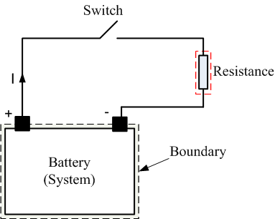
Illustration of Thermodynamic Definition of Work:
Microscopic work interaction due to electric potential difference (without displacement)

Slide 24
Illustration of Thermodynamic Definition of Work:
Macroscopic work interaction with displacement

Slide 25
Observations:
Energy transfer from battery (system) to resistance is not dependent upon temperature and so it is not heat transfer.
There is interaction between the system (battery) and the surroundings due to electric potential difference.
Conclusion:
This mode of energy transfer should be work transfer although it does not have any macroscopic displacement.

Slide 26
Conclusion:
Hence, the thermodynamic definition of work which includes all forms of work and makes a clear distinction between work and heat can be stated as
Work transfer is the transfer of energy, without transfer of mass, because of any property difference other than temperature [3].

Slide 27
Sign Convention:
Work done by the system is taken as positive and work done on the system is taken as negative. (W)

Slide 28
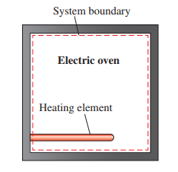
Example of Work Transfer:
Source: [1]
A well-insulated electric oven is being heated by its heating element. If the entire oven, including the heating element, is taken to be the system, it is to be determined whether this is a heat or work transfer.

Slide 29
Example of Work Transfer:
For this problem, the interior surfaces of the oven indicate the system boundary, as shown in figure. The energy content of the oven obviously increases during this process due to a rise in temperature.
This energy transfer to the oven is not caused by a temperature difference between the oven and the surrounding air. Instead, it is caused by electrons crossing the system boundary and thus doing work. Hence, this is a work transfer [1].

Slide 30
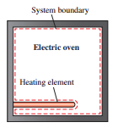
Example of Heat Transfer:
Source: [1]
If the system is taken as only the air in the oven without the heating element, the system boundary will include the outer surface of the heating element and will not cut through it, as shown in figure.

Slide 31
Example of Heat Transfer:
Here, system selection shows no electrons will be crossing the system boundary at any point.
Instead, the energy generated in the interior of the heating element will be transferred to the air around it as a result of the temperature difference between the heating element and the air in the oven. Hence, this is a heat transfer.
Conclusion: For both cases, the amount of energy transfer to the air is the same. These two examples show that an energy transfer can be heat or work, depending on how the system is selected [1].

Slide 32
References:
[1] Thermodynamics: An Engineering Approach: Cengel Y. A. and Boles M. A., McGraw-Hill Education, New York, 2018.
[2] Textbook of Thermodynamics & Heat Transfer: Yadav R. D., Pratibha Prakashan, Nepal, 2018.
[3] Fundamentals of Thermodynamics & Heat Transfer: Luintel M.C., Heritage Publishers & Distributors Pvt. Ltd., Kathmandu, Nepal, 2016.

Slide 33
Thank You

