Slide 1
Course Title:
FUNDAMENTAL OF THERMODYNAMICS AND HEAT TRANSFER
Lecture – 4 (Week 4)
Energy and Energy Transfer
Kathmandu Engineering College
Dr. Lila Raj Koirala

Slide 2
Learning Objective of Lecture:
To impart a great deal of knowledge to undergraduate students on the following topics:
Similarities between Work Transfer and Heat Transfer
Differences between Work Transfer and Heat Transfer
Expressions for Displacement Work Transfer during different Thermodynamic Processes
Power
P – V and T – V Diagrams for different Arrangements of Piston Cylinder Assembly.

Slide 3
Similarities of Work and Heat:
Both are forms of energy and are transient type.
Both are path functions.
Both have inexact differentials [1].
Both are boundary phenomenon.
Both are not thermodynamic properties.
Both are equal for a cyclic process and their cyclic integral is non-zero.
Both are physically equivalent and their unit is Joule.

Slide 4
Work Transfer VS Heat Transfer:
Work Transfer
Heat Transfer
It is the transfer of energy without transfer of mass because of any property difference other than temperature between the system and surroundings[2].
It is the transfer of energy without transfer of mass because of temperature difference between the system and surroundings [2].
Work is high grade energy [3].
Heat is low grade energy [3].

Slide 5
Illustration of Shaft Work
Source: [4]
τ = F r ⇒ F = τ / r
S = 2 π r n

Slide 6
Work Transfer VS Heat Transfer:
Work Transfer
Heat Transfer
Work is ordered motion of molecules in one direction.
Heat is random motion of molecules.
Work can be totally converted into heat.
Heat cannot be totally converted into work.
Entropy of the system does not change during work transfer (dS = 0).
Entropy of the system increases during heat transfer into the system (dS = δQ/T).

Slide 7
Expression for Displacement Work Transfer:
In thermodynamics
many problems of interest are expressed in terms of pressure (P), temperature (T) and volume (V) rather than of force (F) and distance (s).
it is convenient to express the mathematical relations for displacement work (P - dV work) in terms of P and V.

Slide 8
Expression for Displacement Work Transfer:
Consider a piston cylinder device containing a gas. During process 1-2, piston is displaced by ds from initial 1 to final position 2. Applying mechanical definition, displacement work transfer is evaluated as

Slide 9
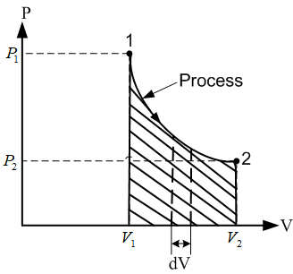
Expression for Displacement Work Transfer:
This equation shows that the work transferred during any process can be determined by evaluating area covered by the process on P - V diagram.

Slide 10
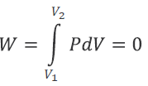
Displacement Work Transfer for a Constant Volume Process:
A thermodynamic process during which the volume of a closed system remains constant. E.g., heating of gas in a rigid container.

Slide 11
Property Diagrams for a Constant Volume Process:

Slide 12

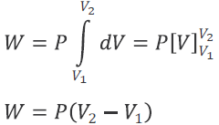
Displacement Work Transfer for a Constant Pressure Process:
A thermodynamic process in which the pressure remains constant. E.g., expansion or compression of a gas inside a cylinder with freely moving frictionless piston.

Slide 13
Property Diagrams for a Constant Pressure Process:

Slide 14
Displacement Work Transfer for a Constant Temperature Process:
A process during which the temperature remains constant.
It can be realized in a piston cylinder device which is surrounded by a constant temperature reservoir having same temperature [3].

Slide 15

Displacement Work Transfer for a Constant Temperature Process:
Pressure volume relationship for an ideal gas undergoing a constant temperature process (Boyle’s law) is given as
Applying the equation for initial, final and any intermediate states,

Slide 16

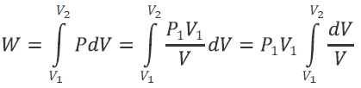

Displacement Work Transfer for a Constant Temperature Process:
Pressure at any intermediate state is given as:
Then work transfer is:

Slide 17
Property Diagrams for a Constant Temperature Process:

Slide 18
Displacement Work Transfer for an Adiabatic Process:
A process during which a change in the state of the system occurs without exchange of heat with the surroundings.
A system whose boundaries are perfectly insulated.
It may be reversible or irreversible and a reversible adiabatic process is known as isentropic process.
For a reversible adiabatic process, the relationship between pressure and volume is given by
where
is specific heat ratio.

Slide 19
Displacement Work Transfer for an Adiabatic Process:

Slide 20



Work transfer during an adiabatic process from state 1 to 2 is derived as
Putting,

Slide 21
Displacement Work Transfer for a Polytropic Process:
Thermodynamic process which follows the pressure volume relation PV^{n} = constant is called a polytropic process and the index n is a polytropic index.
It is a generalized equation for thermodynamic processes and represents different processes for different values of n [2].

Slide 22
Value of index n | Equation | Process
0
P = Constant
Constant pressure or Isobaric
Constant temperature or Isothermal
1
PV = Constant
γ
PV^{γ} = Constant
Adiabatic
Constant volume or Isochoric
∝
V = Constant

Slide 23

Displacement Work Transfer for a Polytropic Process:
Pressure-volume relationship for initial, final and any intermediate state during a polytropic process is given as
Pressure at any intermediate state is given as

Slide 24
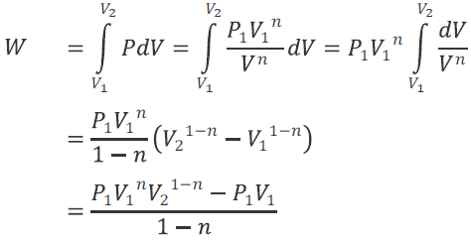


Displacement Work Transfer for a Polytropic Process:
Then work transfer is given as

Slide 25
Polytropic Process on P – V Diagram:
Source: [3]

Slide 26
Power:
The rate of energy transfer.
For designing of practical instruments or devices it is essential to know how much energy is needed to drive a device or how much energy can be obtained from the device,
We need also the rate at which energy can be obtained from the device

Slide 27


Power:
Power can be classified into two types namely thermal power and mechanical power [2].
Mechanical power is defined as the rate of work transfer. Mathematically,
Thermal power is defined as the rate of heat transfer. Mathematically,

Slide 28
P – V and T – V Diagrams for Different Arrangements of Piston Cylinder Assembly:

Slide 29
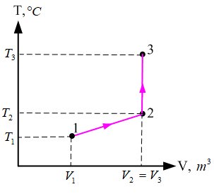
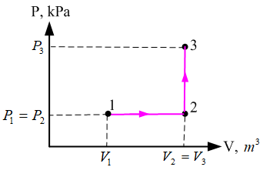
Q

Slide 30
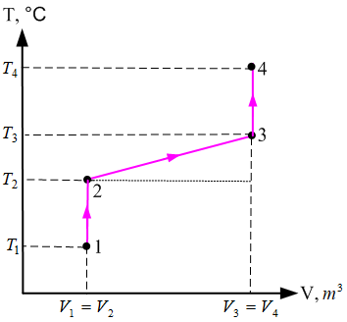
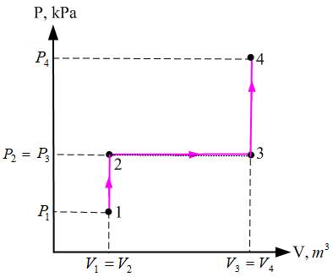

Slide 32
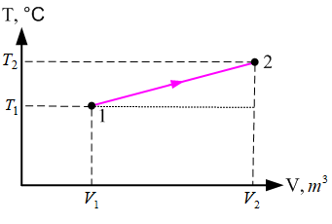
Q

Slide 33
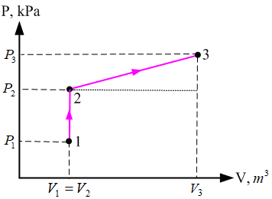
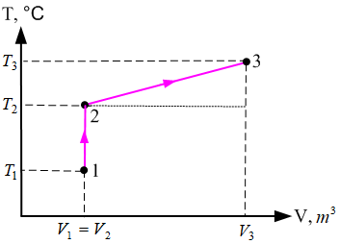
Q

Slide 34
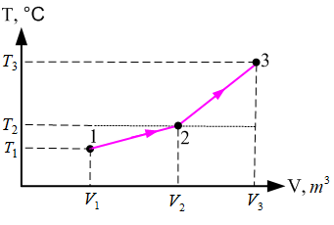
Q

Slide 35
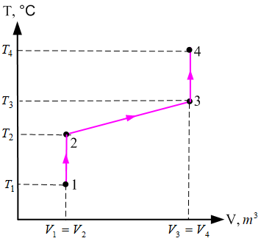
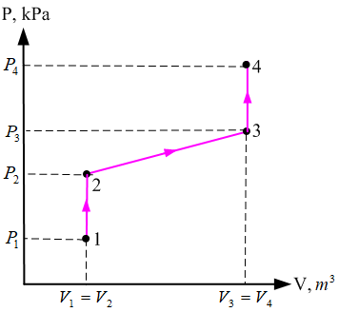

Slide 36
References:
[1] A Textbook of Thermodynamics & Heat Transfer: Yadav R. D., Pratibha Prakashan, Nepal, 2018.
[2] Fundamentals of Thermodynamics & Heat Transfer: Luintel M.C., Heritage Publishers & Distributors Pvt. Ltd., Kathmandu, Nepal, 2016.

Slide 37
References:
[3] Thermal Science and Engineering: Kumar D.S., S. K. Kataria & Sons, India, 2009.
[4] Thermodynamics: An Engineering Approach: Cengel Y. A. and Boles M. A., McGraw-Hill Education, New York, 2018.

Slide 38
Thank You

