Slide 1
Course Title:
FUNDAMENTAL OF THERMODYNAMICS AND HEAT TRANSFER
Lecture – 6 (Week 6)
Properties of Pure Working Substances
Kathmandu Engineering College
Dr. Lila Raj Koirala

Slide 2
Learning Objective of Lecture:
To impart a great deal of knowledge to undergraduate students on the following topics:
Properties of a Two Phase Mixture
Quality and Moisture Content
Specific Volume, Specific Internal Energy, Specific Enthalpy, and Specific Entropy
Other Thermodynamic Properties: Internal Energy, Enthalpy, and Specific Heats
Development of Property Data: Tabular and
Graphical Data Presentation

Slide 3
Properties of a Two-Phase Mixture:
.
As the saturation temperature and the pressure are dependent within two phase mixture, the states along the saturation line cannot be fixed by using only these two dependent properties according to state postulate [1].
Hence, a third property is necessary to complete this task and the third property will be the specific volume.

Slide 4
Properties of a Two-Phase Mixture:
It would be useful to define the specific volume v of the total mass in two phase mixture in terms of the specific volume of the individual phases (i.e. saturated liquid and saturated vapor).
As the specific properties are not additive in nature, to find the specific volume of mixture, a new property called quality of the two phase mixture is introduced.

Slide 5
Properties of a Two-Phase Mixture:
Source: [2]
State 1: 1 atm, 80⁰C
State 2: 1 atm, 100⁰C State 3: 1 atm, 120⁰C

Slide 6
Properties of a Two-Phase Mixture:
Source: [2]
State 4: 1.2 atm, 100⁰C
State 5: 1 atm, 100⁰C
State 6: 0.8 atm, 100⁰C

Slide 7
Quality:
For two-phase mixture (saturation) region, pressure and temperature are no more independent, and we cannot fix the state with dependent pressure and temperature.
To fix the state within the saturation region, we have to use a new property called quality.
It is defined as the ratio of mass of saturated vapor and the total mass of the two phase mixture.

Slide 8
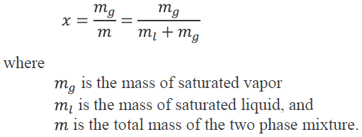
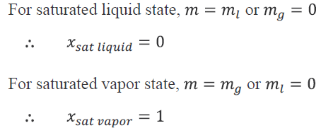
Quality:
It is also called dryness fraction and is denoted by x.

Slide 9
Distribution of quality lines on P−v diagram:

Slide 10

    Moisture Content:
It is defined as the ratio of mass of saturated liquid and the total mass of the two phase mixture. It is denoted by y.
This property can also be used to fix a state within the two phase mixture (saturation) region.

Slide 11
Identification of States:

Slide 12
Identification of States:
For a given specific volume of mixture, if specific volume
implies that the state is sub-cooled or compressed liquid.
implies that the state is superheated vapor.
implies that the state is two phase mixture.

Slide 13
Identification of States:
For a given pressure, if temperature
implies the state is sub-cooled or compressed liquid.
implies the state is superheated vapor.
implies the state is two phase mixture.

Slide 14
Identification of States:

Slide 15
Identification of States:
For a given temperature, if pressure
implies the state is sub-cooled or compressed liquid.
implies the state is superheated vapor.
implies the state is two phase mixture.

Slide 16
Specific Properties of a Two-Phase Mixture:
Specific properties of the two-phase mixture can be expressed in term of quality.
For example, specific volume of a two phase mixture is given by the ratio of total volume of two-phase mixture and the total mass of the two phase mixture, i.e.

Slide 17
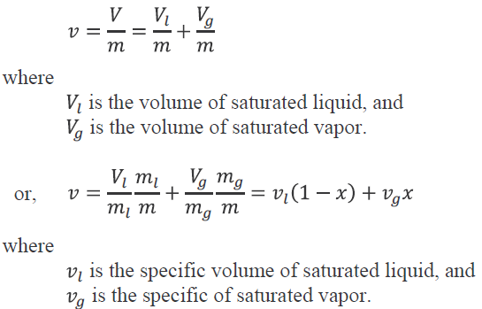
Specific Properties of a Two-Phase Mixture:

Slide 18
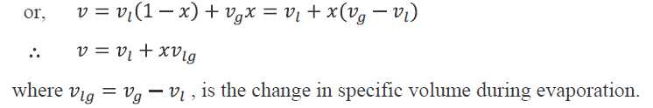

Specific Properties of a Two-Phase Mixture:
.
Other specific properties of the two-phase mixture can be expressed in the similar manner as

Slide 19
Other Thermodynamic Properties:
    Internal Energy:
In the study of thermodynamics internal energy is one of the important thermodynamic property with other properties like temperature, pressure, and specific volume.
It is denoted by U and incorporates the microscopic forms of energy which result from the molecular motions and positions (e.g., Internal or molecular kinetic and potential energy).

Slide 20
    Internal Energy:
As the molecular activities increase with temperature, internal energy of the system increases with increase in temperature and it is determined by the relation
dU = m c_{v} dT
Enthalpy:
The expression (U + PV) occurs so frequently in thermodynamic calculations that it has been defined a new property called enthalpy and it is denoted by H:
H = U + PV

Slide 21
      Specific Heat at Constant Volume:
Specific heat of a pure substance is defined as heat required for raising the temperature of a unit mass of the substance by 1⁰C [2].
Heat supplied to an ideal gas during a constant volume process in which no displacement work occurs is equal to the change in internal energy as per the first law of thermodynamics,
dU = δQ − δW
⇒ δQ = dU.
0

Slide 22
      Specific Heat at Constant Volume:
Hence, specific heat of an ideal gas at constant volume can be defined in terms of change in internal energy.
Now, using state postulate,
The change in specific internal energy can be expressed as function of partial derivatives of two independent variables as

Slide 23



      Specific Heat at Constant Volume:
as for constant volume,
where
is called specific heat at constant volume.
Hence, specific heat at constant volume for a pure substance e.g. an ideal gas is defined as the change in specific internal energy per degree change in temperature during a constant volume process.

Slide 24
      Specific Heat at Constant Pressure:
Heat supplied to an ideal gas during a constant pressure process in which the displacement work (P.dV) occurs is equal to the change in enthalpy.
We know from the first law of thermodynamics,
δQ = dU + δW
δQ = dU + PdV
As dP = 0.
δQ = dU + PdV + VdP
δQ = dU + d(PV)
= d(U + PV)
= dH

Slide 25

      Specific Heat at Constant Pressure:
Hence, specific heat of a pure substance at a constant pressure can be defined in terms of change in enthalpy.
Now, using state postulate,
Now, the change in specific enthalpy can be expressed as

Slide 26


Specific heat at constant pressure:
As for a constant pressure process, dP = 0.
where
is called specific heat at constant pressure.
Hence, specific heat at constant pressure is defined as the change in specific enthalpy per degree change in temperature during a constant pressure process.

Slide 27


      Relationship between Specific Heats for an Ideal Gas:
For an ideal gas specific internal energy is a function of temperature only, i.e.
Similarly, it follows that the specific enthalpy is also a function of temperature only for an ideal gas.

Slide 28

      Relationship between Specific Heats for an Ideal Gas:
From the definition of the specific enthalpy and the use of the ideal gas relation,
h = u + Pv = u + RT
By taking derivative with respect to temperature,
⇒

Slide 29
Development of Property Data:
Properties of a substance at within saturation region or near saturation region cannot be determined using the mathematical equations (e.g. ideal gas equation).
Properties under such conditions are found experimentally and presented in the form of tables or graphs (charts) namely
Tabular data presentation
Graphical data presentation

Slide 30
Tabular Data Presentation:
Property tables can be used to determine the property of a substance for a particular state.
For examples, saturation pressure table, saturation temperature table, subcooled or compressed liquid table and superheated vapour table.
Linear Interpolation for Tabulated Data:
When the values of the properties corresponding to any pressure and temperature are not provided in the tabulated data, then this method is used to find the properties values corresponding to that given pressure and temperature.

Slide 31
Linear Interpolation for Tabulated Data:
In general the following formula is used to find the properties values:
x1 = 125 kPa,
x2 = 150 kPa
y1 =vg(125kPa)= 1.3752m3/kg,
y2=vg(150kPa)=1.1595 m3/kg.
x = 125 kPa
y = vg =?,

Slide 32
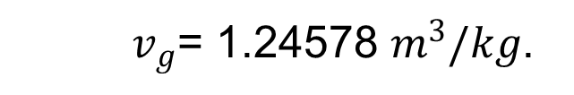
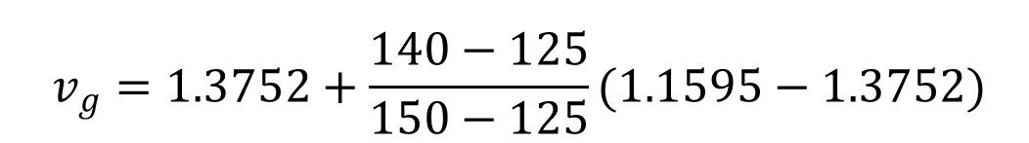
Linear Interpolation for Tabulated Data:
$$v_{g}=1.3752+\frac{140−125}{150−125}(1.1595−1.3752)$$
${ v}_{g}$= 1.24578 $m^{3}/kg$.
Graphical Data Presentation:
Property diagrams or charts can be used to determine the properties for a particular state as well as process can also be plotted.
For examples, P – v , T – v , P – T, P – h, T – s and h – s diagrams.

Slide 33
P − h diagram of Water
Source: [3]

Slide 34
T − s Diagram of Water:
Source: [4]

Slide 35
h − s Diagram (Mollier Diagram):
Source: [4]

Slide 36
References:
[1] Fundamentals of Engineering Thermo- dynamics: Howell J. R. and Buckius R. O., McGraw-Hill, New York, 1992.
[2] Fundamentals of Thermodynamics & Heat Transfer: Luintel M.C., Heritage Publishers & Distributors Pvt. Ltd., Kathmandu, Nepal, 2016.
[3] A Textbook of Thermodynamics & Heat Transfer: Yadav R. D., Pratibha Prakashan, Nepal, 2018.
[4] Thermal Science and Engineering: Kumar D.S.,
S. K. Kataria & Sons, India, 2009.

Slide 37


