Slide 1
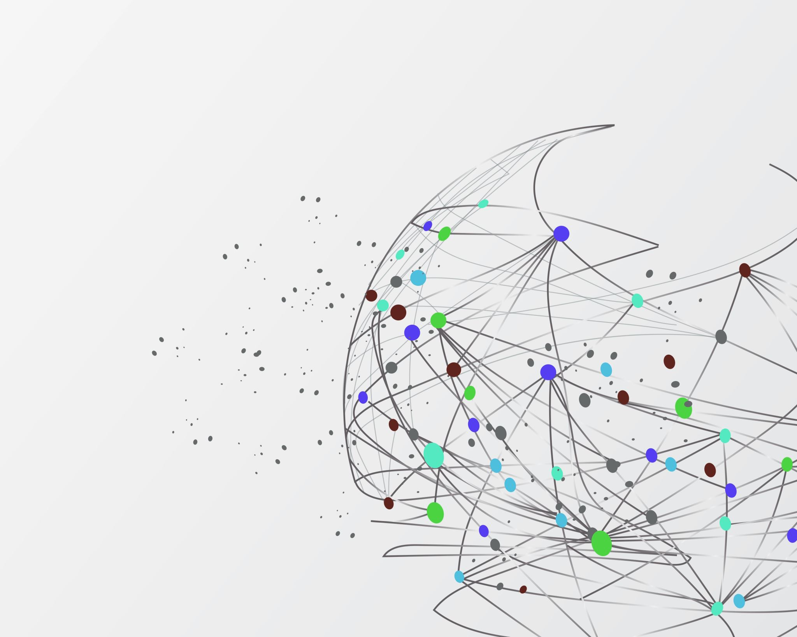
Information Resource Management
Lecturer: Nkundimana Joel, Gakwaya

Slide 2
Chapter 1
Information System in Global Business Today

Slide 3
Objectives
To understand the information system
What are the resources needed to management Today’s business
Role of information system in business transformation
Essential information system for managing today’s business

Slide 4
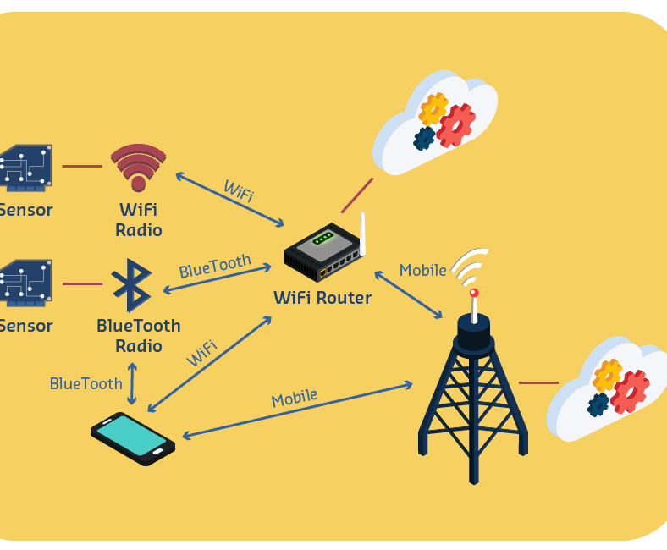
Role of wireless technologies
Billions across the globe to log onto the internet for access information
Cloud computing, mobile digital platform allow more distributed work, decision-making, and collaboration

Slide 5

Opportunities and challenges of Internet
  Internet has drastically reduced costs of operating on global scale
  Presents both challenges and opportunities

Slide 6
What is information system?
Information system is defined as a set of interrelated components that :
  Collect
  Process
  store and
  distribute information
to support decision making and control in an organization

Slide 7
What Is Information?
Data are streams of raw facts representing events or objects
Example: 156,157cm,90,Jokey, etc..
Information is defined as processed data
Information means data that have been shaped into a form that is meaningful and useful

Slide 8
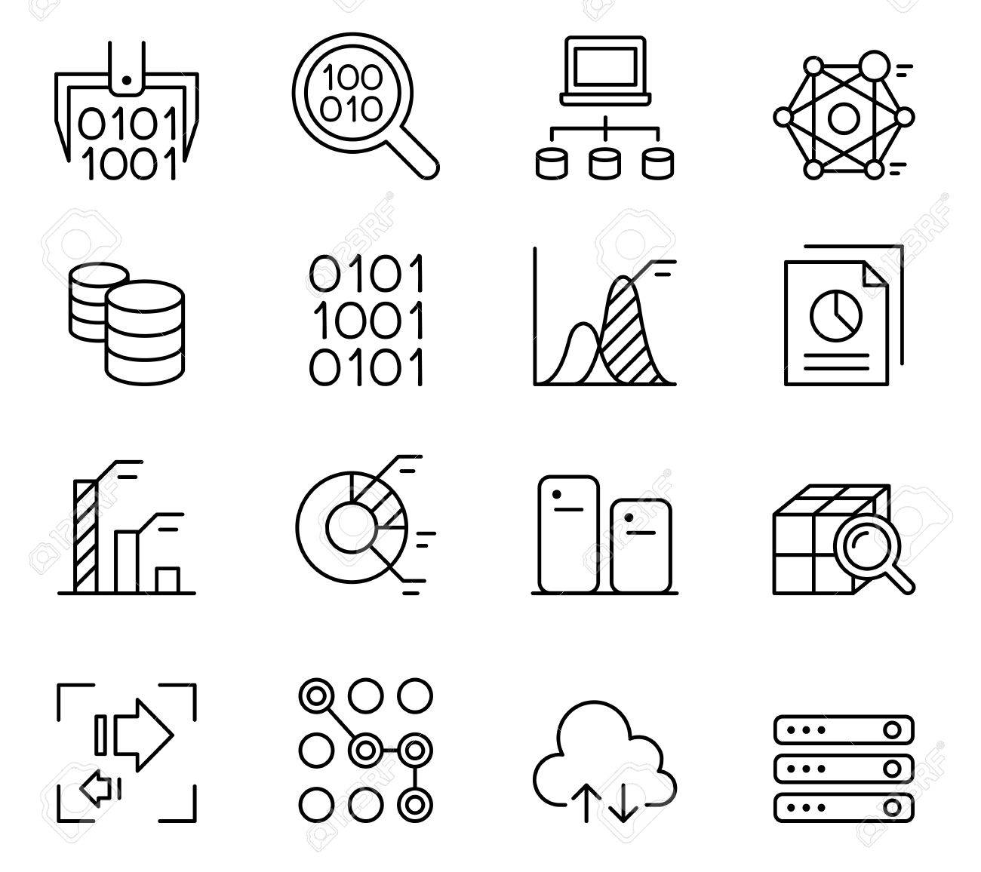

110
23
XXL
X
770
26
CLOTH
Information System
Id | Item | Size | Qty | Price | total
23 | Cloth | X | 1 | 110 | 110
26 | Cloth | XXL | 1 | 770 | 770
Raw data from a various sources can be processed and organized to produce meaningful information

Slide 9
Information system in business
In the emerging, fully digital firm
Significant business relationships are digitally enabled and mediated
Core business processes are accomplished through digital networks
Key corporate assets are managed digitally
Digital firms offer greater flexibility in organization and management
Time shifting, space shifting

Slide 10
Functions Of Information System
Input: Captures raw data from organization or external environment
Processing: Converts raw data into meaningful form
Output: Transfers processed information to people or activities that use it

Slide 11
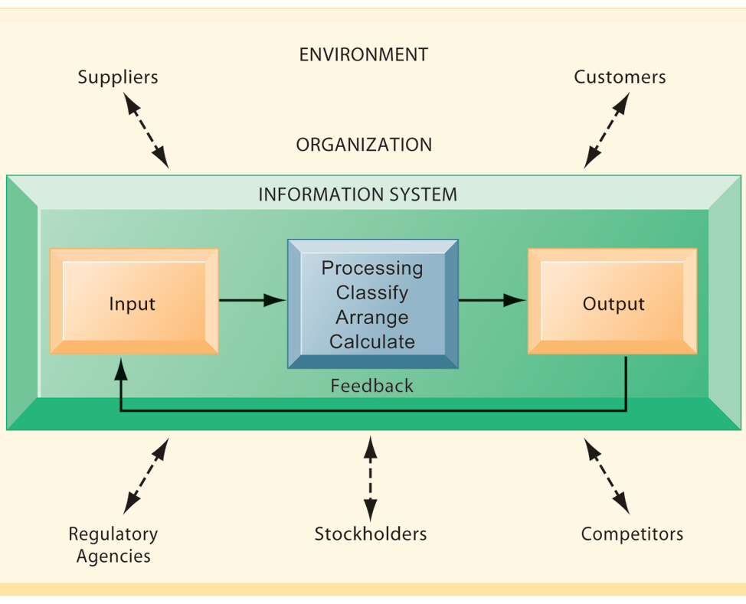
Three basic activities of information systems
Input
Process
Output
Feedback:
Output returned to appropriate members of organization to help evaluate or correct input stage

Slide 12
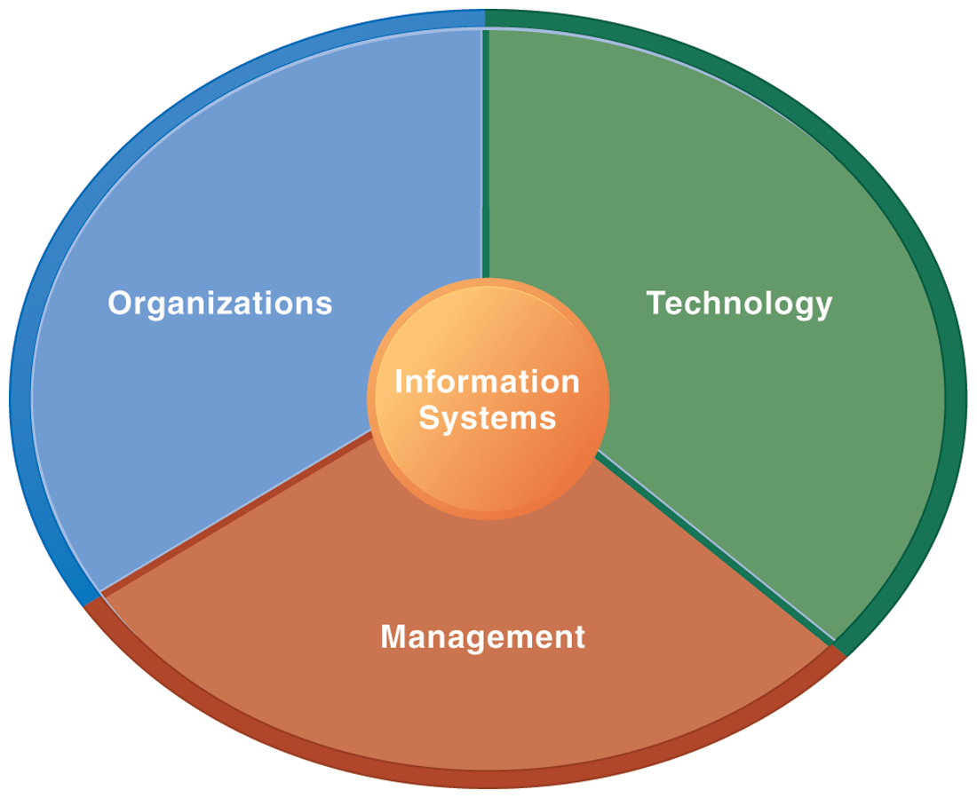
Three factors of Information System

Slide 13
Resources to Operate business
Resource refers to all the materials available in our environment which help us to satisfy our needs and wants

Slide 14
Types of resources
Physical resources: Premises and equipments
Financial resources: Funding system
Human resources: Employee are biggest asset and Customer services
Education resources: know to improve, compare with your competitors

Slide 15
information systems to achieve six strategic business objectives
  Operational excellence
  New products, services, and business models
  Customer and supplier intimacy
  Improved decision making
  Competitive advantage
  Survival

Slide 16
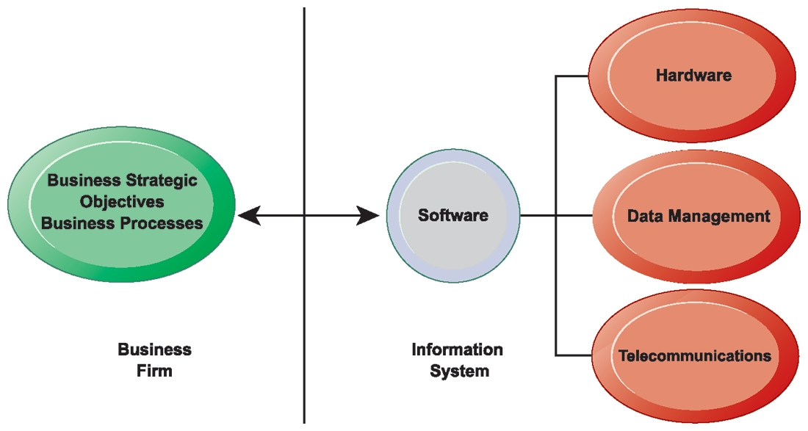

Slide 17
Operational excellence
  Improvement of efficiency to attain higher profitability
  Information systems, technology an important tool in achieving greater efficiency and productivity
  Walmart’s RetailLink system links suppliers to stores for superior replenishment system

Slide 18
New products, services, and business models
  Business model: describes how company produces, delivers, and sells product or service to create wealth
  Information systems and technology a major enabling tool for new products, services, business models

Slide 19
Customer and supplier intimacy
  Serving customers well leads to customers returning, which raises revenues and profits
    Example: High-end hotels that use computers to track customer preferences and use to monitor and customize environment
  Intimacy with suppliers allows them to provide vital inputs, which lowers costs
    Example: J.C.Penney’s information system which links sales records to contract manufacturer

Slide 20
Competitive advantage
  Delivering better performance
  Charging less for superior products
  Responding to customers and suppliers in real time
  Examples: Apple, Walmart, UPS

Slide 21
Improved decision making
  More accurate data leads to better decisions
  Without accurate information:
    Managers must use forecasts, best guesses, luck
    Leads to:
      Overproduction, underproduction of goods and services
      Misallocation of resources
      Poor response times
    Poor outcomes raise costs, lose customers

Slide 22
Organizational dimension of information systems
  Hierarchy of authority, responsibility
    Senior management
    Middle management
    Operational management
    Knowledge workers
    Data workers
    Production or service workers

Slide 23

Business organizations are hierarchies consisting of three principal levels: senior management, middle management, and operational management. Information systems serve each of these levels. Scientists and knowledge workers often work with middle management.

Slide 24
  Separation of business functions
    Sales and marketing
    Human resources
    Finance and accounting
    Manufacturing and production
  Unique business processes
  Unique business culture
  Organizational politics

Slide 25
Management dimension of information systems
  Managers set organizational strategy for responding to business challenges
  In addition, managers must act creatively:
    Creation of new products and services
    Occasionally re-creating the organization

Slide 26
Technology dimension of information systems
  Computer hardware and software
  Data management technology
  Networking and telecommunications technology
    Networks, the Internet, intranets and extranets, World Wide Web
  IT infrastructure: provides platform that system is built on

Slide 27
Business perspective on information systems
  Information system is instrument for creating value
  Investments in information technology will result in superior returns:
    Productivity increases
    Revenue increases
    Superior long-term strategic positioning

Slide 28
What to expect in business today
Investing in information technology does not guarantee good returns
Considerable variation in the returns firms receive from systems investments
Factors:
  Adopting the right business model
  Investing in complementary assets (organizational and management capital)

Slide 29
Contemporary Approaches to Information Systems
Technical Approaches
Management
Computer science
Operation research
Behavioral approaches
Sociology
Economics
Psychology

Slide 30
Two approaches
Technical approach
  Emphasizes mathematically based models
  Computer science, management science, operations research
Behavioral approach
  Behavioral issues (strategic business integration, implementation, etc.)
  Psychology, economics, sociology

Slide 31
Essential information system for managing today’s business
Management Information Systems
  Combines computer science, management science, operations research and practical orientation with behavioral issues
Four main actors
  Suppliers of hardware and software
  Business firms
  Managers and employees
  Firm’s environment (legal, social, cultural context)

Slide 32
Reference
Kenneth C. Laudon & Jane P. Laudon , “Management Information Systems”, Pearson 14e, 2017
Chavez, G., & Lorenzo, O. “The impact of supply chain applications announcements on the market value of firms”. Supply Chain Forum: International Journal, 7(2), 2006.
Allen, J. . “Information systems as technological innovation. Information Technology and People”, 13(3), 210-221, 2000.
Siau, K. “Inter-organizational systems and competitive advantages – Lessons from history”. The Journal of Computer Information Systems, 44(1), 33-39. ,2003

