Slide 1
Chapter 2
Data Governance
By : Dr. Gakwaya Nkundimana Joel

Slide 2
Learning Objectives
Understand What is data governance? And why?
Six phases of data governance
Who is responsible for data governance?
Identify challenges of data governance
What is Enterprise architecture?
The role of information system in data governance
Cloud strategies: Data center, cloud computing and virtualization

Slide 3
What is data governance?
system of decision rights and accountabilities for information-related processes, executed according to agreed-upon models which describe who can take what actions with what information, and when, under what circumstances, using what methods
it encompasses a collection of processes, roles, policies, standards, and metrics that guarantee the efficient and effective use of information, allowing an organization to reach its goals.

Slide 4
Why data governance?
To ensure data is used with integrity.
To specify
  who can take action
  what action,
  in what situations,
  upon what data,
  and what methods.
Data governance framework covers operational roles and responsibilities, as well as tactical and strategic objectives.

Slide 5
Six phases of data governance
Phase 1: Cultural tone
phase 2: access to data
Phase 3: stewardship of data
Phase 4: quality of data
Phase 5: utilization of data
Phase 6: acquisition of data

Slide 6



Phase1: Cultural tone
CULTURAL TONE MEANS ORGANIZATION STRATEGIC DECISIONS BASED ON DATA ANALYSIS AND INTERPRETATION
CULTURAL TONE ENABLES ORGANIZATION TO EXAMINE AND ORGANIZE THEIR DATA WITH THE GOAL OF BETTER SERVING THEIR CUSTOMERS AND CONSUMERS
CULTURAL TONE IS FOR CUSTOMER-CENTRIC APPROACH

Slide 7


Phase 2: access to data
IN THIS PHASE AN ORGANIZATION DEFINES HOW TO MANAGE AND CONTROL WHO HAS ACCESS TO WHAT DATA BOTH INTERNALLY AND EXTERNALLY
IT ENCOMPASSES THE PEOPLE, PROCESSES, AND TECHNOLOGIES REQUIRED TO MANAGE AND PROTECT DATA ACCESS

Slide 8


Phase 3:
DATA STEWARDS ARE VERY RESPONSIBLE FOR WHAT IS STORED IN A TABLES
THEY ARE RESPONSIBLE OF BUSINESS RULES

Slide 9


Phase 4: Quality of data
Healthy data helps you innovate faster, increase efficiency, and understand how to best meet your customers’ needs.
Data quality is the degree to which data is accurate, complete, timely and consistent with all requirements and business rules

Slide 10


Phase 5: utilization of data
Value could represent
Data should always be used with the aim of delivering value, although this doesn’t always equate to a monetary return in the short term.
an investment for the future,
an improvement in ongoing practices or an efficiency in one area that will deliver value in a seemingly unconnected department.

Slide 11
Who is Responsible for Data Governance?
entire enterprise
Data owners
Data stewards
Data custodians
Data governance committee

Slide 12
Data owners
These are the individuals who are responsible for who has right to access information assets within organization
Data owners are very responsible for data content, context

Slide 13
Data stewards
Data stewards are very responsible for what is stored in a tables
They are responsible for collecting and evaluating issues and problems related to data

Slide 14
Data custodians
Data custodians are responsible for the safe protective care, transport, storage of the data
They are responsible of business rules

Slide 15
Responsibilities of data governance teams
Governance teams are responsible for setting
  goals and priorities,
  Architecting the governance model
  Selecting appropriate technologies to use

Slide 16
Challenges of data governance
An average user spends 1.8 hour a day looking for the right data because of insufficient data management
Following are the main challenge of data governance:
  Lack of leadership
  Lack of team support
  Lack of understanding the value of data
  Poor Data management

Slide 17
Now you can answer
Define data governance
What are the responsibilities of data governance teams?
What are the challenges of data governance

Slide 18
Enterprise Architecture and Data Governance
Enterprise Architecture is
  The organization of IT systems and processes.
  Helps or hinders day-to-day operations and company strategy execution.
  Solves two major problems:
    where are we heading and
    how are we going to get there.

Slide 19
Business and IT Benefit of Enterprise Architecture
Reduces IT costs while increasing productivity through information, insight, and ideas.
Determines competitiveness, flexibility, and the economics of information technology
Aligns information technology capabilities with business strategy in order to grow, innovate, and respond to market demands.
Reduces the risk of purchasing or developing systems and enterprise apps.

Slide 20
Component of Enterprise Architecture
Business architecture
Application architecture
Data architecture
Technical arichtecture

Slide 21
Distinction between
DATA, INFORMATION, & KNOWLEDGE
  Raw data describes products, customers, events, activities, and transactions that are recorded, classified, and stored.
  Information is processed, organized, or put into context data with meaning and value to the recipient.
  Knowledge is conveyed information as applied to a current problem or activity.

Slide 22
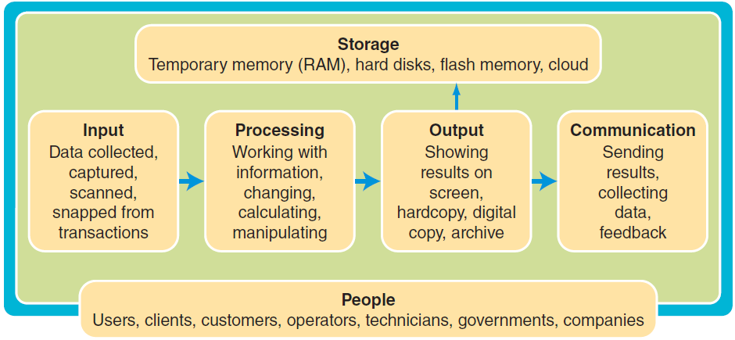
Information System
Input-processing-output model

Slide 23

Cloud strategies
IT Infrastructures
  On-premises data centers
  Virtualization
  Cloud Computing
Data Centers
  Large numbers of network servers used for the storage, processing, management, distribution, and archiving of data, systems, Web traffic, services, and enterprise applications.

Slide 24
Unified Data Center
  Cisco’s single solution integrating computing, storage, networking, virtualization, and management into a single (unified) platform.
  Virtualization gives greater IT flexibility and cutting costs:
    Instant access to data any time in any format
    Respond faster to changing data analytic needs
    Cut complexity and cost

Slide 25
Unified Data Center compared to traditional data integration and replication methods:
Greater Agility
Better Insight
Streamlined Approach

Slide 26
What is “The Cloud”?
  Cloud is
    A general term for infrastructure that uses the Internet and private networks to access, share, and deliver computing resources.
    is Scalable delivery as a service to end-users over a network.
    It Should be approached with greater diligence than other IT decisions as a new technology including Vendor Management and Service-Level Agreements.

Slide 27
Types of Clouds
  Private Cloud: Single-tenant environments with stronger security and control (retained) for regulated industries and critical data.
  Public Cloud: Multiple-tenant virtualized services utilizing the same pool of servers across a public network (distributed).

Slide 28
Cloud Infrastructure
  Provided on demand for storage virtualization, network virtualization, and hardware virtualization.
  Software or virtualization layer creates virtual machines (VMs) where the CPU, RAM, HD, NIC, and other components behave as hardware, but are created with software.

Slide 29
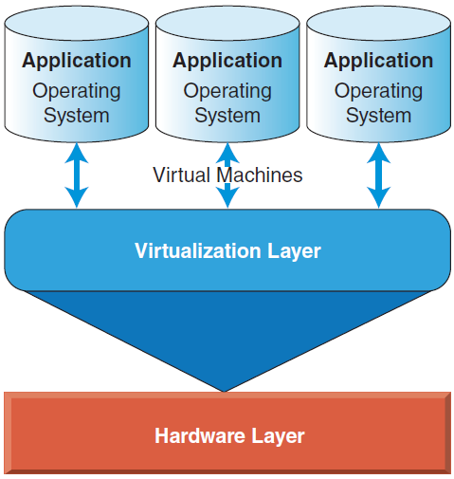
Virtualization
  Created by a software layer (virtualization layer) containing its own operating system and applications as a physical computer.
Software
As a Service
Platform
As a Service
Infrastructure
As a Service
Virtual machines running on a simple computer hardware layer

Slide 30
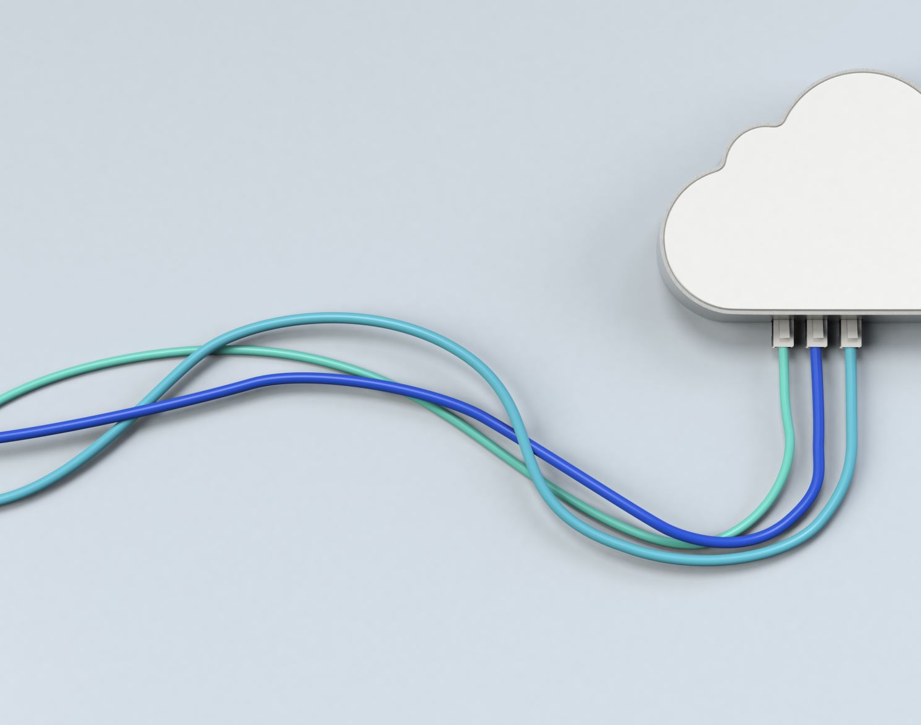
Now you can answer
What is a data center?
Describe cloud computing.
What is the difference between data centers and cloud computing?
What are the benefits of cloud computing?
How does a virtual machine (VM) function?
Explain virtualization.

Slide 31
reference
Kenneth C. Laudon & Jane P. Laudon , “Management Information Systems”, Pearson 14e, 2017
https://www.delphix.com/glossary/what-is-data-governance
Chavez, G., & Lorenzo, O. “The impact of supply chain applications announcements on the market value of firms”. Supply Chain Forum: International Journal, 7(2), 2006.

