Slide 1
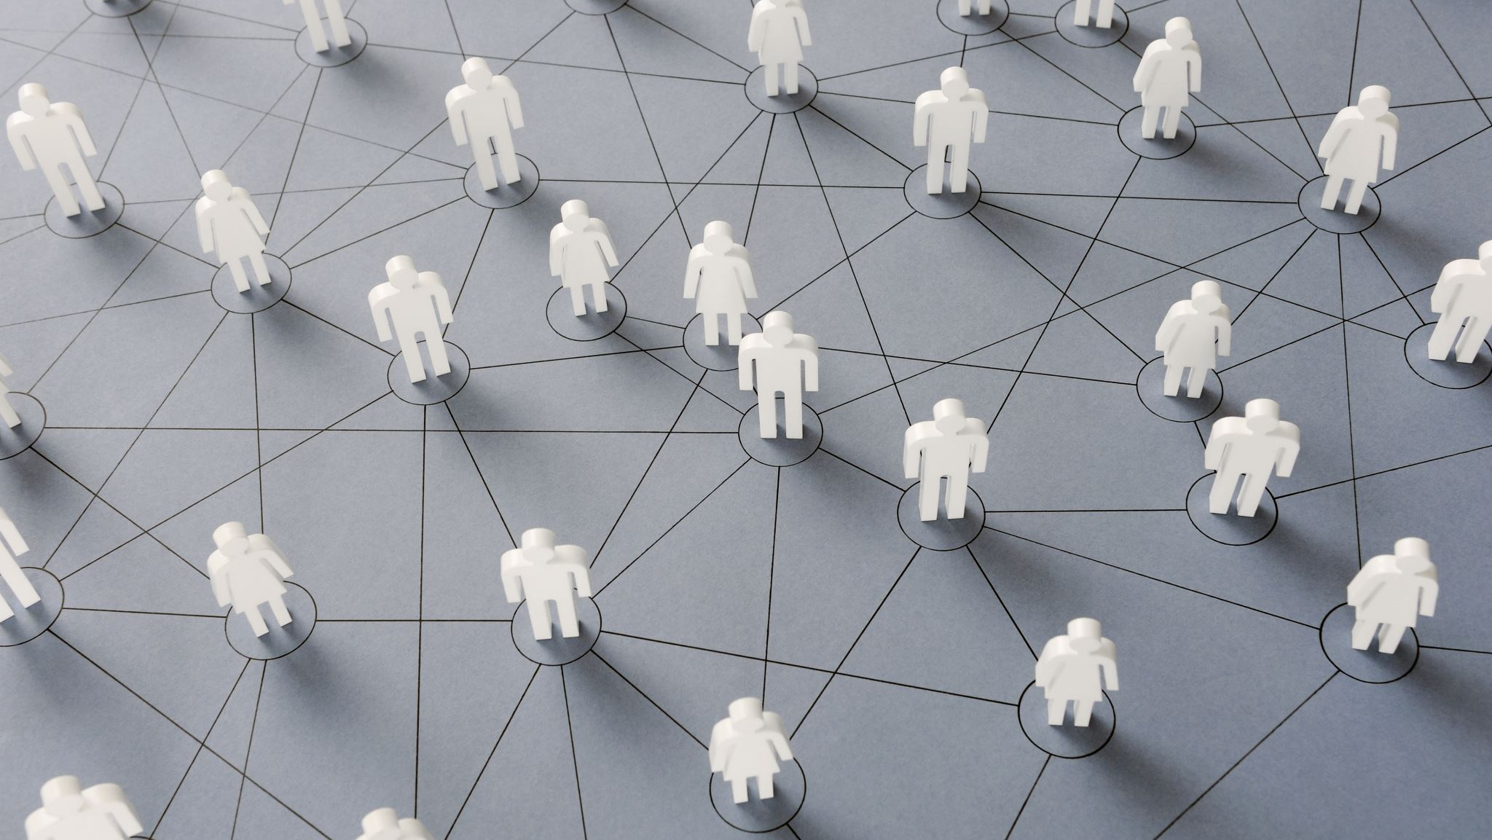
Chapter 5
Ethical and social issues in information system
Lecturer: Dr. Gakwaya Nkundimana Joel

Slide 2
Objective
What are the ethical and social issues in information system?
What are the basic concept of ethical?
How information and property rights are challenged?
Apply the knowledge and skills in individual privacy and intellectual property

Slide 3

What is ethics?
Principles of right and wrong that individuals, acting as free moral agents, use to make choices to guide their behaviors

Slide 4
Recent examples of failed ethical judgment by senior managers
Volskwagen (2015) | Vollkswagen agrees to pay $14.7 billion to consumers and agencies in the U.S and replace nearly 500,000 diesel car with faulty emission software. Face additional fine worldwide
General Motors Inc.(2015) | General Motor CEO admits the firm covered up faulty ignition switches for more than a decade, resulting in the deaths of at least 114 customers. More than 100 million vehicles worldwide need to be replaced
McKinsey & Company (2012) | CEO Rajat Gupta Heard on tape leaking insider information. The former CEO of prestigious management consulting firm McKinsey & Company was found guilty in 2012 and sentenced to two years in prison

Slide 5
Information systems and ethics
Because information systems create opportunities for:
• Intense social change,
Threatening
existing distributions of power, money, rights, and obligations,
They raise new ethical questions.
New types of criminal activity

Slide 6
Five moral dimensions of the information age
Information rights and obligations
Property rights and obligation
Accountability and control
System quality
Quality of life

Slide 7
Key technology trends that raise ethical issues
Doubling of computer power
Rapidly declining data storage costs
Networking advanced and internet
data analysis advances
Mobile devices growth impact

Slide 8
Conti’
doubling of computer power
More firms are relying on computer systems for key activities, which has resulted in a double increase in computer power.
Computer becomes more vulnerable as they increases

Slide 9
cont’
rapidly declining data storage costs
Organizations can readily keep detailed databases on individuals due to rapidly dropping data storage costs.
There are no limits on the data collected about you

Slide 10
Conti’
Networking advances and the internet
Copying data from one area to another and accessing personal data from remote locations are more easier thanks to networking improvements and the Internet.
As of January 2022
  Number of internet users worldwide 4.9bn
  Country with biggest number of internet users: China with 1.02b
  Region with the highest internet penetration rate: Northen Europe 98%

Slide 11
Conti’
Mobile device growth impact
personal mobile can be tracked without user’s knowledge
nearest devices on wifi,Bluetooth, location enable become a tether

Slide 12
Basic concepts for ethical analysis
– Responsibility:
• Accepting the potential costs, duties, and obligations for decisions you make
– Accountability:
• Mechanisms for identifying responsible parties of who took actions
– Liability:
• Permits individuals (and firms) to recover damages done to them in terms of law
– Due process:
• Laws are well-known and understood, with an ability to appeal to higher authorities

Slide 13
Five-step ethical analysis
Identify and clearly describe the facts.
Define the conflict or dilemma and identify the higher-order values involved.
Identify the stakeholders.
Identify the options that you can reasonably take.
Identify the potential consequences of your options.

Slide 14
Case study
Cybercrimes, involving digital transactions, have increased manifold as some novice account holders, who are not so tech savvy, had to switch to digital mode in the midst of the pandemic-induced restrictions. By doing so, they became soft targets of cyber criminals, who have forever been on the prowl for unsuspecting prey. Technology has made everything easy, even scamsters.
But behind the success of scamsters are several emotional vulnerabilities and behavior limitation that makes people easy target. A recent case of a stolen ATM card, in which the thief discovered the PIN information and took around Ninety Thousand dollars, has brought this issue to the forefront once more. In this case, the bank has been held liable for supporting the "thief" by giving account details.

Slide 15
Questions: Should producers of software-based services such as ATMs, be held liable for economic injuries suffered when their system fails? Why or why not explain
Solution:

Slide 16
Candidate ethical principles
Golden Rule
• Do unto others as you would have them do unto you.
– Immanuel Kant’s Categorical Imperative
• If an action is not right for everyone to take, it is not
right for anyone.
– Descartes’ Rule of Change
• If an action cannot be taken repeatedly, it is not right to take at all.

Slide 17
Utilitarian Principle
• Take the action that achieves the higher or greater value.
– Risk Aversion Principle
• Take the action that produces the least harm or
potential cost.
– Ethical “No Free Lunch” Rule
• Assume that virtually all tangible and intangible objects are owned by someone unless there is a specific declaration otherwise.

Slide 18
Real-world ethical dilemmas
One set of interests pitted against another
• Example: right of company to maximize productivity of workers versus workers right to use Internet for short personal tasks

Slide 19
Property rights: intellectual property
Intellectual property is considered to be tangible and intangible products of the mind created by individuals or corporation
Intellectual property is protected under three legal traditions:
  Trade secret
  Copyright
  Patent law

Slide 20
Trade secrets
Trade secrets are any intellectual work product such a formula, device, pattern, method of manufacture or compilation of data used for a business purpose
Trade secret protects these properties in laws grant a monopoly on the ideas behind a work product
  Prevent the secret from falling into the public domain

Slide 21
Copyright
Copyright is law that protects creators of intellectual property from having their work copied by other for any purpose during life of the author plus an 70 years after the author’s death.
For any company the copyright protection lasts for 95 years after their initial creation
The intent of copyright laws has been to encourage creativity and authorship by ensuring the creative people receive the financial and other benefits of their work

Slide 22
Challenges to the intellectual property rights
Use of digital media as means of transmission result in
  Ease of alteration and replication
  Difficult in establishing uniqueness
Internet has made it difficult to protect intellectual property
Internet was designed to transmit information freely around the world

Slide 23
Latest solution to intellectual property right
For streaming on internet
  Spotify
  Netflix
  iTunes
  Amazon kindle
All these above platform protect the properties to be copied or stored on local divices

Slide 24
Internet challenges to privacy
Cookies
• Identify browser and track visits to site
• Super cookies (Flash cookies)
Web beacons (Web bugs)
• Tiny graphics embedded in e-mails and Web pages
• Monitor who is reading e-mail message or visiting site
Spyware
• Surreptitiously installed on user’s computer
• May transmit user’s keystrokes or display unwanted ads

Slide 25
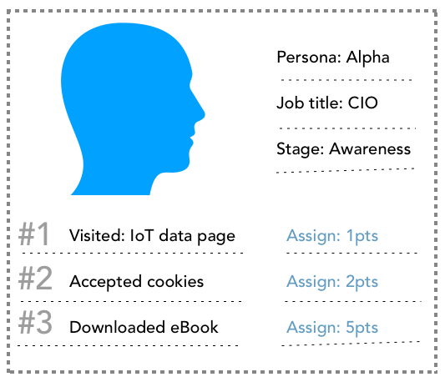
Behavior targeting
Visit a website and being suggested the content which you didn’t plan to buy

Slide 26
Fair information practices
Set of principles governing the collection and use of information
• Basis of most U.S. and European privacy laws
• Based on mutuality of interest between record holder and individual
• Restated and extended by FTC in 1998 to provide guidelines for protecting online privacy

Slide 27
FTC FIP guidelines
FTC FIP are Guidelines that represent widely the principles that concerns fair information in Electronic marketplace.
  FTC stands for Federal Trade Commission
  FIP stands for Fair Information Practices
FTC ensures that online entities collected, and use of personal information are fair used

Slide 28
FTC FIP principles
Notice/awareness (core principle)
• Web sites must disclose practices before collecting
data.
– Choice/consent (core principle)
• Consumers must be able to choose how information is used for secondary purposes.
– Access/participation
• Consumers must be able to review and contest accuracy of personal data.

Slide 29
Cont.
Security
• Data collectors must take steps to ensure accuracy,
security of personal data. –
Enforcement
• Must be mechanism to enforce FIP principles.

Slide 30
System quality: data quality and system errors
Will there be any point in which manager says “ stop testing we’ve done all we can do to perfect this software.”?
What is an acceptable, technologically feasible level of system quality?
• Flawless software is economically unfeasible.

Slide 31
Conti’
Three principal sources of poor system performance
Software ugs, errors
Hardware or facility failures
Poor input data quality (most common source of business system failure)

Slide 32
reference
Kenneth C. Laudon and Jane P. Laudon “Management Information System”, 15ed, 2017
ITU Survey on anti-spam legislation worldwide” www.itu.int(2016)
www.statista.com
https://www.ironpaper.com

