Slide 1
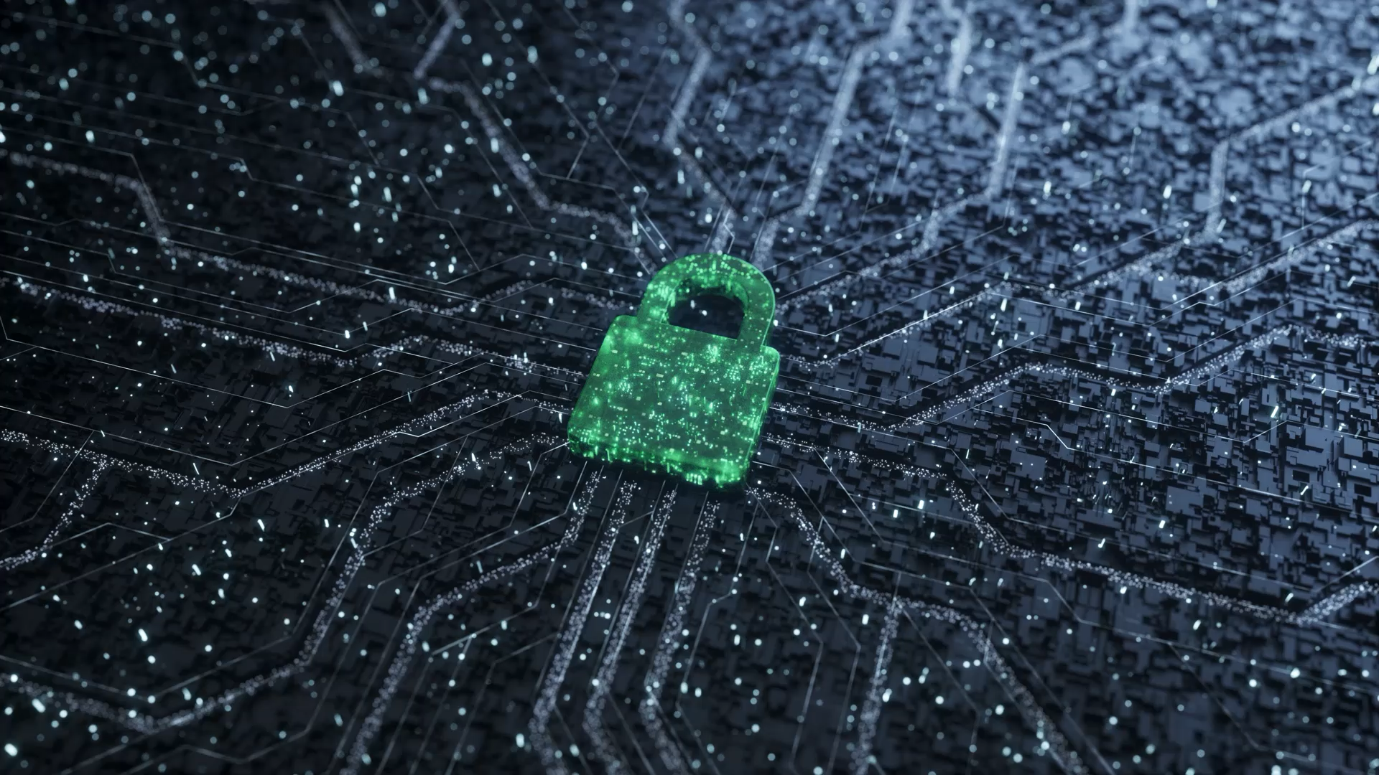
IRM-Lecture 6
Securing Information System
By : Dr. Gakwaya Nkundimana Joel

Slide 2
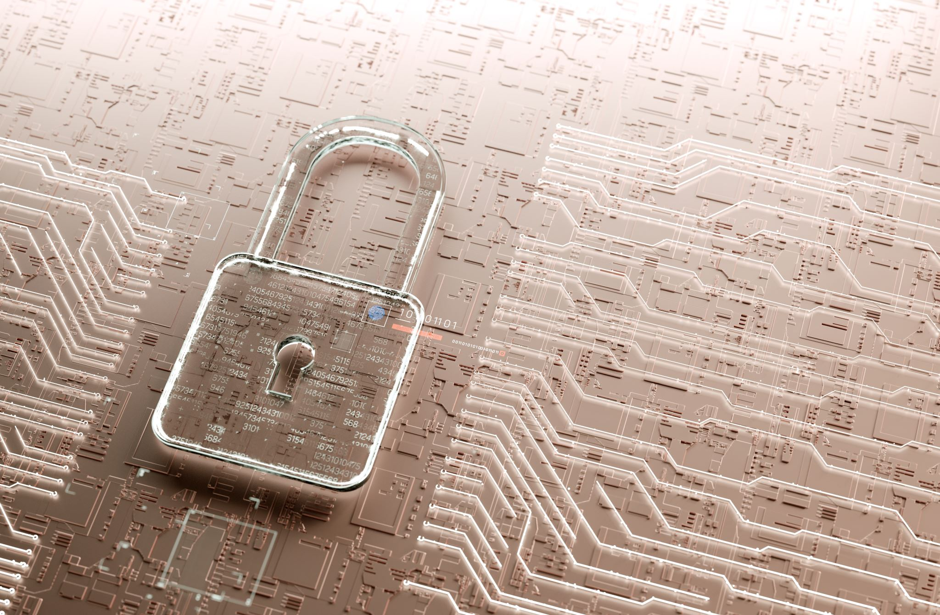
Objective
You will learn what is information security
Types of cybersecurity
Understanding system security, control and vulnerability
Tools and technologies for safeguarding information resource
Ensuring software quality

Slide 3
Information security
The practice of being protected against the criminal or unauthorized use of electronic data, or the measures taken to achieve this.
There are three security model
  Confidentiality: secrecy and use of encryption
  Integrity: certainty that data is not modified
  Availability: Information is available to the authorized users

Slide 4
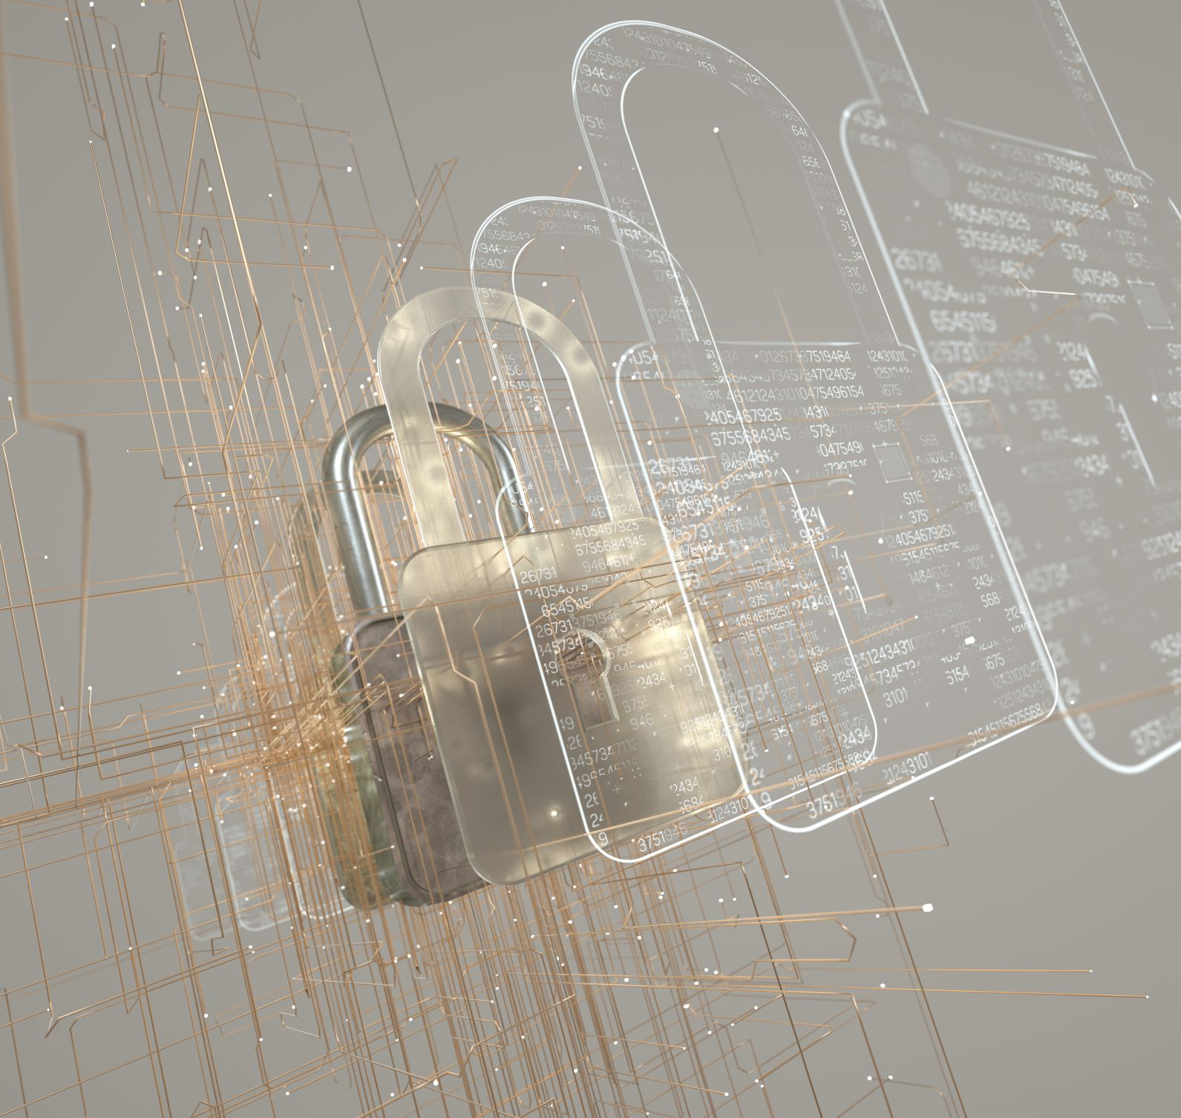
Types of Cybersecurity
Five Types of Cybersecurity:
  Critical infrastructure security
  Application security
  Network security
  Cloud security
  Internet of Things (IoT) security

Slide 5

What is security?
What is control?

Slide 6
System Control and Security
Controls:
• Methods, policies, and organizational procedures that ensure safety of organization’s assets; accuracy and reliability of its accounting records; and operational adherence to management standards
Security:
• Policies, procedures and technical measures used to prevent unauthorized access, alteration, theft, or physical damage to information systems

Slide 7
Information systems controls
Two types of system controls:
General controls
  programs and security of data files in general Govern design, security, and use of computer throughout organization’s information technology infrastructure.
  Apply to all computerized applications
  Combination of hardware, software, and manual procedure to create overall control environment
Application control
  Specific control unique to each computerized application, such as payroll or order processing

Slide 8
Types of general control
Software control
Hardware control
Computer operational control
Data security control
Implementation control
Administrative control

Slide 9
Conti’
Software control
It is intended to monitor the use of system software and prevent unauthorized access of software programs, system software, and computer programs
Hardware control
It ensures that computer hardware is physically secure
It checks if there may be any malfunction of equipment

Slide 10
Conti’
Computer operations control
It oversees the work of the computer department to ensure that programmed procedures are consistently and correctly applied to the storage and processing data
Data security control
To ensure that valuable business data files aon either disk or tape are not subject to unauthorized acess

Slide 11
Conti’
Implementation control
Audit the systems development process at various points to ensure that the process is properly controlled and managed
Administrative control
Formalized standard, rules, procedures and control disciplines to ensure that the organization’s general and application controls are properly executed and enforced

Slide 12
Application control
  Specific control unique to each computerized application, such as payroll or order processing
  It include both automated and manual procedures
  It ensure that only authorized data are completely and accurately processed by that application
  It mainly include
    Input controls
    Processing controls
    Output controls

Slide 13
System Vulnerability
System vulnerability is a flaw or weakness in a system or network that could be exploited to cause damage, or allow an attacker to manipulate the system in some way.
  Hardware
  Software
  Disasters
Use of networks and computers outside the firm’s control

Slide 14
Modern security challenge and vulnerability
Users
Unauthorized access
Error
Communication line
Tapping
Sniffing
Message alteration
Theft and fraud
Company Servers
Virus
Worms
Hacking
Denial of services
Company database
Copying data
Alteration of data
Software failure

Slide 15
Internet vulnerabilities
Network open to anyone
Size of Internet means abuses can have wide impact
Use of fixed Internet addresses with permanent connections to Internet eases identification by hackers
E-mail attachments
E-mail used for transmitting trade secrets
IM messages lack security, can be easily intercepted

Slide 16
Wireless security challenges
Radio frequency bands easy to scan
SSIDs (service set identifiers)
  Identify access points
  Broadcast multiple times
War driving
  Eavesdroppers drive by buildings and try to intercept network traffic
  When hacker gains access to SSID, has access to network’s resources
WEP (Wired Equivalent Privacy)
  Security standard for 802.11
  Basic specification uses shared password for both users and access point
  Users often fail to use security features

Slide 17
Why do people launch cyber attacks?
Cyber attacks against businesses are often deliberate and motivated by financial gain.
Intellectual challenge - eg 'white hat' hacking
espionage - eg spying on competitors for unfair advantage

Slide 18
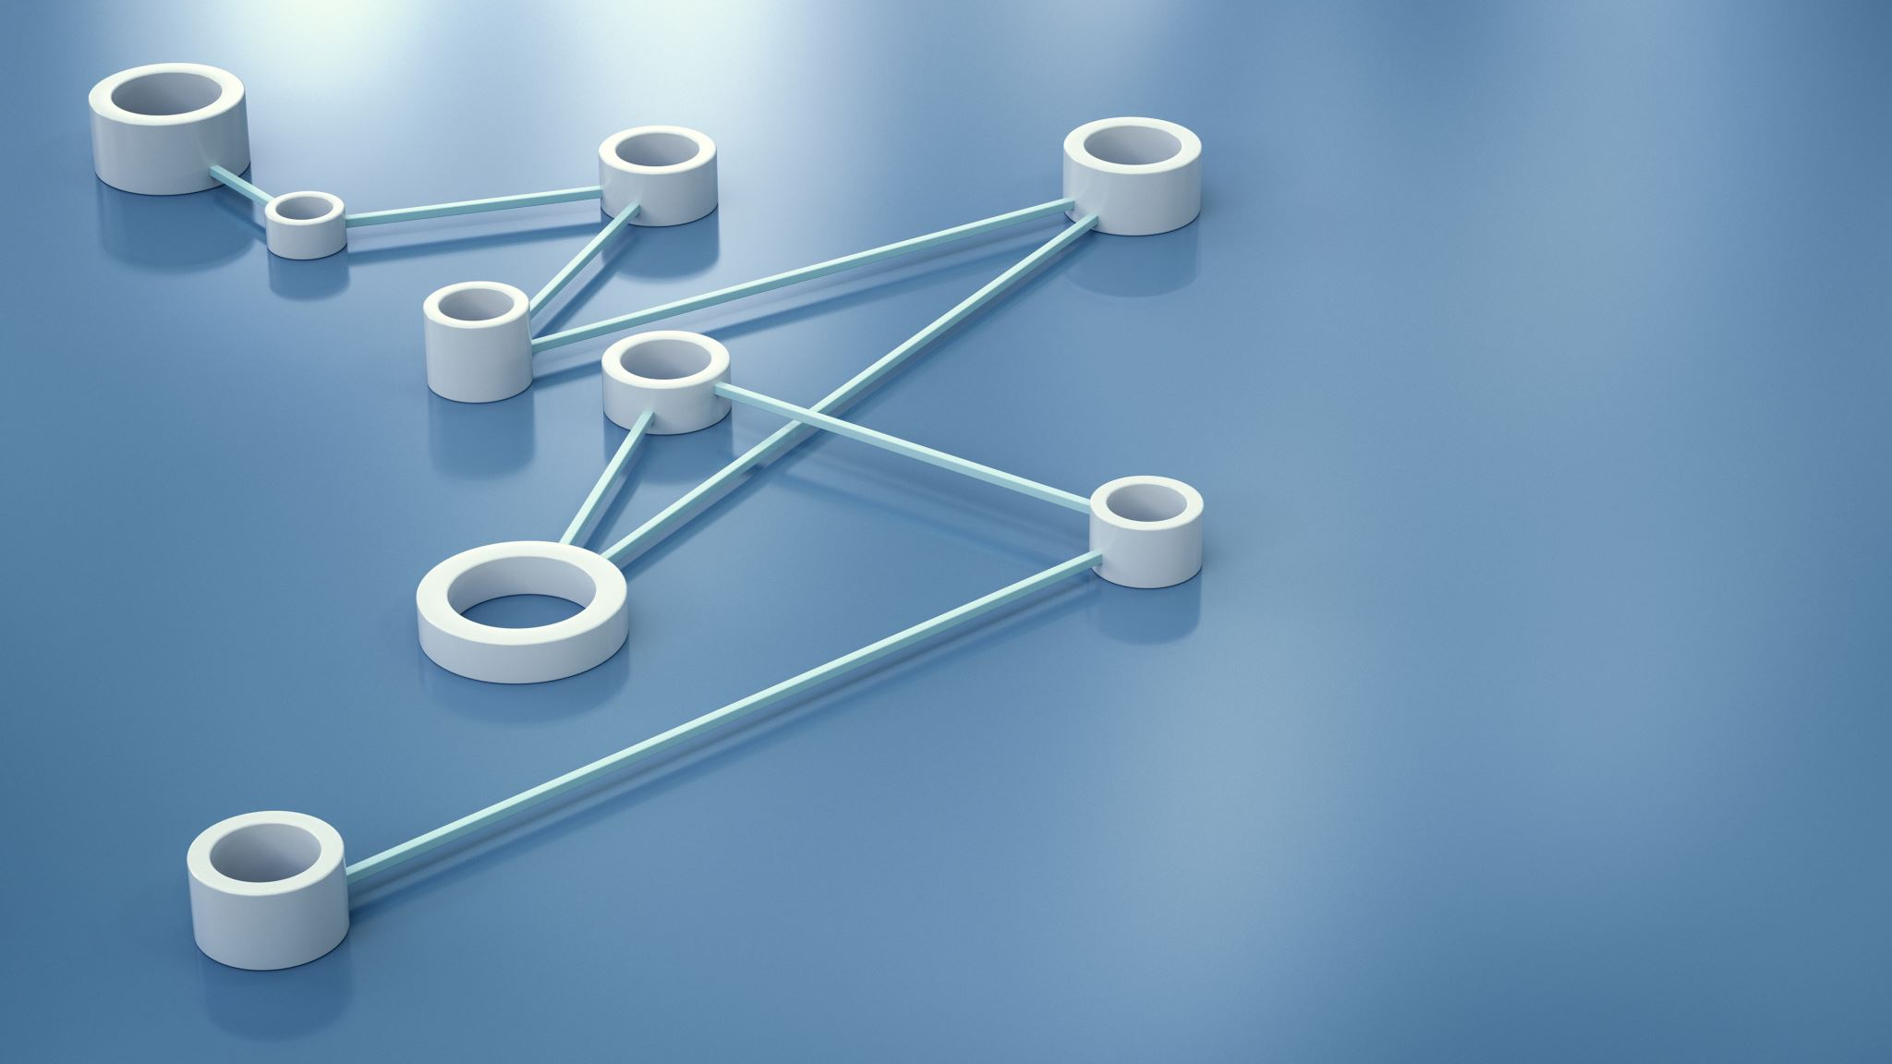
What is cyber attack?
A cyberattack is a malicious and deliberate attempt by an individual or organization to breach the information system of another individual or organization.

Slide 19
Malicious Software
Virus
  Rogue software program that attaches itself to other software programs or data files in order to be executed
Worms
  Independent computer programs that copy themselves from one computer to other computers over a network.
Trojan horses
  Software program that appears to be benign but then does something other than expected.

Slide 20
Cont’
Spyware
  Small programs install themselves surreptitiously on computers to monitor user Web surfing activity and serve up advertising
Key loggers
  Record every keystroke on computer to steal serial numbers, passwords, launch Internet attacks

Slide 21
Hackers and computer crimes
They are activities which includes
  System intrusion
    Unwelcomed interruption on someone’s system
  System damage
    To cause malfunction or failure of system
  Cybervandalism
    Damaging someone’s system with intention of enjoyment and pleasure
    The motivation is not finance

Slide 22
Conti’
Computer crime
Defined as “any violations of criminal law that involve a knowledge of computer technology for their perpetration, investigation, or prosecution”
Computer may be target of crime, e.g.:
  Breaching confidentiality of protected computerized data
  Accessing a computer system without authority
Computer may be instrument of crime, e.g.:
  Theft of trade secrets
  Using e-mail for threats or harassment

Slide 23
Identity theft
• Theft of personal Information (social security id, driver’s license or credit card numbers) to impersonate someone else
Phishing
• Setting up fake Web sites or sending e-mail messages that look like legitimate businesses to ask users for confidential personal data.

Slide 24
Conti’
Click fraud
fraudulently clicks on online ad without any intention Occurs when individual or computer program of learning more about the advertiser or making a purchase
Pharming
Redirects users to a bogus Web page, even when individual types correct web page address into his or her browser

Slide 25
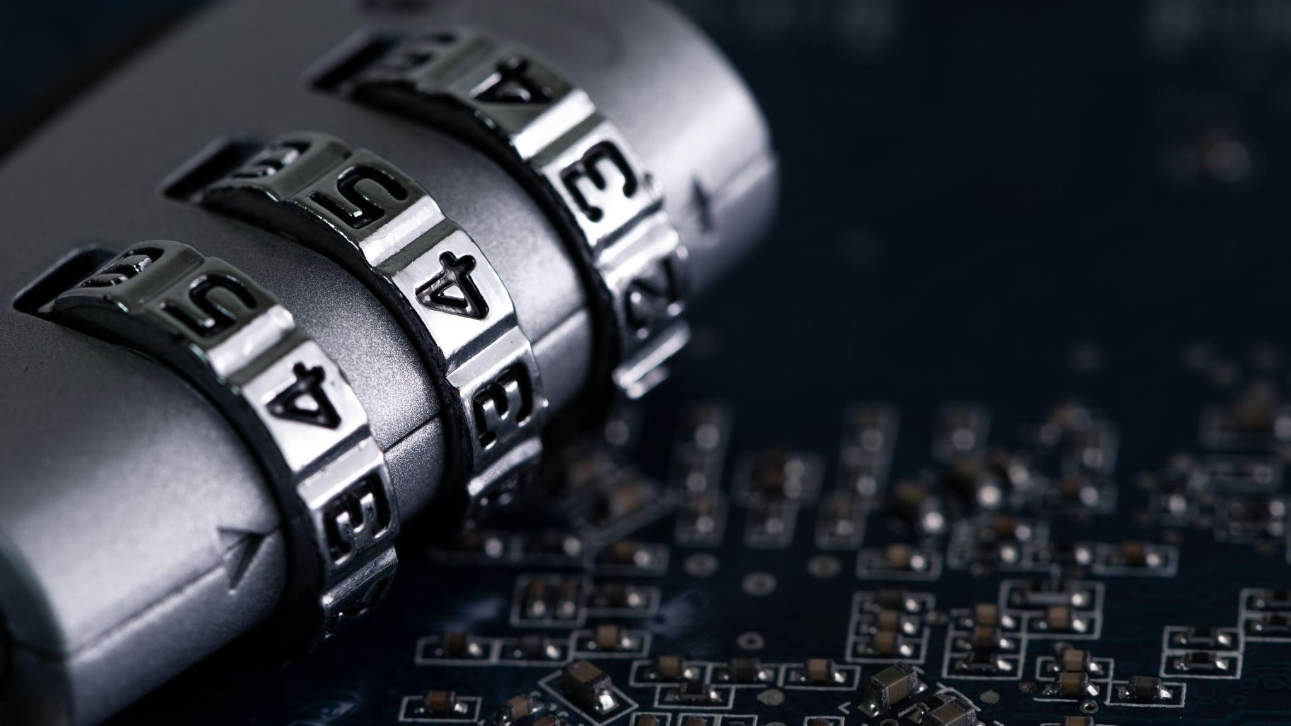
What are the most common cyber attack?
Malware. The term “malware” encompasses various types of attacks including spyware, viruses, and worms. ...
Phishing.
Man-in-the-Middle (MitM) Attacks.
.
Denial-of-Service (DOS) Attack.
SQL Injections.
Zero-day Exploit.
Password Attack.
Cross-site Scripting

Slide 26
What is a botnet?
A botnet is a collection of internet-connected devices, which may include personal computers (PCs), servers, mobile devices and internet of things (IoT) devices, that are infected and controlled by a common type of malware

Slide 27

What are the physical security?

Slide 28
Physical security
Sensors
Alarms (sounds, LED etc)
Notification
Delay ( password, so that the hacker can be humped (slowed down)

Slide 29
Securing mobile application
The organization’s mobile security policy should forbid employees from using unsecure applications for transferring and storing corporate documents and files without encryption
Use of McAfeee, Kaspersky or other security mechanism to protect mobile devices
Use of Coorporate smartphone for transaction related to organization

Slide 30
Securing wireless network
The use of WEP (Wireless Equivalent Privacy) is not efficient due to use of easy encryption key
WEP provide the following security in order enforce its security:
  Virtual Private Network(VPN) to access internal data
  WPA2(wifi protected access 2) with strong security standard

Slide 31
Tools for security
Encryption and Decryption
Public Key Infrastructure
Digital signature
Two methods of encryption
• Symmetric key encryption
• Sender and receiver use single, shared key
• Public key encryption
Uses two, mathematically related keys: Public key and private key
Sender encrypts message with recipient’s public key
Recipient decrypts with private key

Slide 32
Ensuring Software Quality
Software Metrics: Objective assessments of system in form of quantified measurements
  Number of transactions
  Online response time
  Payroll checks printed per hour
  Known bugs per hundred lines of code
Early and regular testing
Walkthrough: Review of specification or design document by
small group of qualified people
Debugging: Process by which errors are eliminated

Slide 33
Reference
Kenneth G. Laudon and Jane P. Laudon, “Management Information System”, pearson 14/e 2017
Boyle, Randall J. and Raymond R. Panko, “Corporate Computer security 4/e. prentice-hall 2015
www. heimdalsecurity.com/blog/home-wireless-network-security
www.cisco.com/c/en_ae/products/security/

