Slide 1
Organizational Behavior
Lecturer: HABUMUREMYI Faustin, MTourMgt.
Lecture 2:
Personality and Individual Differences,
Motivation and Rewards

Slide 2
Personality and Individual Differences

Slide 3
PERSONALITY
Individual differences can be divided into personality and ability differences
Understanding the nature, determinants, and consequences of individual differences is essential for managing organizational behavior

Slide 4
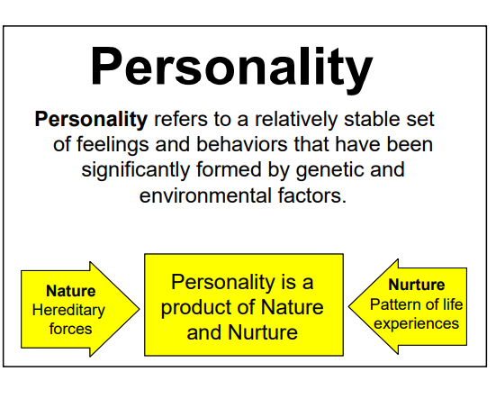

Slide 5
The Big Five Model of Personality
Personality is typically described in terms of traits.
A trait is a specific component of a personality that describes the particular tendencies a person has to feel, think, and act in a certain way

Slide 6
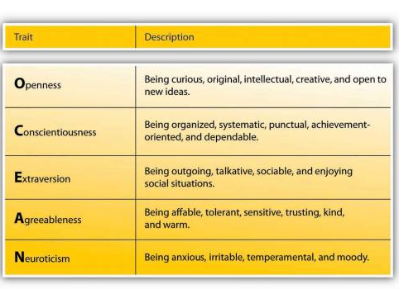

Slide 7
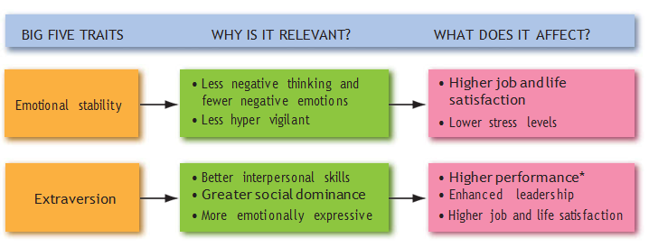
Model of how Big Five Traits Influence OB Criteria

Slide 8
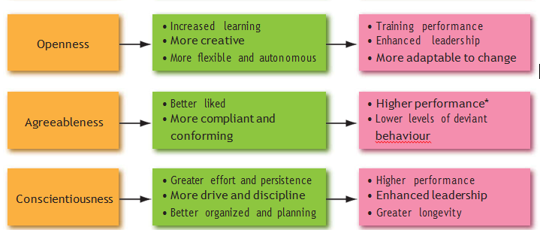
Model of how Big Five Traits Influence OB Criteria

Slide 9
Motivation and Rewards

Slide 10
MOTIVATION
Definitions:
Organizations need motivated employees to maintain an effective workforce that is willing to achieve strategic organizational goals.
Motivation can be defined as “a set of energetic forces that originate both within as well as beyond an individual’s being to initiate work-related behavior, and determine its form, direction, intensity, and duration” (Pinder, 2019, p. 8).

Slide 11
What is Motivation?
  Motivation is an internal state that directs and guides our behavior to attain a goal through processes shaped by cultural norms, values, and practices
  Motivation works like a push pull toy. It can pull or push you and the choice is dependent upon the situation’s motivating factors

Slide 12
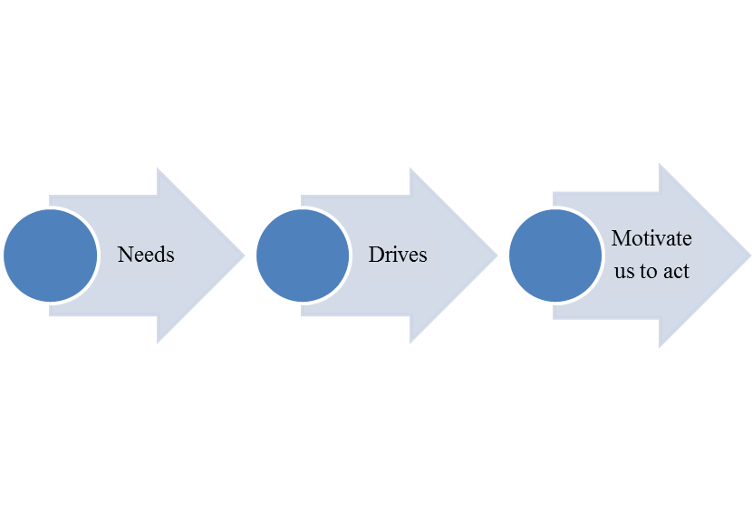
The push to motivate comes from needs
Internal bodily states
linked to
Reduce tension
Incentives
Needs
Drives
The pull to motivate comes from incentives
External factors that motivate us to act to fulfill our needs and reduce our drives
Notes:
Needs: Necessary for motivation and can be biologically, socially, psychologically, cognitively, or environmentally based
Drives :the tension and uneasiness that result when we experience a need

Slide 13
  Two Different types of motivation
    Extrinsic motivation - shapes our behavior through external forces and rewards that are pleasant like verbal praise, money, or awards
    Intrinsic motivation - shapes our behavior through internal forces such as enjoyment, interest, or personal satisfaction

Slide 14

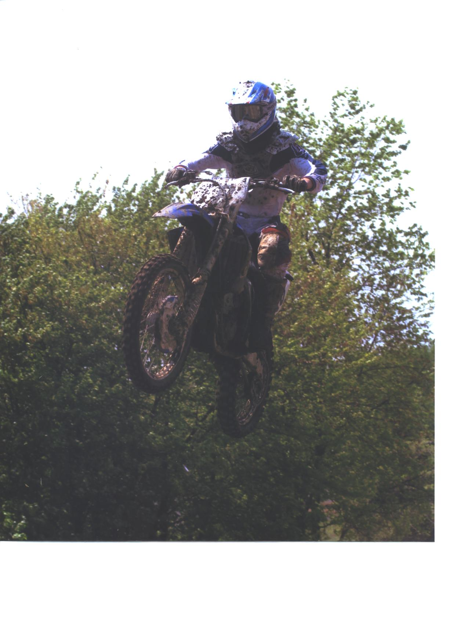
Extrinsic and Intrinsic Motivation

Slide 15
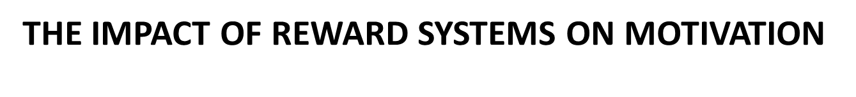
Rewards can be used to influence motivation. By no means are financial rewards the only way to motivate, as there are many HRM practices that aim to motivate.
A reward system consists of the policies and mechanisms by which organizations administer employee rewards, for example, by annual pay increases.

Slide 16
A reward system should satisfy the goals associated with the strategy of an organization, while at the same time be attractive, cost effective, and fair

Slide 17
Within a particular system, it is important to consider two aspects: First, the reward type, the nature of the reward itself that may be financial or not, and fixed or contingent on a certain criterion.
Second, the reward criteria, the norms and principles on which rewards are allocated, for example, individual or team performance

Slide 18
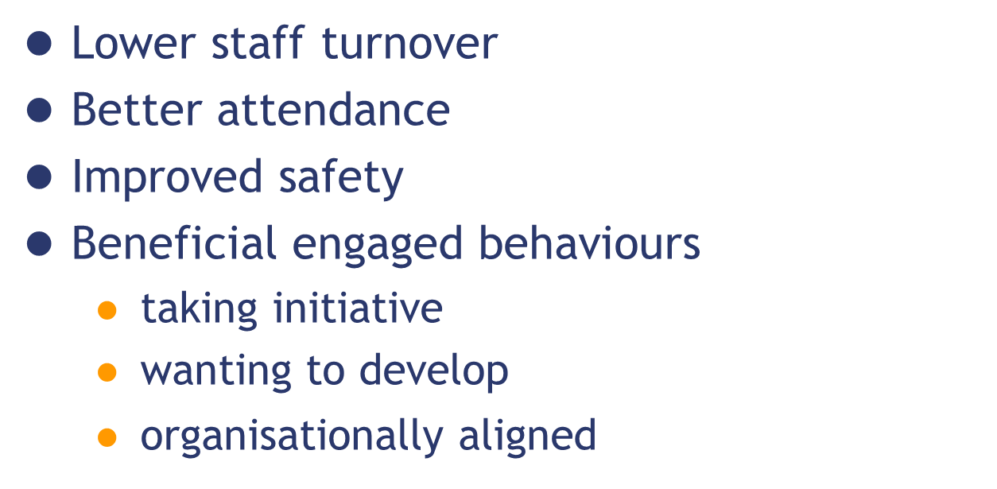


What does motivation deliver?
Higher productivity
Improved customer service

Slide 19
Reference
Robbins, P., Timothy, A. & Katherine ,E., (2018) Essentials of organizational behavior, p 82-90, https://www.pdfdrive.com/essentials-of-organizational-behaviour-e176364014.html
Wendelien Van Eerde (2015) Motivation and Reward Systems
http://dx.doi.org/10.1002/9781118785317.weom060146

Slide 20
Thank you!
Next lecture: Intrinsic Motivation and Job Redesign.
Lecturer :Faustin
Email:hfaus84@gmail.com

