Slide 1
Organizational Behavior
Lecturer: HABUMUREMYI Faustin, MTourMgt.
Lecture 3:
Intrinsic Motivation and Job Redesign

Slide 2
Motivating by Job Design:
The Job Characteristics Model
Jobs are described in terms of five core dimensions:
  Skill variety
  Task identity
  Task significance
  Autonomy
  Feedback

Slide 3
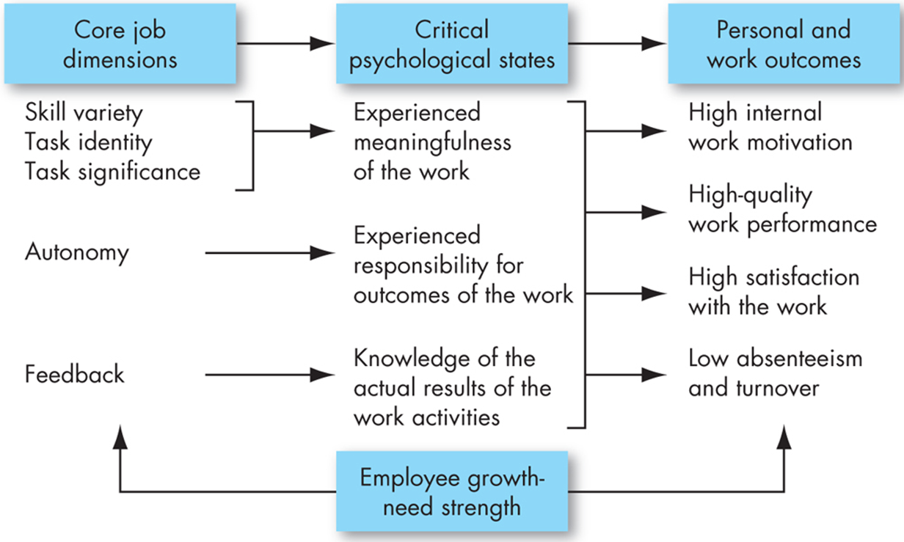
The Job Characteristics Model

Slide 4
Designing Motivational Jobs
JCM-designed jobs give internal rewards
Individual’s growth needs are moderating factors
Motivating jobs must:
  Be autonomous
  Provide feedback
  Be meaningful

Slide 5
How Can Jobs Be Redesigned?
Job Rotation
  The periodic shifting of an employee from one task to another
Job Enrichment
  Increasing the degree to which the worker controls the planning, execution, and evaluation of the work
    Enrichment reduces turnover and absenteeism while increasing satisfaction

Slide 6
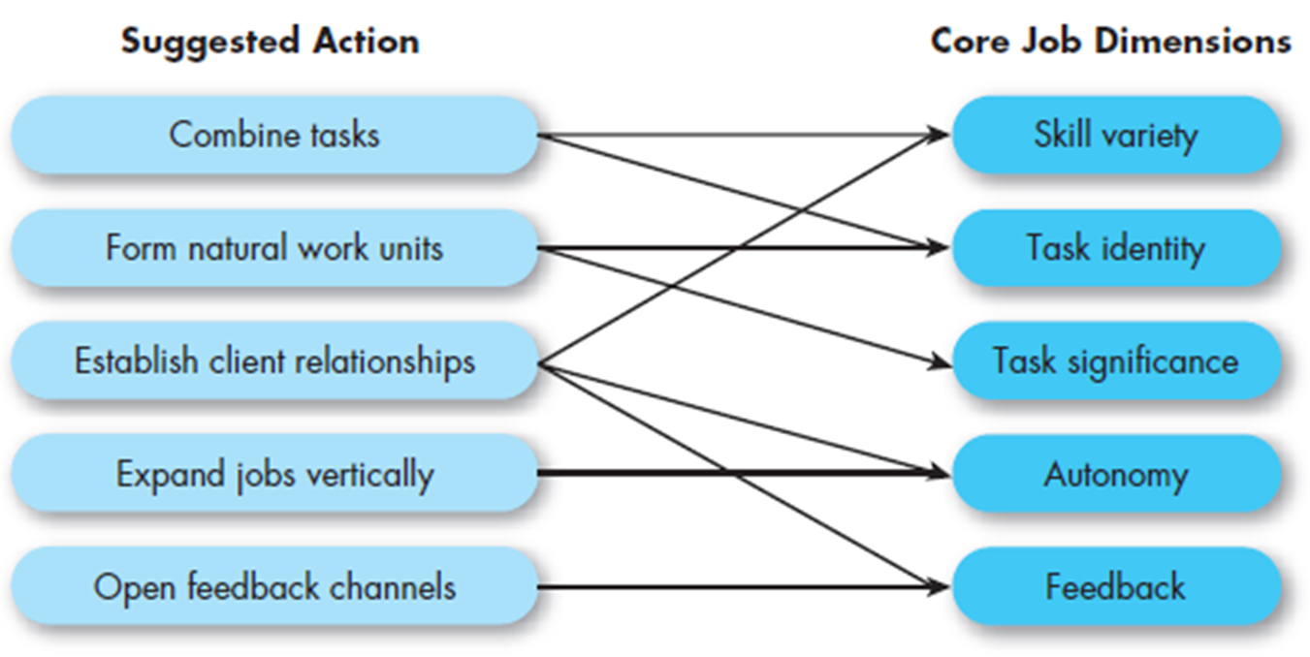
Guidelines for Enriching a Job

Slide 7
How Can Jobs Be Redesigned?
Relational Job Design
  Designing work so employees are motivated to promote the well-being of the organization’s beneficiaries
    Relate stories from customers who have benefited from the company’s products or services
    Connect employees directly with beneficiaries

Slide 8
How Can Jobs Be Redesigned?
Alternative Work Arrangements
  Flextime
    Some discretion over when worker starts and leaves
  Job Sharing
    Two or more individuals split a traditional job
  Telecommuting
    Work remotely at least two days per week

Slide 9
Employee Involvement
Employee involvement: A participative process that uses the input of employees to increase their commitment to the organization’s success
Two types:
  Participative management
  Representative participation

Slide 10
Participative Management
Participative management: Subordinates share a significant degree of decision-making power with superiors
  To be effective:
    Followers must have confidence and trust in leaders
    Leaders should avoid coercion and stress organizational consequences of decisions
  Only a modest influence on productivity, motivation, and job satisfaction

Slide 11
Representative Participation
Representative participation: Workers are represented by a small group of employees who participate in decisions affecting personnel
  Works councils
  Board membership
Redistribute power within an organization
Does not appear to be very motivational

Slide 12
Employee Involvement Programs and Motivation Theories
Theory Y: consistent with participative management
Theory X: consistent with the more autocratic style of managing
Two-factor theory: employee involvement programs could provide intrinsic motivation by increasing opportunities for growth, responsibility, and involvement in the work itself

Slide 13
Using Pay to Motivate Employees
Major strategic rewards decisions:
  What to pay employees
  How to pay individual employees
  What benefits to offer
  How to construct employee
  recognition programs

Slide 14
What to Pay
Establishing a pay structure
  Balance between:
    Internal equity – the worth of the job to the organization
    External equity – the external competitiveness of an organization’s pay relative to pay elsewhere in its industry
  A strategic decision with trade-offs

Slide 15
How to Pay
Variable-Pay Programs
  Base a portion of the pay on a given measure of performance
  Seven types:
    Piece-rate pay plan
    Merit-based pay
    Bonuses
    Skill-based pay
    Profit-sharing plans
    Gainsharing
    Employee-stock ownership plan (ESOP)

Slide 16
Variable-Pay Programs
Piece-Rate Pay: workers are paid a fixed sum for each unit of production completed
Merit-Based Pay: pay is based on individual performance appraisal ratings
Bonuses: rewards employees for recent performance
Skill-Based Pay: pay is based on skills acquired instead of job title or rank – doesn’t address the level of performance

Slide 17
Variable Pay Programs
Profit-Sharing Plans – organization-wide programs that distribute compensation based on an established formula designed around profitability
Gain sharing – compensation based on sharing of gains from improved productivity
Employee Stock Ownership Plans (ESOPs) – plans in which employees acquire stock, often at below-market prices

Slide 18
Using Benefits to Motivate
Benefits are both an employee provision and an employee motivator
Individual employees value the components of benefits packages differently
A flexible benefits program turns the benefits package into a motivational tool

Slide 19
Using Intrinsic Rewards to Motivate
Employee recognition programs
  Can be as simple as a spontaneous comment
  Can be formalized in a program
  Recognition is the most powerful workplace motivator – and the least expensive – but fairness is important

Slide 20
Implications for Managers
Recognize individual differences
Use goals and feedback
Allow employees to participate in decisions that affect them
Link rewards to performance
Check the reward system for equity

Slide 21
Keep in Mind…
Most people respond to the intrinsic job characteristics of the JCM
It is not clear that employee involvement programs work – use caution!
Variable-pay plans can enhance motivation

Slide 22
Michael Gibbs.,(2021) Job Design, Learning & Intrinsic Motivation
https://bfi.uchicago.edu › BFI_WP_2021-47
John Slocum.,(1981) Job Redesign: Improving the Quality of Work Life
https://www.researchgate.net/publication/242154040

Slide 23
Thank you!
Next lecture: Perception, Cognition and Decision Making.
Lecturer :Faustin
Email:hfaus84@gmail.com

