Slide 1
Organizational Behavior
Lecturer: HABUMUREMYI Faustin, MTourMgt.
Lecture 4:
Perception, Cognition and Decision Making

Slide 2
PERCEPTION
A process by which individuals organize and interpret their sensory impressions in order to give meaning to their environment
People’s behaviour is based on their Perception of what reality is, not on reality itself

Slide 3
…..Then, what is Cognition?
The process by which humans select and process information from world around them, introduces further distortions.
Decision makers have a cognitive map that combines perception, biases and understanding of historical lessons which they apply in decision making.

Slide 4
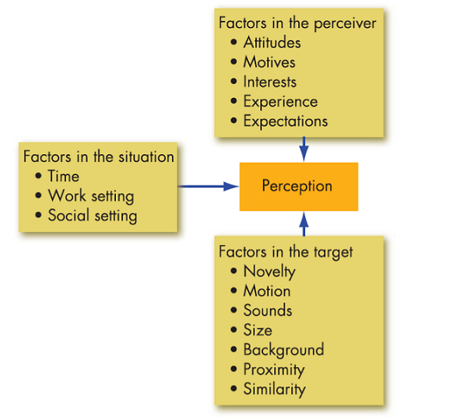
Factors Influencing Perception

Slide 5
Person Perception making judgement about others
Attribution Theory
When Individuals observe behavior, they attempt to determine whether it is internally or externally caused.
-Distinctiveness: Shows different behaviors in different situations.
- Consensus : Response is the same as others to same situation.
-Consistency: Response in the same way over time.

Slide 6
Differences between internal and external causation
Internally caused behaviours are those an observer believes to be under the personal control of another individual.
Externally caused behaviour is what we imagine the situation forced the individual to do.
For example, if one of your employees is late for work, you might attribute that to his overnight partying and subsequent oversleeping. This is an internal attribution. But if you attribute his tardiness to an automobile accident that tied up traffic, you are making an external attribution

Slide 7
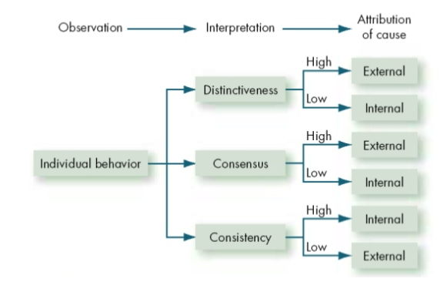
Attribution theory

Slide 8
Common shortcuts in judging others
Selective perception :
-People selectively interpret what they see on the basis of their interests , background experience and attitudes
Halo Effect :
-Drawing a general impression about an individual on the basis of single characteristic.

Slide 9
Common shortcuts in judging others
Contrast Effect :
-Evaluation of person’s characteristics that are affected by comparisons with other people recently encountered who rank higher or lower on the same characteristics.
Stereotyping
-Judging someone on the basis of one’s perception group to which that person belongs

Slide 10
The link between Perception and Individual decision making
Individuals make decisions, choices from among two or more alternatives. Ideally, decision making would be an objective process, but the way individuals make decisions and the quality of their choices are largely influenced by their perceptions.

Slide 11
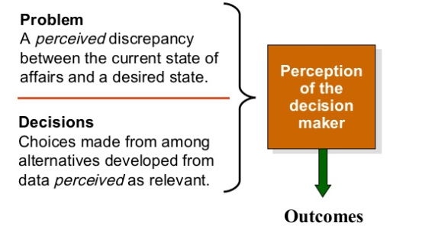
The link between Perception and Individual decision making

Slide 12
Decision making in organizations
In OB, there are generally accepted constructs of decision making each of us employ to make determinations: rational decision making, bounded rationality, and intuition.
Though their processes make sense, they may not lead to the most accurate (or best) decisions. More importantly, there are times when one strategy may lead to a better outcome than another in a given situation

Slide 13
Decision making in organizations
1. Rational Decision Making
The rational decision-making model assumes that the decision maker has complete information, is able to identify all the relevant options in an unbiased manner, and chooses the option with the highest utility.
Steps of rational decision making
Define the problem.
Identify the decision criteria.
Allocate weights to the criteria.
Develop the alternatives.
Evaluate the alternatives.
Select the best alternative.

Slide 14
Decision making in organizations
2. Bounded rationality
Individuals make decisions by constructing simplified models that extract the essential features from problems without capturing all their complexity.
They tend to reduce complex problems to a level they can readily understand
They seek solutions that are “satisfactory and sufficient”.

Slide 15
Decision making in organizations
3. Intuition
a non-conscious process created from distilled experience
Intuitive decision making occurs outside conscious thought;
relies on holistic associations, or links between disparate pieces of information;
is fast; and is affectively charged, meaning it engages the emotions.

Slide 16
Common Biased and Errors in Decision Making
Overconfidence bias :
-Believing too much in our own ability to make good decisions.
Anchoring bias :
-Using early , first received information as the basis for making subsequent judgements.
Confirmation bias :
-Using only the facts that support our decision.
-Seek out information that reaffirms the past choices, and discount information that contradicts them.

Slide 17
Common Biased and Errors in Decision Making
Availability bias :
- Using information that is most readily at hand.
Escalation of commitment refers to our staying with a decision even if there is clear evidence it’s wrong.
Consider a friend who has been dating someone for several years. Although he admits things aren’t going too well, he says he is still going to marry her. His justification: “I have a lot invested in the relationship!”

Slide 18
Common Biased and Errors in Decision Making
Risk Aversion
This tendency to prefer a sure thing over a risky outcome
Hindsight Bias:
-The tendency to believe falsely, after the outcome is known,
- Looking back, once the outcome has occurred, and believing that you accurately predicted the outcome of an event .

Slide 19
Organizational constraints on decision makers
Performance Evaluation
- Evaluation criteria influence the choices of actions.
Reward systems
- Decision makers make actions choices that are favored by the organization.

Slide 20
Organizational constraints on decision makers
Formal regulations
- Organizational rules and policies limit the alternatives choices of decision makers.
System-imposed time constraints
-Organizational requires decisions by the specific deadlines.
Historical Precedents
-Past decisions influence current decisions.

Slide 21
Reference
Robbins, P., Timothy, A. & Katherine ,E., (2018) Essentials of organizational behavior, p 106-125, https://www.pdfdrive.com/essentials-of-organizational-behaviour-e176364014.html

Slide 22
Thank you!
Next lecture: . Well-being at Work
Lecturer :Faustin
Email:hfaus84@gmail.com

