Slide 1
Organizational Behavior
Lecturer: HABUMUREMYI Faustin, MTourMgt.
Lecture 6:
Psychological Contracts

Slide 2
Psychological contract
A relationship between employer and employee
Set of mutual expectations (often unstated)
Relationship continues when “contributions” are met by both employer and employee:
Employee: performance
Employer: pay, benefits

Slide 3
Social exchange theory
People enter into relationship in which not only economic, but also social obligations play a role
People are most comfortable when the exchange is balanced
Psychological contract

Slide 4
Importance of psychological contracts
Link individuals to organizations
Reflect the trust that is a fundamental feature of the employment relationship
Motivate individuals to fulfill their obligations( if they believe the other party will do the same)

Slide 5
Psychological vs. Employee contract
Psychological contracts
Dynamic relationship
defining employee’s
psychological involvement with employer.
Reflect perceptions
of expectations.
Interpretations
may not be similar.
Employee contracts
Formal contract that specifies agreements such as hours and type of work in return for compensation and benefits

Slide 6
Sources of experienced violation
Inadvertent
Disruption
Breach of contract
Able and willing (divergent interpretations made in good faith)
Willing but unable (inability to fulfill contract)
Able but unwilling(reneging)

Slide 7
Consequences of Broken Contracts
Outrage,shock,resentment,anger
Decreased trust and good faith
Decreased job satisfaction
Decreased productivity
Decreased attendance
turnover

Slide 8
Responses to contract violation
1. Exit Response
Active response
Break in the relationship: Termination, Resignation
Most likely:
Transactional contract
Other potential jobs or potential employees available
Brief relationship
Other employees exiting
Previous violations go unresolved or failed solutions

Slide 9
2. Voice Response
Responses to contract violation
Active response
Attempts to remedy the violation
Focus :restore trust, minimize losses
Most likely:
Positive relationship and existence of trust
Voice channels exist
Other employees using “voice "response
Employees belief they can influence compliance

Slide 10
Responses to contract violation
3. Loyalty Response
Passive response or no response:
Avoidance
Loyalty
Willingness to endure or accept circumstances
Most likely:
Ineffective voice channels
No voice channels or established ways to communicate
Lack of alternative opportunities

Slide 11
4. Destructive /Neglect Response
Responses to contract violation
Active response: Destruction
Passive response: Neglect
Erosion of the relationship

Slide 12
Business-Related changes impacting psychological contracts
Technological change
Rate of change in the business environment
Global economy
Changing economic conditions
Uncertainty for workers
Demands for performance, flexibility and innovation
Reengineering
Downsizing
Mergers and acquisitions

Slide 13
Job-Related changes impacting Psychological contracts
Outsourcing, off-shoring, subcontracting of work
Contingent and temporary employment for peripheral employees
Fewer full-time jobs and core employees
Relatively low union representation
Less job security

Slide 14
External Factors that Impact Psychological Contracts
Demographics
Swings in environment
Nomadic nature of the workplace
Changing complexion of the workplace
Changing value trends

Slide 15
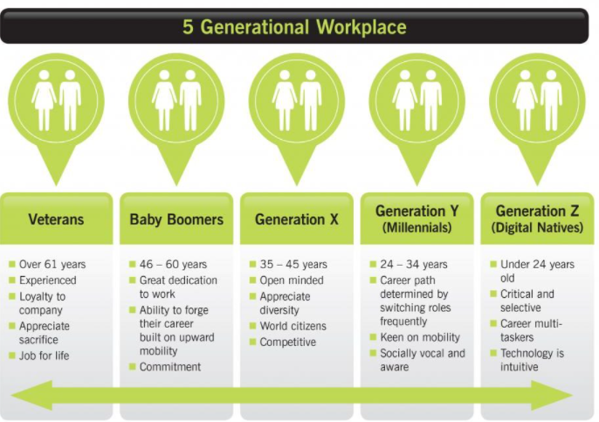
Bakertilly., (2019) The five Generation Workplace
https://www.bakertillymooneymoore.co.uk/wp-content/uploads/2019/05/models_02.19-6-1024x675.jpg

Slide 16

The Shamrock Organization
(Charles Handy, The age of Unreason)
The first leaf:
core workers
Professionals,technicians,managers
Have organizational knowledge
The second leaf:
Specialized knowledge and services
Not part of core technology and competence of the organization

Slide 17
The Shamrock Organization
(Charles Handy, The age of Unreason)
The third leaf:
Pert-time and temporary workers
Fast growing sector of work population

Slide 18
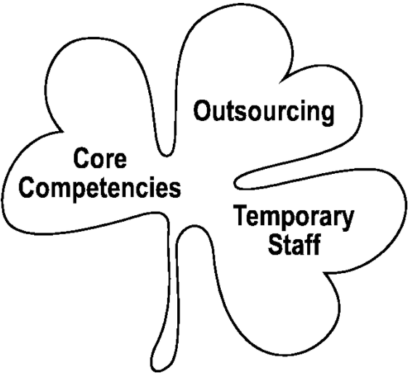
Shamrock Leaf
Sam Lubbe., al.,(2000) Some ad hoc information system issues in South Africa for the new millennium and suggestions as to how to deal with them,
https://www.researchgate.net/profile/Sam-Lubbe/publication/228853196/figure/fig2/AS:651113816674306@1532249039489/The-Shamrock-organisation.png

Slide 19
Employee commitment
Emotional attachment to, involvement in, and identification with organization
Strong belief in and acceptance of organization’s goals and values
Willingness to exert considerable effort on behalf of organization
Strong desire to remain in organization

Slide 20
Advantages of committed Employees:
High performance
High job satisfaction
Adapt better to unforeseen circumstances
Stay with company longer
More organizational citizenship behavior

Slide 21
Organizational citizenship
Organizational citizenship behavior (OCB) is a term that’s used to describe all the positive and constructive employee actions and behaviors that aren’t part of their formal job description.
It’s anything that employees do, out of their own free will, that supports their colleagues and benefits the organization as a whole.

Slide 22
Reference
John Arnold., Joanne.S al.,( 2005) Work Psychology, Understanding Human Behavior in the Workplace, https://books.google.com
Hadi AL-Abrrow., al. (2019) Psychological contract and organizational misbehavior: Exploring the moderating and mediating effects of organizational health and psychological contract breach in Iraqi oil tanks company,
https://www.researchgate.net/publication/337169885

Slide 23
Thank you!
Next lecture: Group Dynamics and Teams
Lecturer :Faustin
Email:hfaus84@gmail.com

