Slide 1
COMMUNICATION SKILLS
Chapter I: Communication Theory
Lecturer: Protais Niyonshima

Slide 2
Objectives
By the end of this session, a learner will be able to:
Define effectively Communication
Explain clearly the elements of a Communication process
Describe well the functions of Communication
Explain the types of Communication

Slide 3
0. Introduction
What do you understand by communication?
Is there any difference in the way you communicate depending on where you are or someone you are addressing?

Slide 4
1. What is Communication?
The word communication is from the verb ‘communicate’ which is historically related to the word ‘common’. Communicate is from the Latin verb communicare, which means ‘to share’ or ‘to make common’. In communication, therefore, we shape a common sense by sharing information. (Karl, 2000).

Slide 5
Cont’
One can define communication as an action of sending, giving or exchanging information. Oxford Dictionary (1998) explains communication as an activity through which people express ideas and feelings or give information.
Although most people are born with physical ability to talk, not all can communicate. Therefore, people can acquire Communication Skills.
Birvenu (1987) states that communication is the process of transmitting feelings, attitudes, facts, beliefs as well as ideas between living beings.

Slide 6
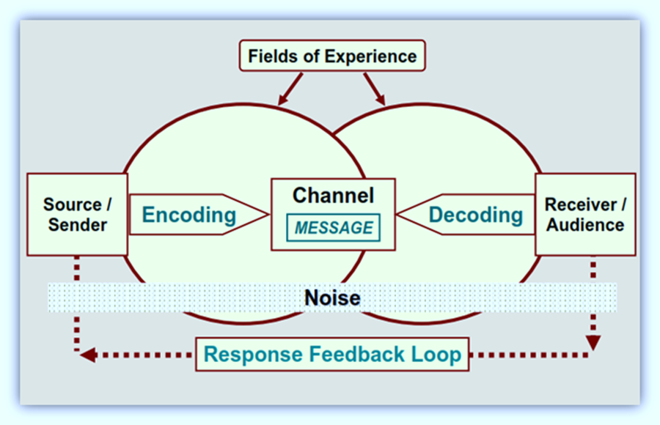
2. Elements of a communication process
Image Source: Akhil T. (2012). The Communication Process. Link: /http://shillongsultans.blogspot.com/2012/11/chapter-5-communication-process.html

Slide 7
Cont’
Sender: The person who conveys the message with an intention of passing information and ideas to others.
Ideas: The subject matter of communication, it is made up of opinion, attitude, feelings, views, orders, or suggestions.
Encoding: Conversion of the subject matter into symbols/sounds to be sent to a receiver.
Communication Channel: A way through which the message pass from the sender to the receiver.

Slide 8
Cont’
5. Receiver: The person who receives the message from the sender; the sent message is meant for him/her.
6. Decoding: An action that comes after receiving the message, the receiver converts symbols/sounds into meaning to his/her complete understanding.
7. Feedback: After getting the message, a receiver may react to prove that he/she has received and understood the message or he/she wants more information.

Slide 9
3. Process of communication
A sender Encodes Message Receiver Decodes symbols/sounds to get a message.
A message passes through a channel of communication.
After getting a message, a receiver may send a feedback to the sender.
Along the process, a message may be affected by the noise.
A message must have a context.

Slide 10
Cont’
The communication process consists of several components that make it successful.
The process of communication is done when a sender sends a message through a channel of communication, the receiver receives the message.
Note: Sometimes, a receiver provides the sender with feedback.

Slide 11
4. Functions of communication
Functions of communication may vary depending on circumstances. Let us discuss some of them at a workplace:
Inform: At a workplace, the management team needs to send a vast amount of information to employees to function and operate.
Control: The management of any organization has plans; communication is used to control daily activities and lead them to objectives attainment.
Persuade: Persuasive words or actions are needed at a workplace to maintain good cooperation among workers.
Coordinate: Sharing information helps to coordinate activities at workplace.

Slide 12
5. Types of Communication
People communicate with each other in a number of ways depending on the message to be delivered and its context.
The choice of communication channel and style of communicating play a big role in communication, thus a variety of types of communication.

Slide 13
Types of communication by basing on communication channels
Verbal Communication
Nonverbal Communication

Slide 14
5.1. Verbal Communication
Verbal communication is a form of communication in which a message is transmitted verbally, by word of mouth, and a piece of writing. In verbal communication it is very important to keep the message short and simple to enable the receiver get it well.
Note: Sometimes when we talk, we assume that our audience gets what we say because we know what we are saying, but it is not the case. Our message can be affected by people’s own attitude, perception, emotions and thoughts about the topic, hence they are not able to get a right meaning.

Slide 15
Cont’
When you are sending a message, it very important to put yourself on the other side of a table and think from your receiver’s perceptive to enhance successful communication.
Verbal Communication is further divided into:
  Oral Communication
  Written Communication

Slide 16
5.1.1. Oral Communication
In oral communication, spoken words are used. This is a case of face-to-face conversation, speech, on-phone conversation, video, radio, television, voice over internet. It is, however, affected by pitch, volume, speed and clarity of speaking.

Slide 17
Advantages and disadvantages
Advantages of oral communication
Oral communication helps to get a quick feedback.
Example: In a face-to-face conversation, by reading facial expression and body language one can guess whether a receiver understands the given information or not.
Disadvantage of oral communication
In face-to-face discussion, users (sender and receiver) are unable to deeply think about what they are delivering.

Slide 18
5.1.2.Written Communication
In written communication, users use written signs or symbols to communicate. A written message can be in printed or hand-written forms. In written communication, a message can be sent via email, letter, report, memo etc. depending the choice of a sender.
In some context, a message, in written communication, is structured by taking into consideration grammatical rules, writing style, precision and clarity of the language.

Slide 19
Advantages and disadvantages
1. Advantages of written communication
  Messages can be edited and revised before they are sent.
  Written communication provides record for future use.
  A written message enables receiver to fully understand it and send relevant feedback.
2. Disadvantages of written communication
  Written communication doesn’t help a sender to get an instant feedback.
  Composing the message takes long time.

Slide 20
5.2. Nonverbal Communication
In nonverbal communication a user sends or receives wordless messages. The message is transmitted via gesture, body language, posture, tone of voice or facial expressions.
In nonverbal communication, it is all about the body language of a user.

Slide 21
Elements of nonverbal communication
The following are elements of nonverbal communication
Speaker’s appearance: The physical appearance in terms of clothing, hairstyle, neatness and use of cosmetics.
Surrounding: How the place looks in terms of room size, lighting, decorations, and furnishings.
Body Language: How a user’s face looks in terms of facial expressions, gestures and postures.
Sounds: How the voice changes in terms of tone and volume.

Slide 22
Types of Communication by basing on Style and Purpose
By basing on style and purpose, there are two main categories of communication:
Formal Communication
Informal Communication

Slide 23
a. Formal Communication
In formal communication, users respect some rules, conventions and principles when they are communicating. Indeed, it occurs in formal setting and structured in an official style.
In formal communication, it is not allowed to use slang and foul language.

Slide 24
Where to use formal communication
We use formal communication in formal settings such as offices, social gatherings, etc. Professional settings like corporate meetings and conferences use the formal communication.

Slide 25
b. Informal Communication
Informal communication is mainly casual talk, established for societal affiliations of members in an organization and face-to-face discussions. Users can use slangs and foul language. Generally, informal communication is done orally. It happens among friends and family members.

Slide 26
Where to use informal communication
Informal communication is used in informal settings such as discussions among friends and family members.

Slide 27
Review
We have discussed the following elements:
Communication
Elements of a Communication Process
Communication Process
Functions of Communication
Types of Communication

Slide 28
Exercises
According to what we have discussed what is communication and when can you say that is successful?
Answer: Communication is a process of sending a message through a channel from a sender to a receiver. Then the receiver decodes the message and sends feedback to the sender. Communication is successful when a receiver gets/understands well a message from a sender to him/her.
2. Discuss the advantages and disadvantages of oral communication.
Answer: In oral communication, spoken words are used. One of the advantages of oral communication is that it brings a quick feedback. However, it has also disadvantages such as not permitting a user to think and arrange ideas before delivering, and it does not permit users to edit their messages.

Slide 29
References
Birvenu,- (1987). Definition of Communication, In Doctor, R and A. Doctor, Principles and Practice of Business Communication, Bombay: Sheth Publishers.
Flesch, R. (1996). The art of plain talk. New York: Harper Brothers Publishers.
Ludlow, R., & Panton, F. (1992). The essence of effective communication. New York: Prentice Hall.
Taylor, S. (2000). Essential communication skills: The ultimate guide to successful business communication. Boston: Pearson Educational.
Karl E. R. (2000). Communication. An introduction. London: Sage Publications.
Oxford Learner’s Dictionaries, accessed on the 14th March 2022, from https://www.oxfordlearnersdictionaries.com/
Image Source: Akhil T. (2012). The Communication Process. Link: /http://shillongsultans.blogspot.com/2012/11/chapter-5-communication-process.html

Slide 30
Thank you and see you in our next session!

