Slide 1
COURSE NAME: MACHINE TOOLS
LECTURE I : INTRODUCTION TO MACHINE TOOLS
Lecturer: HABANABAKIZE THEOPHILE

Slide 2
OUTLINE
Introduction
Definition of machine tools
Different types of machine tools
Main elements of machine tools
Basic functions of machine tools
Specifications of machine tools
Machine tools workshop safety precautions
Cutting fluid/Coolant

Slide 3
LECTURE I. INTRODUCTION TO MACHINE TOOLS
I.1: Introduction
Machine tool are capable of performing several machining operations to produce the part required at the specified accuracy and surface integrity. Machining is performed on a variety of general-purpose machine tools that in turn perform many operations, including chip removal and abrasion techniques, by which cylindrical and flat surfaces are produced.
The main functions of a machine tool are holding the workpiece to be machined, holding the tool, and achieving the required relative motion to generate the part geometry required.

Slide 4
I.2. Definition of machine tools
A machine tool is a machine for shaping or machining metal or other rigid materials, usually by cutting, boring, grinding, shearing, or other forms of deformation. Machine tools employ some sort of tool that does the cutting or shaping. All machine tools have some means of constraining the workpiece and provide a guided movement of the parts of the machine. Thus the relative movement between the workpiece and the cutting tool (which is called the toolpath) is controlled or constrained by the machine to at least some extent, rather than being entirely "offhand" or "freehand".

Slide 5
I.3. TYPE OF MACHINE TOOL
Lathes including automatics
Drilling and boring
Milling
Grinding
Shaper
Planer and others

Slide 6
I.4. Main elements of machine tools
Generally a machine tool should possess the following elements:
A structure that is composed of bed, column, or frame
Slides and tool attachments
Spindles and spindle bearings
A drive system (power unit)
Work holding and tool holding elements
Control systems
A transmission linkages

Slide 7
I.5. Basic functions of machine tools
Machine tools basically produce geometrical surfaces such as:
Flat
Cylindrical
Any other complex shape

Slide 8
Basic functions of machine tools Cont’d
These different shapes are performed on the blanks/workpieces by machining work with the help of cutting tools.
Generally machine tools are there to perform the following functions:
Firmly holding the workipiece/blank and the cutting tool
Transmit the motion to the cutting tool and the blank
Provide power to the cutting tool-work pair for the machining process
Control of the machining parameters like: cutting speed, feed, depth of cut,

Slide 9
EVALUATION 1
What do you understand by machine tool?
Give any five (5) examples of machine tools
What are the physical functions of machine tools?

Slide 10
I.6. Specifications of Machine Tools
A machine tool may have a large number of various features and characteristics. But only some specific salient features are used for specifying a machine tool. All the manufacturers, traders and users must know how machine tools are specified.
Generally, machine tools specifications are guided by the size of the work to be accommodated, the capacity of the machine tools, the size of the machine tools and the range of spindle speed and feed. As this course is concerned about drilling machine, lathe machine and milling machine; the specifications will about the aforementioned machine tools.

Slide 11
Specifications for drilling machine
Specifications for drilling machine can be fixed based on the following parameters:
Maximum drill size (diameter) that can be used.
Size and taper of the hole in the spindle.
Range of spindle speeds.
Range of feeds.
Power of the main drive.
Range of the axial travel of the spindle / bed.
Floor space occupied by the machine.

Slide 12
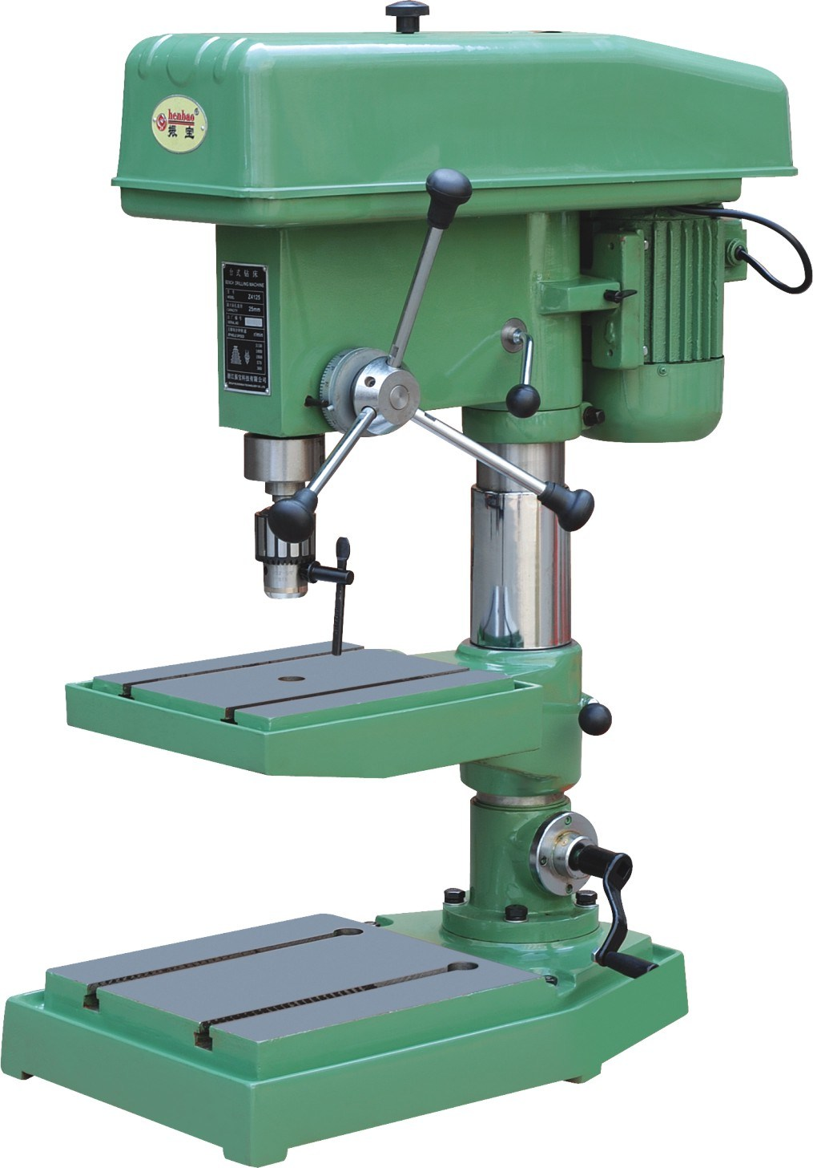
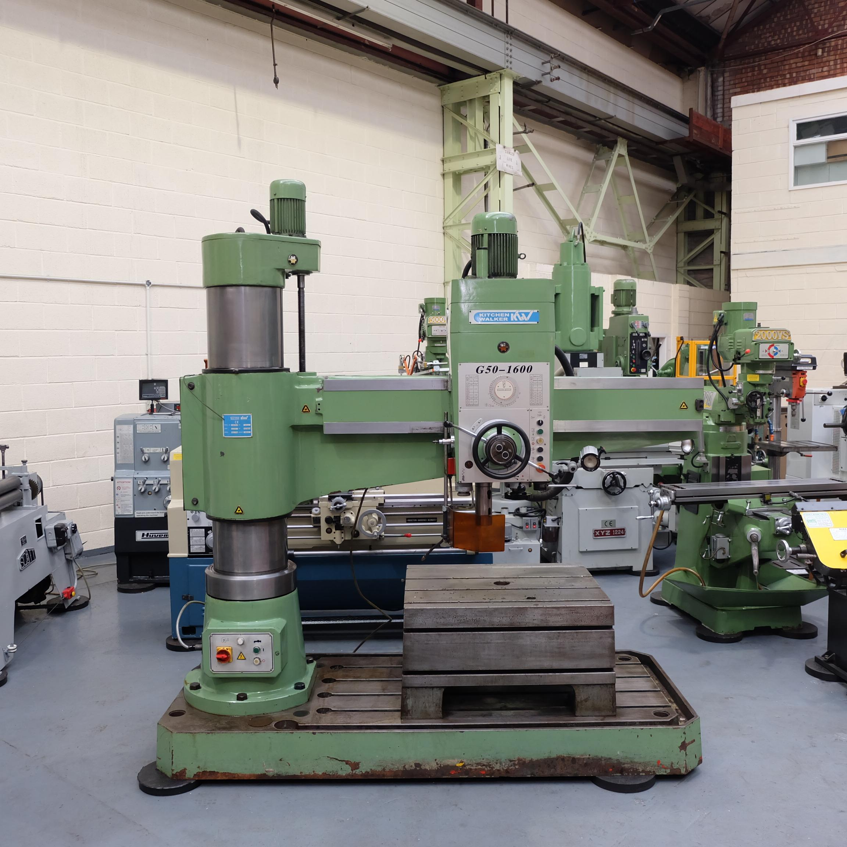
Examples of drilling machines
https://id.images.search.yahoo.com/yhs/search;_ylt=AwrxgvkoqjBiJiEA8gH3RQx.;_ylu=Y29sbwMEcG9zAzEEdnRpZAMEc2VjA3BpdnM-?p=drilling+Machine&type=zxy_a864b661f5f4a3135f&param1

Slide 13
Specification for lathe machine
Specifications for lathe machine can be fixed based on the following parameters:
Maximum diameter and length of the jobs that can be accommodated.
Power of the main drive (motor).
Range of spindle speeds and range of feeds.
Space occupied by the machine.

Slide 14
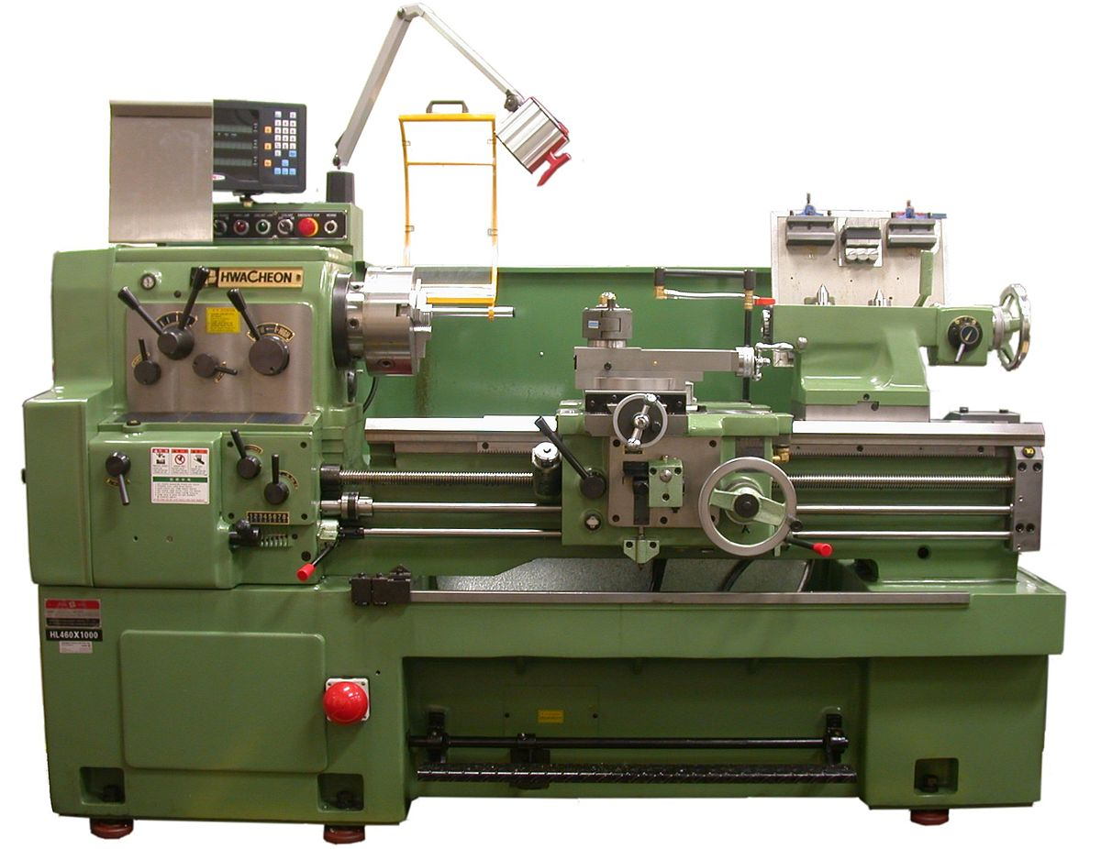
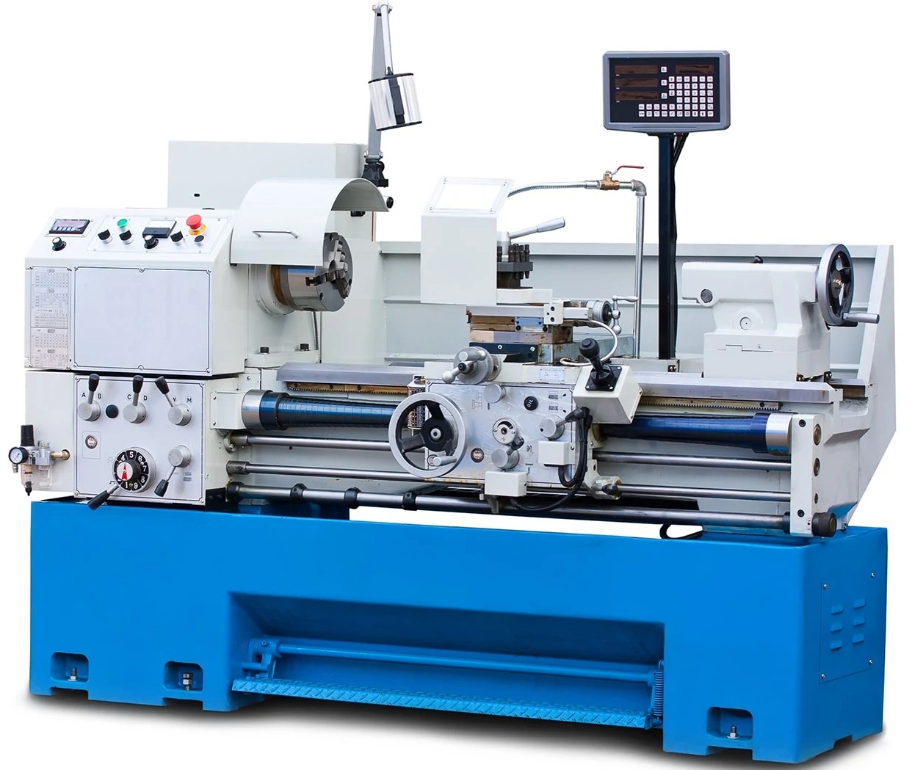
Examples of Lathe Machine
https://id.images.search.yahoo.com/yhs/search;_ylt=AwrwBpXCrDBitbcAuwL3RQx.;_ylu=Y29sbwMEcG9zAzEEdnRpZAMEc2VjA3BpdnM-?p=Lathe+machine&type=zxy_a864b661f5f4a3135f&param1

Slide 15
Specifications for Milling machine (knee type and with arbor):
Specifications for milling machine can be fixed based on the following parameters:
Type; ordinary or swivelling bed type.
Size of the work table.
Range of travels of the table in X - Y - Z directions.
Arbor size (diameter).
Power of the main drive.
Range of spindle speed.
Range of table feeds in X - Y - Z directions.
Floor space occupied.

Slide 16
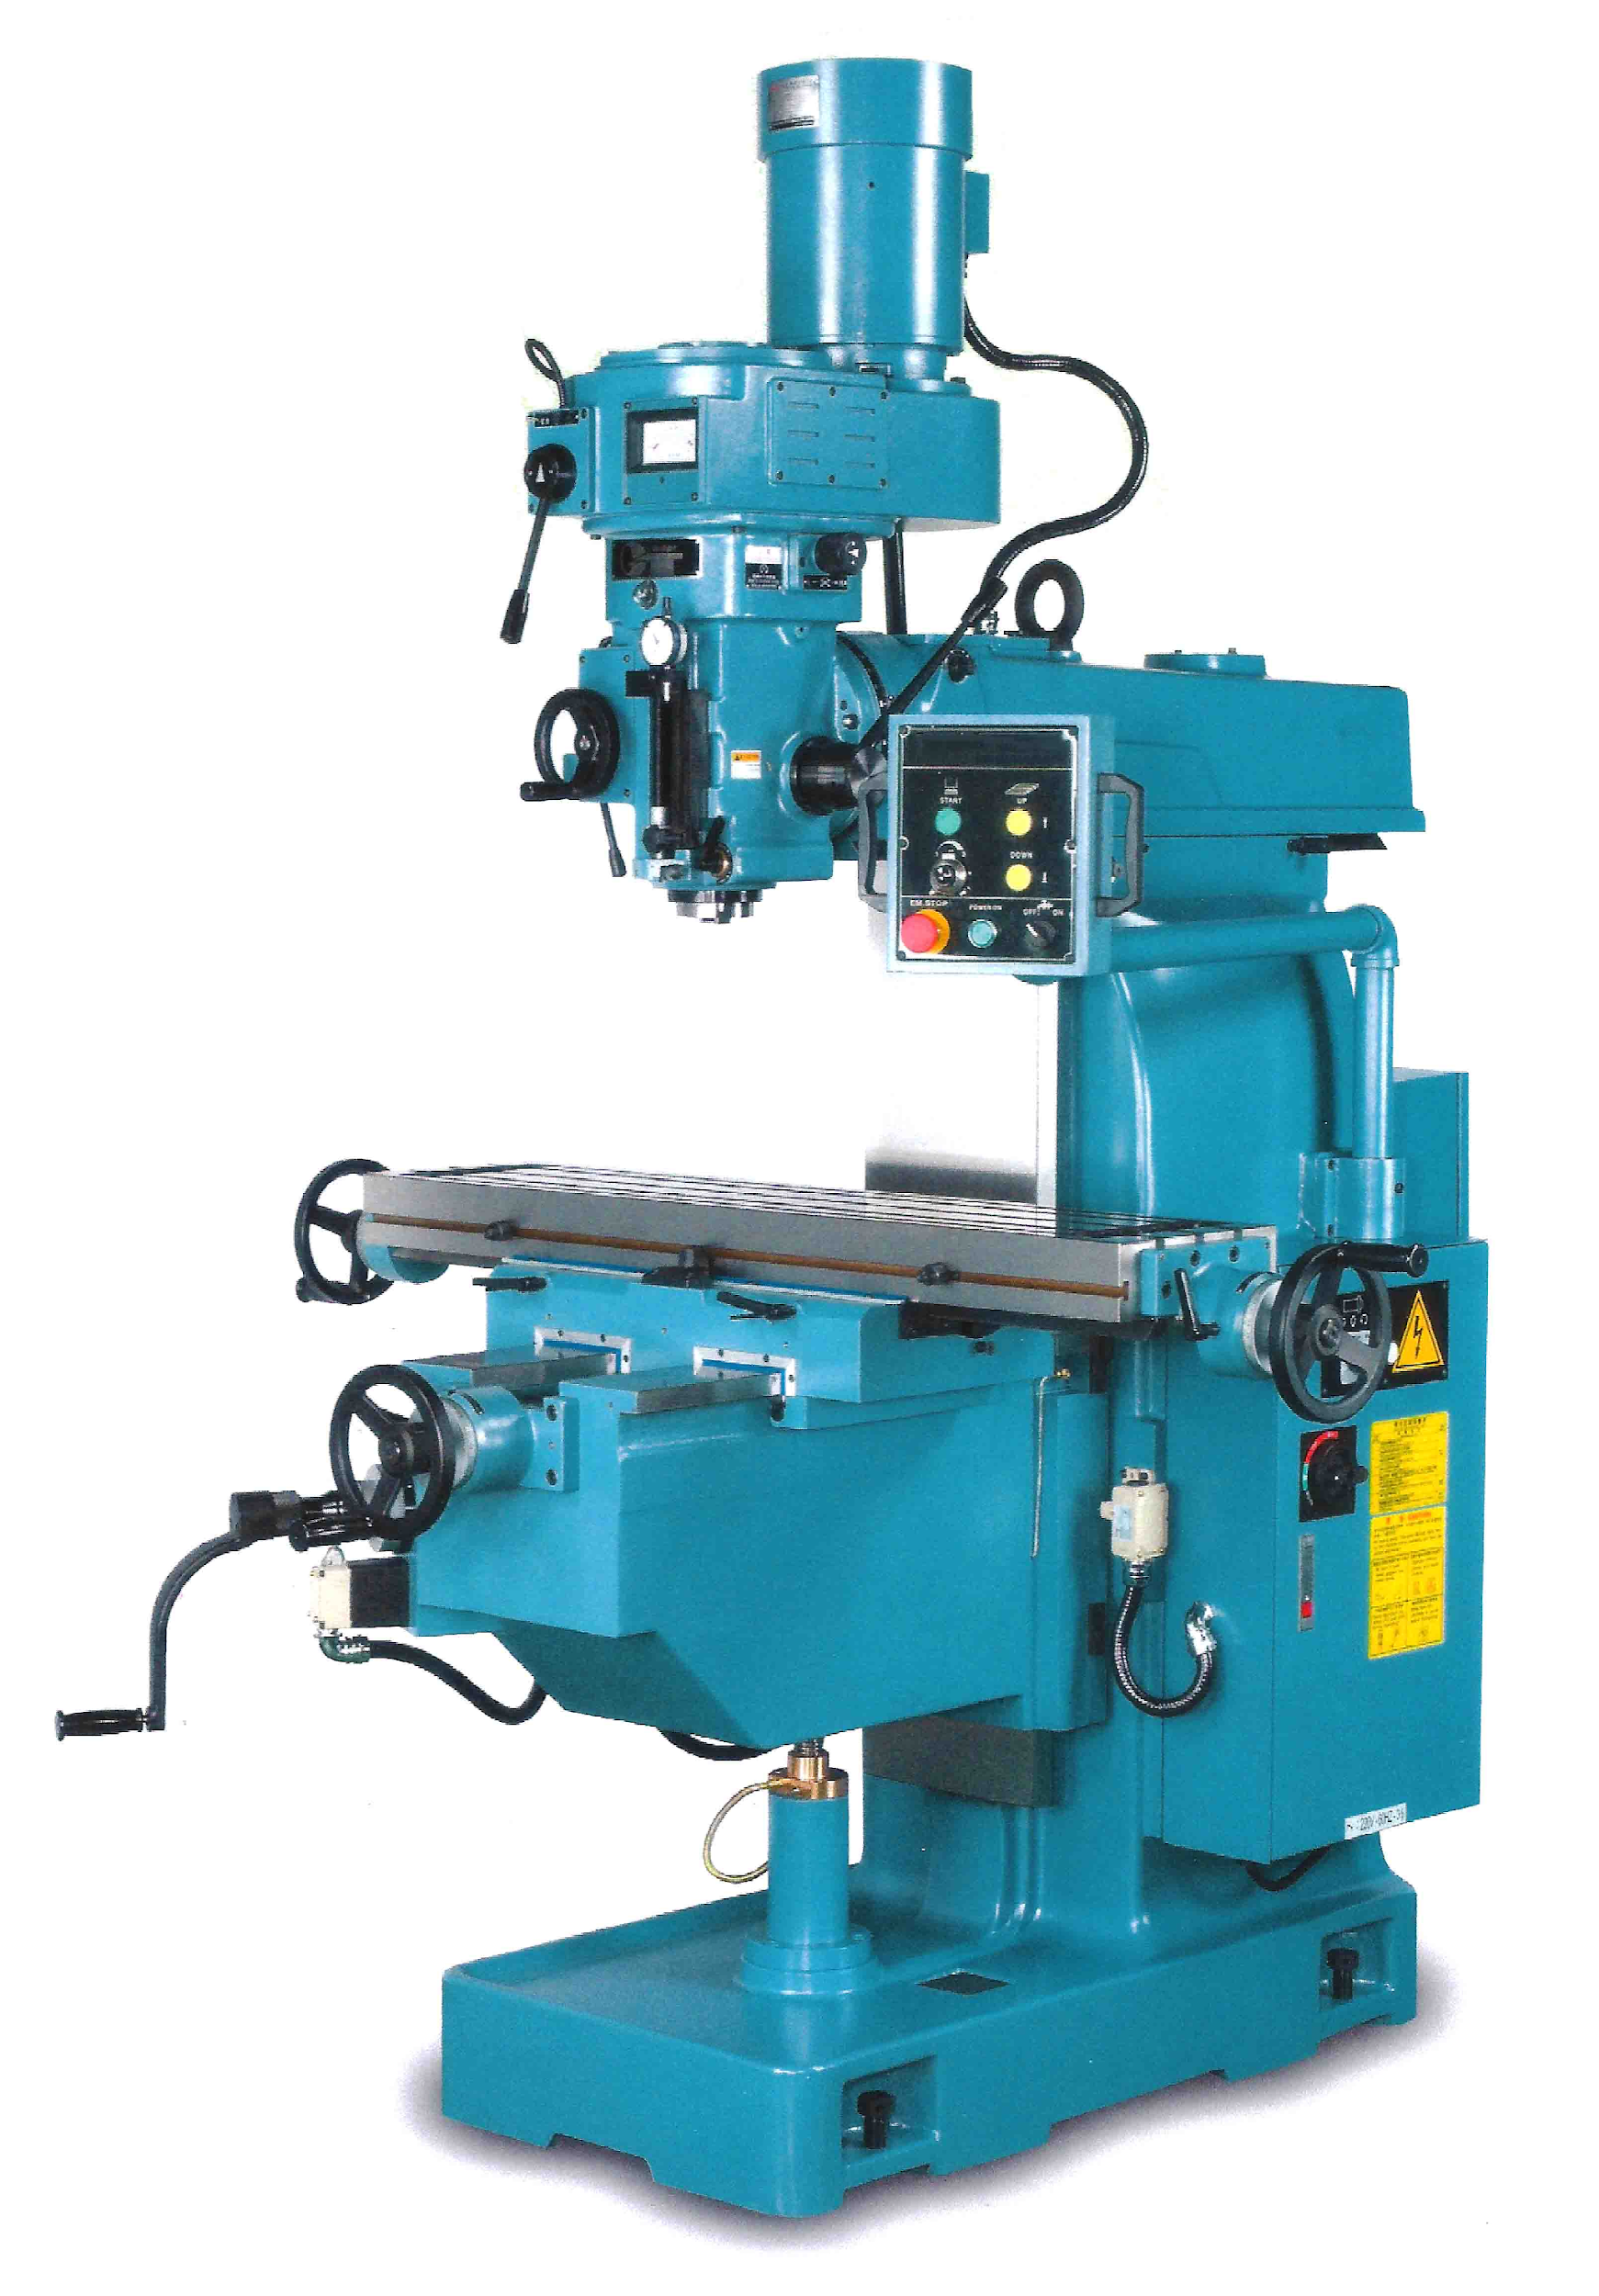
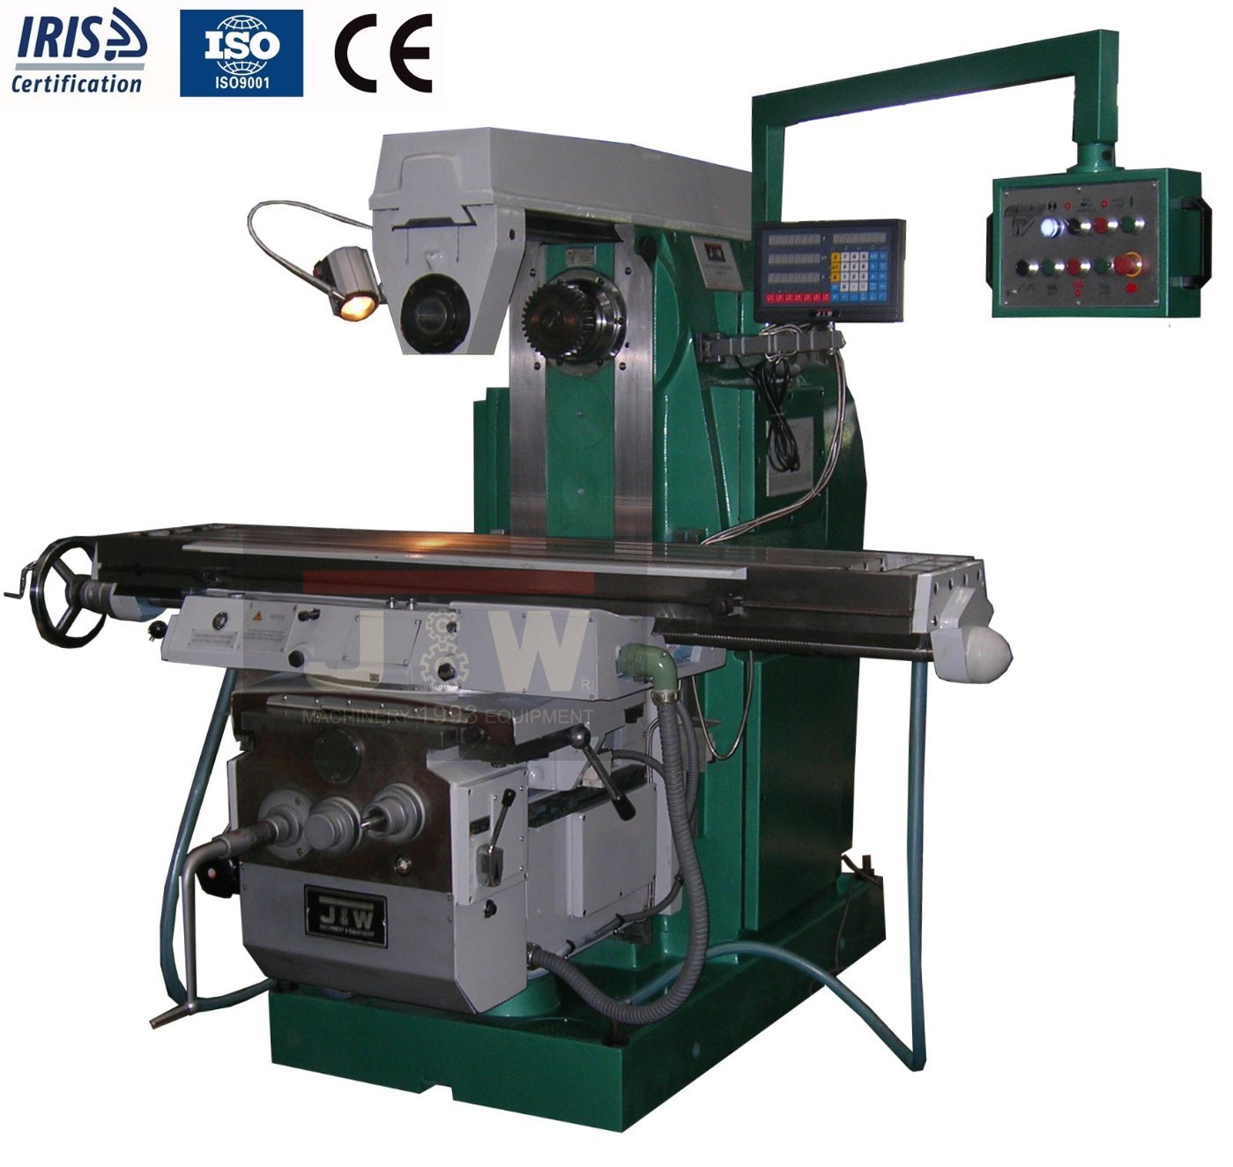
Examples of milling machine
https://id.images.search.yahoo.com/yhs/search;_ylt=Awrx5Za5rjBiMZ0Aaxb3RQx.;_ylu=Y29sbwMEcG9zAzEEdnRpZAMEc2VjA3BpdnM-?p=Milling+machine&type=zxy_a864b661f5f4a3135f&param1

Slide 17
I.7. Machine tools workshop safety precautions
Machine tools operation needs very close attention for they can hurt the operator in one way or the other if safety operation measures are neglected. Safety operation of machine tools is not only sensitive to the operators but also to the environment for their moving parts can lead to accidents.

Slide 18
Machine tools workshop safety precautions cont’d
Do not operate power tools when you are ill: taking strong medications, fatigued or consuming alcoholic drinks. Do not smoke while working with tools. Operating machine tool requires to be in a good health condition in other to be conscience about every action you do.
Pull back long hair in a band and tuck it under your shirt collar or a cap to keep it from getting caught in tools.

Slide 19
Machine tools workshop safety precautions cont’d
Avoid distractions. Keep your mind on your work. Talking or listening to the radio while running machinery can lead to accidents.
Keep guards in place – Safety guards cannot provide the intended protection if they are not in place and in proper working order.
Know the machine. Before using any tool, read the operator's manual, or comparable literature as available, to learn the applications, limitations, and potential of each power tool

Slide 20
Machine tools workshop safety precautions cont’d
Wear proper clothing for the type of work being done. Do not wear loose-fitting clothes or jewellery that can get caught in moving parts. Personal Protective Equipment (PPE) are needed to make sure every part of the body is protected
Safety Glasses must be worn at all times in the shop. Some operations may require additional eye protection or other personal protective equipment.
Keep the work area clean. Keep the floor free of scraps and oil.
Use the correct tools for the job. Do not use a tool or attachment for something it was not designed to do.

Slide 21
I.7. Cutting fluid/Coolant
During machining process, friction between workpiece-cutting tool and cutting tool- chip interfaces cause high temperature on cutting tool.
The effect of this generated heat decreases tool life, increases surface roughness and decreases the dimensional sensitiveness of work material.
Cutting fluids usually in the form of a liquid are to the formation zone to improve the cutting condition. The application of cutting fluids is another alternative to obtain higher material removal rates.
Many types of cutting fluids namely, straight oils, soluble oils, synthetic and semi synthetic are widely used in metal cutting processes.

Slide 22
Cutting fluid/Coolant Cont’d
Cutting fluid is a type of coolant and lubricant designed specifically for metalworking processes, such as machining and stamping. There are various kinds of cutting fluids, which include oils, oil-water emulsions, pastes, gels, aerosols (mists), and air or other gases.

Slide 23
Functions of cutting fluids/coolant
To prevent the tool from overheating; this means that no excessive temperature is reached where the tool’s hardness and resistance to abrasion are reduced, thus decreasing the tool life.
To keep the work cool, preventing machining those results in inaccurate final dimensions.
To reduce power consumption, wear on the tool, and the generation of heat by affecting the cutting process.
This investigation wishes to establish a relationship between the surface chemistry of the lubricants involved and how they can accomplish reducing the contact length on the rake face of the tool where most of the heat during cutting is produced.

Slide 24
Functions of cutting fluids Cont’d
4. To provide a good surface finish on the work.
5. To aid in providing a satisfactory chip formation (related to contact length)
6. To wash away the chips/clear the swarf from the cutting area.
8. To prevent the corrosion of the work, the tool and the machine.

Slide 25
Properties of cutting fluid
Good cutting fluid should have the following characteristics in other to perform cooling and lubrication tasks:
High thermal conductivity for cooling.
Good lubricating qualities.
High flash point should not entail a fire hazard.
Must not produce a gummy or solid precipitate at ordinary working temperatures.
Be stable against oxidation.

Slide 26
Properties of cutting fluid Cont’d
Must not promote corrosion or dislocation of the work material.
Must afford some corrosion protection to newly formed surfaces.
The components of the lubricant must not become rancid easily.
No unpleasant odour must develop from continued use.
Must not cause skin irritation or contamination.
A viscosity that will permit free flow from the work and dripping from the chips.

Slide 27
Properties of cutting fluid Cont’d
The cutting fluids applied in machining processes basically have three characteristics. These functions are the following:
Cooling effect
Lubrication effect
Taking away formed chip from the cutting zone.

Slide 28
Properties of cutting fluid Cont’d
1. The cooling effect:
Cooling effect for cutting fluids is the most important parameter. It is necessary to decrease the effects of temperature on cutting tool and machined workpiece. Therefore, a longer tool life will be obtained due to less tool wear and the dimensional accuracy of machined workpiece will be improved.

Slide 29
Properties of cutting fluid Cont’d
2. The lubrication effect will cause easy chip flow on the rake face of cutting tool because of low friction coefficient. This would also result in the increased by the chips. Moreover, the influence of lubrication would cause less built-up edge when machining some materials such as aluminium and its alloys. As a result, better surface roughness would be observed by using cutting fluids in machining processes.

Slide 30
Properties of cutting fluid Cont’d
3. Take the formed chip away:
This effect allows chips to be separated quickly from cutting tool and machined workpiece surface. Hence the effect of the formed chip on the machined surface would be eliminated causing poor surface finish. Moreover part of the generated heat will be taken away by transferring formed chip.

Slide 31
EVALUATION 2
State five (5) properties of a good cutting fluid/coolant.
Why do we need to provide cutting during machining operations?
Friction between workpiece-cutting tool and cutting tool- chip interfaces cause high temperature on cutting tool. What are the effects of this generated heat?

Slide 32
References
Bruce J. Black (2010), Workshop Processes, Practices and Materials Fourth edition, Elsevier Ltd, 1-30, 102-180. Available from: https://www.google.rw/search?tbo=p&tbm=bks&q=inauthor:%22Bruce+J.+Black%22&source=gbs_metadata_r&cad=3.
J.-D. Caprace, B. Mishra, F. Pires, F. Roland, I. Schipperen, J. Andric, L. Li, N. Osawa, P. Lindstrom, R. Doig, H. Remes, and M.H. Kim, Materials and Fabrication Technology (2015).
H. Abdel-gawad (2009), Machining Processes Machining Processes, 2nd Edition, Springer-Verlag London Limited. Retrieved from: https://e.pdfpremiumfree.com/download/fundamentals_of_machining_processes_conventional_and_nonconventional_processes_second_edition_2nd_edition_by_el_hofy_hassan_abdel_gawad_2013_hardcover/
https://www.britannica.com/technology/machine-tool/Tool-materials
Helmi Youssef A., El-Hofy, H.(2008), Machining Technology: Machine Tools and Operations: CRC PressTaylor & Francis Group, London. Retrieved from https://www.pdfdrive.com/machining-technology-machine-tools-and-operations-e185014971.html.

Slide 33
THANK YOU!!!!!!!!!!
QUESTIONS AND ANSWERS

