Slide 1
COURSE NAME: MACHINE TOOLS
LECTURE II : CONSTRUCTION AND WORKING PRINCIPLE OF DRILLING MACHINE
Lecturer: HABANABAKIZE THEOPHILE

Slide 2
OUTLINE
Introduction to Drilling machine
Definition of drilling
Different types of drilling machine
Drilling machine operations
The types of drill bits

Slide 3
II.1: Introduction
Drilling machines are basically used to drill cylindrical shape holes in a workpiece. The basic work and tool motions that are required for drilling are relative rotation between the workpiece and the tool, with relative longitudinal feeding also occurring in a number of other machining operations. Drilling machines, or drill presses, are one of the most common machines found in the machine shop. A drill press is a machine that turns and advances a rotary tool into a workpiece.

Slide 4
Introduction Cont’d
The drill press is used primarily for drilling holes, but when used with the proper tooling, it can be used for a number of machining operations. The most common machining operations performed on a drill press are drilling, reaming, tapping, counterboring, and countersinking. According to the number of spindles, drilling machines can be classified into two categories: single spindle and multiple spindle drilling machines.

Slide 5
Introduction Cont’d
All the types of drilling machines consist of the following main parts: a base, a column that supports a power head, spindle (spindles), and a work table. The size or capacity of the drilling machine is usually determined by the largest workpiece diameter that can be center-drilled; these typically range from 150 to 1250 mm or (6 to 50 in.). Other ways to determine the size of the drill press are by the largest hole that can be drilled, the distance between the spindle and column, and the vertical distance between the work table and spindle.

Slide 6
II.2. Definition of drilling
By definition drilling is a machining process which is used to originate cylindrical hole in a workpiece. In machining process, drilling mostly is a preliminary step for other machining process like: reaming, tapping and boring. In manufacturing industry, holes are possibly among the most common shapes made, and a high percentage of these holes are created by drilling operation. Using a spinning/rotating cylindrical cutting tool (drill bit), which has two cutting edges on its working end.

Slide 7
II.2.1: How drilling is performed
Cutting edges are at the other end of a drill take the cutting action within the workpiece, so the resulting chips must come out of the hole through flutes while the drill is filling a large portion of it. Friction between the drill body and the newly formed hole generates heat, which causes the temperature of both the drill and workpiece to rise. This generated heat is reduced by providing coolant (cutting fluid) which perform cooling and lubrication action to the drill point.

Slide 8
The drilling operation produces holes with walls that have circumferential marks, usually leaving a burr on the exit surface. The diameter of a hole produced by drilling operation is slightly larger than the diameter of the drill. The amount of oversize depends on the quality of the cutting edge, the quality of the drill press, and the procedure during the drilling.

Slide 9
In summary:
Work piece with the exact location marked on it with the centre punch is clamped rigidly on the work table.
spindle axis and center punch indentation are in same line.
Machine is started and drill bit is lowered by rotating feed handle.
Drill bit touches the work and starts removing material.

Slide 10
II. Different types of drilling machine
There are several different types or shapes of drilling machines, but most single-spindle drilling machines fall into four broad categories:
Bench-type drilling machine
Upright drilling machine
Radial drilling machine, and
Special purpose drill machines.
Based on the number of spindle drilling machines can be classified as single spindle and multi-spindles

Slide 11
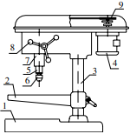
Bench-type drilling machine.
The representation of bench-type drilling press is schematically illustrated in Figure. The spindle rotates on ball bearings within a nonrotating quill that can be moved up and down in the machine head to provide feed to the drill. The spindle is driven by means of a step cone pulley that normally incorporates a belt-drive spindle head. Hand feeding the tool into the workpiece allows the operator to “feel” the cutting action of the tool.
Fig.1: Schematic illustration of Bench-type drilling machine. (Boljanovic, 2009, p 343)) V. (2009)
1. Base, 2. Table, 3. Column (round), 4. Motor, 5. Spindle, 6. Chuck, 7. Quill, 8. Feed control, and 9. Step cone pulley

Slide 12
Drilling machines of this kind can usually create holes up to 13 mm (1/2 inch) in diameter. The same type of this machine can be obtained equipped with a long standing column so that it can stand on the floor instead of on a bench.

Slide 13
Upright drilling machine.
The upright drill press (Fig. 2) is a heavy duty type of drilling machine normally incorporating a geared drive spindle head. This type of drilling machine is used on large hole-producing operations that typically involve larger or heavier parts. The upright drill press allows the operator to hand feed or power feed the tool into the workpiece. The power feed mechanism automatically advances the tool into the workpiece. Upright drilling presses usually have spindle speed ranges from 60 to 3500 rev/min.

Slide 14
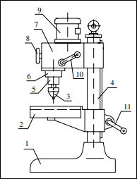
Base,
Table,
Chuck,
Column (round),
Spindle,
Quill,
Power head,
Speed control,
Motor,
Feed control, and
Crank to adjust table
Fig. 2 Schematic illustration of upright drilling machine
(Boljanovic, 2009, p 344)

Slide 15
The work tables on most upright drilling machines include holes and slots for use in clamping firmly the workpiece and have a channel around the edges to collect cutting fluid/coolant when it is used. Some types of upright drill presses are also manufactured with automatic table-raising mechanisms.

Slide 16
Radial drilling machine
The radial drilling press was designed to drill holes at different locations on a large workpiece that cannot readily be moved and clamped on an upright drilling machine. The radial is the most multipurpose drilling machine. One of the reasons this machine is so versatile is the ability it provides an operator to move its drill head to the work using the radial arm. The physical size of the machine also adds to its versatility. The size of the radial arm drill press (machine) is determined by the size of the column and the distance from the center of the spindle to the edge of the column.

Slide 17
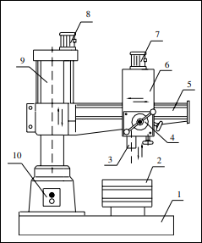
Base
Table
Spindle
Feed control
Radial arm
Drill head
Motor
Motor
Column (round) and
ON/OFF buttons
Fig. 3 Schematic illustration of radial drilling press.
(Boljanovic, 2009, p 344)

Slide 18
As shown in Fig. 3, this has a heavy round vertical column supported on a large base. The column supports a radial arm that can be raised and lowered by power and rotated over the base. The spindle head, with its speed and feed changing mechanism is mounted on the radial arm and can be moved horizontally to any desired position on the arm. On a semi-universal radial drill press the spindle head can be swing about a horizontal axis normal to the arm to point the drilling of holes at an angle in a vertical plane. On a universal drill press, an additional angular adjustment is provided by rotating the radial arm about a horizontal axis. This permits holes to be drilled at any desired angle.

Slide 19
Gang drilling machine
In mass production, gang drilling presses (Fig. 4) are used when successive operations are to be done. For instance, the first head may be used for centering; the second head may be used for drilling; the third head may be used for reaming; the fourth head may be used for chamfers. Operations can be accomplished simply by sliding the workpiece along the work table from one spindle to the next. However, with advances in machine tools, gang drilling machines now are being replaced with numerically controlled turret drilling machines.

Slide 20
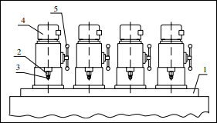
Table
Spindle
Chuck
Motor and
Feed control
Fig. 4 Schematic illustration of gang drilling press
(Boljanovic, 2009, p 345)

Slide 21
Multiple spindle drilling machine
The multiple spindle-drilling machine (Fig. 5) contains two or more spindles located on one main work head; the spindles can perform multiple cutting operations at the same time. All spindles are driven by a single powered motor and fed simultaneously into the workpiece. This type of drilling machine is especially useful when a number of holes located close together must be drilled in the workpiece.

Slide 22
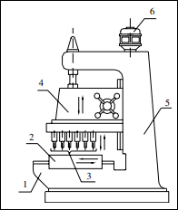
Base
Table
Spindles
Multiple spindle drill head
Column and
Motor
Fig. 5 Schematic illustration of multiple spindle drilling press.
(Boljanovic, 2009, p 345)

Slide 23
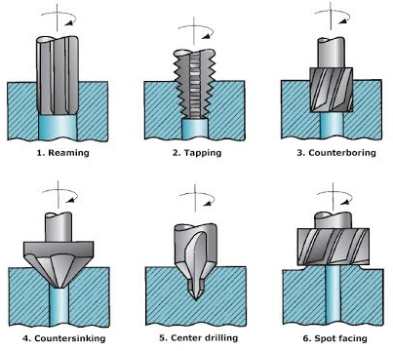
III. Drilling machine operations
Drilling machine can be used to perform many different operations such as:
Reaming
Tapping
Counterboring
Countersinking
Center drilling
Spot facing
Fig. 6 Drilling operations
https://id.images.search.yahoo.com/yhs/search?p=Drilling+machine+operations&fr=yhs-arh-001&type=zxy_a864b661f5f4a3135f&hspart

Slide 24
1. Reaming
Reaming is a process of smoothing the surface of drilled holes using a cutting tool called as reamer.
Initially a hole is drilled slightly smaller in size.
Drill bit is replaced by a reamer.
Cutting speed must be reduced to half that of the drilling.

Slide 25
2. Boring
It is process carried on a drilling machine to increase the size of an already drilled hole.
Initially a hole is drilled to the nearest size and using a boring tool the size of the hole is increased

Slide 26
3. Counter boring
This process involves increasing the size of a hole at only one end.
Cutting tool will have a small cylindrical portion called pilot.
Cutting speed = two thirds (2/3) of the drilling speed for the same hole.

Slide 27
4. Counter sinking
This is an operation of making the end of a hole into a conical shape
Cutting speed = half of the cutting speed of drilling for same hole.

Slide 28
5. Spot facing
It is a finishing operation to produce flat round surface usually around a drilled hole, for proper seating of bolt head or nut.
It is done using a special spot facing cutting tool

Slide 29
6. Tapping
Process of cutting internal threads with a thread tool called as tap.
Tap is a fluted threaded tool used for cutting internal thread
Cutting speed should be very slow.

Slide 30
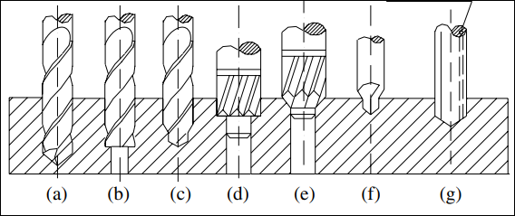
IV. The types of drill bits
There are many types of drill bits such as:
The standard point twist drill,
The core drill,
The step drill,
Counterboring and countersinking drill,
The center drill, and the gun drill (Fig. 6).
Fig.7 a) standard-point twist drill; b) core drill; c) step drill; d) counterboring drill; e) countersinking drill; f) center drill; g) gun drill.
The standard point twist drill or simply Twist drill is mostly used in drilling activities that is why it was discussed in details in the following slides

Slide 31
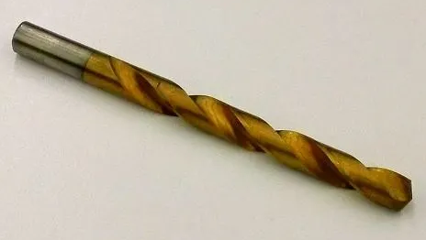
IV.1. Twist Drill
The common type of drill used nowadays is the twist drill. This type of drill was basically formed by twisting a flat piece of tool steel longitudinally for a number of revolutions, then grinding the diameter and point. Presently, twist drills are produced by two machining spiral flutes or grooves that run lengthwise around the body of the drill.
Fig. 8 Twist Drill
https://www.theengineerspost.com/wp-content/uploads/2020/07/Twist-drill.jpg?ezimgfmt=ng:webp/ngcb19

Slide 32
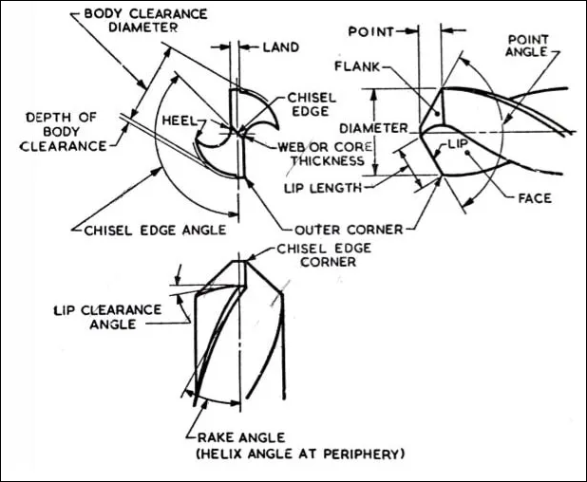
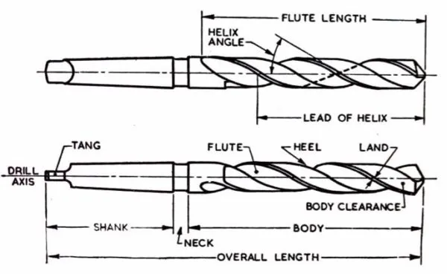
IV.2. Parts of a Twist Drill
Fig. 9 Drill Twist Nomenclature

Slide 33
IV.3. Description of twist drill elements
1. Axis
The longitudinal centre line of the drill.
2. Body
That portion of the drill increasing from its extreme point to the origin of the neck, if present, otherwise increasing to the origin of the shank.
3. Body Clearance
That portion of the body surface which is reduced in diameter to provide diameter clearance.
4. Chisel Edge
The edge formed by the intersection of the flanks. The chisel edge is also sometimes called the dead centre. The dead centre or the chisel edge cats as a flat drill and cuts its own hole in the workpiece.

Slide 34
Description of twist drill elements Cont’d
5. Chisel Edge Corner
The corner produced by the intersection of a lip and the chisel edge.
6. Face
The portion of the flute surface adjacent to the lip one which the chip impinges as it is cut from the work.
7. Flank
The surface at a drill point that extends behind the lip to the following flute.
8. Flutes
The groove in the body of the drill that gives lip. The uses of the flutes are:
To From the cutting edges on the point.
To allow the chips to escape.
For to cause the chips to curl.
To allow the cutting fluid to enter the cutting edges.

Slide 35
Description of twist drill elements Cont’d
9. Heel
The edge produced by the intersection of the flute surface and the body clearance.
10. Lands
The cylindrical ground surface at major edges of drill flute. The land width is measured at the right angle of the flute helix. The drill is full size only across the lands at the pointed end. Land keeps the drill aligned.
11. Lip (cutting edge)
The edge formed by the intersections of the flank and face. The requirements of the drill lips are:
Both lips should be at the same angle of inclination with the drill axis, 59° for general work.
The lips should be of equal length.
Both lips must be given with the correct clearance.
12. Neck
The diameter between the body and the legs of the drill is partially reduced. The diameter and other details of the drill are engraved on the neck.
13. Outer Corner
The corner formed by the intersection of the flank and face.

Slide 36
Description of twist drill elements Cont’d
14. Point
The sharpened end of the drill, consisting of all that part of the drill which is shaped to produce lips, faces, flanks, and a chisel edge.
15. Right Hand Cutting Drill
A drill that cuts when rotating in a counter-clockwise direction viewed on the pointed end of the drill.
16. Shank
That part of the drill by which it is held and driven. The most common types of shank are the taper and straight shank. The taper shank provides means of centering and holding the drill by friction in the tapered end of the spindle.
17. Tang
The flattened end of the taper shank designed to fit inside a drift slot in the spindle, socket, or drill holder. The tang ensures a positive drive of the drill from the drill spindle.
18. Web
The central portion of the drill situated between the roots of the flutes and extending from the point toward the shank; the pointed end to the web or core forms the chisel edge.

Slide 37
References
Boljanovic, V. (2009) Metal Shaping Processes: Casting and Molding; Particulate Processing; Deformation Processes; and Metal Removal (p333-342). Industrial Press, Inc. New York.
Trent, E., & Wright, P. (2000). Metal Cutting (4th ed) (p.13) Butterworth–Heinemann.
Timings, R. (2008) Fabrication and welding Engineering. Elsevier Ltd. (p226-238)
https://id.images.search.yahoo.com/yhs/search?p=Drilling+machine+operations&fr=yhs-arh-001&type=zxy_a864b661f5f4a3135f&hspart
https://www.theengineerspost.com/twist-drill-nomenclature/
https://www.theengineerspost.com/wp-content/uploads/2020/07/Twist-drill.jpg?ezimgfmt=ng:webp/ngcb19
https://www.theengineerspost.com/wp-content/uploads/2020/07/Twist-drill-nomenclature-min.jpg?ezimgfmt=ng:webp/ngcb19

