Slide 1
COURSE NAME: MACHINE TOOLS
LECTURE III : CONSTRUCTION AND WORKING PRINCIPLE OF LATHE MACHINE
Lecturer: HABANABAKIZE THEOPHILE

Slide 2
OUTLINE
Introduction to Lathe machine
Definition of turning operation
Different types of lathe machine
Lathe machine operations
The types of cutting tools used in turning operation

Slide 3
III.1: Introduction to lathe machine
Lathes are generally considered to be the first machine tools still used in industry. About one-third of the machine tools operating in engineering plants are lathe machines. Lathes are employed for turning external cylindrical, tapered, and contour surfaces, boring cylindrical and tapered holes, machining face surfaces, cutting external and internal threads, knurling, centering, drilling, counterboring, countersinking, spot facing and reaming of holes, cutting off, and other operations. Lathes are used in both job and mass production.

Slide 4
Definition of turning operation Cont’d
Many different types of lathe machines of varying complexity are available to suit specific applications. The basic requirements for any of these lathes are:
1. Means for holding and rotating the workpieces and
2. Means for holding and moving the cutting tools.

Slide 5
III.1.1 Holding and Rotating the Workpiece
Workpieces are held in a lathe between centers (live center and dead center)or by a chuck, collet, fixture, or faceplate. Rotation of the workpiece is accomplished by a spindle mounted in the lathe headstock. The spindle is sometimes driven directly by an electric motor, but the drive is usually through belts and) or a gear train. Chucks or faceplates connected to the headstock spindle are used to hold short, large-diameter workplaces. Collets are used for short, small diameter workpieces or workplaces machined on the end of a bar or tube that is fed through the spindle and parted from the stock when completed.

Slide 6
Holding and Rotating the Workpiece Cont’d
Between-center holding is used for long workplaces and requires that center holes be previously drilled in each end of the workpiece. For between-center turning, a center is provided on the spindle and a tailstock is mounted on the outboard end of the bedways. The tailstock is adjustable along the ways for various workpiece lengths and is equipped with a center. The center can be replaced by a drill or reamer when required for chucking operations. Steady rests or follow rests are sometimes placed against the workpiece at positions between the centers to minimize deflection during machining.

Slide 7
III.1.2 Holding and moving the cutting tools
The carriage of a basic engine lathe consists of a carriage, cross slide, compound rest, and apron. The carriage slides longitudinally along ways on the lathe bed, thus guiding the carriage parallel to the lathe and workpiece axis. Movement of the cross slide, actuated by a feedscrew, is across the bedways (perpendicular to the lathe axis) and over slide ways on top of the carriage.

Slide 8
Holding and moving the cutting tools Cont’d
Clamped to the top of the cross slide is a compound rest that can be rotated 360⁰ and secured at any angle with respect to the lathe axis. The compound rest has a T-slot used to clamp a toolpost or toolblock. A slide on the compound rest can be moved along the base by a feedscrew to provide movement of the cutting tool at any desired angle with respect to the workpiece axis. An apron fastened to the underside of the carriage comprises the gears and clutches for longitudinal and cross feeds. It also has a split nut to engage a Ieadscrew mounted on the lathe bed to drive the carriage when cutting threads.

Slide 9
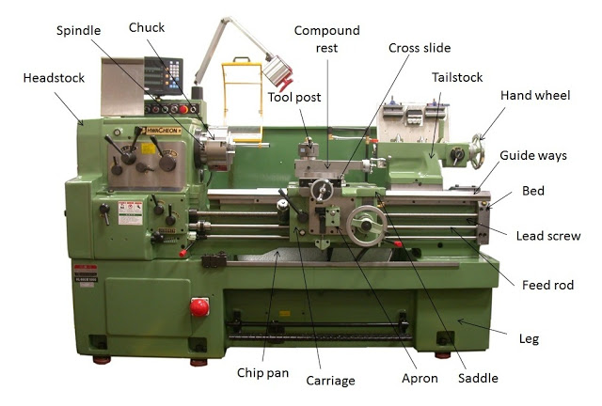
III.1.3 The construction of Lathe machine
https://tse1.mm.bing.net/th?id=OIP.5tcHmIG2KtUs0Absv3C7JAHaFi&pid=Api&P=0&w=230&h=172
Fig.3.1 Lathe machine Parts

Slide 10
III.1.4 The function of the main parts of lathe machine
A simple lathe comprises of a bed made of grey cast iron on which headstock, tailstock, carriage and other components of lathe are mounted. Figure below shows the different parts of engine lathe or central lathe. The major parts of lathe machine are given as under:
1. Bed 3. Tailstock 5. Feed mechanism
2. Headstock 4. Carriage 6. Thread cutting mechanism

Slide 11
The function of the main parts of lathe machine Cont’d
1. Headstock
It is present at the left hand side of the lathe. It holds the gear train, main spindle, chuck, gear speed control levers and feed controllers. It is aligned with the tailstock. The head stock is made up of cast iron.
(i) Chuck
It is that part of lathe machine which is used to hold the work piece. It is attached to the main spindle of the headstock. It rotates with the spindle and also rotates the work piece. In the lathe machine we generally use three jaw or four jaw check. The three jaw of the three jaw chuck is made to move simultaneously but the jaws of the four jaw chuck moves independently.
(ii) Main Spindle
This part of the lathe machine is used to hold cylindrical work piece within it. It is a hollow shaft on which the chuck is mounted.
(iii) Feed Selector
It is used to select the direction of the feed i.e. whether we want to move the tool from left to right or right to left. Feed selector is present on the headstock.

Slide 12
The function of the main parts of lathe machine Cont’d
2. Tailstock
It is present at right hand side of the lathe. It is used to provide supports to the work piece. It supports the work piece from one end i.e. right end.
3. Bed
It is the main part of the lathe. All the parts of the lathe is bolted on the bed. It comprises of headstock, tailstock, carriage guide ways and other parts. It is made of cast iron.
4. Guide ways
Guide ways are present on the bed. As its name indicates it is used to guide the tail stock and carriage. The tailstock and carriage, slides over the guide ways. It is an inverted V

Slide 13
The function of the main parts of lathe machine Cont’d
5. Carriage
The carriage is present in between the headstock and tailstock. It carries apron, saddle, compound rest, cross slide and tool post.
The carriage is used for support, guide and feed the tool against the job when the machining is done.
It holds moves and controls the cutting tool.
It gives rigid supports to the tool during operations.
It transfers power from feed rod to cutting tool through apron mechanism for longitudinal cross-feeding.
It simplifies the thread cutting operation with the help of lead screw and half nut mechanism.

Slide 14
Carriage Cont’d
(i) Tool Post: It is used to hold the tool. It has T-slot for holding the tool. Tool post is bolted on the carriage.
(ii) Compound Rest: It is used to set the tool at desired angle for taper turning and other operations.
(iii) Cross Slide: The cross slide is used to move the tool perpendicular to the axis of the lathe.
(iv) Saddle: The top portion of the carriage is called saddle. Cross slide is mounted on the saddle.
(v) Apron: The front portion of the carriage is called apron. It contains all the moving and control mechanism of the carriage.

Slide 15
The function of the main parts of lathe machine Cont’d
6. Lead Screw
Lead screw is used to move the carriage automatically during threading.
7. Feed Rod
It is used to move the carriage from left to right and vice versa.
8. Chip Pan
Chip pan is used to collect the chips that are produced during the lathe operation. It is present at the bottom of the lathe.
9. Hand Wheel
It is the wheel which is operated by hand to move cross slide, carriage, tailstock and other parts

Slide 16
III.2 Definition of turning operation
Turning is a machining process in which a workpiece is held and rotated about its longitudinal axis on a machine tool called a lathe. Cutting tools mounted on the lathe are fed into the workpiece to remove material and thus produce the required shape. The principal surfaces machined are concentric with the longitudinal axis of the workpiece. Turning operations are defined as the removal of material from external surfaces on rotating workpieces.

Slide 17
Definition of turning operation Cont’d
Turning is a machining process in which a workpiece is held and rotated about its longitudinal axis on a machine tool called a lathe. Cutting tools mounted on the lathe are fed into the workpiece to remove material and thus produce the required shape. The principal surfaces machined are concentric with the longitudinal axis of the workpiece. Turning operations are defined as the removal of material from external surfaces on rotating workplaces. Related operations on external surfaces, also performed on lathes, include facing, chamfering, grooving or necking, knurling, skiving, threading, and cutoff (parting).

Slide 18
III.2.1 Turning operation Variables
The are many factors which can influence turning operation. The three major ones are cutting speed, feed rate, and depth of cut.
Cutting speed refers to the rotational speed of the lathe spindle and workpiece and can be expressed in revolutions per minute (rpm). For turning and most other machining operations, however, the cutting speed is generally given in surface feet per minute (sfm) or meters per minute (m/min), which is the rate at which the workplace surface moves past the cutting tool. The surface speed equals the rotary speed (rpm) of the spindle times the circumference of the workpiece (in feet or meters).

Slide 19
Turning operation Variables Cont’d
Feed rate is the rate at which the tool advances along its cutting path. It is expressed in inches or millimeters per minute (ipm or mm/ min), or in inches or millimeters per revolution (ipr or mm/rev).
Depth of cut is the thickness of the layer of material removed from the workpiece surface (the distance from the uncut surface to the cut surface), expressed in inches or millimetres.
When turning cylindrical workpieces, the diameter is reduced by twice the depth of cut.

Slide 20
III.3 Different types of lathe machine
A wide variety of lathes machines is available in many sizes to suit specific application requirements. They can be controlled manually, semi-automatically, or automatically. Major classifications of different types include engine lathes, contouring lathes, turret lathes, and NC/ CNC turning machines. Each classification is further subdivided into specific kinds. Other lathe-related machines such as single-spindle automatic.

Slide 21
III.3.1 Bench lathe machine
These machines are essentially engine lathes small enough to be placed on a workbench, although modern bench lathes are usually supported by a cabinet or base. This classification includes high-speed (to 5000 rpm or more), instrument, jeweler’s, and watchmaker’s lathes. Since power feed is seldom required, most bench lathes are hand fed. Hand feed is often desirable on these small lathes, particularly for delicate, precision operations. Workpieces machined on bench lathes are small. The maximum swing on most machines generally ranges from about 4-9” (102-229 mm), with center-to-center distances to 24” (610 mm) and bed lengths seldom exceeding 6 ft (1.8 m).

Slide 22
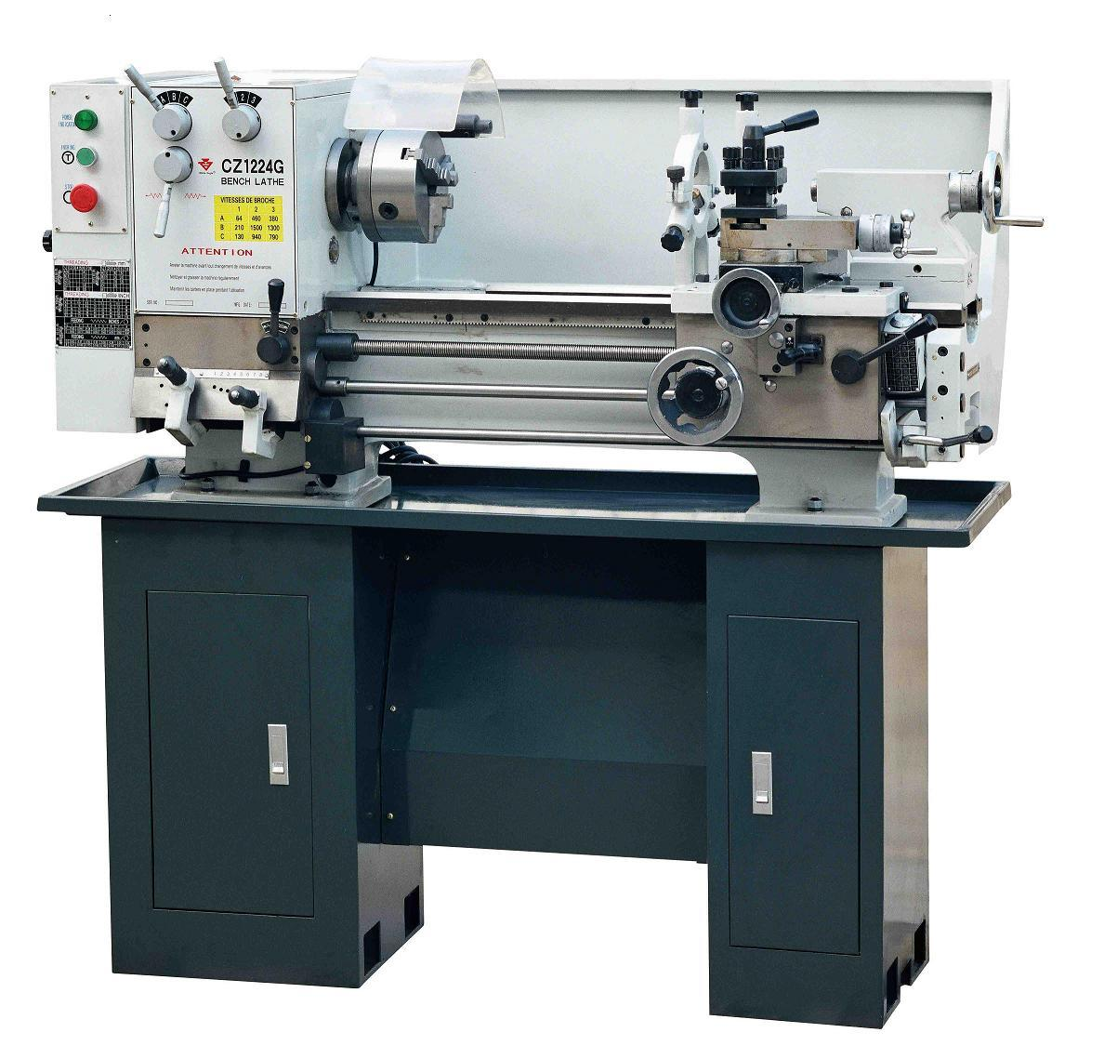
Bench lathe machine
http://image.made-in-china.com/2f0j00dewazvCKEtVU/Bench-Lathe-CZ1224G-CZ1237G-.jpg
Fig.3.2 Bench lathe machine

Slide 23
III.3.2 Engine lathe or center lathe machine
The engine lathe (Fig.3.1) is a basic, general-purpose machine tool that is used primarily to generate forms by removing material with one single-point cutting tool at a time. The tool moves parallel, perpendicular, or at an angle to the axis of rotation of the workpiece. Through the use of attachments and accessories, a number of different operations can be performed on engine lathes. These operations include single-point threading, thread chasing, tapping, taper turning, duplicating and contouring, drilling, reaming, boring, milling, and grinding.

Slide 24
Engine lathe or center lathe machine Cont’d
The versatile engine lathe is widely used for producing many different parts in small quantities, as well as for toolroom and maintenance work. Engine lathes are generally classified as either chucking or center-type machines. On chucking machines, workpieces are held in chucks or collets or on faceplates mounted on the lathe spindles. On center-type machines, workplaces are supported between centers mounted in the spindles and the tailslocks of the lathes. Every engine lathe provides a means for traversing the cutting tool both along the axis of workpiece revolution and at an angle to that axis. Beyond this similarity, lathes may embody characteristics common to several different classifications.

Slide 25
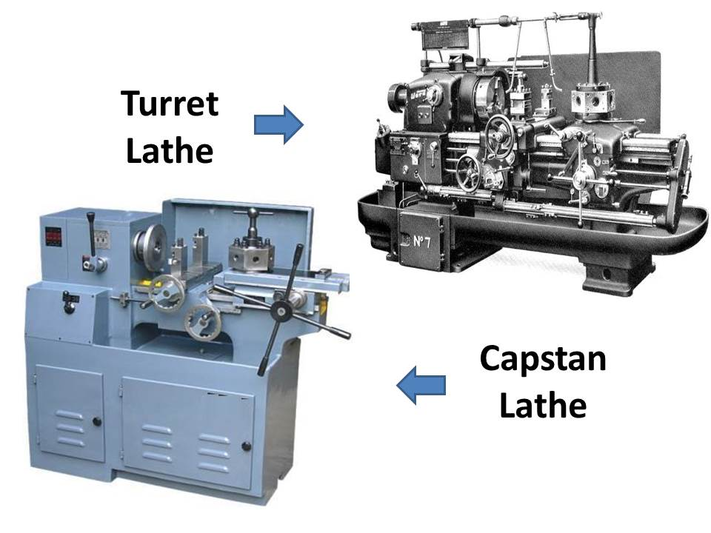
III.3.3 Turret and capstan lathe machine
https://www.mech4study.com/wp-content/uploads/2018/04/capstan-vs-turret.jpg
Fig.3.3 Turret and capstan lathe machine

Slide 26
Capstan vs Turret lathe machine
No | Capstan Lathe Machine | Turret Lathe Machine
1 | Capstan lathe is a light-duty machine and | This is a heavy-duty machine.
2 | In capstan Lathe, the tool head is mounted in ram and the ram is mounted on the saddle. | The tool head is mounted on the saddle.
3 | To provide feed in this ram movement is required. | Here to provide feed saddle movement is required.
4 | This is used for small type workpieces because here ram movement is limited | This one is used for larger workpieces because here ram movement is not limited or fixed.
5 | It is a kind of horizontal lathe. | But this one works both horizontal and vertical type work.
6 | The turret head can not move crosswise. | Here the turret head can move crosswise.
7 | In a capstan lathe easy to move the turret head as its slides over the ram. | It is difficult to move the turret head along with the saddle
8 | To hold the workpiece the collect is used. | Here to hold the workpiece jaw chuck is used.
9 | Turret’s head can move manually. | Turret’s head can not move manually.

Slide 27
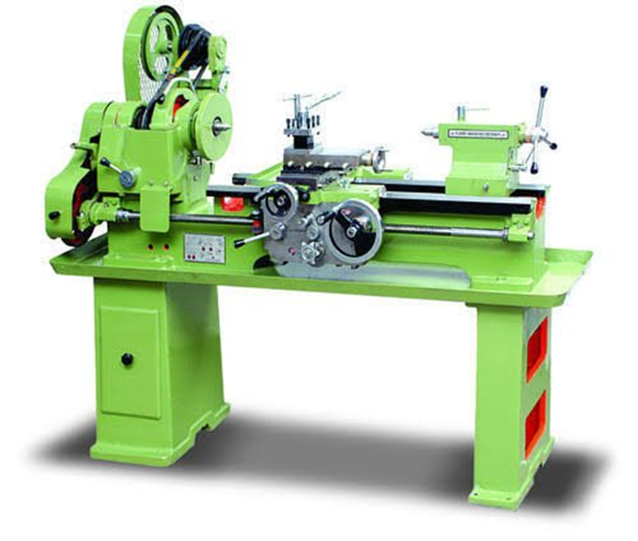
III.3.4 Tool Room lathe Machine
Tool Room lathe is a modern engine lathe that is equipped with all the necessary accessories for the accurate tool room work. It is best suited for the production of small tools, dies, gauges, etc.
It is a geared head driven machine with considerable rage in spindle speed and feeds. Its speed can range from very low to a very high speed of up to 2500 rpm.
Fig.3.4 Tool room lathe machine
https://themechanicalengineering.com/wp-content/uploads/2019/12/Tool-room-Lathe.jpg

Slide 28
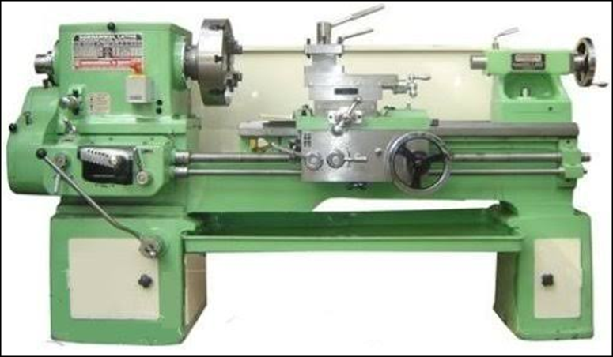
III.3.5 Speed lathe machine
This is the simplest form of the lathe and consists of a simple Headstock, tailstock, and a tool post. Having no gearbox, lead screw, and carriage. Very high speed of the headstock spindle. The speed of the spindle ranges from 1200 to 3600rpm.
Tools are hand-operated. Cone-pulley is the only source provided for speed variation of the spindle. Speed Lathes are intensively used in woodturning, metal spinning, and polishing operation.
Fig.3.5 Speed lathe machine
https://themechanicalengineering.com/wp-content/uploads/2019/12/Speed-Lathe-Machine.jpg

Slide 29
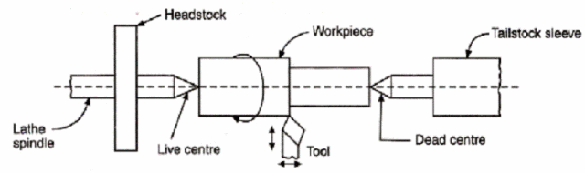
III.4 Working principle of Lathe Machine
The lathe is a machine tool which holds the workpiece between two rigid and strong supports called centres or in a chuck or face plate which revolves. The cutting tool is rigidly held and supported in a tool post which is fed against the revolving work. The normal cutting operations are performed with the cutting tool fed either parallel or at right angles to the axis of the work.
Fig.3.6 Schematic illustration of
workpiece between centres
https://image.slidesharecdn.com/principleoflathemachine-131226093423-phpapp01-170413192110/95/principle-of-lathe-machine-2-638.jpg?cb=1492111364

Slide 30
III.5 Lathe machine selection
Selecting the most appropriate lathe for a specific application can be difficult because of the wide variety of types and sizes available. Size and complexity of the workpieces to be machined; production, accuracy, and surface-finish requirements; operator skills; and economic considerations are major factors in making a selection of the appropriate lathe. With respect to workpiece size, swing over the lathe bed and bed length are important criteria.

Slide 31
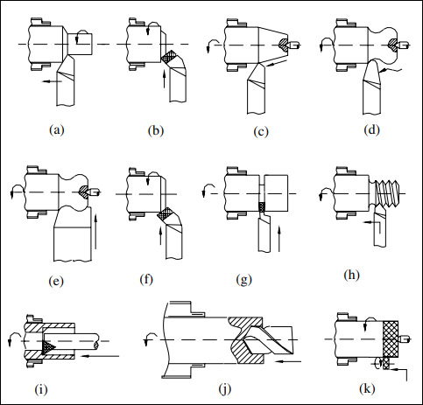
III.6 Lathe Machine Operations
As indicated in Fig. bellow, a wide variety of machining operations can be performed on a lathe.
Fig.3.7 Machining operations that can be performed on a lathe: a) straight turning; b) facing; c) taper turning; d) contour turning; e) form turning; f) chamfering; g) cutoff; h) external threading; i) boring; j) drilling; k) knurling.

Slide 32
Lathe Machine Operations Cont’d
Form turning: External cylindrical, conical, and irregular surfaces of limited length can be turned by using a tool having a specific shape, end-fed inward against the workpiece. The shape of the resulting surface is determined by the shape and size of the cutting tool. Such machining is called form turning.
Chamfering: Machining an angled edge around the end of a cylindrical workpiece is called chamfering or bevelling.
Cutoff: If the feeding of the tool continues through to the axis of the workpiece, it will be cut in two; this is called cutoff or parting, and a simple, thin tool is used. A similar tool is used for necking or partial cutoff.

Slide 33
Lathe Machine Operations Cont’d
Threading: If the cutting tool (whose shape depends on the type of thread to be cut) is fed linearly across the cylindrical outside or inside surface of the rotating workpiece in a direction parallel to the axis of rotation at an effective feed rate, threads in the cylinder are created.
Boring: Boring is a variation of turning. Essentially it is internal turning, in that a single-point cutting tool produces internal cylindrical or conical surfaces.
Drilling: The alignment between the headstock and tailstock of the lathe enables holes to be drilled into the rotating workpiece along its axis that are precisely centered.

Slide 34
Lathe Machine Operations Cont’d
Reaming: This can be performed in a similar way to drilling.
Knurling: Technically, this is not a machining operation because it does not remove material. Instead, it is a metal forming operation used to produce a regularly shaped roughness on cylindrical surfaces.
These abovementioned turning (lathe machine) operations will be discussed in details in the next lectures.

Slide 35
III.7 The types of cutting tools used in turning operations
Turning operations cutting tools can be classified based on different parameters. For now just few parameters were considered, here cutting tools are classified according to the number of their cutting edges, material of fabrication, types of operation and the cutting tool movement.

Slide 36
III.7.1 Types of cutting tools based on the number of cutting edges
Based on the number of cutting edges cutting tools can be classified as:
Single-Point Cutting Tool
Double-Point Cutting Tool
Multi-point Cutting Tool
Single-Point Cutting Tool
In a single-point cutting tool, there is only one cutting edge by which the material will remove, the examples of single-point cutting tools are turning the tool, shaping tools.

Slide 37
2. Double-Point Cutting Tool
In this type of cutting tool, there are two edges to cut the material, for example, a twist drill.
3. Multi-point Cutting Tool
In a multi-point cutting tool, there are no. of cutting edges by which the material will be removed, here are the examples of multi-point cutting tool, drilling tool called milling cutter, in broaching machine, etc

Slide 38
III.7.2 The types of cutting tool based on material of fabrication
Based on the materials used to fabricate a cutting tool, the cutting tool is divided into the following groups:
High Carbon Steel
High-Speed Steel
Cast non-ferrous steel cobalt
Ceramic
Cemented Carbide
Diamond
Abrasives

Slide 39
III.7.3 Types of cutting tools based on the types of operation
Different types of turning operations need different types of cutting tools. Most of cutting tools used in turning operations are the following:
Turning Tool (Used for turning in lathe machine)
Drilling Tool (Used for drilling operation performed in drilling machine or lathe machine)
Parting Off Tool (Used to cut the job after the operation is finished in Lathe machine)
Milling Tool (Used to cut the slots and gears)
Thread Cutting Tool (Used to cutting thread in a lathe machine

Slide 40
III.7.4 Types of cutting tools based on cutting tool movement
The cutting tool can be categorized in term of tool movement, and that is: Right-hand tool and Left-hand tool
1. Right-Hand Tool:
In the right-hand cutting tool, the tool movement is from the right side to the left side.
2. Left-Hand Tool:
In the left-hand cutting tool, the tool movement is from the right side to the left side.
Both the cutting tools we can use in the lathe machine according to the types of operation we need

Slide 41
III.7.5 Characteristic of Cutting Tool Materials
A cutting tool must be made from a material which has specific characteristics in other to perfectly perform its functions. Some of those characteristics are:
Cutting tools should have high strength, hardness even at higher or lower temperatures.
It should not change any of the material properties (ductility, hardness, strength) in the long rung.
It should have high toughness and should have the ability to withstand shock and vibration.
The tool should be cheap in price.
Easily manufactured.
It should have a low coefficient of friction

Slide 42
References
Miller. R & Richard.M.M (2004). Machine Shop Tools and operations(5th Edition) (p107-145). Wiley Publishing, Inc. Canada.
Boljanovic, V. (2009) Metal Shaping Processes: Casting and Molding; Particulate Processing; Deformation Processes; and Metal Removal (p319-332). Industrial Press, Inc. New York
Ronald. A. W (2001)Handbook Of Machining And Metalworking Calculations (p143-148). McGraw-Hill Companies,Inc.
Thomas. J. D (1998)Tool and Manufacturing Engineers Handbook Knowledge Base (Vol.1) (4th Ed)• Society of Manufacturing Engineers. Dearborn, Michigan.
https://www.sciencedirect.com/topics/materials-science/cutting-tool
https://www.sme.org/technologies/manufacturing-topics/cutting-tool-geometries/
https://image.slidesharecdn.com/principleoflathemachine-131226093423-phpapp01-170413192110/95/principle-of-lathe-machine-2-638.jpg?cb=1492111364
https://www.mech4study.com/wp-content/uploads/2018/04/capstan-vs-turret.jpg

