Slide 1
COURSE NAME: MACHINE TOOLS
Lecture 4: PERFORM FACING, TURNING, DRILLING AND BORING OPERATIONS ON LATHE MACHINE
Lecturer: HABANABAKIZE THEOPHILE

Slide 2
OUTLINE
Definitions
Facing operation
Turning operations
Drilling operation on lathe machine
Boring operation on lathe machine

Slide 3
IV.1 Definitions
Facing, turning, drilling and boring are some of the machining operations which can be performed using lathe machine. Depending on the type of machining operation to be performed it may require specific cutting tool but sometimes one cutting tool can perform more than one machining operation. For now the lecture will be about the abovementioned machining operations only.

Slide 4
IV.1.1 Facing
Facing, also carried out on a lathe, generates a flat surface, normal to the axis of rotation, by feeding the tool from the surface towards the center or outward from the center. In facing, the depth of cut is measured in a direction parallel to the axis and the feed in a radial direction. A characteristic of this operation is that the cutting speed varies continuously, approaching zero towards the center of the bar.

Slide 5
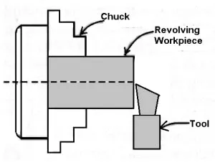
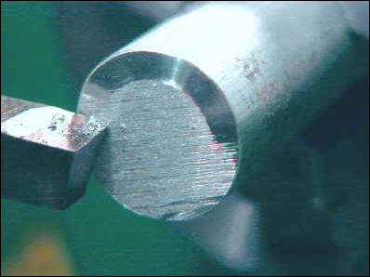
Facing Cont’d
Fig.4.1 Schematic illustration of facing operation
Fig.4.2 Facing operation
https://www.theengineerspost.com/wp-content/uploads/2019/03/turning-1-e1524716526807-300x280.jpg?ezimgfmt=rs:300x280/rscb19/ng:webp/ngcb19
http://www.mini-lathe.com/Mini_lathe/Operation/Facing/Roughing_y.jpg

Slide 6
Facing Cont’d
When facing on the lathe, the machinist uses a facing tool to cut a flat surface perpendicular to the workpiece’s rotational axis. The facing tool is then fed perpendicularly across the axis. Facing will take the workpiece down to its finished length very accurately: depending on how much material needs to be removed, a machinist can choose to take roughing or finishing cuts. Depending on how much material needs to be taken off, a machinist can choose to take roughing or finishing cuts.

Slide 7
Factors that affect lathe facing operation
There are many factors that can affect the quality and efficiency of the lathe end facing processes, such as the cutting tool speed and feed, size and material, the type of material to be processed, and the method of workpiece clamping. We can choose to rough machining or to precision finish according to the material to be removed.

Slide 8
IV.1.2 Turning
Turning is the removal of material from the outside diameter of a cylindrical workpiece/job to get one or different finished diameter. Generally, there are three kinds of turning which are:
Plain or straight or parallel turning.
Step/stepped turning
Taper turning.

Slide 9
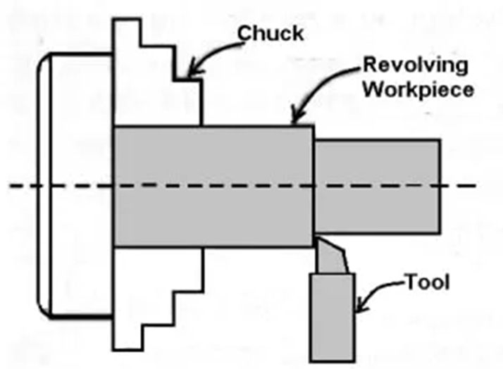
a. Plain turning
Plain turning machining is performed in the way that after removal of material, finished diameter at both the ends all-over the length remains equal.
In plain turning, the workpiece is turned straight throughout the entire length when it is made to rotate about the lathe axis, and the cutting tool is fed along the lathe axis. The plain/parallel or straight turning produces a cylindrical surface after machining.
Fig.4.3 Schematic illustration of Pain Turning
https://www.theengineerspost.com/lathe-machine-operations/

Slide 10
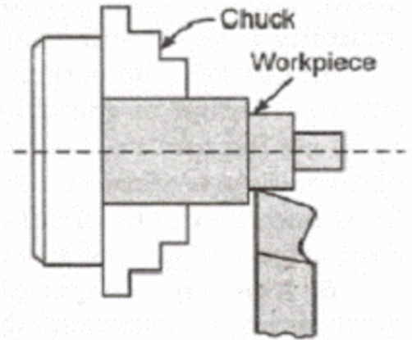
b. Step or Stepped turning
In case of turning operation where the entire length is divided in stages (steps) of different diameters but each step individually finished by using plain turning is known as step turning. For stepped turning, the workpiece is turned in such a way that throughout the turning length it forms the steps of different diameters.
Fig.4.4 Schematic illustration of Step turning
http://engineering.myindialist.com/wp-content/uploads/2009/10/clip_image002_thumb2.gif

Slide 11
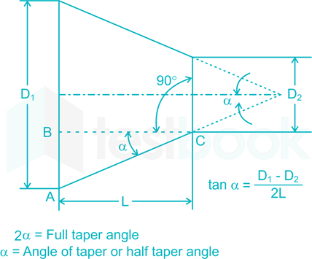
c. Taper turning
A taper turning is the gradual reduction in diameter from one portion of a cylindrical workpiece into another portion as a machining process is done in a lathe machine. Tapers can be external or internal. If a workpiece is confined to the outside, it has an external taper; if it is confined to the inside, it has an internal taper.
Fig.4.5 schematic illustration of taper turning
https://testbook.com/question-answer/for-taper-turning-on-center-lathes-the-method-of--5d602566fdb8bb0d2e20a82a

Slide 12
Taper turning Cont’d
In conventional straight turning, the cutting tool travels along a line parallel to the axis of the workpiece, resulting in a completed product that has the same diameter throughout. When cutting a taper, on the other hand, the tool travels at an angle to the axis of the work, resulting in the production of a taper.

Slide 13
Taper turning Cont’d
For turning a taper, the technique employed is determined by factors such as the degree of the taper, the length of the taper, its placement (internal or external tapers on a turret lathe or lathe machine), and the number of pieces to be turned.
Briefly, a consistent rise or decrease in the diameter of a cylindrical workpiece measured over its length is referred to as a taper whereas taper turning on a lathe is the process of progressively expanding (internal) or lowering (external) the diameter of a cylindrical workpiece to achieve a conical surface.

Slide 14
Taper Turning Methods
There are many methods of performing taper turning, from which the four different types of taper turning methods in lathe machines are discussed:
Form tool method
Tailstock set over method
Compound rest method
Taper turning attachment method
When using any of these techniques, it is critical that the cutting tool be precisely centered with respect to the axis of the workpiece; otherwise, the workpiece will not be properly conical, and the rate of taper will fluctuate with each cut.

Slide 15
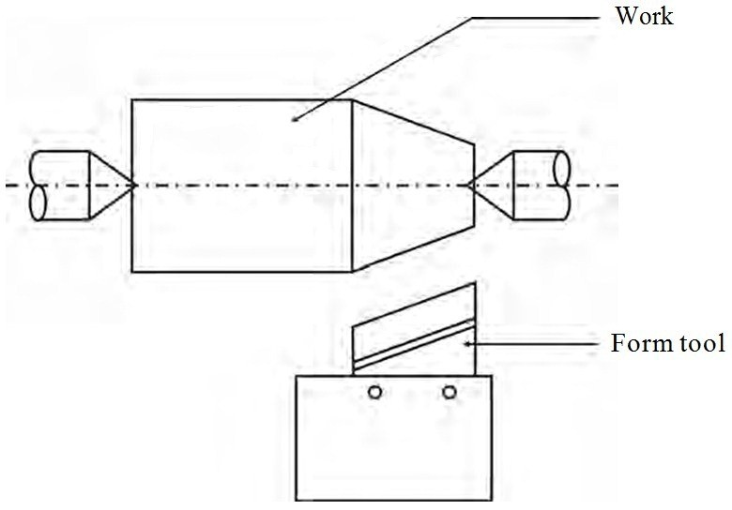
1. Taper Turning Operation by Form tool method
Form turning is one of the easiest taper turning process on a lathe machine to make a short taper. This method is shown in fig.4.6. At the required angle, the form is grounded. The tool is fed perpendicular to the lathe axis when the workpiece rotates.
Fig.4.6 Schematic illustration of Taper Turning Operation by Form tool method
https://blogmech.com/taper-turning-methods-in-lathe-machine-types-of-taper-turning/

Slide 16
Form tool method Cont’d
Condition to perform taper turning operation using form tool method, requires the tool’s cutting edge length must be greater than the taper length. Since the entire cutting edge removes the metal, it will produce a lot of vibration and hence a large force is required. It is done at a slow speed.

Slide 17
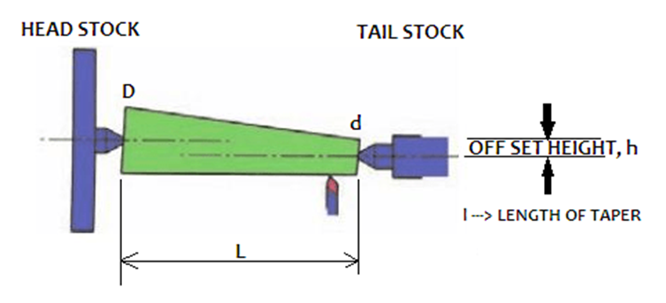
2. Taper Turning Operation by Tailstock set over method
When it comes to the offsetting of the tailstock in the lathe machine, one thing to consider is the length of the taper. When it comes to the taper, length is important. If the length of the taper varies, the offset will vary as well.

Slide 18
Tailstock set over method Cont’d
Hence, by applying this of tailstock set over method, the job is inclined at the required angle as it is shown in the figure above. When the workpiece rotates, the tool is moved parallel to the lathe axis so that the taper will be generated on the workpiece.

Slide 19
Tailstock set over method Cont’d
Advantages of tailstock set over method
It is possible to offer a power feed.
It is possible to get a nice surface finish.
The taper can be made to the maximum length possible.
Threads on the taper section of the taper can be made externally.
It is possible to make duplicate tapers.

Slide 20
Tailstock set over method Cont’d
Disadvantages of the tailstock set over method
Only the external taper may be turned.
It’s tricky to get the offset just right.
When work is held exclusively between the centers, taper turning is achievable.
The alignment of the lathe centers will be altered (steep tapers cannot be turned), resulting in damage to the work’s center drilled holes.

Slide 21
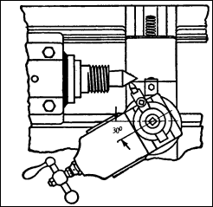
3. Compound rest method
Taper turning process by swivelling the compound slide will is the second most straightforward method of creating a taper after that. It can only be used on short tapers. On the compound slide, the angle that has been chosen is half that needed for the taper to be included. It is necessary to use caution in order to prevent a bad ending.
Fig.4.8 Taper turning by Compound rest method (Miller. R & Richard.M.M 2004, p162).

Slide 22
Compound rest method Cont’d
Generally, a short and steep taper will be produced using these taper turning methods on a lathe machine. In this method, the workpiece will be held in the chuck and rotated about the lathe axis. The compound rest is swiveled to the required angle, and then it will be clamped in position.
Then, by using the compound rest handwheel, the tool can be fed. Both the internal and external tapers on a lathe can be turned using this method. The important feature is that the compound rest in lathe can be swiveled up to 45° on both sides. Only with the help of the hand, can the tool be moved.

Slide 23
Compound rest method Cont’d
Even though this technique may provide very accurate results, it has certain limitations owing to the absence of an automated feed and because the length of the taper is limited by how far the slide can travel. It is possible to adjust the compound rest base to the necessary angle for taper turning since it is graded in degrees.
It is essential to know the included angle of the taper that will be machined in order to perform the operation. In the case of two crossing straight lines, an included angle is produced by and between them. The angle formed between the taper and the centerline is one-half of the included angle, and it is this angle that the compound rest will be adjusted for when it is assembled.

Slide 24
Compound rest method Cont’d
Advantages of compound slide:
Internal and external taper are both possible.
It is possible to create a steep taper.
The compound slide is simple to set up.
Disadvantages of compound slide:
Only hand-feeding is possible.
The taper section of the threads cannot be manufactured.
The length of the taper is governed by the top slide’s movement.

Slide 25
4. Taper turning attachment method
A Taper Turning Attachment may be used for longer tapers if the tapers are longer in length. In these taper turning methods on lathe machining techniques, a different attachment of the lathe machine is used by using a bottom plate or bracket. A taper turning attachment is attached to the rear end of the bed. It has a guide bar, which is usually pivotal at its center. The guide bar has the ability to swing, and it can be set at any required angle. It has graduation degrees.

Slide 26
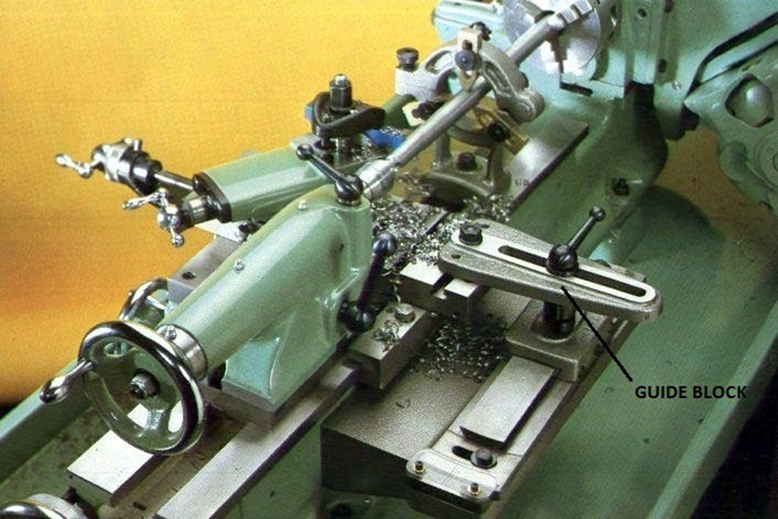
Taper turning attachment method Cont’d
On either side, the guide bar can be swiveled to a maximum angle of 10°. It has a guide block that connects to the rear end of the cross slide and it moves on the guide bar. The binder screw is removed, before connecting the cross slide, so the cross slide is free from the cross slide screw.
Fig.4.9 Taper turning attachment method
https://blogmech.com/taper-turning-methods-in-lathe-machine-types-of-taper-turning/

Slide 27
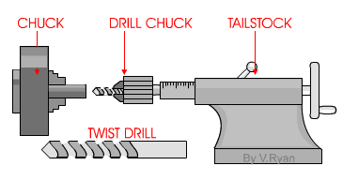
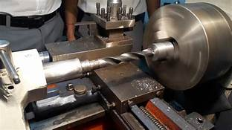
IV.1.3 Drilling
Fig. 4.10 Drilling operation operation
https://id.images.search.yahoo.com/yhs/search?p=steps+of+drilling+operation+on+lathe&fr=yhs-arh-001&type=zxy_a864b661f5f4a3135f&hspart
The tailstock of a lathe can be used for drilling, with the aid of a drill chuck attachment. The drill chuck has a morse taper shaft which can be push into the shaft of the tailstock, locking it in position.

Slide 28
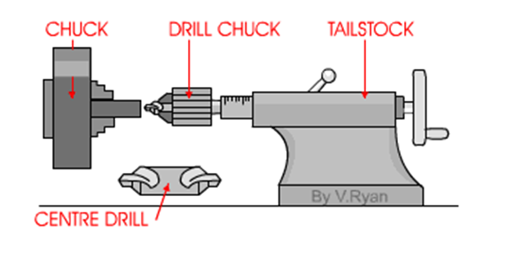
Drilling Cont’d
The usual starting point for drilling with a centre lathe is to use a countersink bit. This is used to drill slightly into the material and creates a starting point for other drills that are going to be used. Attempting to drill with a traditional drill bit without countersinking first will lead to the drill bit slipping straight away. It is not possible to drill a hole successfully or safely with out using a centre drill first.
Fig.4. 11 Center drill fixed in drill chuck
https://technologystudent.com/equip1/mlathe4.htm

Slide 29
Function of center drill
If a long piece of material has to be turned on a lathe then a centre drill is used to produce the hole at one end. This allows the drilled end to be supported by the tailstock centre.
Once a hole has been produced by a centre drill, machine twist drills can be used to enlarge the hole and if necessary to drill all the way through. If a large diameter hole is needed then a small hole is drilled first (eg. 4mm dia). Then the hole is enlarged approximately 2mm at a time. Trying to drill a large diameter hole in one go will inevitably lead to the drill bit over heating and then jamming in the material. This is potentially dangerous

Slide 30
IV.1.4 Boring
Boring, also called internal turning, is similar to a turning operation with a single-point; the only difference is that boring is used to increase the inside diameter of a hole. The original hole is made with a drill, or it may be a cored hole in a casting or forging. By definition boring operation can be defined as the process of enlarging an existing hole produced by drilling.

Slide 31
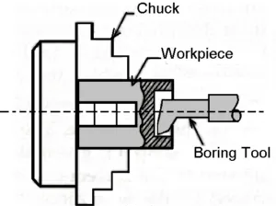
In this operation, the workpiece is revolved in a chuck or a faceplate and the tools which are fitted to the tool post is fed into the work.
Fig.4.12 Schematic illustration of boring operation on lathe
https://www.theengineerspost.com/wp-content/uploads/2018/04/Boring-operation-on-lathe-machine-e1524814032614-300x257.png?ezimgfmt=ng:webp/ngcb19

Slide 32
Boring Cont’d
Boring machining operation consists of a boring bar having a single-point cutting tool that enlarges the hole. It also corrects out of the roundness of a hole. This method adopted for boring small-sized works only. The speed of this process is slow. Boring can be performed in different ways according to the shape of hole produced. It can be boring, counterboring, taper boring.
Counterboring:
Counterboring is the operation of enlarging the end of the hole through a certain distance. It is similar to shoulder work in external turning.
The operation is similar to boring and plain boring tools or a counterbore may be used. The tool is used called a counterbore. The speed is slightly less than drilling.
Taper Boring:
The principle of turning a tapered hole is similar to the external taper turning operation and is completed by rotating the work on a chuck or a faceplate. The feeding tool is at an angle to the axis of rotation of the workpiece.

Slide 33
References
Miller. R & Richard.M.M (2004). Machine Shop Tools and operations(5th Edition) (p158-164). Wiley Publishing, Inc. Canada.
Boljanovic, V. (2009) Metal Shaping Processes: Casting and Molding; Particulate Processing; Deformation Processes; and Metal Removal (p333-334). Industrial Press, Inc. New York
Trent, E., & Wright, P. (2000). Metal Cutting (4th ed) (p.14) Butterworth–Heinemann.
https://winnmachine.com/2020/12/01/the-facing-operation-in-machining-explained/
http://www.mini-lathe.com/Mini_lathe/Operation/Facing/Roughing_y.jpg
https://blogmech.com/taper-turning-methods-in-lathe-machine-types-of-taper-turning/
https://blogmech.com/wp-content/uploads/2020/04/01-Taper-turning-attachment-for-external-taper-and-internal-taper-taper-turning-attachment-diagram.jpg
https://id.images.search.yahoo.com/yhs/search?p=steps+of+drilling+operation+on+lathe&fr=yhs-arh-001&type=zxy_a864b661f5f4a3135f&hspart

