Slide 1
COURSE NAME: MACHINE TOOLS
Lecture 5: LATHE MACHINE CUTTING TOOLS
Lecturer: HABANABAKIZE THEOPHILE

Slide 2
OUTLINE
Introduction
Types of lathe machine cutting tools
Characteristics of cutting tool material
Single point cutting tool shaping

Slide 3
V.1 Introduction
In the context of machining, a cutting tool or cutter is typically a hardened metal tool that is used to cut, shape, and remove material from a workpiece by means of machining tools as well as abrasive tools by way of shear deformation. The majority of these tools are designed exclusively for metals. There are several different types of single edge cutting tools that are made from a variety of hardened metal alloys that are ground to a specific shape in order to perform a specific part of the turning process resulting in a finished machined part.

Slide 4
Single edge cutting tools are used mainly in the turning operations performed by a lathe in which they vary in size as well as alloy composition depending on the size and the type of material being turned. These cutting tools are held stationary by what is known as a tool post which is what manipulates the tools to cut the material into the desired shape. Single edge cutting tools are also the means of cutting material performed by metal shaping machines and metal planning machines which removes material by means of one cutting edge

Slide 5
V.1.1 Cutting tool’s cutting condition
Cutting tool materials must be harder than the material which is to be cut, and the tool must be able to withstand the heat and force generated in the metal-cutting process. Also, the tool must have a specific geometry, with clearance angles designed so that the cutting edge can contact the workpiece without the rest of the tool dragging on the workpiece surface. The angle of the cutting face is also important, as is the flute width, number of flutes or teeth, and margin size. In order to have a long working life, all of the above must be optimized, plus the speeds and feeds at which the tool is run

Slide 6
V.1.2 Cutting tool Material
Cutting tool materials are materials that are used to make cutting tools which are used in machining (drill bits, tool bits, milling cutters, etc.) but not other cutting tools like knives or punches. Cutting tool materials must be harder than the material of the workpiece, even at high temperatures during the process.
The following different materials for cutting tool:
High Carbon Steel
High-Speed Steel
Cast non-ferrous steel cobalt
Ceramic
Cemented Carbide
Diamond
Abrasives

Slide 7
Cutting tool Material Cont’d
Carbon tool steels:
They lose their hardness at 200 °C
High speed steel:
They lose their hardness at 600 °C, and are widely used in machining. Due to their ability to retain hardness at higher temperature, higher cutting speed are possible.
Cutting ceramic:
They are even harder than cemented carbides but have lower toughness. Aluminium oxide and silicon nitride are used. The latter has higher toughness, but can't be used for machining Steel, due to very high wear

Slide 8
Cutting tool Material Cont’d
Cemented carbides:
Harder than tool steels, but less tough. Can be used up to 900 °C. There are many sort of cemented carbides like ones made of tungsten carbide and cobalt or cermet.
Diamond:
The hardest known material, but can only be used up to 600 °C and can't be used to machine steel.

Slide 9
V.2 Types of lathe cutting tools
Different types of cutting tools are used in different types of machine, according to the usage of the cutting tool, they can be classified into 7-types:
According to the shape of the cutting tool.
According to the types of cutting.
Depending on types of operations.
The material of the cutting tool.
With respect to the number of the cutting tool used in one tool.
According to the direction of the tool movement.
According to the motion of the tool.

Slide 10
V.2.1 According to the shape of the cutting tool:
A cutting tool can be distinguished with the help of their shapes, in this category we can divide a cutting tool into the following:
Solid
Tool Bit
Tipped Tool
Pointed Tool
Grain Size

Slide 11
According to the shape of the cutting tool Cont’d
Solid:
Generally this type of cutting tool used in turning operations like lathe turning tool.
Tool Bit:
It is a non-rotary cutting tool, this type of cutting tool is used on shaping, planning, etc.
This is a single-point cutting tool that means there will be one cutting edge.
The example of this kind of cutting tools is the Lathe turning tool fixed in the holder and Cast non-ferrous satellite cobalt, etc.

Slide 12
According to the shape of the cutting tool Cont’d
Tipped Tool:
This cutting tool is made of different types of materials.
That means the body of the cutting tool is made by other material and the cutting portion of the tool is made by some other material, to join two different materials we use different types of process like weld, clamped, etc. etc.
Pointed Tool:
As the name suggests point, that means the tip of the tool is so fine, and edges end in a single line, few examples of these types of cutting tools are diamond pointed on the holder, hard carbide pointed tool. These are one of the expensive types of cutting tools.
Grain Size:
Cutting tools depends on the number of grain and size of the grain, if suppose the grain size is big then it will remove more material and if the grain size is small it will remove less material.(a typical example is grinding wheel)

Slide 13
V.2.2 According to the types of cutting:
According to the types of cutting, we can divide a cutting tool into two types.
Orthogonal Cutting
Oblique Cutting

Slide 14
According to the shape of the cutting tool Cont’d
Orthogonal Cutting:
In this type of cutting, the cutting edge is perpendicular to the direction of the motion of the tool.
For example, two-dimensional cutting for square shoulder operation.
Oblique Cutting:
In oblique cutting the angle between the cutting edge and the direction of the tool, motion is anywhere except 90 degrees.
For example, three dimensional cutting mostly used in turning operations.

Slide 15
V.2.3 Cutting tools depends on the types of operation:
Based on the types of operations, they need different types of cutting tools. They are categorized as following:
Turning Tool (Used for turning in lathe machine)
Drilling Tool (Used for drilling operation performed in drilling machine or lathe machine)
Parting Off Tool (Used to cut the job after the operation is finished in Lathe machine)
Milling Tool (Used to cut the slots and gears)
Thread Cutting Tool (Used to cutting thread in a lathe machine)

Slide 16
V.2.4 According to the number of the cutting tool used in one tool
There are three types of cutting tools in this category,
Single-Point Cutting Tool
Double-Point Cutting Tool
Multi-point Cutting Tool

Slide 17
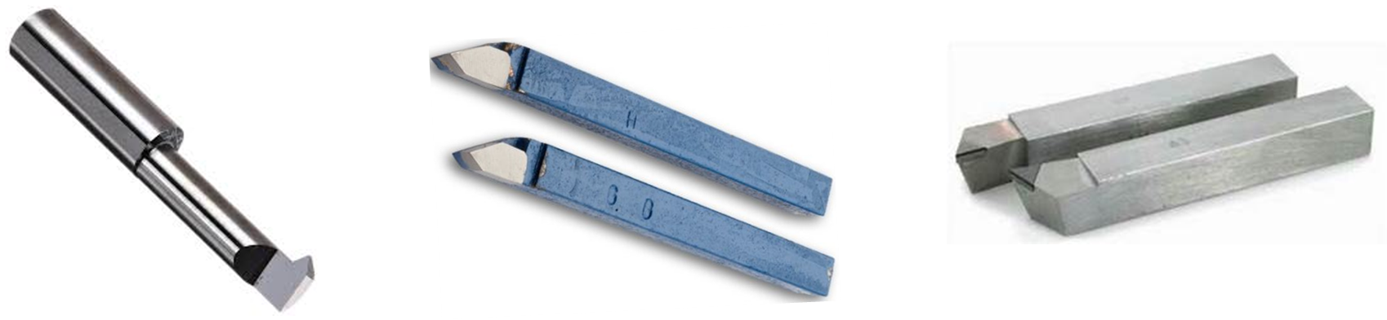
According to the number of the cutting edges Cont’d
Single -Point Cutting Tool:
In a single-point cutting tool, there is only one cutting edge by which the material will remove, the examples of single-point cutting tools are turning the tool, shaping tools.
Fig.5.1 Boring cutting tool
Fig.5.2 Threading cutting tools
Fig.5.3 Facing, turning cutting tools

Slide 18
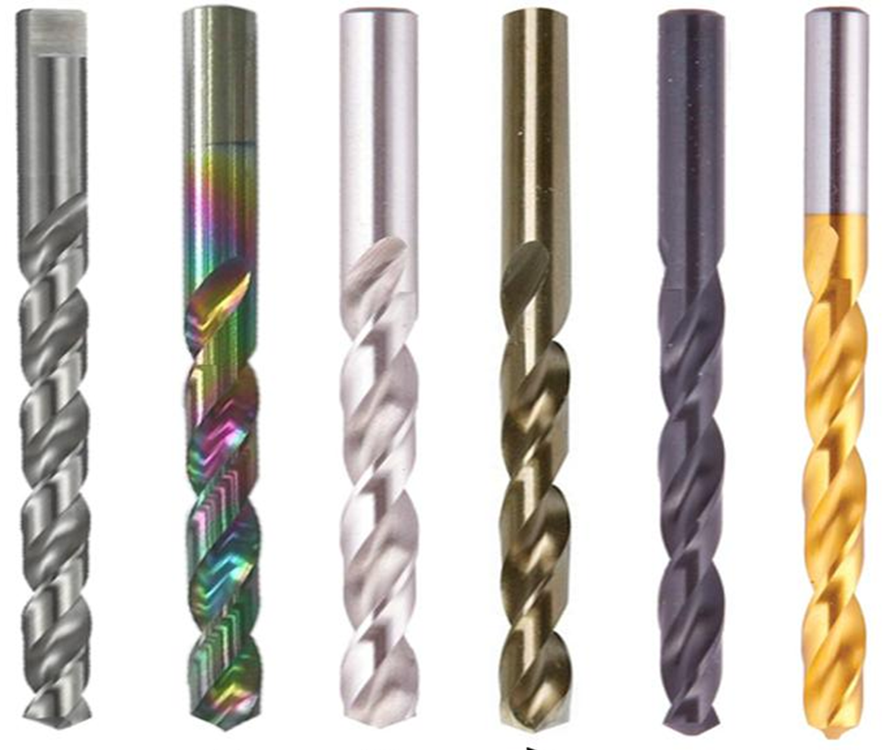
Double-Point Cutting Tool:
In this type of cutting tool, there are two edges to cut the material, for example, a twist drill.
Fig.5.4 Double point cutting tool
https://id.images.search.yahoo.com/yhs/search;_ylt=AwrtgU4jvFpiRFIzkigeHYpQ;_ylu=c2VjA3NlYXJjaARzbGsDYnV0dG9u

Slide 19
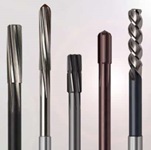
Multi-Point Cutting Tool:
In a multi-point cutting tool, there are no. of cutting edges by which the material will be removed, here are the examples of multi-point cutting tool, drilling tool called milling cutter, in broaching machine, etc.
https://guehring.com/wp-content/uploads/2018/09/Header_Produktseite_Reibwerkzeuge.jpg
Fig.5.5 Multi-point cutting tool

Slide 20
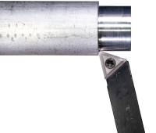
V.2.5 According to the direction of the tool movement:
The cutting tool can be categorized in term of tool movement, and that is:
Right Hand Tool
Left-hand Tool
Right-Hand Tool:
In the right-hand cutting tool, the tool movement is from the right side to the left side. This is the most common turning activity, cutting towards the lathe chuck. The cutting edge is on the left side. Tools where the second letter is "R" are right-hand tools.
Fig.5.6 Right Hand Tool
https://littlemachineshop.com/info/turning_tools.php

Slide 21
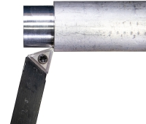
Left-Hand Tool:
In the left-hand cutting tool, the tool movement is from the left side to the right side. This tool cuts away from the lathe chuck. The cutting edge is on the right side. Tools where the second letter is "L" are left-hand tools.
Fig.5.7 Left Hand Tool
https://littlemachineshop.com/info/turning_tools.php

Slide 22
V.2.6 According to the motion of the tool:
Again cutting tool are divided into 5-category according to the motion, and those are:
Translatory Motion (Lathe cutting tools)
Intermittent Translatory Motion (Planning tools)
Reciprocating Motion (Shaping tools)
Rotary Motion (Milling tools)
Rotary and Vertical/horizontal Translatory Motion (Drilling tools)

Slide 23
V.3 Characteristic of Cutting Tool Materials:
When you have choose a cutting tool you should take care of its property, strength, and its quality.
Cutting tools should have high strength, hardness even at higher or lower temperatures.
It should not change any of the material properties (ductility, hardness, strength) in the long rung.
It should have high toughness and should have the ability to withstand shock and vibration.
The tool should be cheap in price.
Easily manufactured.
It should have a low coefficient of friction.

Slide 24
V.3.1 Different materials used in cutting tool
Cutting tools must be made from materials which allow them to perform their functions perfectly. This means that many of cutting tools are made from alloys. The following are some of elements which can be one of the constituents of the cutting tool to perform specific function:
No | Material | Function
1 | Silicon | It is used to make the tool elastic and corrosion resistance.
2 | Nickel | It is used to give strength and toughness to the tool
3 | Chromium | It is used to increase the hardness as well as to resist corrosion
4 | Tungsten | It can resist high temperatures
5 | Molybdenum | It is used to increase the sharpness of cutting edges

Slide 25
V.4 Single point cutting tool shaping
As it was explained before, Single-Point Cutting Tools are cutting tools which has only one cutting edge by which the workpiece material can be removed. According to the operation to be performed single point lathe cutting tool must have a specific form especially its cutting edge. For example the cutting tool for turning, threading, boring, …

Slide 26
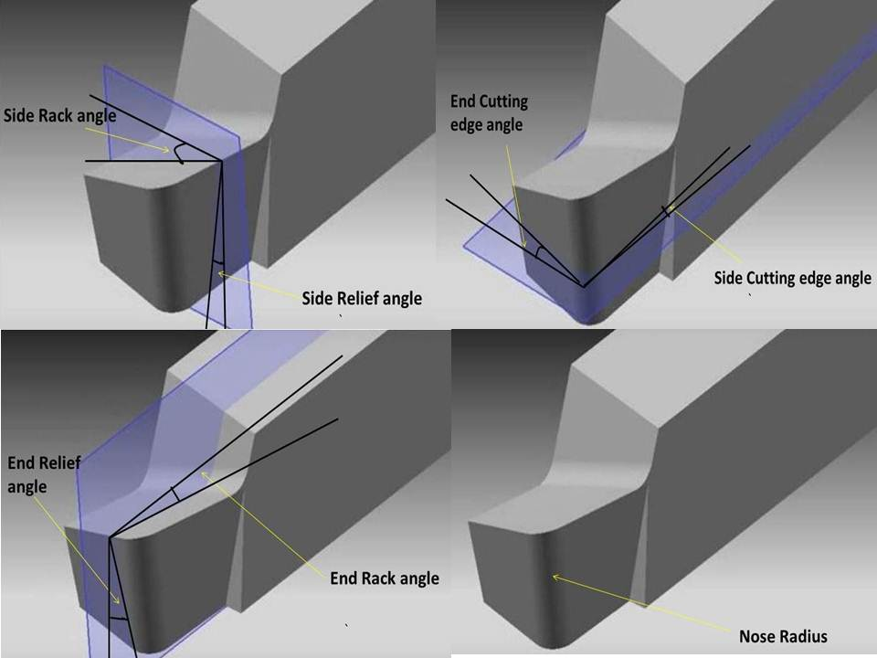
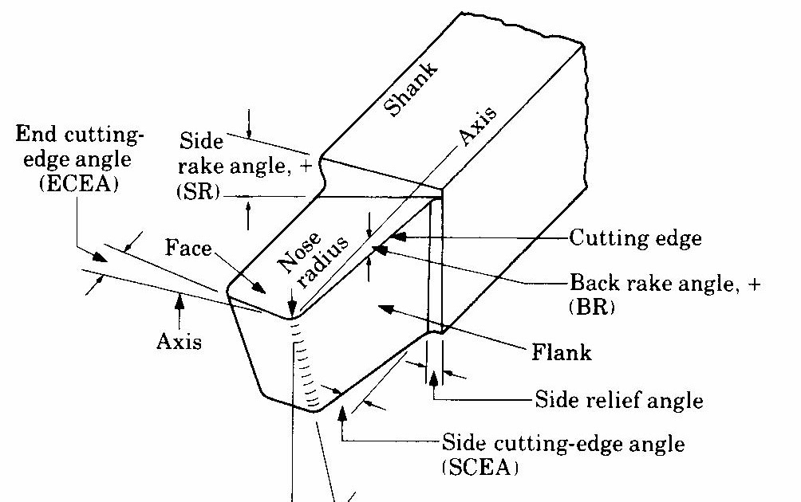
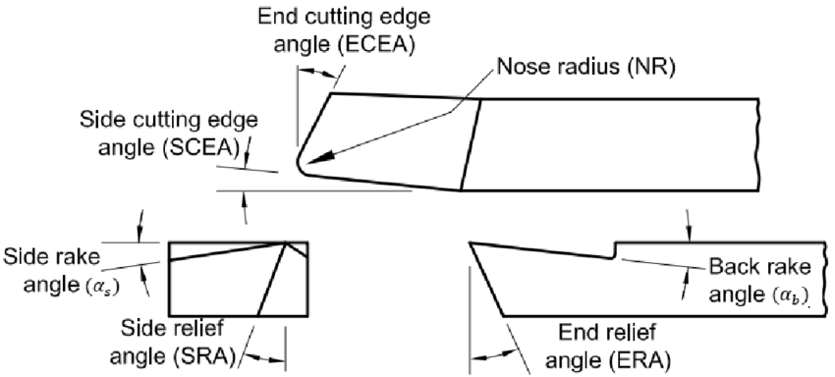
V.4.1 Single point cutting tool geometry
Fig.5.8 Single point cutting tool geometry
https://id.images.search.yahoo.com/yhs/search?p=Single+point+cutting+tool+shaping&fr=yhs-arh-001&type=zxy_a864b661f5f4a3135f&hspart-from.ppm&action=click

Slide 27
1. Shank:
The main body of the tool is known as the shank. It is the backward part of the tool which is held by tool post.
2. Face:
The top surface tool on which chips passes after cutting is known as a face. It is the horizontal surface adjacent of cutting edges.
3. Flank:
Sometime flank is also known as cutting face. It is the vertical surface adjacent to the cutting edge. According to cutting edge, there are two flank side flank and end flank.
3. Nose or Cutting Point:
The point where both cutting edge meets known as cutting point or nose. It is in front of the tool.

Slide 28
4. Base:
The bottom surface of the tool is known as the base. It is just the opposite surface of the face.
5. Heel:
It is an intersecting line of face and base.
6. End Cutting Edge Angle:
The angle between the end cutting edge or flank to the plane perpendicular to the side of the shank is known as the end cutting angle.
This angle usually varies from 5 to 15 degree
7. Side Cutting Edge Angle:
The angle between the side cutting edge or flank to the plane parallel to the side of the shank known as side cutting edge angle.

Slide 29
8. Back Rake Angle:
The angle form to smooth flowing of chips from the face, known as rack angle. It allows to smooth flow of chips.
The back rack angle is the angle between the face and the plane perpendicular to the end cutting edge.
Softer the material, greater should be the positive rake angle.
The back rake angle may be positive negative or neutral.

Slide 30
9. Side Rack Angle:
The angle between the face and plane perpendicular to the side cutting edge is known as the side rack angle. It allows chips to flow smoothly when material cut by side cutting edge.
The amount by which a chip is bent depends upon this angle. When the side rack angle increases, the magnitude of chip bending decreases. Smoother surface furnish is produced by a larger side rake angle.

Slide 31
10. End Relief Angle:
It is also known as a clearance angle. It is the angle that avoids tool
wear. It avoid the rubbing of flank with a workpiece.
End cutting angle made by end flank to the plane perpendicular to the base.
This angle may vary from 6 to 10 degrees.

Slide 32
11. Side Relief Angle:
It is the angle made by the side flank to the plane perpendicular to the base. It avoid rubbing of side flank with a workpiece.
This angle allows the tool to fed sideways into the job in order to cut the work material without rubbing.
When the side relief angle is very small, the tool will rub against the job and therefore it will get overheated and become blunt and the surface finish obtained will be poor.
12. Nose Radius:
The intersecting area of both cutting edges is known as the nose of the tool.

Slide 33
From the above, it is realized that single point cutting tools have a shape which seem to be complex because they have different angles to consider in other to facilitate machining operation and to avoid friction while machining activity. To shape this type of cutting tools bench type grinder machine are mostly used in machine shop for this purpose.

Slide 34
References
Fritz Klocke: Manufacturing Processes 1 - Cutting, Springer, 2011, p. 95
Trent, Wright: Metal Cutting. Butterworth Heinemann, 2000, 4. edition , p. 132-250
Fritz Klocke: Manufacturing Processes 1 - Cutting, Springer, 2011, p. 95-196Graham
T. Smith: Cutting Tool Technology - Industrial Handbook, Springer, 2008, p. 1-32
J. Paulo Davim: Machining - Fundamentals and Recent Advances, Springer, 2008, p. 37-48
https://id.images.search.yahoo.com/yhs/search?p=Single+point+cutting+tool+shaping&fr=yhs-arh-001&type=zxy_a864b661f5f4a3135f&hspart-from.ppm&action=click
https://en.wikipedia.org/wiki/Cutting_tool_(machining)
https://learnmechanical.com/types-of-cutting-tools/
https://littlemachineshop.com/info/turning_tools.php
https://id.images.search.yahoo.com/yhs/search;_ylt=AwrtgU4jvFpiRFIzkigeHYpQ;_ylu=c2VjA3NlYXJjaARzbGsDYnV0dG9u

Slide 35
THANK YOU

