Slide 1
COURSE NAME: MACHINE TOOLS
Lecture 6: CALCULATION ON TURNING OPERATIONS
Lecturer: HABANABAKIZE THEOPHILE

Slide 2
OUTLINE
Introduction
Cutting speed
Feed, feed rate and Depth of cut
Machining Time

Slide 3
VI.1 Introduction
Previous lectures discussed various topics related to lathe machining operations. There are machining parameters such as: spindle speed, cutting speed, depth of cut, feed and feed rate, material being cut,…which are involved in machining operations.
This lecture will be about some machining parameters calculations. In addition it will also calculate Machining time required to perform machining operation.

Slide 4
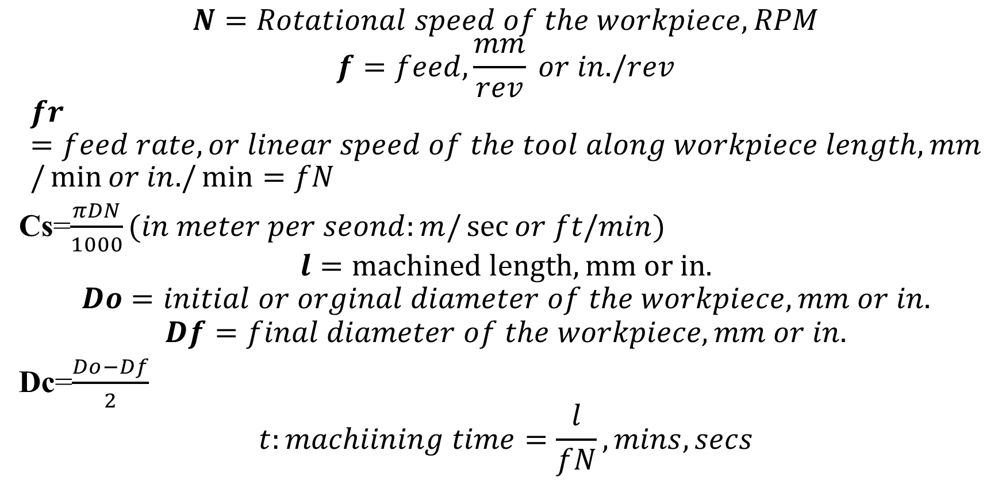
The summary of turning formula

Slide 5
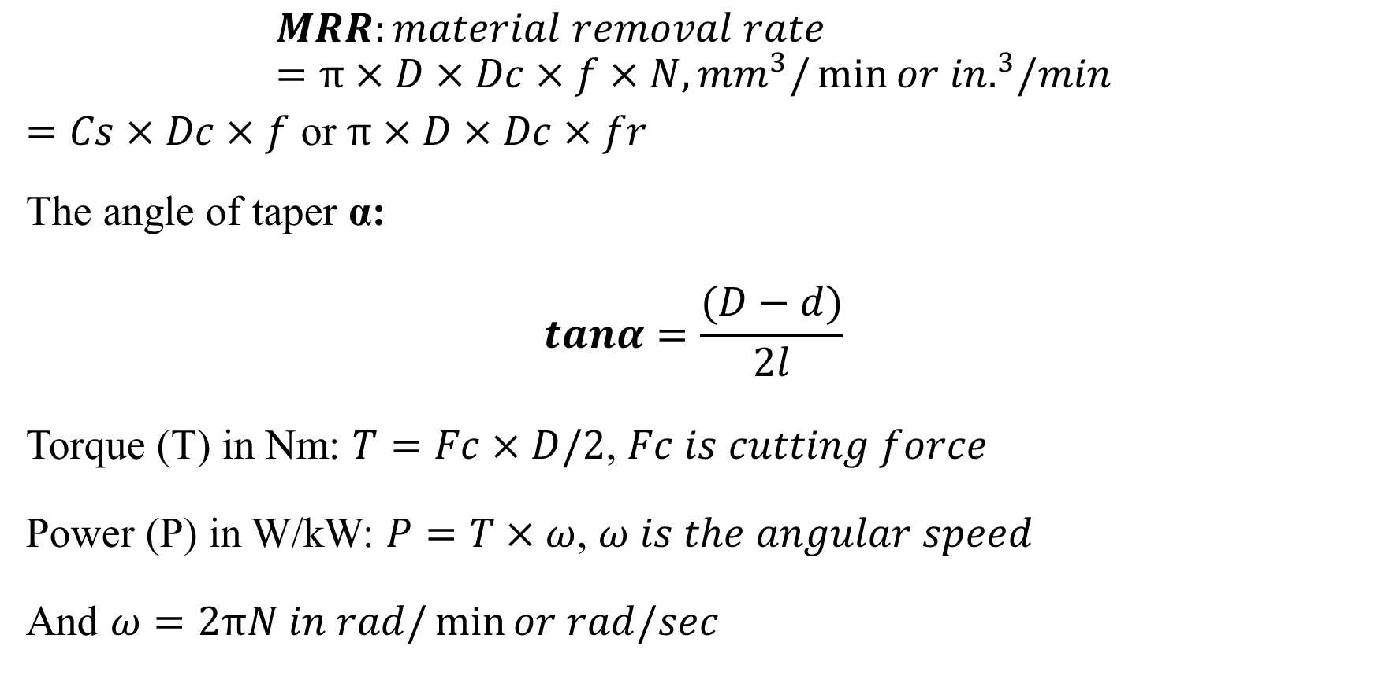
The summary of turning formula Cont’d

Slide 6
The formulas summarized in the above slides are known as turning formulas. These formulas help lathe machining operation activities for using them the operator can monitor effectively machining parameters (spindle speed, workpiece material, cutting speed, feed, depth of cut). For the same material cutting speed reduces as the size increases and it increases as the size reduces.

Slide 7
VI.2 Cutting speed
The cutting speed (Cs) of a tool is the speed at which the metal is removed by the tool from the workpiece or the rate at which point on work circumference travels past cutting tool. In a lathe, it is the peripheral speed of the work past the cutting tool expressed in meters per minute.
Where,
D: is the diameter of the work in mm.
N: is the number of revolutions that the work makes per minute (RPM).

Slide 8
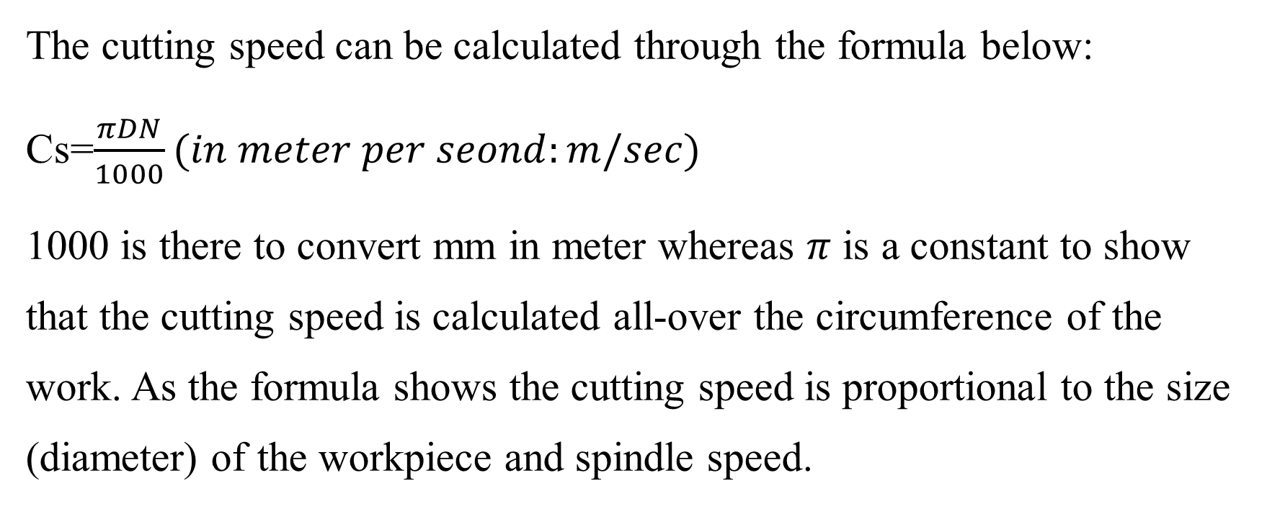
Cutting speed Cont’d

Slide 9
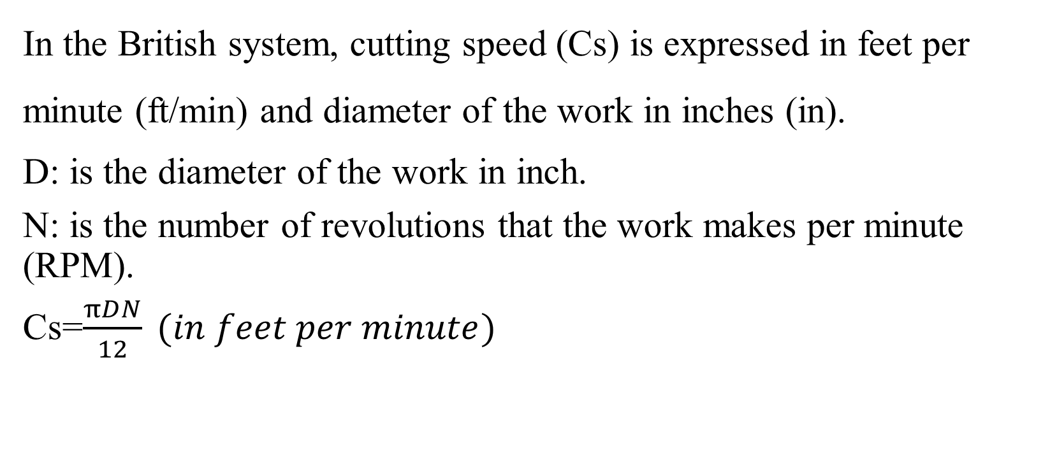
Cutting speed Cont’d

Slide 10
The hardness of the cutting tool material has a great deal to do with the recommended cutting speed. The harder the cutting tool material, the faster the cutting speed. The softer the cutting tool material, the slower the recommended cutting speed.
The depth of the cut and the feed rate will also affect the cutting speed, but not to as great an extent as the work hardness.
The softer the work material, the faster the recommended cutting speed

Slide 11
The sample of lathe cutting speed
Depending on the type of the material being cut, the cutting speed is different from one type of material to an other. Here below are the samples of cutting speed for some types of materials
No | Material being cut | Cutting speed (m/min)
1 | Mild steel | 20 to 28
2 | Cast iron | 18 to 25
3 | High carbon steel | 12 to 18
4 | Brass | 45 to 90
5 | Bronze | 15 to 21
6 | Aluminium | Up to 300

Slide 12
Setting spindle speeds on a Lathe Machine
Sometimes people get to confuse when it comes to the spindle speed and cutting speed. Firstly, spindle speed (N) is expressed in revolutions per minute whereas cutting speed is expressed in meter per minute or feet per minute depending on the used standard. Secondly, cutting speed involves workpiece rotation and cutting tool feed as per definition cutting speed (Cs) of a tool is the speed at which the metal is removed by the tool from the workpiece or the rate at which point on work circumference travels past cutting tool.

Slide 13
When it comes to spindle speed, it can be defined as the rotational frequency of the spindle of the machine tool, measures in revolutions per minute (RPM) (and it is set by the operator). Spindle speed affects the torque or power applied to the cutting action. Low speed generally applies more torque. The cutting speed is proportional to the spindle speed and the diameter at which cutting is being done.

Slide 14
Changing spindle speed
General safety precaution: When setting spindle speed on lathe machine it is strictly prohibited changing the speed while lathe is running.
Geared-head lathe
Speeds changed by moving speed levers into proper positions according to r/min chart fastened to headstock
Changed by stepped pulleys or gear levers

Slide 15
Changing spindle speed Cont’d
Belt-driven lathe
Various speeds are obtained by changing flat belt and back gear drive
Geared-head lathe
Speeds are changed by moving speed levers into proper positions according to r/min chart fastened to headstock

Slide 16
VI.2.1 Factors that Determine cutting speed
In machining process the cutting speed is determined by the following parameters:
The material being cut
The rigidity and condition of the machine
The material of which the tool is made from
The depth of cut and the feed rate
Availability of coolant (cutting fluid)

Slide 17
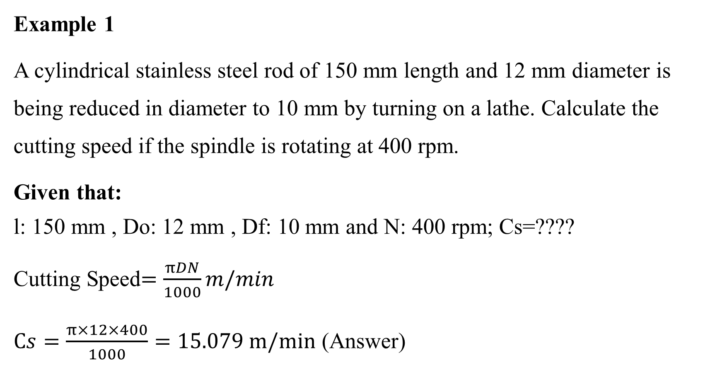
Examples

Slide 18
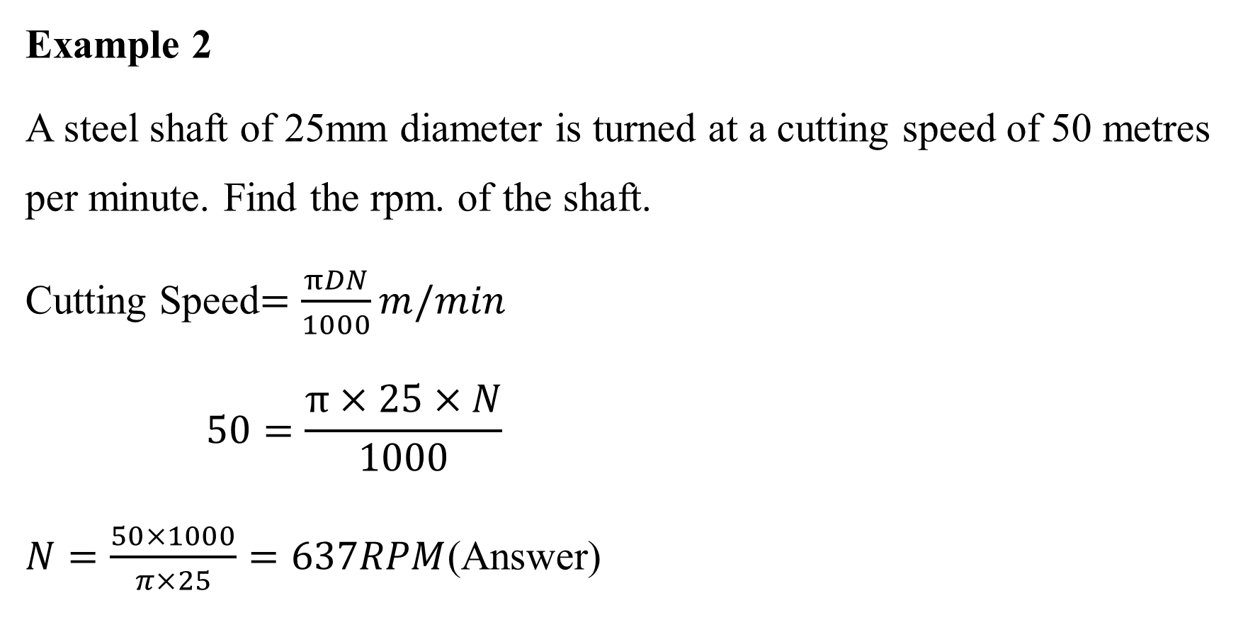
Examples Cont’d

Slide 19
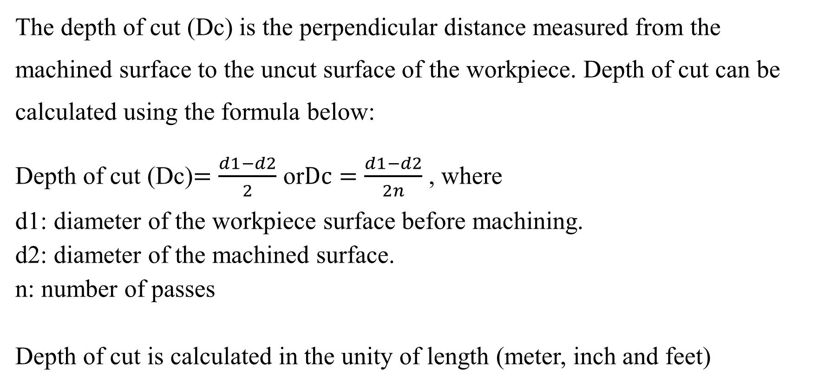
VI.3 Feed, feed rate and Depth of cut

Slide 20
Examples
Example 1
A Stainless steel rod of 400 mm long and 204 mm in diameter is to be reduced to 200 mm in diameter over 300 mm of its length in two travels/passes. Calculate depth of cut
Given data:
d1: diameter of the workpiece surface before machining= 204 mm
d2: diameter of the machined surface= 200 mm
n: number of passes= 2

Slide 21
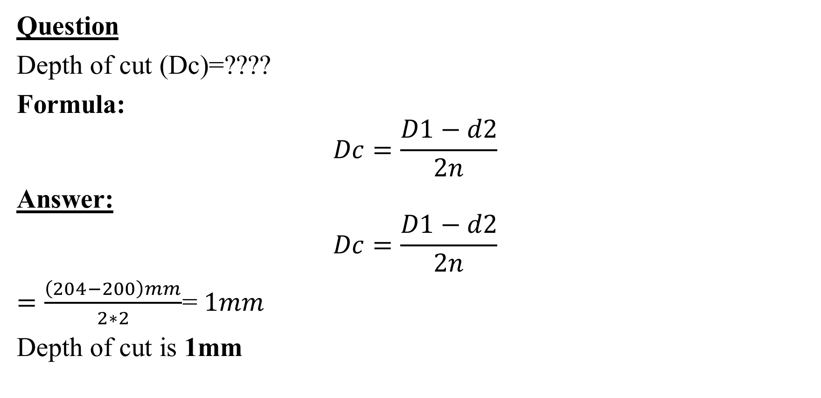

Slide 22
Example 2
An Aluminium rod is to be turned over the length of 300 mm and it has 206 mm diameter which will be reduced to 200 mm in diameter all over its length in three (3) travels/passes. The machine spindle rotates at 15 revolutions per second (rps), whereas the tool will be moving at an axial feed of 0. 0005 m/rev; calculate the following:
  Feed rate
  Depth of cut (in mm)
  Cutting speed (in m/min )

Slide 23
Answer:
Given data:
Do=206 mm
Df=200 mm
l=300 mm
n=3
N=15 rps=15*60=900 rpm
f=0. 0005 m/rev=0.5 mm
Question:
  Feed rate
  Depth of cut (in mm)
  Cutting speed (in m/min )

Slide 24
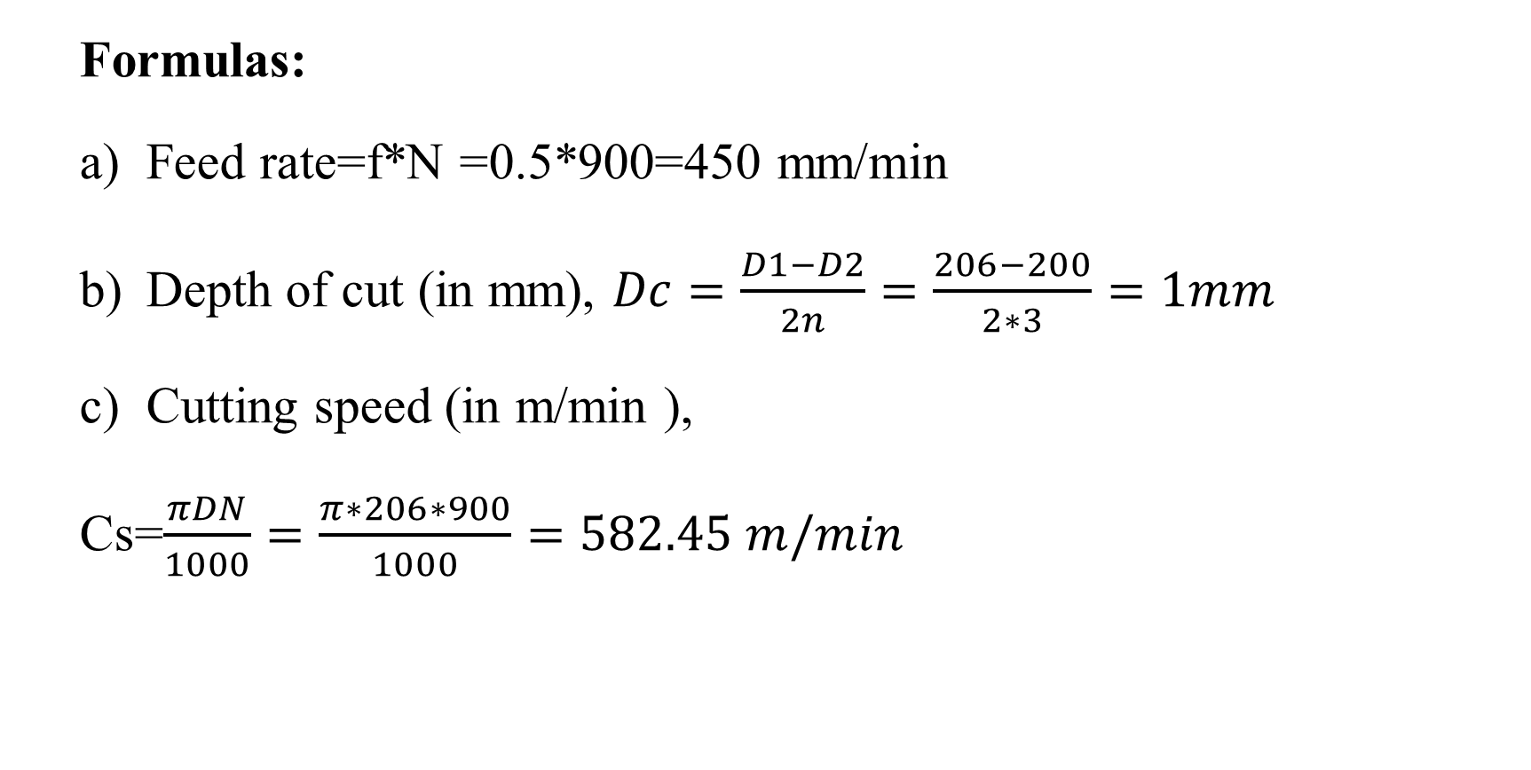

Slide 25
VI.5 Machining time
Example 1
Find the time required for one full cut on a workpiece of 350mm long and 50mm in diameter. The cutting speed is 35 metres per minute and feed is 0.5mm per revolution.

Slide 26
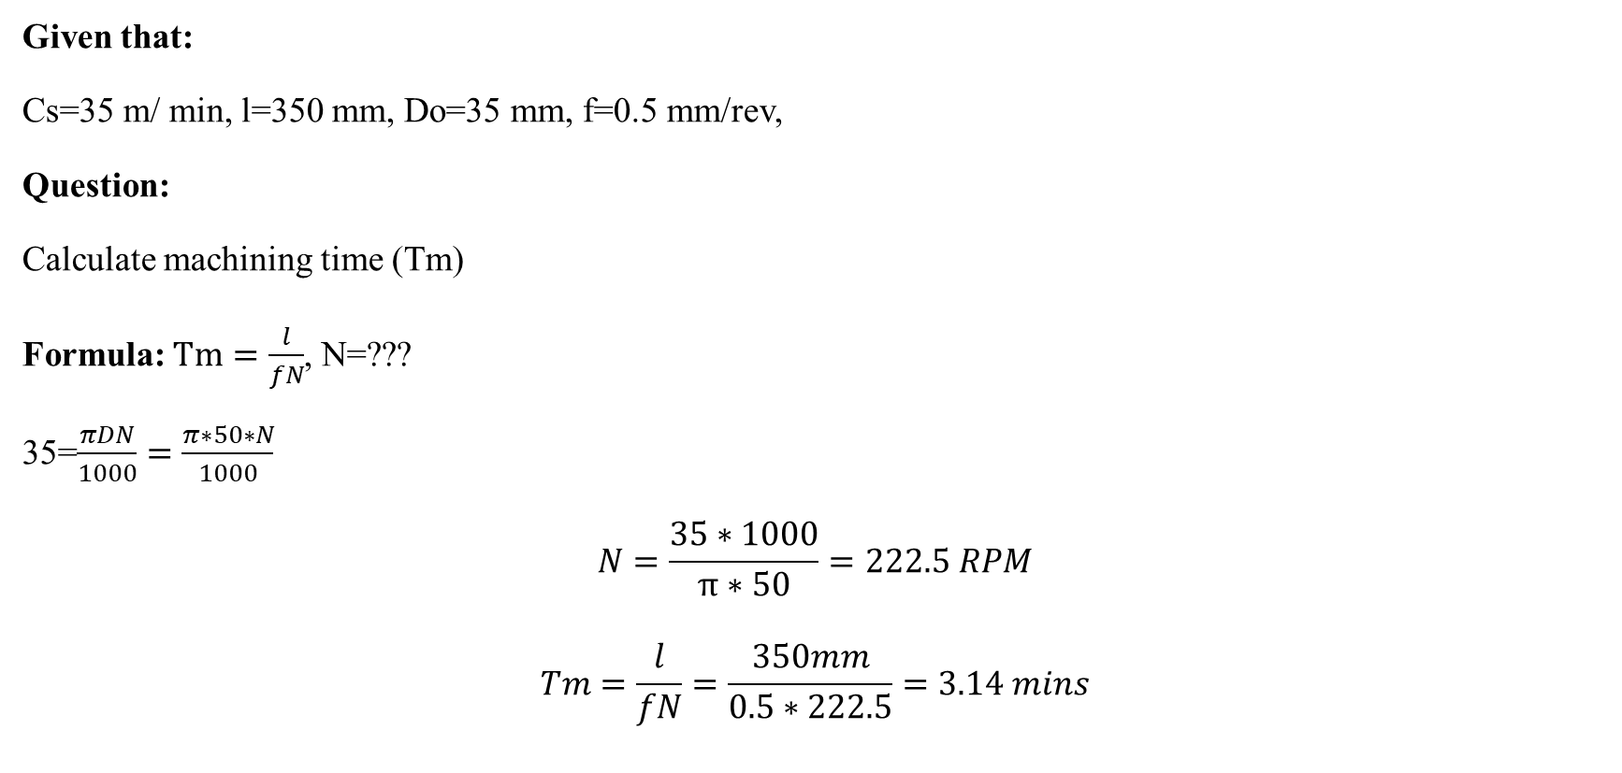
Solution

Slide 27
Example 2
A mild steel rod having 60 mm diameter and 500 mm length is to be turned on a lathe. Starting by drawing machining operation, determine the total machining time in minutes taken considering workpiece and cutting tools setting time to reduce the rod to 45 mm in five (5) passes when cutting speed is 30 m/min and a feed of 0.7 mm/rev is used. Be aware that workpiece and cutting tool setting process took 472.5 seconds.

Slide 28
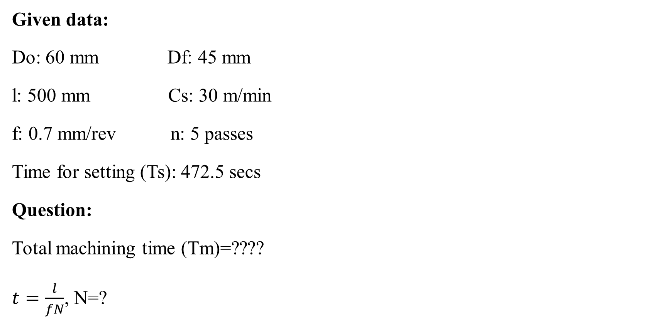
Solution

Slide 29
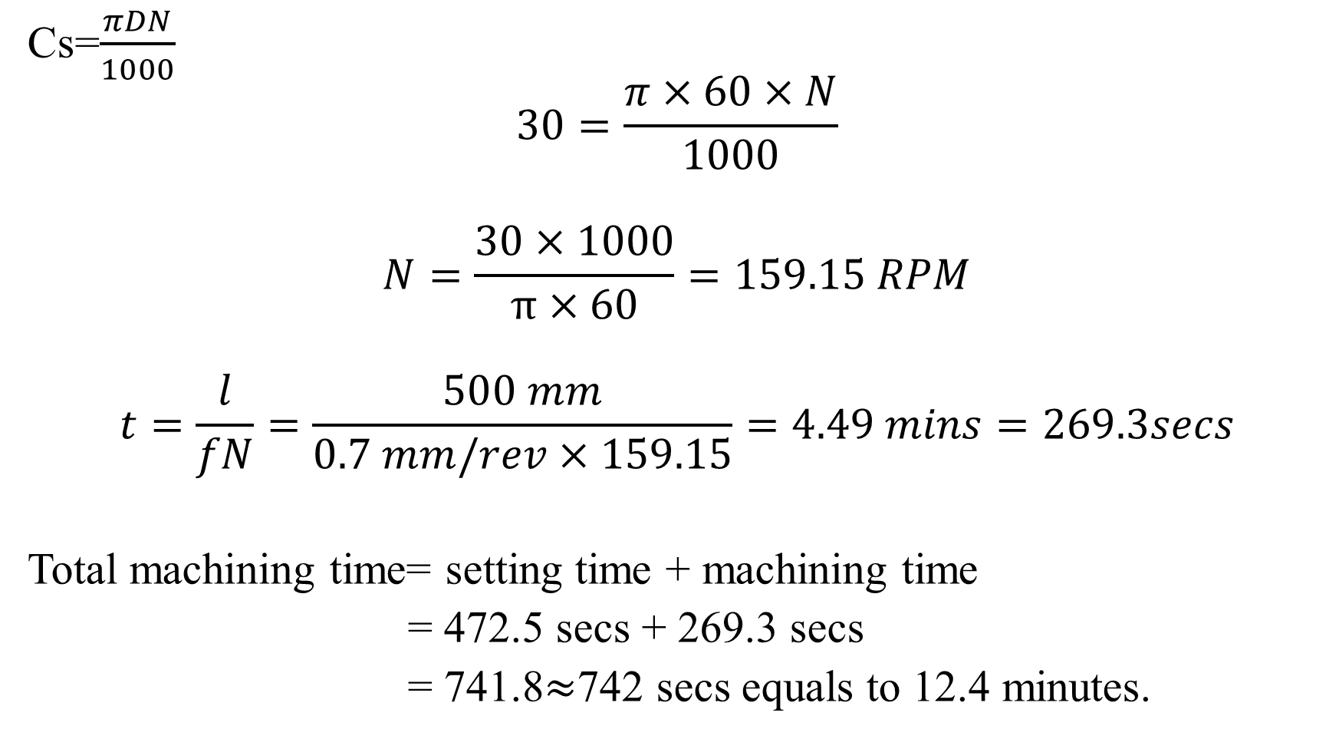

Slide 30
Reference
Boljanovic, V. (2009) Metal Shaping Processes: Casting and Molding; Particulate Processing; Deformation Processes; and Metal Removal (p333-334). Industrial Press, Inc. New York
Trent, E., & Wright, P. (2000). Metal Cutting (4th ed) (p.14) Butterworth–Heinemann.
Fritz Klocke: Manufacturing Processes 1 - Cutting, Springer, 2011, p. 95
Trent, Wright: Metal Cutting. Butterworth Heinemann, 2000, 4. edition , p. 132-250
Fritz Klocke: Manufacturing Processes 1 - Cutting, Springer, 2011, p. 95-196Graham
T. Smith: Cutting Tool Technology - Industrial Handbook, Springer, 2008, p. 1-32

Slide 31
THANK YOU

