Slide 1
Fundamentals
OF ELECTRONICS
WEEK 1:
Description and applications of electronic lab and workshop equipment/ Part 1
Lecturer: NSABIMANA Camille, M.Sc. IT

Slide 2
Introduction to the workshop equipment
Basic purpose of the electronic workshop components or equipment part is to introduce you with electronics lab/workshop components and their use in electronics lab/workshop experiments.
Identification of electronic lab / workshop equipment
    Multimeter
    LC meter
    AC /DC variable Power supply
    Function generator
    Oscilloscope
    Soldering station

Slide 3
Description of electronic lab / workshop equipment
1. Multimeter
A multimeter or multitester is a measuring instrument that can measure multiple electrical properties. A typical multimeter can measure voltage, resistance, and current, in which case it is also known as a volt-ohm-milliammeter (VOM).
A multimeter is also defined as an indispensible tool used to diagnose and troubleshoot circuit.
A multimeter is has three parts:
  Display
  Selection Knob
  Ports

Slide 4
Working of Multimeter
The display usually has four digits and the ability to display a negative sign. A few multimeters have illuminated displays for better viewing in low light situations.
The selection knob allows the user to set the multimeter to read different things such as milliamps (mA) of current, voltage (V) and resistance (Ω).

Slide 5
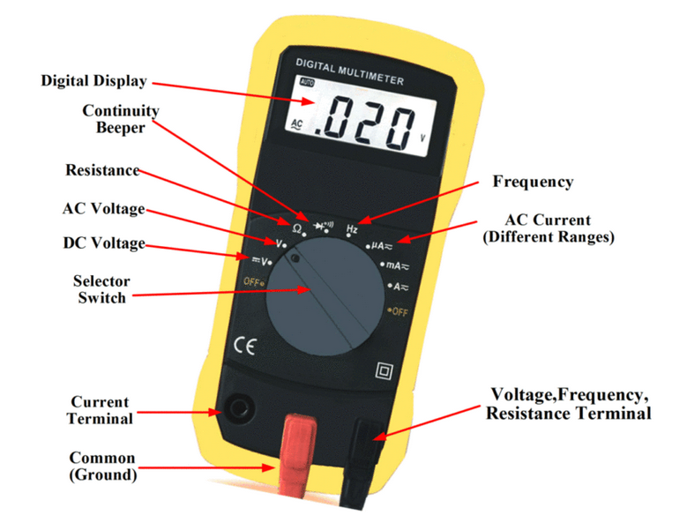
Figure 1: Multimeter
Source: https://electricalacademia.com/wp-content/uploads/2017/06/digital-multimeter-labelled.gif

Slide 6
Multimeter Cont’
The display usually has four digits and the ability to display a negative sign. A few multimeters have illuminated displays for better viewing in low light situations.
The selection knob allows the user to set the multimeter to read different things such as milliamps (mA) of current, voltage (V) and resistance (Ω).
Two probes are plugged into two of the ports on the front of the unit. COM stands for common and is almost always connected to Ground or „-‟ of a circuit. The COM probe is conventionally black but there is no difference between the red probe and black probe other than color. 10A is the special port used when measuring large currents (greater than 200mA). mAVΩ is the port that the red probe is conventionally plugged in to. This port allows the measurement of current (up to 200mA), voltage (V), and resistance (Ω). The probes have a banana type connector on the end that plugs into the multimeter. Any probe with a banana plug will work with this meter.

Slide 7
Pre-operational Safety checks or Measures
Be sure the test leads and rotary switch are in the correct position for the desired measurement.
Never use the meter if the meter or the test leads look damaged.
Never measure resistance in a circuit when power is applied.
Never touch the probes to a voltage source when a test lead is plugged into the 10 A or 300 mA input jack.
To avoid damage or injury, never use the meter on circuits that exceed 4800 watts.
Never apply more than the rated voltage between any input jack and earth ground.
Be careful when working with voltages above 60 V DC or 30 V AC rms. Such voltages pose a shock hazard.
Keep your fingers behind the finger guards on the test probes when making measurements.
To avoid false readings, which could lead to possible electric shock or personal injury, replace the battery as soon as the battery indicator appears.

Slide 8
Multimeter Cont’
Input Jacks
The black lead is always plugged into the common terminal. The red lead is plugged into the 10 A jack when measuring currents greater than 300 mA, the 300 mA jack when measuring currents less than 300 mA, and the remaining jack (V-ohms-diode) for all other measurements.
Range Fixing
The meter defaults to auto range when first turned on. You can choose a manual range in V AC, V DC, A AC, and A DC by pressing the button in the middle of the rotary dial. To return to auto-range, press the button for one second.

Slide 9
Procedure For Voltage Measurement
A.C. Voltage Measurement
1. Connect the positive(red) test lead to the „V/mA‟ jack socket and the negative(black) lead to the „COM‟ jack socket.
2. Set the selector switch to the desired mV D.C./D.C.V/A.C.V range.
3. Connect the test leads to the circuit to be measured.
4. Turn on the power to the circuit to be measured, the voltage value should appear on the digital display along with the voltage polarity(if reversed only).

Slide 10
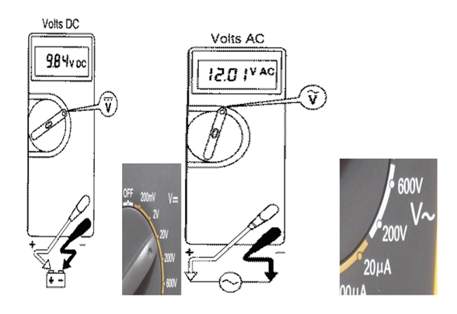
Figure 2: (Multimeter) voltage measurement
Source: Fundamentals of electronics. Book 1, Electronic devices and circuit applications, Thomas F. Schubert, Jr. and Ernest M. Kim.,an Rafael, California (1537 Fourth Street, San Rafael, CA 94901 USA) : Morgan & Claypool, 2014.
Notes:
Figure 2 is from:
2. Fundamentals of electronics. Book 1, Electronic devices and circuit applications, Thomas F. Schubert, Jr. and Ernest M. Kim.,an Rafael, California (1537 Fourth Street, San Rafael, CA 94901 USA) : Morgan & Claypool, 2014.

Slide 11
Procedure For Current Measurement
Connect the positive(red) test lead to the „V/mA‟ jack socket and the negative(black) lead to the „COM‟ jack socket(for measurements up to 200mA). For measurements between 200mA and 10A connect the red test lead to the „10mA‟ socket.
Set the selector switch to the desired uA/mA/A range.
Open the circuit to be measured and connect the test leads in SERIES with the load in which current is to be measured.
To avoid blowing an input fuse, use the 10A jack until you are sure that the current is less than 300 mA. Turn off power to the circuit. Break the circuit. (For circuits of more than 10 amps, use a current clamp.) Put the meter in series with the circuit and turn power on.

Slide 12
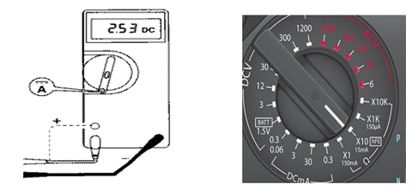
Figure 3: (Multimeter) Current measurement
Source: Fundamentals of electronics. Book 1, Electronic devices and circuit applications, Thomas F. Schubert, Jr. and Ernest M. Kim.,an Rafael, California (1537 Fourth Street, San Rafael, CA 94901 USA) : Morgan & Claypool, 2014.

Slide 13
Resistance Measurement
Connect the positive(red) test lead to the „V/mA‟ jack socket and the negative(black) lead to the „COM‟ jack socket.
Set the selector switch to the desired „OHM Ω‟.
If the resistance to be measured ia part of a circuit, turn off the power and discharge all capacitors before measurement.
Connect the test leads to the circuit to be measured.
The resistance value should now appear on the digital display.
If the resistance to be measured is part of a circuit, turn off the power and discharge all capacitors before measurement.

Slide 14
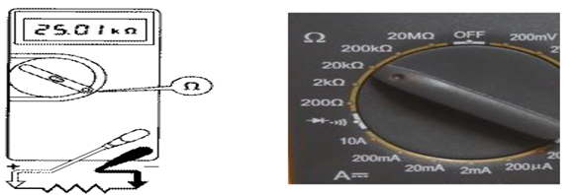
Figure 4: (Multimeter) Resistance Measurement
Source: Fundamentals of electronics. Book 1, Electronic devices and circuit applications, Thomas F. Schubert, Jr. and Ernest M. Kim.,an Rafael, California (1537 Fourth Street, San Rafael, CA 94901 USA) : Morgan & Claypool, 2014.
Notes:
Figure 4 is from:
2. Fundamentals of electronics. Book 1, Electronic devices and circuit applications, Thomas F. Schubert, Jr. and Ernest M. Kim.,an Rafael, California (1537 Fourth Street, San Rafael, CA 94901 USA) : Morgan & Claypool, 2014.

Slide 15
Continuity Test
This mode is used to check if two points are electrically connected. It is often used to verify connectors. If continuity exists (resistance less than 210 ohms), the beeper sounds continuously.
Connect the positive(red) test lead to the „V/mA‟ jack socket and the negative(black) lead to the „COM‟ jack socket.
Set the selector switch to the position.
Connect the test leads to two points of the circuit to be tested. If the resistance is Ohms the buzzer will sound.
If the resistance to be measured is part of a circuit, turn off the power and discharge all capacitors before measurement.

Slide 16
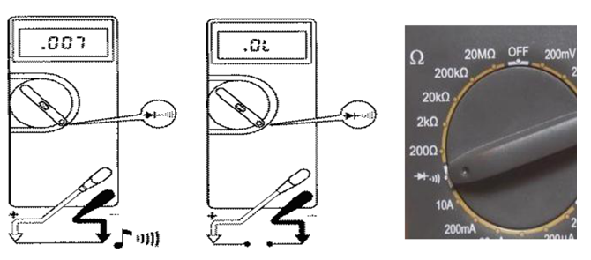
Figure 5: (Multimeter) Continuity Test
Source: Fundamentals of electronics. Book 1, Electronic devices and circuit applications, Thomas F. Schubert, Jr. and Ernest M. Kim.,an Rafael, California (1537 Fourth Street, San Rafael, CA 94901 USA) : Morgan & Claypool, 2014.
Notes:
Figure 5 is from:

Slide 17
2. LC METER
What is LCR meter ?
As we know L stands for inductance, C stands for Capacitance and R stands for resistance. The device which measures these parameters is known as LCR meter.
Digital LCR meter type measures I(through DUT) and V (across DUT) and phase angle between measured I and V. From these measured parameters useful impedance parameters are calculated. LCR meter can also be used to measure impedance which is later converted to L, C or R for display.

Slide 18
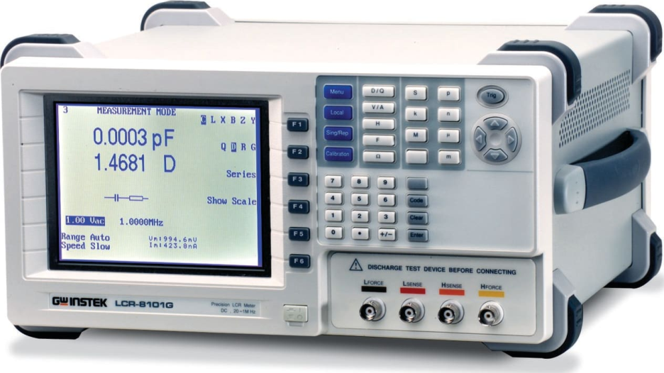
    Figure 6: LC meter
Instek LCR-8101G 20Hz ~ 1MHz Precision LCR Meter
Source: https://www.tequipment.net/InstekLCR-8101G.html

Slide 19
LCR meter types
There are two LCR meter types viz. benchtop and handheld. Benchtop are developed for bench applications and hence are kept at fixed location without much of movement. Handheld are developed for portable applications and hence can be moved around for test and measurement purpose.
Handheld LCR meters are lightweight and are battery powered. It usually will have USB port to transfer data tothe PC/Laptop. It provides measurement of inductance and AC resistance. It will usually have measurement accuracy between 0.1% to 0.2%.
Benchtop LCR meter will have additional features compare to handheld type such as programmable frequency setting. It will have very higher measuement accuracy of about 0.01%. It provides advanced measurement capabilities such as DC bias current and voltage, sweep etc. This type of LCR meter is used for AC calibration of L, C and R. Typically measurements is performed at frequencies such as 100Hz, 120Hz, 1kHz and 10kHz.

Slide 20
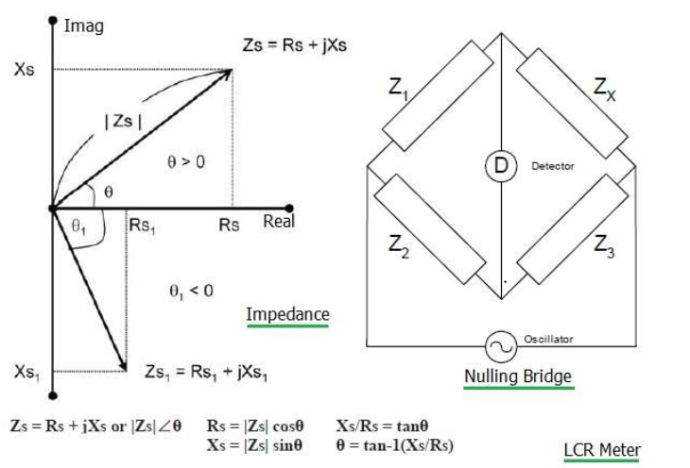
Figure 7: LCR meter working principle | How LCR meter works
Source: https://www.rfwireless-world.com/test-and-measurement/LCR-meter-basics-and-how-does-LCR-meter-work.html
.

Slide 21
LCR meter working principle
Before we move to understand how LCR meter works, let us understand concept of impedance first. As shown in the figure, impedance consists of two parts viz. resistance (i.e. real) and reactance(i.e. imaginary). Zs represents series impedance which is combination of resistance(Rs) and reactance(Xs).
Impedance can be expressed with magnitude |Z| and phase angle θ When θ>0 the reactance is inductive and when θ<0 the reactance is capacitive. There are two reactance types viz. inductive reactance (XL) and capacitive reactance (XC). They can be expressed as follows:
XL = 2*π * f * L
XC = 1/ (2* π * f * C)

Slide 22
LCR meter working principle
Impedance can be measured either in series or in parallel mode. Impedance in parallel mode can be expressed as reciprocal of admittance(Y).
Here , Z=1/Y,
Y = G + j*B, where G = Conductance and B = Susceptance
There are various techniques for the measurement of impedance. The most common method is nulling type bridge as shown in the figure-1 above. When there is no current flow through detector(D), value of unknown impedance can be expressed as follows:
Zx = (Z1/Z2)*Z3
Different applications use different combinations of L, C and R as elements of the bridge. Hence LCR meter working principle depends on its application usage.

Slide 23
Other uses of LCR Meter
Test Frequency
LCR meters operate within the frequency range from 10Hz to 2Mhz. The DUT is used under its own frequency. LCR meters have to match the frequency of their measurement to the frequency that the DUT is tuned to.
Test Voltage
A particular voltage is applied to the DUT. The AC output voltage of an LCR meter has to match it.
Accuracy
If the accuracy of your measurement is high, it takes more time to record that measurement for the LCR meter. Accuracy is hampered if the measurement is recorded in a short time. Most LCR meters provide 3 speeds for measurement: slow, medium, and fast. You have to make a choice between speed and accuracy.

Slide 24
LCR meter Advantages
Following are the advantages of LCR meter:
• User friendly to operate.
• It measures passive components with minimal of errors.
• This instruments are very easy in calibration.
• There are many companies which manufactures the LCR meter and hence more features and options are available for user to purchase.

Slide 25
    3. AC/DC variable power supply
A variable power supply is one which includes some means for the user to easily adjust the output voltage and sometimes the current. Adjustment is most often accomplished with a potentiometer, but may also be done with an analog control voltage, a digital input, an autotransformer, etc.

Slide 26
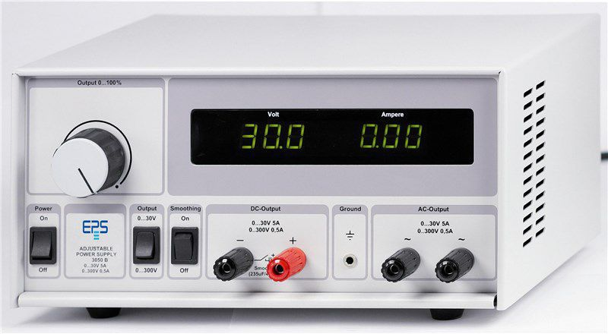
Figure 8: AC/DC variable power supply
Source: https://www.directindustry.com/prod/eps-stromversorgung-gmbh/product-162486-1687672.html

Slide 27
    AC/DC variable power supply working principle
A power supply is a device that supplies electrical power to an electrical load. The term is most commonly applied to electric power converters that convert one form of electrical energy to another, though it may also refer to devices that convert another form of energy (mechanical, chemical, solar) to electrical energy. A regulated power supply is one that controls the output voltage or current to a specific value; the controlled value is held nearly constant despite variations in either load current or the voltage supplied by the power supply's energy source.
A power supply may be implemented as a discrete, stand-alone device or as an integral device that is hardwired to its load. Examples of the latter case include the low voltage DC power supplies that are part of desktop computers and consumer electronics devices. Commonly specified power supply attributes include:
The amount of voltage and current it can supply to its load.
How stable its output voltage or current is under varying line and load conditions.

Slide 28
Power Supplies Types and DC Power Supply Specification
Power Supplies Types:
Battery
DC power supply
AC power supply
Linear regulated power supply
Switched mode power supply
Programmable power supply
Uninterruptible power supply
High voltage power supply
Voltage multipliers
DC Power Supply Specification:
Adjustable 0~30V/0~2A
The design is limit the voltage overload
The power supply input 220V, 230V, 240V AC
Output voltage: 0-30V DC
Work temperature:
-10⁰C-40º C

Slide 29
Main Function of AC/DC variable power supply
Output constant current adjustable.
Output constant voltage adjustable.
LCD voltage and current display.
Constant voltage and current operation in individual.
Over current protection.

Slide 30
References
Fundamentals of electronics. Book 1, Electronic devices and circuit applications, Thomas F. Schubert, Jr. and Ernest M. Kim.,an Rafael, California (1537 Fourth Street, San Rafael, CA 94901 USA) : Morgan & Claypool, 2014.
Principles of Electrical Engineering. Wiley., 1922.
Starting Electronics, Keith Brindley (Fourth Edition), published by Elsevier Ltd, 2011.
https://www.rfwireless-world.com/test-and-measurement/LCR-meter-basics-and-how-does-LCR-meter-work.html
https://www.directindustry.com/prod/eps-stromversorgung-gmbh/product-162486-1687672.html
https://www.tequipment.net/InstekLCR-8101G.html

