Slide 1
FUNDAMENTALS
OF ELECTRONICS
WEEK 2:
DESCRIPTION AND APPLICATIONS OF ELECTRONIC LAB AND WORKSHOP EQUIPMENT/ PART 2
Lecturer: NSABIMANA Camille, B.Sc. Eng., M.Sc. IT

Slide 2
Description of electronic lab / workshop equipment
4. FUNCTION GENERATOR
A function generator is a specific form of signal generator that is able to generate waveforms with common shapes. Unlike RF generators and some others that only create sine waves, the function generator is able to create repetitive waveforms with a number of common shapes.
In particular it can be made to become a sine wave generator, square wave generator, and triangular wave generator.
Also a function generator may be able to vary the characteristics of the waveforms, changing the length of the pulse, i.e. the mark space ratio, or the ramps of the different edges of triangular or sawtooth waveforms, but it is only be able to create the waveforms that are built in to the function generator. It cannot be programmed to create additional waveforms - an arbitrary waveform generator.

Slide 3
Function Generator
Apart from just generating the waveforms themselves, this type of test instrument has the capability to add a DC offset to the signal. This can be very useful in a number of testing applications.
Function generator capabilities
Function generators are capable of producing a variety of repetitive waveforms, generally from the list below:

Slide 4

Function generator Cont’
Sine wave: A function generator will normally be able to act as a sine wave generator. This is the standard waveform that oscillates between two levels with a standard sinusoidal shape. Using the function generator as a sine wave generator is one of the more commonly used applications. Sine waves are widely used in testing applications.
Source: https://www.electronics-notes.com/articles/basic_concepts/electronic-electrical-waveforms/waveform-types-basics-sine-square-triangle-ramp.php

Slide 5
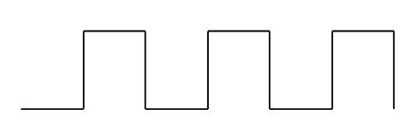
Function generator Cont’
Square wave: Another very widely used waveform is the square wave. It consists of a signal moving directly between high and low levels. Used as a square wave generator, this test instrument provides a very useful source of a basic digital waveform.
Source: https://www.electronics-notes.com/articles/basic_concepts/electronic-electrical-waveforms/waveform-types-basics-sine-square-triangle-ramp.php

Slide 6
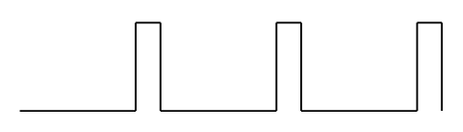
Function generator Cont’
Pulse: A pulse waveform is another type that can be produced by a function generator. It is effectively the same as a square wave, but with the mark space ratio very different to 1:1. This form of waveform is again often used within digital applications.
Source: https://www.electronics-notes.com/articles/basic_concepts/electronic-electrical-waveforms/waveform-types-basics-sine-square-triangle-ramp.php

Slide 7
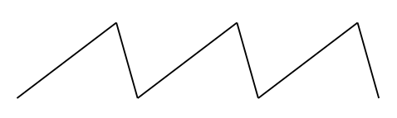
Function generator Cont’
Triangular wave: This form of signal produced by the function generator linearly moves between a high and low point. This form of waveform is often generated using an operational amplifier acting as an integrator. The triangular waveform generator typically also has a square wave output as well, and it is used as the basis for generating all the waveforms in a function generator test instrument.
The triangular waveform is often used in testing amplifiers - it is far easier to see distortion and clipping on a triangular waveform than it is on a sine waveform.
Source: https://www.electronics-notes.com/articles/basic_concepts/electronic-electrical-waveforms/waveform-types-basics-sine-square-triangle-ramp.php

Slide 8
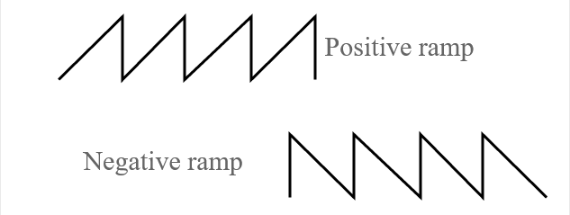
Function generator Cont’
Sawtooth (ramp) waveform: A sawtooth or ramp waveform is one which rises to its final value and then falls away with a near vertical drop. This gives a positive ramp waveform. It is also possible to have a negative ramp where the signal slowly falls from a maximum to the low value and then rises with a near vertical slope to the maximum value again.
Ramp signals were widely used for analogue televisions where the spot scanned from one side of the screen to the other and then flew back to the beginning again. A ramp voltage was used to steadily move the spot across the screen and then the swift fall would return it tot he start of the scan again. There are many other forms of waveform found in electronic circuits, but these are some of the more widely used.
Source: https://www.electronics-notes.com/articles/basic_concepts/electronic-electrical-waveforms/waveform-types-basics-sine-square-triangle-ramp.php

Slide 9
Function generator Cont’
Function generator controls
In addition to a selection of the basic waveforms that are available, other controls on the function generator may include:
Frequency: As would be expected, this control alters the basic frequency at which the waveform repeats. It is independent of the waveform type.
Waveform type : This enables the different basic waveform types to be selected:
  Sine wave
  Square wave
  Triangular wave
DC offset: This alters the average voltage of a signal relative to 0V or ground.
Duty cycle: This control on the function generator changes the ratio of high voltage to low voltage time in a square wave signal, i.e. changing the waveform from a square wave with a 1:1 duty cycle to a pulse waveform, or a triangular waveform with equal rise and fall times to a sawtooth.

Slide 10
Function generator usage
Function generators are normally used within electronics development, manufacturing test and service departments. They provide a flexible form of waveform generation that can be used in many tests.
These test instruments are very flexible and not thought of as specialist instruments. Although they can often generate signals into the low end of the RF spectrum, normally a specific RF generator would be used, unless none were available.
Also they are generally not used for performance audio testing as the levels of distortion on the sine waves that would normally be used would have higher levels of distortion than these tests sometimes require. A typical figure for the sine wave distortion might be about 1%.
If very high frequency stability is required, ten some of these test instruments allow for the output signal to be phase locked to another source.

Slide 11
Types of function generator
There are several forms that the function generator can take. With modern digital technology there are many formats for this type of test equipment.
Bench top test instrument: The most widely used form of function generator in the test laboratory is the test instrument contained within a box that sits on the laboratory bench. This test instrument contains the power supply, controls, display and of course the output connector.
Rack based test instrument: Another format that this type of test equipment can take is a module within a rack system like PXI. Based on PCI, the PXI rack system has been developed specifically for test applications and includes a slot for either a controller or link to a computer. Test instrument cards slot into the chassis, enabling a test system to be created to meet the needs of the particular test application required.

Slide 12
Types of function generator cont’
The test instrument cards can include any type of test instrument including volt meters, oscilloscopes, and of course a function generator
USB function generator: A number of small function generators are available as USB based test instruments. They contain the core oft he function generator within the module that connects to a computer via a USB connection. This approach means that the power and control interfaces can use the PC rather than having the expense and space required to provide these within a larger box for the test instrument.
Computer based function generator: A different approach is to use software based within a computer to provide the required waveforms and then use a digital card of the computer's audio output for the signal. Whilst very cheap, this may not have the output capability and accuracy of other types of test instrument. Also if the output is damaged as a result of the testing and a possible misconnection, etc it can result in costly repairs.

Slide 13
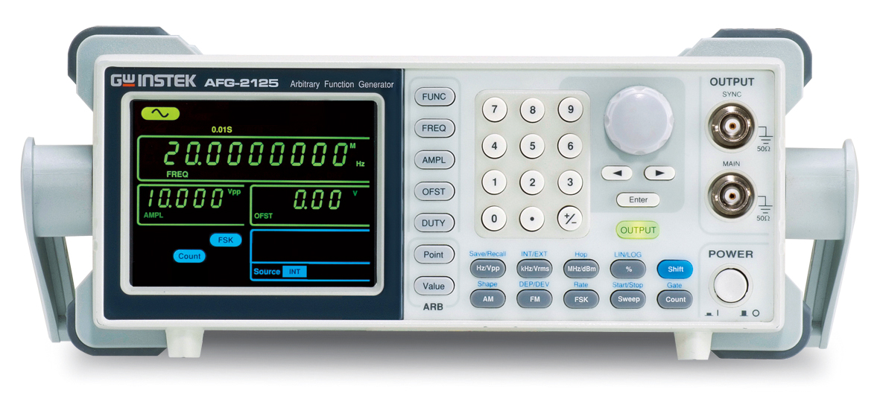
Figure: Function Generator
Source: https://userequip.com/Function-Generator?sort=model&direction=1&&page=29

Slide 14
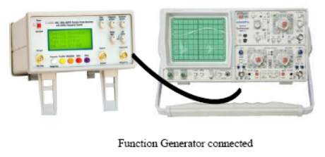
Procedures
Turn on the oscilloscope
Connect the function generator to one vertical channel of the oscilloscope using BNC Connector
Select the type of wave form by pressing Function control button.
Set the waveform at desired frequency by adjusting Frequency variable control button.
Now adjust the amplitude control of the function generator to establish a 4 V peak-to-peak (p-p) sinusoidal waveform on the screen.
Source: https://userequip.com/Function-Generator?sort=model&direction=1&&page=29/

Slide 15
Function Generator Controls
Knobs Number | Control Name | Functions
1 | Power | Push button switch to power ON the instrument.
2 | LCD Display | 20 x 4 Character bright back lit Liquid Crystal Display.
3 | Frequency | Used for selection of frequency range step by step.
4 | Function | Used for selection of Particular waveform. A total number of 6 different waveforms : Sine, Square, Triangle, Ramp, Pulse
5 | Modulation | Used for selection of Frequency Modulation.
6 | Attenuation | Used for Selection of 20dB or 40dB attenuation
7 | Menu | Used for selection of Function Generator/Frequency counter mode.
8 | Duty Cycle | When pulse output function is selected, this controls the pulse duty cycle from 15% to 85%.

Slide 16
Function Generator Controls
9 | Frequency Variable | In conjunction with frequency range, selected by frequency key on front Panel.
10 | Amplitude Variable | In conjunction with attenuators (6), this varies the level of output.
11 | DC Offset | This control provides DC offset. Approximately ±5VDC is superimposed on the output. Keep the control off if DC offset is not required.
12 | Output (BNC connector) | Output of 10 MHz function generator i.e. 20Vpp (Open Circuit)
13 | External Counter (BNC Connector) | Input BNC connector for measuring the frequency of external signal when External Counter mode is selected by Menu key on the LCD display.
14 | Modulation Input | Maximum modulation Input i.e. 2Vpp.

Slide 17
    CATHODE-RAY OSCILLOSCOPE (CRO) /Oscilloscope
The device consists mainly of a vacuum tube which contains a cathode; anode, grid, X&Y-plates, and a fluorescent screen (see Figure below). When the cathode is heated (by applying a small potential difference across its terminals), it emits electrons.
Having a potential difference between the cathode and the anode (electrodes), accelerate the emitted electrons towards the anode, forming an electron beam, which passes to fall on the screen.

Slide 18
CRO Cont’
When the fast electron beam strikes the fluorescent screen, a bright visible spot is produced. The grid, which is situated between the electrodes, controls the amount of electrons passing through it thereby controlling the intensity of the electron beam.
The X&Y- plates are responsible for deflecting the electron beam horizontally and vertically.

Slide 19
CRO Cont’
A sweep generator is connected to the X-plates, which moves the bright spot Horizontally across the screen and repeats that at a certain frequency as the source of the signal.
The voltage to be studied is applied to the Y-plates. The combined sweep and Y voltages produce a graph showing the variation of voltage with time.

Slide 20
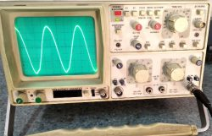
Experimental Figures
Fig 1. Cathode Ray tube Oscilloscope
Source: https://electronics-club.com/cathode-ray-oscilloscope-cro-working/

Slide 21
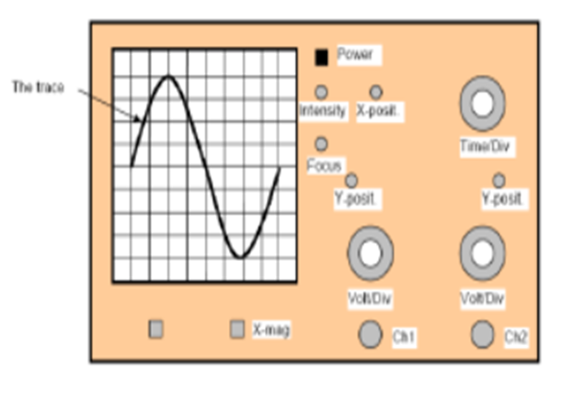
Experimental Figures
Fig 2. Out Line Diagram of CRO
Source: https://electronics-club.com/cathode-ray-oscilloscope-cro-working/

Slide 22
Procedure
Turn on the Oscilloscope
Adjust the intensity and the focus of the trace.
Use the X & Y knobs to center the trace horizontally and vertically.
Connect the cable from Ch1 of the CRO to Function generator.
A signal will appear on the screen.
Make sure that the inner red knobs of the Volt/Div and the Time/Div are locked clockwise.
Set the frequency of the generator to 100 Hz.
Adjust the Volt/Div and the Time/Div knobs so that you get a suitable size signal

Slide 23
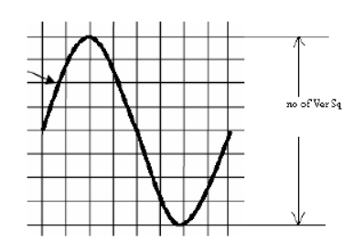
Procedure
Count the number of vertical squares lying within the signal, then calculate the peak to peak value as:
Vp-p = No. vertical Div * Volt/Divs
Source: https://electronics-club.com/cathode-ray-oscilloscope-cro-working/

Slide 24
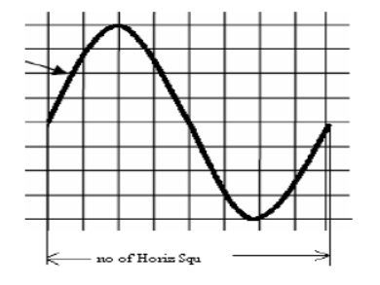
Procedure
Count the number of horizontal squares lying within the one Duty Cycle, then calculate time value as shown in the figure.
Time = No. Horizontal Div * Time/Divs 11.
Calculate the Frequency of signal by using the formula:
Freq = 1 /Time
Source: https://electronics-club.com/cathode-ray-oscilloscope-cro-working/

Slide 25
    SOLDERING STATION
A soldering station acts as a control station for your soldering iron if you have an adjustable iron. The station has the controls for adjusting the temperature of the iron as well as other settings. You may plug your iron into this soldering station.
What Is Soldering?
Soldering is a technique for joining metal parts together. It involves melting a metal known as solder into the space between two metal components. When this solder cools and hardens, it forms a permanent connection between the parts. Solder acts as a sort of metallic glue that joins elements together.
Joining electronic components may be the most common use of soldering irons. You can also use them on piping for plumbing, engine components, arts and crafts projects and more.

Slide 26
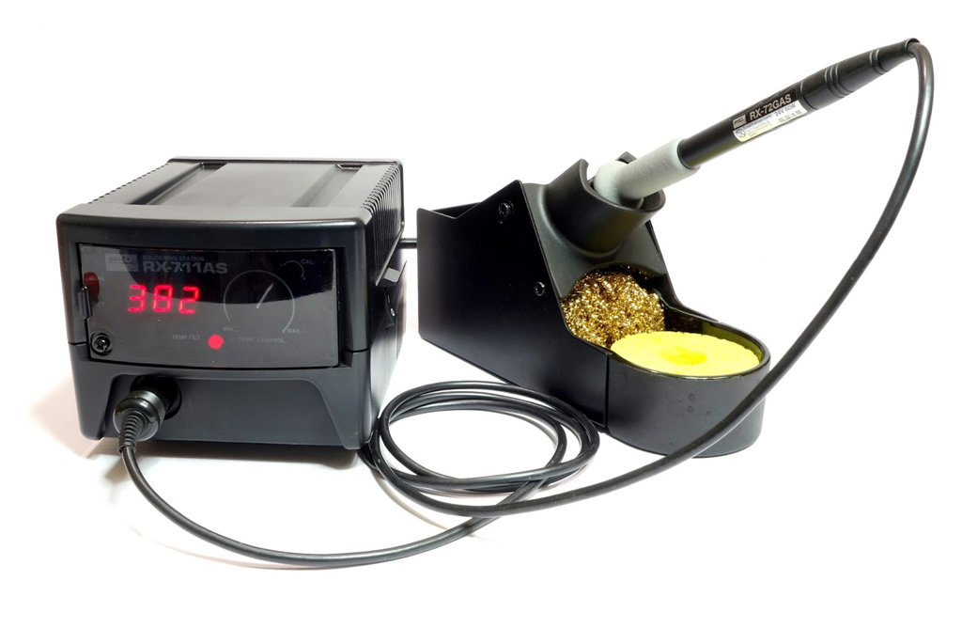
Fig: Soldering Station
Source: http://www.electronicsandyou.com/blog/soldering-station-guide.html

Slide 27
Soldering Station Components
The main soldering station elements which determine its compatibilities are soldering tools. Different tools are used for different applications and soldering stations may be equipped with more than one of them at a time. The main tools for soldering are:
    contact soldering irons;
    desoldering tweezers or SMD hot tweezers;
    desoldering gun;
    hot air gun;
    infrared heater.
Soldering iron is the most common working tool of a soldering station. Some stations may use simultaneously several soldering irons to make the process quicker and more convenient, as there is no need to change the soldering tips or readjust the station or the soldering temperature. Some stations may use some specialized soldering irons, such as ultrasonic soldering irons or induction soldering irons.

Slide 28
Soldering Station Components cont’
The means that may be integrated in soldering stations are:
SMD hot tweezers heat up and may not only melt the solder alloy but grab the needed component as well. They may have different types of tips for different applications.
Desoldering iron is usually made in a shape of a gun. It is capable of taking in the air (vacuum pickup) and solder alloy.
Non-contact heating tools include hot air and infrared heaters. They are used for SMT disassembling.

Slide 29
Soldering Station Components cont’
Hot Air Guns
Accta 301 soldering station with hot air gun and soldering iron
They use a hot air stream for heating up the components. Hot air is focused on the certain area using special hot air nozzles. Usually soldering hot air guns are capable of providing temperatures from 100 to 480 °C.
Infrared Heaters
Soldering stations with infrared (IR) heaters are a separate type of soldering stations and differ a lot. Such stations provide high-precision soldering and the process is more like that in electronics industry. The temperature profile may be set based on the components being soldered. This minimizes the risk of components deformation or damage due to the temperature difference.

Slide 30
References
Fundamentals of electronics. Book 1, Electronic devices and circuit applications, Thomas F. Schubert, Jr. and Ernest M. Kim., an Rafael, California (1537 Fourth Street, San Rafael, CA 94901 USA) : Morgan & Claypool, 2014.
Principles of Electrical Engineering. Wiley., 1922.
Starting Electronics, Keith Brindley (Fourth Edition), published by Elsevier Ltd, 2011.
https://userequip.com/Function-Generator?sort=model&direction=1&&page=29
http://www.electronicsandyou.com/blog/soldering-station-guide.html
https://electronics-club.com/cathode-ray-oscilloscope-cro-working/
https://www.electronics-notes.com/articles/basic_concepts/electronic-electrical-waveforms/waveform-types-basics-sine-square-triangle-ramp.php

