Slide 1
Fundamentals
OF ELECTRONICS
WEEK 3:
Description and applications of passive devices/
Part 1: RESISTORS
Lecturer: NSABIMANA Camille, B.Sc. Eng., M.Sc. IT

Slide 2
DESCRIPTION AND APPLICATIONS OF RESISTORS
Content
Definition
Identification of different types of resistors and their applications
Selection of Resistors based on:
  Resistors’ color coding
  Specifications and ratings
  Applications

Slide 3
MEANING OF PASSIVE DEVICES
A passive component is an electronic component which can only receive energy, which it can either dissipate, absorb or store it in an electric field or a magnetic field. Passive elements do not need any form of electrical power to operate.
As the name ‘passive’ suggests – passive devices do not provide gain or amplification. Passive components cannot amplify, oscillate, or generate an electrical signal.

Slide 4
Identification of different types of resistors and their applications:
Resistors are electronic components which have a specific, never-changing electrical resistance. The resistor's resistance limits the flow of electrons through a circuit.
They are passive components, meaning they only consume power (and can't generate it). Resistors are usually added to circuits where they complement active components like op-amps, microcontrollers, and other integrated circuits. Commonly resistors are used to limit current, divide voltages, and pull-up I/O lines.

Slide 5
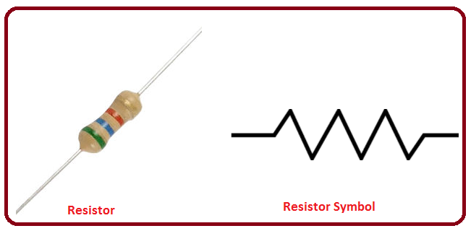
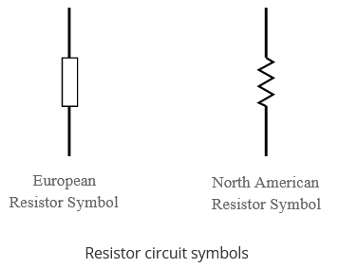
Resistor units and Symbol
The electrical resistance of a resistor is measured in ohms. The symbol for an ohm is the greek capital-omega: Ω. The (somewhat roundabout) definition of 1Ω is the resistance between two points where 1 volt (1V) of applied potential energy will push 1 ampere (1A) of current.
Source: https://www.electronics-notes.com/articles/electronic_components/resistors/resistor-types.php

Slide 6
    Fixed resistors
Fixed resistors are by far the most widely used type of resistor. They are used in electronics circuits to set the right conditions in a circuit. Their values are determined during the design phase of the circuit, and they should never need to be changed to "adjust" the circuit.
There are many different types of resistor which can be used in different circumstances and these different types of resistor are described in further detail below.

Slide 7
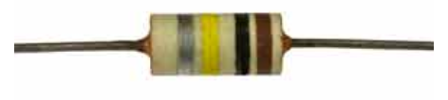
Fixed resistor types
There are a number of different types of fixed resistor:
Carbon composition: The carbon composition resistor is a type of resistor that was once very common - it was the main type of resistor, but are now seldom used because newer forms of resistor provide better performance, they are smaller and also cheaper.
Carbon composition resistors are formed by mixing carbon granules with a binder which was then made into a small rod. This type of resistor was large by today's standards and suffered from a large negative temperature coefficient.
Source: https://www.electronics-notes.com/articles/electronic_components/resistors/resistor-types.php
Notes:
Source: https://www.electronics-notes.com/articles/electronic_components/resistors/resistor-types.php

Slide 8

Fixed resistor types cont’
Carbon film: This type of resistor was introduced during he early days of transistor technology when power levels tended to be lower.
The carbon film resistor is formed by "cracking" a hydrocarbon onto a ceramic former. The resulting deposited film had its resistance set by cutting a helix into the film. This made these resistors highly inductive and of little use for many RF applications. They exhibited a temperature coefficient of between -100 and -900 parts per million per degree Celcius. The carbon film is protected either by a conformal epoxy coating or a ceramic tube.
Source: https://www.electronics-notes.com/articles/electronic_components/resistors/resistor-types.php
Notes:
Source: https://www.electronics-notes.com/articles/electronic_components/resistors/resistor-types.php

Slide 9
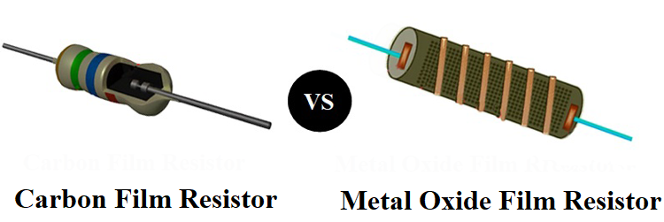
Fixed resistor types cont’
Metal oxide film resistor: This type of resistor is now the most widely used form of resistor. Rather than using a carbon film, this resistor type uses a metal oxide film deposited on a ceramic rod. As with the carbon film, the the resistance can be adjusted by cutting a helical grove in the film. Again the film is protected using a conformal epoxy coating. This type of resistor has a temperature coefficient of around + or - 15 parts per million per °Celcius, giving it a far superior performance to that of any carbon based resistor. Additionally this type of resistor can be supplied to a much closer tolerance, 5% or even 2% being standard, with 1% versions available. They also exhibit a much lower noise level than carbon types of resistor, however it has mainly been superseded but he metal film resistor.
Source: https://www.electronics-notes.com/articles/electronic_components/resistors/resistor-types.php

Slide 10

Fixed resistor types cont’
Metal film resistor: The metal film resistor is very similar to the metal oxide film resistor. Visually it is very similar and the performance is also comparable. Instead of using a metal oxide film, this type of resistor uses a metal film as the name indicates. Metals such as nickel alloy may be used.
Source: https://www.electronics-notes.com/articles/electronic_components/resistors/resistor-types.php

Slide 11
Fixed resistor types cont’
Wire wound resistor: This resistor type is generally reserved for high power applications. These resistors are made by winding wire with a higher than normal resistance (resistance wire) on a former.
The more expensive varieties are wound on a ceramic former and they may be covered by a vitreous or silicone enamel. This resistor type is suited to high powers and exhibits a high level of reliability at high powers along with a comparatively low level of temperature coefficient, although this will depend on a number of factors including the former, wire used, etc. As wire wound resistors are often intended for high power applications, some varieties are designed so that they can be mounted onto a heatsink to ensure that the power is dissipated into metalwork so it can be carried away.

Slide 12
Fixed resistor types cont’
In view of their wound nature, they are not suitable for operation above low frequencies, although by winding parts of the resistance wire in different directions the inductance can be reduced somewhat.
Surface mount resistors: Surface mount technology, SMT is now the major format used for electronic components. They are easier to use in automated manufacturing, and they are able to provide very high levels of performance. SMT resistors utilise similar technologies to other forms, but in a surface mount format.

Slide 13
Variable resistors
A variable resistor is a resistor of which the electric resistance value can be adjusted. A variable resistor is in essence an electro-mechanical transducer and normally works by sliding a contact (wiper) over a resistive element. When a variable resistor is used as a potential divider by using 3 terminals it is called a potentiometer.
When only two terminals are used, it functions as a variable resistance and is called a rheostat. Electronically controlled variable resistors exist, which can be controlled electronically instead of by mechanical action. These resistors are called digital potentiometers.

Slide 14
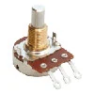
Types of variable resistors
Potentiometer
The potentiometer is the most common variable resistor. It functions as a potential divider and is used to generate a voltage signal depending on the position of the potentiometer. This signal can be used for a very wide variety of applications including: Amplifier gain control(audio volume), measurement of distance or angles, tuning of circuits and much more. When variable resistors are used to tune or
calibrate a circuit or application, trimmer
potentiometers or trimpots are used, this
are mostly small potentiometers mounted
on the circuit board, which can be adjusted
using a screwdriver.
Source: https://www.electronics-notes.com/articles/electronic_components/resistors/resistor-types.php

Slide 15
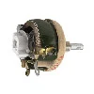
Variable resistors cont’
Rheostat
Rheostats are very similar in construction to potentiometers, but are not used as a potential divider, but as a variable resistance. They use only 2 terminals instead of the 3 terminals potentiometers use. One connection is made at one end of the resistive element, the other at the wiper of the variable resistor. In the past rheostats were used as power control devices in series with the load, such as a light bulb. Nowadays rheostats are not used as power
  control anymore as this is an inefficient
  method. For power control, rheostats are
  replaced by more efficient switching electronics.
Preset variable resistors, wired as rheostats are
used in circuits to perform tuning or calibration.
Source: https://www.electronics-notes.com/articles/electronic_components/resistors/resistor-types.php

Slide 16
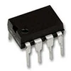
Variable resistors cont’
Digital resistor
A digital variable resistor is a type of variable resistor where the change of resistance is not performed by mechanical movement but by electronic signals. They can change resistance in discrete steps and are often controlled by digital protocols such as I2C or by simple up/down signals.
Source: https://www.electronics-notes.com/articles/electronic_components/resistors/resistor-types.php

Slide 17
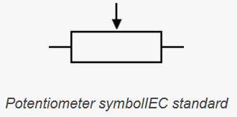
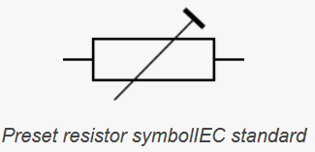
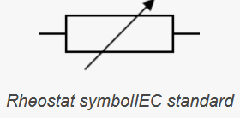
Variable resistors symbols
Source: https://www.electronics-notes.com/articles/electronic_components/resistors/resistor-types.php

Slide 18
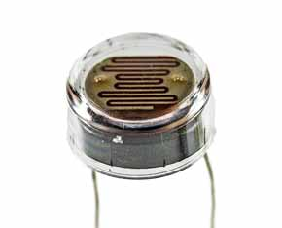
Light dependent resistor(LDR)
Light dependent resistor / photoresistor: Light dependent resistors or photoresistors change their resistance with the level of light. They are used in a number of sensor applications and provide a very cost effective solution in many instances.
Light dependent resistors have a
lag in the time taken to respond to
light changes, but they are cheap
and easy to use.
Source: https://www.electronics-notes.com/articles/electronic_components/resistors/resistor-types.php

Slide 19
Thermistor
Thermistor: As the name indicates, thermistors are heat sensitive resistors. The resistance of the thermistor varying with temperature. Some have a negative temperature coefficient, NTC thermistors(where the resistance decreases with increasing temperature), whist others have a positive temperature coefficient, PTC thermistors(the resistance increases with increasing temperature).
The name thermistor is a shortening of the words thermal resistor. It is essentially a thermally sensitive resistor, giving a change in resistance for a change in temperature.

Slide 20

Thermistor cont’
Thermistors can be used in many ways, enabling the temperature of the medium surrounding the device or the device itself to alter its resistance. This can then be detected by the equipment and used for everything from broad temperature sensing to overload cut-outs and many more ideas.
Thermistors are found in many circuits and equipment, providing a simple and cost effective but effective method of basic temperature sensing.
Thermistor circuit symbol
The thermistor is recognised within circuits by its own circuit
symbol. The thermistor circuit symbol uses the standard
resistor rectangle as its basis and then has a diagonal
line through it which has a small vertical section.
Source: https://www.electronics-notes.com/articles/electronic_components/resistors/resistor-types.php

Slide 21
Thermistor applications
There are many different thermistor applications - they are found in many applications. They provide very cheap, yet effective elements in circuits and as such they are very attractive to use. The actual applications depend upon whether the thermistor is a positive or negative temperature co-efficient.
Applications for negative temperature coefficient thermistors:
Very low temperature thermometers: They are used as resistance thermometers in very low-temperature measurements.
Digital thermostats: These thermistors are also commonly used in modern digital thermostats.

Slide 22
Thermistor applications cont’
Battery pack monitors: NTC thermistors are also used to monitor the temperature of battery packs while charging. As modern batteries such as Li-ion batteries are very sensitive to overcharging, the temperature provides a very good indication of the charging state, and when to terminate the charge cycle.
In-rush protection devices: NTC thermistors can be used as in-rush-current limiting devices in power supply circuits. They present a higher resistance initially which prevents large currents from flowing at turn-on, and then heat up and become much lower resistance to allow higher current flow during normal operation. These thermistors are usually much larger than measuring type thermistors, and are purpose designed for this application.

Slide 23
Thermistor applications cont’
Applications for positive temperature coefficient thermistors:
Current limiting devices: PTC thermistors can be used as current limiting devices in electronic circuits, where they can be used as an alternative to a fuse. Current flowing through the device under normal conditions causes a small amount of heating which does not give rise to any undue effects. However if the current is large, then it gives rise to more heat which the device may not be able to lose to the surroundings and the resistance goes up. In turn this gives rise to more heat generation in a positive feedback effect. As the resistance increases, so the current falls, thereby protecting the device.
Thermistors can be used in a wide variety of applications. They provide a simple, reliable and inexpensive method of sensing temperatures. As such they may be found in a wide variety of devices from fire alarms to thermostats. Although they may be used on their own, they may also be used as part of a Wheatstone bridge to provide higher degrees of accuracy.

Slide 24
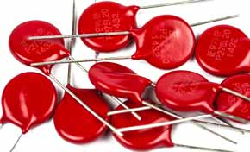
Varistor
Varistor: Varistors are available in a number of forms. Essentially these electronic components vary their resistance with the applied voltage and as a result they find uses for spike and surge protection. Often they may be seen described as Movistors, which is a contraction of the words Metal Oxide Varistor.
Varistors are the devices that are widely used in surge or transient protected mains extension leads and used
to protect computers. It should be
remembered that each time the varistor
receives a spike its properties
change slightly.
Source: https://www.electronics-notes.com/articles/electronic_components/resistors/resistor-types.php

Slide 25
Selection of Resistors
Although resistors may be thought of as simple electronics components to use, there are a number of parameters that need to be considered when choosing the correct resistor type. Parameters apart from just the resistance are important. Voltage withstand, power dissipation and the actual type of resistor itself all have an impact on the performance. With a variety of resistor types available, it is necessary to choose the correct type for any particular application. In this way the best performance can be assured.

Slide 26
Resistors’ colour coding
Resistor Colour Coding uses coloured bands to easily identify a resistors resistive value and its percentage tolerance.
An international and universally accepted resistor colour code scheme was developed many years ago as a simple and quick way of identifying a resistors ohmic value no matter what its size or condition.
Resistor values are often indicated with color codes. Practically all leaded resistors with a power rating up to one watt are marked with color bands. The coding is defined in the international standard IEC 60062.
It consists of a set of individual coloured rings or bands in spectral order representing each digit of the resistors value.

Slide 27
Resistors’ colour coding
The resistor colour code markings are always read one band at a time starting from the left to the right, with the larger width tolerance band oriented to the right side indicating its tolerance. By matching the colour of the first band with its associated number in the digit column of the colour chart below the first digit is identified and this represents the first digit of the resistance value.
Again, by matching the colour of the second band with its associated number in the digit column of the colour chart we get the second digit of the resistance value and so on. Then the resistor colour code is read from left to right as illustrated below:

Slide 28
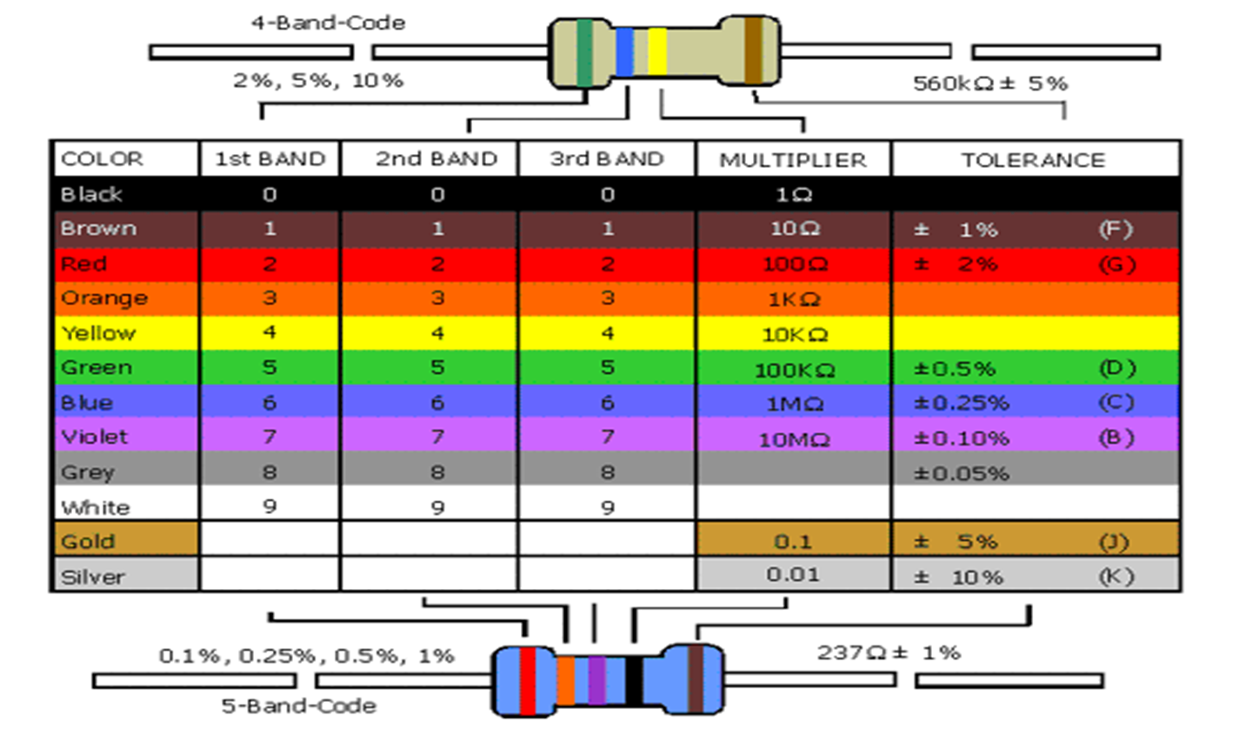
Resistors’ colour coding
Source: http://burnhamradioclub.co.uk/index.php/useful-tools/resistor-colour-codes/

Slide 29
Resistors’ colour coding
The resulting mnemonic matches the first letter of each word to each colour which makes up the resistors colour code by order of increasing magnitude and there are many different mnemonic phrases which can be used. However, these sayings are often very crude but never the less effective for remembering the resistor colours. Here are just a few of the more “cleaner” versions but many more exist:
Bad Boys Ring Our Young Girls But Vicky Goes Without
Better Be Right Or Your Great Big Venture Goes Wrong
Etc

Slide 30
Resistors’ colour coding
The colour bands are always read left to right from the end that has the bands closest to it.
In the case of a resistor with four colour bands, The 1st (A) and the 2nd colour bands (B) represent the first significant digit and the second significant digit respectively of the resistance value.
The 3rd band (C) is the multiplier factor and the 4th band (D) indicates the tolerance in percentage.
R = AB x 10^{C} ± D

Slide 31
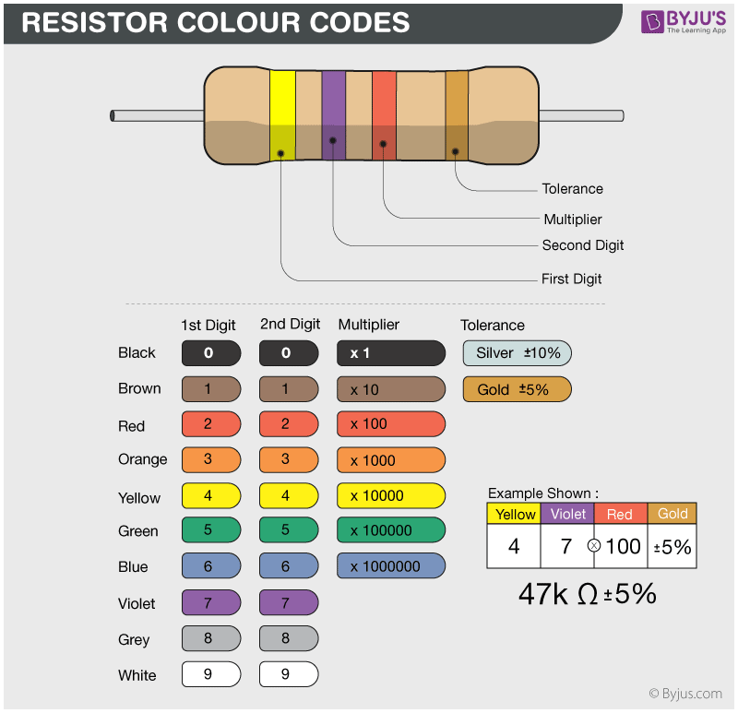
Example
Source: https://byjus.com/physics/resistor-colour-codes/

Slide 32
Selection of Resistors based on: specifications and ratings
There are several specifications or specs and parameters that need to be considered when choosing a resistor.
Apart from the basic resistance there are several other parameters that need to be considered when looking at a resistor specification.

Slide 33
Resistance value or specification
The resistance is obviously the key resistor specification. The value of the resistance is required by the calculations for the particular application in which it is to be used.
It is always best to use preferred values as these are easier to obtain. There are several series of resistor values that are used. These are referred to as the E-series. E3 has three values in a decade, i.e. 1.0, 2.2 and 4.7. Values of 10Ω 22Ω 47Ω are available in the tens of Ohms decade, 100Ω 202Ω 470Ω are available in the hundreds of Ohms decade and so forth.
It is always preferable to use as few values in a circuit design as possible as this reduces the number of different types required for any one design. Other series are also available, E6 with six values in each decade: 1.0, 1.5, 2.2, 3.3, 4.7, 6.8. There are also E12, E24, E48 and E96 etc values available, although their costs can increase marginally and they mean that many more component types are needed in a given design.

Slide 34

Power dissipation specification
Although the resistance is the key parameter for any type of resistor, another important parameter in the resistor specification is the amount of power it can dissipate.
When current passes through a resistor power is dissipated and this manifests itself in the form of heat. In turn this cases the temperature of the resistor to rise, and if too much current passes through the resistor, the temperature rise can be too great and it can cause the resistance to change, or in extreme cases it can cause damage to the resistor.
The power dissipated in a resistor is easy to calculate. The basic equation for power is:
where:
W= power in watts, V = voltage in volts and I = current in amps

Slide 35
Temperature coefficient specification
In certain circumstances the resistor specification for temperature coefficient is of importance.
The temperature coefficient specification is the parameter that indicates the change in resistance with changing temperature. The resistor specification for the temperature coefficient will be very dependent upon the type of resistor, and it may also vary from one manufacturer to another. It is therefore important to check the resistor specification for the temperature coefficient to ensure the particular resistor is suitable for the given application.
The temperature coefficient is the change in value of the resistance over a given temperature change. Normally it is expressed in term of parts per million, ppm, per degree Celcius, i.e. ppm/°C.In other words a 100kΩ resistor with temperature coefficient specification of 1000ppm/°C for a 10 °C temperature rise would change would change by 1000 /1 000000 * 100 * 100 000 Ω = &10Ω. This could be quite significant in some circumstances.

Slide 36
Maximum temperature specification
The resistor specification for temperature needs to be adhered to. Above certain temperatures the resistor may function outside its specified operating parameters. Also under extreme conditions damage could result and the overall circuit may cease to function.
If resistors are operated well above their rated temperatures for extended periods, the value of the resistance can permanently increase, and this could cause the overall circuit to malfunction.
A further reason for operating below the rated temperature is overall reliability. Resistors, and all other components are more likely to fail if operated outside their specified ranges. Often components are operated inside their specification with a good margin to ensure that the reliability is maximised

Slide 37
Resistor specification for maximum voltage
Resistors are designed to operate up to a certain voltage. Above this voltage there is the possibility of breakdown as a result of the electrical stress applied to the component.
As a result of this resistor datasheets will contain a resistor specification for the maximum voltage that should be applied.
The actual value will depend on a variety of factors including the physical size of the resistor, its structure, the technology used, and a variety of other factors.
Typically it is not good practice to run a resistor close to its rated voltage specification. Often design standards recommend running a resistor at a maximum of 60% or even les of the maximum rated voltage to ensure reliability is maintained.
These resistor specifications are some of the more commonly seen resistor specifications and parameters. Other exist and manufacturer datasheets should be consulted before settling on a given type.

Slide 38
Selection of Resistors based on: Applications
There are six important application areas for the specialized, targeted resistors:
      High voltage;
      Circuit protection;
      High power and dissipation;
      Current sensing;
      Pulse/surge situations;
      Signal conditioning and instrumentation.
Specialized resistor manufacturers rely on various advanced physical configurations and construction techniques using highly purified materials in order to meet the diverse requirements of these areas.

Slide 39
References
Fundamentals of electronics. Book 1, Electronic devices and circuit applications, Thomas F. Schubert, Jr. and Ernest M. Kim., an Rafael, California (1537 Fourth Street, San Rafael, CA 94901 USA) : Morgan & Claypool, 2014.
Principles of Electrical Engineering. Wiley., 1922.
Starting Electronics, Keith Brindley (Fourth Edition), published by Elsevier Ltd, 2011.
https://www.electronics-notes.com/articles/electronic_components/resistors/resistor-types.php
https://byjus.com/physics/resistor-colour-codes/
http://burnhamradioclub.co.uk/index.php/useful-tools/resistor-colour-codes/

