Slide 1
Fundamentals
OF ELECTRONICS
WEEK 4:
Description and applications of passive devices/
Part 2: INDUCTORS
Lecturer: NSABIMANA Camille, B.Sc. Eng., M.Sc. IT

Slide 2
Content
Definition
Identification of different types of indutors and their applications
Selection of Inductors based on:
  Coding
  Specifications and ratings
  Applications

Slide 3
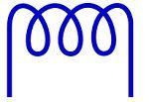
Definition of inductors
The inductor is a passive component which stores the electrical energy in the magnetic field when the electric current passes through it. Or we can say that the inductor is an electrical device which possesses the inductance.
The inductor is made of wire which has the property of inductance, i.e., opposes the flow of current. The inductance of wire increases by increasing the number of turns. The alphabet ‘L’ is used for representing the inductor, and it is measured in Henry. The inductance characterises the inductor. The figure below shows the symbolic representation of inductor.
Source: https://circuitglobe.com/inductor.html

Slide 4

Inductor cont’
The electric current I flows through the coil generates the magnetic field around it. Consider the magnetic field generates the flux Φ when current flows through it. The ratio of the flux and the current gives inductances.
The inductance of the circuit depends on the current paths and the magnetic permeability of the nearer material. The magnetic permeability shows the ability of the material to forms the magnetic field.

Slide 5
How Inductor Works?
The inductor is an electrical device used for storing the electrical energy in the form of the magnetic field. It is constructed by wounding the wire on the core. The cores are made of ceramic material, iron or by the air. The core may be toroidal or E- shaped.
The coil-carrying the electric current induces the magnetic field around the conductor. The intensity of the magnetic field increases if the core is placed between the coil. The core provides the low reluctance path to the magnetic flux.

Slide 6
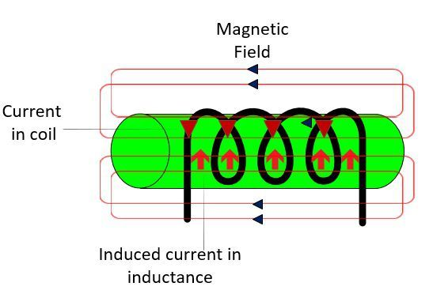
How Inductor Works?
The magnetic field induces the EMF in the coil which causes the current. And according to Lenz’s law, the causes always oppose the effect. Here, the current is the causes, and it is induced because of the voltage. Thus, the EMF oppose the change of current that changes the magnetic field. The current which reduces because of the inductance is known as the inductive reactance. The inductive reactance increases with the increase of the number of turn of coils.
Source: https://circuitglobe.com/inductor.html

Slide 7
Identification of different types of inductors and their applications
The inductors are classified into the following types:
    Air-core Inductor
    Iron-Core Inductor
    Toroidal Inductors
    Laminated Core Inductors
    Powdered Iron Core Inductors

Slide 8
i. Air Cored Inductor
The commonly seen inductor, with a simple winding is this air-Core Inductor. This has nothing but air as the core material.
The non-magnetic materials like plastic and ceramic are also used as core materials and they also come under this air-core Inductors.
These Inductors offer a minimum signal loss at the applications having a very high magnetic field strength. Also, there exists no core losses as there is no solid core material.
The following image shows various air-core inductors.

Slide 9
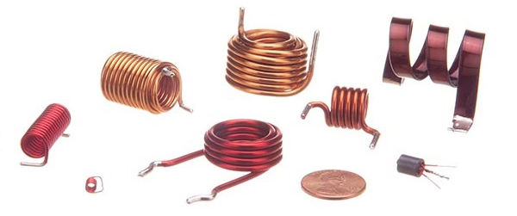
Figure: Air Cored Inductor
Source: https://www.tutorialspoint.com/basic_electronics/basic_electronics_types_of_inductors.htm

Slide 10
ii. Iron Core Inductor
These Inductors have Ferromagnetic materials, such as ferrite or iron, as the core material. The usage of such core materials helps in the increase of inductance, due to their high magnetic permeability. Permeability measures the ability of supporting the formation of magnetic fields within the materials.
The following image shows how an Iron-core Inductor looks like

Slide 11
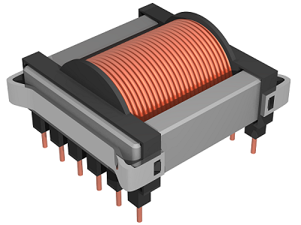
Iron Core Inductor
The inductors that have ferromagnetic core materials just like these, suffer from core losses and energy losses at high frequencies. These Inductors are used in the manufacture of few types of transformers.
Source: https://www.tutorialspoint.com/basic_electronics/basic_electronics_types_of_inductors.htm

Slide 12
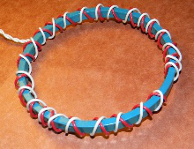
iii. Toroidal Inductors
These Inductors have a magnetic material as the core substance to which the wire is wound.
The main advantage of this type of inductors is that, due to the circular shape, symmetry is achieved in the whole shape of the inductor, due to which there are minimum losses in the magnetic flux. These inductors are mostly used in AC circuit applications.
These are in circular ring shape, just as shown in the following figure.
Source: https://www.tutorialspoint.com/basic_electronics/basic_electronics_types_of_inductors.htm

Slide 13
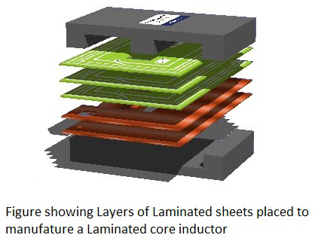

iv. Laminated Core Inductors
These are the inductors that have laminated thin steel sheets, such as stacks, as the core materials. Usually for an inductor, if the loop area is increased for the current to travel, the energy losses will be more. Whereas, in these laminated core Inductors, thin steel sheets of stacks are helpful in blocking the eddy currents, which minimize the loop action.
The following figure shows an image of a laminated core inductor.
The main advantage of these inductors is minimizing the energy loss with its construction. These laminated core inductors are mostly used in the manufacture of transformers.

Slide 14
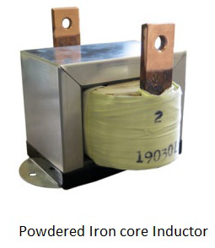
v. Powdered Iron Core Inductors
As the name implies, the core of these inductors have magnetic materials with some air gaps in it. But this kind of construction provides an advantage to the core, to store high level of energy compared with the other types. The following figure shows an image of a Powdered Iron core Inductor.
These inductors provide very low eddy current losses and hysteresis losses. These are available at lowest prices and have very good inductance stability.
Source: https://www.tutorialspoint.com/basic_electronics/basic_electronics_types_of_inductors.htm

Slide 15
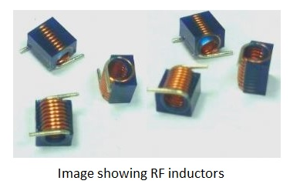
vi. RF Inductors
RF inductors are the radio frequency inductors, which are used at high resonant frequencies.
These can be multilayered coil inductor or a thin film coated ceramic inductor or some wire wound ceramic inductor. The following figure represents few RF inductors.
These inductors are characterized by low current rating and high electrical resistance. But as the high frequencies are used here, the wire resistance increases. Also, few effects come into picture because of these high resonant radio frequencies. Let us have a look at them.
Source: https://www.tutorialspoint.com/basic_electronics/basic_electronics_types_of_inductors.htm

Slide 16
Selection of Inductors based on: Coding
An inductor establishes a magnetic field when current passes through it. Most of the inductors are in the range of milli Henry (mH) or micro Henry (µH). These are available with air, ferrite and iron cores. In today’s market there are several inductors available from various manufacturers and their size varies from larger to smaller units.
Inductor values can be determined mainly by two ways, namely text coding and color coding methods. Some inductors are larger in size, thus often their values are printed on their body (name plate details).
However, for smaller inductors, abbreviation or text is used because there may not be enough room , for printing the actual value on it. Also, some inductor values can be determined by reading color on the body of inductors by comparing them with color coding chart.

Slide 17
Inductor Value Identification using Color Coding
The color coding system for inductors is very similar to that of resistors, especially in case of molded inductors.
This color coding is in accordance with the color code table. Starting from the band closest to the one end, this color code sequence is identified. 4-band and 5-band color coding methods are described below with examples.

Slide 18
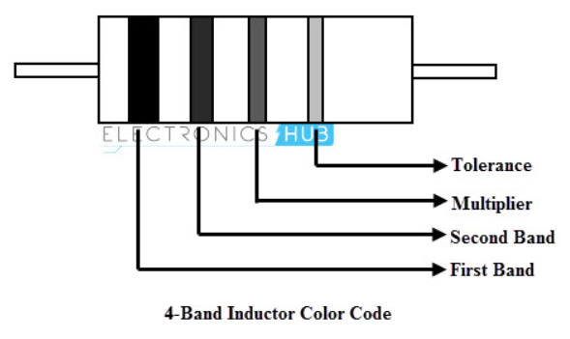
4-Band Inductor Color Code
he above figure shows the 4-band inductor consisting four different color bands. Similar to the number coding, first and second color bands represents the first and second digits of the value, third color band is the multiplier and fourth band is the tolerance.
Therefore the value of inductor can be determined by reading the colors of inductor body and comparing them with color code chart. It is to be noted that the result of this color coded value is in the unit of micro Henry (µH).
Source:https://www.electronicshub.org/inductor-color-code/

Slide 19
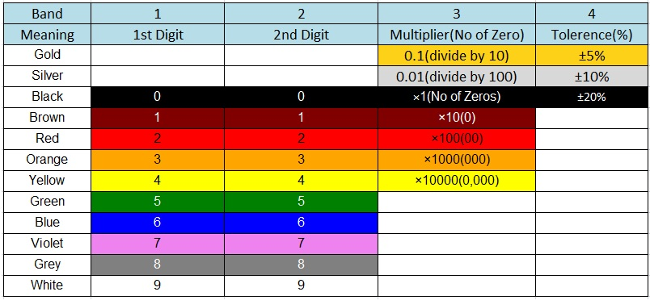
The table below shown gives the color corresponding to the numerical values for a four band inductor.
Source: https://www.electronicshub.org/inductor-color-code/

Slide 20
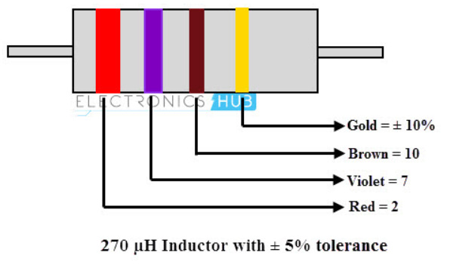
4-Band Inductor Color Code Example
Let us consider the following inductor in order to identify the value of inductor using 4-band color coding.
Initially, note down the tolerance percentage of the inductor which is mostly colored in gold, silver and black.
Now note the colors from other end of an inductor. In the inductor the first band is red; according to the above table the number associated with this color is 2.
Now move to second band, observe the color and note the associated number according to the color given in the table. Here, the second band is violet and its number is 7. Then the value becomes ‘27’.
Coming to 3rd band i.e., multiplier is brown in color and its corresponding number is 10.
Thus the inductor value is 27 X 10 uH = 270 uH with a tolerance rating of ±5%.
In some cases we can have this multiplier band color as gold or silver. If the multiplier is gold divide the value by ‘10’ and if the multiplier band is silver, divide the value by ‘100’.
Source: https://www.electronicshub.org/inductor-color-code/

Slide 21
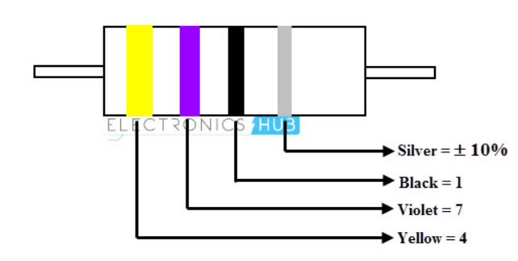
Example 2
Consider the below inductor with band colors yellow, violet, black and silver.
1st band yellow = 4
2nd band violet = 7
3rd band black = 1
4th band is silver = ±10% tolerance.
Thus by this we can say that the inductor is 47 uH with ±10% tolerance.
Source: https://www.electronicshub.org/inductor-color-code/
Notes:
To get more visit: https://www.electronicshub.org/inductor-color-code/

Slide 22
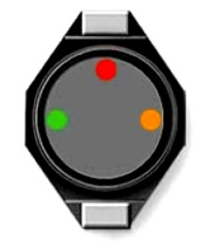
Surface Mount Device (SMD) or Chip Inductor Codes
Some inductors consist of color dots on surface of the device instead of bands and these are very small in size. Generally these are coded according to the top colored dot on the surface. From this top dot we have to calculate the inductor value in clockwise direction. These dots will not indicate polarity. This type of inductors measured in nano-henries.
Consider the following example:
Green and red color indicates the value of inductor in nano Henries and the orange color indicates the multiplier.
Thus the value of this inductor is 52 * 10ˉ3=52,000 nH
Source: https://www.electronicshub.org/inductor-color-code/

Slide 23
Selection of Inductors based on: Specifications and ratings
Like any electronic component, there are several parameters and specifications that are associated with inductors.
The inductor parameters and specifications enable the component to be satisfactorily described and correctly used within the circuit.
The various parameters that can be used enable the inductor performance to be fully specified so that it can confidently used within the required circuit.

Slide 24
Inductance
The key parameter for any inductor is its inductance. The inductance is the property of the inductor that tends to oppose any change in the current flowing.
The SI unit of inductance is the henry, H. The inductance of a circuit is one henry if the rate of change of current in a circuit is one ampere per second and this results in an electromotive force of one volt.
The actual level of the inductance is influenced by many factors including the number of turns on the coil, coil diameter and in particular the core used within the coil.
are more normally specified in terms of microhenries,, µH.

Slide 25
DC Resistance
Another important inductor parameter is the DC resistance it exhibits. As inductors are often manufactured from very thin wire, the DC resistance can sometimes be significant. Even when thicker wire is used, it is still an important factor because it can significantly affect the overall performance as an inductor.
The DC resistance can be considered to be in series with the pure indictor for the sake of most circuit simulations, although in reality it is distributed throughout the inductor.
The DC resistance, measured with a steady current is normally specified in Ohms, Ω and typically given as a maximum value as it is sometimes difficult to control accurately.

Slide 26
Saturation Current
The saturation current is another parameter or specification which is of importance for an inductor.
In an inductor it is possible to saturate the core because there is a limit to the level of magnetic flux a magnetic core such as iron, ferrite or another compound can take. When this occurs the relative permeability falls and in turn this causes the level of inductance falls.
The saturation current is generally taken to be the current at which the level of inductance falls by a specified amount. Figures of 10% are often used for inductors with ferrite cores and 20% for those with iron powdered cores.

Slide 27
Incremental current
Often inductors run with a bias current passing through them. For example, this may be the quiescent current for a transistor collector where the inductor is in the collector circuit itself. There is a drop in inductance that is caused by this current and it is necessary to understand this so that the circuit will be able to operate satisfactorily even when the DC bias current is flowing.
The incremental current inductor parameter is generally taken as the DC bias current flowing through the inductor that causes the inductance to fall by 5% from its initial value with zero bias.
The value for the incremental current parameter or specification indicates the level where a further increase in current would cause the inductance to fall by a significant value.
The incremental current value for an inductor is most important when using ferrite cores as they exhibit a much faster reduction in inductance with increasing current than other forms of core such as a powered iron core.

Slide 28
Rated current
Another important inductor parameter is the rated current. This specification is the maximum continuous current that the inductor can withstand. Generally the limiting factor for this parameter is the temperature rise of the inductor.
With thin wire being used in many inductors to keep the size to a minimum, the current flow can result in power being dissipated in the inductor with the result that the temperature rises. Undue temperature rises can reduce the reliability or even cause catastrophic failure in some circumstances.

Slide 29
Core permeability
The permeability of the inductor core is a key parameter. It governs the inductance of the inductor for a given inductor geometry. Higher permeability core materials result in the inductor providing a higher level of inductance.
The core material as well as the core shape, size and geometry affect the overall effective permeability, and therefore these factors also need to be taken into consideration as well.

Slide 30
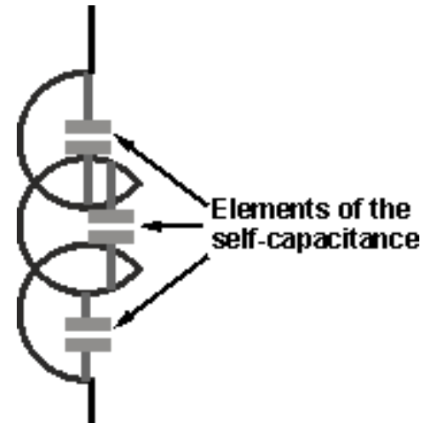
Winding self-capacitance
The inductor self-capacitance or distributed capacitance is a particularly important parameter in many applications. It arises from the fact that apart from adding inductance, the wires also have a small but appreciable level of capacitance between each other.
The diagram shows individual capacitors within the inductor as this a simplified way of showing the self-capacitance. However the capacitance is distributed throughout the whole inductor and it is not separate capacitance.
The level of capacitance depends on the area of the wire, the distance between the two wires and the permittivity of the material between them. Normally the level is relatively low, but it manifests itself to an external circuit as a small amount of capacitance across the inductor. This gives rise to what is termed the self-resonant frequency of the inductor.
Source: https://www.electronicshub.org/inductor-color-code/

Slide 31
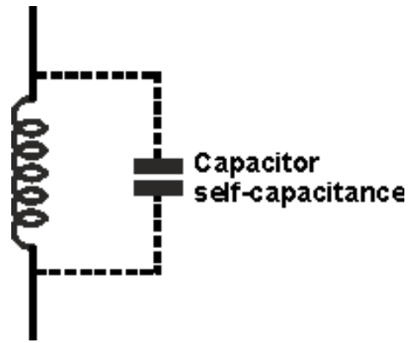
Self resonant frequency
In view of the self-capacitance or distributed capacitance, the inductor forms a parallel resonant circuit as shown.
At the point where the inductor resonates the inductive reactance and the capacitive reactance will cancel each other out, and the overall impedance of the circuit will fall to a value governed by the DC resistance of the circuit. Below the resonant frequency the inductive reactance will dominate, whereas above the self-resonant frequency the capacitive reactance will dominate.
As a result inductors are normally used below their self-resonant frequency to ensure that the effects of self-resonance are not experienced.
Source: https://www.electronicshub.org/inductor-color-code/

Slide 32
Selection of Inductors based on: Applications
Inductors are used in tuning circuits
With the help of inductors, the tuning circuits can select the desired frequency. The capacitors type along with the inductor are used in various electronic devices such as radio tuning circuits, a television in order to modify the frequency and help to select within multiple channels of frequency.
These are used as sensors
The inductive proximity sensors are very reliable in operation and is a contactless sensor. Inductance is the main principle behind it in which the magnetic field in the coil will oppose the flow of electric current. The proximity sensors mechanism is used in traffic lights to detect traffic density.

Slide 33
Selection of Inductors based on: Applications
It is also used to store energy in a device
Inductors can store energy for a small period of time because the energy which is being stored as a magnetic field will be gone when the power supply is removed. Uses of inductors can be seen in computer circuits where power supplies can be switched.
Inductors are used in induction motors
In induction motors, the shaft in the motor will rotate due to the presence of the magnetic field produced due to alternating current. The speed of the motor can be fixed according to the frequency of the supply of power from the source. The use of inductors into the motor’s speed can be controlled.

Slide 34
Selection of Inductors based on: Applications
It is used as transformers
A combination of multiple inductors with a shared magnetic field can be designed into a transformer. One of the major uses of transformer can be seen in power transmission systems. These are used in decreasing or increasing the power transmission as step down or step-up transformers.
Inductors are used as filters
Inductors when combined with capacitors will be used as filters. The input signal’s frequency while entering the circuit is limited by the use of these filters. With the increase in the frequency of supply, the inductor’s impedance increases.

Slide 35
Selection of Inductors based on: Applications
Uses of inductors in chokes
As we are aware that when AC current flows through inductors, it will create a current flow in the opposite direction. This results in the inductor choking the AC current flow and passing the DC current. This mechanism is used in the power source where the AC supply is converted into DC.
It is used as ferrite beads
We have seen ferrite beads used in computer parts and in charging cables of mobile. Inductors used in ferrite beads helps in reducing the frequency of radio interface which the cable creates.
These are used as relays
Relay behaves as an electrical switch. With the use of an inductor coil in the switch, there is a magnetic field produced wherever the switch comes in contact with the flow of AC current.

Slide 36
References
Fundamentals of electronics. Book 1, Electronic devices and circuit applications, Thomas F. Schubert, Jr. and Ernest M. Kim.,an Rafael, California (1537 Fourth Street, San Rafael, CA 94901 USA) : Morgan & Claypool, 2014.
Principles of Electrical Engineering. Wiley., 1922.
Starting Electronics, Keith Brindley (Fourth Edition), published by Elsevier Ltd, 2011.
https://www.electronicshub.org/inductor-color-code/ https://www.tutorialspoint.com/basic_electronics/basic_electronics_types_of_inductors.htm
https://circuitglobe.com/inductor.htm
https://www.tutorialspoint.com/basic_electronics/basic_electronics_types_of_inductors.htm

