Slide 1
Fundamentals
OF ELECTRONICS
WEEK 5:
Description and applications of passive devices/
Part 3: CAPACITORS
Lecturer: NSABIMANA Camille, B.Sc. Eng., M.Sc. IT

Slide 2
Content
Definition
Identification of different types of capacitors and their applications
Selection of Capacitors based on:
  Coding
  Specifications and ratings
  Applications

Slide 3
Definition of capacitors
A capacitor (originally known as a condenser) is a passive two-terminal electrical component used to store energy electrostatically in an electric field. The forms of practical capacitors vary widely, but all contain at least two electrical conductors (plates) separated by a dielectric (i.e., insulator). The conductors can be thin films of metal, aluminum foil or disks, etc. The 'nonconducting' dielectric acts to increase the capacitor's charge capacity. A dielectric can be glass, ceramic, plastic film, air, paper, mica, etc. Capacitors are widely used as parts of electrical circuits in many common electrical devices. Unlike a resistor, a capacitor does not dissipate energy. Instead, a capacitor stores energy in the form of an electrostatic field between its plates.
When there is a potential difference across the conductors (e.g., when a capacitor is attached across a battery), an electric field develops across the dielectric, causing positive charge (+Q) to collect on one plate and negative charge (-Q) to collect on the other plate.

Slide 4
Capacitor cont’
If a battery has been attached to a capacitor for a sufficient amount of time, no current can flow through the capacitor. However, if an accelerating or alternating voltage is applied across the leads of the capacitor, a displacement current can flow.
An ideal capacitor is characterized by a single constant value for its capacitance. Capacitance is expressed as the ratio of the electric charge (Q) on each conductor to the potential difference (V) between them. The SI unit of capacitance is the farad (F), which is equal to one coulomb per volt (1 C/V). Typical capacitance values range from about 1 pF (10⁻¹² F) to about 1 mF (10⁻³ F).
The capacitance is greater when there is a narrower separation between conductors and when the conductors have a larger surface area. In practice, the dielectric between the plates passes a small amount of leakage current and also has an electric field strength limit, known as the breakdown voltage. The conductors and leads introduce an undesired inductance and resistance.

Slide 5
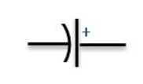
Capacitor cont’
Capacitors are widely used in electronic circuits for blocking direct current while allowing alternating current to pass. In analog filter networks, they smooth the output of power supplies. In resonant circuits they tune radios to particular frequencies. In electric power transmission systems they stabilize voltage and power flow.
The electric symbol of the capacitor is shown below.
Capacitance
The capacitance is the ratio of electric charge (Q) to the voltage (V) and the mathematical expansion is following.
Where:
Q is the electric charge in coulombs, C is the capacitance in farad
And V is the voltage between the plates in volts

Slide 6
Identification of different types of capacitors and their applications
The different types of capacitors are following:
  Electrolytic Capacitor
  Mica Capacitor
  Paper Capacitor
  Film Capacitor
  Non-Polarized Capacitor
  Ceramic Capacitor

Slide 7
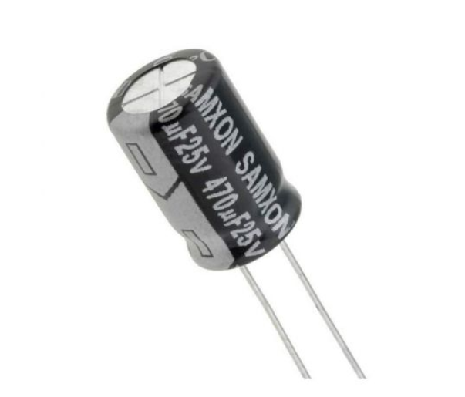
Electrolytic Capacitor
Generally, the electrolyte capacitors are used when the large capacitor values are required. The thin metal film layer is used for one electrode and for the second electrode (cathode) a semi-liquid electrolyte solution which is in jelly or paste is used. The dielectric plate is a thin layer of oxide, it is
developed electrochemically in
production with the thickness of
the film and it is less than the ten
microns.
Source: https://electropeak.com/electrolytic-capacitor-16v-470uf

Slide 8
Electrolytic Capacitor cont’
This insulating layer is very thin, it is possible to make capacitors with a large value of capacitance for a physical size, which is in small and the distance between the two plates is very small. The types of capacitors in the majority of electrolytic are polarized, which is DC voltage is applied to the capacitor terminal and they must be correct polarity.
If the positive to the positive terminal and the negative to the negative terminal as an incorrect polarization will break the insulating oxide layer and there will be permanent damage. All the polarized electrolytic capacitors have polarity clearly with the negative sign to show the negative terminal and the polarity should be followed.
The uses of electrolytic capacitors are generally in the DC power supply circuit because they are large in capacitance and small in reducing the ripple voltage. The applications of this electrolytic capacitors are coupling and decoupling. The disadvantage of the electrolytic capacitors is their relatively low voltage rating because of the polarization of electrolytic capacitor.

Slide 9
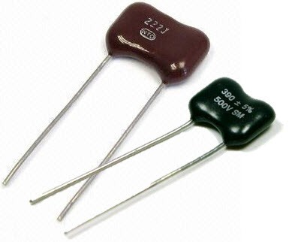
Mica Capacitor
This capacitor is a group of natural minerals and the silver mica capacitors use the dielectric. There are two types of mica capacitors which are clamped capacitors & silver mica capacitor. Clamped mica capacitors are considered as an obsolete because of their inferior characteristic.
The silver mica capacitors are prepared
by sandwiching mica sheet coated with
metal on both sides and this assembly
is then encased in epoxy to protect the
environment.
Source: https://www.linquip.com/blog/what-is-mica-capacitor-2/

Slide 10
Mica Capacitor cont’
The mica capacitors are used in the design calls for stable,
reliable capacitor of relatively small.
The mica capacitors are the low loss capacitors, used at high frequencies and this capacitor is very stable chemically, electrically, and mechanically, because of its specific crystalline structure binding & it is a typically layered structure.
The most common used are Muscovite and phlogopite mica. The Muscovite mica is better in the electrical properties and the other Mica has a high-temperature resistance.

Slide 11
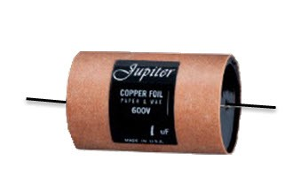
Paper Capacitor
The construction of paper capacitor is between the two tin foil sheet and they are separated from the paper, or, oiled paper & thin waxed. The sandwich of the thin foils and papers then rolled into the cylindrical shape and then it is enclosed into the plastic capsule. The two thin foils of the paper capacitors attach to the external load.
In the initial stage if the capacitors the paper was used in between the two foils of the capacitor, but
these days the other materials like plastics
are used, therefore it is called as a paper
capacitor. The capacitance range of the paper
capacitor is from 0.001 to 2.000micro farad and
the voltage is very high which is up to 2000V.
Source: https://www.watelectronics.com/different-types-of-capacitors-applications/

Slide 12
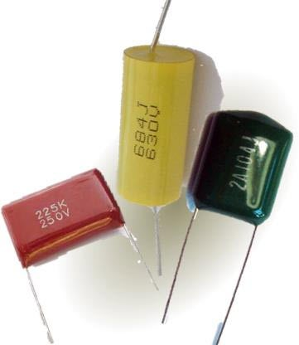
Film Capacitor
The film capacitors are also capacitors and they use a thin plastic as the dielectric. The film capacitor is prepared extremely thin using the sophisticated film drawing process. If the film is manufactured, it may be metalized depend on the properties of a capacitor. To protect from the environmental factor the electrodes are added and they are assembled.
Source: https://www.apogeeweb.net/electron/the-film-capacitor-and-its-application.html/

Slide 13
Film Capacitor cont’
There are different types of film capacitors are available like polyester film, metallized film, polypropylene film, PTE film and polystyrene film. The core difference between these capacitors types is the material used as a dielectric and dielectric should be chosen properly according to their properties. The applications of the film capacitors are stability, low inductance, and low cost.
The PTE film capacitance is a heat resistance and it is used in the aerospace and military technology. The metalized polyester film capacitor is used in the applications are it requires long stability at a relatively low.

Slide 14
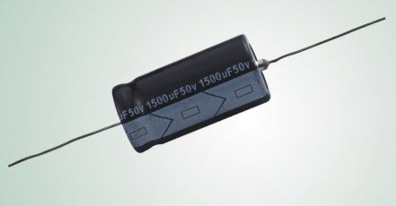
Non-Polarized Capacitors
The nonpolarized capacitors are classified into two types plastic foil capacitor and the other one is the electrolytic nonpolarized capacitor.
Source: Source: https://www.apogeeweb.net/electron/the-film-capacitor-and-its-application.html/

Slide 15
Non-Polarized Capacitors cont’
The plastic foil capacitor is non-polarized by nature and the electrolytic capacitors are generally two capacitors in the series, which are in the back to back hence the result is in the non-polarized with half capacitance. The nonpolarized capacitor requires the AC applications in the series or in parallel with the signal or power supply.
The examples are the speaker crossover filters and power factor correction network. In these two applications, a large AC voltage signal is applied across the capacitor.

Slide 16
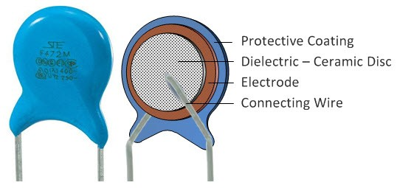
Ceramic Capacitor
The ceramic capacitors are the capacitors and use the ceramic material as a dielectric. The ceramics are one of the first materials to use in the production of capacitors as an insulator.
Source: https://www.apogeeweb.net/electron/the-film-capacitor-and-its-application.html/

Slide 17
Selection of Capacitors based on: Coding
Generally, the actual values of Capacitance, Voltage or Tolerance are marked onto the body of the capacitors in the form of alphanumeric characters.

Slide 18
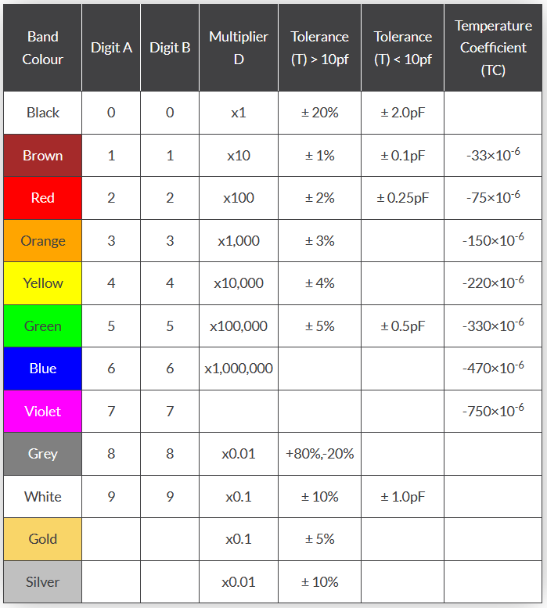
Capacitor Colour Code Table
Source: https://www.electronics-tutorial.net/electronic-components/capacitors/colour-coding-in-capacitors/

Slide 19
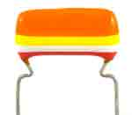
Capacitor Colour Code
You can see the chart has two tolerance values in it. When the calculated value of capacitance is larger than 10 pF the first tolerance column should be considered. If the calculated value is less than 10 pF the second tolerance column should be taken. There is a significant difference between the two methods, so don’t miss them while decoding the capacitor.
Capacitor Value = [Digit1 Digit 2 * multiplier] ± Tolerance
Let see a small example for this,
Source: https://www.electronics-tutorial.net/electronic-components/capacitors/colour-coding-in-capacitors/

Slide 20
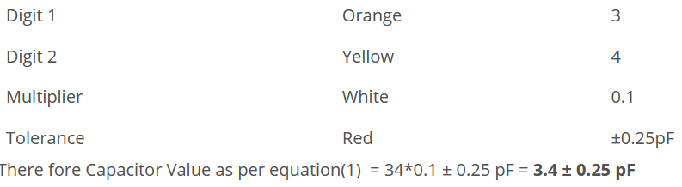
Capacitor Colour Code
Here we have color coded polyester capacitor. Noting the colors we can formulate the codes and finally we can find out the capacitance value.
Source: https://www.electronics-tutorial.net/electronic-components/capacitors/colour-coding-in-capacitors/

Slide 21
Selection of Capacitors based on: Coding
Understanding the relevant capacitor specifications, parameters and characteristics in the data sheets is essential if the right capacitor is to be chosen for any given circuit.
Electrolytic capacitor, ceramic, film, tantalum capacitor, etc. may all have values of capacitance that can be equated, but some of their other properties may vary, making one type more suitable for a particular circuit than another.
Basic capacitor specifications like the value, tolerance and working voltage are needed along with others including self inductance, dielectric absorption and others. Although these may not always be important in every circuit, it is necessary to know and understand which ones are.
Having a good understanding of all the different capacitor specifications and parameters enables the right capacitor to be chosen when selecting and buying capacitors for electronic circuits.

Slide 22
Key capacitor specifications
Some of the key capacitor specifications and characteristics which need to be considered when selecting and buying capacitors include:
Capacitance value: The nominal capacitance is probably the most important capacitor specifications. The basic unit of capacitance is the Farad, although most capacitors have values well below a Farad - the submultiples below being the most common.:
  microfarads, µF, a millionth of a Farad, 10⁻⁶
  nanofarads, nF a 1000 millionth of a Farad, 10⁻⁹
  picoFarads, pF a million millionth of a Farad, 10⁻¹²

Slide 23
Capacitance value Cont’
  Sometimes capacitors can be marked in two ways. For example 100nF is the same as 0.1µF. This means that capacitors can be marked in several different ways.
  It is worth noting that, some super-capacitors have very high levels of capacitance that are actually measured in terms of Farads.
  The nominal capacitance may also be quoted at a certain frequency as the capacitance for some forms of capacitor, typically electrolytic will vary slightly with frequency.
  Obviously the value of the capacitance will govern the impedance it provides at different frequencies. The larger the capacitance, the lower the impedance

Slide 24
Tolerance
Another key parameter for a capacitor is the tolerance on its value. Dependent upon the capacitor and its properties, it may be very accurate, or there may be a wide tolerance on the value.
The tolerance value is the extent to which the actual value of the capacitor can vary from the stated or nominal value and it is often expressed as a percentage., although for values of a few picofarads it may be expressed as an actual value, i.e. 20pF ±1pF, etc.
Normally the tolerance of a capacitor is given in terms of the percentage tolerance, expressed as ±NN%. Values of ±5% and ±10% are commonly used for coupling and decoupling applications. For components used in applications where better tolerances are required, there are many with tolerances of ±1 and ±2%, and occasionally better.

Slide 25
Working voltage
The working voltage capacitor characteristic defines the maximum continuous voltage that may be applied across the capacitor. This is normally printed on the case and will be mentioned in the datasheet. The voltage normally refers to the largest DC voltage that can be applied. Also be aware that when a capacitor is operating in a circuit with an AC waveform superimposed on a DC voltage, then the voltages experienced may be well above the quiescent DC value.
For some capacitors used in AC applications, an AC value may be quoted. Be aware that this refers to the RMS voltage and not the peak value which is √2, or 1.414 times greater.
Although some capacitors can withstand a short peak voltage, this can cause others to break down irreparably, so it is wise to beware. As a result, some capacitors may also have a surge rating - these capacitors tend to be those that might be used for AC power applications where surges occur.

Slide 26
Working voltage cont’
It is always good practice to run capacitors well within their rated voltage. There is a link between the margin provided between the actual voltage at which the capacitor is run and its rated operating voltage. The greater the margin, the higher the reliability.
Often commercial design guidelines stipulate that capacitors should not be run above 50% of their rated values, and guidelines for designing high reliability military equipment follow similar guidelines. Operating with a good margin ensures high levels of reliability are achieved.

Slide 27
Dielectric
The dielectric is one of the key items that governs many of the capacitor characteristics. As a result capacitors are often referred to by their dielectrics: electrolytic; tantalum, ceramic; plastic film; silver mica; and the like. As the characteristics of these capacitors and the capacitance ranges available vary, it is important to select the required dielectric, looking carefully at the performance and overall capacitor specification in the datasheet.
The dielectric tends to govern a number of aspects of the capacitor operation and therefore capacitors with different dielectric types tend to be used for different applications.
Notes:
Dielectric: a medium or substance with a dielectric property; an insulator. It means having the property of transmitting electric force without conduction; insulating.

Slide 28
Dielectric cont’
Aluminium electrolytic capacitors: Large capacitance - normally above 1µF, large ripple current, low frequency capability - not normally used above 100kHz or so, higher leakage than other types.
Tantalum capacitors: High value in very small volume - values normally above 1µF, higher frequency capability than aluminium electrolytic, normally low voltage, very intolerant to over-voltage and reverse voltage.
Ceramic capacitors: Values tend to be below 1µF, normally capable of high frequency operation, low leakage current; as there are several types of ceramic dielectric, check the properties.
In view of the different characteristics, it is necessary to check which dielectric is most suitable for the circuit, and position within the circuit where it will be used.

Slide 29
Working temperature
All capacitors have a limited working temperature range whether ceramic capacitors, electrolytic capacitors, tantalum capacitors or whatever type. This specification details the limits within which the capacitor will work satisfactorily and over which it is designed to operate.
Some aspects that limit the working range of a capacitor are the voltage - this falls with increasing temperature; the ripple current - again lower with increasing temperature. The lower temperature specification can be governed by a number of factors. One is the electrolyte operation in components such as electrolytic capacitors. The working temperature is particularly important for electrolytic capacitors as their expected life falls rapidly with increasing temperature.

Slide 30
Temperature coefficient
Capacitors, like all components vary with temperature. The degree is relatively small, and does not make a difference in circuits where the value is not critical, but in others where the circuit is dependent upon the exact value, e.g. an LC oscillator, etc, the temperature coefficient can be very important.
The temperature coefficient is often expressed as the variation in parts per million per degree Celsius.

Slide 31
Leakage resistance/ current
The leakage current or leakage resistance specification indicates the amount of current that flows through the capacitor. Leakage current occurs as a result of the fact that capacitors are not perfect insulators. If a capacitor is charged up, and then disconnected, it will slowly lose its charge. Also when it is charged and continuously supplied then current will flow through it.
Both the leakage current and leakage or insulation resistance are seen quoted in specifications. As they are related by Ohm's law it is simple to translate between the two. Typically the insulation resistance is used where very high value of resistance are encountered, and the current often used for large capacitors and where there is more leakage. For example: supercapacitors, and aluminium electrolytic capacitors normally have values of leakage current quoted, but for ceramic capacitors or plastic film capacitors where the leakage current is minute, the values of resistance are typically given.
Note: A very high leakage resistance value can mean that if the capacitor is used in a high voltage circuit, then these voltages can remain for some time after the unit is switched off if there is not external leakage path. Beware when handling circuits where high voltages have been present as retained charge may present for some time after switch-off.

Slide 32
ESR and Self inductance
ESR: The Equivalent Series Resistance or ESR, is an important specification in many instances. It is the impedance of the capacitor to alternating current and it is particularly important at high frequencies. The ESR specification includes the resistance of the dielectric material, the DC resistance of the terminal leads, the DC resistance of the connections to the dielectric and the capacitor plate resistance all measured at a particular frequency.
Self inductance: Capacitors are not just a pure capacitance - they include various other spurious elements beyond the basic capacitance. One that is of particular importance for high frequency / RF circuits is the self inductance.
Normally the inductance in capacitors is relatively small - it may be in the region 1 - 20 nH, but the actual value will be very dependent upon the type of capacitor and its construction. As a result of the small value of inductance, the effects of the self inductance are normally only seen at high frequencies.
Notes:
Self-inductance: Self inductance is defined as the phenomenon in which a change in electric current in a circuit produces an induced electro-motive-force in the same circuit.

Slide 33
Self resonant frequency
The self resonant frequency of a capacitor arises from a resonant circuit being set up between the equivalent series inductance and the capacitance of the capacitor. This is often specified separately for capacitors that are like to be used in RF applications - sometimes a plot of the response may be included as there may be several resonant frequencies.
At the resonant frequency, Fr, the inductive and reactive impedances cancel leaving the resistive elements of the circuit, i.e. the ESR. Also, remember that above the resonant frequency, the capacitor will appear inductive. The resonant frequency is normally associated with RF circuits, and therefor it is normally ceramic capacitors that can be specified in this way.
Notes:
Resonant frequency is the oscillation of a system at its natural or unforced resonance. Resonance occurs when a system is able to store and easily transfer energy between different storage modes, such as Kinetic energy or Potential energy as you would find with a simple pendulum.

Slide 34
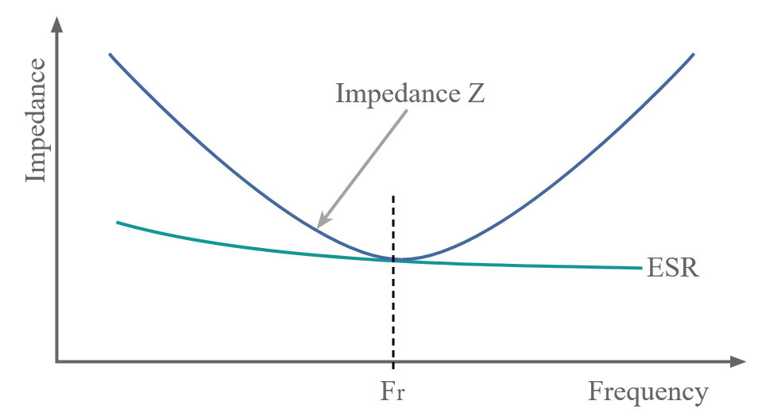
Figure: Capacitor impedance curve showing self resonance
Source: https://www.watelectronics.com/different-types-of-capacitors-applications

Slide 35
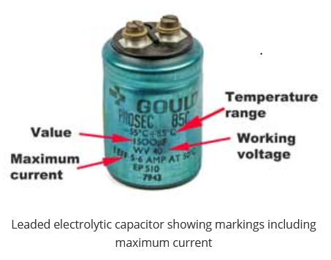
Ripple current
This specification is of great importance for circuits where significant levels of current are flowing. One of the main applications where this is important is within power supply circuits, particularly within the smoothing sections of the supply.
It is necessary to determine the
maximum ripple current within
the circuit and then consult the
datasheet to ensure that the
ripple current specification is
not exceeded and better still
that there is a good margin.
Source: https://www.watelectronics.com/different-types-of-capacitors-applications
Notes:
Ripple Current and its Effects on the Performance of Capacitors
https://passive-components.eu › ripple-current-and-its-e...
2 Nov 2020 — In most electronic devices, the DC current signal applied to a circuit has an AC portion. This AC portion is referred to as the ripple current. Some ...
People also ask
What is meant by ripple current?
The ripple current in capacitors mainly means the current flowing into capacitors when the load current to IC changes. At this time, capacitors generate heat by the ripple current since they have resistance called ESR in themselves. ... This is called permissible ripple current.

Slide 36
Selection of Capacitors based on: Applications
I. Aluminium Electrolytic Capacitors
Characteristic: Aluminum Electrolytic Capacitors are polarized, so they cannot be used with AC. They can achieve high capacitance value but with large variations, typically 20%.
Applications: These are useful in applications which do not need tight tolerances or AC polarization. They are most commonly used in power supplies for decoupling purposes, i.e. to reduce voltage ripple reaching the circuit. They are also used widely in DC/DC switching voltage converters.

Slide 37
II. Ceramic Capacitors
Characteristic: There are two main types of ceramic capacitors: Multi-layer chip capacitors (MLCCs) and ceramic disc capacitors. MLCCs are very widely used in electronic devices and are popular because they have high stability and low losses. They have lower Equivalent Series Resistance (ESR) and variation compared to electrolytic or tantalum capacitors but can achieve lower capacitance (only up to a few µF) . Because of high packing densities, MLCC capacitors provide a size advantage and are great for printed circuit boards (PCBs).
Applications: Since these are not polarized, they can be used with AC. They are widely used as a ‘general-purpose’ capacitor and used for high frequency blocking, filtering, oscillator tuning and EMI suppression.

Slide 38
III. Tantalum Capacitors
Characteristic: These are a subtype of electrolytic capacitors and are highly polarized. Care needs to be taken as they are known to have catastrophic failure modes which can be triggered by voltage spikes even slightly more than rated voltage. They can achieve high capacitance value and are very stable over time. They are smaller in size than aluminum electrolytic capacitors of the same capacitance but can handle lower maximum voltages.
Applications: Due to their low leakage current, stability, and high capacity, they are common for sample and hold circuits which rely on low leakage current to achieve long hold duration. They are also used in power supply filtering due to their smaller size and long term stability.

Slide 39
IV. Film Capacitors
Film capacitors are non-polarized which makes them suitable for AC signal use. They have low Equivalent Series Resistance (ESR) and self-inductance (ESL) and are used in A/D converters.
They can handle high peak current and can thus be used as snubber capacitors to “snub” inductive kickback voltage spikes in DC-DC converters.

Slide 40
V. Mica Capacitors
Mica capacitors are non-polarized, have low losses, high stability, and have great high-frequency properties. They are useful for radio frequency circuits. Mica capacitors can cost a few dollars per piece, so they are being replaced by ceramic capacitors for low-power applications.
However, they remain critical for high power applications such as RF transmitters due to their high breakdown voltage.

Slide 41
VI. Polymer Capacitors
Polymer capacitors are polarized just like other electrolytic capacitors but have several advantages such as lower losses due to lower ESR and longer lifetime. For conventional aluminium electrolytic capacitors, there is a risk of electrolyte dry-out at lower temperatures, but due to the use of solid polymer material as dielectric, polymer capacitors have high reliability even at very low temperatures.
Polymer capacitors are used in place of electrolytic capacitors for high quality motherboards and DC-DC converters.

Slide 42
References
Fundamentals of electronics. Book 1, Electronic devices and circuit applications, Thomas F. Schubert, Jr. and Ernest M. Kim., an Rafael, California (1537 Fourth Street, San Rafael, CA 94901 USA) : Morgan & Claypool, 2014.
Principles of Electrical Engineering. Wiley., 1922.
Starting Electronics, Keith Brindley (Fourth Edition), published by Elsevier Ltd, 2011.
https://electropeak.com/electrolytic-capacitor-16v-470uf
https://www.linquip.com/blog/what-is-mica-capacitor-2/
https://www.watelectronics.com/different-types-of-capacitors-applications/
https://www.apogeeweb.net/electron/the-film-capacitor-and-its-application.html
Source: https://www.electronics-tutorial.net/electronic-components/capacitors/colour-coding-in-capacitors/

