Slide 1
FUNDAMENTALS
OF ELECTRONICS
WEEK 6:
DESCRIPTION AND APPLICATIONS OF ACTIVE DEVICES/
PART 1: DIODES
Lecturer: NSABIMANA Camille, B.Sc. Eng., M.Sc. IT

Slide 2
Content
Identification of different types of diodes
        Ordinary diode
        Zener
        LED
        Photo-diode
        Tunnel diode
        Varactor diode
Selection of Diode based on
        Coding
        Specifications & ratings
        Applications

Slide 3
Definition of Active Devices
An active device is any type of circuit component with the ability to electrically control electric charge flow (electricity controlling electricity).
In order for a circuit to be properly called electronic, it must contain at least one active device.

Slide 4
Definition of Diode
A diode is a two-terminal electronic component that conducts current primarily in one direction; it has low resistance in one direction, and high resistance in the other.
The most common function of a diode is to allow an electric current to pass in one direction (called the diode's forward direction), while blocking it in the opposite direction (the reverse direction). As such, the diode can be viewed as an electronic version of a check valve.

Slide 5
How do diodes work?
Before knowing the uses of diodes, we should know that an ideal diode is enclosed in a plastic or glass case to mark the cathode side of it. There are two ways a diode functions, either it is a forward-biased or it is reverse-biased.
Let us consider a P-N junction type diode;
If the diode is in forward bias, the P-type region is connected with the positive terminal of the voltage source and N-type to the negative terminal. Electrons will get attracted to this terminal and will form a covalent bond with the P-type material.
FORWARD-BIASED | REVERSE-BIASED
Current flows from anode to cathode. | Current flows from cathode to anode

Slide 6
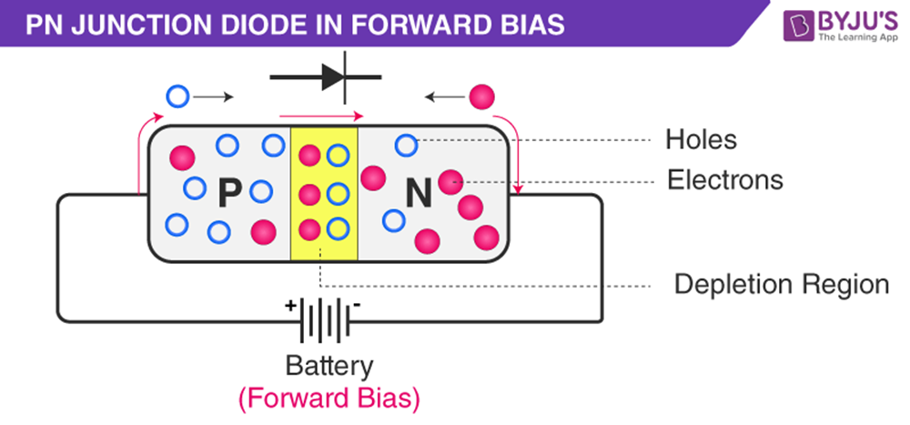
How do diodes work? Cont’
So, without any hindrance, the PN-junction diode will behave as a short circuit.
Source: https://byjus.com/physics/uses-of-diode/

Slide 7
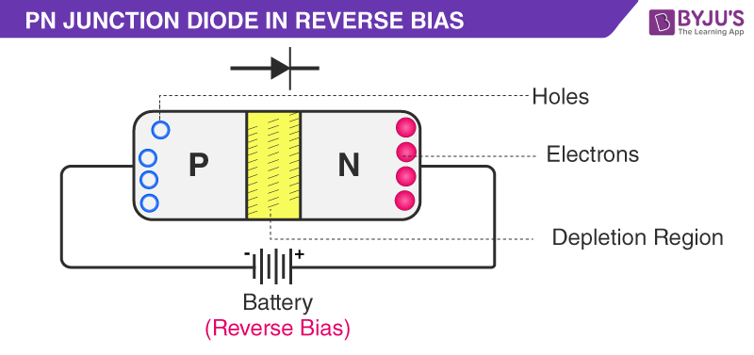
How do diodes work? Cont’
When the diode is in reversed bias, the P-type region is connected to the negative terminal and the N-type region is connected to the positive terminal of the source. Because the positive terminal is connected to N-type, the free electrons are attracted towards that region due to the presence of positive terminal.
Source: https://byjus.com/physics/uses-of-diode/

Slide 8
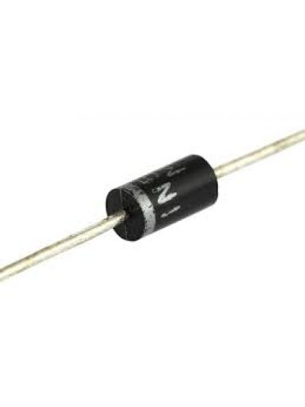
        Identification of different types of diodes
Ordinary diode
An ordinary diode is designed to be used as a rectifier and not for operating in reverse breakdown. Consequently, an ordinary diode will not be able to reliably
  handle much current before
  the junction is damaged
  permanently.
Source: https://byjus.com/physics/uses-of-diode/

Slide 9
Zener Diode
Zener diode is a special type of diode designed to reliably allow current to flow "backwards" when a certain set reverse voltage, known as the Zener voltage, is reached.
Zener diodes are manufactured with a great variety of Zener voltages and some are even variable. Some Zener diodes have a sharp, highly doped p-n junction with a low Zener voltage, in which case the reverse conduction occurs due to electron quantum tunnelling in the short space between p and n regions − this is known as the Zener effect, after Clarence Zener.
Diodes with a higher Zener voltage have a more gradual junction and their mode of operation also involves avalanche breakdown.

Slide 10
Zener Diode
Both breakdown types are present in Zener diodes with the Zener effect predominating at lower voltages and avalanche breakdown at higher voltages.
Zener diodes are widely used in electronic equipment of all kinds and are one of the basic building blocks of electronic circuits.
They are used to generate low-power stabilized supply rails from a higher voltage and to provide reference voltages for circuits, especially stabilized power supplies. They are also used to protect circuits from overvoltage, especially electrostatic discharge (ESD).
Notes:
Note: Electrostatic discharge is the sudden flow of electricity between two electrically charged objects cause by contact an electrical short, or dielectric breakdown. A buildup of static electricity can be caused by tribocharging or by electrostatic induction.

Slide 11
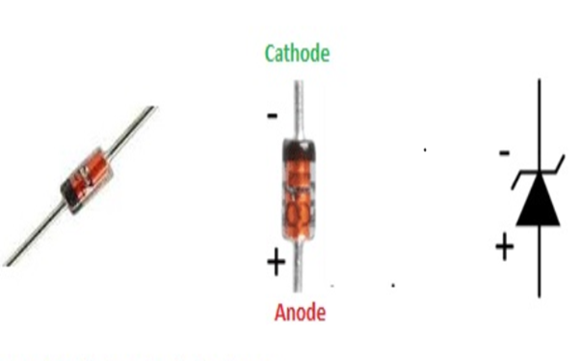
Figure: Zener Diode
Source: https://www.theengineeringprojects.com/2019/09/what-is-the-zener-diode.html

Slide 12
Zener Diode cont’
Zener Effect
Zener Effect is the category of the electric failure (breakdown) that exits in reverse biasing PN junction the strong statice field allow the electrons to move from the valance band to the conductive band of a semiconductor.
Its name is due to the use of this factor in the operation of the Zener diode.
Applications of Zener Diode
It is commonly used as a voltage reference device.
It used in voltage regulators.
It used for switching purposes.
Zener diode is an important part of the clamp and clipping circuitries.
It used in many security circuitries.
It also used in electronic devices like mobile laptops, computers, etc.

Slide 13
Light-Emitting Diode
A light-emitting diode (LED) is a semiconductor device that emits light when an electric current is passed through it. Light is produced when the particles that carry the current (known as electrons and holes) combine together within the semiconductor material. Since light is generated within the solid semiconductor material, LEDs are described as solid-state devices.
The term solid-state lighting, which also encompasses organic LEDs (OLEDs), distinguishes this lighting technology from other sources that use heated filaments (incandescent and tungsten halogen lamps) or gas discharge (fluorescent lamps).

Slide 14
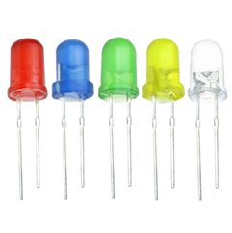
Main LED materials
The main semiconductor materials used to manufacture LEDs are:
Indium gallium nitride (InGaN): blue, green and ultraviolet high-brightness LEDs
Aluminum gallium indium phosphide (AlGaInP): yellow, orange and red high-brightness LEDs
Aluminum gallium arsenide (AlGaAs): red and infrared LEDs
Gallium phosphide (GaP): yellow
and green LEDs
Source: https://byjus.com/physics/uses-of-diode/

Slide 15
LED Con’t
Working principle of LED
When a suitable voltage is applied to the leads, electrons are able to recombine with electron holes within the device, releasing energy in the form of photons.
This effect is called electroluminescence, and the color of the light (corresponding to the energy of the photon) is determined by the energy band gap of the semiconductor.

Slide 16
Photodiode
A photodiode/photodetector is a semiconductor p-n junction device that converts light into an electrical current. The current is generated when photons are absorbed in the photodiode.
The operating principle of the photodiode is such that when the junction of this two-terminal semiconductor device is illuminated then the electric current starts flowing through it. Only minority current flows through the device when the certain reverse potential is applied to it.
Note: A photon is a tiny particle that comprises waves of electromagnetic radiation. As shown by Maxwell, photons are just electric fields traveling through space. Photons have no charge, no resting mass, and travel at the speed of light.

Slide 17
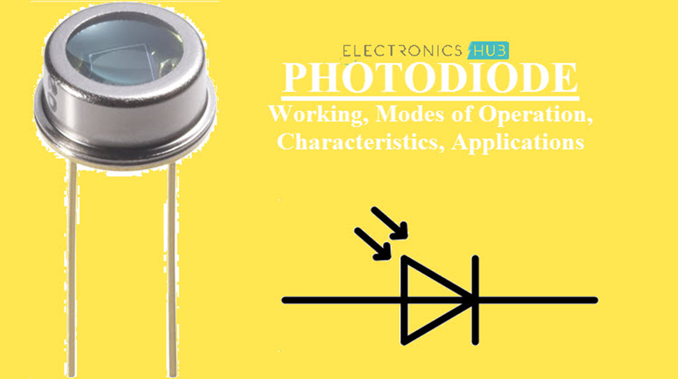
Figure: Image and symbol for photodiode
Source: https://www.electronicshub.org/photodiode-working-characteristics-applications/

Slide 18
Working of a photodiode
Generally, when a light is made to illuminate the PN junction, covalent bonds are ionized. This generates hole and electron pairs. Photocurrents are produced due to generation of electron-hole pairs. Electron hole pairs are formed when photons of energy more than 1.1eV hits the diode.
When the photon enters the depletion region of diode, it hits the atom with high energy. This results in release of electron from atom structure. After the electron release, free electrons and hole are produced.

Slide 19
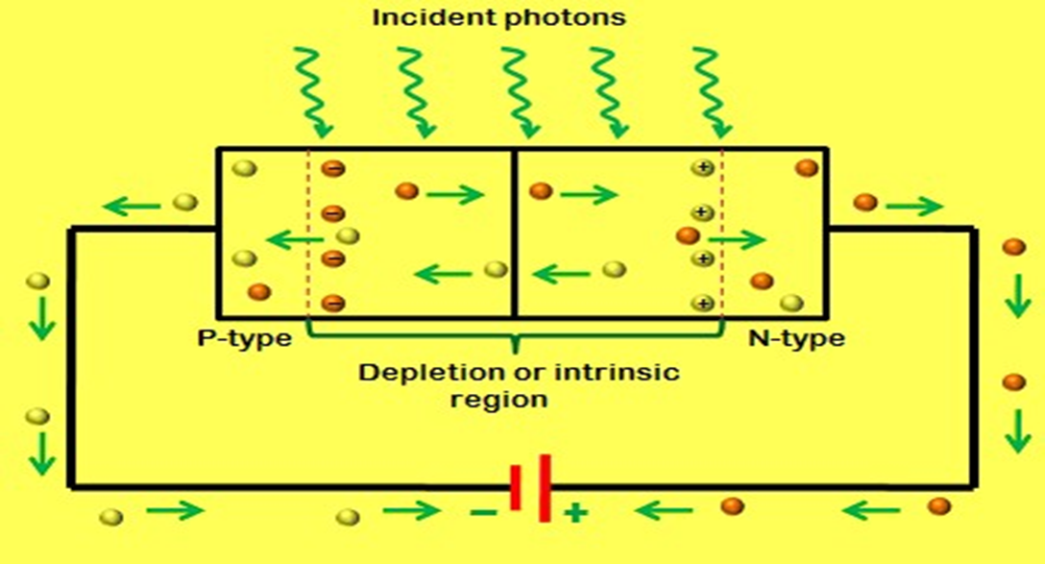
Figure: Working of photodiode

Slide 20
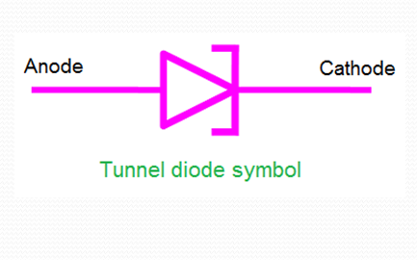
TUNNEL DIODE
A tunnel diode (also known as a Esaki diode) is a type of semiconductor diode that has effectively “negative resistance” due to the quantum mechanical effect called tunneling. Tunnel diodes have a heavily doped pn junction that is about 10 nm wide.
Quantum tunnelling or tunneling (US) is the quantum mechanical phenomenon where a wavefunction can
propagate through a potential barrier.
The transmission through the barrier can
be finite and depends exponentially on
the barrier height and barrier width.
Source: https://www.physics-and-radio-electronics.com/

Slide 21
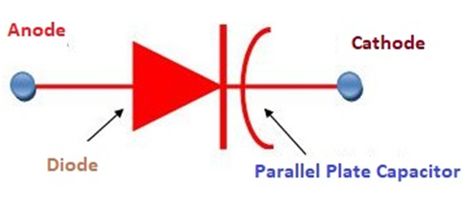
        Varactor diode
Varactor Diode Varactor diode is a type of diode whose internal capacitance varies with respect to the reverse voltage. It always works in reverse bias condition and is a voltage-dependent semiconductor device.
Varactor diode is known by several names as Varicap, Voltcap, Voltage variable capacitance, or Tunning diode.
Source: https://circuitglobe.com/varactor-diode.html

Slide 22
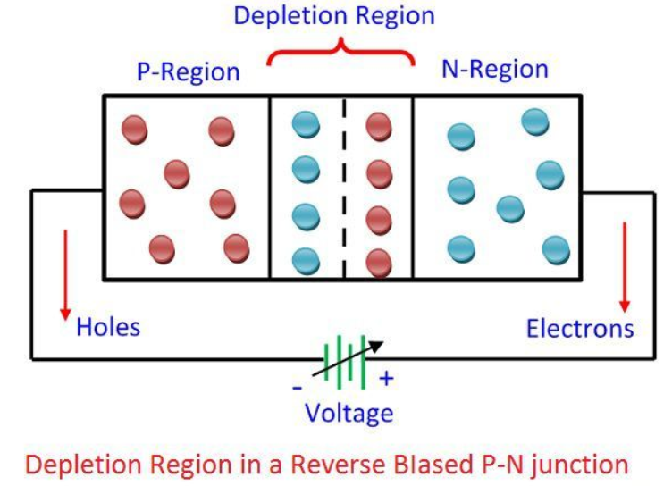
Working of Varactor Diode
The Varactor diode is made up of n-type and p-type semiconductor material. In an n-type semiconductor material, the electrons are the majority charge carrier and in the p-type material, the holes are the majority carriers. When the p-type and n-type semiconductor material are joined together, the p-n junction is formed, and the depletion region is created at the PN-junction. The positive and negative ions make the depletion region. This region blocks the current to enter from the PN-region.
Source: https://circuitglobe.com/varactor-diode.html

Slide 23
Working of Varactor Diode cont’
The varactor diode operates only in reverse bias. Because of reverse bias, the current does not flow. If the diode is connected in forward biasing the current starts flowing through the diode and their depletion region become decreases. The depletion region does not allow the ions to move from one place to another.
The Varactor diode is used for storing the charge not for flowing the charge. In the forward bias, the total charge stored in the diode becomes zero, which is undesirable. Thus, the Varactor diode always operates in the reverse bias.

Slide 24
Selection of Diode based on Coding
The European System(ES) Diode Code
Identification consists of an alphanumeric code as per below:
[1] Two letters and three figures.
[2] Three letters and two figures.
The first naming method is for General purpose diodes and the second option is for special purpose diodes. As shown in the above figure, mostly cathode terminal is identified with the help of marking of the stripe.
First letter = Semiconductor material
A – Germanium
B – Silicon
C – Gallium Arsenide
D – Photodiodes

Slide 25
Selection of Diode based on Coding cont’
Second Letter = Application
A – General Purpose diode
B – Variable capacitance diode
E – Tunnel diode
P – Photo diode
Q – Light Emitting Diode
T – Controlled Diode
X – Varactor Diode
Y – Power rectifier
Z – Zener Diode
Third letter – The third letter does not have any particular significance. The letter is used to mention the specialized application of the diode.

Slide 26
Selection of Diode based on Specifications and Ratings
Semi conductor material: Silicon & Germanium
Diode type: PN junction, etc
Forward voltage drop is the voltage drop across the diode when it is forward conduction. For silicon diodes V_{f} = 0.6 V. Zener Diodes. Zener diodes have all the same characteristics of normal diodes.
Peak inverse voltage or Peak Reverse Voltage (PRV) refer to the maximum voltage a diode or other device can withstand in the reverse-biased direction before breakdown. Also may be called Reverse Breakdown Voltage.
Reverse breakdown voltage is the reverse anode voltage at which the diode conducts a specified amount of reverse current. Since it's the reverse current across a junction, IR exhibits a knee shaped rise, increasing rapidly once breakdown occurs.

Slide 27
Selection of Diode based on Specifications and Ratings cont’
Maximum forward current: The Maximum value of the forward current that a PN junction or diode can carry without damaging the device is called its Maximum Forward Current. The rating of a PN junction or a diode is specified by the manufacturer in its datasheet.
Junction operating temperature: The junction temperature refers to the temperature of the silicon die within the package of the device when the device is powered. The junction temperature can also be referred to as the operating temperature.

Slide 28
Selection of Diode based on Specifications and Ratings Cont’
Junction-to-ambient thermal resistance (θJA) is defined as the thermal resistance from the semiconductor junction to the ambient air (junction-to-ambient). θJA is a measure of the ability of a device to dissipate heat from the surface of the die to the ambient air via all paths.
Leakage current: the current that the diode will leak when a reverse voltage is applied to it.

Slide 29
Selection of Diode based on Specifications and Ratings Cont’
  Even though diodes are one-way devices, and they are only supposed to conduct current through them when they receive forward voltage (positive voltage to the anode), they will still conduct a small amount of current, called leakage current, when connected in reverse biased (positive voltage) to the cathode.
Junction capacitance: Junction capacitance of a PN junction diode: capacitance which must be added to the circuit model of a p-n diode. The capacitance associated with the charge variation in the depletion layer is called the. junction capacitance, while the capacitance associated with the excess carriers in the quasi-neutral region is called the diffusion capacitance.

Slide 30
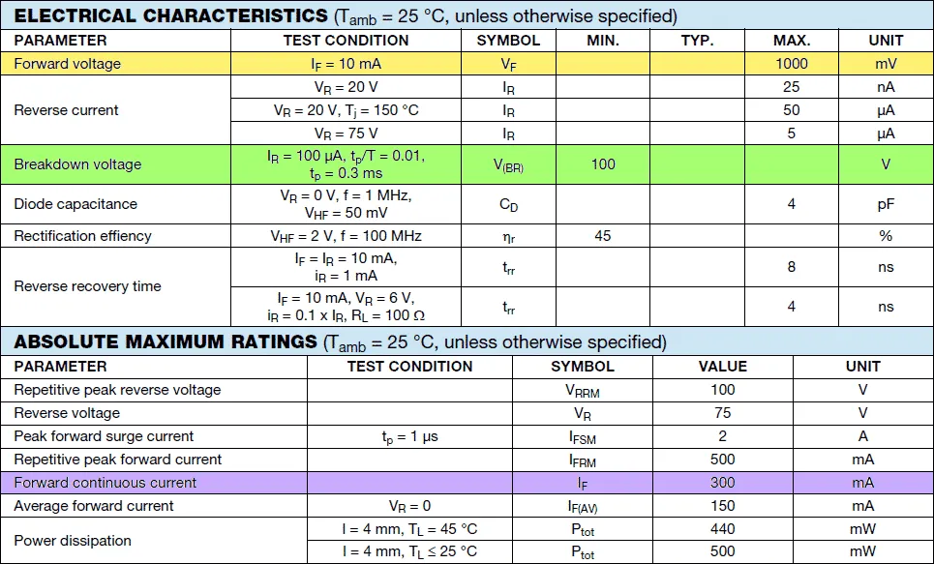
DIODES RATING
Source: https://www.electricalclassroom.com/diode-ratings-diode-datasheet/

Slide 31
DIODES RATING Cont’
Forward voltage drop (V_{f})
The voltage drop measured across a forward-biased diode during conduction is known as forward voltage drop. A silicon diode has a forward voltage drop of 0.6V and a germanium diode has a forward voltage drop of 0.7V.
Peak Inverse Voltage (PIV)
Peak Inverse Voltage refers to the maximum reverse bias voltage a diode withstands without damaging itself, before breakdown. The peak inverse voltage is also known as peak reverse voltage. The peak inverse voltage rating of a diode increases and decreases with temperature. A typical diode used in rectifiers has a PIV rating of at least 50Vdc at room temperature.
Maximum repetitive reverse voltage (V_{RRM})
The maximum reverse voltage a diode can withstand in the form of repetitive pulses is known as Maximum repetitive reverse voltage (V_{RRM}). In other words, it is the maximum reverse voltage that a diode can withstand when applied repeatedly. It is a very important diode rating, that is taken into account while selecting a diode for rectifiers.

Slide 32
DIODES RATING Cont’
Maximum DC reverse voltage, V_{R}
Maximum DC reverse voltage, V_{R}, is defined as the maximum continuous reverse-biased voltage a diode can withstand. The maximum DC reverse voltage is also known as the maximum DC blocking voltage (V_{DC}).
Forward Viltage V_{F}:
A certain amount of voltage is required to trigger conduction in the forward direction. Forward voltage can be defined as the minimum voltage that when applied across diode triggers conduction in the diode. For silicon diodes, the typical forward voltage is around 0.7V and for germanium diode, the typical forward voltage is around 0.3V.

Slide 33
DIODES RATING Cont’
Repetitive Peak Forward Surge Current – I_{FRM}
The repetitive peak forward surge current is the maximum current surge the diode can handle as repetitive pulses without damaging itself.
Maximum reverse current or leakage current – I_{R}
The maximum amount of current the diode can conduct during reverse bias is known as reverse leakage current or leakage current. It is negligible when compared to the forward continuous current. For an ideal diode, the leakage current assumed to be zero.
Maximum power dissipation – P_{Dmax}
Maximum power dissipation is the maximum possible power dissipation in the diode when operating in forward bias. It is typically the multiplication of forward voltage by the forward continuous current. The P-N junction offers a resistance to the current flow resulting in power loss in the form of heat across the junction.

Slide 34
Selection of Diode based on Applications
Diodes are selected according to the following applications:
Limiters
Clippers
Logic gates
Rectifiers
Gain control
Amplifiers
Etc.
This is because in each application we can choose a diode which can fit.

Slide 35
References
Fundamentals of electronics. Book 1, Electronic devices and circuit applications, Thomas F. Schubert, Jr. and Ernest M. Kim.,an Rafael, California (1537 Fourth Street, San Rafael, CA 94901 USA) : Morgan & Claypool, 2014.
Principles of Electrical Engineering. Wiley., 1922.
Starting Electronics, Keith Brindley (Fourth Edition), published by Elsevier Ltd, 2011.
https://circuitglobe.com/varactor-diode.html
https://www.physics-and-radio-electronics.com/electronic-devices-and-circuits/semiconductor-diodes/tunneldiode-howitworks.html
https://www.electronicshub.org/photodiode-working-characteristics-applications/
https://www.theengineeringprojects.com/2019/09/what-is-the-zener-diode.html
https://byjus.com/physics/uses-of-diode/
https://www.electricalclassroom.com/diode-ratings-diode-datasheet/

