Slide 1

THE SOCIAL ASPECTS OF ENGINEERING PROJECT MANAGEMENT
Lesson 10
https://www.innovationlab-logistics.com/social-aspects-must-not-be-forgotten/
Lecturer: M. Kurbonov

Slide 2
THE SOCIAL ASPECTS OF ENGINEERING PROJECT MANAGEMENT
L10
It is a cute cliché that engineers lack social and interpersonal skills. In actual fact, being a good engineering project manager is a highly social activity, and you will find that exercising effective interpersonal skills is an important part of your success as an engineering project manager. In this part of the lesson, we will learn what you need to know: aligning and building an effective team, motivating and inspiring people, managing conflict, and other topics. The good news is that the engineers can actually learn to do this aspect of the job just fine … despite the clichés.
You will spend most of your time as the manager of an engineering project dealing with people: employees, subcontractors, vendors, buying customers, paying customers, supervisors, other stakeholders, your corporate law department, your corporate human relations department, and so forth.
Since you will be spending so much of your time dealing with people, the social aspects of engineering project management – motivating people, aligning your team, resolving conflict, managing expectations, and so forth – are hugely important to your success, and to the success of your project.

Slide 3
Dealing With People, Becoming a Leader
L10
As an engineer, you certainly expect to deal with technical issues: requirements, design, implementation, testing, and so forth. But when we become a manager – most likely, starting as the manager of a small segment within a larger project, and working our way over time up to more responsible positions – we also deal with management issues. This includes items such as the following:
Cost estimation
Change control
Scheduling
Management and direction of resources
Contract negotiations
Customer understanding and satisfaction
Selecting and motivating people
Listening to all of the stakeholders
Conflict resolution
Balancing the need for good decisions against the need for prompt decisions.

Slide 4
Dealing With People, Becoming a Leader
L10
When you are the manager of an engineering project, you lead and integrate all aspects of the project: technical, financial, contractual, safety, quality, and everything else that we have discussed so far in our lessons.
You also lead the interaction with all of the stakeholders:
Your team
Your corporation’s management
Your corporation’s stockholders or owners, and the investment community
Your corporate specialist staff functions (e.g. human relations, finance, law, contracts, quality, etc.)
Your buying customer
Your users
Other interested and affected parties (including, perhaps, the general public).

Slide 5
Alignment
L10
As the project manager, it is part of your job to synchronize and align all of these people. By this, we mean that you take responsibility for bringing all of the project’s stakeholders to agreement about the items listed in Figure 1.
By the term alignment, in the context of an engineering project, we mean that all of the project’s stakeholders:
Are motivated by the purposes of the project, are willing to take actions and make an effort so that the project can succeed, and at times, will accept less than they want (e.g. will compromise with other stakeholders)
Understand and agree with the goals for your project, and understand and agree with the limitations (e.g. schedule, cost, capability, etc.) within which you are going to attempt to realize those goals
Understand and agree with your approach (methods, tools, locations, facilities, key personnel, sequencing of steps, the design, etc.)
Are willing to work together, and to reach reasonable compromises in order to resolve difficulties
Desire to keep the project sold, and see it through to a successful conclusion

Slide 6
Alignment
L10
All of the items on this list interact. You can start with a motivation: Why should someone want to pay for this project? Why should someone want to work on this project? Positive answers to questions like these will likely derive from your ability to explain the purposes of the project, and to create a sense that you have a feasible approach to achieve that purpose, and that there are aspects of that approach which are better than competing approaches. We have already discussed the need for you to understand your customers and other stakeholders, and how they determine value; this knowledge will allow you to express the above in their coordinate system of value, so that they will react positively.
You must similarly provide motivation to your employees. I find that the best and most enduring motivation usually comes from engaging the employees in the value proposition of the system: Why is this system going to benefit society? If you are building a military system, your employees are participating in the defense of your country and its allies. If you are building a health‐care system, your employees are participating in improving the health and lives of many fellow citizens. Additional motivation comes from pride in good work; you can make it clear that you and the company expect – and will reward – employees who do good work. Further motivation comes from participation in the team, the sense that they are a part of something larger than themselves. Usually, this sense of being part of something larger than themselves is stronger for the tangible engineering project on which they are working every day than for the less specific role of the company as a whole; that is, the people working on a good project actually self‐identify as a member of the project team more strongly than they self‐identify as an employee of the company.

Slide 7
Alignment
L10
No approach to a complicated engineering system is perfect in the value system of all the stakeholders, however, so you must go further: you must engage their interest enough so that they will at times be willing to compromise, so that you can in fact create a consensus among all of the stakeholders. This particular stakeholder will pay a bit more than they wanted to, this particular stakeholder will wait a bit longer than they wanted to, this other stakeholder will accept slightly less technical capability than they wanted to, and so forth. This allows you to balance all of the differing wants and needs of the stakeholders with an approach that is feasible. People will in general only be willing to compromise in this fashion if their interest is truly engaged; that is, if they really want what you have proposed, if they really believe that your approach is better than all of the others, if they perceive you as an effective and fair leader, and so forth. You must go out and create this consensus. You must also keep re-creating it every day; as things change, so will the perspective of your stakeholders, employees, supervisors, and the others involved, and your consensus will slip away if you are not constantly working to rebuild it.

Slide 8
Alignment
L10
You must also remember that there is always competition for your project, even after you have won the competition and signed the contract:
Person 1 will come along after you have started and propose to replace your contract with a new contract, using their new‐fangled design.
Person 2 will come along and propose to replace your contract with a new contract that does the work in the district of some particular Congressman.
Person 3 will come along and propose to replace your contract with a new contract that does the work using only small, disadvantaged businesses.
Person 4 will come along and propose to stop your contract because they (perhaps incorrectly) see some safety or environmental or equity issue in your approach. Even if they are completely wrong, they might be able to stop your contract.
Person 5 will come along and propose to replace your contract with nothing, because they prefer that the money be allocated to some completely different purpose.

Slide 9
Alignment
L10
Note that the process described above for getting your team aligned is in some ways like how we would go about trying to understand our customers. We said that you must strive to understand the value system of your customers, so that you can marshal the right approach and the right arguments as you try to win the competition, and as you operate the project through to a conclusion. Similarly, you must strive to understand the value system of your employees: what do they value? Then you must use that insight to create consensus around the value of the project (this creates motivation), and around the approach (this creates alignment). And later in this lesson we will show that you do the same thing with your supervisory chain.
Also notice that you need to take the time to work out how – in the context of your specific project – you want to go about obtaining this alignment. This is why you need a team‐building plan on your project start‐up list (Figure 2).
Achieving alignment clearly involves getting people to listen to us, to give our opinions a fair hearing, and, at times, to actually follow our suggestions. So, next, we will talk about how you can accomplish this.

Slide 10
Motivating Your Team
L10
We all respond to multiple, different motivations, all at the same time. We have the most basic needs: food, water, shelter. Striving to satisfy these forms a first layer of motivation. Interestingly, once we are in a situation where these needs are met, obtaining more of them is only a minor additional motivation; once we have eaten a big meal, we are not strongly motivated by opportunities for food for at least a few hours.
Many motivations share that characteristic: once they are met, they cease to be major motivations. If we want to motivate our employees every single day, we therefore need a different type of motivation, one that is enduring and not readily satiated. Fortunately, there are many of these types of motivation: the quest for things such as respect, honor, the opportunity for accomplishments, recognition, and a sense of purpose do not appear to plateau in the same way that the quest for basic needs does. We can use this insight to design our approach to motivating our employees. Every employee will respond to these items a little differently, but by using a set of such motivators, we can reach most of our employees.
Interestingly, compensation appears to form a middle example; it does not plateau quite as rapidly as the quest for the basic needs of food, water, and shelter, but the beneficial effects of more compensation become diluted quite markedly once compensation passes some adequate level.

Slide 11
Motivating Your Team
L10
Let’s talk now about how you can use these techniques.
Be an inspiration. Create a compelling vision: why this project is important, how it will improve the world, and how each person can specifically contribute to that success.
Remove obstacles. Make sure that conditions exist that allow each person to succeed within their role, and to feel that they can and are succeeding. This usually involves a combination of tangible and intangible support.
Align the team. Drive the team to a real consensus about how we will perform and complete the project.
Recognize the problems. Recognize and articulate what aspects of your engineering project remain as hard and unsolved, and drive the team to a real bottom‐up consensus about how to solve those problems, or at least how to approach creating a solution.
Provide the opportunity for personal growth. Assign each person with work that is challenging, but not impossible or unreasonable. Create mechanisms for many types of personal growth for all team members: special assignments, opportunities to present in front of customers and corporate leadership, in‐house training, mentoring, continuing education, and so forth.

Slide 12
Motivating Your Team
L10
Be a role model. Always be polite, display good work habits, be calm and rational, listen before talking and before deciding, accept responsibilities, make apologies, and accept blame. In other words, be what you want your team members to emulate. Act promptly to curtail unprofessional or disruptive behavior by others; make sure that an offender is aware of exactly what behavior was inappropriate, and that they understand such behavior is not to be repeated, and that apologies and/or amends are to be made.
Value personal growth. Encourage and reward people who acquire additional skills, especially technical people who learn how to translate their technical skills into business success.
Provide empowerment. Delegate actual authority, always making sure that you have provided the necessary enablers for the assigned person to succeed. Provide them with someone to teach them how to do those assigned responsibilities, if they need that. Provide a mentor, from whom they can informally obtain guidance.
Insist on responsibility. Meet your commitments, and expect other people to meet theirs.
Value reasoned risk‐taking. Show that you will seek out and succeed at the hard assignments, and that you will reward others who do the same.

Slide 13
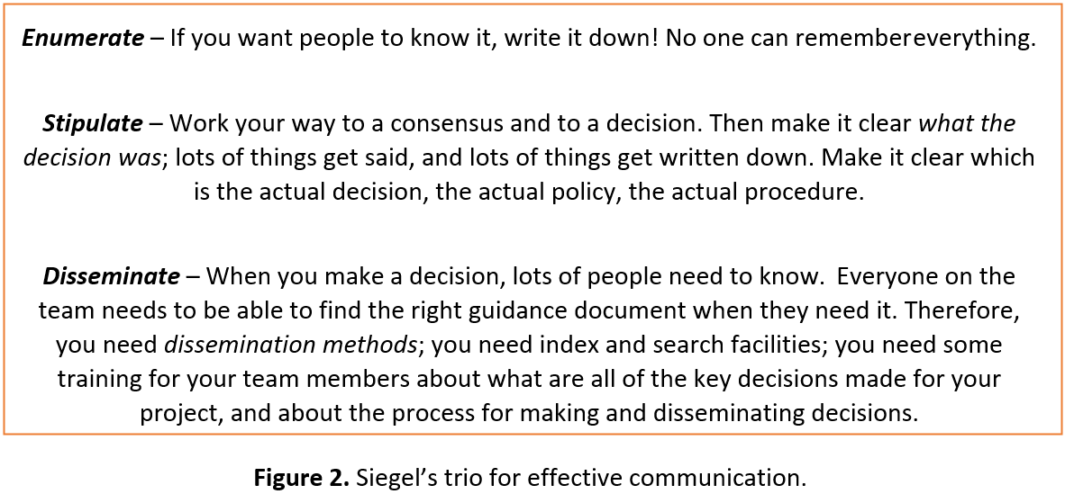
Motivating Your Team
L10

Slide 14
Motivating Your Team
L10
Be a communicator. Become an effective communicator – especially in listening and writing. Effective communication always includes three steps, which I call “Siegel’s trio for effective communication”: enumerate, stipulate, and disseminate. Effective communication to the team always includes written materials (e.g. plans, schedules, etc. – these are a part of achieving alignment), but also includes you spending time with your team, face‐to‐face, both in structured settings (e.g. all‐hands meetings, staff meetings, the meetings involved in the periodic management rhythm, etc.) and in unstructured settings (walking the hallways, engaging in informal conversations, encouraging unsolicited one‐on‐one conversations through what a former colleague called the open‐door philosophy – e.g. any person on my staff could, if my door was open, just walk in and talk, or alternatively, could get onto my calendar by talking to my secretary).
Model and enforce ethics. Talk about and be seen always considering the ethics of each decision, and always stay far from the boundary of questionable behavior, even if the company risks losing business as a result. Ask for advice from your experts: the law department, your contract manager, your business manager, your human relations manager. Take prompt action if ethical violations occur. If serious violations occur, you need to be seen making serious responses.

Slide 15
Motivating Your Team
L10
Deal with the important aspects of diversity. Every person has differing norms, differing values, differing styles, and so forth. Differences that are neither illegal nor disruptive should not only be allowed, but should actually be cultivated. This is because diversity of opinion and diversity of thought process is important to successful engineering projects and successful engineering: we need people with a range of skills, experience, points of view, opinions, and so forth. This variety of ideas and thought processes is important in order for us to solve the complex problems that our project will face. We cannot, however, look inside the heads of our employees and measure these things directly. We make the assumption that people who vary in these attributes that we can see potentially have the variation in experience, point of view, and so on that we need and want, and use these surrogates as a way to build the necessary diversity into our team. In those instances where we have actually worked with people in the past, and thereby know something about their work styles, their strengths and weaknesses, we should use that knowledge too in order to create the right kind of diversity in our teams.
Create the right reward system. Establish and operate rewards that encourage people to see success in terms of the accomplishments of the team, rather than in terms of their own personal accomplishments. Act in a fashion that causes them to believe that the team’s success is truly a viable path to their own individual success.

Slide 16
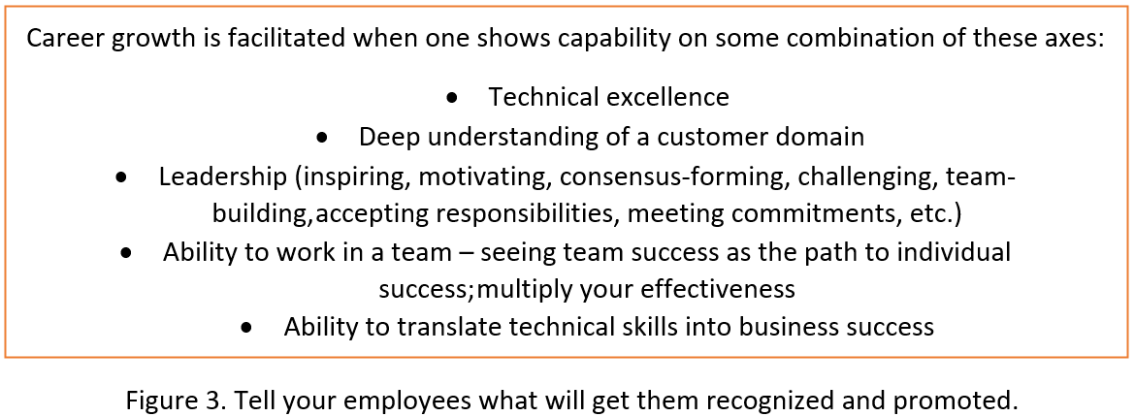
Motivating Your Team
L10
Tell your employees how to get promoted. Everyone is interested in promotion. You be transparent about what will get your employees recognized and promoted.

Slide 17
Recognizing and Resolving Conflict
L10
There is an old joke: “Two people, three opinions.” When more than one person is involved in an activity, there will be conflict. As the manager of the project, we must learn how to recognize and resolve conflict.
There are valid and productive reasons for conflict the mere existence of conflict is actually not a sure sign that “people are a problem.” The conflict only signifies that there are multiple opinions, multiple candidate approaches. Remember that when we talked about systems engineering trade studies, we went so far as to state that creating multiple candidate approaches was a virtue, and even a necessity. The problem is not the existence of multiple opinions – that is, the problem is not the conflict itself. Instead, the problem is the poor methods that many people – and, unfortunately, many project managers – use to recognize and resolve conflict. Let’s talk about how to recognize and resolve conflict appropriately, so that we can gain benefit from the diversity of opinions, without letting things get personal and/or disruptive.
Of course, on something as complicated as an engineering project, you cannot realistically hope to sort out everything in advance. Each day, you will discover new matters that either require a rethinking of previous decisions, or are items that have not been previously decided. That is to say, achieving alignment is a continuous process that gets worked on every day until the project is completed.

Slide 18
Recognizing and Resolving Conflict
L10
These are the stereotypical “bad behaviors” to which we often attribute all conflict. Try to remember that this is not true; some conflict is valid and productive! Furthermore, just because some of the behaviors which we can call unproductive are present does not mean that there are not valid and productive issues that are masked underneath that unproductive behavior. We ought not to decide an issue solely on the basis of bad behavior, tempting though that may be. The person behaving badly might be right, even if they are expressing it inappropriately.
This distinction between productive and unproductive conflict makes clear another motivation for striving to achieve the alignment that we discussed above: if the team is aligned, they share a sense of the value of the mission; they have enthusiasm for the project; they share a definition of what the project is to produce; they largely agree on methods, tools, and sequencing; they have a shared definition of what constitutes success; they understand how they can contribute; they understand how the project’s success may translate into success for them personally; and they have some sense of a shared destiny – we all succeed or fail together.

Slide 19
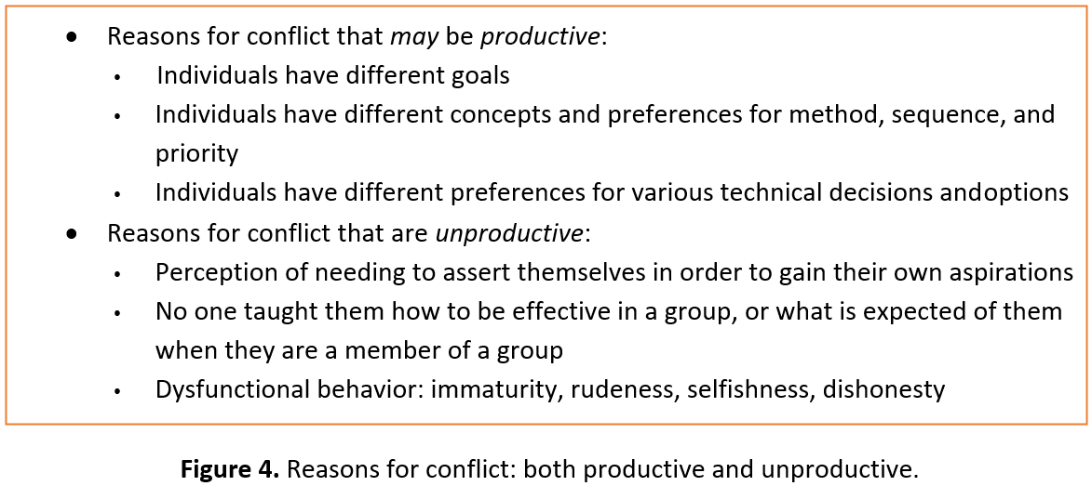
Recognizing and Resolving Conflict
L10
With all of that, the team members can develop some level of trust in one another. And the presence of that trust – in combination with some guidance, and some methodology, ought to allow them to avoid or minimize unproductive conflict.

Slide 20
Recognizing and Resolving Conflict
L10
We can say this in a negative form too. Here are some reasons that teams fail:
Poorly developed or unclear goals
Poorly defined project team roles and interdependencies
Lack of project team motivation
Poor communication
Poor leadership
Perception of unfairness, unequal treatment, and inconsistency in how people are treated
Bad news is perceived as unwelcome
Turnover among project team members
Dysfunctional behavior.
For many of us, this is a difficult transition, especially the fact that we must derive our satisfaction from the accomplishments of the team. In fact, usually no one tells us that we need to make this transition! You need to tell your employees. Then you need to be seen taking actions that reward the team, not just individuals.

Slide 21
Recognizing and Resolving Conflict
L10
So, how do we resolve interpersonal conflict in our engineering projects? We can use the following approach:
Focus on the problem, not on the people. Make a decision by analyzing the problem causing the conflict, not by considering the characteristics or position of the people involved.
Understand what each party wants and needs, and why. What do they have at stake? Why do they care about this outcome?
Before starting the decision‐making process, create a wide range of candidate solutions.
Before starting the decision‐making process, create decision criteria. Insist on criteria that are both objective and reasonable.
Be prepared. Do not “make it up as you go along”; getting facts wrong decreases your credibility and negotiation effectiveness. It is better to stop a meeting and request additional facts and analysis than to proceed in correctable ignorance. Task specific people in advance of meetings with the job of preparing analyses of the problem. What are the premises? What are the limitations and constraints? What are the available analysis methods? What are the data? What are the results of the analysis? What are the magnitudes of the uncertainties? What methods, if any, might be available in order to lessen those uncertainties?

Slide 22
Recognizing and Resolving Conflict
L10
Make the purpose of the discussion clear: are we just gathering facts, creating options, assessing analyses, or have we arrived at the decision‐making stage? If the latter, make it clear who has the authority to make the decision.
During the decision‐making process, keep the discussion about premises and analysis methods; do not discuss positions or the desired answers.
During the decision‐making process, use a structure to moderate the discussion that allows everyone to have a chance to express their views, and to respond to the views of others.
Create rules that will allow an orderly and calm discussion. Cut off inappropriate discussions. Make it clear that a rule violation has occurred and identify the nature of that violation. Restart the discussion. Do not prevent the offender from participating again, as long as they participate appropriately. Have a person designated as moderator in any meeting, charged with the responsibility to enforce this approach. It need not be you.
If you have delegated the decision‐making authority to someone else, do not take any action that appears to pre‐empt that authority.

Slide 23
Recognizing and Resolving Conflict
L10
As the project manager, you are likely to be the senior person present. You must not pre‐empt other viewpoints by speaking strongly in favor, or against, any particular approach too early in the discussion. Because of your senior position, once you make your views known, many people will be reluctant to bring forth opposing views. Try to speak last.
Remain calm and polite. Insist that everyone else does too. Interestingly, you will likely find that remaining calm and polite is an effective negotiating tool, and not just at work, but in all life situations.
Thank all participants. Make it clear that everyone contributed, even those who did not obtain the decision they desired.
Keep notes about everything. Archive all artifacts; you may need to recreate the analysis later, and will want the data, the spreadsheets, and so forth.
The most important and most subtle item on the above list is the one about “keeping the discussion about premises and analysis methods; do not discuss positions and the desired answers.”

Slide 24
Recognizing and Resolving Conflict
L10
If, on the contrary, we each discuss our premises and analysis methods (that is, our lines of reasoning that we use to go from our premises to our conclusion), we can have an actual discussion, have the potential to learn something, and might discover an approach that we can both agree on. Your premises might include that social security must be protected at all costs; mine might include that the government should stop running at a financial deficit. We can each explain why we think these are valid premises, and how we reason from those premises to preferred legislative programs, and eventually to our selection of a candidate. One or both of us might learn something, change our mind, or even determine that the election of neither X nor Y is likely to advance our desires. We might decide that we should both vote for Z instead.
In the world of engineering projects, this method works well. You may prefer that we use the C++ programming language for our project. If we start our discussion with our desired conclusions, we have nothing to discuss, and are likely to annoy each other, and our colleagues too. If, on the other hand, we each start by identifying our premises, we can have an actual discussion. For example, you may say that the use of strong typing and inheritance is, in your opinion, the key aspect of the programming for our system, and that language features A, B, and C in C++ are the best‐in‐class mechanisms for those purposes.

Slide 25
Recognizing and Resolving Conflict
L10
In engineering, we usually have more flexibility and opportunity for nuance in the final answer than we do in the voting booth. For example, the software for our system will probably consist of hundreds of modules, and they need not all be in the same programming language; perhaps we will decide to build the user forms in Java, and the rest of the software in C++. We might even come to believe that this is a better approach than using either language for all of the software. Or, having identified the premises, our analysis might lead us both to realize that we both would actually prefer to use some other programming language in lieu of C++ and Java for all of the software. That is, we can create better answers through the discussion than either of us entered with at the beginning of the discussion. This is a true win–win situation, but we can get there only if we start with premises, work our way through analysis methods, and only then arrive at conclusions.
Doing this takes practice. Not only does it often lead to better decisions, but it can also be very empowering to people, and a great team‐building activity. People really feel that they are working together and creating something better through that collaboration than any of them could have created by themselves. As the project manager, that is what we want! Also, just having your employees experience this process, and thereby believing that they were allowed to participate, makes it easier for them to accept the decision, even on those occasions when that decision is not the one that they advocated.

Slide 26
Recognizing and Resolving Conflict
L10
Conflict ends with someone – often you, since you are the project manager – making a decision. People hate ambiguity, and so the tendency for most people is to make decisions too quickly and on too little data; to throw out alternatives too soon; to close the trade space too quickly. Do not be afraid to ask for more analysis, more options, more time. But you cannot be seen as dithering either, and of course decisions need to be made in order to allow the work to progress. Life is tough as a project manager.
Only judgement and experience can help you determine when it is the right time to make a decision. In a few pages, we will introduce the concept of a mentor; he or she can help you with this type of problem.
Good management can lessen the opportunities for conflict. Basically, through management actions, we get issues and potential issues identified, premises and analysis methods identified, people assigned to gather data and perform analysis, and then, we actually reach a point where we are ready to make a decision. That decision then gets, and all of the supporting materials archived

Slide 27
Recognizing and Resolving Conflict
L10
Documenting agreements is a vital aspect of project communication. Therefore, the project communication plan should include your plans for establishing both the project decision‐making process, the decision log for capturing decisions, and the methods that your project will use for communicating decisions.
Not all conflict is about technical matters. Often, it is about people: who is responsible for what pieces of work, who gets to make what decisions, who gets priority access to people or facilities, who gets promoted to an open position, and so forth. Clear statements of scope in the mini‐contracts and other project documents are the resources you use to lessen these occurrences. When such issues do arise, you must address them promptly; they do not go away by themselves and can get worse over time if left unaddressed.

Slide 28
Summary for resolving conflict:
L10
Discuss premises and lines of reasoning rather than discussing candidate answers!
Bring issues into discussion (openness; don’t bury the problem or shoot the messenger)
Be willing to listen
Understand your and other parties’ needs/wants
Get the facts agreed upon before starting the process of trying to reach a decision
Don’t speak for others; that is disempowering. If you state an opinion, use “I.” Ask that others do the same
Ask questions to get to the bottom of an issue, paraphrase and restate what others say, so as to make sure that you understand what they actually meant
Be willing to expand the candidate solution set – this is often a path to resolution of conflict.

Slide 29
Dealing With Special People.
Your Management
L10
The social aspects of project management including dealing with your management and your customers, not just your employees. Your management is one of your stakeholders too. Therefore, just like for your customers, you must identify their coordinate system of value. What do they need from your project, and from you? What do they want from your project, and from you?
Just as you have multiple customers, you have multiple managers too. You do have a direct supervisor, and that is likely to be one person. But that person has a supervisor too, all the way up to the president or chairman of your company, and the board of directors. There are also the heads of the specialist staff organizations (law, contracts, human relations, engineering, and so forth), who in some ways also have a supervisory role over you and your project. Therefore, the voice of your management is not a single, unified voice. You are in the same position of having to find a suitable balance between competing and conflicting goals, just like you are with your customers.

Slide 30
Dealing With Special People.
Your Management
L10
In some real sense, dealing with your management is easier than dealing with your customers. For example, there will usually be lots of written guidance about what the company (and therefore your management) expect of you and your project. These include items such as:
Corporate policies and procedures
Corporate project management handbooks
Corporate financial goals, and methods of calculating these
Management incentive goals
Your contract
Applicable laws and regulations.

Slide 31
Dealing With Special People.
Your Management
L10
You need to know all of these – get help and training from your staff specialists, such as the corporate law department! Do not be afraid (or embarrassed) to ask for help. When things are going well, dealing with your management is not so hard. But every project worth running is complex enough that there will be problems at some point in time; this is the most important time in your relationship with your management.
Just as an advice is to do not wait until there is a problem to start building a relationship with all of the people who occupy roles in your management chain. Build a relationship now, discuss your plans, discuss risks (e.g. what might go wrong), incorporate statistical effects into your predictions – and do all these things when everything is still going great in your project.
This helps you understand how they think, and what they value. It also builds a relationship, some trust, and credibility, and all of this forms some emotional “credit” that you can draw upon later when a problem occurs.

Slide 32
Dealing With Special People.
Your Management
L10
When a problem arises, that information does not improve with age. Talk about it right away, even if you are not yet asking for help, and even if you do not yet know exactly how you are going to solve the problem. You can talk about what you do know, how you will go about preventing the situation from getting worse, how you are going to go about gathering more information, and how you will go about creating a solution. Do not fudge or gloss over the problems, and do not downplay the potential significance of the problems. There is a strong desire in all of us to downplay the significance of problems. Don’t do it; you will lose credibility later.
Do not, however, delegate your job to your management. Present them with options, show decision criteria, and show your current thinking. They will offer advice but do not ask them or expect them to solve the problem for you. As the project manager, that is your job.

Slide 33
Your Customers
L10
In many ways, dealing with your customers is similar to dealing with your management. We must start by trying to understand what their coordinate system of value is: What do they need? What do they want?
Our customers often have lots of constraints: rules that they must adhere to which determine how they interact with you, limit how fast they can at times respond, and so forth. You need to understand those constraints, as they will in part constrain your degrees of freedom. Your staff specialists can help you with this. So, can the customer’s staff specialists; they have contracts and law staff, too, and they are usually glad to meet with contractor project managers and explain how they operate.
One final piece of advice about dealing with your management and your customers: do not say one thing to your customer, and something else to your management. You will find that they do talk to each other!

Slide 34
The Human Resources Department – An Important Partner
L10
Your project will have a human resources specialist. This is the person who makes offers of employment, deals with the administrative aspects of pay raises and promotions, and other administrative tasks relating to employees.
It is easy to think of this person as an administrator. But in fact, this person can become an important asset to you, a partner. People are obviously an essential element of your success as a project manager; you cannot do the job alone. Your human resources specialist is the person who can help you find and entice the right set of people to come and work on your project.

Slide 35
The Human Resources Department – An Important Partner
L10
Hiring people is complicated; the world of business has created entire vocabulary about this subject. Your human resources specialist will ask you to define your personnel requirements:
How many people with each skill set (e.g. software programmers, etc.) do you require, when, and for how long?
What level of capability? Novice, right out of college? Seasoned professional? How many of each?
Which of these people require special professional certifications?
Which of these people require security clearances?

Slide 36
The Human Resources Department – An Important Partner
L10
This is not sufficient though. Someone – hopefully not you – has to worry about questions like these:
Are these people available inside the company, or do we have to plan to hire them from outside?
Is it best to hire some of these people on a temporary basis (this is often called con- tract labor), or is it best to hire them as regular, permanent, employees?
What is the going market rate of compensation for each of these types of people?
What types of employee benefits are needed in order to attract the right talent to your team?

Slide 37
The Human Resources Department – An Important Partner
L10
In order to hire a person, someone will need to write a requisition defining all of the above characteristics. This job description is posted in various places where potential applicants might see it; this could be an internal company web page, a company web page that is available to the general public, or other arrangements. Specific potential applicants might even be solicited to apply for a particular position.
Then some time is allowed for the applications to come in; a deadline for applications might have been specified in the job posting. Once the deadline has passed, the applications can be reviewed.

Slide 38
The Human Resources Department – An Important Partner
L10
In most companies, the process of selecting which candidates to hire or select for a position is quite structured:
Usually, you will need to interview prospective team members. You do not make your selection solely on the basis of the written applications.
There may be a selection process before the interviews; perhaps your company received so many applications that it is not feasible to interview all of the applicants. More frequently, applicants whose written qualifications appear markedly weaker or markedly less suitable are eliminated from consideration before the interviews.
Learn the rules of your company regarding the interview process – failing to follow those rules can land your company in court. Your human resources specialist knows these rules.
You should have some written selection criteria, which are prepared in advance of conducting the interviews. The questions that you ask of candidates during the inter- view should relate to these criteria.
It is a good idea to develop written interview questions that you ask each applicant.
Use the same questions for all candidates, and

Slide 39
The Human Resources Department – An Important Partner
L10
Avoid questions or discussion about irrelevant subjects – ethnicity, age, marriage and children, personal matters, religious beliefs, etc.
For more senior positions, your company will probably require that more than one person participate in the interviews. This might be a series of individual interviews, a group interview, or a mixture of both.
This group of people might include the human resources specialist, the relevant functional manager, and some of your existing senior technical staff.
During the interviews, make notes that will allow you to score the applicants against the established selection criteria.
After the interviews are complete, the group of people who conducted the interviews will usually get together and formally score the applicants. The scoring is not necessarily the sole criteria for selection, especially if the scores are very close to each other; scoring is an imperfect process. The purpose of the scoring is to keep the discussion of the merits of the candidates to the identified characteristics advertised and needed for the position. The results of the scoring and the notes about the discussions are captured for the record.

Slide 40
The Human Resources Department – An Important Partner
L10
The designated person, using the scoring and the discussion, makes a selection.
Only certain people are authorized to make actual job offers; usually, only the human resources specialist is so authorized. You, as project manager, are usually not authorized to make an actual job offer.
Job offers must usually be made in writing; it is fine to make a courtesy call telling an applicant that he or she has been selected and that a written offer is on the way, but the terms of the offer ought to be conveyed only in writing. You must be careful never to appear to make a verbal job offer.
It is good practice to obtain written acceptance of the offer from the candidate that you selected. A start date can then be selected, and the candidate processed into the company.
Always get back in a timely fashion to all of the applicants. People who were not selected for interview can be provided with written notification that they were not selected.

Slide 41
The Human Resources Department – An Important Partner
L10
The process can be faster if all of the candidates are already employees of your company, but many of the above steps are still required, especially for positions with management responsibilities.
As you can imagine from the above description, hiring does not occur in a day. In fact, it can often take months to develop a requisition, post the job, select the interview candidates, set up interviews, conduct interviews, reach agreement on whom you will extend an offer to, make the offer, receive candidate acceptance, process the candidate into the company, notify unsuccessful candidates, and so forth. You have to allow a realistic time line for staffing your project, especially at the beginning.

Slide 42
Change on Your Project
L10
Change usually makes people uncomfortable. But change is a fact of life on engineering projects; we just cannot know everything in advance.
Therefore, you must:
Cope with it yourself, in your role as the project manager
Help your team and customer cope with it
Manage the changes, so that you can receive the benefits of the change, and do so without causing too much disruption.
Generally, the bigger the project, the more the amount of change there is that takes place, and the harder it is to cope. These changes come from two different sources:
From the customers and the other stakeholders (externally), and
From within the project team (internally).
Usually, change from these two different sources must be handled somewhat differently, due to the fact that if the change is sourced externally to your team, there will be additional people involved in reviewing and (eventually) approving the change.

Slide 43
Change on Your Project
L10
What might change? Almost anything: a requirement, an aspect of the design, the schedule, the budget, predictions of technical performance, personnel assignments, the strategy for training, the tools for software development, the legal and regulatory environment, and on and on.
How do we manage and control change? The steps are largely the same, whether the change is sourced internally or externally:
Noticing that a change is called for
Discussion and analysis of the impact of the proposed change (see below)
Approval or non‐approval of the change, and of its implementation method
Configuration control of documents and products
Validation that the implementation of the change is correct.
In your buying customer’s organization, there is usually only one single person who can authorize changes to your contract, deliverables, terms, schedule, and price … and it is usually not the customer’s project manager! In fact, it is usually the customer’s manager of contracts. Do not act on requests for change until after they have been directed in writing by the authorized person!

Slide 44
Leadership vs. Management
L10
Management – the act of supervising other employees – may not be to everyone’s taste. You can get ahead in your career without taking on management roles. But everyone can be a leader, and everyone can derive satisfaction from providing some form of leadership. By leadership, we have to understand inspiring, providing motivation, driving consensus, and so forth. You can provide leadership every day, or whenever you are so motivated; your position in the hierarchy is not relevant.
Participation in management is optional – many people have success and satisfaction without it. And you can go in and out of management over the course of your career – it is not a one‐way journey. If you are willing to do management roles at times, it increases your value to the company.

Slide 45
Summary: Social Aspects of Engineering Project Management
L10
The project manager is the leader of a set of people, and the interface to an additional set of people. You interact with all of those people, and facilitate their interaction with each other. People are at the center of the project manager’s universe. Therefore, there are important social aspects to the role of a project manager.
You must persuade people to want to follow you.
Since people are involved, there will be conflict. You must learn to handle and manage that conflict, and to channel it to productive discussion. Discuss premises and lines of reasoning, rather than discussing candidate answers.
Management and customers are people too, and you must deal with them. Build credibility in advance of a problem.
Your working career will consume a lot of your life. Therefore, satisfaction is at least as important as success. Just as in systems engineering and project management, you must strive to achieve balance between satisfaction and success.
Understanding how to get ahead starts by understanding what is valued by your institution; and your boss is a proxy for that institution. The key enablers and disablers are all discoverable.

Slide 46
References:
Engineering Project Management, Neil G. Siegel, Wiley, 2019
English for Careers: business, professional and Technical, Leila R. Smith, Roberta Moore, Pearson Education Inc, 2020
Technical Communication. Process and Product, Sharon J. Gerson, Steven M. Gerson, Pearson Education Inc, 2020

Slide 47
THANK YOU FOR YOUR ATTENTION!

