Slide 1

APPLYING OUR IDEAS IN THE REAL WORLD,
ETHICS IN ENGINEERING
Lesson 12
https://www.jobboom.com/career/spotlight-on-ethics-in-engineering/
Lecturer: M. Kurbonov

Slide 2
APPLYING OUR IDEAS IN THE REAL WORLD, ETHICS IN ENGINEERING
L12
In many aspects of engineering and engineering project management, there are factors in tension with each other. In fact, we have seen many examples in our previous lessons: hiring more people for your project might get it finished sooner, but probably increases the total cost at completion; and so forth. Every engineering management process that we have discussed is subject to similar tension when you go out into the real world and try to apply it. In this lesson, we will try to understand how to use these techniques within the limitations of actual people, companies, and customers.

Slide 3
Applying Our Ideas in the Real World
L12
To being a project manager can also consume your life for long periods of time; accepting the position of manager of a large, complex engineering project is a big commitment. As the manager of an engineering project, you will spend most of your time dealing with people. The skills that you learn for dealing with people will help in the rest of your life too, including knowing when to let others do the leading.
You learn about the vital importance of understanding the value systems of other people. As we discussed before, understanding the value system(s) of your customers and other stakeholders is necessary in order to be a good engineering project manager, but understanding the value systems of other people is also a useful skill in the rest of your life. You learn how to identify and solve technical problems, but also how to identify and solve social problems.
You do not yourself perform most of the project management; instead, you establish guidelines and principles for how they are to be done, you ensure that they are actually performed, and then you monitor the efficacy of that performance. For example, you don’t yourself prepare the process‐behavior chart and time‐series analyses of the operational and technical performance measures, but you mandate that all quantifiable data used for decision‐making on the entire project be analyzed as a time series via the process‐behavior chart methodology.

Slide 4
Applying Our Ideas in the Real World
L12
In engineering project management, there are a lot of artifacts: the work‐breakdown structure, the activity network, the statement of work, the requirements specifications, the design documents, etc. We never expect to make these artifacts perfect. At any point in time, they are probably incomplete and contain errors. The real point is that they represent a commitment and a process by which fact‐based analyses can be investigated and fact‐based decisions made. The discussions regarding what the customer values, the discussions about risk and opportunities, the discussions about design alternatives, the meetings entailed in the periodic management rhythm – this is where the “magic” takes place that leads to successful projects, through the give‐and‐take among knowledgeable, motivated people. You continuously drive the team to look at the facts, identify their premises, discuss the candidate approaches and their implications, and drive toward decisions. You ought not be afraid to change your plans if the data indicate that is appropriate. You do all of this while also trying to operate in accordance with a long‐range vision that represents a combination of the customer’s value system, your value system, and your vision for an effective, feasible, and simple design.

Slide 5
Applying Our Ideas in the Real World
L12
In our previous lessons, we observed methods for resolving conflict between people. As we understand already, because engineering projects are full of conflict: conflicting goals, goals not in line with resources, different stakeholders not agreeing, your customers and your management not agreeing, different members of your team not agreeing. You cannot avoid such conflict; many of these conflicts are inherent in the nature of an engineering project, and others arise from the fact that “people are a problem.”
As the project manager, you must recognize when conflict is arising, and manage it. This is both really hard, and really important. It will help, while you are working on resolving conflict, to think about the characteristics that we learned for effective leaders, and always try to remain calm, polite, respectful, and patient. Work hard to achieve consensus and resolution, but do not take the conflict personally. Do not expect that you will always be popular; in the role of project manager, it is more important to move the project toward success than to be liked. In the end, if you do your job well, you will be generally respected, which is something different from being popular or being liked. This comes with the job.

Slide 6
Applying Our Ideas in the Real World
L12
Do not expect to satisfy everyone; that is just not always possible. You have an obligation to keep the project moving on a sound and feasible path. If you have to make a unilateral decision that is unpopular with some people, so be it. Even after you are promoted to be the manager of a large, complex engineering project, you still have things to learn. Every day will provide practice in your people skills; the sort of reading is always helpful too.
You also need to make a modest effort to understand the new technical capabilities and approaches that your team is considering and/or using. You are not going to become the chief designer of your system, but you do need to understand the approaches, options, risks, and opportunities involved; you cannot be an effective project manager depending solely on the word even of a trusted technical subordinate. Life will be busy during your tenure as the manager of an engineering project, but never dull.

Slide 7
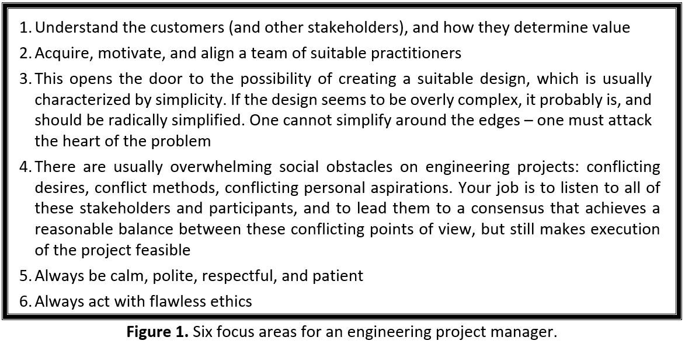
Applying Our Ideas in the Real World
L12

Slide 8
Ethics in Engineering
L12
As the manager of an engineering project, you must believe that you have four primary constituencies that you must satisfy. These four primary constituencies are the following:
Your customer
Your management
Your team, and
Yourself.
We have talked a lot in our previous lessons about those first three constituencies: your customers, your management, and your team. You must not forget that fourth constituency: yourself! You satisfy yourself by doing the best you can, by flawless ethics, by continuous politeness and kindness to those around you, by maintaining a reasonable work-life balance, and by achieving an effective balance of listening and deciding. We have talked already about all of these, except for ethics.

Slide 9
Ethics in Engineering
L12
Many engineering projects create products and services that are important to society; many have explicit safety implications; some are distinguished by explicitly supporting national security. Failures and deficiencies that might be considered “routine” in some settings can in these cases directly and predictably cause injuries and lost lives, in addition to harming national security. In such a setting, decisions regarding quality, testing, reliability, and other “engineering” matters can become ethical decisions, where balancing cost and delivery schedule, for example, against marginal risks and qualities is not, by itself, a sufficient basis for a decision. When operating in the context of an engineering project with such important societal implications, established engineering processes must, in my view, be supplemented with additional considerations and decision factors based on ethics.
Proper analyses would indicate when major problems are being overlooked in the specification and design of a system. When those analyses are not performed with sufficient detail and rigor, and therefore those problems remain overlooked, that is when bad engineering can lead to bad engineering ethics. We have reached a state of bad engineering ethics when, by being insufficiently thorough and rigorous, we allow our systems to endanger the safety or the health of our users, or the health and/or security of our society.

Slide 10
How Do Engineers Get into
Situations of Ethical Lapse?
L12
No one enters a career in engineering intending to put lives and missions at risk through ethical lapses; at the very least, this is not the path to promotion and positive career recognition. So how could engineers find themselves in ethical quandaries? The problem with this tendency is that rare events do occasionally occur! This is why we ought to buy fire insurance for our homes, and collision insurance for our cars.
In particular, we already learned about two special types of risks, one of which was the low‐likelihood, high‐impact event. Those low‐likelihood, high‐impact events are potential sources of ethical lapse; if we assume that, since they are low likelihood, we need not take actions to mitigate their impact, we can have serious, adverse consequences. We do not use expected‐value techniques based on estimating the likelihood of these events as a method to determine whether we ought to undertake efforts to mitigate the impact. Instead, if we have identified a risk that will have a serious impact which might include harm to people or society, we must mitigate that potential impact, no matter how low we estimate the likelihood to be. Failing to do this may put you in a situation of ethical lapse.

Slide 11
Complexity and Scale Introduce Non‐linearities
L12
An important characteristic of modern systems is their complexity and scale. Complexity and scale introduce non‐linearities in system behavior, so that our intuition – which many people who study the human brain suspect operates by linear or proportional extrapolation – is no longer even approximately valid. This can cause lapses in consideration of failure modes, for example – which can in turn manifest themselves as unsafe operation. Many systems in fact exhibit serious failure modes that derive entirely from scale, complexity, and the resulting errors in their dynamic behavior – that is, scale and complexity can be actual sources of failure. This, therefore, can become a path through which we can create an ethical lapse: we understand the scale and complexity of the system we are designing, but fail to account for the failure modes that such scale and complexity introduce themselves, above normal engineering considerations.

Slide 12
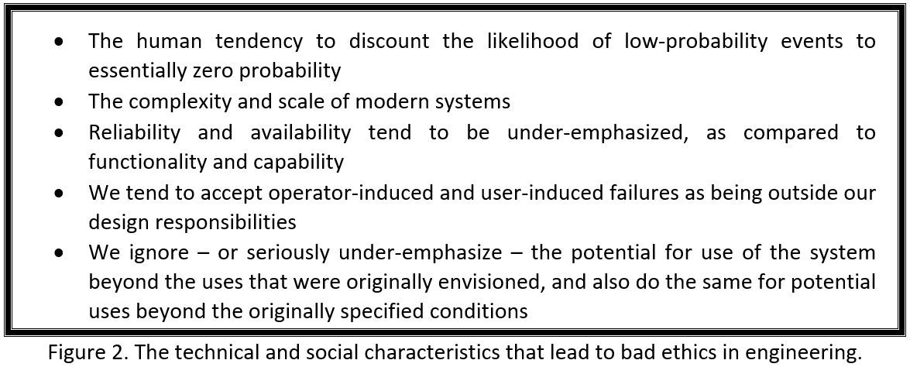
Complexity and Scale Introduce Non‐linearities
L12

Slide 13
Reliability and Availability are Under‐emphasized
L12
Reliability and availability, when they are under‐emphasized in favor of focusing on system capabilities and functionality, can also become a source of lapses in engineering ethics. There is a natural tendency to focus on functionality and the visible features and capabilities of our systems, and therefore to under‐emphasize quality characteristics such as reliability and availability, which are in some sense “less visible” to the eye of the intended user than system capabilities and functions. This tendency is reinforced by our contracts and system specifications: it is often the case that as many as 99% of the requirements for a typical system describe functions and capabilities, whereas only a small portion of the requirements deal with reliability, availability, and other quality factors. But reliability and availability – and other quality factors too – are quite likely to be involved in safety and other important societal considerations, even though they did not require very many words in the specification to define their requirements.

Slide 14
Reliability and Availability are Under‐emphasized
L12
As a result, many system development efforts perform only rudimentary analysis during design of these quality parameters; the fault tree might only identify the most obvious types of faults, completely omitting many more subtle faults that have significant negative impact but are harder to see. The result is that the realized system reliability and other quality measures often fall far short of the levels predicted and/or required. Another result of this behavior is that even if the occurrence rate of faults is as predicted, the severity can be far higher than predicted. Having system reliability far lower than predicted, and/or the impact of system faults being more severe than predicted, can have serious safety and other consequences and therefore, once again, we have created an ethical lapse through incomplete or inadequate engineering.

Slide 15
Treating Operator‐Induced Failures as Being Outside Our Design Responsibilities
L12
Yet another characteristic of modern systems that can cause ethical lapses is that we tend to accept the idea that operator‐induced failures are outside our design responsibilities. That is, if the user or operator of our system does something wrong and a problem result, we tend to say that it was his or her responsibility, rather than saying that we the designers should have foreseen the possibility of such a mistake, and made the system react in a safe and predictable fashion, even in the presence of such “wrong” inputs.
This is an ethical lapse because it is 100% certain that at some point in the life of a system, the users of our systems will “punch the wrong button,” or create an input outside the nominal range, or provide some other “wrong” input or action. A robust design is precisely one that protects the system and its users against excessive adverse consequences from such an action.

Slide 16
Treating Operator‐Induced Failures as Being Outside Our Design Responsibilities
L12
Much more common, and much more subtle, is the creation of physical damage through a combination of commands – none of which may be intrinsically unreasonable – which only in combination cause physical damage. Think of the chain of valves and pumps that operate an oil refinery or a chemical plant. With heavy, hot fluids moving through pipelines, the commands to a succession of valves and pumps must be properly synchronized, else the momentum of the column of moving fluid can burst a pipe wall, or cause other damage. A command to an individual valve or pump may be within the range of operation for that single device, but in the context of the total operating picture of the facility, that same command may be a disaster.
Another characteristic, somewhat related to the example immediately above, is that we often ignore – or seriously under‐emphasize – the potential for using our systems in ways that we did not envision, or beyond the specified operating conditions. Many of us have used a screwdriver as a chisel, or vice‐versa.

Slide 17
Corrective Actions
L12
First and foremost, is the matter of placing proper emphasis on good design. It is fair to say that many engineering projects place their primary emphasis on developing good requirements, rather than on developing a good design. Many texts and corporate guidelines about performing systems engineering, for example, are heavily focused on the matter of requirements. Many academic papers that examine the question of problems in the system development process focus on requirements too, citing factors like incomplete requirements, or “requirements creep”, as the root cause of the large number of engineering projects that have significant problems. It is natural for the customers and eventual users of the system to focus on the requirements too; after all, the requirements are something they can understand, and are also something they have a natural reason for wishing to influence.
Creating a good design for an engineered system is far more difficult than developing the requirements for that same system. We get a lot of “help” as we develop the requirements for an engineering system; after all, our customers and our users understand well what they want the new system to do, and such what constitutes a major portion of the requirements.

Slide 18
Corrective Actions
L12
We do not usually have such a resource pool to help us with the design. The design is far subtler than the requirements; interactions between elements of the design are far more likely to have significant impacts on the system and its performance than are interactions between elements of the requirements, and the design is far more technical. Those same customers who are able to help us with the requirements can seldom offer us significant help with the design.
Furthermore, most projects do not have reasonable technical metrics for measuring the progress of the design; they tend to use only management metrics for measuring progress on the design. As a result of all these factors, weak designs are adopted by many engineering projects. Engineered systems almost always aspire to create some sort of emergent behavior, a sort of “1 + 1 = 3,” where useful things happen due to the interaction of formerly separate elements. But what often happens, while creating a design which leads to the desired emergent behaviors, is that the design fails to prevent the arising of unplanned emergent behaviors which appear as unintended adverse consequences.

Slide 19
Corrective Actions
L12
As a result, unintended adverse emergent behavior often creeps into our systems through such incomplete designs. This is the true root cause of most failures of engineering project developments, and such incomplete design – that is, a design that does not incorporate features explicitly aimed at preventing such unintended emergent behavior – is likely to exhibit the poor characteristics and therefore, these are the projects most likely to fail and/or be canceled.
After the design, the next most important corrective action, is the risk management process. Most big projects have some type of formal risk management process; the process itself is usually fairly rigorous. Such a statement is useless as a risk register entry; first of all, it is true on every project that has a material amount of software, therefore it is not specific in any fashion to this particular project. But far worse is the fact that it contains no insight about what the project should be measuring every month in order to determine if in fact the risk is coming to pass, or what steps should be taken to mitigate the impact if and when they determine, through those measurements, that the risk is coming to pass.

Slide 20
Corrective Actions
L12
Therefore, the next corrective action is generating far more specific and far more measurable entries on the risk register, and then taking the corresponding actions in the rest of the risk management process. Of course, doing this takes intense effort, expertise, and a lot of time. It also results in there being many more items on the risk register! These are probably some of the reasons that this task is not performed properly more often.
Proper analyses would indicate when major problems are being overlooked in the specification and design of a system. When those analyses are not performed with sufficient detail and rigor, and therefore those problems remain overlooked, that is when bad engineering can lead to bad engineering ethics. We have reached a state of bad engineering ethics when, by being insufficiently thorough and rigorous, we allow our systems to endanger the safety or the health of our users, or the security of our society.

Slide 21
The Organization Chart
L12
Why do we organize people? Mathematics tells us that inside any group, the potential communication links rise as a factorial with the number of people involved. There are six potential communication links in a three‐person group. There are 3 628 800 potential communication links in a 10‐person group. The scale of such communication complexity will overwhelm us. In addition, it seems likely that the opportunities for confusion will rise along with the number of such potential communication links.
Furthermore, the social scientists tell us that people can deal with only a limited number of interfaces at once; there has long been a rule of thumb that a supervisor ought not to have more than seven direct reports. To have more is confusing, and also dilutes the time that you can spend with each subordinate; you have only so much time per day. You will find that, as a manager, time is one of your most important resources.
But most real engineering projects have far more than three people working on them; how are we to cope? We do so by creating a hierarchy of people, so as to manage the complexity of scale inherent in large teams.
This hierarchy deals with scale, but also lessens ambiguity, through the assignment to specific named people of specific roles. The resulting hierarchy is the organizational structure; a depiction of this organizational structure is called an organization chart.

Slide 22
The Organization Chart
L12
There are various principles that we can use to select an organizational structure for our engineering project. But before you select an organization, you need to have:
Draft requirements (what the system is supposed to do, and how well)
A draft work‐breakdown structure (what the work to be accomplished consists of, and how you want to organize it)
Draft schedule and cost estimates (which will determine how large an organization is suitable and affordable)
Some of your key personnel identified by name (your direct reports and a few other key people, such as the project’s chief engineer). People have skills, but they also have weaknesses.
Only after you have these four prerequisite items are you ready to selection an organizational structure. Note that since you include the strengths and weaknesses of your key personnel as a factor in designing the organization, this means that as people move off your project onto a new assignment – and are therefore replaced by other people, each of whom will have their own strengths and weaknesses – you may need to adjust the structure of the organization.

Slide 23
The Organization Chart
L12
What are the goals of the organizational structure? We can use the following list:
Manage the stakeholders, both internal and external
Keep the project sold
Shape and manage expectations
Understand their goals, aspirations, and ways of measuring value
Continuously improve the plan for accomplishing the work
Monitor progress against the work
Assess progress, risks, mitigation efforts, etc.
Continuously assess how well individual people are performing
Does someone need help?
Does someone need to be replaced?
Is someone ready to take on additional responsibilities?
Accomplish the actual work
Meet the terms of the contract
Keep your people motivated, healthy, and safe
Create institutional checks and balances, including against your own weaknesses.

Slide 24
The Organization Chart
L12
Once you have the four prerequisite items, and understand the goals of an organizational structure, we are ready to select our organizational structure. There are two principal types of organizational structure:
Projectized organizations. This is a made‐up term, used to signify that the people who work on the project belong to the project, rather than to a functional department within the company who are merely on loan to the project.
Functional organizations. This signifies that the people have a permanent position within the company in a functional department (e.g. engineering, law, human relations, finance, etc.), and are simply on loan to the project.
Additional characteristics of each type of organizational structure are defined in the figure.

Slide 25
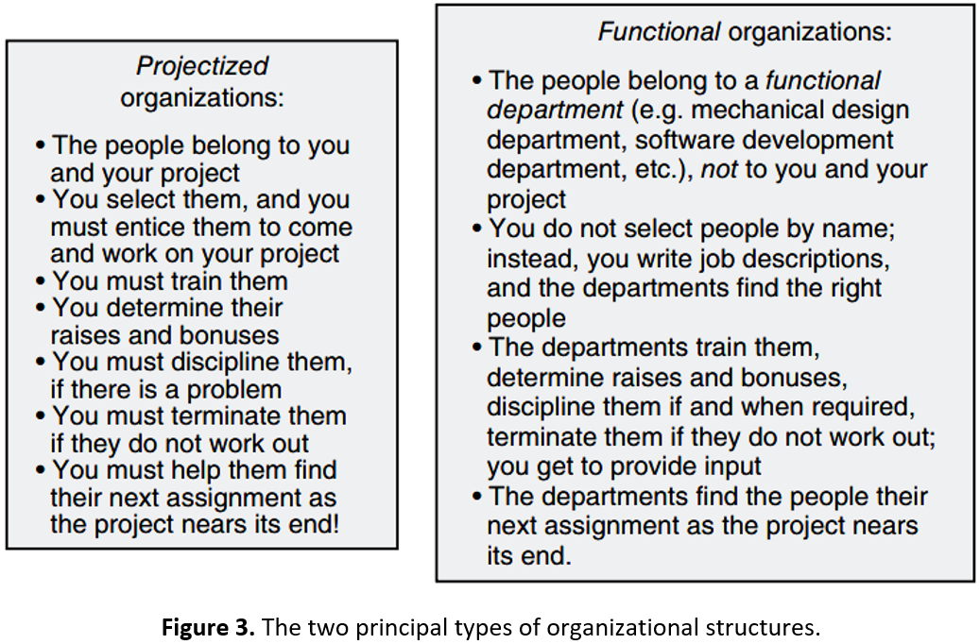
The Organization Chart
L12

Slide 26
The Organization Chart
L12
Of course, there are also hybrid approaches, that combine the characteristics of the two basic types in various ways:
Some functions could be staffed by the project, but others by the functional departments. For example, engineering personnel could be recruited and managed by the project, but support disciplines, such as law, finance, human resources, and quality, could be recruited and managed by the functional departments.
The project might transition over time:
A large project could be started depending on the functional departments; using the company’s functional departments assists you in achieving the initial staffing at the start of the project.
This project could then be transitioned to use a projectized organization; this facilitates continuity for key positions, and is often less expensive.
This project could then be transitioned back to a functional organization as it nears its end; this facilitates the transitioning of the people to their next assignment.

Slide 27
The Organization Chart
L12
There are many other combinations that are possible, of course. Actually, in the real world, there is seldom a completely projectized engineering project. This is because of something that we have already pointed out: your company probably assigns some of the work to other companies.
We use the term subcontractor if such an outside company’s role includes development, and we therefore likely use a subcontract, as described above, to formalize our relationship with that company.
We use the term vendor if such an outside company’s role does not include development; that is, we are purchasing from them standardized products and services that require no significant adaptation in order to be suitable for use on our project. Our relationship with this outside company might be formalized by a document called a purchase order.

Slide 28
The Organization Chart
L12
If you think about it, you will see that using such outside companies is similar in many ways to using your own company’s functional departments:
You write statements of work, and they bid against them
They – not you – select the individual people
They – not you – are responsible for finding the people their next assignment
They might even be responsible for selecting the organizational model for their portion of the team.
When should you use which type of project organizational structure? Here are the strengths and weaknesses of these different project structures. A projectized organizational structure, as compared to a functional organization structure:
Is usually less expensive to establish and to operate.
Entails more work and more risk for the project manager, as you try to get the project started; as you perform mid‐project staffing actions as people leave the company, retire, or take other positions within the company; as you end the project.

Slide 29
The Organization Chart
L12
Can achieve stronger focus and higher levels of employee motivation.
Can usually adjust faster to changes in requirements and market conditions.
Can usually make faster decisions, because fewer people must be consulted. This seems good, but remember that faster decisions are not always better decisions.
Can usually make faster decisions regarding poorly performing personnel and/or poorly performing vendors and subcontractors.
Works well for long, complex projects.
Maximizes the authority of the project manager, but also imposes the most responsibility (and the most work) on the project manager.
A functional organizational structure is more or less the opposite for each of the above. It achieves these effects by a sharing of authority and responsibility between the project manager and the functional department managers. In hybrid organizational structures, we try to get the best of both worlds, picking and choosing a combination that we believe will be effective for our project and our company.

Slide 30
The Organization Chart
L12
Therefore, you should design your organization based on where you believe:
Your particular project needs emphasis
You (as the project manager) have weaknesses
There are particularly large risks
Where the skills are located that are needed in order to do the work, starting with examining the question of whether those skills exist at all inside your company, or whether you must go outside the company for those skills. Not every company, even big companies, are good at everything. Be warned that companies often unreasonably pressure you to use internal sources.
To take advantage of the skills of key personnel. For example, perhaps some key people work for a functional department, and are not willing to transfer to a projectized organization.
How fast you expect changes to occur, and of what magnitude
What will be desired or expected by your customer and your management. But don’t let this factor unduly dominate; you must exercise your own judgement!

Slide 31
The Organization Chart
L12
Whichever type of organizational structure you select, you must make sure that it is clear which people have which responsibilities; the titles on the organization chart do not eliminate the potential for misunderstandings and disputes about authority and responsibility!
For example, your organization chart might have a box labeled systems engineering and a box labeled software; these are pretty typical entities on an organization chart for an engineering project. Which one of these managers is responsible for the development of the requirements specifications for the software? The box titles by themselves do not answer this question. The point is that the titles by themselves don’t answer the question; you need some additional artifact.
Good projects therefore produce written job descriptions for each box on the organization chart, to address this problem. Of course, the mini‐contract and its statement of work will answer this question too, but it is almost always socially useful to have written job descriptions corresponding to each box on the organization chart. People like to know their job responsibilities, and the responsibilities of the other people with whom they will interact.

Slide 32
The Organization Chart
L12
Some projects also create a responsibility assignment matrix, which is a graphical depiction that maps project responsibilities along one axis and people/role names along the other. If, however, you have followed my approach for creating the work‐breakdown structure – which includes assigning every element of the work‐breakdown structure to a named person – you may not need to create a responsibility assignment matrix, because the names are already assigned to every element of the work‐breakdown structure. But some projects follow a practice of not including names in the work‐breakdown structure, in which case the responsibility assignment matrix is useful.
Since you prefer that include names in the work‐breakdown structure, you might wonder why we would also need to create an organization chart. First of all, the work‐breakdown structure does not reflect our choice for the organizational structure (that is, projectized versus functional versus hybrid). We can depict that in an organization chart, by including annotations in a box indicating that the responsibility entailed by this box is assigned to a functional organization; the name of the individual selected by the functional organization to lead that work would also appear in the box. Second of all, at times we will have the same person leading multiple items on the work‐breakdown structure; we can also elect to group multiple elements of work from the work‐breakdown structure into a single box on the organization chart.

Slide 33
The Project Plan
L12
Projects require written plans; these plans are a key ingredient in achieving the alignment. They allow the project to create a shared vision of what we are trying to do, how we will go about doing it, in what sequence we will perform activities, who will do what, what constitutes success, and so forth. Without project plans, we could not have a shared vision, and without that, we will not succeed. The items that we have talked about so far in this lesson – the work‐breakdown structure and the organization chart – become portions of the project plan. But there are many other things that require planning, in addition to those two items. Figure 4 shows a list of the subjects that might be covered in a project plan this table is long.
That is a long list! But you, as the project manager, do not prepare all of this material yourself. As we will discover in many other ways, your job is not to do the work, but instead to ensure that someone else does it, and that it is done according to standards and guidelines that you approve.
You will therefore organize a set of people to prepare the project plan. You will probably write a few of the earlier sections yourself, and you will read, review, make suggestions, and eventually approve the complete plan.

Slide 34
The Project Plan
L12
Section title | Typical contents of a project plan Description
Overview | Summary of the project: What we are building. For whom. The objectives and scope of the project
Business objectives | Our goals regarding profit, cash-flow management
General approach | A short description of the approach to the work: What techniques and technologies will we use? Are there earlier products that we are enhancing? What work will be done by our company, and what work will be done by other companies? What are all of the work locations, and what work will be done at each of those locations?
Identification of the customer and their value system | Who will be the eventual users of the products and services produced by our project? What do they need and want? What is their value system? Who are the other stakeholders for our project?
Operation performance measures | How will we measure the goodness of our design and our products in a fashion that will be meaningful for those users?
Desired differentiators | What are the areas in which we intend for our product to be better than other competing products? What are the actual parameters that we will measure? What are the actual values that we aspire to achieve?
Project schedules | By what date must each item that we are producing be complete? Are there intermediate milestones that we must achieve? How do the various pieces of work depend on each other?
Figure 4. Typical contents of a project plan.

Slide 35
The Project Plan
L12
Section title | Typical contents of a project plan Description
Reporting requirements | To whom in our company will this project report? What information does that person expect, and at what intervals? Are there other corporate reporting requirements, (e.g. to the corporate finance department?) What is the organizational structure selected for our project? What is the organizational chart for our project?
Deliverable’s plan | What must we deliver to the customer, and when? In what form? At what locations?
Customer-furnished items | What material items, data, facilities, or services is the customer responsible for providing to us? When is each item due to be provided? In what form? Where?
Project financial resources | What is the customer-furnished budget for this project? What is the time-phasing of the availability of those funds? Are there additional financial resources (e.g. capital) being made available by the company, and if so, how much and when?
Project personnel resources | Characterize the number, skills, and time-phasing of the personnel required. Are they being made available by one or more functional departments, or is the project undertaking its own staffing, or is some hybrid staff model being employed? Who, by name, is responsible for each portion of the staffing? Are there key personnel required, by name? At which locations will which people be located? Do any of these people require special certifications (e.g. accreditation or skill certifications), and if so, by when?
Figure 4. Typical contents of a project plan (continuation).

Slide 36
The Project Plan
L12
Section title | Typical contents of a project plan Description
Security plan | How will we protect the company-proprietary information developed by the project? How will we share or limit access to such data by the other companies participating on the project? Do any of our people require special security accreditations, such as government security clearances? If so, how will we go about obtaining such clearances, and by when?
Communication plan | How will we communicate to all of the project personnel, both employees of our own company, and those employees of other companies who work on our project? Do we need specific permissions from those other companies to communicate with their employees? What mechanisms will we use, how often, and who is responsible for each? Do we need to obtain customer permission for communications that describe anything about the project, and if so (this is very likely), how do we obtain such permissions? How will we measure the effectiveness of communications? Who besides the project personnel do we need to communicate with? The buying customer? The users? The other stakeholders? The general public? How do we coordinate such communications with the buying customer and their requirements regarding such communications?
Metrics plan | What items are we going to measure – technical, operational, and management measures –and how will we go about making those measurements, how will we process and analyze those data, how often will we do each measurement, and who is responsible for reviewing and approving each data item?
Figure 4. Typical contents of a project plan (continuation).

Slide 37
The Project Plan
L12
Section title | Typical contents of a project plan Description
Preliminary bill of materials | What are the items that we anticipate purchasing outside of the company for use on the project, whether for internal use, or as part of a deliverable item? When do we anticipate purchasing each item? From whom? For what price? Do we have firm quotations? Who must approve each purchase? How do we perform receiving (and if appropriate) inspection of each received item?
Project start-up plan | How will we start the project, (e.g. obtain the facilities, people, equipment, data, and other items needed to get the project going?) How is this time-phased? What are all of the project work processes that we will need? What form does each take, and by when must it be in place? Who is responsible for the creation of each, and who approves the installation of each? How are project personnel trained in the use of these work processes? How are they stored, and made available to project personnel? How and when do we create the various project systems (e.g. earned-value baseline, etc.) that we will use? Do we have time limitations from either the company or the customer on the creation of these project systems?
Risk / opportunity management plan | What could go wrong on our project? How will we notice? What will we do in advance to lessen the likelihood and impact of such events? What are the opportunities to improve our project performance? How will we realize those opportunities?
Figure 4. Typical contents of a project plan (continuation).

Slide 38
The Project Plan
L12
Section title | Typical contents of a project plan Description
Tools plan | What tools and methods will the project use, for everything from routine (e.g. electronic mail, document archives, etc.) to more specific (e.g. software compilers and debug tools, software configuration management systems, etc.)? Who selects and acquires each tool or method? By when does each need to be in place? Who needs to approve each selection? Who confirms each installation as successful? How?
Safety plan | What are the risks to personnel, equipment, and facilities entailed in the project? How do we mitigate each risk? Who has responsibility for each? What outside authorities (e.g. city or corporate fire department, city building and safety department, Nuclear Regulatory Commission, etc.) must be involved, what is their role, and what approvals (if any) must they provide? By when must each such mitigation and approval be in place? Which facilities and locations are involved?
Team-building plan | How do we create alignment among the employees, corporate management, users, and other stakeholders for this project? Who is responsible for what portions of this activity? What is done at the beginning of the project, and what is done on a recurring basis? How do we measure the effectiveness of the team-building efforts? How do we incorporate the employees and management of the other companies who are working on the project?
Figure 4. Typical contents of a project plan (continuation).

Slide 39
The Project Plan
L12
Then, you will provide that plan to all of your managers – everyone who appears by name in the work‐breakdown structure and/or the organization chart, and direct that each manager at each level should create their own plan, that addresses just their portion of the project. Their “customer” is their direct supervisor, their deliverables are the items that their portion of the project must create, their schedule and budget reflect just their portion of the project, and so forth. Each such plan for a segment of the project must be approved in writing by the appropriate immediate supervisor. Each supervisor ensures that the set of plans prepared by their subordinates covers all of the responsibilities that are allocated to him/her by their supervisor, and so forth, all the way up and down the levels of the work‐breakdown structure and the organization chart.

Slide 40
Your Role in All of This
L12
The creation of the work‐breakdown structure is usually done during the business capture and proposal effort, and in any case before you sign the contract and initiate work on your project. You will likely want to have your initial set of desired differentiators, preliminary requirements and design, and anticipated risks in hand before you prepare your work‐breakdown structure.
As the project manager, you of course organize all of the tasks described in this lesson, select the people who will lead each task, and ensure that they then follow through on the execution of those tasks. You will also likely personally make the decision about the structure of the work‐ breakdown structure and the organizational structure, although – as indicated earlier – your customer and your company may constrain your choices. You will delegate much of the creation of these artifacts to your staff, but you should have a set of “hot‐button” issues that you want to be able to see in the work‐breakdown structure, most likely derived from the desired differentiators and the risk register. You should insist that the work‐breakdown structure be organized, even at the lower levels, in a manner that ensures that these items get attention and visibility.

Slide 41
Your Role in All of This
L12
Differentiators, the design, and the identified risks need to match up. For example, if one of your desired differentiators is for your computer system to achieve some fabulous input rate, you certainly have some specific design features to achieve this, and you certainly have some entries in the risk register about what might go wrong, and you have some specific mitigation plans to deal with those problems. You will then certainly also want to have specific, visible tasks in the work‐breakdown structure that relate to these differentiators, design elements, and risks. This forces your staff to focus on these matters, and allows you, through the periodic management rhythm, to see progress (or lack of progress) and to drive appropriate corrective actions. That is, the work‐breakdown structure must be informed and shaped by the technical aspects of your project: your desired differentiators, the key aspects of the design that will provide those differentiators, and the risks that might prevent you from achieving them.

Slide 42
Your Role in All of This
L12
Decomposition of an entity into a hierarchy is one of the core techniques of systems engineering, and for project management too. Every project – large or small – needs a work‐breakdown structure and an organization chart.
The work‐breakdown structure depicts how the work is organized, and who by name is responsible for each piece of work. The work‐breakdown structure is brought to a useful state by the negotiation and signing of mini‐contracts between each pair of responsible people listed on the work‐breakdown structure.
The organization chart depicts how the people are organized. The work‐breakdown structure and the organization chart are portions of a project plan. Every project needs an overall project plan, and furthermore, every manager at every level of the project needs a plan for their own segment of the project.

Slide 43
References:
Engineering Project Management, Neil G. Siegel, Wiley, 2019
English for Careers: business, professional and Technical, Leila R. Smith, Roberta Moore, Pearson Education Inc, 2020
Technical Communication. Process and Product, Sharon J. Gerson, Steven M. Gerson, Pearson Education Inc, 2020

Slide 44
THANK YOU FOR YOUR ATTENTION!

